Slide 1
Even Data Placement for Load Balance in Reliable Distributed Deduplication Storage Systems
Min Xu¹, Yunfeng Zhu², Patrick P. C. Lee¹, Yinlong Xu²
¹The Chinese University of Hong Kong,
²University of Science and Technology of China
IWQoS ’15
Notes:
Hello, I will present our work, “Even …”

Slide 2
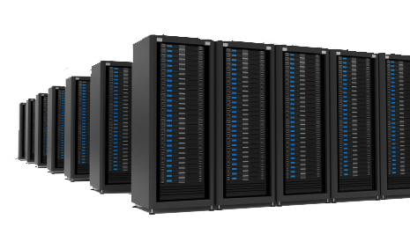
Data Explosion
Source: IDC's Digital Universe Study, December 2012
Storage cost ~8 trillion US dollars
Notes:
Nowadays, nearly everyone has different types of electronic devices.
They generate large volume of digital data.
To properly store the data, users tend to upload their data onto some storage service providers, such as Dropbox
However, the global data volume has been growing explosively, and it is estimated that, by the year 2020, the global digital universe will be as large as around 40,000 exabytes
To store such large volume of data, the storage devices, such as hard disk, will cost around 8 trillion US dollars.
This poses huge financial burden for the storage service providers.

Slide 3
Modern Storage Products
Deduplication removes content redundancy to improve storage efficiency
Store one copy of chunks with same content
Up to 20x storage cost reduction with practical storage workloads [Andrews, ExaGrid’13]
Adopt distributed architecture to extend the storage capacity
Deploy erasure coding technology for high fault-tolerance
Notes:
Therefore, modern storage products utilizes deduplication to remove content-level redundancy to improve storage efficiency
Deduplication stores one copy of chunks with the same content, and previous studies have shown that the storage cost can be reduced by 20 times for practical workloads
In addition, the storage products also adopt distributed architecture for storage capacity and erasure coding for high fault-tolerance

Slide 4
Deduplication
A
F
I
E
G
E
I
A
E
A
F
A
H
A
B
C
D
H
A
B
C
D
E
G
File 1
File 2
File 3
Node 1
Node 2
Node 3
Node 4
File 2 consists of 4 chunks: one duplicate chunk, A; three unique chunks, E, F and G.
Duplicate Chunk
Unique Chunk
Notes:
Now, let’s see how deduplication works with this toy example:
Three files, each with 4 chunks, are uploaded to a storage cluster with 4 storage nodes
For file 1, four chunks are unique, and conventional distribution algorithm distributes the 4 chunks to 4 storage nodes in round-robin manner
For file 2, chunk A is existing in the storage system, and we regard it as duplicate chunk. The 3 unique chunks are evenly distributed to the storage cluster.
Similar for file 3.
By the way, in this example, deduplication reduces the storage cost by 25%

Slide 5
What's the problem?
A
B
C
D
A
E
F
G
A
E
H
I
File 1
File 2
File 3
Node 1
Node 2
Node 3
Node 4
A
D
A
B
A
C
E
H
E
F
G
I
Conventional distribution algorithms are unaware of duplicate chunks
Achieve only storage balance while poor read balance can degrade parallel file read performance
Notes:
Now, when we want to download the files from the storage system
For file 1, we only need 1 parallel read to retrieve the file
For file 2, file retrieval is bottlenecked by reading two chunks from node 1
And it gets even worse for file 3.
We can see that conventional distribution algorithms blindly cluster chunks of a file on a single storage node
And, in a networked storage cluster with parallel data access and limited link bandwidth, reading a single file is bottlenecked by the storage node with the most chunks of the file

Slide 6
Our Contributions
We model the file data distribution problem in a reliable distributed deduplication storage system as integer optimization problem
We propose a polynomial time algorithm, the even data placement (EDP) algorithm, to tackle the problem
We implement a prototype with proposed algorithms, and conduct extensive evaluations on top of it

Slide 7
Problem Modeling
Balance chunks of a file online
We should manage merely the unique chunks
Information on duplicate chunks is available at upload time
Preserve the storage balance
In each upload, volume of unique data, distributed to each storage node, should be comparable

Slide 8
Problem Modeling
We balance multiple files so that both storage balance and read balance are achievable
File 1
File 2
File 3
File 4
Node 1
Node 2
Node 3
Node 4
Node 5
Notes:
We realize that we have to balance multiple files at one time to achieve both storage balance and read balance
We accumulate the unique chunks of multiple files as a distribution batch.
Within the distribution batch, we fix the number of unique chunks to each storage node
And we can freely manage how the unique chunks of each file are placed within the batch
The number of unique chunks to each storage node in our implementation is pre-set at configuration, and is decided by the cluster scale and coding scheme; Refer to the paper for the details;
Within the distribution batch, we can freely place the unique chunks of each file to achieve the read balance

Slide 9
Optimization Problem
The theoretical optimal distribution of a file should has $E_{i}$ chunks on each node, where
$E_{i}=\frac{\sum_{j=1}^{N}{u_{i,j}+d_{i,j}}}{N}, 1≤i≤t$
Thus, we aim to find a distribution that minimizes the gaps between bottlenecks of files and their corresponding optimal value:
$$\sum_{i=1}^{t}{(1−\frac{E_{i}}{\max_{j=1}^{N}\left\{u_{i,j}+d_{i,j}\right\}})}$$
Notes:
To balance the distribution of chunks of file, first we need to know what the theoretical optimal result that we can achieve
We calculate the total number of chunks of a file, and divide it by the number of nodes in the storage cluster. The result is the number of

Slide 10
Optimization Problem
$Minimize: \sum_{i=1}^{t}{(1−\frac{E_{i}}{\max_{j=1}^{N}\left\{u_{i,j}+d_{i,j}\right\}})}$
$Subject to: \sum_{j=1}^{N}{u_{i,j}=U_{i}, 1≤i≤t},$ (1)
$\sum_{i=1}^{t}{u_{i,j}=C, 1≤j≤N,}$ (2)
$u_{i,j}∈\left\{0,1,…,U_{i}\right\}, 1≤i≤t \& 1≤j≤N.$ (3)
Constraint 1 All unique chunks should be assigned to one of the storage nodes
Constraint 2 Each storage node should be assigned C unique chunks
Constraint 3 Each chunk is distributed integrally
Notes:
The first constraint indicates that all unique chunks of a file should be assigned to one of the storage nodes;
The second constraint indicates that each storage node should be assigned C unique chunks to sustain storage balance;
The last constraint implies that chunk is the unit of data distribution, which manifests the integral nature of the problem

Slide 11
Algorithm Design
The algorithm should output fast
The online processing should NEVER bottleneck the upload operation
Brute-force approach is prohibitive due to the huge solution space of the problem
The algorithm output should be accurate
Guarantee improvement over conventional distribution approaches in terms of read performance
Close to optimal result for practical workloads

Slide 12
Greedy Assignment
Each unique chunk of a file in a batch is logically assigned to the storage node with the least number of existing chunks
Existing chunks include both duplicate chunks and previously assigned unique chunks of the file
B
C
D
C
F
A
C
A
A
E
File 1
File 2
$\left(d_{1,1},d_{1,2},d_{1,3}\right)$
$=(2,0,1)$
Objective Value:
1-7/(3*3)
+1-6/(3*3)
=5/9
Node 1
Node 2
Node 3
E
A
C
$\left(d_{2,1},d_{2,2},d_{2,3}\right)$
$=(1,2,1)$
F
B
D
Notes:
To break tie, the first priority is the node that holds the previous contiguous chunk.
The second priority is the node succeeding the last node in round-robin fashion

Slide 13
Inter-file Swapping
Greedy assignment fails for later files in a batch due to the constraints of storage load balancing
Identify one previous file and swap some chunks of it with the current file to further reduce the objective value
B
C
D
C
F
A
C
A
A
E
File 1
File 2
$\left(d_{1,1},d_{1,2},d_{1,3}\right)$
$=(2,0,1)$;
$\left(d_{2,1},d_{2,2},d_{2,3}\right)$
$$=(1,2,1)$$
Objective Value:
1-7/(3*3)
+1-6/(3*2)
=2/9
Node 1
Node 2
Node 3
D
A
E
C
F
D
B
E

Slide 14
Discussions
Both greedy assignment and inter-file swapping are conducted in memory without I/O operations
The time complexity of EDP is polynomial, linear to the number of unique chunks in a batch and quadratic to the number of files in a batch
We extend EDP to tackle the distribution problem, with heterogeneous topology or using variable-sized chunking scheme

Slide 15
Discussions
We evaluate the effectiveness of our EDP algorithm via simulations and experiments
The size of a distribution batch has intricate effects on performance of EDP
If the batch is so small that all the unique chunks belong to the same file, EDP has no improvement over conventional algorithms
If the batch contains unique chunks of many distinct files, considerable improvement of EDP over conventional algorithms is expected, whereas with increased processing overhead

Slide 16
Implementation
Chunking
Deduplication
Meta-data
DB
Coding
I/O
Placement
Client
MDS
Storage Nodes
Client: Chunking, coding and data transmission
MDS: Deduplication and data placement control
Storage Node: Read/write of chunk data
Notes:
1. configurable fixed-size chunking or variable-size chunking;
2. OpenSSL for hash (SHA-1);
3. Jerasure [Plank, 2014] & GF-Complete [Plank, 2013] for encoding;
4. Implementation in C.

Slide 17
Evaluation Setup
How is the performance of EDP compared to baseline round-robin distribution?
Real-world datasets
Setup
16 storage nodes using (14,10) erasure coding
$C=1050$, 4KB chunk size, variable-size for FSLHOME and fixed-size for LINUX and LINUXTAR
 | Logical Size (GB) | Physical Size (GB) | File Type
FSLHOME | 6615 | 348 | Mixed-size
LINUX | 7.81 | 2.34 | Small
LINUXTAR | 101 | 47.46 | Large

Slide 18
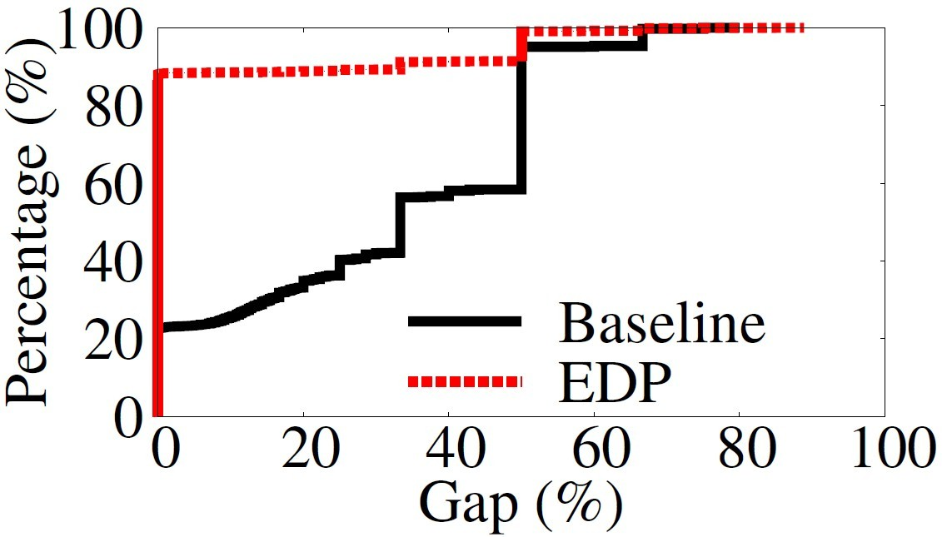
Trace-driven Simulation
FSLHOME
Read Balance Gap:
$$1−\frac{E_{i}}{\max_{j=1}^{N}\left\{u_{i,j}+d_{i,j}\right\}}$$
$,for each file i$
EDP consistently outperforms baseline distribution in terms of read balance metric.

Slide 19
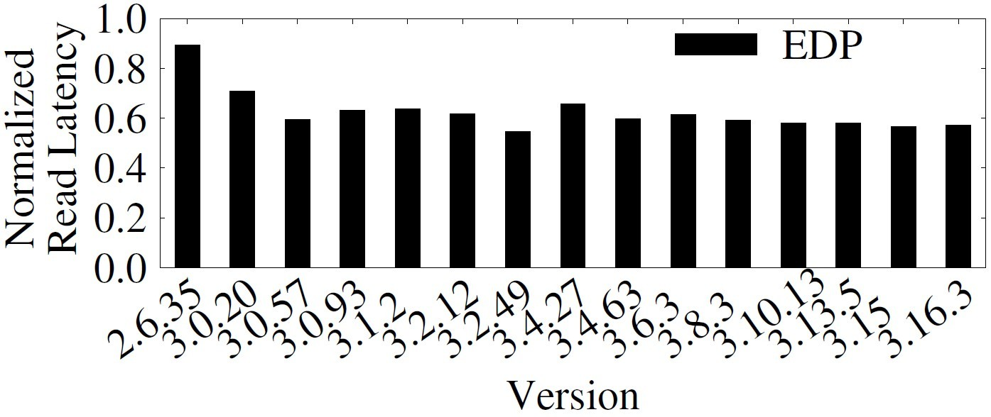
Test-bed Performance
LINUX
Improved read load balance directly translates into reduction in parallel read latency.
On average, EDP reduces the read latency of the baseline by 37.41% fixed-size chunking scheme
Notes:
Normalized read latency is the read latency of files distributed by EDP over that of file distributed by baseline
The link bandwidth between each storage node and the client is 100Mbps.

Slide 20
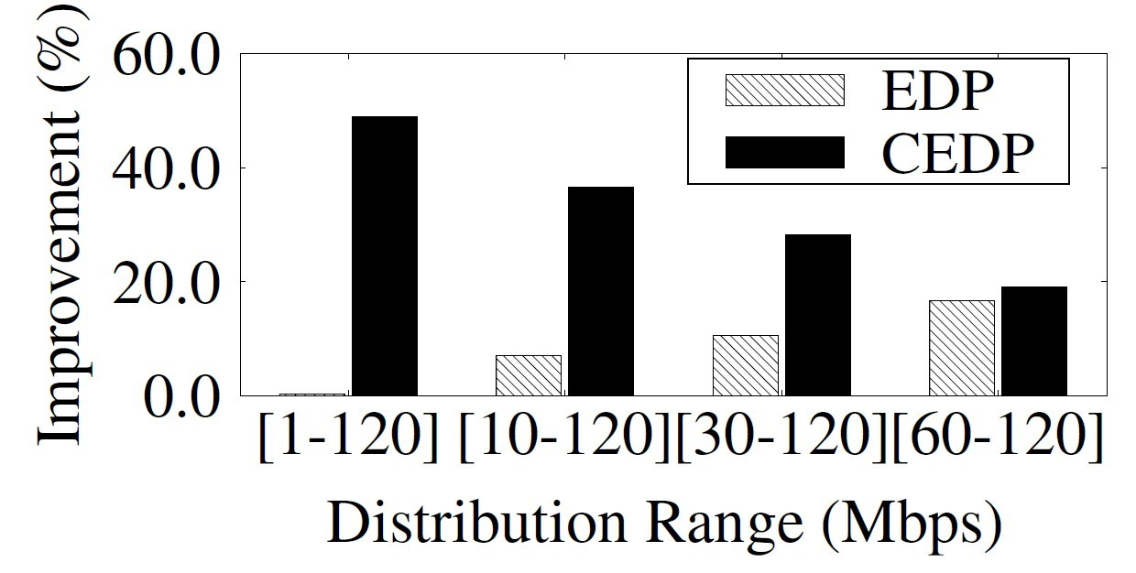
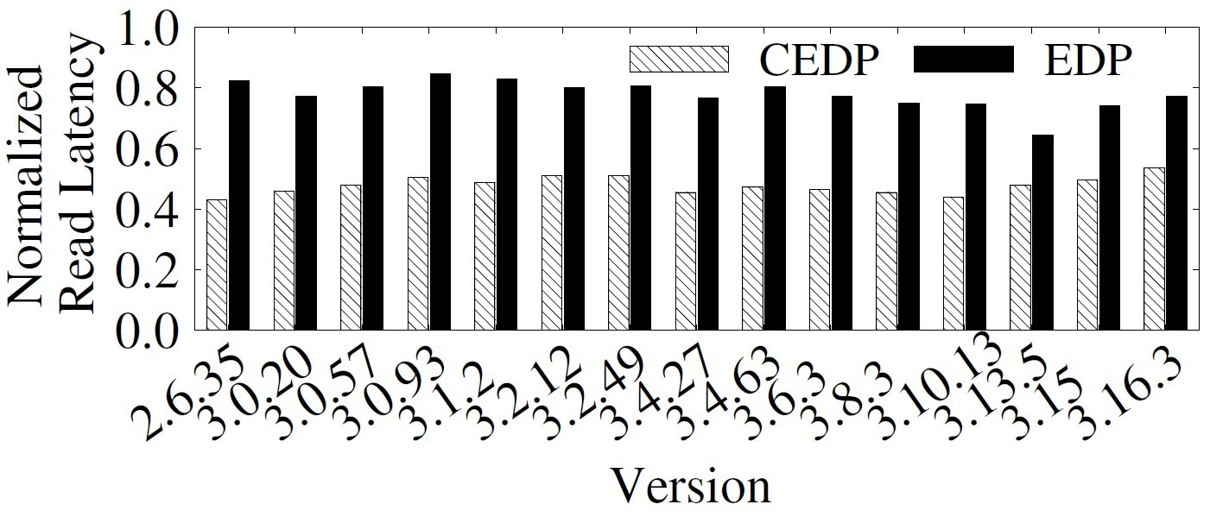
Heterogeneity
LINUX
In heterogeneous network, cost-based EDP (CEDP) outperforms both EDP and baseline
Larger variation in network bandwidth leads to larger improvement
LINUX
Notes:
The cost-based EDP balance distribution of chunks based on the download cost, i.e. latency, from each storage node, instead of the number of chunks on each node
We configure the link bandwidths of 5, 6 and 5 storage nodes to be 10Mbps, 100Mbps and 1Gbps, respectively

Slide 21
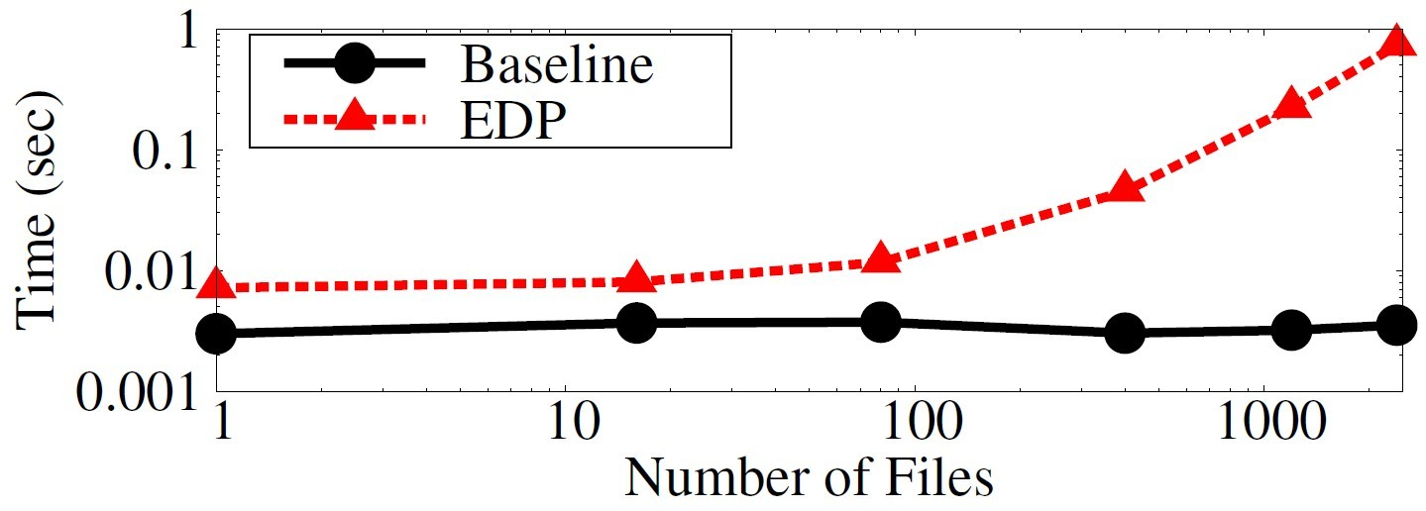
Computational Overheads
As the number of files increases, the processing time of EDP increases faster than that of the baseline
We leave as future work to reduce gap via parallel processing or bounding the number of files in a batch
Notes:
1. Processing time of EDP increases faster than baseline due to its quadratic complexity to the number of files

Slide 22
Evaluation Summary
EDP outperforms baseline consistently in trace-driven simulations, and its performance is close to optimal for practical workloads
EDP reduces the file read latency of baseline by 37.41% in the test-bed experiments
In heterogeneous network, CEDP outperforms both EDP and baseline
EDP lags as the number of files gets large, and we will improve this in the future

Slide 23
Conclusions
We study the read load balance problem in reliable distributed deduplication storage systems
We propose polynomial time algorithm, EDP, to solve the problem efficiently
We also extend the algorithm to tackle practical factors, including heterogeneous topology and variable-size chunking
Our prototype is available at http://ansrlab.cse.cuhk.edu.hk/software/edp

