Slide 1
Fine-Grained Dissection of WeChat in Cellular Networks
Qun Huang¹, Patrick P. C. Lee¹,
Caifeng He², Jianfeng Qian², Cheng He²
¹The Chinese University of Hong Kong, Hong Kong
²Noah’s Ark Lab, Huawei Technologies, Hong Kong
IWQoS’15

Slide 2
Motivation
WeChat: one of the most popular mobile applications
By August 2014, 432 million users, including 100 million outside China
50% media resource sharing among social networks in China
WeChat functionalities
Instant messaging
text, images, voice, video
Real-time chatting
full-duplex VoIP
half-duplex walkie-talkie
Moment (sharing platform)
Posts, photos, other resources from Internet
Media access
E.g. subscription articles
It is interesting to characterize WeChat traffic
Notes:
Do you know WeChat? How many do you use WeChat?
WeChat, developed by Tencent company, provides different functionalities. For example, blabla… (moment is called “friend circle” in Chinese)
It is now the most popular mobile applications in the world.
By August 2014, 432 million users, including 100 million outside China.
In addition, today it accounts for around 50% media resource sharing among social networks in China.
Thus, the diversity of functionalities and scale of users raise many interesting questions on WeChat.
In this work, we perform a fine-grain measurement study of real-world WeChat traffic from commercial cellular networks.

Slide 3
Challenges for WeChat Measurement
Real-world traffic
Mix of a large number of applications
WeChat traffic
Mix of WeChat functionalities
No knowledge on WeChat
WeChat protocol specifications are proprietary
It is infeasible to
Distinguish WeChat traffic from real-world traces
Classify WeChat traffic into functionalities
Notes:
However, it is very challenging to study WeChat in real-world traces.
On one hand, real-world traces is typically mix of a large number of applications.
This requires to identify WeChat traffic from the traces.
Further, to study of the traffic characteristics of different functionalities, we must further classify the identified traffic.
However, on the other hand, we have no any knowledge on the signatures of WeChat.
In particular, WeChat protocol specifications are proprietary and not available to the public.
Therefore, it is infeasible to distinguish WeChat traffic from the real-world traces, not mention to classify them into different functionalities.

Slide 4
Our Contribution
ChatDissect: infer both format and semantics of WeChat messages
Measurement study based on the inference results
Distinguish 150K WeChat users and 16GB WeChat traffic from real-world network traces
Classify distinguished traffic into functionalities
Unveil WeChat architecture and functionality workflows
Characterize traffic dynamics
To our best knowledge, this is the first and the only published study on real-world WeChat traffic
Notes:
So, in this work, we first propose a tool, namely ChatDissect, to infer both format and semantics of WeChat messages
Based on the inference results, we successfully identify 150K WeChat users and 16GB WeChat traffic from our real-world traces.
The inference results also allow us to classify the identified traffic into different WeChat functionalities, such as instant messaging or the moment operations.
The inference results further unveil the WeChat architecture and functionality workflows. Finally, we characterize the traffic dynamics of WeChat.
To our best knowledge, this is the first and the only published study on real-world WeChat traffic.

Slide 5
Architecture
Control Experiments
Training
Set
Extract
Signatures
Feedback
WeChat
Signatures
Architecture
Workflow
Traffic dynamics
Classify
Traffic
Real-world
Traces
Notes:
We first introduce the architecture of our work.
(1) Since we have any no knowledge on WeChat before this work, we conduct some control experiments to capture some clean traces of WeChat.
(2) Then we use several traffic classification techniques to extract WeChat traffic, where the captured trace servers as the training set.
(3) The extraction produce a set of WeChat signatures.
(4) We can use these signatures to classify traffic in real-world network traces.
(5) The classified results can be used to infer the architecture and functionality workflow of WeChat, and to measure WeChat traffic dynamics.
(6) We also feedback the classification results to enhance the extraction module.
(7) Now, let’s focus on the controlled experiments first.

Slide 6
Control Experiments: Approach
WeChat
Servers
Smartphones
Private wireless
network
Public Internet
Captured Traces
Different setup
Smartphones: Android and iPhone
WeChat client versions: 4.5 and 5.0
Noisy handling
Disable all other foreground applications
Manually examine and eliminate unwanted traffic in the captured traces
We perform 16 functionalities, each repeated several times
Notes:
In the controlled experiments, we have one Android and one iPhone. In each smartphone, we use two versions of WeChat.
(They are the most updated versions when this work is completed. we also try later versions by capturing traces in our desktop.)
We connect to WeChat servers using our private network and capture traces transmitted from and to the two smartphones.
During the experiments, we disable all other frontend apps. But the smartphone still generate a small amount of some background traffic.
(For example, iPhone will always send traffic to Apple servers)
Thus, we manually examine and eliminate unwanted traffic after capturing traces.
We have performed 16 functionalities, for each of them, we repeat several times to make sure the captured traces are representative.

Slide 7
Control Experiments: Results
22K IP packets with 12MB payload volume
Comprises 4 types of traffic
WeChat traffic
DNS
HTTP
Non-DNS UDP
Non-HTTP TCP
Short flows
Used by most tasks
Many small and short flows
One or two large flows
For real-time chatting
Long flows
Used by most tasks
Each flow includes multiple tasks
We refer to them as W-DNS, W-HTTP, W-UDP and W-TCP, respectively
Notes:
We totally collect 22K IP packets with 12MB payload volume after filtering noise.
We find that the captured traces compromises 4 types of traffic.
They have different characteristics and are used for different functionalities.
The first type is DNS, and we know that it is used for resolve hostname to ip address mappings.
The second one is HTTP. They are short flows and used by most WeChat tasks.
The third one is some Non-DNS UDP traffic. All of them are related to real-time chatting.
For each chat, we observe some small and short flows and one or two large and long flows.
The final one is Non-HTTP TCP. They are long flows and used by most WeChat tasks.
Each flow may encapsulate multiple tasks, including some tasks generated by WeChat clients but not users
We simplify the presentation, we call the four types as W-DNS, W-HTTP, W-UDP and W-TCP in the paper and this presentation.

Slide 8
Outline
Control Experiments
Training
Set
Extract
Signatures
Feedback
WeChat
Signatures
Architecture
Workflow
Traffic dynamics
Classify
Traffic
Network
Traces
Notes:
Now let’s move on to the part of extracting WeChat signatures.
This part is motivated and guided by the findings in our controlled experiment.

Slide 9
Signature Definition
WeChat payload signatures
format and semantics of WeChat message protocol
Network protocol format
A sequence of fields
Fields have different length
Each field is defined with a set of values
Network protocol semantics
“meaning” of fields and their values
Notes:
First, let’s define the signatures.
Read the slide, blabla.

Slide 10
Methodologies
WeChat traffic comprises four types
No unified methodology for all types
WeChat traffic
W-DNS
W-HTTP
W-UDP
W-TCP
Documentations are available
No documentations
Parse and inspect fields directly
Inference protocol format and semantics
We do not propose new techniques,
but combine existing techniques to extract signatures.
Notes:
However, extracting signatures are difficult for WeChat.
The main reason is that WeChat traffic comprises four types,
And there is not a unified methodology which can be applied to all the types.
So, we employ different approaches for them.
For W-DNS and W-HTTP, since DNS and HTTP documentations are available, we can parse and inspect their fields directly.
However, for W-UDP and W-TCP, since there is no documentation on their message protocols, we have to infer their protocol format and semantics, and then use the inference results as signatures.
(3) Note that here we do not propose new techniques, but customize and extend existing techniques to make them efficient for WeChat.

Slide 11
Extract Signatures for W-DNS and W-HTTP
Challenges: enormous fields
Payload
W-DNS
Hostnames
Field
Selection
W-HTTP
Hostnames, Method, URL, Referer, User-Agent
Representative fields
Keyword
Extraction
Extract values for each field
Based on longest common substring approach [Ma et al. 2006, Tongaonkar et al. 2013]
{Field: values}
Output Signatures
Notes:
We fist address the W-DNS and W-HTTP traffic.
Even though the documentations are available, the challenge is that there are too many fields in their payload.
So, to extract the signatures for the two types of traffic, we first select some representative fields.
We hope that these fields will contain some values related to WeChat.
(2)In particular, for W-DNS, we consider the hostname field and for W-HTTP, we consider five fields: blabla.
(3)Then, we extract keywords in the selected fields to pro
(4) The extraction is based on the longest common substring approach.
(5) The extraction assign some values for each field, and the field:value mapping are considered to be the output sinagures

Slide 12
Extract Signatures for W-UDP and W-TCP
WeChat
Payloads
Payload segmentation
Extent ProWord [Zhang et al. 2014]
Iteratively execute the Voting Experts algorithm [Cohen and Adams 2001]
Address packet fragmentation issue in W-TCP
Payload
Segmentation
Field 1: offset, length, values
Field 2: offset, length, values
Field type inference
Consider 5 field types
Constant, seq number, length, req./res., opcode
For each type, propose a heuristic to determine whether a field belongs to the type
…
Field Type
Inference
Field 1: type
Field 2: type
Opcode correlation
Employ 3 techniques for the correlation
Inspect traces in control experiments
Reverse-engineer Android APK package
Check co-occurrence with other known tasks
…
Opcode correlation
Mapping:
{Opcode value -> Task}
Notes:
Now, let’s address W-UDP and W-TCP.
As we have mentioned, we have to infer the protocol format and semantics for the two types because we have no knowledge on them.
The inference has three steps.
First, we segment the payloads into some fields. The segmentation outputs the offset, length and possible values for each field.
Our segmentation is based on ProWord, which is published in INFOCOM 2014. We extends the ProWord in two aspects.
First, we iteratively execute the Voting Experts algorithm in ProWord to make sure the segmented fields are short enough
Second, we address the packet fragmentation issue in TCP flows
(3) Our second step “Field type inference” is to assign a type to each of the segmented fields.
We consider five field types in this work.
For each field type, we propose a heuristic to determine whether a field belongs to this type.
Among the five types, the most important one is the opcode field because its value indicates the functionality of a packet.
(4) So The final step opcode correlation is to map each value in the opcode field with an actual WeChat functionality.
We use 3 techniques to address this extremely hard problem, including manually inspecting traces in control experiments, reverse-engineering Android package
And checking co-occurrence with other known tasks.

Slide 13
Classify Traffic & Feedback
Traffic classification
Step 1: group packets into flows
Step 2: categorize flows into DNS, HTTP, Non-DNS UDP and Non-HTTP TCP
Step 3: match payloads with signatures
Feedback
Motivation
Control experiments only cover partial signatures
Approach: for each classified WeChat flow
Identify all unclassified flows with the same server-side IP and port
Apply the same extraction procedure to the feedback traffic
We may need multiple rounds of feedback
Our experience: feedback once is sufficient
Notes:
Give the extracted signatures, we can identify WeChat traffic and classify their functionalities in the real-world traces
Firstly, we group the packets in the trace into flows.
Then, we categorize the flows into 4 sets:
Finally, we match each packet payload of a flow with the extracted signatures.
If all signatures are matched to a packet, then we say the packet is a WeChat packet and determine its functionality based on its opcode field.
As we have mentioned, we feedback the classification results to enhance the extraction module.
The motivation is that the controlled experiments only covers partial signatures because the performed operations are limited,
So we need to enhance the extraction results with signatures appearing in the real-world traces.
Our approach is to identify flows with the same server IP and port with known WeChat flows.
Since all WeChat traffic are handled by the WeChat servers, we hope that these flows are likely to be WeChat traffic.
Then, we apply the same extraction procedure to these feedback flows.
The feedback mechanism may need multiple rounds. However, our experience is that one round of feedback is sufficient in practice.

Slide 14
Outline
Control Experiments
Training
Set
Extract
Signatures
Feedback
WeChat
Signatures
Architecture
Workflow
Traffic dynamics
Classify
Traffic
Network
Traces
Notes:
Now, we present our results, including the WeChat signatures and measurement results on classified traffic.

Slide 15
Results: Payload Signatures
W-DNS
W-HTTP
weixin.qq.com
wx.qq.com
…
Hostname (WeChat aliases)
Hostname Referer
User-Agent
weixin
wechat
MicroMessenger
W-UDP
4 message types
All for real-time chatting
(Content, heartbeats, signaling)
Method and URL indicate functionalities
Post method
Most WeChat tasks
Third-party resources
Get method
WeChat-specific resources
W-TCP: persistent flows for most WeChat tasks
0
4
8
11
12
Length
Constant
Request /
Response
O
P
Sequence
Number
We identify the functionalities for 126 opcodes
Notes:
(1) W-DNS: hostname field contains WeChat-specific strings such as …
(2) W-HTTP: hostname, referer, user-agent fields contain WeChat-specific strings
Method and URL indicate the functionalities so that they can be considered as opcode fields
(In particular, post method is used by most WeChat tasks and by accessing third-party resources, get method is to access WeChat-specific resources, such as photos in moment platform)
(3) W-UDP: includes 4 message types, all are used by real-time chatting, including heartbeats, chatting content, and chatting signaling
(4) W-TCP: only one format for all W-TCP packets. Here, we draw its payload layout. Note that byte 11 is the opcode field. We observe 126 values for the opcode field and identify the functionality of all the values.

Slide 16
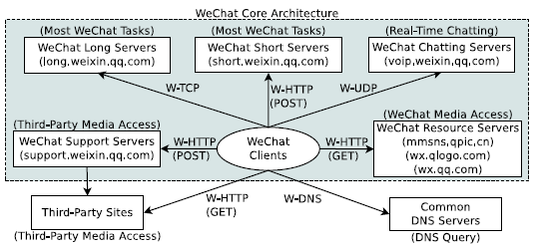
Results: Service Architecture
WeChat architecture comprises a set of clusters
Each for one group of functionalities
Notes:
This figure shows the architecture of WeChat servers.
WeChat maintains several clusters. Each cluster is responsible for a group of functionalities.
For example, the long servers with hostname “long.weixin.qq.com” serve most WeChat requests issued by W-TCP.
the servers with hostname “voip.weixin.qq.com” are responsible for real-time chatting.

Slide 17
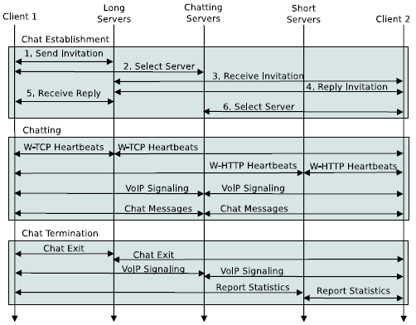
Results: Workflow
Most WeChat tasks completed by
W-TCP to long servers,
Or W-HTTP to short servers
Real-time chatting
Three phases
Resource access completed by
W-HTTP GET to servers directly,
Or W-HTTP POST to replay requests
Notes:
Next is the workflow for different WeChat functionalities.
(1)(2) read the slides
(3) real-time chatting is much more complicated than others. It consists of three phases including handshaking for establish the chatting, chatting, and termination.

Slide 18
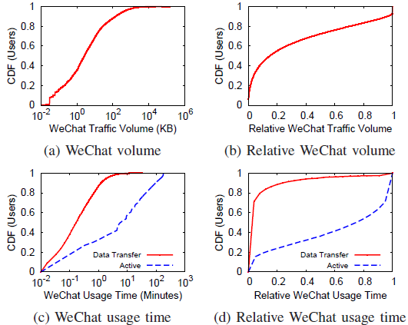
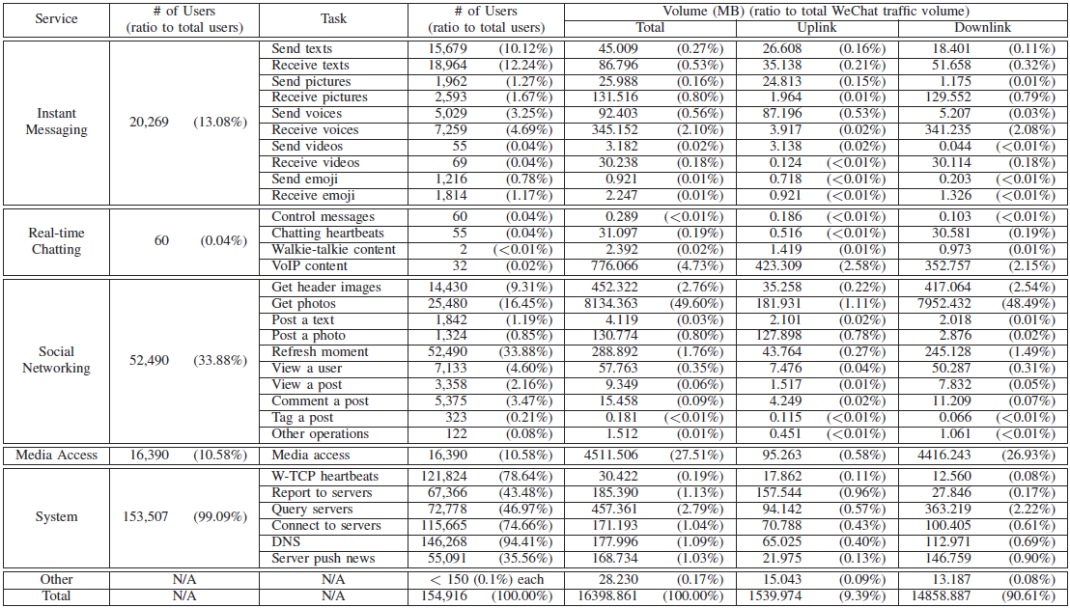
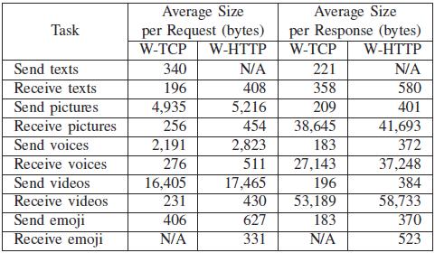
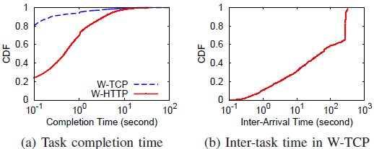
Results: Traffic Dynamics
We identify 150K WeChat users and 16GB WeChat traffic
Account for 50% of total users and 9% of total traffic volume
We measure traffic dynamics, including
User activities
Functionality usage
Flow characteristics
Notes:
Finally, we identify 150 WeChat uses and 16GB WeChat traffic in our real-world traces.
We measure the traffic dynamics of the identified traffic.
Our measurement includes
WeChat user activities, functionality usage and flow characteristics.

Slide 19
Results: Main Findings
Enormous users, but most are quiet
WeChat accounts for 50% of total users
Most users keep online, but only transfer a few traffic
Downlink traffic has much higher volume than uplink traffic
Nearly 91% traffic are downlink
Most tasks are completed using either W-HTTP and W-TCP
W-TCP has better user experience
W-TCP introduces heartbeat messages to keep flows persistent
We will measure more results on larger traces in the future.
Notes:
Since the time is very limited, we list our main findings directly.
Read the slide

Slide 20
Conclusions
Propose ChatDissect, a tool to infer message formats of network protocols
Present payload signatures for various types of WeChat traffic
Unveil the core architecture and workflows of WeChat tasks
Identify 150K WeChat users and 16GB WeChat traffic
Measure user activities, functionality usage, flow characteristics of real-world WeChat traffic
Notes:
To conclude this paper,
We propose … (Read the slide)

