Slide 1
Double Regenerating Codes for Hierarchical Data Centers
Yuchong Hu¹, Patrick P. C. Lee², and Xiaoyang Zhang¹
¹Huazhong University of Science and Technology
²The Chinese University of Hong Kong
yuchonghu@hust.edu.cn
Notes:
You know, in many data centers, cross-rack links are often congested? and most coding schemes are not specially designed to reduce the cross-rack traffic. So we will show how to design a new code to help reduce the cross-rack traffic significantly.
This is our work. Double Regenerating Codes for Hierarchical Data Centers.

Slide 2
Outline
Background
Motivation
Lower Bound
Code Construction
Evaluation

Slide 3
Hierarchy in Data Center
Notes:
So What is the Hierarchy in Data Center?
Let’s see what a datacenter is composed of.

Slide 4
Hierarchy in Data Center
Notes:
First, we have thousands of nodes.

Slide 5
Hierarchy in Data Center
Rack 1
Rack 2
Rack 3
Notes:
Second, the nodes are grouped into racks, and two nodes in one rack are connected to the same switch

Slide 6
Hierarchy in Data Center
Network core
Rack 1
Rack 2
Rack 3
Notes:
Third, switches are connected to the network core.

Slide 7
Hierarchy in Data Center
Network core
Rack 1
Rack 2
Rack 3
Link hierarchy
Notes:
Here, the hierarchy in Data Center refers to the link hierarchy.

Slide 8
Hierarchy in Data Center
Network core
Rack 1
Rack 2
Rack 3
Link hierarchy:
Sufficient intra-rack link
Notes:
Which means, compared to the sufficient intra-rack bandwidth,

Slide 9
Hierarchy in Data Center
Network core
Rack 1
Rack 2
Rack 3
Link hierarchy:
Sufficient intra-rack link
Scarce cross-rack link
the cross-rack capacity available per node in the worst case is only 1/5 to 1/20 of the
intra-rack capacity [1,3,20].
Notes:
In some bad cases, the cross-rack bandwidth per node is a small fraction of the intra-rack bandwidth.

Slide 10
cross-rack bandwidth
Many studies aim to reduce it:
Chowdhury et. al., Sigcomm 11
Broadcast transfer
Chowdhury et. al., Sigcomm 13
Replica placement
Li et.al., DSN 15
Transitions from Replication to Erasure Coding
Jalaparti et.al., Sigcomm 15
Scheduling for Data-Parallel Jobs
Notes:
Many studies aim to reduce to cross-rack bandwidth. But they focus on different problems

Slide 11
cross-rack bandwidth
Many studies aim to reduce it:
Chowdhury et. al., Sigcomm 11
Broadcast transfer
Chowdhury et. al., Sigcomm 13
Replica placement
Li et.al., DSN 15
Transitions from Replication to Erasure Coding
Jalaparti et.al., Sigcomm 15
Scheduling for Data-Parallel Jobs
Failure repairing
Notes:
In this paper, we also aim to reduce the cross-rack bandwidth, but focus on the failure repairing problem.

Slide 12
Failures are common
Notes:
As we know, failures are common in data centers.

Slide 13
Redundancy
Redundancy
replication
Erasure coding
Notes:
And one solution is to adopt redundancy. There are two kinds of common techniques for data redundancy: replication and erasure coding.

Slide 14
Redundancy
Redundancy
replication
Erasure coding
Erasure coding has much less storage overhead relative to replication.

Slide 15
Inefficient Repair for EC
File of
size M
Erasure codes
Repair bandwidth= M
A
A
Node 1
B
Node 2
B
B
Node 3
A+B
A
A+B
Node 4
A+2B
Notes:
However, erasure coding may cause an inefficient repair. For example, to repair the lost fragment in Node 1, the repair bandwidth, which means the total amount of transferred traffic for repair, has to be two fragments.

Slide 16
Regenerating Codes
[Dimakis et al., TIT’10]
File of
size M
Erasure codes
Repair bandwidth= M
A
A
Node 1
B
Node 2
B
B
Node 3
A+B
A
A+B
Node 4
A+2B
Regenerating codes [5]
Repair bandwidth= 0.75M
A
File of
size M
Node 1
A
B
B
C
Node 2
C
D
D
Node 3
A+C
C
B+D
A
A+C
B
Node 4
A+D
A+B+C
B+C+D
Notes:
To reduce the repair bandwidth, Dimakis and others proposed RC
Regenerating Codes remains challenging in terms of cross-rack repair bandwidth.
Next we will give use an example to motivate our work.

Slide 17
Outline
Background
Motivation
Lower Bound
Code Construction
Evaluation

Slide 18
Observation: n = 6, k = 3, file size = M
[Rashmi et al., Sigcomm 15]
Cross-rack
Repair Bandwidth
= 5/9 M
MSR codes [15]
Notes:
We consider the state of art of minimum storage regenerating codes.
We can see that each node is located in a different rack, in order to maximize the tolerance to node failures and rack failures.
observe that with MSR codes, that are minimum storage regenerating codes, Cross-rack Repair Bandwidth is five ninth of M.
Note that, MSR codes
instead of placing one fragment per rack,
we can place multiple fragments per rack (while we still keep
one fragment per node), and exploit inner-rack regeneration
to reduce the cross-rack repair bandwidth.

Slide 19
Failures are common

Slide 20
Failures are common
Notes:
Then we can find that rack failures are much less frequent than node failures in practice

Slide 21
Observation: n = 6, k = 3, file size = M
Cross-rack
Repair Bandwidth
= 5/9 M
MSR codes
Notes:
So what if we just tolerate only a single rack failure instead of tolerating multiple rack failures,

Slide 22
Observation: n = 6, k = 3, file size = M
Cross-rack
Repair Bandwidth
= 5/9 M
MSR codes
Notes:
It is kind of like this. we can place multiple nodes in each rack.

Slide 23
Observation: n = 6, k = 3, file size = M
Cross-rack
Repair Bandwidth
= 5/9 M
Cross-rack
Repair Bandwidth
= 1/3 M
MSR codes
Notes:
In this example we can design our codes which reduces the cross-rack repair bandwidth to one third of M.

Slide 24
Observation: n = 6, k = 3, file size = M
Cross-rack
Repair Bandwidth
= 5/9 M
Cross-rack
Repair Bandwidth
= 1/3 M
40% repair bandwidth
reduced!
MSR codes

Slide 25
Observation: n = 6, k = 3, file size = M
Cross-rack
Repair Bandwidth
= 5/9 M
Cross-rack
Repair Bandwidth
= 1/3 M
40% repair bandwidth
reduced!
MSR codes
Double regeneration
Notes:
The intuition is that we can use intra-rack bandwidth to reduce the cross-rack bandwidth.
The main idea is to perform regeneration twice: first within one rack and then across multiple racks. We call this double regeneration.

Slide 26
Challenges
How to design new double regenerating codes to minimize cross-rack repair bandwidth :
Can we obtain the lower bound of cross-rack repair bandwidth in theory based on double regeneration?
Can we design regenerating codes to match the lower bound?
Notes:
It is natural to ask two questions:

Slide 27
Outline
Background
Motivation
Lower Bound
Code Construction
Evaluation

Slide 28
System Model
X_{1,1}
X_{1,1}
Rack 1
X_{1,2}
β
X_{2,1}
Parameters: n=6, k=3, r=3
Constraint: (6,3) MDS codes
Goal: To minimize β (rack-to-rack repair bandwidth)
Rack 2
X_{2,2}
β
X_{3,1}
Rack 3
X_{3,2}
Notes:
To solve the above questions, we first give the system model.
Three parameters: n ,k are familiar to us, I think. R is the number of racks.
X1,1 refers to the first node of rack 1. When X11 fails,
X underline 1,1 refers to a new node to repair the lost data of X11.
Note that our goal is to minimize the cross-rack bandwidth \beta.

Slide 29
Information Flow Graph
X_{1,1}
X_{1,1}
X_{1,2}
β
X_{2,1}
X_{2,2}
β
X_{3,1}
X_{3,2}
Notes:
In order to analyze the system model,
We construct an information flow graph to describe a data center network for a single-node repair.

Slide 30
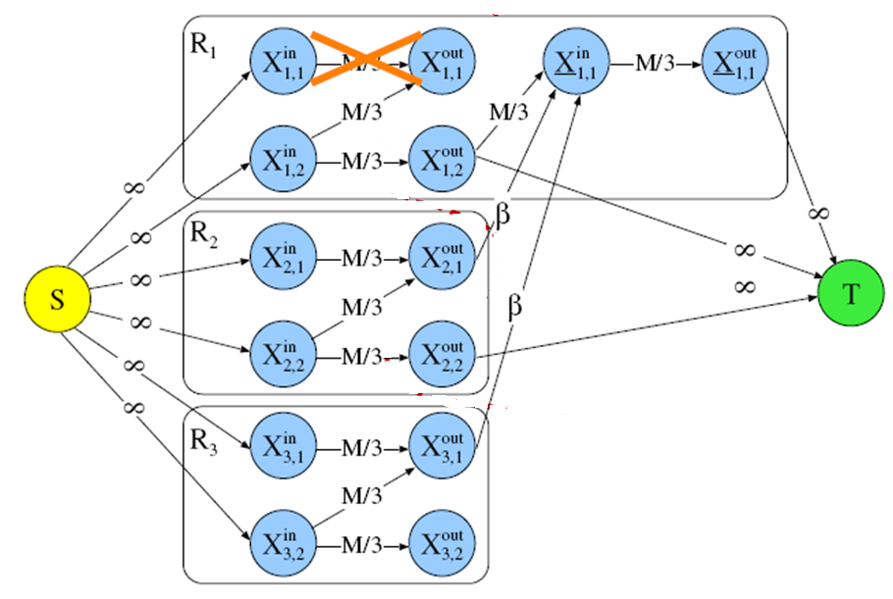
Information Flow Graph
X_{1,1}
X_{1,1}
X_{1,2}
β
X_{2,1}
X_{2,2}
β
X_{3,1}
X_{3,2}
Notes:
It is kind of like this. You can see the paper to see the details.

Slide 31
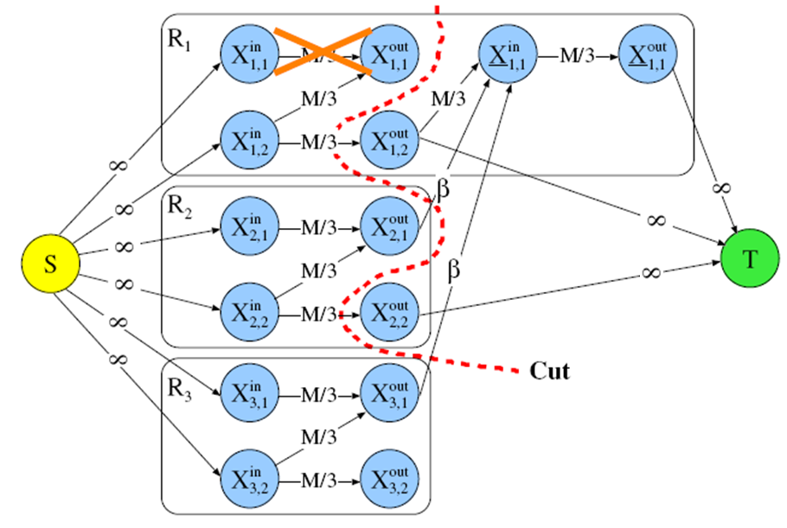
Information Flow Graph
Notes:
To get the lower bound of beta, we need to find all the cuts. Like this.

Slide 32
Lower Bound of β
Notes:
Based on network coding theory in distributed storage, we have lemma 2 that specifies the lower bound of beta

Slide 33
Lower Bound of β
Main idea of Proof:
Each min-cut needs to be at least M, which responds to one inequality. Reduce all inequalities to the result.

Slide 34
Lower Bound of β
Main idea of Proof:
Each min-cut needs to be at least M, which responds to one inequality. Reduce all inequalities to the result.
Necessary lower bound of β
Some min-cuts M
Some data collectors can not reconstruct the file
＜
＜
Notes:
And this is the lower bound of beta

Slide 35
Outline
Background
Motivation
Lower Bound
Code Construction
Evaluation

Slide 36
Code Construction
Double Regenerating Codes (DRC):
We propose DRC such that its optimal single-node repair satisfies
and maintains the MDS property after a single-node repair.
Notes:
Based on Lemma 2, we propose DRC such beta is equal to the lower bound, and we will prove the existence of DRC.

Slide 37
Code Construction
Double Regenerating Codes (DRC):
We propose DRC such that its optimal single-node repair satisfies
and maintains the MDS property after a single-node repair.
Repair-Optimal
Code construction matching the necessary lower bound is correct
the bound is tight;
the code construction is repair-optimal
Notes:
Note that if our code construction matches the necessary lower bound.

Slide 38
Code Construction
Initialization

Slide 39
Code Construction
Initialization
q blocks
X_{1,1}
……
node
q blocks
X_{1,n/r}
……
rack
The
original
File: M
divide
encode
q×k blocks
q blocks
X_{r,1}
……
q blocks
X_{r,n/r}
Block size = M/qk
Notes:
Here, q is equal to r minus the floor of kr over n, so the block size is equal to M/qk. Those qk blocks are encoded to n nodes, each node has q blocks.

Slide 40
Code Construction
Initialization
q blocks
X_{1,1}
……
node
q blocks
X_{1,n/r}
……
rack
The
original
File: M
divide
encode
q×k blocks
q blocks
X_{r,1}
……
q blocks
X_{r,n/r}
Block size = M/qk
P_{1,1}
X_{1,1}
(n, k, r) = (6, 3, 3), q=2
R1
P_{1,2}
X_{1,2}
File
A1
A2
P_{2,1}
X_{2,1}
divide
encode
R2
A3
A4
P_{2,2}
X_{2,2}
A5
A6
P_{3,1}
X_{3,1}
R3
P_{3,2}
X_{3,2}
Notes:
This an example. We will use this example to specify the single node failure repairing.

Slide 41
Code Construction
Single-node Repair:
X_{1,1}
X_{1,1}
P_{1,1}
P’_{1,1}
Notes:
Suppose that X1,1 fails, and we reconstruct a new fragment P′1,1 in a new node X1,1.

Slide 42
Code Construction
Single-node Repair:
X_{1,1}
X_{1,1}
P_{1,1}
P’_{1,1}
Stage 1: X_{h,1} (where 2 ≤ h ≤ r) compute a new block, p′_{h}, from all stored blocks in rack R_{h} , where c_{h} denotes a coefficient vector:
1st regenerating
Notes:
In stage 1, this is the first regenerating of data from one rack

Slide 43
Code Construction
Single-node Repair:
X_{1,1}
X_{1,1}
P_{1,1}
P’_{1,1}
Stage 1: X_{h,1} (where 2 ≤ h ≤ r) compute a new block, p′_{h}, from all stored blocks in rack R_{h} , where c_{h} denotes a coefficient vector:
1st regenerating
P_{1,1}
X_{1,1}
R1
P_{1,2}
X_{1,2}
P_{2,1}
X_{2,1}
p’₂ =[P_{2,1};P_{2,2}]c₂
R2
P_{2,2}
X_{2,2}
P_{3,1}
X_{3,1}
p’₃ =[P_{3,1};P_{3,2}]c₃
R3
P_{3,2}
X_{3,2}
Notes:
P’2 and p’3 are the result of the first regeneration

Slide 44
Code Construction
Single-node Repair:
X_{1,1}
X_{1,1}
P_{1,1}
P’_{1,1}
Stage 2: X_{1,1} computes a new fragment P′_{1,1}, from all the surviving blocks in rack R1 as well as all the p′_{h} (where 2 ≤ h ≤ r), D is a coefficient matrix:
2nd regenerating
Notes:
In stage 2, this is the second regenerating of data from multiple racks

Slide 45
Code Construction
Single-node Repair:
X_{1,1}
X_{1,1}
P_{1,1}
P’_{1,1}
Stage 2: X_{1,1} computes a new fragment P′_{1,1}, from all the surviving blocks in rack R1 as well as all the p′_{h} (where 2 ≤ h ≤ r), D is a coefficient matrix:
2nd regenerating
P_{1,1}
X_{1,1}
P’_{1,1}
X_{1,1}
R1
X_{1,2}
P’_{1,1} =[P_{1,1}; p’₂ ; p’₃] D
P_{1,2}
P_{2,1}
X_{2,1}
p’₂ =[P_{2,1};P_{2,2}]c₂
p’₂
R2
P_{2,2}
X_{2,2}
P_{3,1}
X_{3,1}
p’₃ =[P_{3,1};P_{3,2}]c₃
p’₃
R3
P_{3,2}
X_{3,2}
Notes:
P’1,1 are the result of the second regeneration

Slide 46
Code Construction
Single-node Repair:
X_{1,1}
X_{1,1}
P_{1,1}
P’_{1,1}
Stage 2: X_{1,1} computes a new fragment P′_{1,1}, from all the surviving blocks in rack R1 as well as all the p′_{h} (where 2 ≤ h ≤ r), D is a coefficient matrix:
2nd regenerating
P_{1,1}
X_{1,1}
P’_{1,1}
X_{1,1}
R1
X_{1,2}
P’_{1,1} =[P_{1,1}; p’₂ ; p’₃] D
P_{1,2}
β = block size= M/qk
=
P_{2,1}
X_{2,1}
p’₂ =[P_{2,1};P_{2,2}]c₂
p’₂
R2
P_{2,2}
X_{2,2}
P_{3,1}
X_{3,1}
p’₃ =[P_{3,1};P_{3,2}]c₃
p’₃
R3
P_{3,2}
X_{3,2}
Notes:
We can find that the rack2rack cross-rack bandwidth beta is equal to the lower bound. So if this code construction does exist, then the code is repair-optimal and bound is tight.

Slide 47
Existence
Theorem 1. There exists a linear coding construction for DRC
defined in the finite field F, such that the MDS property is still maintained after a single-node repair with a probability arbitrarily driven to 1 by increasing the field size of F.
Notes:
We now prove the existence of this code construction by Theorem 1,

Slide 48
Existence
Theorem 1. There exists a linear coding construction for DRC
defined in the finite field F, such that the MDS property is still maintained after a single-node repair with a probability arbitrarily driven to 1 by increasing the field size of F.
Main idea of Proof:
We can always tune encoding coefficients c_{h} and D of the DRC construction, such that the MDS property can be maintained after no matter how many single-node repairs.
Lemma 3: how to tune encoding coefficients c_{h} and D.
Notes:
We now prove the existence of DRC by showing that it maintains the MDS property after a single-node repair.

Slide 49
Outline
Background
Motivation
Lower Bound
Code Construction
Evaluation

Slide 50
Quantitative Comparisons
RS: Reed-Solomon (RS) codes use the conventional repair, whose cross-rack repair bandwidth equals the original data size M.
MSR[5]: The repair bandwidth of MSR codes is
DRC: The minimum cross-rack repair bandwidth is
(r−1)min{β} =
IEC: Assume that the existence of ideal erasure codes (IEC), whose cross-rack repair bandwidth equals the lost data size of the failed node, i.e., M/k.

Slide 51
Quantitative Comparisons
Observations:
The cross-rack repair bandwidth of DRC is always less than that of MSR codes, by up to 45.5% (e.g., n = 12, k = 8, r = 4).
DRC has the same cross-rack repair bandwidth as IEC in some cases.
Notes:
Figure 3 depicts the cross-rack repair bandwidths of different
erasure codes versus the number of nodes n in terms of the
percentage of the original data size M.
The reason
is that the “floor” function may keep ⌊ kr
n ⌋ the same even if r
becomes smaller.

Slide 52
Future Work
Deterministic and Systematic Code Construction
Further Reduce the intra-rack bandwidth
Practical Performance
More hierarchy
Geographically Distributed Data Centers
Multiple Clouds

Slide 53
Thank You!

Slide 54
Code Construction
Initialization
q blocks
……
q blocks
1 ≤ h ≤ r
1 ≤ I ≤ n/r
……
X_{h,i}
The
original
File: M
divide
encode
q × k blocks
q blocks
……
q blocks
Block size = M/qk
p_{h,i,j} : column vector specifying the coefficients for the j^{th} block of the i^{th} fragment of the h^{th} rack

Slide 55
Code Construction
Initialization
q blocks
……
q blocks
1 ≤ h ≤ r
1 ≤ I ≤ n/r
……
X_{h,i}
The
original
File: M
divide
encode
q × k blocks
q blocks
……
q blocks
Block size = M/qk
p_{h,i,j} : column vector specifying the coefficients for the j^{th} block of the i^{th} fragment of the h^{th} rack
P_{h,i} : matrix comprising the column vectors {p_{h,i,j}}_{1 ≤ j ≤ q} specifying the coefficients for the i^{th} fragment of the h^{th} rack

Slide 56
Hierarchy in Data Center
Network core
Rack 1
Rack 2
Rack 3
Link hierarchy:
Sufficient intra-rack link
Scarce cross-rack link
Notes:
Cross-rack bandwidth is considered to be a scarce resource

