Slide 1

SpreadSketch: Toward Invertible and Network-Wide Detection of Superspreaders
Lu Tang † , Qun Huang ‡, and Patrick P. C. Lee †
† The Chinese University of Hong Kong
‡ Institute of Computing Technology, CAS
IEEE INFOCOM 2020

Slide 2
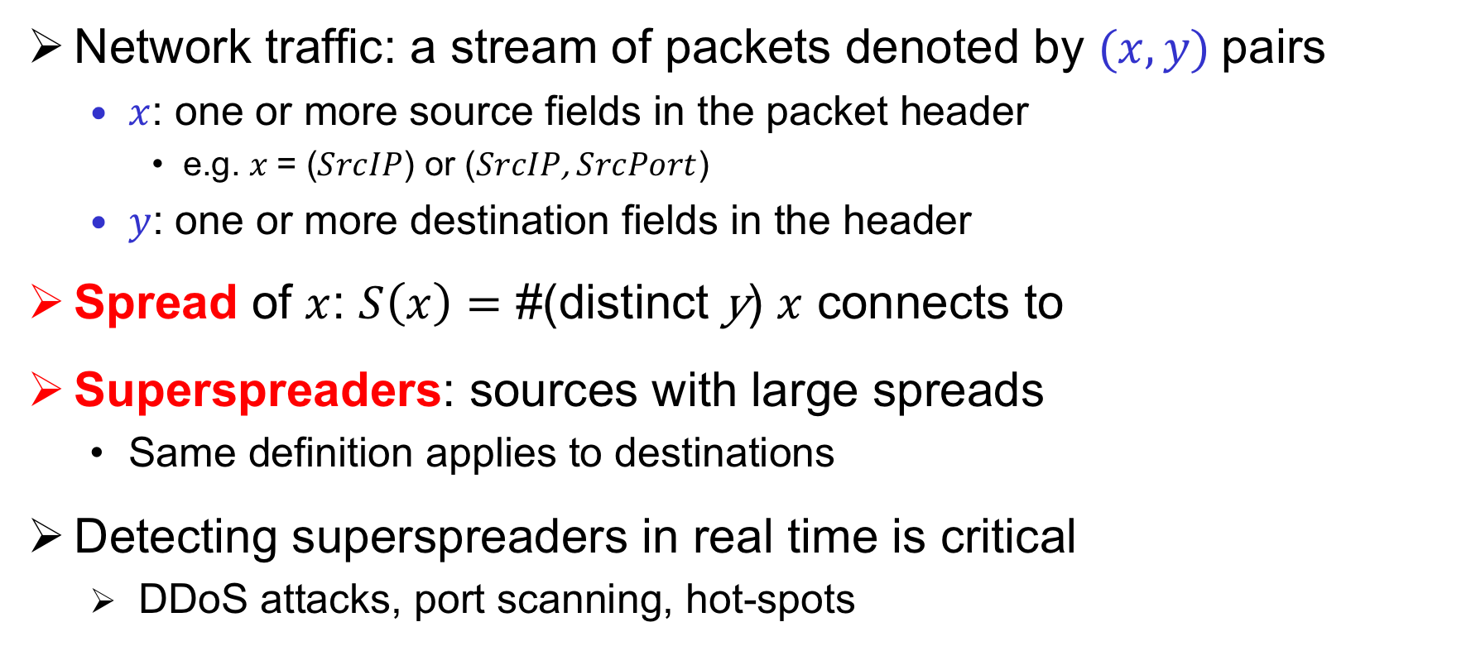
Superspreader Detection
Network traffic: a stream of packets denoted by $(x, y)$pairs
  $x$: one or more source fields in the packet header
    e.g. $x$= ($SrcIP$) or ($SrcIP$, $SrcPort$)
  $y$: one or more destination fields in the header
Spread of $x$: $S\left(x\right)=$ #(distinct y) $x$ connects to
Superspreaders: sources with large spreads
  Same definition applies to destinations
Detecting superspreaders in real time is critical
  DDoS attacks, port scanning, hot-spots

Slide 3
Challenges
Network-wide view
  The myriad connection of a superspreader can span the entire network
Fast processing and detection speed
  e.g. 10 Gb/s link: one packet every 67 ns
  Mitigating malicious attacks requires fast recovery of superspreaders
Memory efficiency
  Programmable switches: 1-2 MB per stage [Bosshart, SIGCOMM’13]
  Servers: tens of MB of SRAM

Slide 4

Sketches
Sketches: summary data structures
  e.g., Count-Min [Cormode, 2005], Count Sketch [Charikar, 2002]
  Idea: project high-dimensional data into small subspace
Count-Min [Cormode, 2005]:
  Update with a packet
    Hash flow key to one counter per row
    Increment each hashed counter
  Query a flow
    Return the minimum among all
    hashed counters
+1
+1
+1
Packet $x$
+1
Each element is a counter

Slide 5

Sketches
Good:
  Memory efficiency
  Fast processing speed
Bad:
  Unable to count the number of distinct flows
    Counters in Count-Min only count the frequency of each flow in the stream
  Non-invertible
    Cannot readily return all superspreaders
    e.g., Count-Min needs to enumerate all possible flows in entire flow key space to recover all superspreaders
+1
+1
+1
Packet $x$
+1

Slide 6
Our Contribution
SpreadSketch, a fast and invertible sketch for network-wide superspreader detection in network data streams
  Fast and invertible
    High processing speed, fast recovery of superspreaders
  Compact: small and static memory usage
  Network-wide: network-wide view of superspreaders
Theoretical analysis on accuracy, space, and time complexity
Extensive experiments on real-world network traces
  Higher accuracy and performance over state-of-the-art sketches
  Feasibility on a Barefoot Tofino switch with resource efficiency

Slide 7
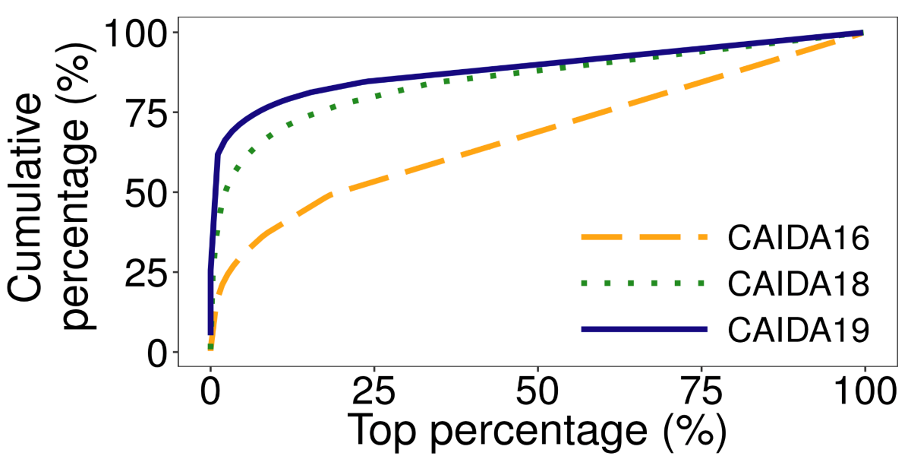
Observations
SpreadSketch: non-trivial extension of Count-Min
Build on two observations
  Observation I: Highly skewed fan-out distributions
    CAIDA19: top 1% sources account for 60% total spread
    CAIDA18: top 10% account 67%
    CAIDA16: top 10% account 38%
    A superspreader dominates its hashed
    bucket in sketch w.h.p.

Slide 8
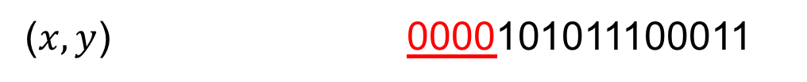
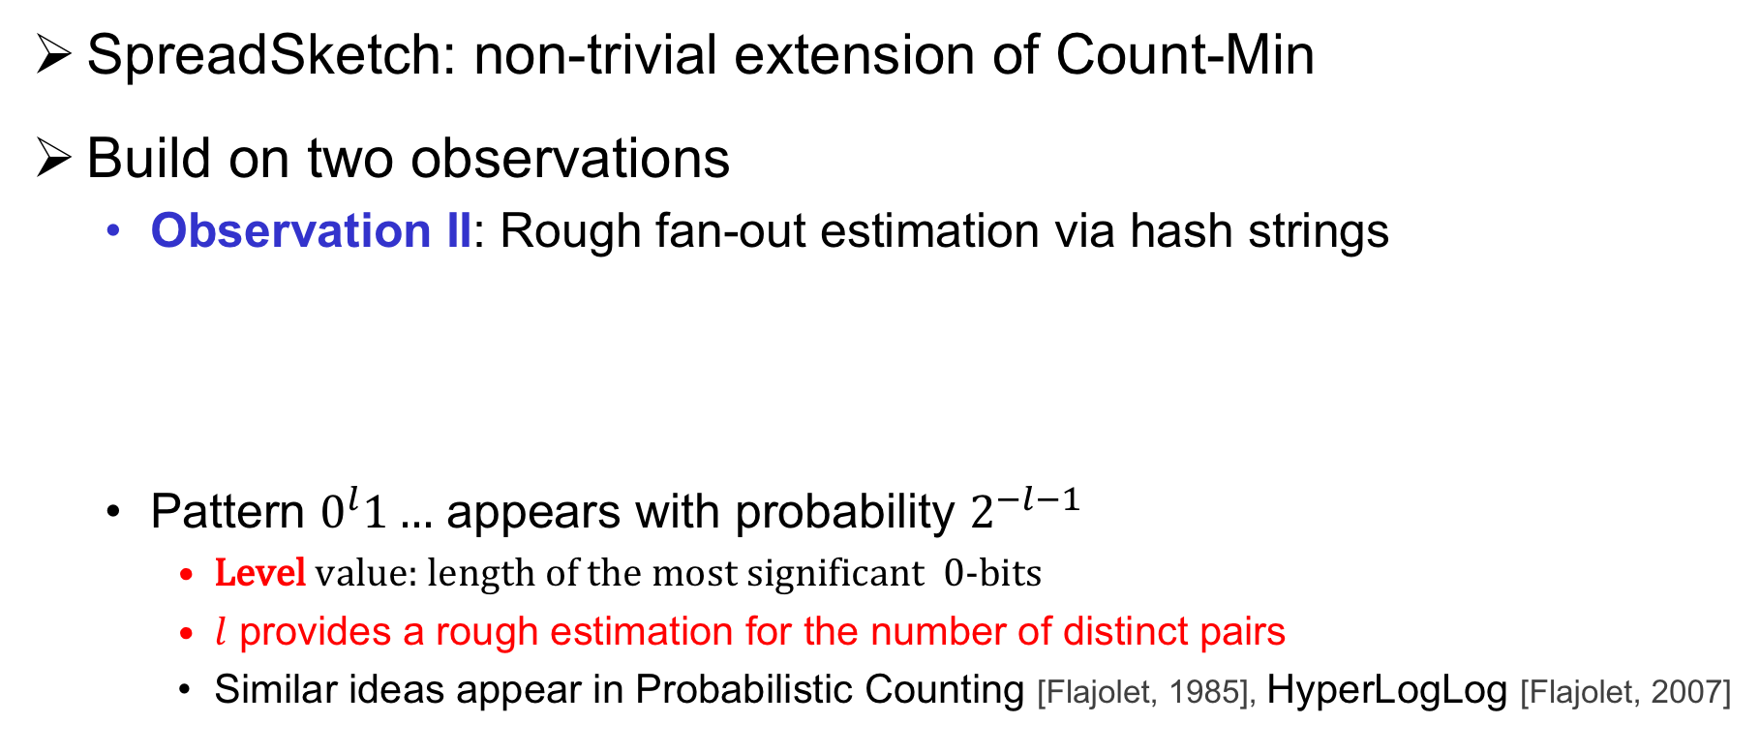
Observations
SpreadSketch: non-trivial extension of Count-Min
Build on two observations
  Observation II: Rough fan-out estimation via hash strings
  Pattern $0^{l}1…$ appears with probability $2^{−l−1}$
    Level value: length of the most significant 0-bits
    $l$ provides a rough estimation for the number of distinct pairs
    Similar ideas appear in Probabilistic Counting [Flajolet, 1985], HyperLogLog [Flajolet, 2007]
hash
($x,y$) 0000101011100011

Slide 9
Design – Main Idea
Track the source in each bucket that dominates the bucket’s spread
  By observation I, a superspreader w.h.p. to be tracked in the sketch
  Achieve invertibility in sketch
Find the source with highest spread by tracking highest level value
  By observation II, the source with the highest level has the highest spread
Replace integer counters in sketch with distinct counters
  Enable distinct counting in sketch
  Use multiresolution bitmap [Estan, IMC’03]

Slide 10





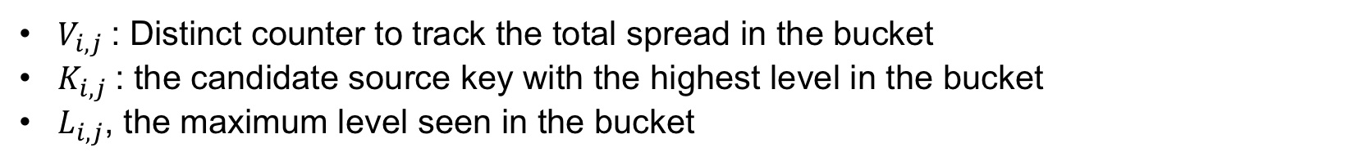


Design – Data Structure
Data structure: $r×w$ table of buckets
Bucket $B(i,j)$
Spread
Flow key
Level
$r$ rows
$$V_{i,j}$$
$$K_{i,j}$$
$$L_{i,j}$$
$w$ buckets
$V_{i,j}$: Distinct counter to track the total spread in the bucket
$K_{i,j}$: the candidate source key with the highest level in the bucket
$L_{i,j}$, the maximum level seen in the bucket

Slide 11




Update
Insert a source-destination pair $(x,y)$ into the sketch
  Calculate the level $l$
    hash($x,y$) = 00011011
    $l$ = 3
  Map$x$to one bucket per row
  For each bucket
    Insert ($x,y$) to V
    Compare $l$with L
      Case 1: $l ≤$ L, do nothing
Packet $(x, y)$
Bitmap
Key
Level
Bitmap
Key
Level
V
$$y$$
5
V’
$$y$$
5
Before
After

Slide 12



Update
Insert a source-destination pair $(x,y)$ into the sketch
  Calculate the level $l$
    hash($x,y$) = 00011011
    $l$ = 3
  Map$x$to one bucket per row
  For each bucket
    Insert ($x,y$) to V
    Compare $l$with L
      Case 1: $l≤$ L, do nothing
      Case 2: $l$ > L, copy $x$ to K, update L
Packet $(x, y)$
Bitmap
Key
Level
Bitmap
Key
Level
V
$$z$$
1
V’
$$x$$
3
Before
After

Slide 13
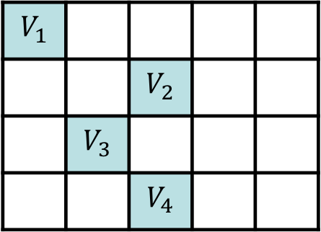
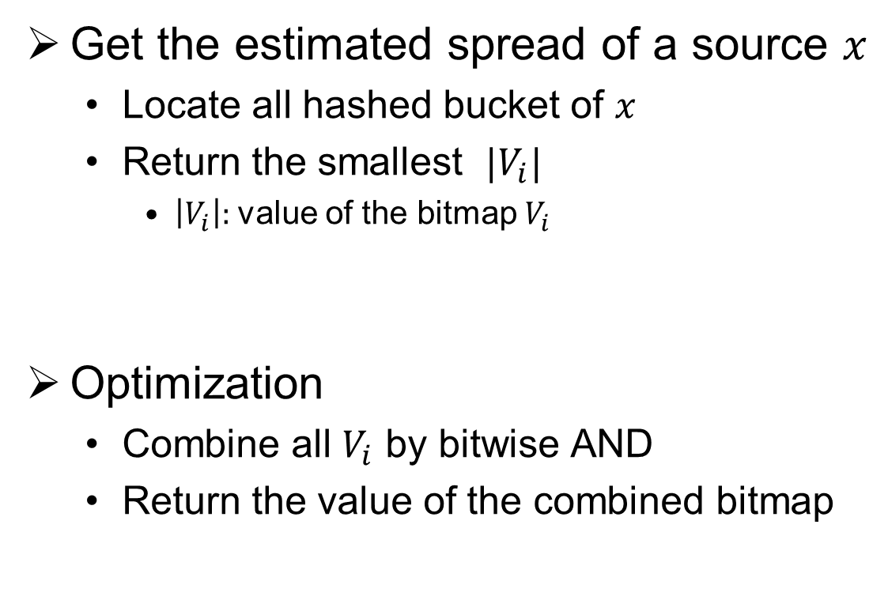

Query
Get the estimated spread of a source $x$
  Locate all hashed bucket of $x$
  Return the smallest $|V_{i}|$
    $\left|V_{i}\right|:$value of the bitmap $V_{i}$
Optimization
  Combine all $V_{i}$ by bitwise AND
  Return the value of the combined bitmap
$$V_{1}$$
 |  | $$V_{2}$$
 | $$V_{3}$$
 |  | $$V_{4}$$
Source $x$

Slide 14
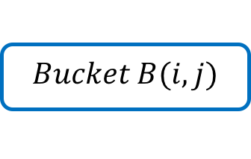
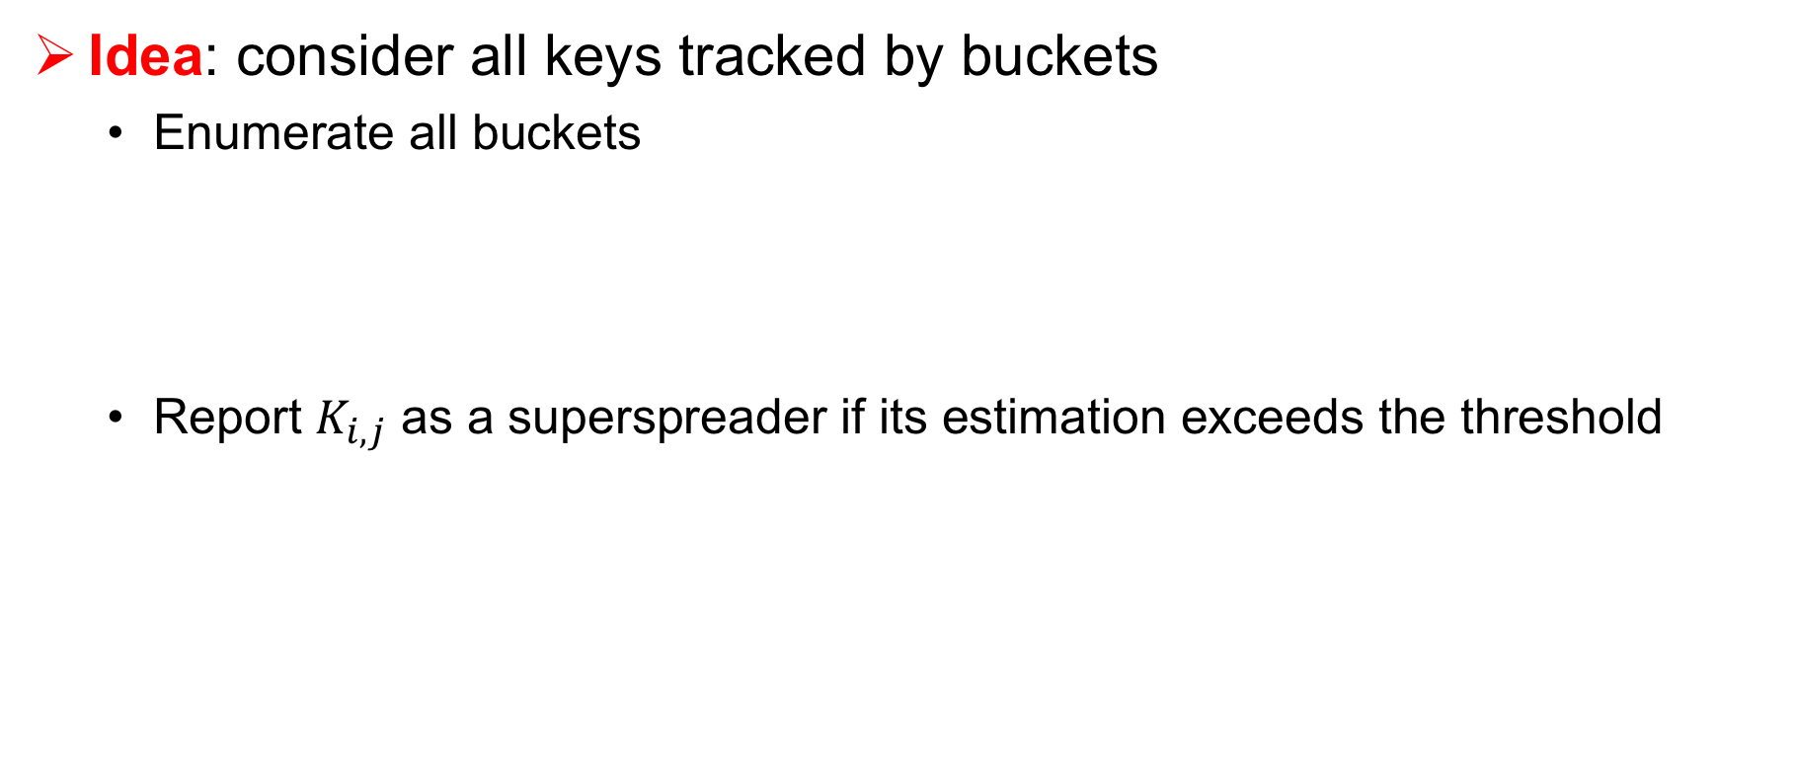

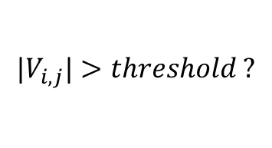
Superspreader Detection
Idea: consider all keys tracked by buckets
  Enumerate all buckets
  Report $K_{i,j}$ as a superspreader if its estimation exceeds the threshold
$${|V}_{i,j}|>threshold ?$$
$$Bucket B(i,j)$$
Get the estimated spread of $K_{i,j}$

Slide 15


Network-Wide Deployment
Architecture: $q$ > 1 monitoring nodes and a centralized controller
  Monitoring node: maintain and send the sketch to controller
  Controller: merge all sketches and output superspreaders based on the merged sketch
Goal: provide a network-wide view of superspreaders at controller
Sketch
Sketch
Sketch
Controller

Slide 16





Network-Wide Scheme
Monitoring node: no assumption on the deployment
  e.g. we can deploy SpreadSketch on any end hosts or switches
Controller: construct a merged sketch
Sketch1
Sketch2
Merged Sketch
Bitmap
Key
Level
Bitmap
Key
Level
Bitmap
Key
Level
$$V_{1}$$
$$x$$
3
$$V_{2}$$
$$y$$
5
$$V_{1}∪V_{2}$$
$$y$$
5

Slide 17
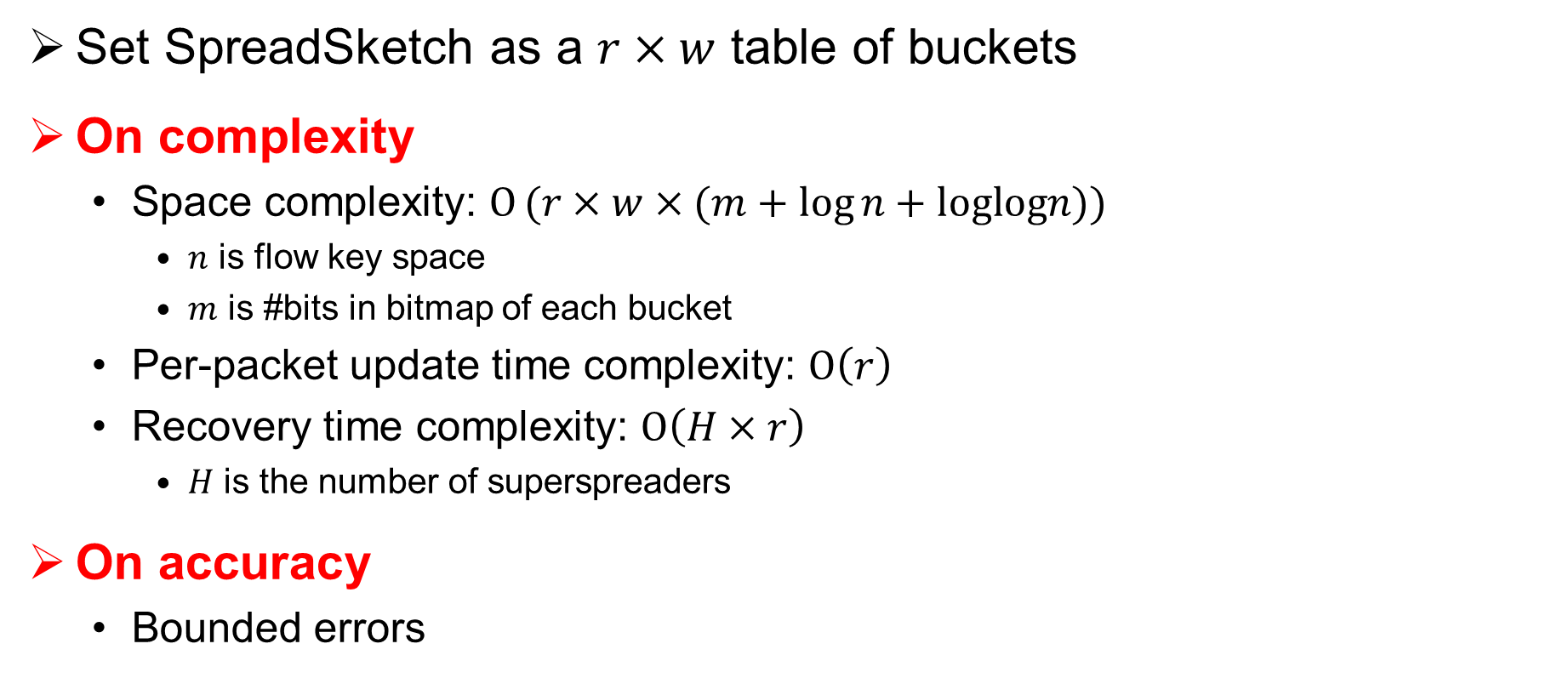
Theoretical Analysis
Set SpreadSketch as a $r×w$ table of buckets
On complexity
  Space complexity: $Ο(r×w×(m+log{n+loglogn))}$
    $n$ is flow key space
    $m$ is #bits in bitmap of each bucket
  Per-packet update time complexity: $Ο\left(r\right)$
  Recovery time complexity: $Ο\left(H×r\right)$
    $H$ is the number of superspreaders
On accuracy
  Bounded errors

Slide 18
Evaluation Setup
Traces: three One-hour traces from CAIDA
We compare SpreadSketch with:
Trace | Unique flows | Unique srcIP | Unique dstIP | #pkts
CAIDA16 | 973023 | 452984 | 107165 | 29077193
CAIDA18A | 1744694 | 338332 | 403462 | 28516482
CAIDA18B | 6992108 | 1244441 | 1253639 | 94819857
Average size per minute
Distinct-Count Sketch (DCS) [Ganguly , ICDCS’07] | RevSketch (REV) [Schweller, ToN’07]
Connection Degree Sketch (CDS) [Wang, TIFS’11] | Fast Sketch (FAST) [Liu, INFOCOM’12]
Count-Min-Heap (CMH) [PODS’05] | Vector Bloom Filter (VBF) [Liu, TIFS’16]

Slide 19
Result – Accuracy CAIDA19
SpreadSketch is more robust and accurate compared with state-of-the-art sketches
Similar observations on CAIDA18 and CAIDA16 traces

Slide 20
Result – Speed
SpreadSketch (SS) achieves throughput more than 22 MPPS
  it is easily catch up with10 Gbs line speed
SpreadSketch recoverys superspreaders within few milliseconds
Overall, SpreadSketch achieves both high update and recovery speed

Slide 21
Result – Implementation on Hardware
Switch resources usage of SpreadSketch
(percentages in brackets are fractions of total resource avaiable)
We implement SpreadSketch in P4 and compile it in a Barefoot Tofino chipset
  SpreadSketch consumes limited hardware resource
  SpreadSketch processes packets at line-rate on a Tofino switch

Slide 22
Conclusion
SpreadSketch, an invertible sketch that enables fast and accurate network-wide superspreader detections in network data streams
Contributions:
  Propose a new invertible sketch design to detect superspreaders
    High accuracy and robust on real-work traces
    Fast processing and recovery speed
    Feasibility on commodity hardware switches
  Detailed theoretical analysis on both accuracy and complexities
  Extensive experiments on real-world traces
Source code: http://adslab.cse.cuhk.edu.hk/software/spreadsketch/

Slide 23
Thank you!

Slide 24
Backup Slides
†
‡
†

Slide 25
Result – Accuracy on CAIDA16
SpreadSketch (SS)
Only slightly lower than CDS
maintains accuracy between 0.86-0.96

Slide 26
Result – Accuracy on CAIDA18
SpreadSketch(SS)
achieves best accuracy on the moderate skewed trace

Slide 27
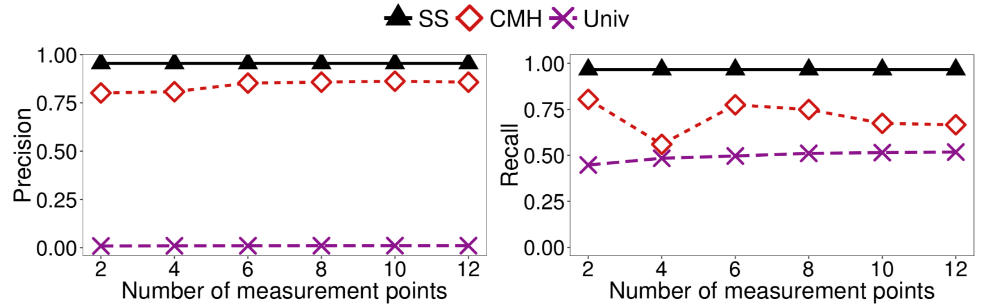
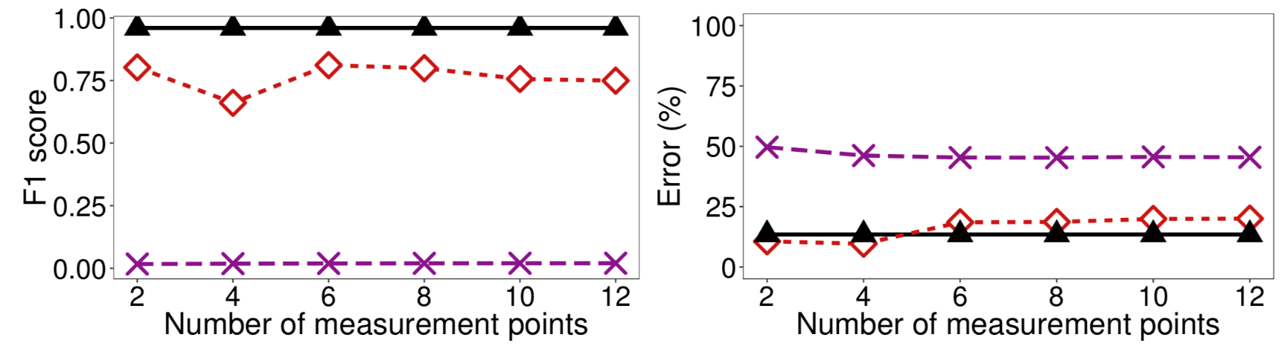
Result – Accuracy in Network-Wide

Slide 28
Existing approaches
Streaming methods
  Compact Spread Estimator [Yoon, INFOCOM’09], Online Streaming Module [Zhao, IMC’05]
  Compact, however non-invertible
Sampling methods
  Two-Phase Filtering [Bu, INFOCOM’09], Two Level Filtering [Venkataraman, NDSS’05]
  Unable to support accurate network-wide detection
Sketch-based methods
  Count-Min-Heap [Cormode, PODS’05], FAST [Liu, TDASC’15], VBF [Liu, TIFS’16], CDS [Guan, GLOBECOM’09], RevSketch [NDSI’13]
  Large memory usage and high memory access overhead

Slide 29
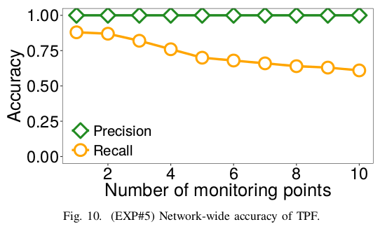
We do not consider Two-Phase-Filtering in Two Reasons
First, it does not support network-wide detection
Recall drops below 0.65 even if using the maximum sampling rate
Reasons:
  1. A superspreader can be very small in each monitoring point to escape from sampling
  2. Even if the superspreader is sampled in some of the points, the bias accumulated by the filtering makes its spread below the threshold
Accuracy on CAIDA16. Similar results on the other two traces

Slide 30
We do not consider Two-Phase-Filtering in Two Reasons
Second, it does not support query for the spread of any given flow
  It only keeps the spread information of large flows
Comparing SSketch with TPF is similar to comparing Sketches with counter-based techniques in top-k problems.

Slide 31
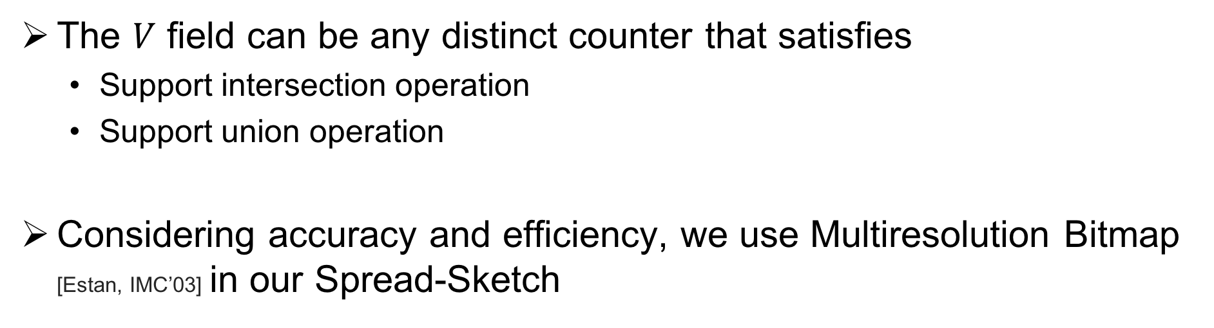
The Choice of Distinct Counters
The $V$ field can be any distinct counter that satisfies
  Support intersection operation
  Support union operation
Considering accuracy and efficiency, we use Multiresolution Bitmap [Estan, IMC’03] in our Spread-Sketch

