Slide 1
MV-Sketch: A Fast and Compact Invertible Sketch for Heavy Flow Detection in Network Data Streams
†
‡
†
Lu Tang , Qun Huang, Patrick P. C. Lee
† The Chinese University of Hong Kong ‡ Institute of Computing Technology, CAS
IEEE INFOCOM 2019

Slide 2
Heavy Flow Detection
Network traffic: a stream of packets denoted by $(x, v_{x})$ pairs
$x$: flow key, e.g., 5-tuple, source IP address
$v_{x}$: value, e.g., 1 for packet counting, payload bytes for size counting
Heavy flows – abnormal patterns in network traffic
Heavy hitters: flows with high traffic volume
Heavy changers: flows with high change of traffic volume
Detecting heavy flows in real time is critical for:
anomaly detection, load balancing, traffic engineering

Slide 3
Challenges
Fast packet processing
e.g. 10 Gb/s link: one packet every 67 ns
Limited memory
Programmable switches: 1-2 MB per stage [Bosshart, SIGCOMM’13]
Servers: tens of MB of SRAM
Per-flow tracking is expensive
e.g., a maximum of $2^{104}$ entries for 5-tuple flows

Slide 4
Sketches
Sketches: summary data structures
e.g., Count-Min [Cormode, 2005], Count Sketch [Charikar, 2002]
Idea: project high-dimensional data into small subspace
Count-Min [Cormode, 2005]:
Update with a packet
Hash flow key to one counter per row
Increment each hashed counter
Query a flow
Return the minimum among all
hashed counters
+$v_{x}$
+$v_{x}$
+$v_{x}$
Packet $(x, v_{x})$
+$v_{x}$
Each element is a counter

Slide 5
Sketches
Good:
High accuracy with small memory
Fast processing speed
Bad: Non-invertible
Cannot readily return all heavy flows
e.g., Count-Min needs to enumerate all possible flows in entire flow key space to recover all heavy flows

Slide 6
Existing Invertible Sketches
Use extra data structures to store candidate heavy flows
e.g., Count-Min-Heap [Cormode, PODS’05], LD-Sketch [Huang, INFOCOM’14]
High memory access overhead, increasing with number of heavy flows
Dynamic memory allocation
Apply group testing by keeping one counter per bit
e.g., Deltoid [Cormode, ToN’05], Fast Sketch [Liu, INFOCOM’12]
High update overhead, increasing with key length
Prune flow key space via new hash schemes
e.g., Reversible Sketch [Schweller, INFOCOM’06], SeqHash [Bu, INFOCOM’07]
High update overhead, increasing with key length

Slide 7
Our Contributions
MV-Sketch, a fast and compact invertible sketch for heavy flow detection in network data streams
Built on Majority Voting [Boyer and Moore, 1991]
Small and static memory usage
High processing speed
High accuracy
Theoretical analysis on accuracy, space, and time complexity
Experiments on real-world network traces
Higher accuracy; up to 3.38$×$ throughput gain over state-of-the-arts
Match 10Gb/s line rate with SIMD instructions

Slide 8
Problem Formulation
Perform detection at regular time intervals called epochs
Input: packet stream $(x, v_{x})$
Heavy hitter: all $x$with $S\left(x\right)>φ$
$S\left(x\right)$: total traffic volume of flow $x$ in one epoch
$φ$: user-specified threshold
Heavy changer: all $x$ with $D(x) >φ$
$D(x)$: total traffic change of flow $x$ across two epochs
Problem: infer $S\left(x\right)$ and $D\left(x\right)$ in real-time with limited memory

Slide 9
Design
Key observation: small number of large flows dominate
e.g., 9% of flows account for 90% of traffic [Fang, 1999]
Idea:
A heavy flow has more traffic than all other flows in the same bucket with high probability
Track a candidate heavy flow in each bucket via majority voting (MJRTY) [Boyer and Moore, 1991]
Theorem: MJRTY ensures that the true majority vote (with over half of total vote counts) must be tracked

Slide 10
Design
Data structure: $r×w$ table of buckets
Bucket $B(i,j)$
Total sum
Flow key
Indicator
$r$ rows
$$V_{i,j}$$
$$K_{i,j}$$
$$C_{i,j}$$
$w$ buckets

Slide 11
Update
Insert a packet $(x, v_{x})$ into the sketch
Map $x$to one bucket per row
Increment $V$ with $v_{x}$
Compare $x$ with $K$
Case1: $K=x$, increment $C$ with $v_{x}$
Packet $(1101,19)$
Total sum
Flow key
Indicator
Total sum
Flow key
Indicator
80
1101
20
99
1101
39
Before
After

Slide 12
Update
Insert a packet $(x, v_{x})$ into the sketch
Map $x$to one bucket per row
Increment $V$ with $v_{x}$
Compare $x$ with $K$
Case1: $K=x$, increment $C$ with $v_{x}$
Case2: $K≠x$, decrement $C$ with $v_{x}$
Packet $(1101,19)$
Total sum
Flow key
Indicator
Total sum
Flow key
Indicator
Total sum
Flow key
Indicator
Total sum
Flow key
Indicator
75
0110
25
94
0110
6
80
1101
20
99
1101
39
Before
After
Before
After

Slide 13
Update
Insert a packet $(x, v_{x})$ into the sketch
Map $x$to one bucket per row
Increment $V$ with $v_{x}$
Compare $x$ with $K$
Case1: $K=x$, increment $C$ with $v_{x}$
Case2: $K≠x$, decrement $C$ with $v_{x}$
if $C<0$, copy $x$ to $K$, $C=abs(C)$
Packet $(1101,19)$
Total sum
Flow key
Indicator
Total sum
Flow key
Indicator
Total sum
Flow key
Indicator
Total sum
Flow key
Indicator
Total sum
Flow key
Indicator
Total sum
Flow key
Indicator
75
0110
5
94
1101
14
75
0110
25
94
0110
6
80
1101
20
99
1101
39
Before
After
Before
After
Before
After

Slide 14
Query
Returns the estimated sum of a given flow
Total sum
Flow key
Indicator
90
1101
10
${est}_{1}$=$\frac{90+10}{2}=50$
120
0011
6
${est}_{2}$=$\frac{120−6}{2}=57$
100
1101
2
${est}_{3}$=$\frac{100+2}{2}=51$
Query flow: $1101$
210
0101
90
${est}_{4}$=$\frac{210−90}{2}=60$
$est$(1101) = $Min$(50, 57, 51, 60) = 50

Slide 15
Identify Heavy Hitters
Idea: consider keys tracked by buckets
Enumerate all buckets
Report $K_{i,j}$ as a heavy hitter if its estimation exceeds threshold
$$V_{i,j} >threshold ?$$
$$Bucket B(i,j)$$
Get the sum estimation of $K_{i,j}$

Slide 16
Identify Heavy Changers
Idea: use estimated maximum change
Get upper and lower bounds of $x$ in one sketch:
Upper bound $U(x)$: estimated sum of $x$
Lower bound $L(x)$: check each hashed bucket $B(i, j)$
$L_{i,j}(x)$= $\left\{\begin{aligned}C_{i,j}, if K_{i,j}=x \\ 0 , if K_{i,j}≠x\end{aligned}\right.$ , $L(x) = Max\{L_{i,j}(x)\}$
Estimate maximum change: $\hat{D}\left(x\right)=max⁡\{|U^{1}\left(x\right)−L^{2}(x)|,|L^{1}\left(x\right)−U^{2}(x)|\}$
MV-Sketch at 1st epoch
MV-Sketch at 2nd epoch
$U_{}^{1}\left(x\right)$ and $L_{}^{1}\left(x\right)$
$U_{}^{2}\left(x\right)$ and $L_{}^{2}\left(x\right)$

Slide 17
Distributed Detection
Architecture: $q$ > 1 monitoring nodes and a centralized controller
Goal: detect heavy flows at $d$ < $q$ monitoring nodes with threshold $φ/d$locally and report results to the controller at the end of an epoch
Assumption: traffic of a flow is uniformly distributed to $d$ out of $q$ nodes
Controller aggregates estimated value of each flow received from all nodes
Reports heavy flows with aggregate estimates exceeding φ
MV-Sketch
MV-Sketch
MV-Sketch
Controller

Slide 18
Theoretical Analysis
On accuracy
Bounded errors
Small false negative rate (almost zero false negatives in our evaluation)
On complexity
Space complexity: $Ο(log{n)}$, $n$ is flow key space
Per-packet update time complexity: $Ο\left(1\right)$

Slide 19
Evaluation Setup
Traces:
CAIDA16 1-hour trace, we focus on the first five minutes
Epoch length: 1 minute
Each epoch: ~29M packets, ~1M flows on average
Approach:
Compare with Count-Min-Heap, LD-Sketch, Deltoid, Fast Sketch
Flow key: 64 bit (source/destination address pairs)
Metric:
Accuracy: precision, recall, relative error
Speed: throughput (pkts/s)

Slide 20
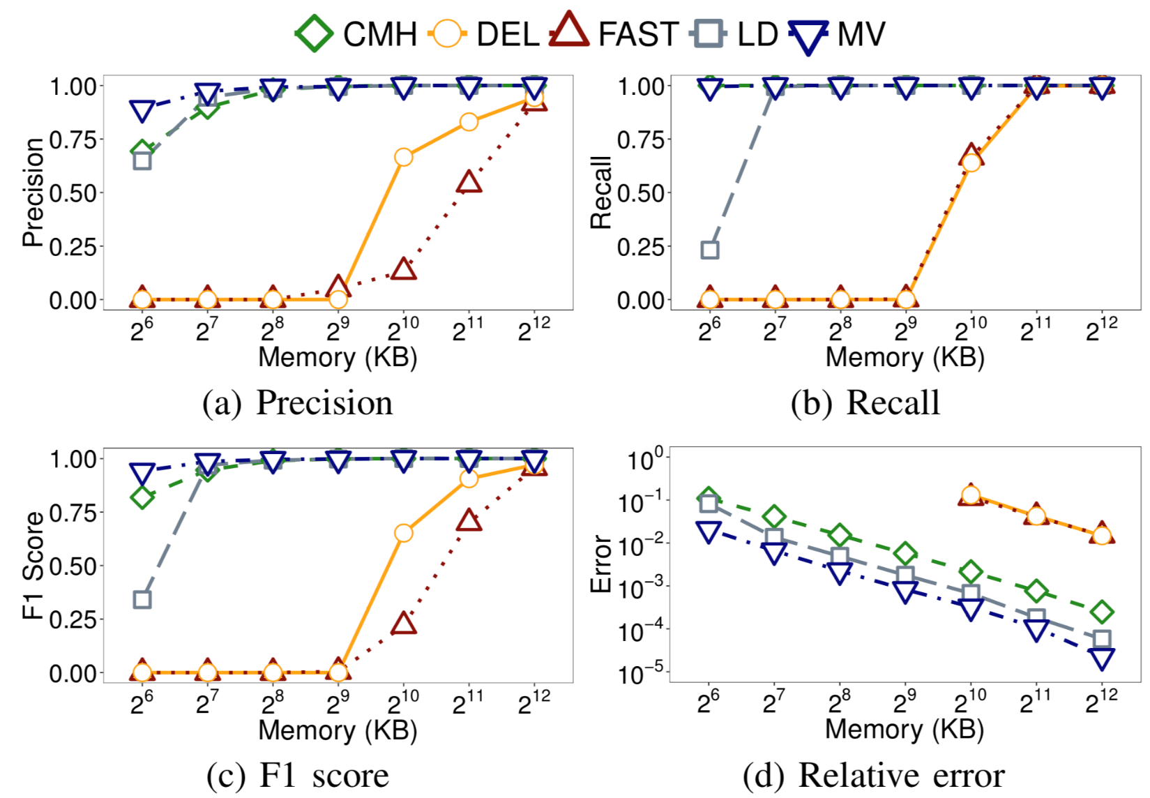
Evaluation - Accuracy
Heavy hitter detection
MV-Sketch has highest accuracy
Reduce relative error by 55% and 87% over LD-Sketch and Count-Min-Heap, resp.

Slide 21
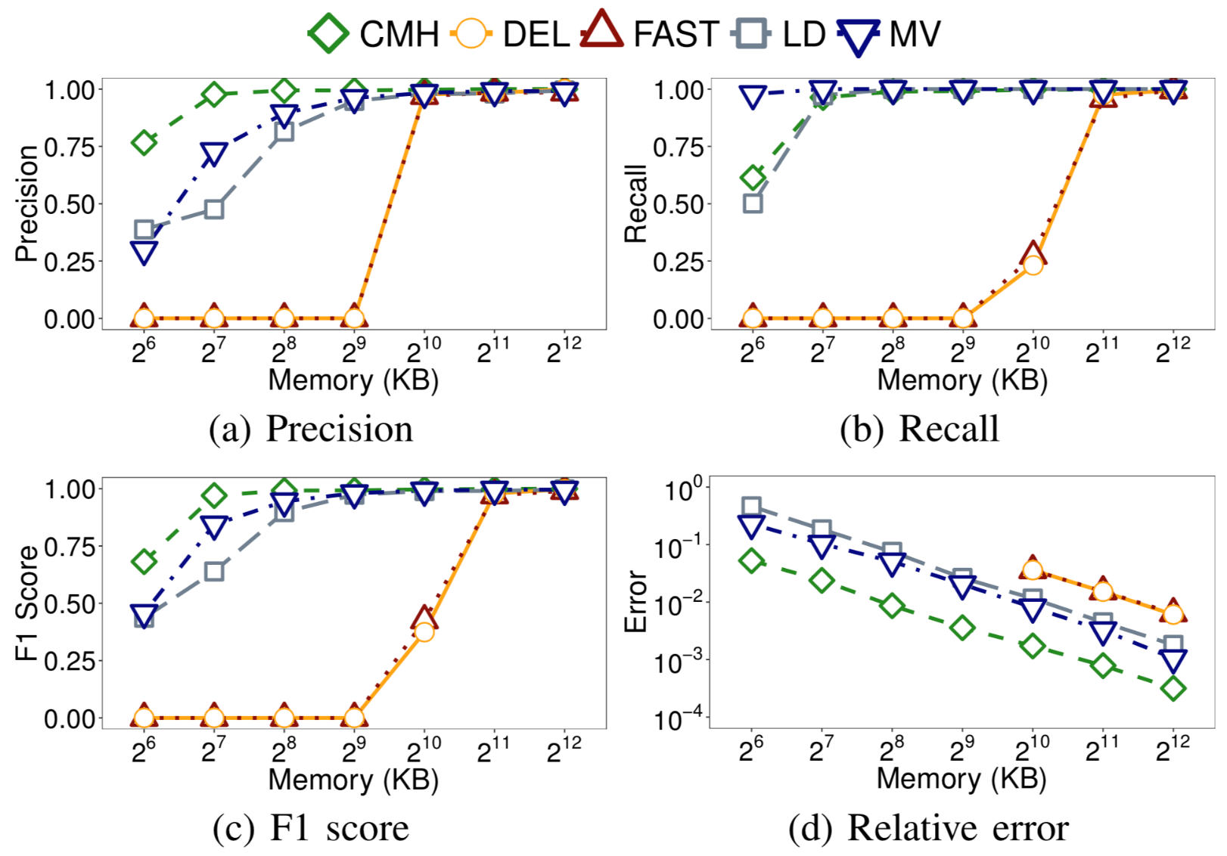
Evaluation - Accuracy
Heavy changer detection
MV-Sketch has recall 1 in all cases except 64KB
MV-Sketch has lower precision than CMH for small memory

Slide 22
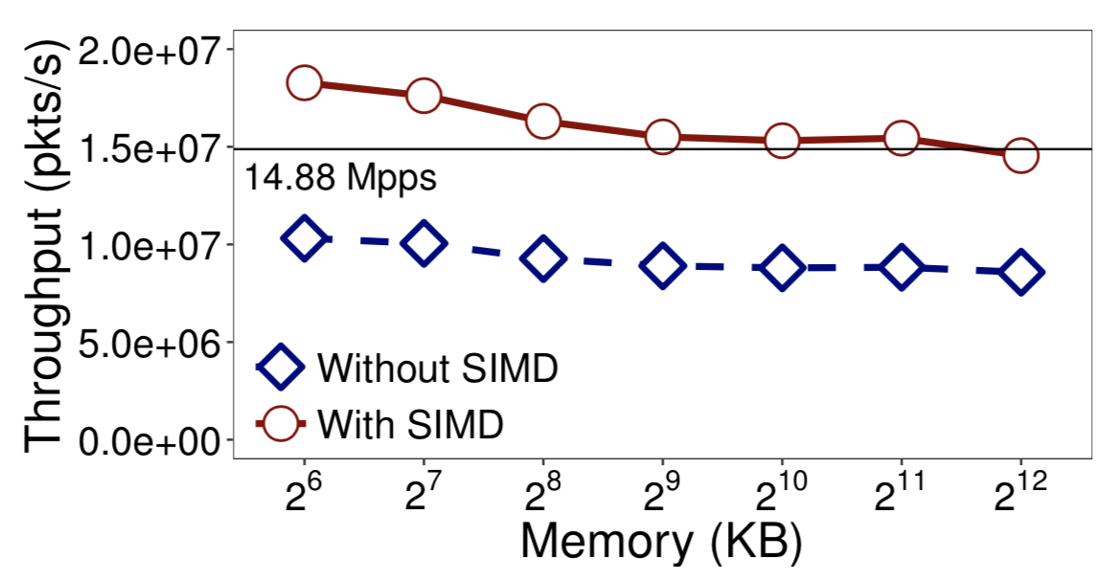
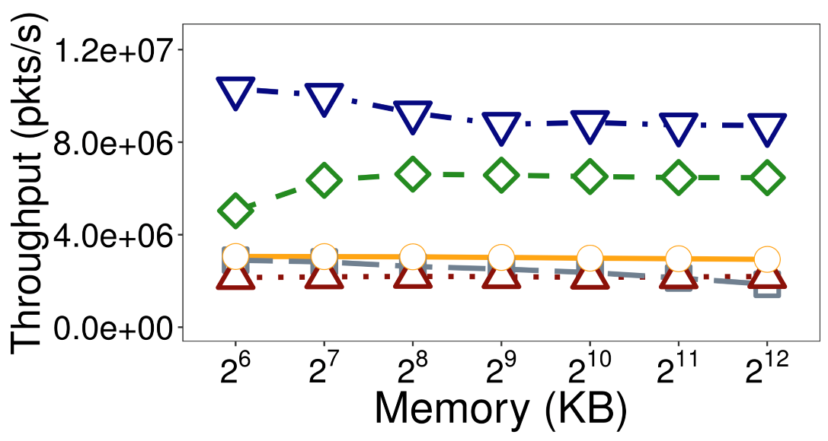
Evaluation - Speed
MV-Sketch achieves up to 3.38X throughput gain
With SIMD, MV-Sketch’s throughput further improves by 75%

Slide 23
Conclusions
MV-Sketch, an invertible sketch that enables fast and accurate heavy flow detection in network data streams
Contributions:
Propose a new sketch design for invertible sketches
High accuracy with small and static memory
Fast processing speed
Extensions to distributed heavy flow detection
Extensive experiments on real-world traces
Source code:
http://adslab.cse.cuhk.edu.hk/software/mvsketch

Slide 24
Thank you! & Questions?

