Slide 1
Toward Optimal Storage Scaling via Network Coding:
From Theory to Practice
Xiaoyang Zhang¹, Yuchong Hu¹, Patrick P. C. Lee², Pan Zhou¹
¹Huazhong University of Science and Technology
²The Chinese University of Hong Kong
INFOCOM 2018

Slide 2
Introduction
Fault tolerance for distributed storage is critical
  Availability: data remains accessible under failures
  Durability: no data loss even under failures
Erasure coding is a promising redundancy technique
  Minimum data redundancy via “data encoding”
  Higher reliability with same storage redundancy than replication
  Reportedly deployed in Google, Azure, Facebook’s data centers
    e.g., Azure reduces redundancy from 3x (replication) to 1.33x → PBs saving

Slide 3
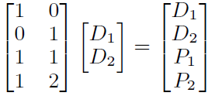
Erasure Coding
An (n, k) code (k < n) encodes k data blocks to n-k parity blocks
  Distribute the set of n blocks (stripe) to n nodes
Maximum Distance Separable (MDS)
  Any k out of n blocks can recover file data
  Redundancy = n/k is minimum
Nodes
D₁
D₁
D₁
D₂
D₂
encode
D₂
P₁
P₁
(n, k) = (4, 2)
P₂
P₂

Slide 4
Storage Scaling
Requirements in storage systems:
  Adapt to increasing storage demands (i.e., new nodes added)
  Adapt to workload changes by tuning redundancy to trade between performance and storage overhead
    e.g., Facebook f4 [Muralidhar et al., OSDI’14]; HACFS [Xia et al., FAST’15]
Storage scaling: (n, k) code → (n’, k’) code
  Relocate some existing data to different nodes
  Recompute erasure-coded data based on new data layout

Slide 5
Scaling Problem
Scaling problem:
  Minimize scaling bandwidth (i.e., amount of network traffic due to scaling)
  Related to classical repair problem of minimizing repair bandwidth, but fundamentally different
    Repair problem: redundancy maintained
    Scaling problem: redundancy changed
Challenges:
  How to quantify the scaling bandwidth?
  What is the fundamental limit of scaling bandwidth?
  Can we design a scaling approach that matches the limit?

Slide 6
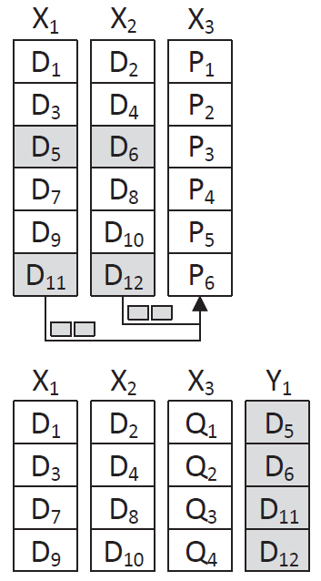
State-of-the-Art
Scale (3, 2) code to (4, 3) code
  Existing nodes: X₁, X₂, X₃
  Add one new node Y₁
Scale-RS*:
  Parity block updates
    Send 4 data blocks to X₃ for parity updates
  Data block migration
    Move 4 data blocks to Y₁
Scaling bandwidth: 8 blocks
*Huang et al., “Scale-RS: An Efficient Scaling Scheme for RS-coded Storage Clusters”, TPDS 2015
Notes:
Note here that the parity blocks are stored in a dedicated node in Scale-RS

Slide 7
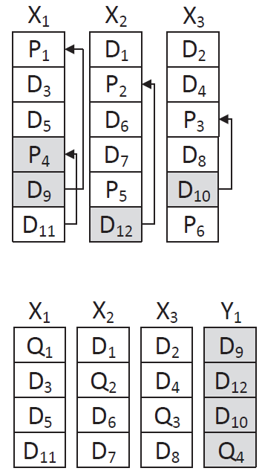
Network Coding
Combine parity block updates and data block migration
Idea:
  Update parity blocks locally
  Send encoded outputs to new nodes
    e.g., Send Q₄ to Y₁
  Maintain a balanced parity layout
Scaling bandwidth: 4 blocks

Slide 8
Our Contributions
Prove information-theoretically minimum scaling bandwidth
  First formal study of applying network coding to storage scaling
Design and implement NCScale
  A prototype that realizes network-coding-based scaling
  Achieve minimum (or near-minimum) scaling bandwidth
Conduct experiments on Amazon EC2
  Up to 50% of scaling bandwidth savings
  Consistent with theoretical findings

Slide 9
Problem Formulation
(n, k, s)-scaling: Transform (n, k) code to (n+s, k+s) code for s > 0
Properties:
  MDS and systematic
    MDS: tolerate any n-k failures with minimum redundancy
    Systematic: k blocks are kept in a stripe
  Uniform data and parity distribution
  Decentralized scaling
Goal: minimize scaling bandwidth subject to above properties
* Our ISIT’18 paper covers a more general case of scaling

Slide 10
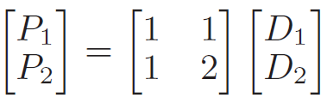
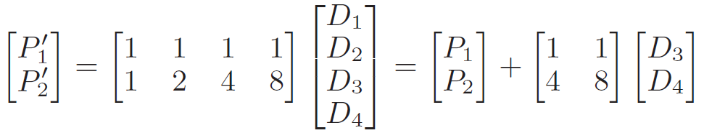
Vandermonde-based Reed-Solomon Codes
Building scaling on Vandermonde-based Reed-Solomon codes
  Parity blocks computed from an (n-k) x k Vandermonde matrix
Each new parity block can be computed by adding an existing parity block with a parity delta block
Example:
  (4, 2) code:
  → (6, 4) code:
Parity delta blocks

Slide 11
Vandermonde-based Reed-Solomon Codes
Note: systematic Vandermonde-based Reed-Solomon codes are generally non-MDS in finite fields
  Data blocks cannot be recovered from any k blocks
Nevertheless, MDS property holds for practical parameters
See: http://www.cse.cuhk.edu.hk/~pclee/www/pubs/infocom18_corrections.pdf

Slide 12
Lower Bound Analysis
X₁
Let (n, k, s) = (4, 2, 2)
  i.e., (4,2) code → (6,4) code
File size = M
β = bandwidth between any existing node
X_{i} (1 ≤ i ≤ n) to new node Y_{j} (1 ≤ j ≤ s)
Goal: minimize β
  Scaling bandwidth = n ∙ s ∙ β
X₂
X₃
X₄
Y₁
β
Y₂

Slide 13
Lower Bound Analysis
Information flow graph:
in
mid
out
X₁
M/k
X₁
M/(k+s)
X₁
∞
∞
in
mid
out
∞
X₂
M/k
X₂
M/(k+s)
X₂
S
∞
∞
in
mid
out
X₃
M/k
X₃
M/(k+s)
X₃
∞
T
in
mid
out
X₄
M/k
X₄
M/(k+s)
X₄
∞
in
out
Y₁
M/(k+s)
Y₁
∞
β
in
out
Y₂
M/(k+s)
Y₂

Slide 14
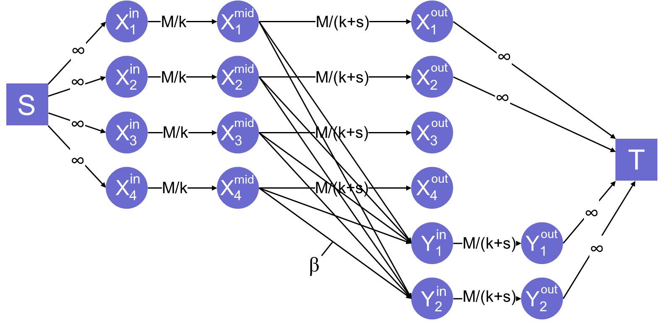

Lower Bound Analysis
Lemma 1:
β must be at least $\frac{M}{n(k+s)}$.
Proof: Each new node Y_{j}$\text{(1 }\text{≤ }\text{j}\text{ ≤ }\text{s}\text{)}$ must receive at least $\frac{M}{(k+s)}$ units of data from every node X_{i} $\text{(1 }\text{≤ }\text{i}\text{ ≤ }\text{n}\text{)}$.

Slide 15
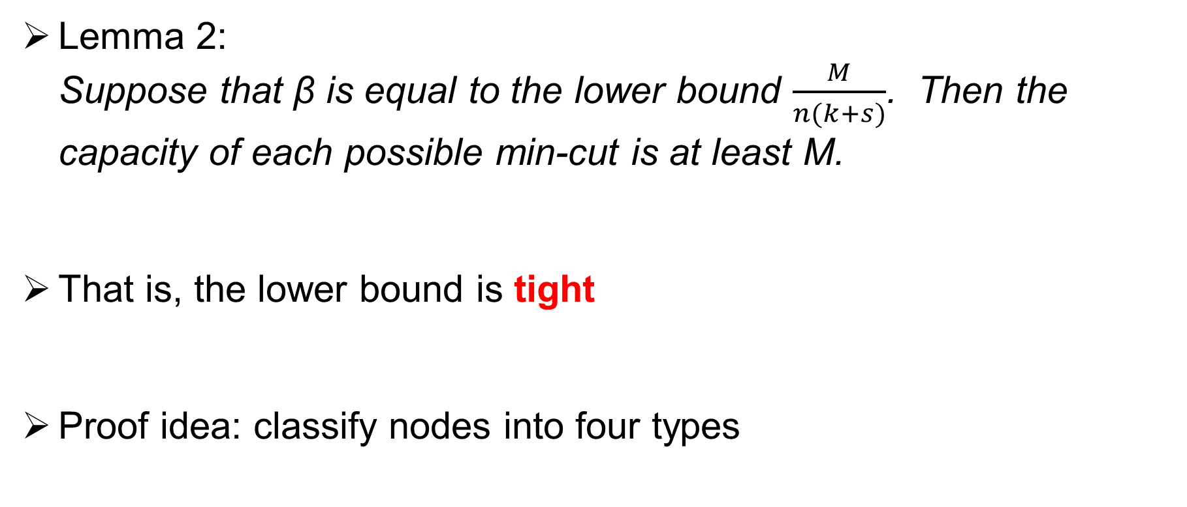
Lower Bound Analysis
Lemma 2:
Suppose that β is equal to the lower bound $\frac{M}{n(k+s)}$. Then the capacity of each possible min-cut is at least M.
That is, the lower bound is tight
Proof idea: classify nodes into four types

Slide 16
Lower Bound Analysis
cut
in
mid
out
X₁
M/k
X₁
M/(k+s)
X₁
∞
∞
in
mid
out
∞
X₂
M/k
X₂
M/(k+s)
X₂
S
∞
∞
in
mid
out
X₃
M/k
X₃
M/(k+s)
X₃
∞
T
in
mid
out
X₄
M/k
X₄
M/(k+s)
X₄
∞
in
out
Y₁
M/(k+s)
Y₁
∞
β
Type 1
in
out
Y₂
M/(k+s)
Y₂

Slide 17
Lower Bound Analysis
cut
in
mid
out
X₁
M/k
X₁
M/(k+s)
X₁
∞
∞
in
mid
out
∞
X₂
M/k
X₂
M/(k+s)
X₂
S
∞
∞
in
mid
out
X₃
M/k
X₃
M/(k+s)
X₃
∞
T
in
mid
out
X₄
M/k
X₄
M/(k+s)
X₄
∞
in
out
Y₁
M/(k+s)
Y₁
∞
β
Type 2
in
out
Y₂
M/(k+s)
Y₂

Slide 18
Lower Bound Analysis
cut
in
in
out
mid
out
X₁
mid
X₁
X₁
X₁
X₁
M/k
X₁
M/k
M/(k+s)
M/(k+s)
∞
∞
∞
∞
out
in
out
in
mid
X₂
mid
X₂
X₂
X₂
X₂
M/(k+s)
X₂
M/k
M/(k+s)
∞
M/k
∞
∞
S
∞
S
∞
∞
mid
in
mid
in
out
X₃
out
X₃
X₃
X₃
X₃
M/k
X₃
M/k
M/(k+s)
M/(k+s)
T
∞
T
∞
in
in
out
mid
out
X₄
mid
X₄
X₄
X₄
X₄
M/(k+s)
X₄
M/k
M/(k+s)
M/k
∞
∞
in
in
out
out
Y₁
Y₁
Y₁
Y₁
M/(k+s)
M/(k+s)
∞
β
β
Type 3
out
in
out
in
Y₂
Y₂
Y₂
Y₂
M/(k+s)
M/(k+s)

Slide 19
Lower Bound Analysis
cut
in
mid
out
X₁
M/k
X₁
M/(k+s)
X₁
∞
∞
in
mid
out
∞
X₂
M/k
X₂
M/(k+s)
X₂
S
∞
∞
in
mid
out
X₃
M/k
X₃
M/(k+s)
X₃
∞
T
in
mid
out
X₄
M/k
X₄
M/(k+s)
X₄
∞
in
out
Y₁
M/(k+s)
Y₁
∞
β
Type 4
in
out
Y₂
M/(k+s)
Y₂

Slide 20
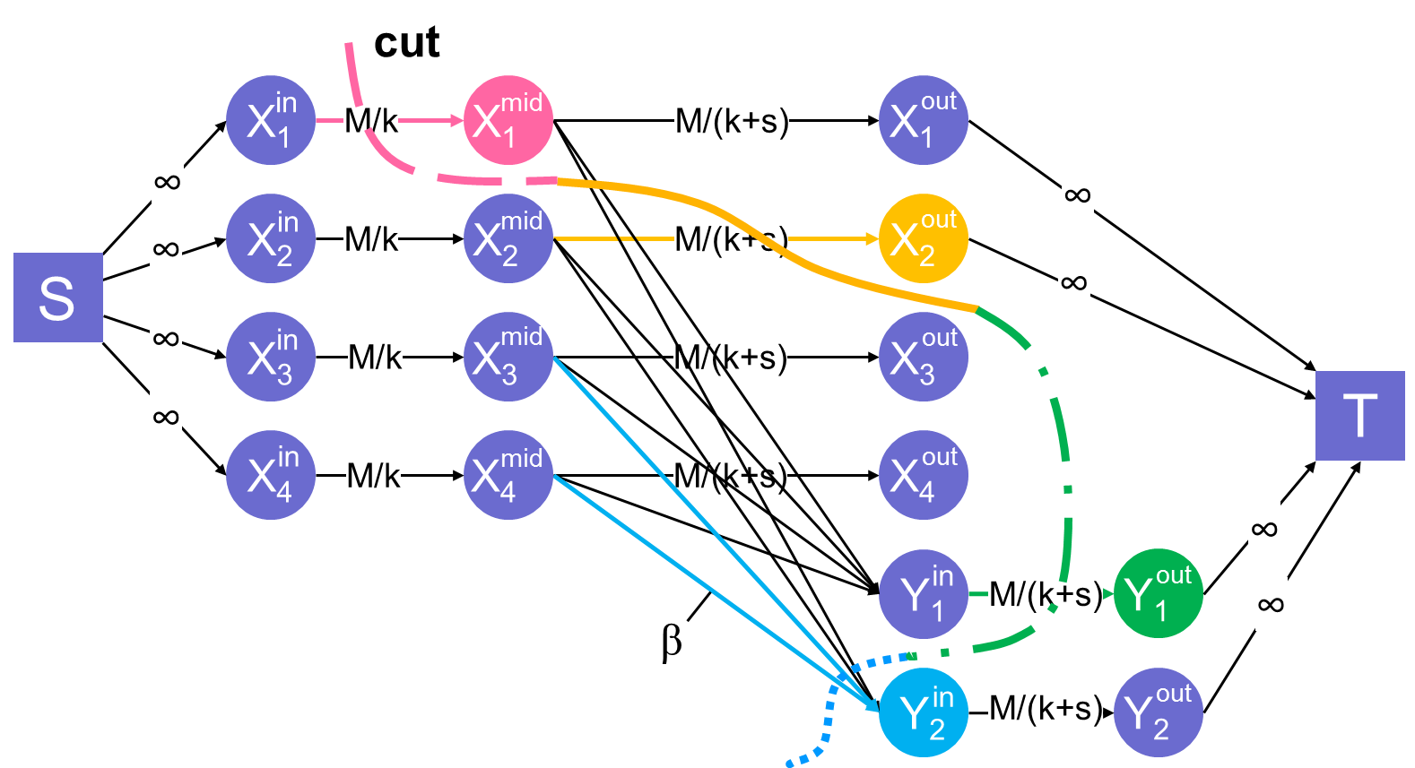
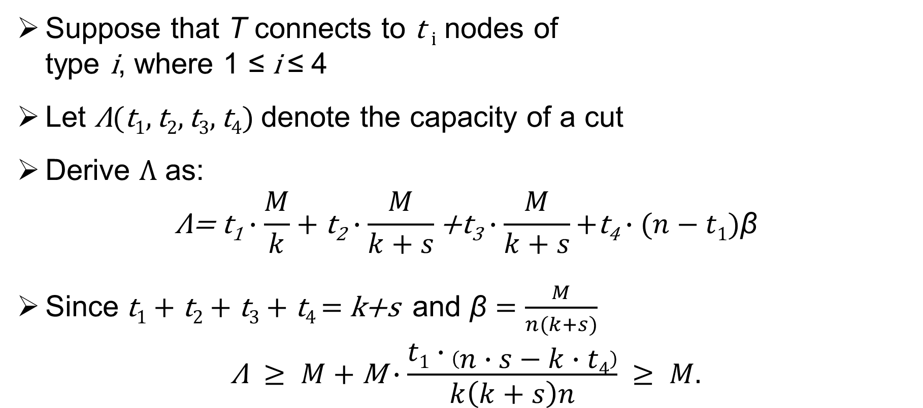
Lower Bound Analysis
Suppose that T connects to $\text{t} i$ nodes of
type $\text{i}$, where 1 ≤ $\text{i}$≤ 4
Let $\text{Λ}\text{(}\text{t}\text{1}, \text{t}\text{2},\text{t}\text{3},\text{t}\text{4}\text{)}$ denote the capacity of a cut
Derive $\text{Λ}$ as:
$$\text{Λ}\text{= }\text{t}\text{1}∙\frac{M}{k}+\text{t}\text{2}∙\frac{M}{k+s}\text{+}\text{t}\text{3}∙\frac{M}{k+s}\text{+}\text{t}\text{4}∙(n−t1)\text{β}$$
Since $\text{t}\text{1}+\text{t}\text{2}+\text{t}\text{3}+\text{t}\text{4 }\text{= }\text{k}\text{+}\text{s} \text{and} \text{β}=\frac{M}{n(k+s)}$
$$\text{Λ} ≥ M+\text{M}∙\frac{t1∙\left(n∙s−k∙t4\right)}{k\left(k+s\right)n} ≥ M.$$

Slide 21
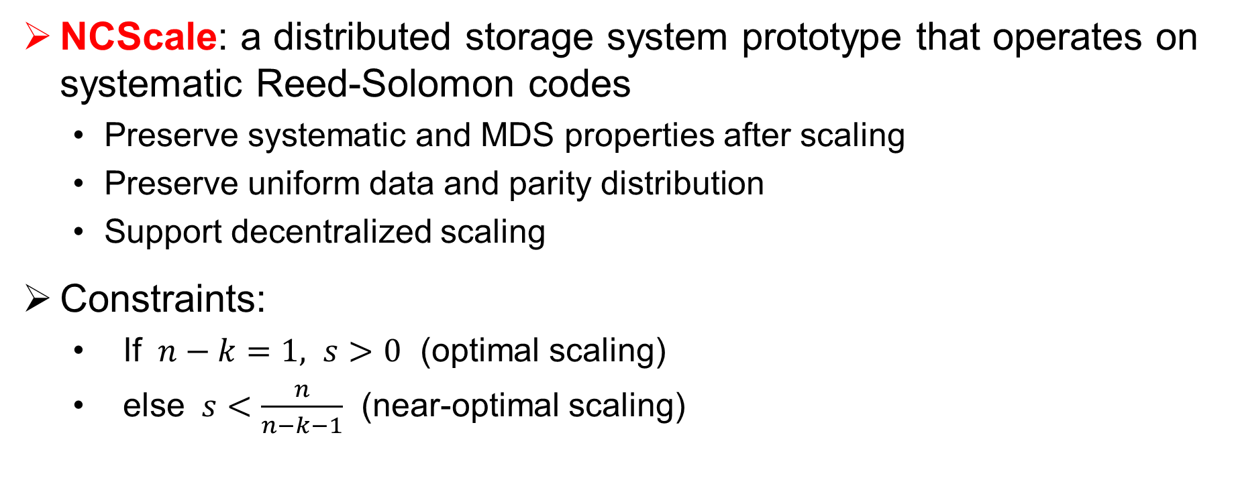
NCScale
NCScale: a distributed storage system prototype that operates on systematic Reed-Solomon codes
  Preserve systematic and MDS properties after scaling
  Preserve uniform data and parity distribution
  Support decentralized scaling
Constraints:
  If $n−k=1, s>0$ (optimal scaling)
  else $s<\frac{n}{n−k−1}$ (near-optimal scaling)

Slide 22
NCScale
Prepare step:
  Identify the set of blocks involved in scaling operations
Two groups of stripes
  PG: a group of stripes in which parity blocks will be updated
  DG: a group of stripes in which data blocks are used to update the parity blocks in PG

Slide 23
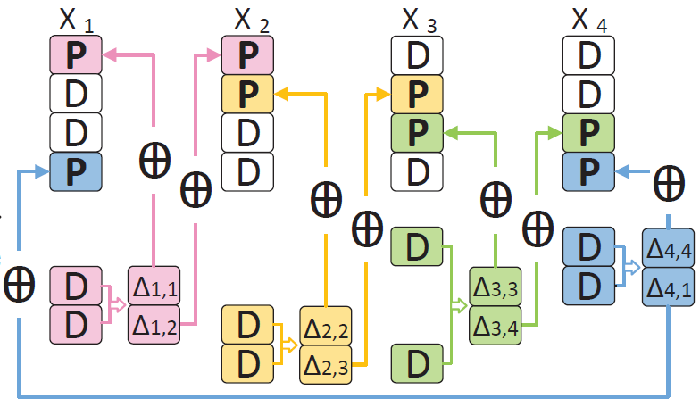
NCScale
Compute step:
  Update parity blocks in PG using data blocks in DG

Slide 24
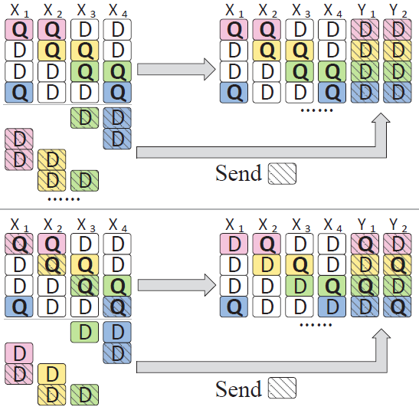
NCScale
Send step:
  Send data blocks to new nodes
  Send the locally updated parity blocks and data blocks to new nodes

Slide 25
Implementation
NCScale prototype:
  Intel ISA-L for erasure code implementation
  Both Scale-RS and network-coding-based scaling implementations for comparisons
Setup:
  Amazon EC2
  Up to 14 m4.4xlarge instances

Slide 26
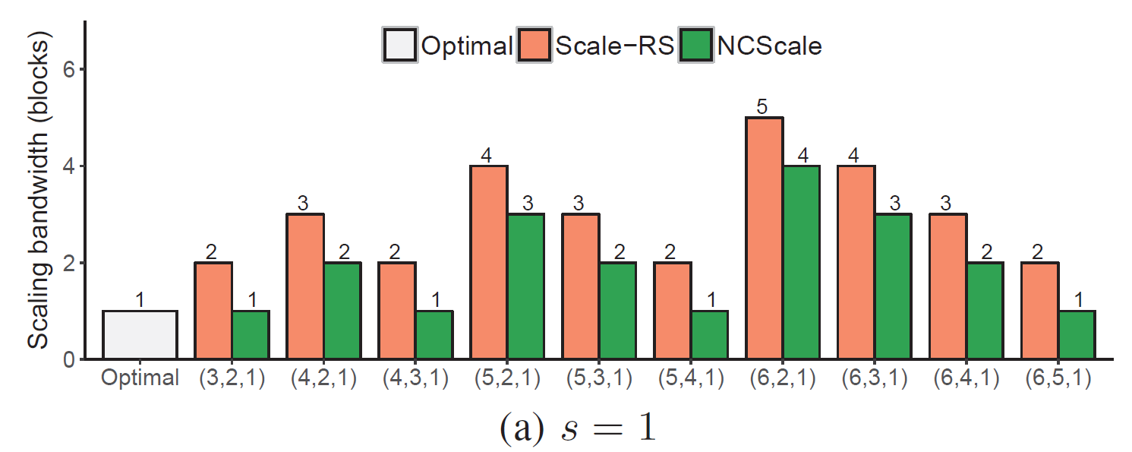
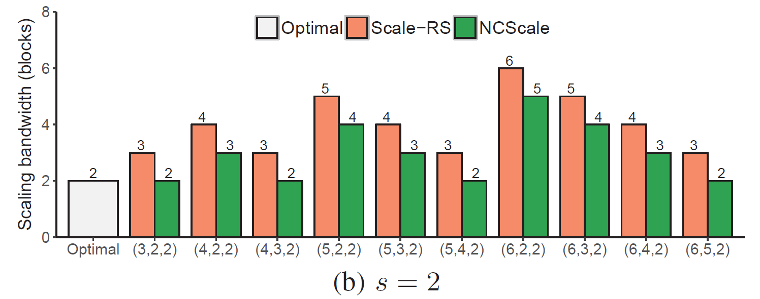
Numerical Evaluation
Scaling bandwidth (per stripe):
  Optimal: 𝑠 blocks
  Scale-RS: 𝑠 + 𝑛 − 𝑘 blocks
  NCScale: 𝑠 + 𝑛 − 𝑘 − 1 blocks
NCScale reaches optimal point when 𝑛 − 𝑘 = 1

Slide 27
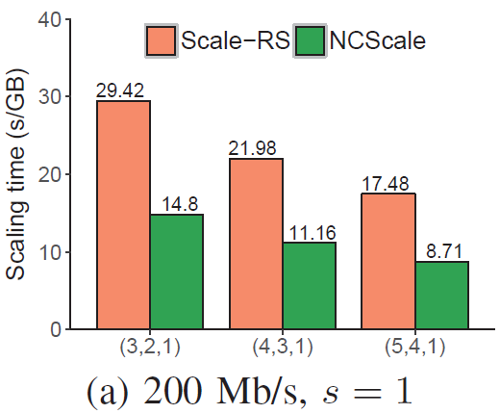
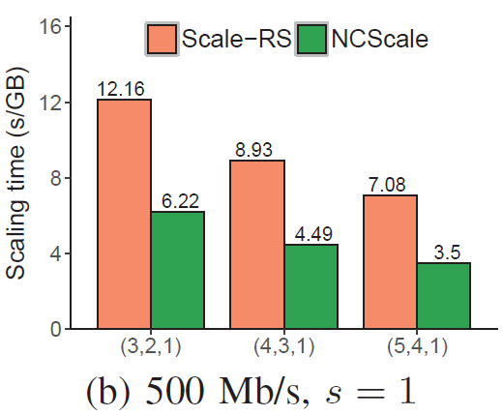
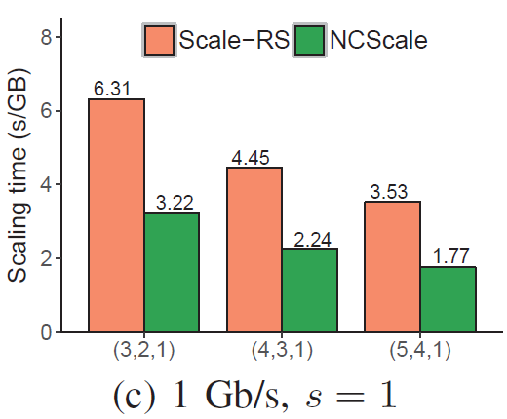
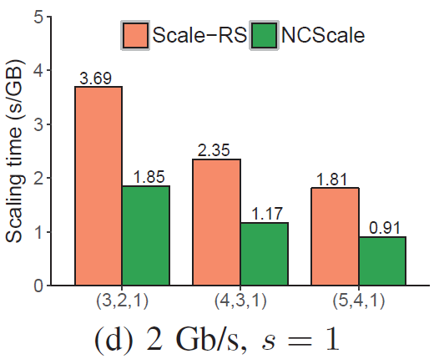
Amazon EC2 Experiments
Impact of bandwidth between VM instances
  64 MB block size
Findings:
  Empirical results are consistent with numerical results

Slide 28
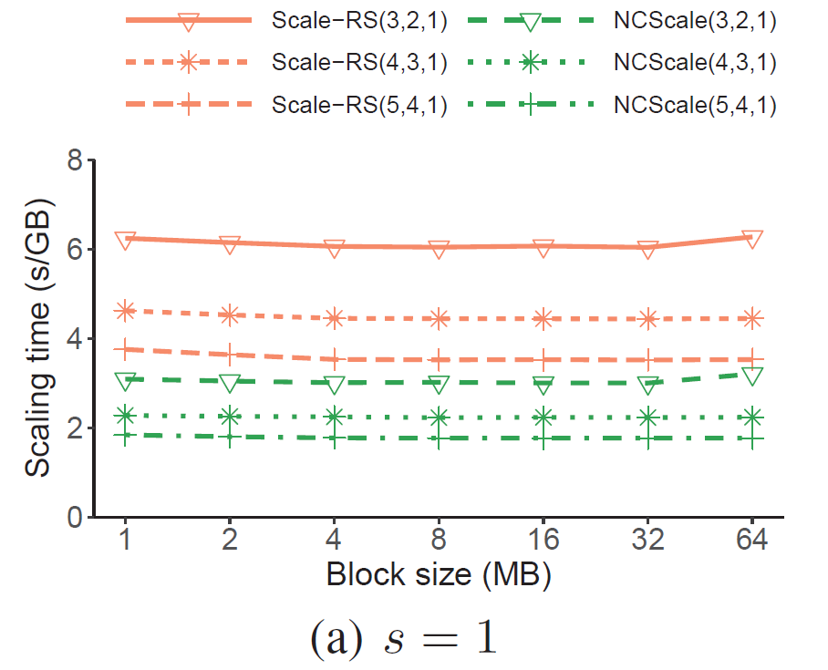
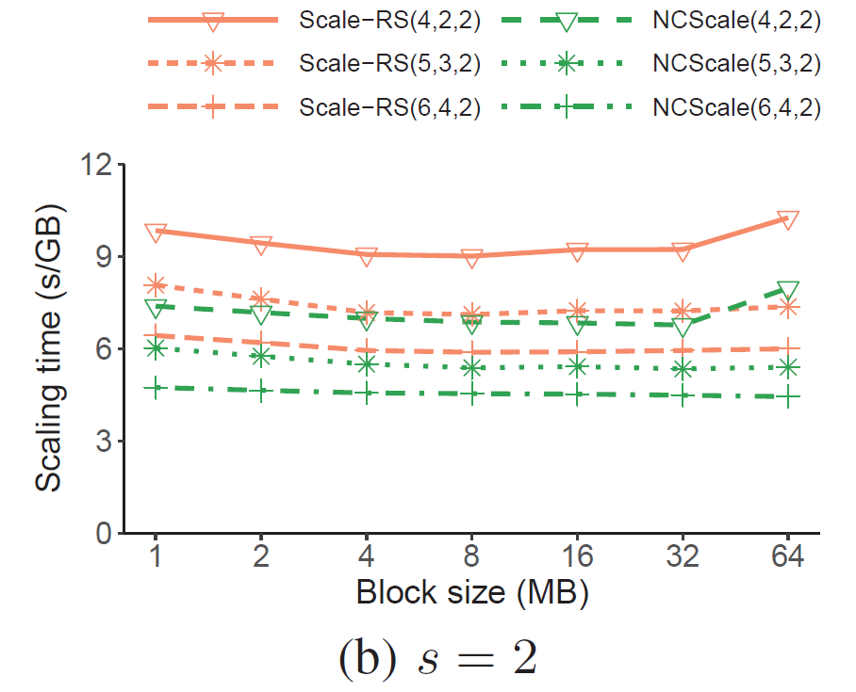
Amazon EC2 Experiments
Impact of block size
  Scaling times of NCScale and Scale-RS are fairly stable across block sizes
  NCScale still shows performance gain over Scale-RS

Slide 29
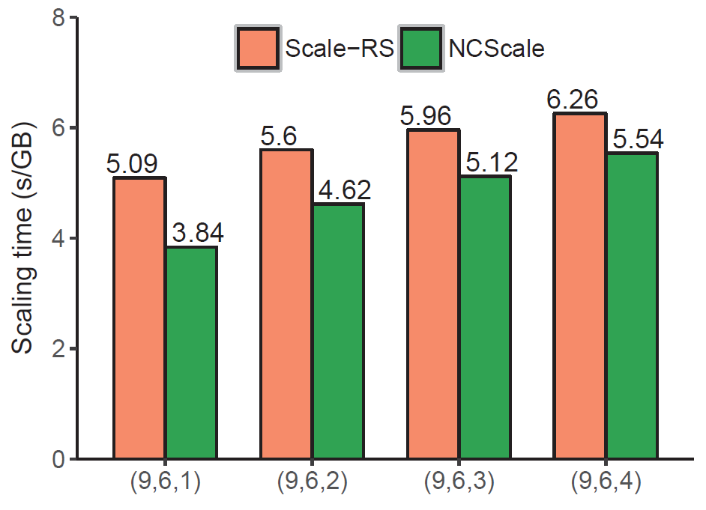
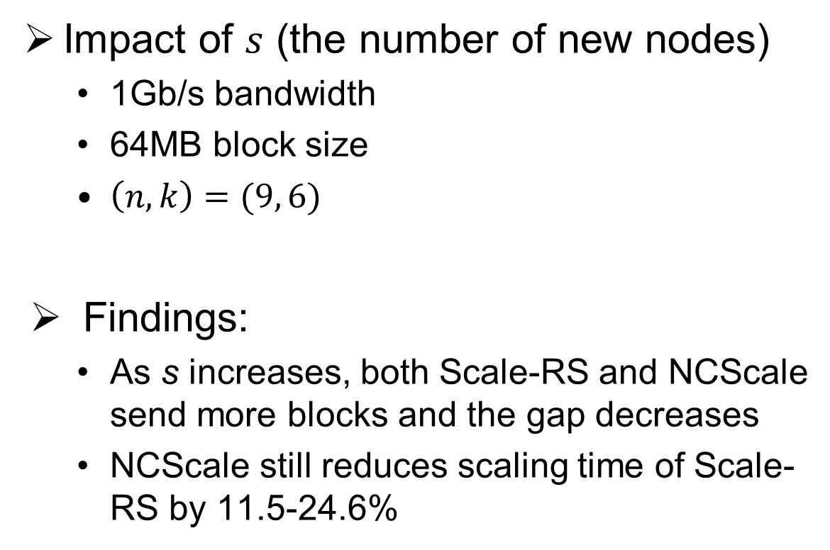
Amazon EC2 Experiments
Impact of $s$ (the number of new nodes)
  1Gb/s bandwidth
  64MB block size
  $\left(n,k\right)=(9, 6)$
Findings:
  As s increases, both Scale-RS and NCScale send more blocks and the gap decreases
  NCScale still reduces scaling time of Scale-RS by 11.5-24.6%

Slide 30
Conclusions
Study how to apply network coding to storage scaling from both theoretical and applied perspectives
Formally prove the information-theoretically minimum point
Build NCScale prototype to realize network-coding-based scaling
Conduct extensive experiments on Amazon EC2
  Empirical results match theories

