Slide 1
LD-Sketch: A Distributed Sketching Design for Accurate and Scalable Anomaly Detection in Network Data Streams
Qun Huang and Patrick P. C. Lee
The Chinese University of Hong Kong, Hong Kong
INFOCOM’14

Slide 2
Motivation
Network traffic: a stream of (key, value) tuples
  Keys: src IPs, five-tuple flows
  Value: # of packets, payload bytes
Heavy keys - classical anomalies in network traffic
  Heavy hitters: keys with large volume in one period
    e.g. SLA violation
  Heavy changers: keys with large volume change across two periods
    e.g. DoS attacks, component failures
Goal:
  identify heavy keys in real time

Slide 3
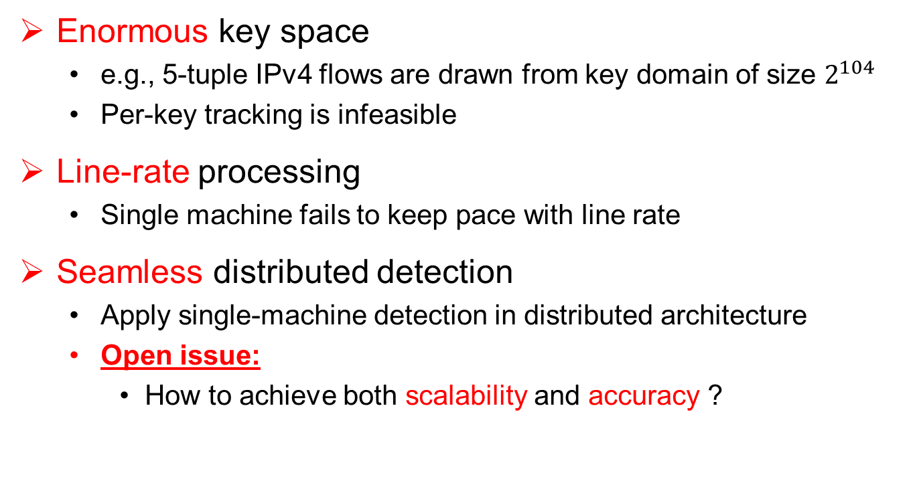
Challenges
Enormous key space
  e.g., 5-tuple IPv4 flows are drawn from key domain of size $2^{104}$
  Per-key tracking is infeasible
Line-rate processing
  Single machine fails to keep pace with line rate
Seamless distributed detection
  Apply single-machine detection in distributed architecture
  Open issue:
    How to achieve both scalability and accuracy ?

Slide 4
Related Works
Counter-based techniques
  Misra-Gries algorithm [Misra & Gries 82]; Lossy Counting [Manku et al. 02]; Space Saving [Metwally et al. 05]; Probalistic Lossy Count [Dimitropoulos et al. 08]
  Only address for heavy hitter detection in single machine
Sketch-based techniques
  Multi-stage filter [Estan et al. 03]; CGT [Cormode et al. 04]; Reversible Sketch [Schweller et al. 06]; SeqHash [Tian et al. 07]; Fast Sketch [Liu et al. 12]
  Only work in single machine
Distributed detection
  [Cormode et al. 2005]
  [Manjhi et al. 2005]
  [Yi et al. 2009]
  Only address heavy hitter detection

Slide 5
Our Work
LD-Sketch: a new sketching design for heavy key detection in a distributed architecture
A sketch technique for local detection
  High accuracy
  High speed
  Low space complexity
A distributed detection scheme not only achieves scalability but also improves accuracy
Experiments on real-world traces

Slide 6
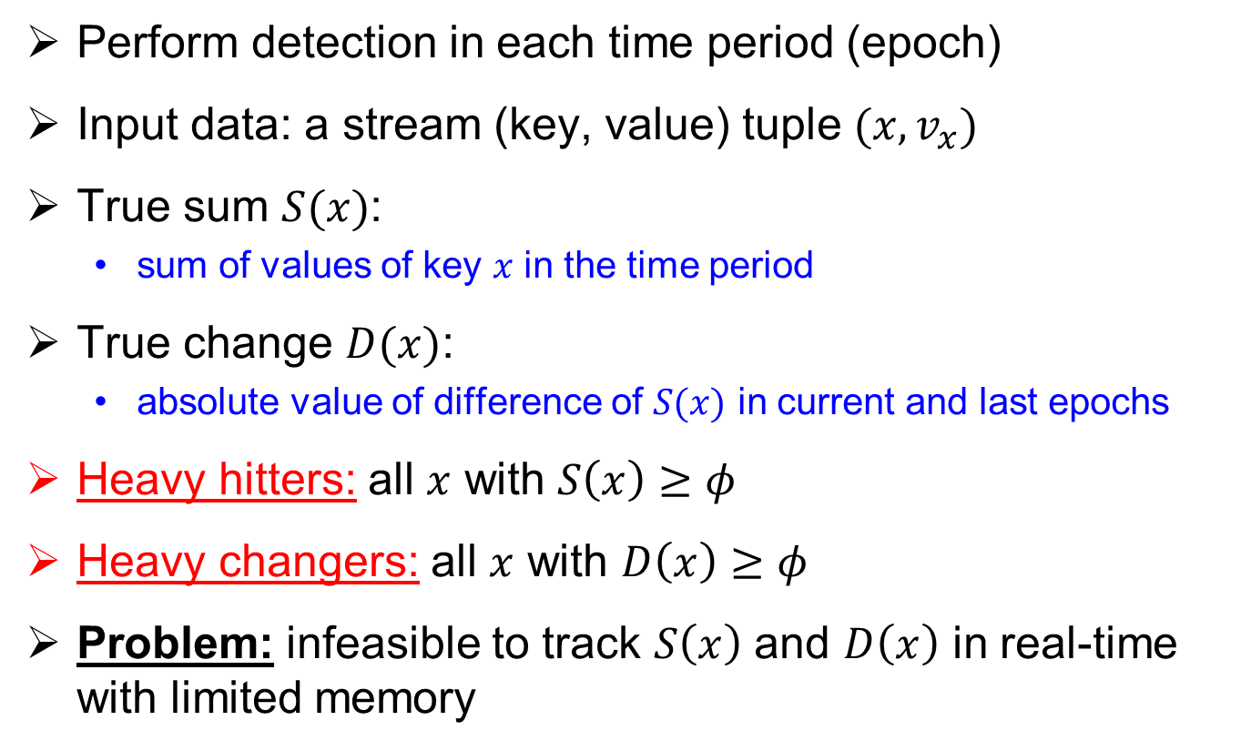
Problem Formulation
Perform detection in each time period (epoch)
Input data: a stream (key, value) tuple $(x, v_{x})$
True sum $S(x)$:
  sum of values of key $x$ in the time period
True change $D(x)$:
  absolute value of difference of $S(x)$ in current and last epochs
  Heavy hitters: all $x$ with $S\left(x\right)≥φ$
  Heavy changers: all $x$ with $D\left(x\right)≥φ$
  Problem: infeasible to track $S\left(x\right)$ and $D\left(x\right)$ in real-time with limited memory

Slide 7
Architecture
Data
source
Data
source
Data
source
Data
source
Data
source
Remote
site
Remote
site
Remote
site
Remote
site
Remote
site
Worker
Worker
Worker
Distributed detection
Local detection
Local detection
Local detection
Local detection results
Final detection results

Slide 8

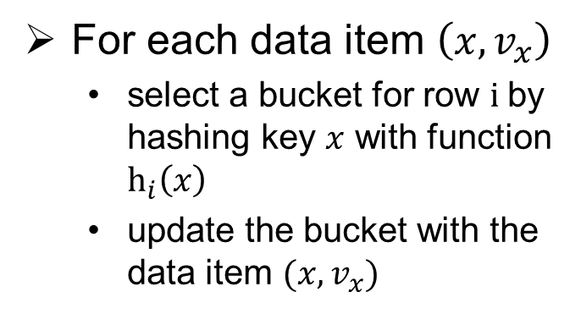



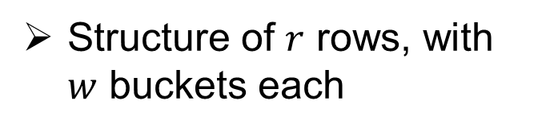


Local Detection
LD-Sketch
$w$ buckets
Structure of $r$ rows, with $w$ buckets each
Update phase
$$h_{1}$$
For each data item $\left(x, v_{x}\right)$
  select a bucket for row $i$by hashing key $x$ with function $h_{i}\left(x\right)$
  update the bucket with the data item $(x, v_{x})$
key $x$
$$h_{2}$$
$r$ rows
$$h_{r}$$
Detection phase
Examine the buckets and report heavy keys

Slide 9


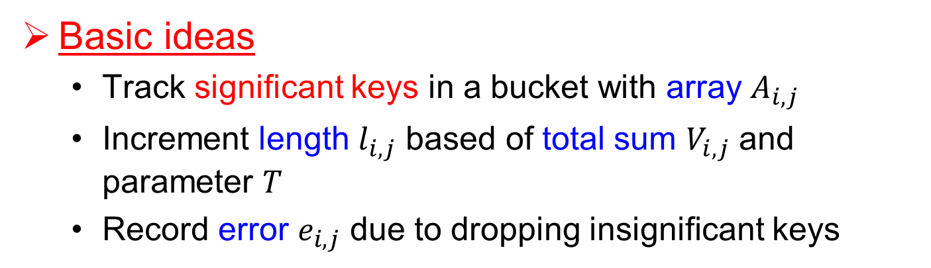
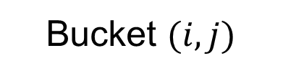








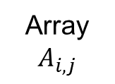
Inside a Bucket
Basic ideas
  Track significant keys in a bucket with array $A_{i,j}$
  Increment length $l_{i,j}$ based of total sum $V_{i,j}$ and parameter $T$
  Record error $e_{i,j}$ due to dropping insignificant keys
Bucket $(i, j)$
Expansion parameter $T$
Total sum:
$$key 1$$
$$value$$
$$V_{i, j}$$
Array
$$A_{i,j}$$
$$key 2$$
$$value$$
$$…$$
length: $l_{i,j}$
Error:
$$e_{i, j}$$
$$empty$$

Slide 10

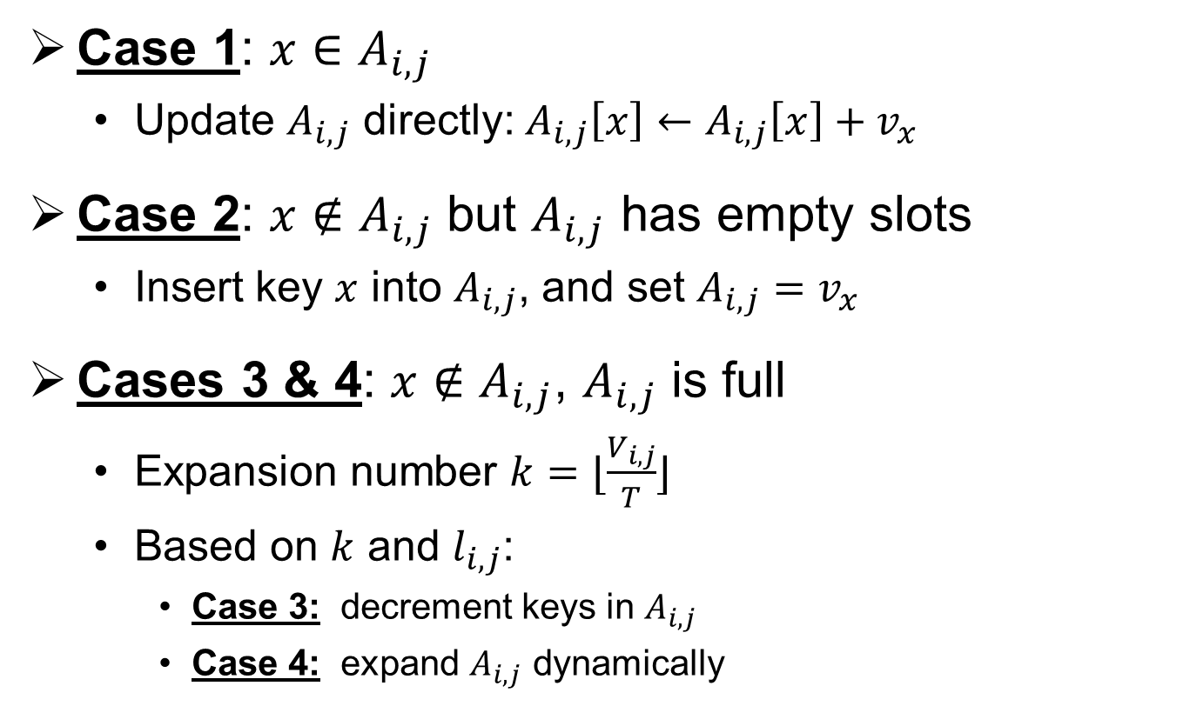
Update Bucket with $(x, v_{x})$
Four cases
Case 1: $x∈A_{i,j}$
  Update $A_{i,j}$ directly: $A_{i,j}\left[x\right]←A_{i,j}\left[x\right]+v_{x}$
Case 2: $x∉A_{i,j}$ but $A_{i,j}$ has empty slots
  Insert key $x$ into $A_{i,j}$, and set $A_{i,j}=v_{x}$
Cases 3 & 4: $x∉A_{i,j}$, $A_{i,j}$ is full
  Expansion number $k=⌊\frac{V_{i,j}}{T}⌋$
  Based on $k$ and $l_{i,j}$:
    Case 3: decrement keys in $A_{i,j}$
    Case 4: expand $A_{i,j}$ dynamically

Slide 11

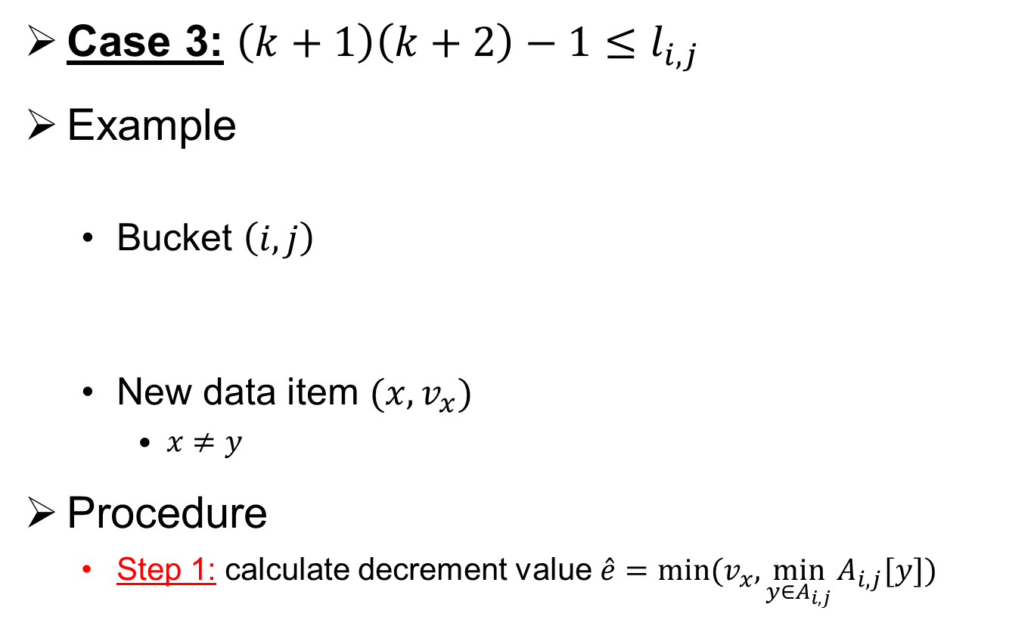




Decrement Keys
Case 3: $\left(k+1\right)\left(k+2\right)−1≤l_{i,j}$
Example
  Bucket $\left(i, j\right)$
  New data item $(x, v_{x})$
    $x≠y$
Procedure
  Step 1: calculate decrement value $\hat{e}=min⁡(v_{x},\min_{y∈A_{i,j}}{A_{i,j}[y])}$
$$A_{i,j}$$
y
5
$k=0$
$$l_{i,j}=1$$
$$e_{i,j}=2$$
Step 1
$$\hat{e}=\left\{\begin{aligned}3, if v_{x}=3 \\ 5, if v_{x}=5 \\ 5, if v_{x}=8\end{aligned}\right.$$

Slide 12





Decrement Keys
Procedure (cont.)
  Step 2: Update $e_{i,j}←e_{i,j}+\hat{e}$
  Step 3: Update $A_{i,j}:$
    $A_{i,j}\left[y\right]←A_{i,j}\left[y\right]−\hat{e}$, for all $y∈A_{i,j}$
    Remove all $y$ with $A_{i,j}\left[y\right]=0$
    Insert key $x$ with $A_{i,j}\left[x\right]=v_{x}−\hat{e}$ if $v_{x}>\hat{e}$
Step 2
$$e_{i,j}=\left\{\begin{aligned}5, if v_{x}=3 \\ 7, if v_{x}=5 \\ 7, if v_{x}=8\end{aligned}\right.$$
After
y
2
$$v_{x}=3$$
Step 3
Before
y
5
After
empty
$$v_{x}=5$$
After
x
3
$$v_{x}=8$$

Slide 13



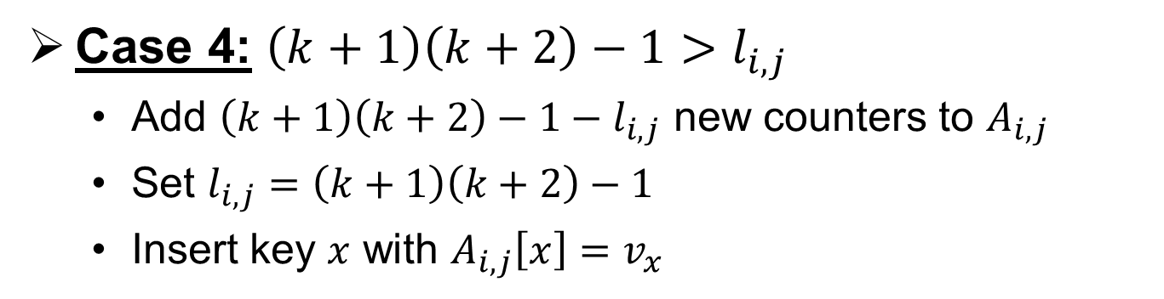













Dynamic Expansion
Case 4: $\left(k+1\right)\left(k+2\right)−1>l_{i,j}$
  Add $\left(k+1\right)\left(k+2\right)−1−l_{i,j}$ new counters to $A_{i,j}$
  Set $l_{i,j}=\left(k+1\right)\left(k+2\right)−1$
  Insert key $x$ with $A_{i,j}\left[x\right]=v_{x}$
Before
$$A_{i,j}$$
$$y_{1}$$
$$y_{2}$$
$$y_{3}$$
$$y_{4}$$
$$y_{5}$$
$$l_{i,j}=5$$
$k=2$
After
$$A_{i,j}$$
$$y_{1}$$
$$y_{2}$$
$$y_{3}$$
$$y_{4}$$
$$y_{5}$$
$$x$$
$$l_{i,j}=11$$
Notes:
We consider accesses in physical address space.

Slide 14
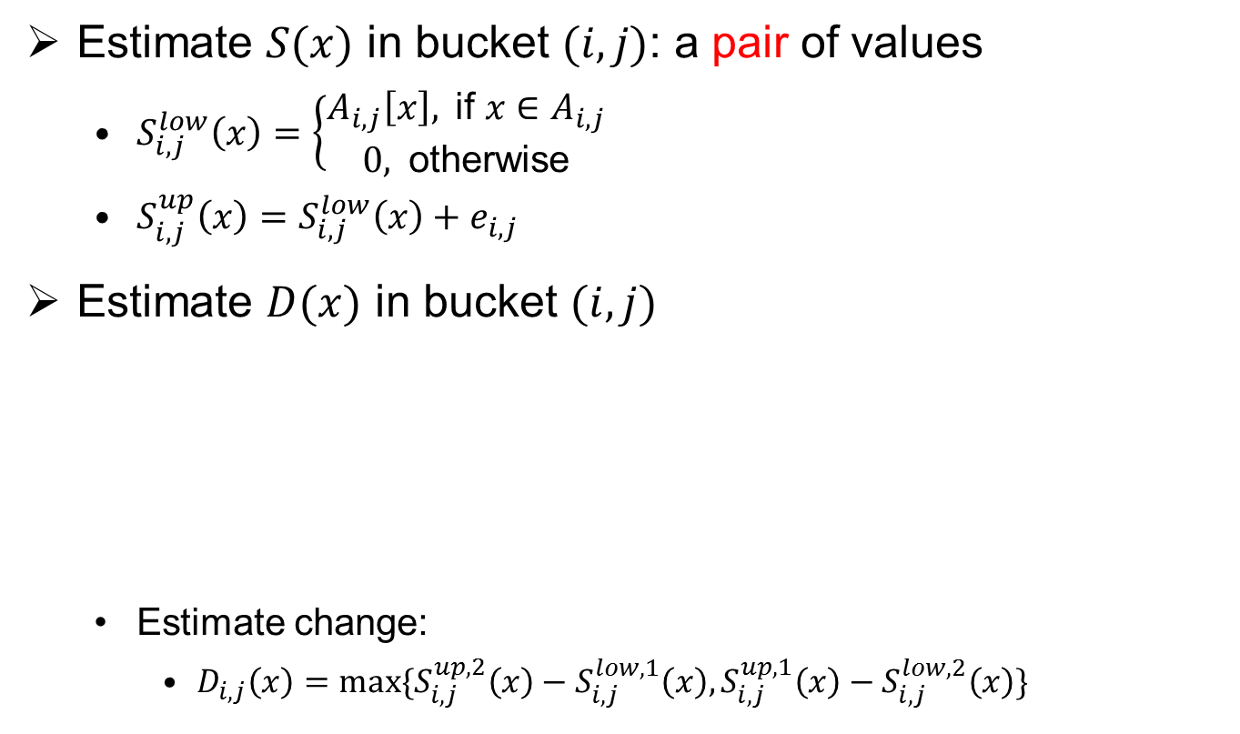




Estimate True Sum or Change
Estimate $S(x)$ in bucket $(i,j)$: a pair of values
  $S_{i,j}^{low}\left(x\right)=\left\{\begin{aligned}A_{i,j}\left[x\right], \text{if} x∈A_{i,j} \\ 0, \text{otherwise}\end{aligned}\right.$
  $S_{i,j}^{up}\left(x\right)=S_{i,j}^{low}\left(x\right)+e_{i,j}$
Estimate $D(x)$ in bucket $(i,j)$
  Estimate change:
    $D_{i,j}\left(x\right)=max⁡\{S_{i,j}^{up,2}\left(x\right)−S_{i,j}^{low,1}\left(x\right),S_{i,j}^{up,1}\left(x\right)−S_{i,j}^{low,2}\left(x\right)\}$
Bucket $(i, j)$ at 1st epoch
Bucket $(i, j)$ at 2nd epoch
$S_{i,j}^{low,1}\left(x\right)$ and $S_{i,j}^{up,1}\left(x\right)$
$S_{i,j}^{low,2}\left(x\right)$ and $S_{i,j}^{up,2}\left(x\right)$

Slide 15
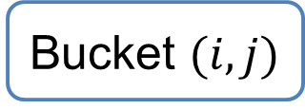
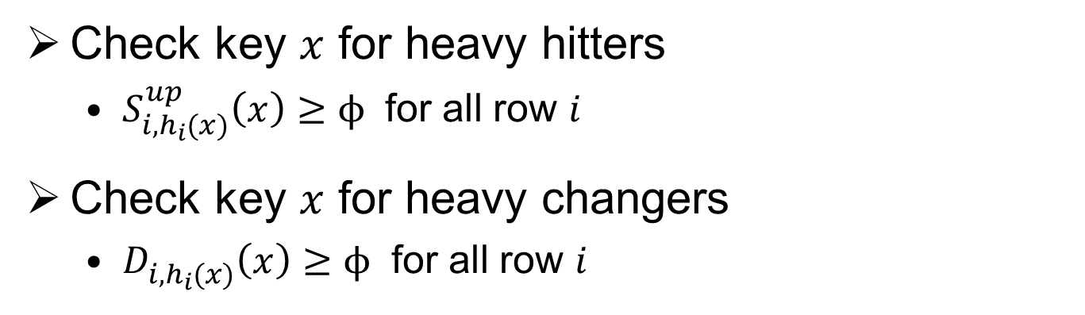
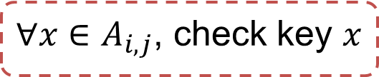

Identify Heavy Key
Key point: consider keys tracked by buckets
Enumerate all buckets
$$V_{i,j}≥φ$$
Bucket $(i, j)$
${∀x∈A}_{i,j}$, check key $x$
Check key $x$ for heavy hitters
  $S_{i,h_{i}(x)}^{up}\left(x\right)≥ϕ$ for all row $i$
Check key $x$ for heavy changers
  $D_{i,h_{i}(x)}^{}\left(x\right)≥ϕ$ for all row $i$

Slide 16
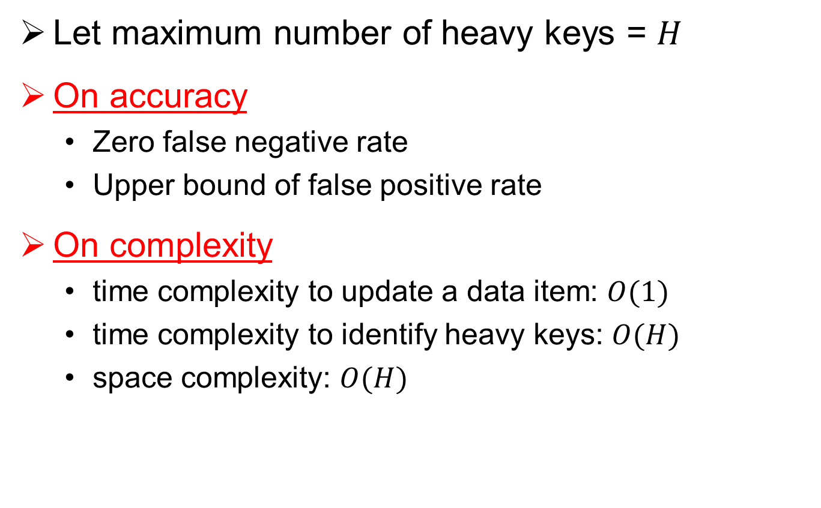
Analysis
Let maximum number of heavy keys = $H$
On accuracy
  Zero false negative rate
  Upper bound of false positive rate
On complexity
  time complexity to update a data item: $O(1)$
  time complexity to identify heavy keys: $O(H)$
  space complexity: $O(H)$

Slide 17
Distributed Detection
Goal
  Scalability: reduce complexity
  Accuracy: reduce false positive rate
Remote Site
  How to partition data streams
Final results
  How to aggregate local detection results
Remote
site
Worker
Local detection
Local detection results
Final detection results

Slide 18
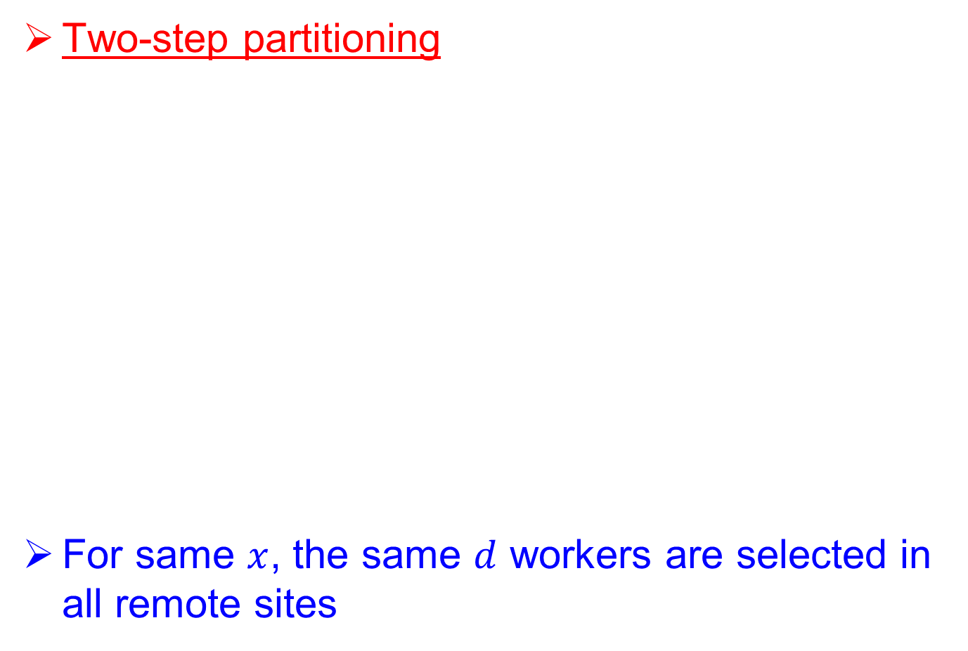



Remote Sites
Two-step partitioning
For same $x$, the same $d$ workers are selected in all remote sites
Data item $(x, v_{x})$
Step 1: select $d$ workers based on $x$
Worker
Worker
Worker
Worker
Worker
Step 2: select one from the $d$ workers uniformly
Worker
Worker
Worker

Slide 19
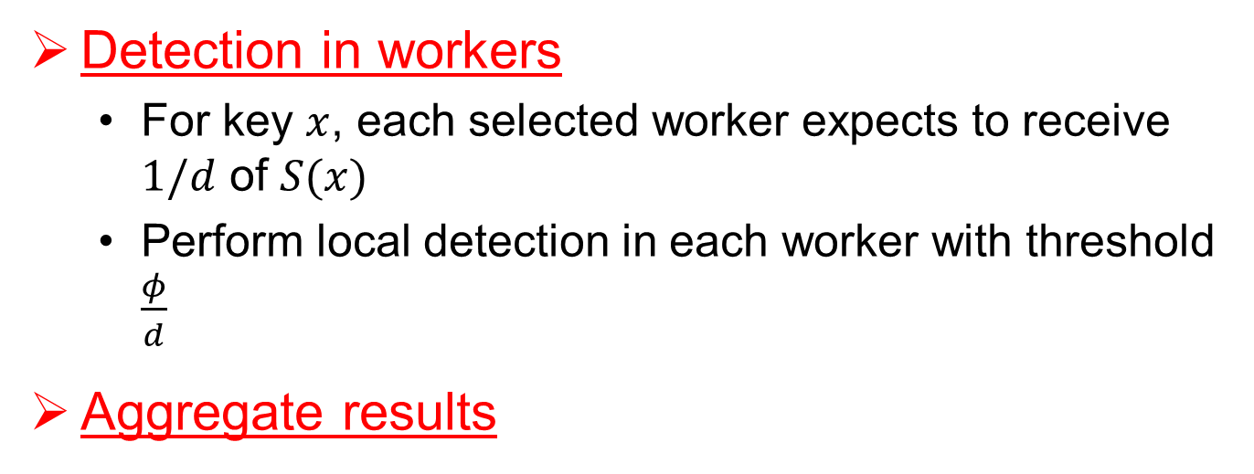

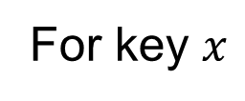
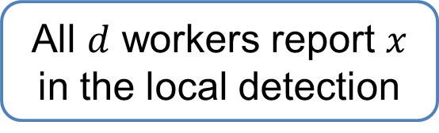
Detection and Aggregation
Detection in workers
  For key $x$, each selected worker expects to receive $1/d$ of $S(x)$
  Perform local detection in each worker with threshold $\frac{φ}{d}$
Aggregate results
For key $x$
All $d$ workers report $x$ in the local detection
Report $x$ as a heavy key

Slide 20
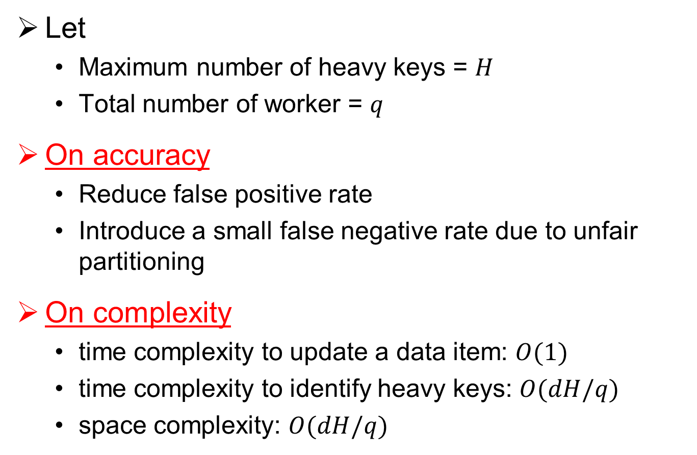
Analysis
Let
  Maximum number of heavy keys = $H$
  Total number of worker = $q$
On accuracy
  Reduce false positive rate
  Introduce a small false negative rate due to unfair partitioning
On complexity
  time complexity to update a data item: $O(1)$
  time complexity to identify heavy keys: $O(dH/q)$
  space complexity: $O(dH/q)$

Slide 21
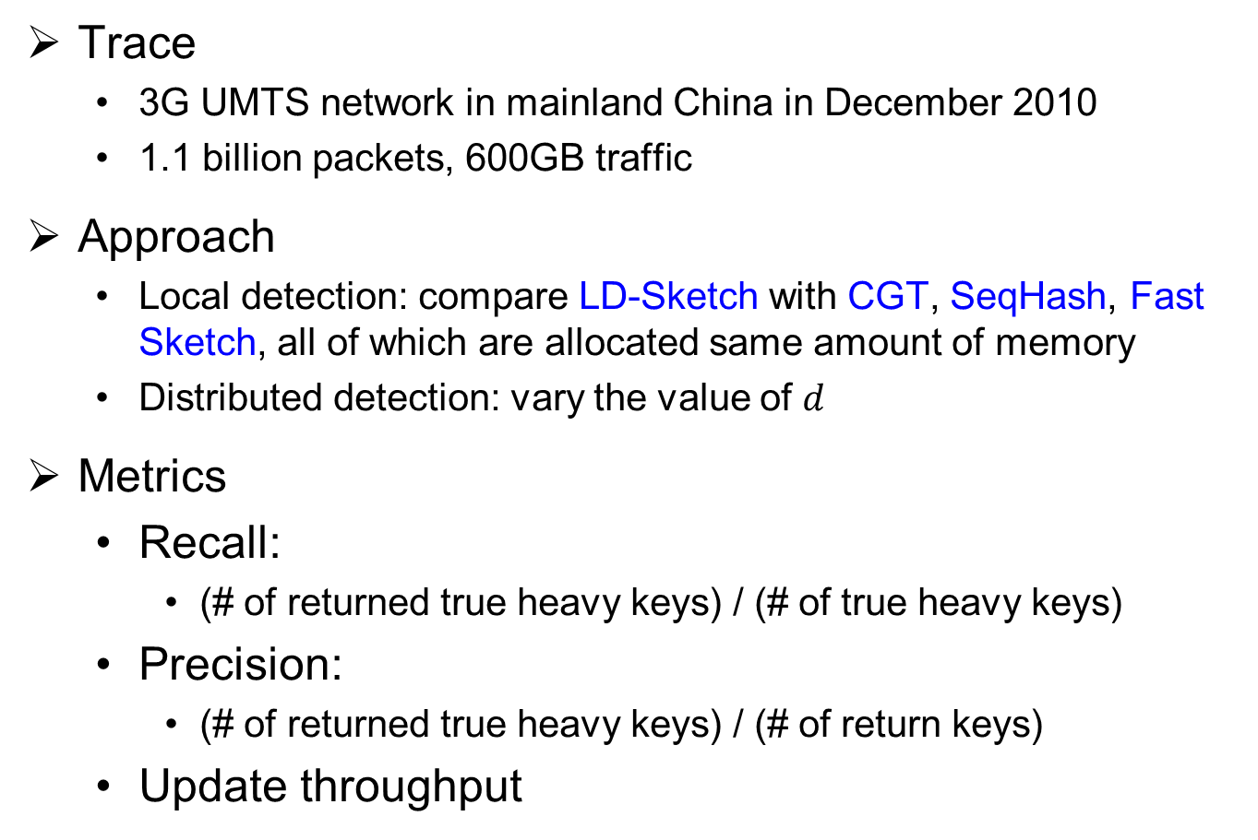
Experimental Results
Trace
  3G UMTS network in mainland China in December 2010
  1.1 billion packets, 600GB traffic
Approach
  Local detection: compare LD-Sketch with CGT, SeqHash, Fast Sketch, all of which are allocated same amount of memory
  Distributed detection: vary the value of $d$
Metrics
  Recall:
    (# of returned true heavy keys) / (# of true heavy keys)
  Precision:
    (# of returned true heavy keys) / (# of return keys)
  Update throughput

Slide 22
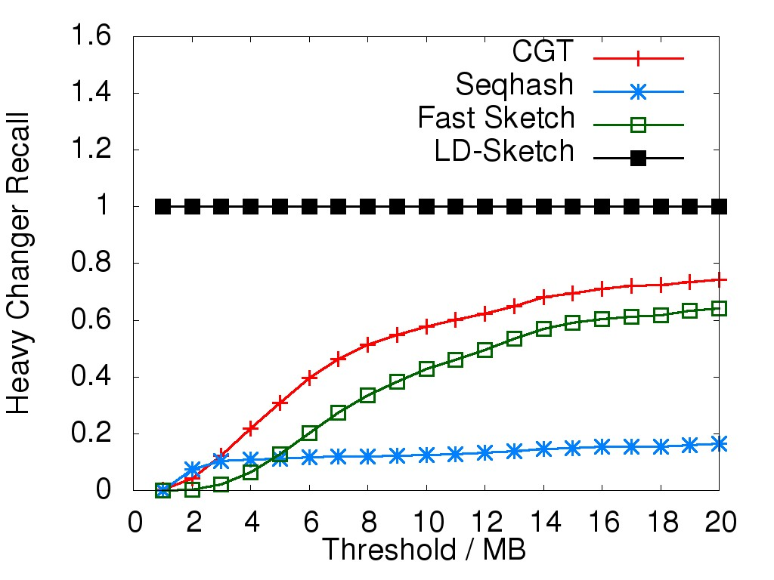
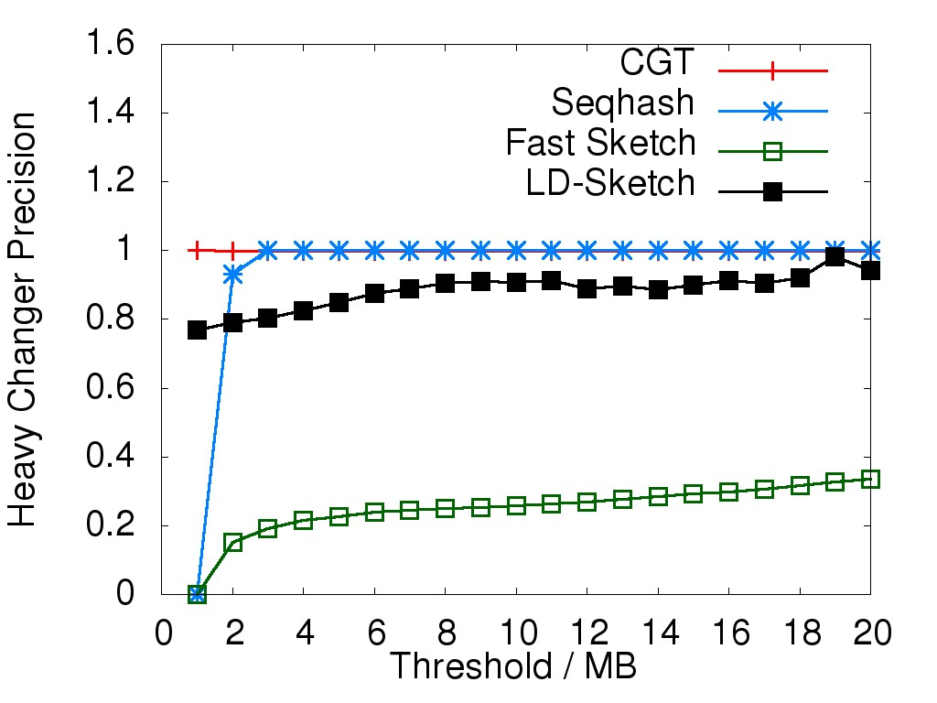
Accuracy of Local Detection: Heavy Changer
LD-Sketch achieves 100% recall
LD-Sketch has a little lower precision than CGT and Seqhash, but we can improve with distributed detection

Slide 23
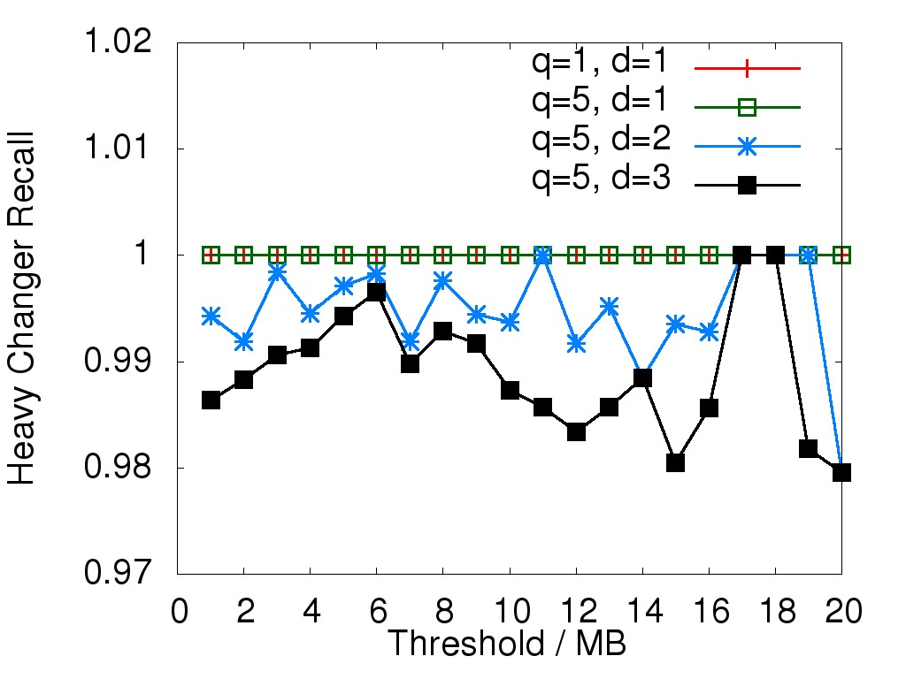
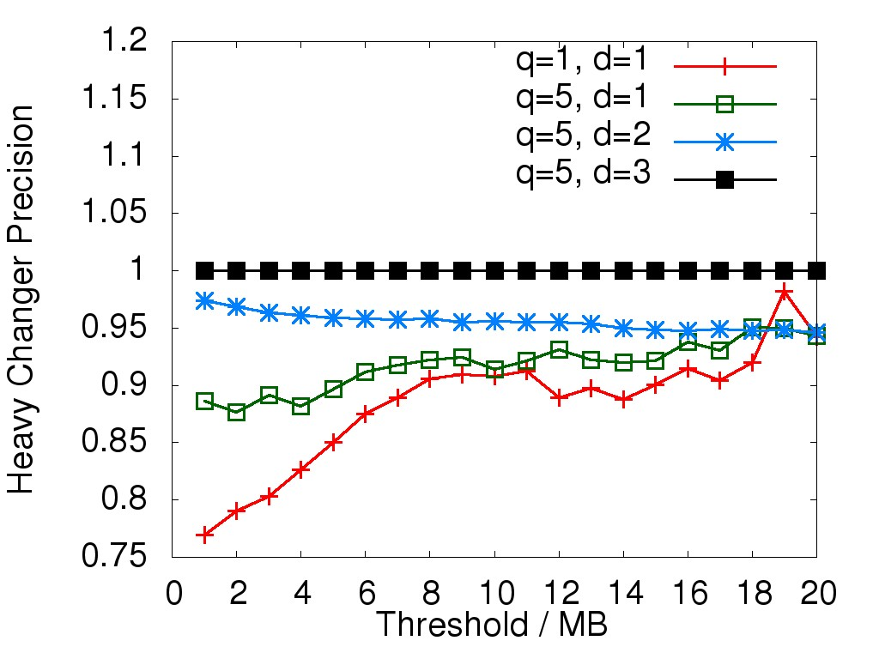
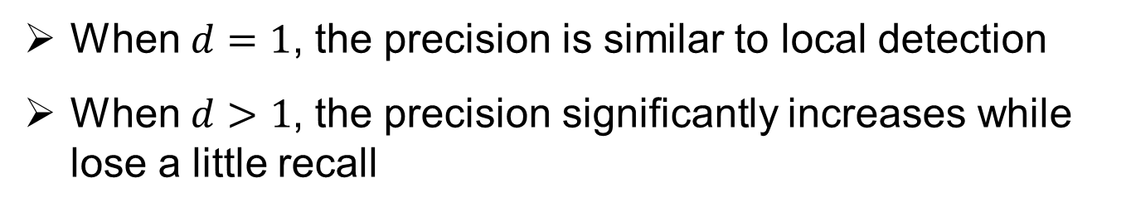
Accuracy of Distributed Detection: Heavy Changer
When $d=1$, the precision is similar to local detection
When $d>1$, the precision significantly increases while lose a little recall

Slide 24
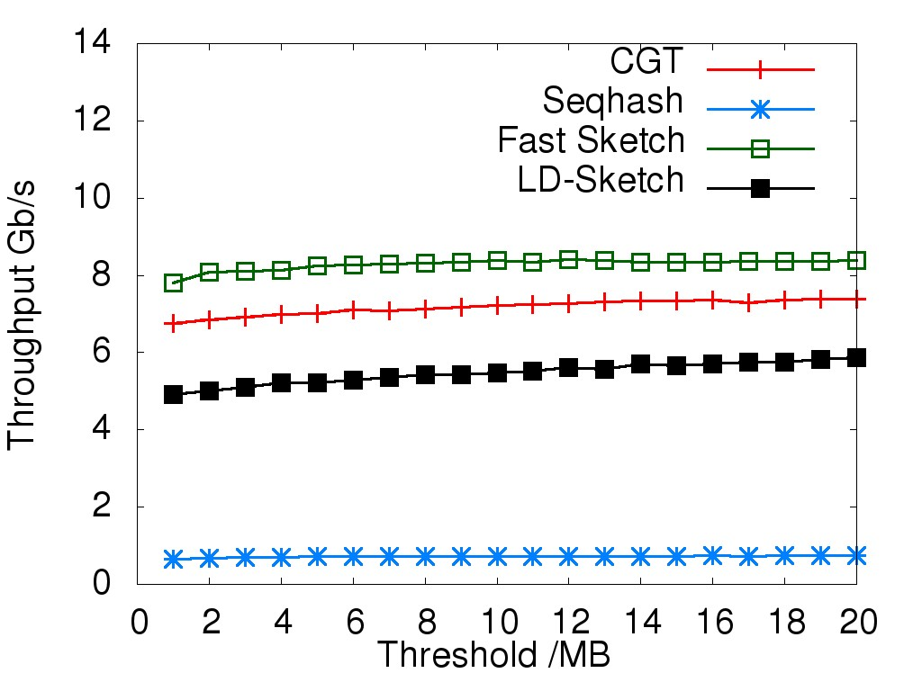
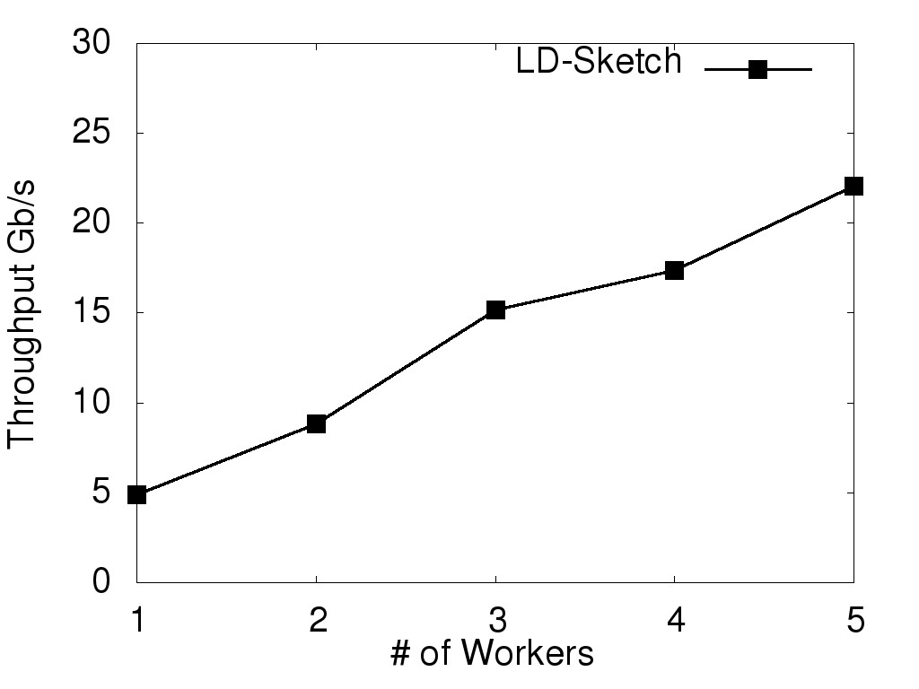
Throughput
Local detection
Distributed detection
LD-Sketch has a little lower throughput than CGT and Fast Sketch in local detection
LD-Sketch can scale linearly in distributed detection

Slide 25
Conclusions
Propose LD-Sketch, a sketching approach for real-time heavy key detection in a distributed architecture
  Composed of local detection and distributed detection
Propose a sketch structure for local detection
  High accuracy
  Low complexity in space and time
  Seamlessly deployed in distributed architecture
Propose a distributed detection scheme
  Reduce complexity
  Improve accuracy

