Slide 1
Analysis and Construction of Functional Regenerating Codes with Uncoded Repair for Distributed Storage Systems
Yuchong Hu, Patrick P. C. Lee, Kenneth W. Shum
The Chinese University of Hong Kong
INFOCOM’13

Slide 2
Distributed Storage
Distributed storage is widely adopted
P2P storage: OceanStore, TotalRecall, etc.
Cloud storage: Azure, GFS, etc.
Data availability is important
Cause: node failures are common
Solution: redundancy over multiple storage nodes
Redundancy schemes
Replication: make identical copies
Erasure codes: encode data into parity blocks
Erasure codes have less storage overhead than replication
One class of erasure codes: maximum distance separable (MDS) codes
Notes:
Replication: Simple but Expensive.
Maximum Distance Separable (MDS) codes: Much less redundancy overhead than replication.

Slide 3
(n, k) MDS codes
Encode a file of size M into chunks
Distribute encoded chunks into n nodes
Each node stores M/k units of data
MDS property: any k out of n nodes can recover file
Nodes
A
A
B
B
C
C
File
divide
A
encode
D
D
B
C
A+C
A+C
D
B+D
B+D
File of
size M
A+D
A+D
B+C+D
B+C+D
n = 4, k = 2

Slide 4
Repairing a Failure
Conventional repair: download data from any k nodes
Node 1
A
repaired node
A
B
B
Node 2
C
C
C
D
D
D
A
Node 3
A+C
A+C
B
File of
size M
B+D
B+D
Node 4
A+D
B+C+D
Repair Traffic = = M
Disk Read = = M
＋
＋
Q: Can we minimize repair traffic?

Slide 5
Regenerating Codes
[Dimakis et al.; ToIT’10]
Repair in regenerating codes:
Surviving nodes encode chunks (network coding)
Download one encoded chunk from each node
Node 1
A
repaired node
A
B
B
C
C
C
Node 2
D
D
A
Node 3
A+C
A+C
File of
size M
B+D
B
Node 4
A+D
A+B+C
B+C+D
Disk Read = = M
Repair Traffic = = 0.75M
＋
＋
＋
＋
Q: Can we minimize disk read further?

Slide 6
Functional Minimum Storage Regenerating (FMSR) Codes
[Hu et al., FAST’12]
Repair in FMSR codes:
No chunk encoding in surviving nodes (uncoded repair)
Download one chunk from each surviving node
Parity chunk P_{i} = linear combination of original native chunks
New parity chunk P’_{i} = linear combination of downloaded chunks
Node 1
P1
repaired node
A
P2
B
P3
P3
C
Node 2
D
P4
P1’
Node 3
P5
P5
P2’
File of
size M
P6
Node 4
P7
P7
P8
Disk Read = = 0.75M
Repair Traffic = = 0.75M
＋
＋
＋
＋
Notes:
Remark: A trade-off of FMSR codes is that the
whole encoded file must be decoded first if parts of a file are
accessed. Nevertheless, FMSR codes are suited to long-term
archival applications, since data backups are rarely read and
it is common to restore the whole file rather than file parts.

Slide 7
FMSR Codes
NCCloud [Hu’12] implements and evaluates FMSR codes
FMSR codes in NCCloud aim for following goals:
Double-fault tolerance and optimal storage efficiency (k = n-2)
MDS property: any n-2 out of n nodes can recover file
Each node stores M/k units of data
Minimum repair bandwidth
Up to 50% saving compared to conventional repair
Uncoded repair
Non-systematic codes
Suited to long-term archival storage whose data is rarely read

Slide 8
Related Work
Theoretical studies on FMSR codes [Dimakis et al. ’10]
Uncoded MSR codes
e.g., [Tamo'11], [Wang'10], [Wang'11]
Implementation complexity unknown
Applied work: NCCloud [Hu’12]
Implement and evaluate FMSR codes for k=n-2
Correctness of FMSR codes proven for n=4, k=2 [Shum’12]
Notes:
Explanations: Regenerating codes exploit the optimal trade-off between storage and repair traffic. One end of the trade-off corresponding to storage refers MSR codes; the other end corresponding to repair traffic refers to MBR codes.

Slide 9
Challenge
Can FMSR codes maintain double-fault tolerance after any number of rounds of repair?
NCCloud only shows via simulations that FMSR codes maintain MDS property after hundreds of repair rounds
In other words, can we achieve benefits of network coding without network coding?
No node encoding required
Provide theoretical foundations for applied work
Notes:
Explanations: given that new parity chunks are regenerated
in each round of repair, we need to ensure that such chunks preserve the fault tolerance of MDS codes after
multiple rounds of repair.

Slide 10
Our Contributions
Prove existence of FMSR codes
Preserve double-fault tolerance after any number of repair rounds with uncoded repair
➔ Minimize disk read and repair bandwidth
Provide a deterministic FMSR code construction:
Specify chunks to be read from surviving nodes
Specify encoding coefficients for regenerating new chunks
→ Minimize computational time to construct new parity chunks
Evaluate our deterministic FMSR codes
random FMSR codes: exponentially increasing time
deterministic FMSR codes: done in 0.5 seconds

Slide 11
FMSR Codes in NCCloud
File Upload
NCCloud
n(n-k) chunks
k(n-k) chunks
P1,1
P1,1
P1,2
P1,2
File
F1
P2,1
divide
F2
encode
P2,2
P2,1
upload
P2,2
F3
P3,1
F4
P3,2
P3,1
P4,1
P3,2
n=4, k=2
P4,2
P4,1
P4,2
File Download
P1,1
NCCloud
P1,2
download
k(n-k) chunks
k(n-k) chunks
P2,1
File
P2,2
P1,1
F1
MDS
Property
P1,2
decode
F2
merge
P3,1
P2,1
F3
P3,2
P2,2
F4
P4,1
decodable
P4,2
n=4, k=2
Notes:
Remark: In this slide, we introduce the following definition
MDS property: For any subset of k out of n nodes, if the k(n − k) parity chunks from the k nodes can be decoded to the k(n −k) native chunks of the original file, then the MDS property is satisfied.
Decodability. We say that a collection of k(n−k) parity chunks is decodable if the parity chunks can be decoded to the original file.

Slide 12
Counter-Example
NCCloud
1st repair
Node 1
P1,1
P1,2
Node 2
P2,1
New node 1
P2,2
P2,1
Node 3
P3,1
encode
P’1,1
repair
P’1,1
P3,1
P’1,2
P’1,2
P3,2
Node 4
P4,1
P4,1
P4,2
NCCloud
2nd repair
Node 1
P’1,1
P’1,2
Node 2
P2,1
New node 2
P2,2
P’1,1
encode
P’2,1
repair
P’2,1
Node 3
P3,1
P3,1
P’2,2
P’2,2
P3,2
P4,1
Node 4
P4,1
P4,2
Notes:
Remark: NCCloud randomly read the chunk from the surviving nodes, so the first two repairs may be shown in this slide.

Slide 13
Counter-Example
Observe file decoding after the 2nd repair
P’1,1
P’1,2
download
NCCloud
P’2,1
P’2,2
P’1,1
P’1,1
P’1,2
reduce
P’1,2
reduce
P2,1
P3,1
P3,1
P3,2
P’2,1
P3,1
P4,1
P’2,2
P4,1
P4,1
File decoding fails!!
P4,2
linear dependent
chunks

Slide 14
LDC
Linear Dependent Collection (LDC)
P2,1
P’1,1
P’1,1
P’1,1
encode
P’1,1
lead to
P’1,2
P’1,2
P’1,2
P3,1
P’1,2
P2,1
P2,1
P3,1
P3,1
P4,1
P4,1
P4,1
1st repair
Three LDCs of the 1st repair
Definition: An LDC of the r^{th} repair is a collection of k(n-k) chunks formed by less than k(n-k) chunks of the r^{th} repair
Problem: If the selected chunks after the (r+1)^{th} repair are formed by an LDC of the r^{th} repair , then file decoding fails

Slide 15
RBC
Repair-based Collection (RBC)
Definition: An RBC of the r^{th} round of repair is a collection of k(n-k) chunks formed as follows:
Step 1 Select any n-1 out of n nodes.
Step 2 Select k-1 out of the n-1 nodes found in Step 1 and collect n-k chunks from each selected node.
Step 3 Collect one chunk from each of the non-selected n-k nodes.
Node 1
P’1,1
P’1,1
P’1,1
P’1,1
P’1,2
P’1,2
P’1,2
P’1,2
Node 2
P2,1
P2,1
P2,1
P2,1
P2,2
P2,2
P3,1
P3,1
P3,1
P3,1
Node 3
one RBC
after the 1st repair
P3,2
P3,2
Node 4
P4,1
Step 1
Step 2
Step 3
P4,2
Fact:RBCs contain all the LDCs.
Notes:
In order to solve the problem, we first introduce a concept “RBC”

Slide 16
Repair MDS Property
Repair MDS (rMDS) property
Definition: If all RBCs, after excluding the LDCs, of the r^{th} repair are decodable, rMDS property is satisfied
NCCloud: two-phase checking
MDS property check of current round of repair
rMDS property check: MDS property check for every possible failure in next round of repair
Can two-phase checking maintain MDS property after any number of rounds of repair?

Slide 17
Lemma 1
There are two or more common chunks between selected chunks from surviving nodes for repairing and each LDC
P2,1
P’1,1
P’1,1
P’1,1
P3,1
P’1,2
P’1,2
P’1,2
P4,1
P2,1
P2,1
P3,1
P3,1
P4,1
P4,1
Selected chunks in 1st repair
Three LDCs of the 1st repair
P2,1
P2,1
P3,1
P3,1
P4,1
P4,1

Slide 18
Lemma 2
If the rMDS property is satisfied, there always exist n-1 chunks from any n-1 nodes (each offers one chunk) s.t. any RBC containing them is decodable
If the RBC doesn’t have green chunks, it is not a LDC
If the RBC has a green chunk, we replace the chunk by a blue chunk (P_{2,2}, P_{3,2} or P_{4,2}). So it won’t be a LDC
Node 1
P1,1
P’1,1
P1,2
P’1,2
P’1,1
P’1,1
P’1,1
Node 2
P2,1
P2,1
P’1,2
P’1,2
P’1,2
P2,2
P2,2
P2,1
P2,1
P3,1
Node 3
P3,1
P3,1
P3,1
P4,1
P4,1
P3,2
P3,2
Three LDCs of the 1st repair
Node 4
P4,1
P4,1
P4,2
P4,2
Notes:
Corollary: We can always use the un-selected chunks of the repair to construct an RBC such that it is decodable.

Slide 19
Theorem
Consider a file encoded using FMSR codes with k = n-2:
In the r^{th} repair, the lost chunks are reconstructed by random linear combinations of n-1 chunks selected from n-1 surviving nodes (each offers one chunk)
After the repair, the reconstructed file still satisfies both MDS and rMDS properties with probability driven arbitrarily to 1 with increasing field size.
Theorem → prove existence of FMSR codes

Slide 20
Theorem: Proof
Proof: (by induction).
Initialization
We use Reed-Solomon codes to encode a file into n(n-k) = 2n chunks that satisfy both the MDS and rMDS properties
MDS property check
The chunks of any k nodes are linearly combined with a certain RBC which is decodable via Lemma 2
Sufficient field size ensures the probability of MDS property can be driven to one via Schwartz-Zippel Theorem

Slide 21
Theorem: Proof
Proof (cont.):
rMDS property check: all RBCs excluding the LDCs are decodable.
(3.1) The RBC selects the repaired node in Step 2
We exclude the LDCs, and prove that remaining RBCs are decodable via induction hypothesis
(3.2) The RBC selects the repaired node in Step 3
We can prove the RBC is not an LDC via Lemma 1 and is decodable

Slide 22
Deterministic FMSR codes
Code construction:
Store a file
(1.1) Divide a file into k(n-k) = 2k equal-size chunks
(1.2) Encode them into n(n-k) = 2(k+2) chunks by P_{1,1},P_{1,2};…;P_{k+2,1},P_{k+2,2} using Reed-Solomon codes
(1.3) Upload them to n nodes.
P1,1
P1,1
2k chunks
P1,2
P1,2
File
F1
P2,1
P2,1
divide
F2
encode
P2,2
upload
P2,2
F3
P3,1
F4
RS codes
P3,2
P3,1
P4,1
P3,2
n=4, k=2
P4,2
P4,1
P4,2

Slide 23
Deterministic FMSR codes
Code construction:
1st repair (suppose node 1 fails)
(2.1) Select k+1 chunks P_{2,1},...,P_{k+2,1}.
(2.2) Construct coefficients that satisfy inequalities
(2.3) Regenerate the chunks from (2,1) and (2.2)
Node 1
P1,1
P1,2
Node 2
P2,1
P2,2
P2,1
Node 3
P3,1
encode
P’1,1
P3,1
P’1,2
P3,2
Node 4
P4,1
P4,1
Encoding coefficients based on given inequalities
P4,2

Slide 24
Deterministic FMSR codes
Code construction:
r^{th} repair (only chunk selection is different)
(3.1) Select k+1 chunks different from those selected in (r-1)^{th} repair
(3.2) Construct coefficients based on given inequalities
Node 1
P’1,1
P’1,2
Node 2
P2,1
P2,2
P’1,1
encode
P’2,1
Node 3
P3,1
P3,2
P’2,2
P3,2
P4,2
Encoding coefficients based on given inequalities
Node 4
P4,1
P4,2
E.g., In the 2nd repair, we select P’_{1,1}(or P’_{1,2}) and P_{3,2} and P_{4,2} to perform the repair, since they are different from P_{2,1}, P_{3,1} and P_{4,1} which are selected in the 1st repair.

Slide 25
Experiments
Implementation
C language
Galois Field (2⁸)
Intel CPU at 2.4GHZ
Coding schemes
random FMSR codes in NCCloud [Hu’12]
our deterministic FMSR codes
Metric
Checking time spent on finding the chunks from surviving nodes for recovery

Slide 26
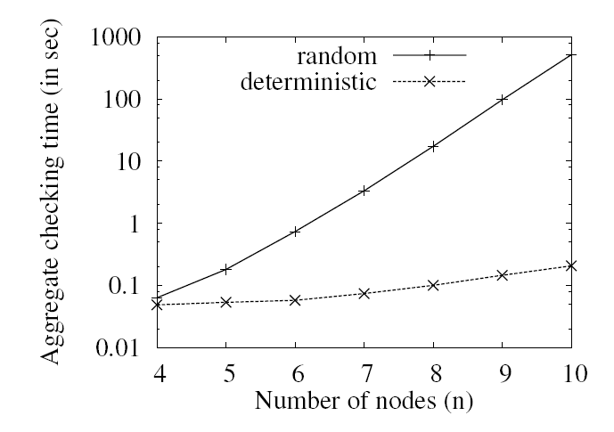
Evaluation
Aggregate checking time of 50 rounds of repair
Random FMSR codes: exponentially increasing time
Deterministic FMSR codes : time remains significantly small
Notes:
Our investigation finds that the checking time of random
FMSR codes increases dramatically as the value of n increases.
For example, when n = 12 (not shown in our
figures), we find that the repair operation of our random
FMSR code implementation still cannot return a right set of
regenerated chunks after running for two hours. In contrast,
our deterministic FMSR codes can return a solution within
0.5 seconds.

Slide 27
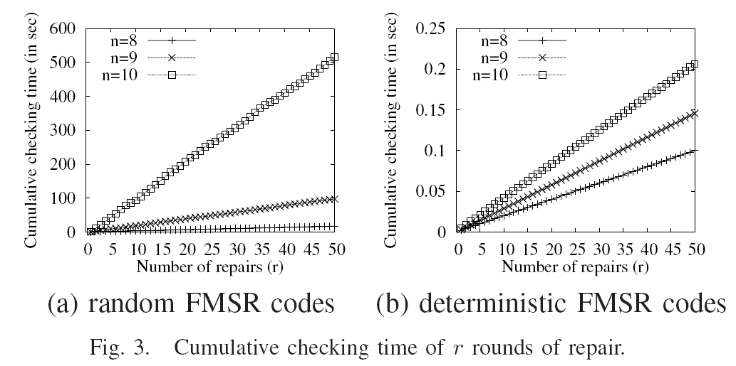
Evaluation

Slide 28
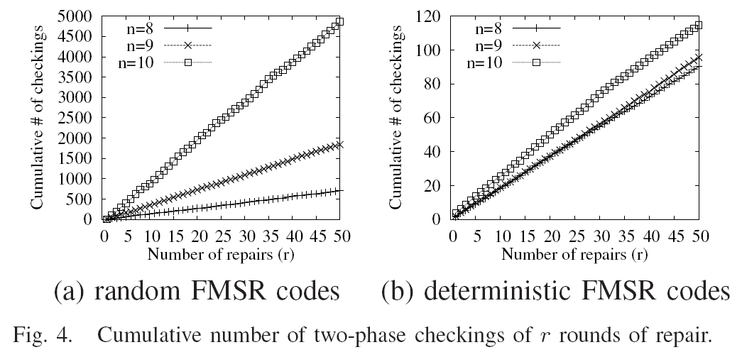
Evaluation
Summary: Deterministic FMSR codes significantly reduce the number of iterations of two-phase checking overhead of ensuring that the MDS property is preserved during repair.

Slide 29
Conclusions
Formulate an uncoded repair problem based on FMSR codes
Prove existence of FMSR codes
Provide a deterministic FMSR code construction
Show via our evaluation that our deterministic FMSR codes significantly reduce the repair time overhead of random FMSR codes.
Slides available: http://www.cse.cuhk.edu.hk/~pclee

