Slide 1
An In-Depth Analysis of Cloud Block Storage Workloads in Large-Scale Production
Jinhong Li*, Qiuping Wang*, Patrick P. C. Lee*, Chao Shi#
*The Chinese University of Hong Kong (CUHK) #Alibaba Group

Slide 2
Background
Trace analysis are important in storage workload optimizations
Several field studies have analyzed the I/O behaviors of Microsoft Research Cambridge (MSRC) traces
However, it may have different patterns with cloud applications

Slide 3
Motivation
Requirements in cloud storage systems
Quality-of-services guarantees
Efficient resource utilizations
Design considerations of cloud block storage systems
Load balancing: Balance the traffic in different volumes and time intervals
Cache efficiency: Improve cache hit ratios and boost I/O performance
Storage cluster management: Improve performance and endurance of flashes

Slide 4
Architecture
Volume: Each volume is perceived by an upper-layer application
Storage Cluster: Provide the physical space for users
Desktop
OS
Web
DB
KV
…
Volume
Volume
Volume
Volume
Volume
…
Block Storage
Storage Cluster
Storage Cluster
…

Slide 5
Our Contribution
An in-depth study on the block-level I/O traces collected from a cloud block storage system at Alibaba Cloud
We analyze two traces from a high-level perspective to compare their basic characteristics
We provide 15 findings on the I/O characterization in terms of
Load intensity
Spatial patterns
Temporal patterns
We release our block-level traces, with billions of I/O requests and hundreds of terabytes of I/O traffic

Slide 6
Traces
AliCloud:
Traces collected from a product of Alibaba Cloud
1000 volumes
Starts from January 1st 2020 and ends with January 31st 2020
Fields
Volume ID, request type, request offset, request size, and timestamp
MSRC:
Microsoft Research Cambridge traces from a data center of Windows servers
36 volumes
One week in February 2007
Fields
Volume ID, request type, request offset, request size, timestamp, and response time

Slide 7
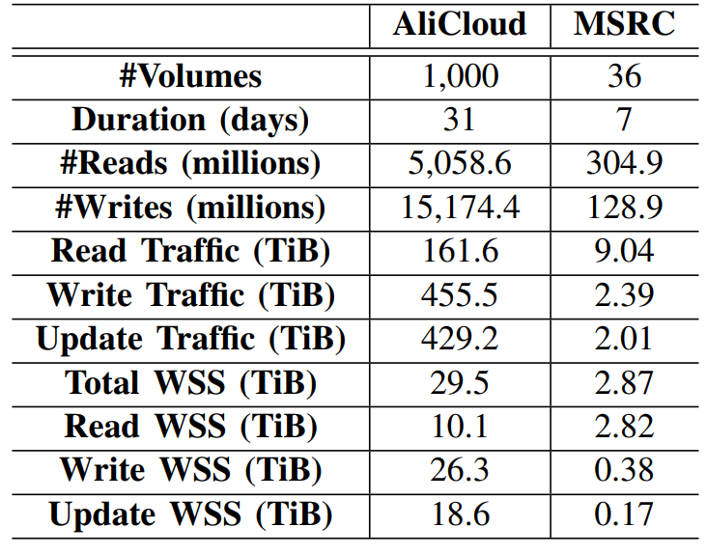
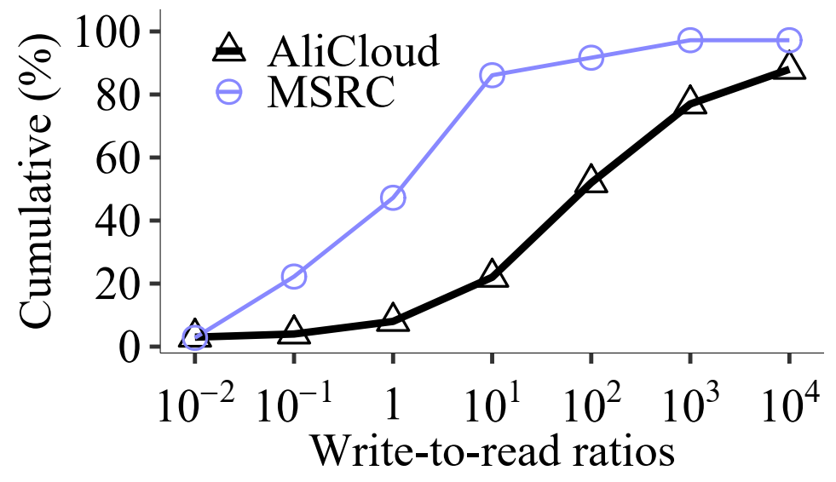
High-level Analysis
AliCloud has a larger scale.
Duration: 4.3x
I/O requests: 46.6x
Volumes: 27.8x
Traffic: 54.1x
Working set size (WSS): 10.3x
Reads span small working sets in AliCloud.
Most AliCloud volumes are write-dominant.
Notes:
Reads span only 34.3% of WSS in AliCloud, but 98.4% in MSRC
Writes span 89.4% of WSS in AliCloud
Write-to-read ratio: the number of writes divided by the number of reads.
The write-to-read ratio of AliCloud (MSRC) is 3:1 (0.42:1)
91.5% of AliCloud volumes are write-dominant, while only 53% of volumes are write dominant in MSRC
42.4% volumes have write-to-read ratios larger than 100

Slide 8
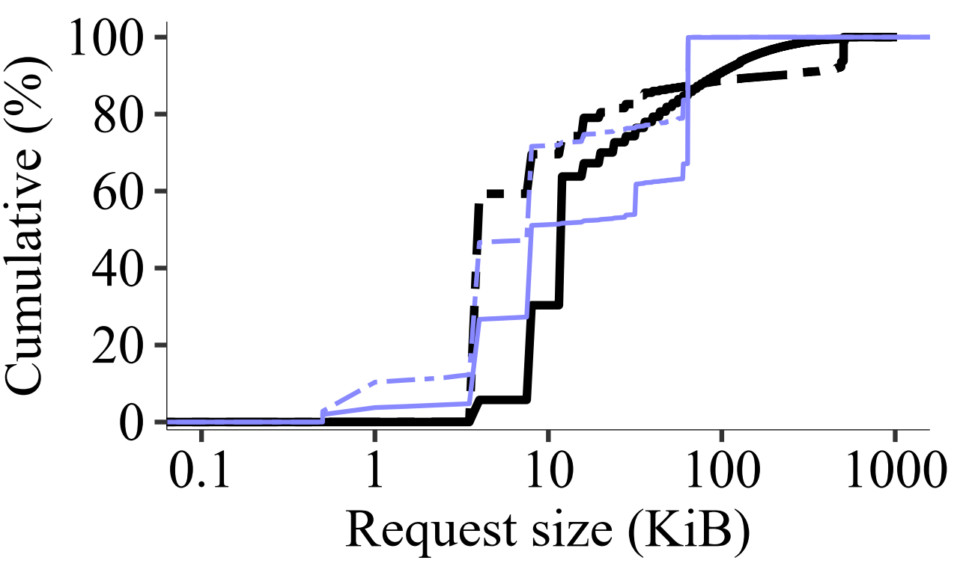
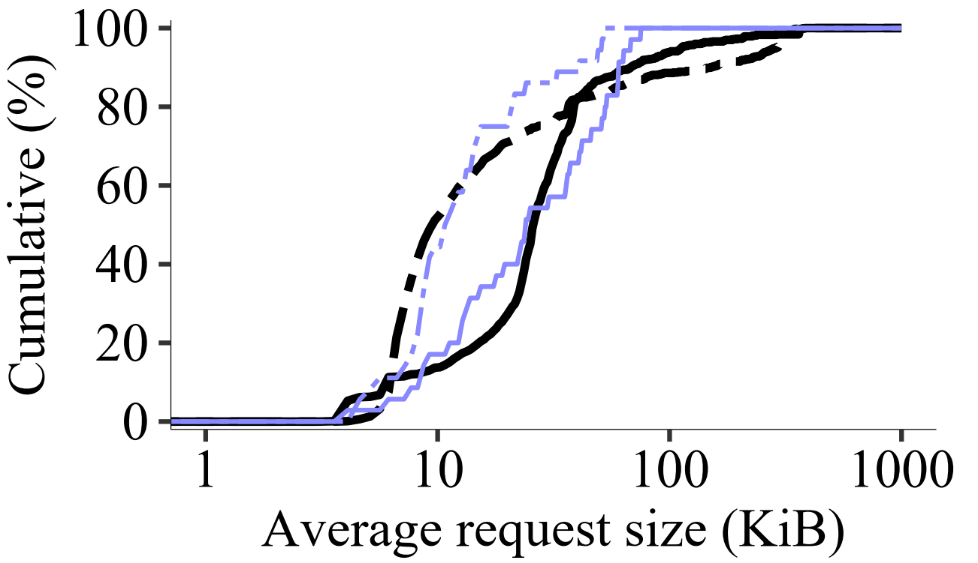
High-level Analysis
Small I/Os dominate in both traces.
Left: Request sizes
AliCloud: 75% of reads (writes) are no larger than 32 KiB (16 KiB).
MSRC: 75% of reads (writes) are no larger than 64 KiB (20 KiB)
Right: Average request sizes of volumes
AliCloud: 75% of the average read (write) sizes are less than 39.1 KiB (34.4 KiB)
MSRC: 75% of the average read (write) sizes are less than 50.8 KiB (15.3 KiB)

Slide 9
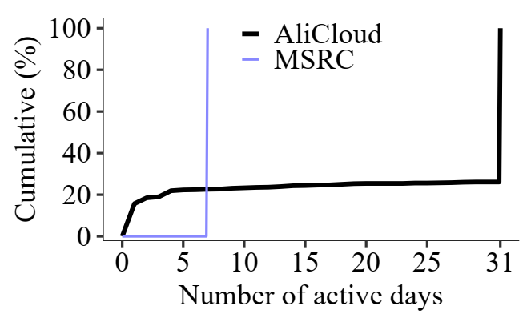
High-level Analysis
A non-negligible fraction of volumes in AliCloud are active in short time periods.
A volume is said to be active if it has at least one I/O request.
We measure the active days of the volumes:
AliCloud: 15.7% of volumes are active for only one day.
MSRC: All volumes are active in 7 days.

Slide 10
High-level Analysis - Summary
Commonality:
Small I/Os are dominant
Differences from MSRC:
A larger scale, in terms of duration, traffic, working set size, and the number of I/O requests
Smaller read working sets
Some volumes are active in short time
Larger write-to-read ratios

Slide 11
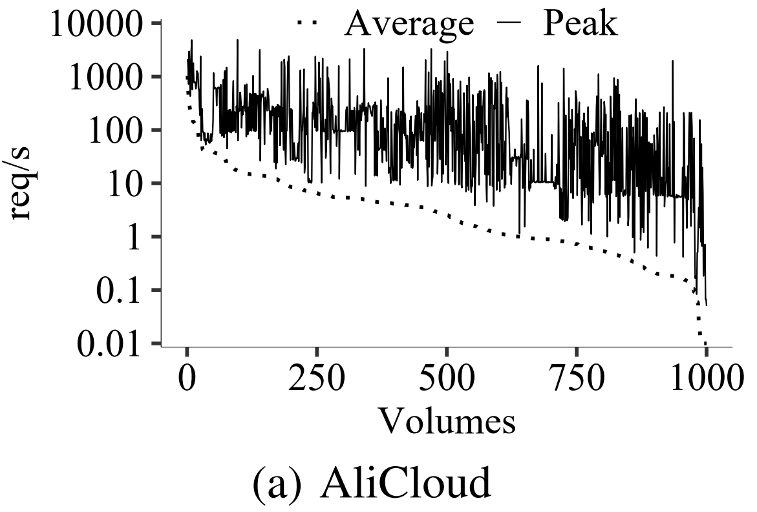
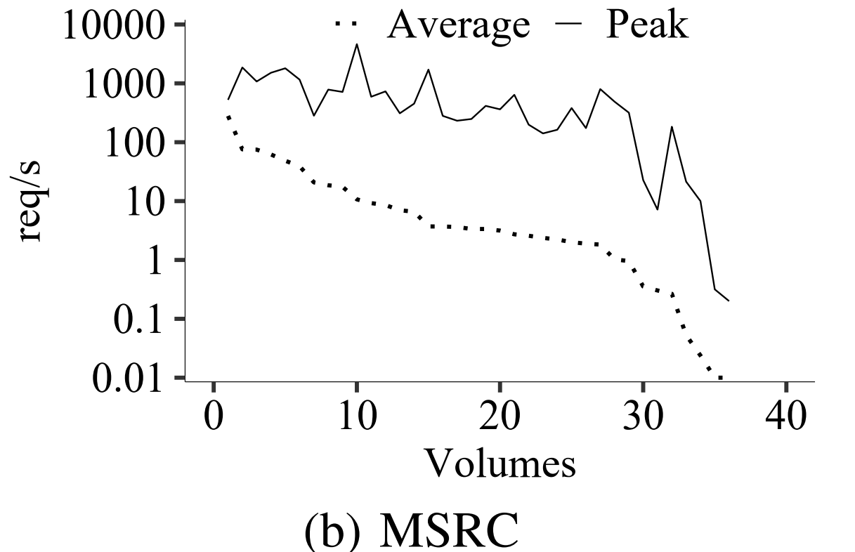
Findings on Load Intensity
Finding 1: Both traces have similar load intensities of volumes
Load intensities (req/s):
Average intensity: The traffic divided by the duration of all requests
Peak intensity: The maximum traffic in each minute of each volume
The average intensity and peak intensity is similar in both traces.

Slide 12
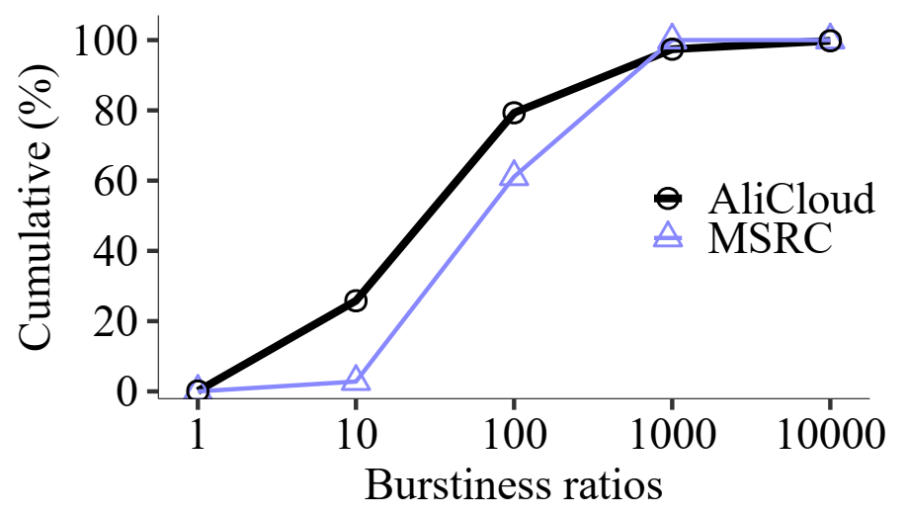
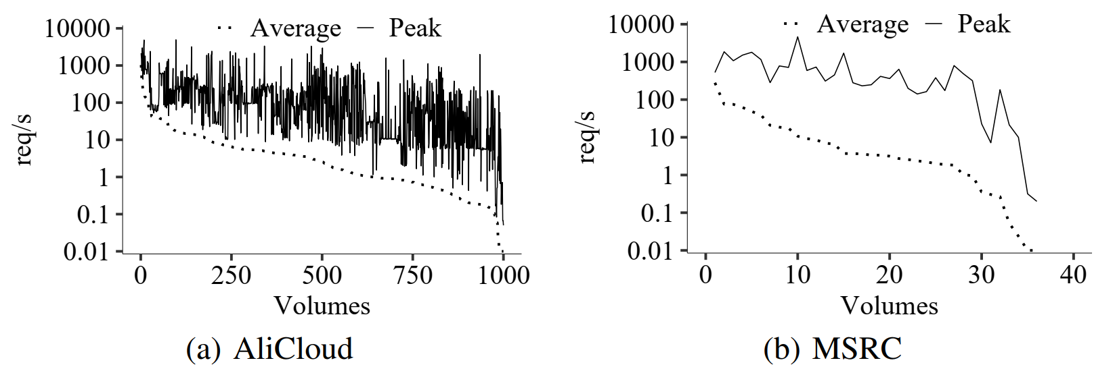
Findings on Load Intensity
Finding 2: Both traces have high burstiness in some volumes.
Burstiness ratios:
The peak intensity divided by the average intensity
The overall burstiness ratios are 2.11 (7.39) for AliCloud (MSRC).
Finding 3: AliCloud has more diverse burstiness across volumes.

Slide 13
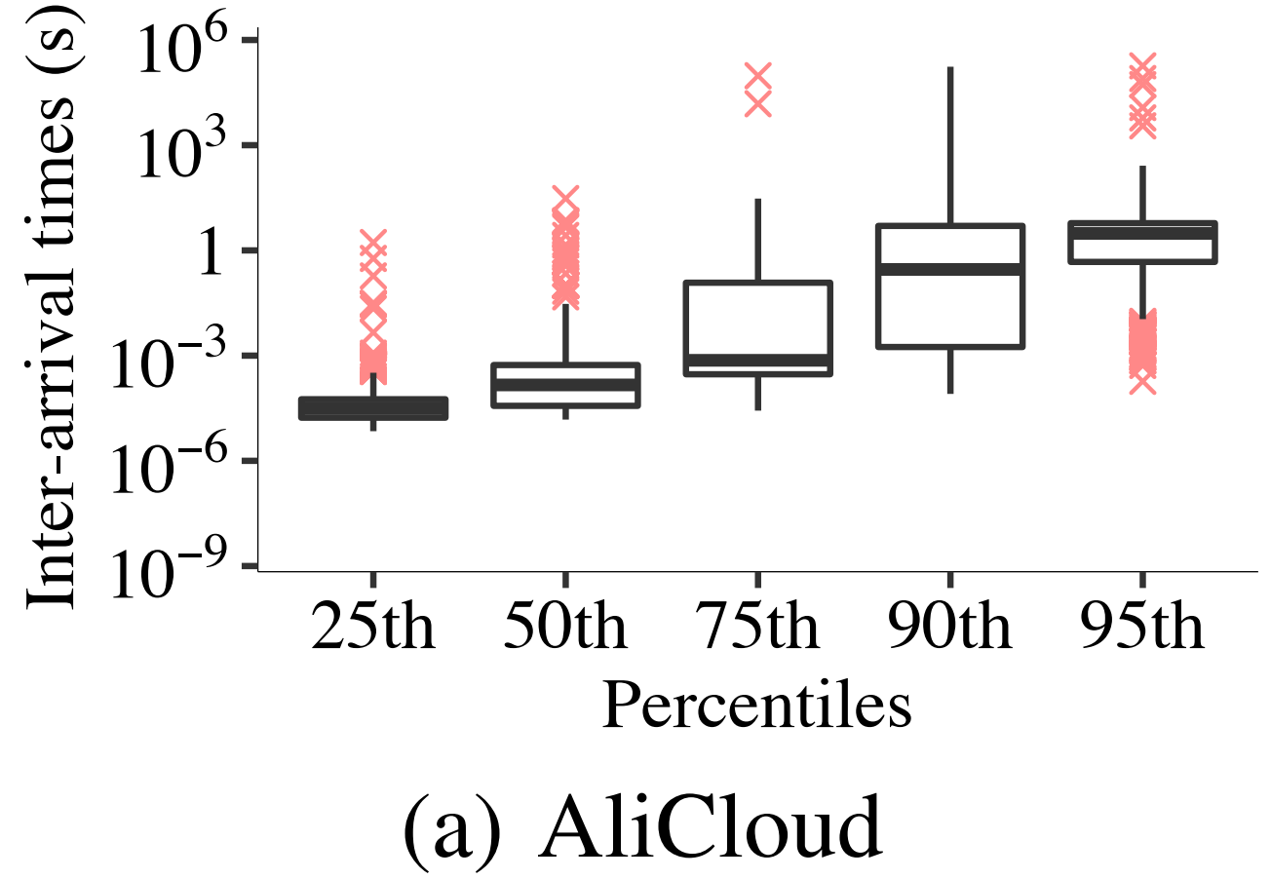
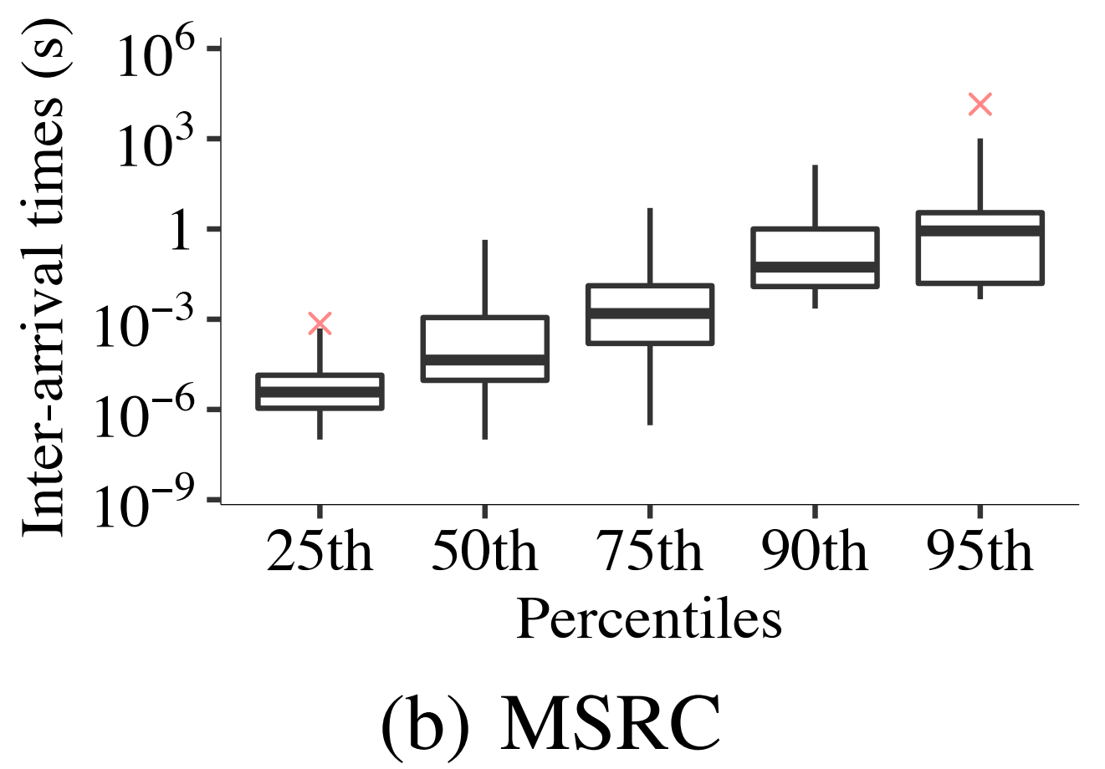
Findings on Load Intensity
Finding 4: Both traces have high short-term burstiness from the perspective of inter-arrival times of requests.
Inter-arrival time:
The elapsed time between two adjacent requests
The 25th, 50th, and 75th percentiles are lower than 1.3 ms (equivalent to at least 700 req/s)

Slide 14
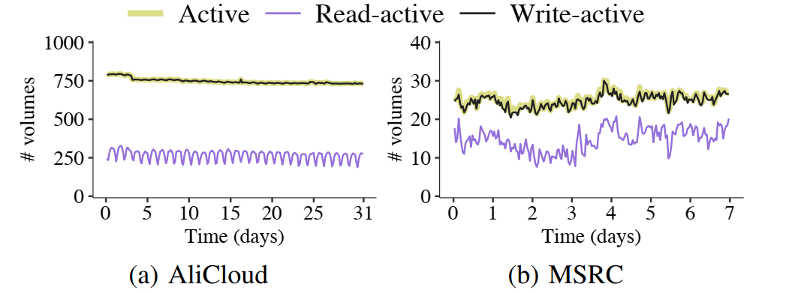
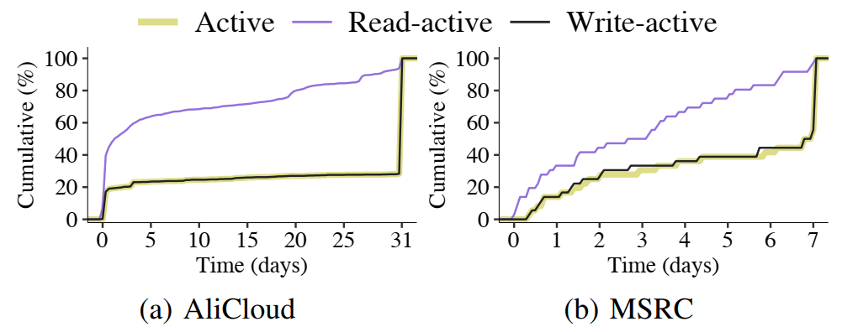
Findings on Load Intensity
Finding 5: Most of the volumes in both traces are active throughout the trace periods, while AliCloud is more active than MSRC.
We divide the traces into 10-minute intervals and examine the activeness in each interval.
At least 59.4% of the traces are active all the time
72.2% (55.6%) volumes are active in 95% trace periods of AliCloud (MSRC).

Slide 15
Findings on Load Intensity
Finding 6: Writes are the dominant factor in determining activeness in both AliCloud and MSRC.
Finding 7: Removing write requests shows drastic decreases in activeness in both AliCloud and MSRC.
After removing write requests, the number of active volumes drops by more than 58.3% in AliCloud, and 24.6% in MSRC

Slide 16
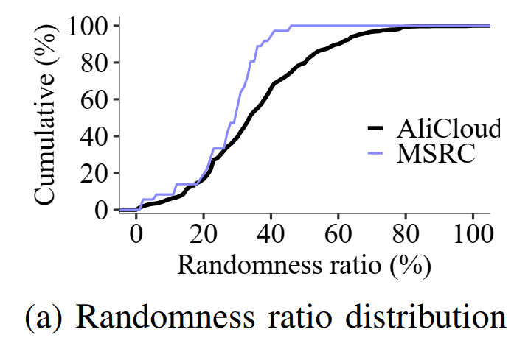
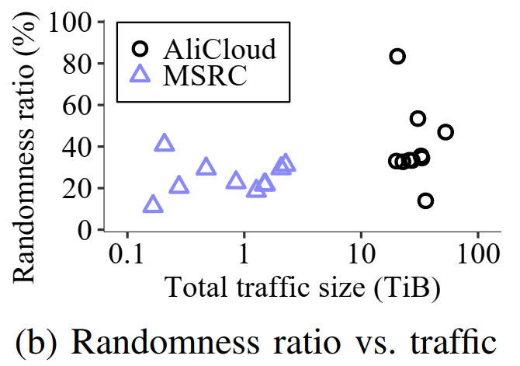
Findings on Spatial Patterns
Finding 8: Random I/Os are common in both traces. The volumes in AliCloud see more random I/Os than those in MSRC.
Randomness: Measured by the minimum distance between offsets of the current request and previous 32 requests
The request is a random request if the distance is smaller than 128 KiB
The randomness ratios in top-10 volumes of AliCloud is higher.

Slide 17
Findings on Spatial Patterns
Finding 9: Reads and writes aggregate in small working sets for a non-negligible fraction of volumes in both AliCloud and MSRC.
Writes are more aggregated than reads.
Finding 10: Reads and writes tend to aggregate in read-mostly and write-mostly blocks in AliCloud, respectively.
MSRC shows stronger aggregation in reads, but weaker in writes.
Finding 11: AliCloud generally has higher update coverage than MSRC. The update coverage also varies across volumes.

Slide 18
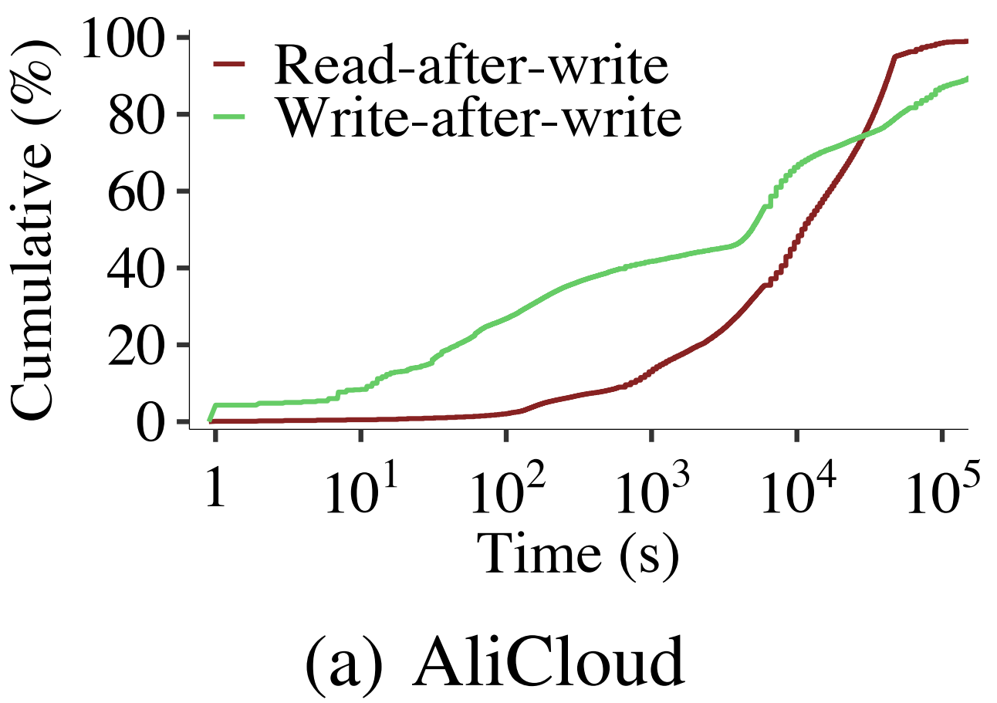
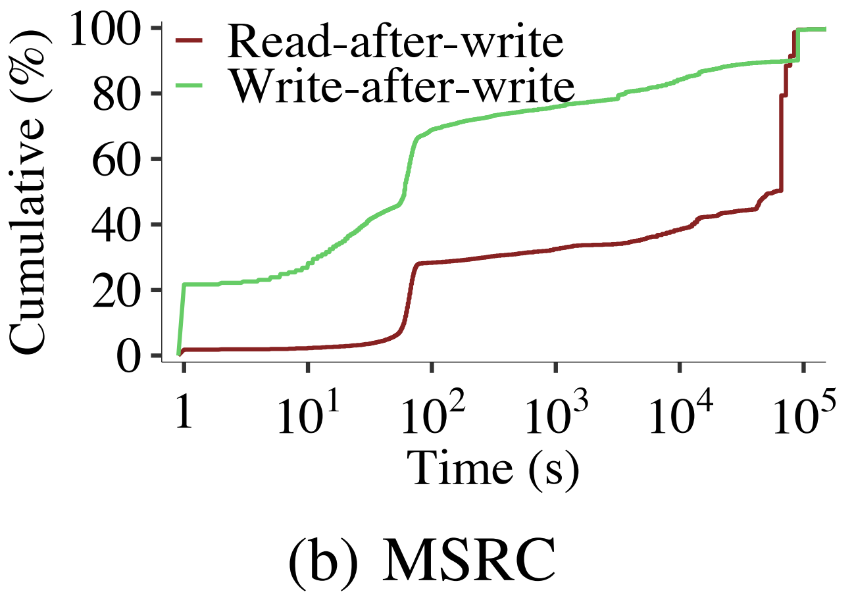
Findings on Spatial Patterns
Finding 12: Both traces have large read-after-write (RAW) time, but small write-after-write (WAW) time.
The median of RAW time in AliCloud (MSRC) is 3.0 hours (16.2 hours).
The median of WAW time in AliCloud (MSRC) is 1.4 hours (0.2 minutes).

Slide 19
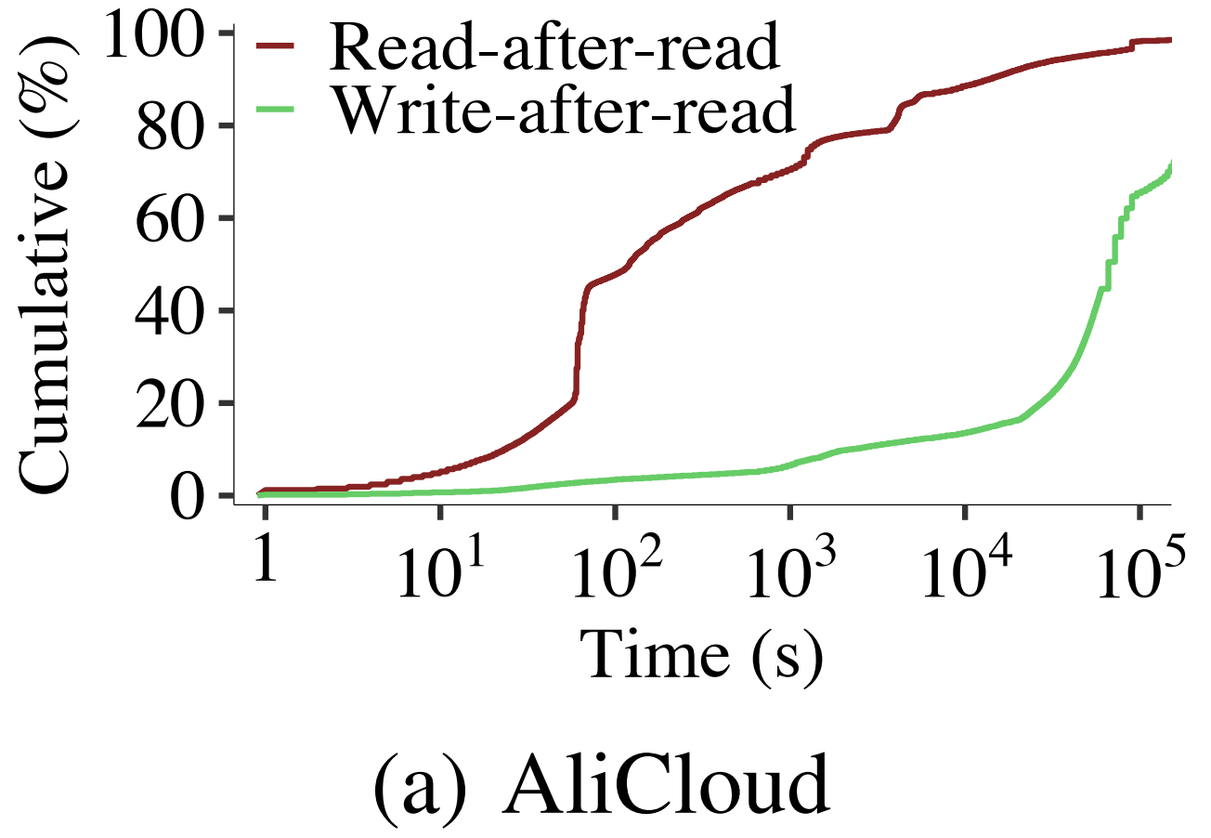
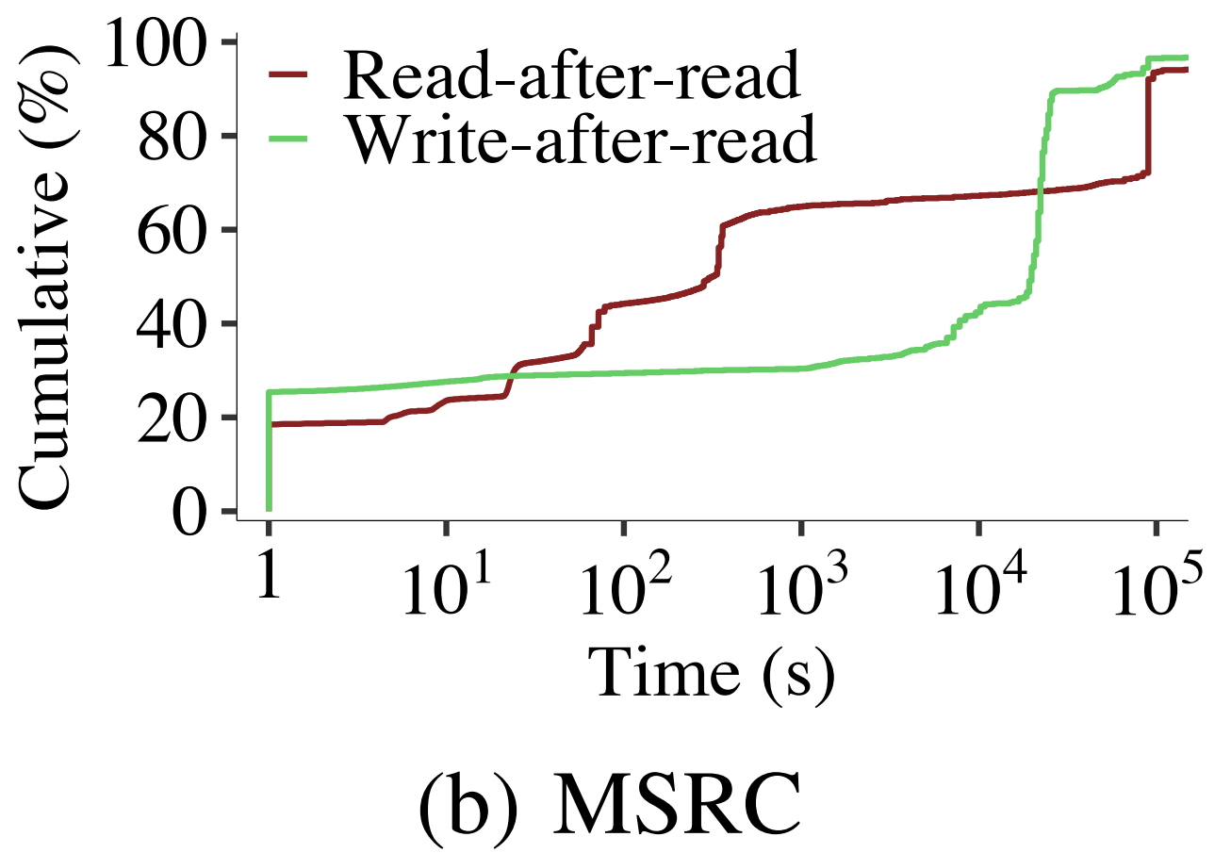
Findings on Spatial Patterns
Finding 13: Most of the read-after-read (RAR) and write-after-read (WAR) requests in AliCloud have large elapsed time.
AliCloud: Most of the RAR and WAR times are larger than 1 minute
MSRC: There exist non-negligible fractions of RAR and WAR times (35.6% and 29.2%, respectively) that are less than 1 minute.

Slide 20
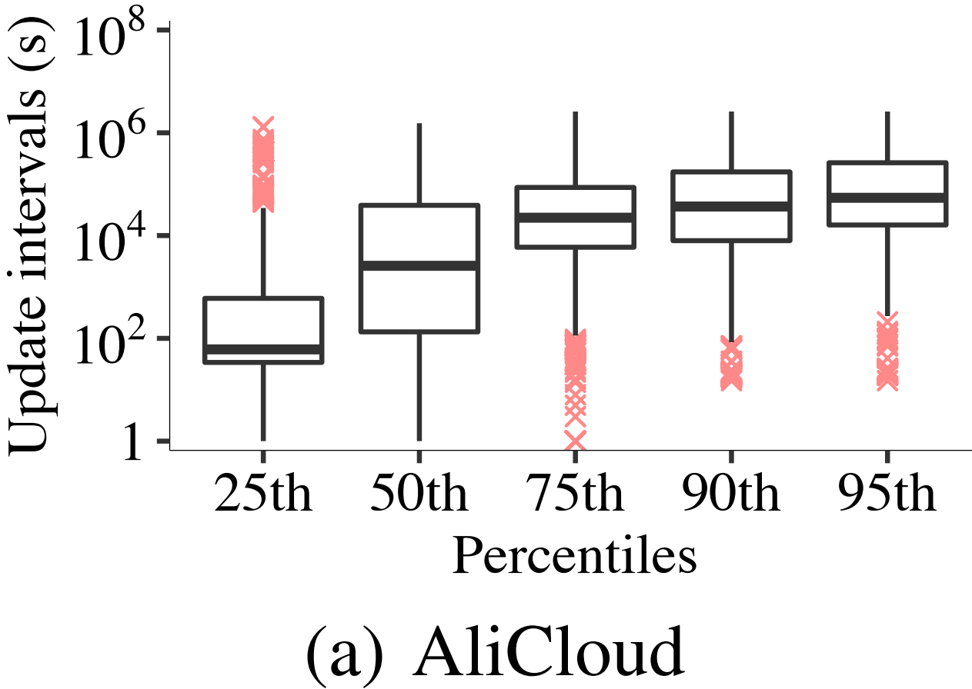
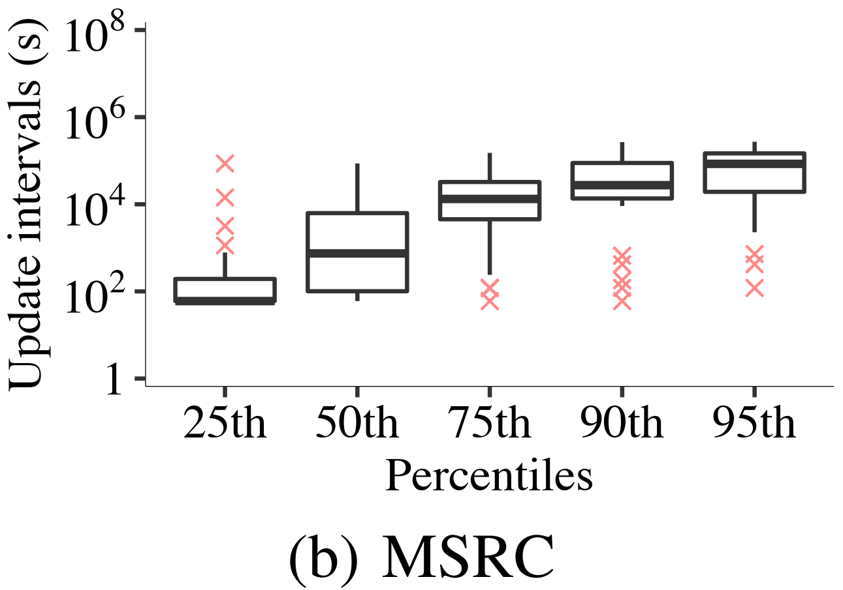
Findings on Spatial Patterns
Finding 14: Written blocks have varying update intervals.
Update interval: The elapsed time between two consecutive writes to the same block.
The update intervals distributes in different values in different percentiles.

Slide 21
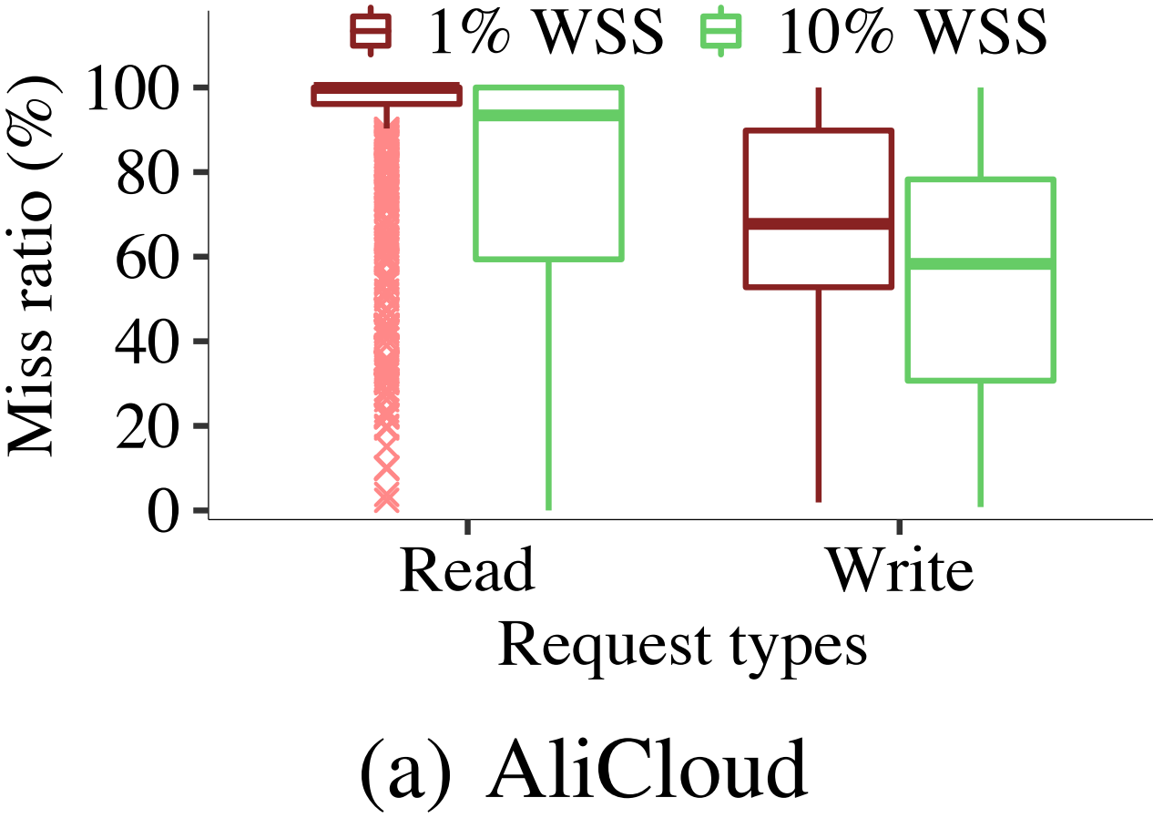
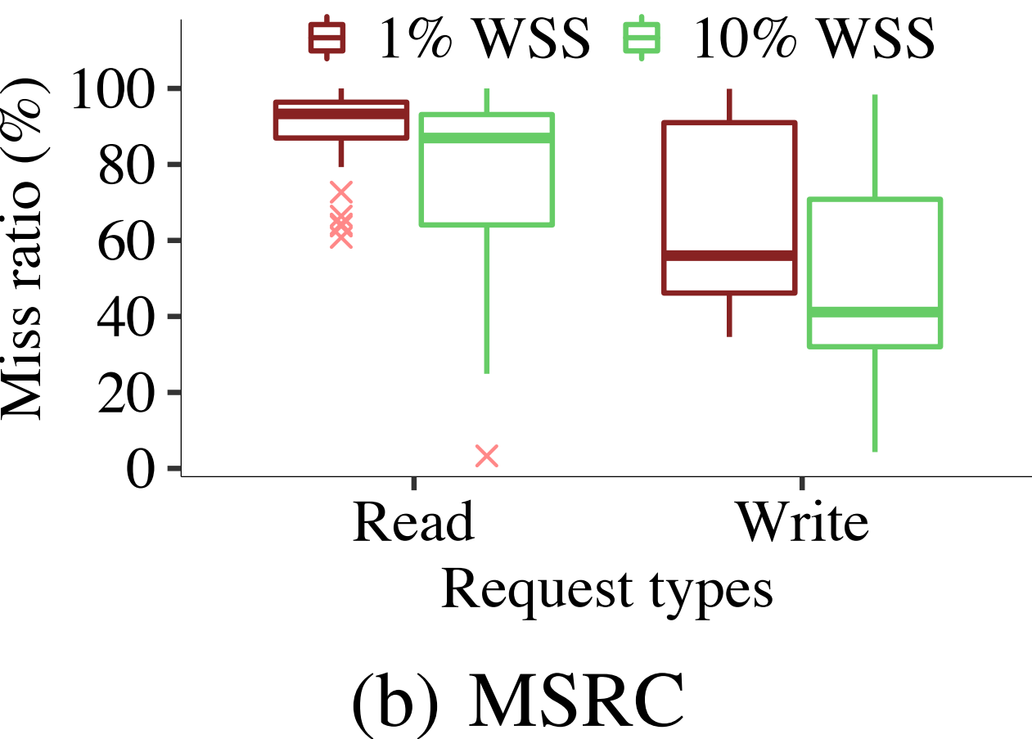
Findings on Spatial Patterns
Finding 15: AliCloud shows higher reduction in miss ratios than MSRC when the cache size increases.
Cache sizes as the 1% or 10% of WSS of each volume, LRU policy
In AliCloud, the absolute reduction of the 25th percentile read or write miss ratios is 36.7% and 22.1%
In MSRC, the corresponding number is only 22.8% and 14.1%

Slide 22
Implications of Findings
Load balancing:
Writes dominate in the activeness, and the load balancing on writes is more important in AliCloud.
Cache efficiency:
It is viable to allocate limited cache resources to improve the I/O throughput.
It is possible to identify read-mostly and write-mostly blocks in the workloads.
The cloud storage systems may benefit from disk-based write caching.
Storage cluster management:
Building log structures or upper-layer FTLs may optimize the performance on small and random I/Os and deal with the variation of the update patterns

Slide 23
Conclusion
We provide 15 findings on the I/O characterization in terms of
Load intensity, spatial patterns, and temporal patterns
We provide important insights from the findings on how to solve problems in
load balancing, cache efficiency, and storage cluster management
Our traces: https://github.com/alibaba/block-traces

Slide 24
Thank You! Q & A
Notes:
This is all I got. Thanks for your watching.

