Slide 1
A Simulation Analysis of Reliability in Primary Storage Deduplication
Min Fu¹, Patrick P. C. Lee², Dan Feng¹, Zuoning Chen³, Yu Xiao¹
¹Huazhong University of Science and Technology ²The Chinese University of Hong Kong ³National Engineering Research Center for Parallel Computer, China

Slide 2
Storage Deduplication
Modern storage systems adopt deduplication for storage and bandwidth savings
backup and archival storage [Zhu, FAST'08]
primary storage (e.g., file system) [Srinivasan, FAST'12]
virtualization storage [Clements, USENIX ATC'09]
cloud storage [Li, USENIX ATC'15]

Slide 3
Deduplication Basics
Deduplication removes content redundancy to improve storage efficiency
Divides data into variable-size chunks
Chunking is done by Rabin Fingerprinting
Identifies each chunk with a fingerprint
A fingerprint can be a cryptographic hash
Fingerprints are stored in a key-value index
Stores one chunk copy with same fingerprint; other identical chunks refer to the copy by pointers
A file recipe lists all pointers to all chunks of a file

Slide 4
Deduplication Basics
Storage savings are huge
Rough estimates of deduplication ratio (i.e., raw storage to actual storage)
Workloads | Dedup ratio
Backup workload | 20:1
VM images | 50:1
Primary workloads | 2:1

Slide 5
How about Reliability?
Reliability is critical in storage systems, e.g.,
Characterizing reliability issues of HDDs and SSDs [Schroeder, FAST'07 and '16]
Improving reliability by redundancy [Patterson, SIGMOD'88] and monitoring [Ma, FAST'16]
How deduplication changes reliability?
Only few studies in the field; no discussion on:
Loss variations: impact of data loss depends on granularities (e.g., chunks/files)
Repair strategies: reliability depends on when important data copies are repaired first

Slide 6
Open Questions
Does deduplication improve reliability?
Deduplication reduces data loss probability as it reduces storage footprints
Does deduplication degrade reliability?
Each data loss may imply loss of multiple chunks/files
Accuracy of MTTDL is debatable, and is unexplored in deduplication storage

Slide 7
Our Contributions
A new simulation framework for deduplication storage reliability, including
New reliability metrics from NOMDL [Greenan, HotStorage’10]
Disk model from field data
Deduplication model from real file system snapshots
Comprehensive comparison of storage system reliability with and without deduplication
A Deliberate Copy Technique (DCT) to improve reliability of deduplication storage

Slide 8
Our Simulation Framework
Extended from Greenan’s simulator:
Disk model: generates disk events, e.g., whole-disk failure and disk repair
RAID state machine: monitors data loss events, e.g., uncorrectable sector errors and unrecoverable disk failures
Deduplication model: calculates magnitude of data loss in deduplication storage and outputs reliability metrics

Slide 9
Our Metrics
NOMDL [Greenan, HotStorage'10]
Expected amount of data loss per usable terabyte
Extend NOMDL for deduplication storage
Logical amount of data loss normalized to logical system capacity
4 reliability metrics:
Chunk-level and file-level
Non-weighted (in number of chunks/files) and weighted (in amounts of data)

Slide 10
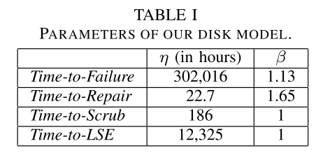
Disk Model
Disk errors:
Whole-disk failures: RAID repairs the failed disk using operational disks
Latent Sector Errors (LSEs): RAID uses disk scrubbing to periodically correct LSEs
Disk model parameters are derived from near-line 1 TB SATA Disk A model [Elerath, ToS 2014]

Slide 11
Data Loss Events
Two types of data loss events:
Unrecoverable Disk Failures (UDF)
e.g., two simultaneous whole-disk failures in RAID-5
Uncorrectable Sector Errors (USE)
e.g., a single whole-disk failure paired with LSEs in other operational disks in RAID-5
Physical data loss depends on repair progress
e.g., if the 2nd whole-disk failure in RAID-5 occurs after the 1st failed disk is repaired by 40%, we lose 60% of data in physical view

Slide 12
Deduplication Model
Goal: calculates logical amount of data loss for each data loss event
A USE corrupts a physical sector and the associated physical chunk
Logical amount of data loss depends on the chunk's reference count and the files referencing it
A UDF assumes a log-structured chunk layout, and two repair strategies: forward and backward
We expect forward repair has better reliability than backward repair

Slide 13
Deliberate Copy Technique
Our insight is that highly referenced chunks only account for small fraction of physical capacity
Chunk reference counts show long-tailed distribution
Deliberate Copy Technique (DCT) improves reliability of deduplication storage:
Allocate a small, dedicated physical area in RAID for storing extra copies of highly referenced chunks
Repair first the physical area during RAID reconstruction
Can be done offline; no impact on write path

Slide 14
Experimental Setup
RAID-6 with 16 1TB SATA disks
10-year mission time
1025 billion iterations of simulations to obtain enough data loss events for small relative errors
1,389,250 UDFs and 332,993,652 USEs
18 deduplication models derived from 18 real file system snapshots
9 from Stony Brook University and 9 from our lab
DCT is configured with 1% physical capacity

Slide 15
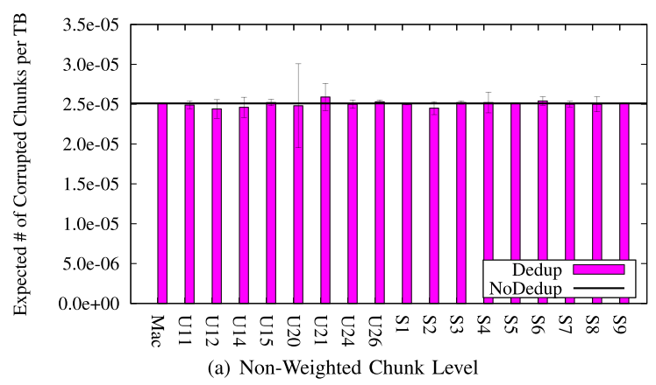
Chunk-level USE
Observation (1) -- Deduplication will not significantly alter the expected amount of corrupted chunks by USEs when compared to without deduplication

Slide 16
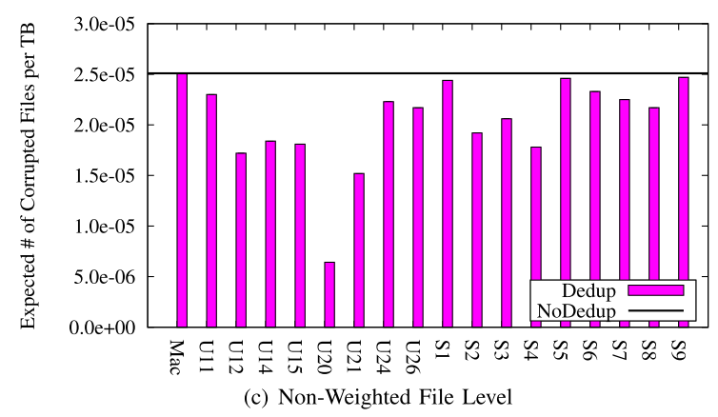
File-level USE
Observation (2) -- In the presence of individual chunk corruptions caused by USEs, deduplication decreases the expected amounts of corrupted files, mainly due to the intra-file redundancy found in individual snapshots
Intra-file redundancy is more common than inter-file redundancy

Slide 17
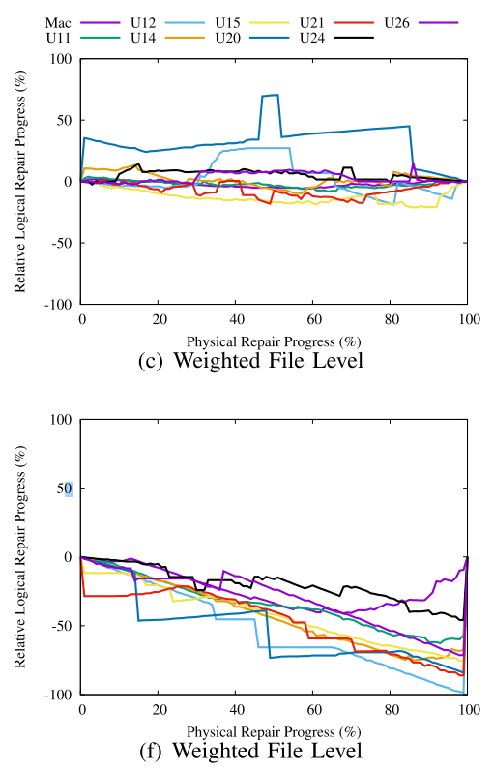
Logical Repair Progress
Forward repair
Observation (3) -- The logical repair progress is affected by the placement of highly referenced chunks and the severity of chunk fragmentation
Backward repair
Notes:
The Y-axis shows the relative logical repair progress to without deduplication.
Negative values indicates slower rate in restore.
The backward repair restores files in significantly slower rate

Slide 18
Chunk-level UDF
Observation (4) -- If we do not carefully place highly referenced chunks and repair them preferentially, deduplication can lead to more corrupted chunks in the presence of UDFs.
Observation (5) -- DCT significantly reduces the expected amounts of corrupted chunks by UDFs.
Notes:
As expected, the backward repair shows significantly worse reliability than without deduplication.
With DCT, both forward and backward repair achieves better or comparable reliability than without deduplication

Slide 19
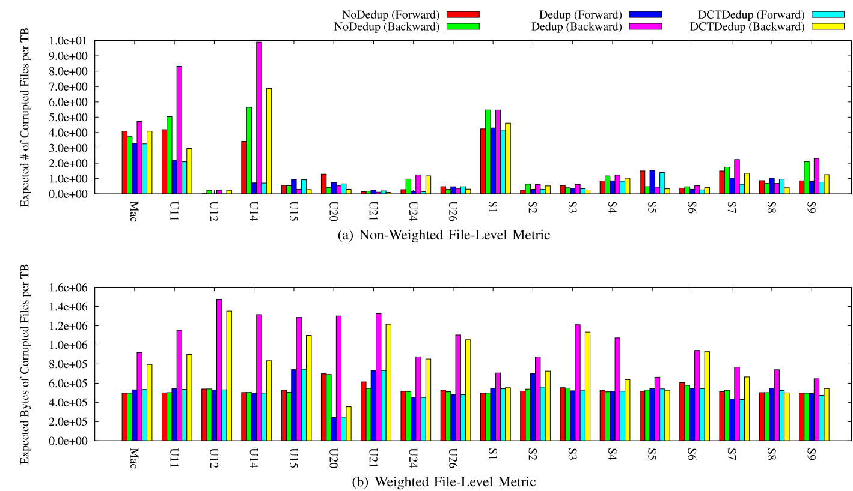
File-level UDF
Observation (6) -- Deduplication is significantly more vulnerable to UDFs in terms of the file-level metrics if popular small files and chunk fragmentation are not carefully handled.
Observation (7) -- DCT reduces the expected amounts of corrupted files remarkably, but a defragmentation algorithm is necessary to further improve reliability in the weighted file-level metric
Notes:
The above figure shows the file-level not-weighted metric, and the bottom shows the file-level weighted metric.
the backward repair is worse than the forward repair, because popular small files are more possibly in the log beginning and the log end is much more fragmented.
In not-weighted metric, DCT is very useful because it achieves better or comparable reliability than without deduplication.
Although DCT improves weighted metric, a defragmentation algorithm is still required.

Slide 20
Conclusions
A new simulation framework for quantitative reliability analysis
Characterizes impacts of loss variance and repair strategies
A DCT technique to improve reliability in deduplication storage
Source code: https://github.com/fomy/simd

