Slide 1
Impact of Data Locality on Garbage Collection in SSDs:
A General Analytical Study
Yongkun Li, Patrick P. C. Lee, John C. S. Lui, Yinlong Xu
The Chinese University of Hong Kong
University of Science and Technology of China

Slide 2
SSD Storage
Solid-state drives (SSDs) widely deployed
  e.g., desktops, data centers
Pros:
  High throughput
  Low power
  High resistance
Cons:
  Limited lifespan
  Garbage collection (GC) overhead

Slide 3
Motivation
Characterizing GC performance is important for understanding SSD deployment
We consider mathematical modeling:
  Easy to parameterize
  Faster to get results than empirical measurements

Slide 4
Challenges
Data locality
  Data access frequencies are non-uniform
  Hot data and cold data co-exist
  More general access patterns are possible (e.g., warm data [Muralidhar, OSDI’14])
Wide range of GC implementations

Slide 5
Two Questions
What is the impact of data locality on GC performance?
How data locality can be leveraged to improve GC performance?

Slide 6
Our Contributions
A general analytical framework that characterizes locality-oblivious GC and locality-aware GC
A non-uniform workload model
A probabilistic model for a general family of locality-oblivious GC algorithms
A model for locality-aware GC with data grouping
Validation and trace-driven simulations

Slide 7
Related Work on GC
  Theoretical analysis on GC
    Hu et al. (SYSTOR09), Bux et al (Performance10), Desnoyers (SYSTOR12): model greedy algorithm on GC
  Li et al. (Sigmetrics13): model design tradeoff of GC between performance and endurance
  Benny Van Houdt (Sigmetrics13, Performance13): model write amplification of various GC algorithms under uniform workload and hot/cold workload
  Yang et al. (MSST14): analyzing the performance of various hotness-aware GC algorithms
Our work focuses on the impact of data locality on GC performance under general workload

Slide 8
How SSDs Work?
Organized into blocks
Each block has a fixed number (e.g., 64 or 128) of fixed-size (e.g., 4-8KB) pages
Three basic operations: read, write, erase
  Read, write: per-page basis
  Erase: per-block basis
Out-of-place write for updates:
  Write to a clean page and mark it as valid
  Mark original page as invalid

Slide 9
How SSDs Work?
Garbage collection (GC) reclaim clean pages
  Choose a block to erase
  Move valid pages to another clean block
  Erase the block
Limitations:
  Blocks can only be erased a finite number of times
    SLC: 100K, MLC: 10K, 3 bits MLC (several K to several hundred)
  GC introduces additional writes (cleaning cost)
    Degrades both performance and endurance
2. erase
Block A
0
1
2
Block A
1. write
Block B
0
2
Block B
Before GC
After GC

Slide 10
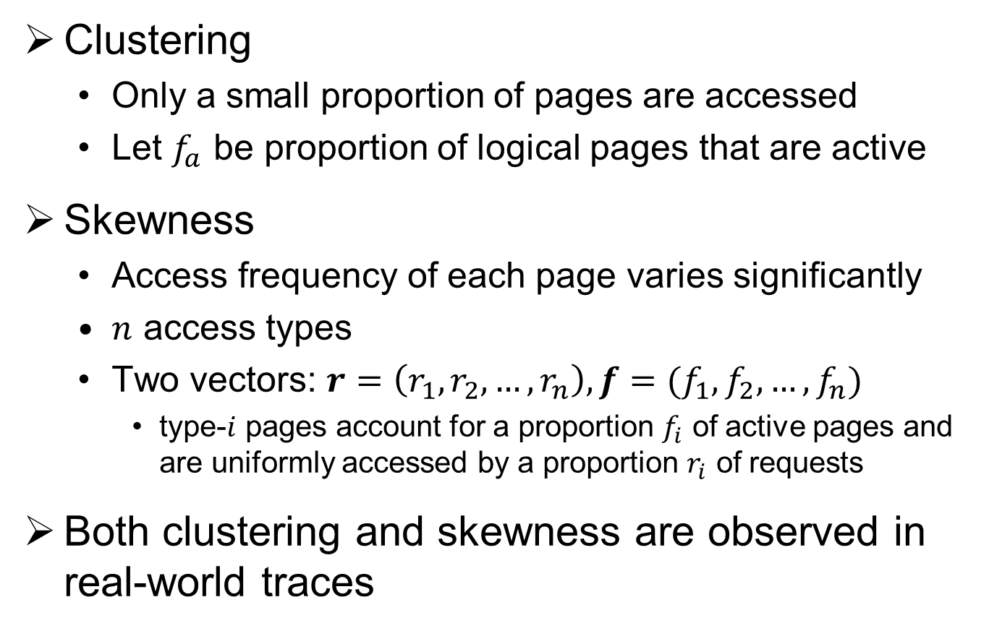
Workload Model
Clustering
  Only a small proportion of pages are accessed
  Let $f_{a}$ be proportion of logical pages that are active
Skewness
  Access frequency of each page varies significantly
  $n$ access types
  Two vectors: $r=\left(r_{1},r_{2},…,r_{n}\right),f=(f_{1},f_{2},…,f_{n})$
    type-$i$ pages account for a proportion $f_{i}$ of active pages and are uniformly accessed by a proportion $r_{i}$ of requests
Both clustering and skewness are observed in real-world traces

Slide 11
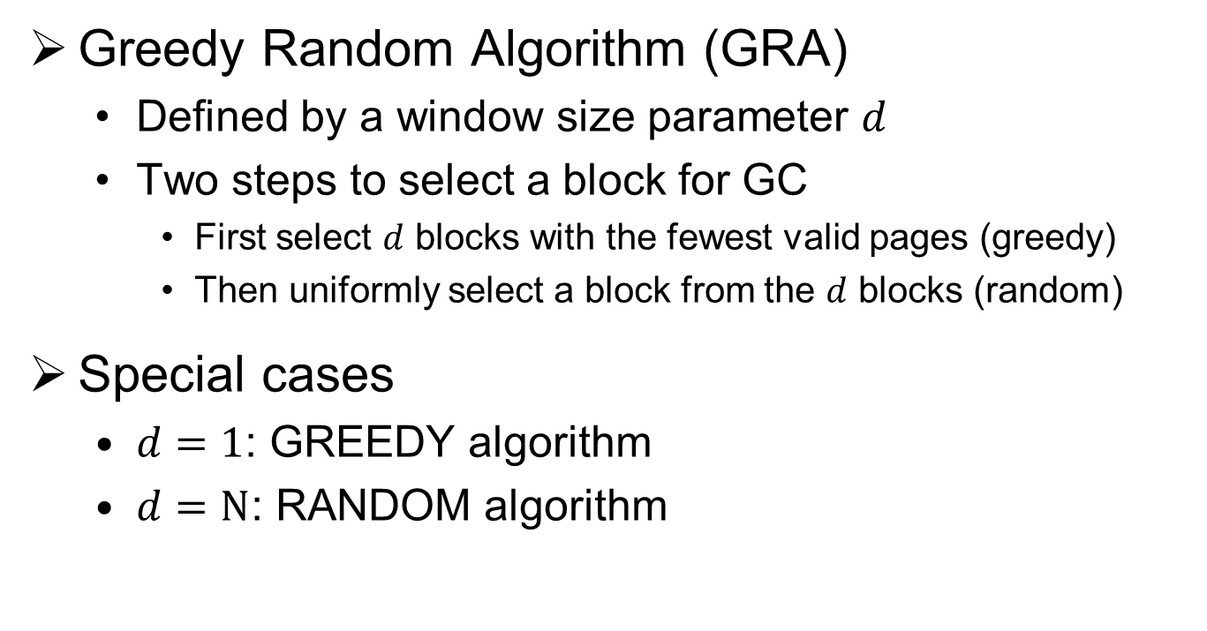
GC Algorithms
Greedy Random Algorithm (GRA)
  Defined by a window size parameter $d$
  Two steps to select a block for GC
    First select $d$ blocks with the fewest valid pages (greedy)
    Then uniformly select a block from the $d$ blocks (random)
Special cases
  $d=1$: GREEDY algorithm
  $d=N$: RANDOM algorithm

Slide 12
Locality-oblivious GC
Write and GC process with single write frontier
  One block is allocated as the write frontier at any time
Writes are sequentially directed to write frontier
  Internal writes: due to GC
  External writes: due to workload
Write frontier is sealed until all clean pages in the block are used up
Another clean block is allocated as write frontier
  GC is triggered to reclaim a block

Slide 13
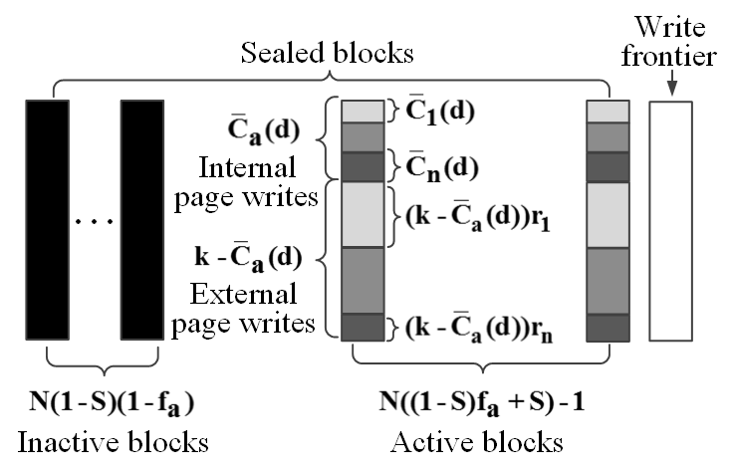
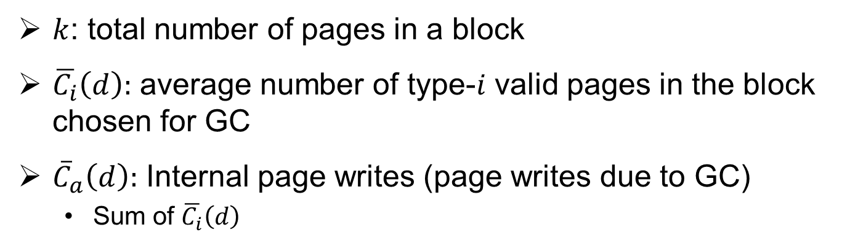
State of Blocks
$k$: total number of pages in a block
$\overline{C_{i}}\left(d\right):$ average number of type-$i$ valid pages in the block chosen for GC
${\overline{C}}_{a}\left(d\right):$ Internal page writes (page writes due to GC)
  Sum of $\overline{C_{i}}\left(d\right)$

Slide 14
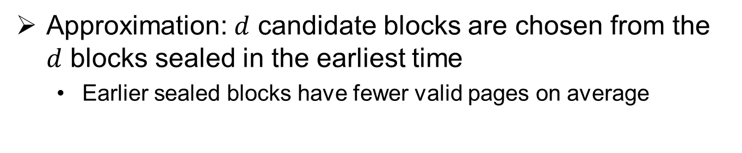
State of Blocks
Approximation:$d$ candidate blocks are chosen from the $d$ blocks sealed in the earliest time
  Earlier sealed blocks have fewer valid pages on average

Slide 15
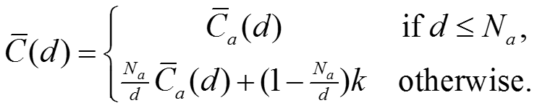
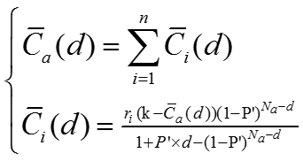

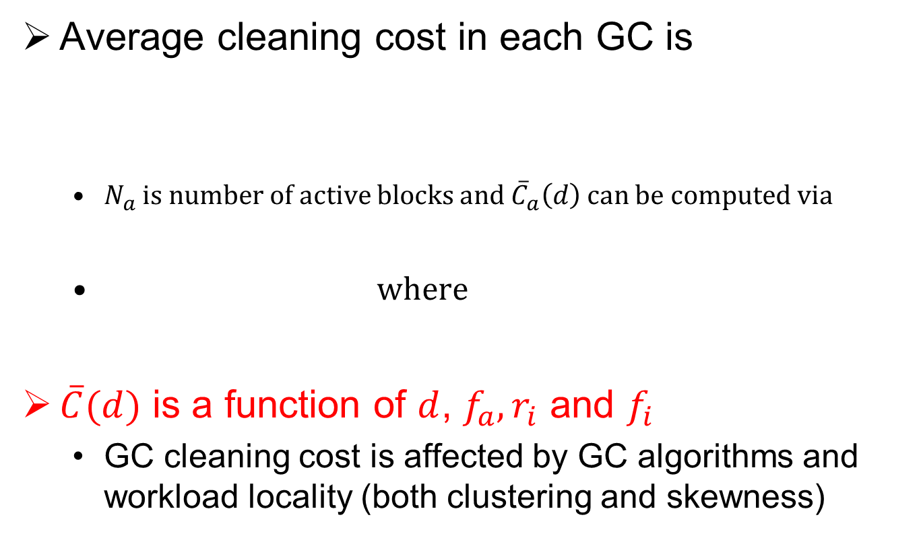
General Analysis Framework
Average cleaning cost in each GC is
  $N_{a}$ is number of active blocks and ${\overline{C}}_{a}\left(d\right)$ can be computed via
  where
$\overline{C}(d)$ is a function of $d$, ${f_{a}, r}_{i}$ and $f_{i}$
  GC cleaning cost is affected by GC algorithms and workload locality (both clustering and skewness)

Slide 16
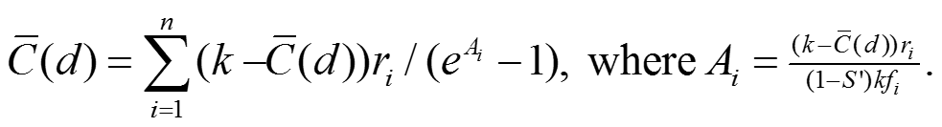

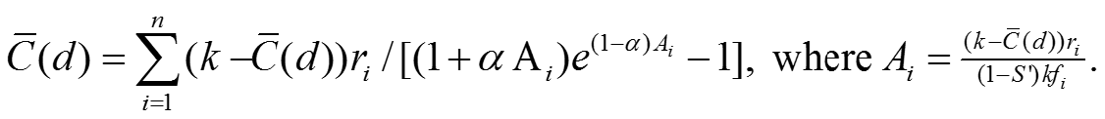
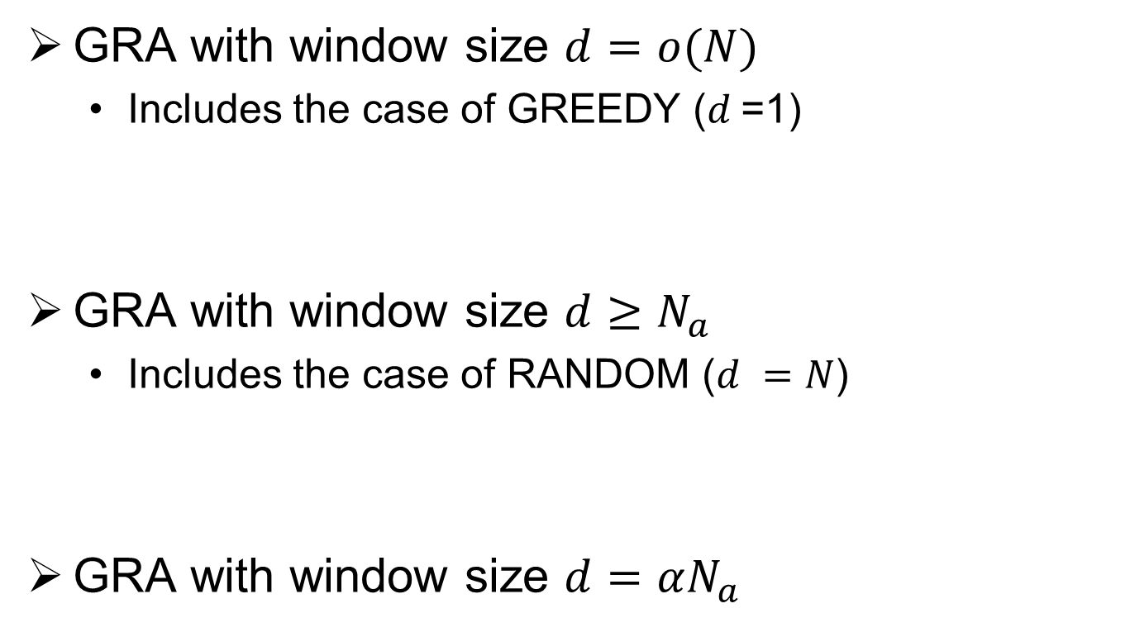
Case Studies
GRA with window size $d=o(N)$
  Includes the case of GREEDY ($d$=1)
GRA with window size $d≥N_{a}$
  Includes the case of RANDOM ($d =N$)
GRA with window size $d=αN_{a}$

Slide 17
Locality-aware GC
Differentiating data reduces GC cleaning cost
Consider locality-aware GC using data grouping
  Differentiating different types of data pages
  Storing them separately in separate regions
Issues to address:
  How data grouping influences the GC performance
  How much is the influence for workloads with different degrees of locality

Slide 18
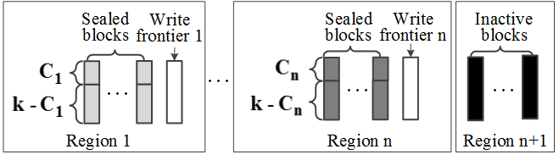
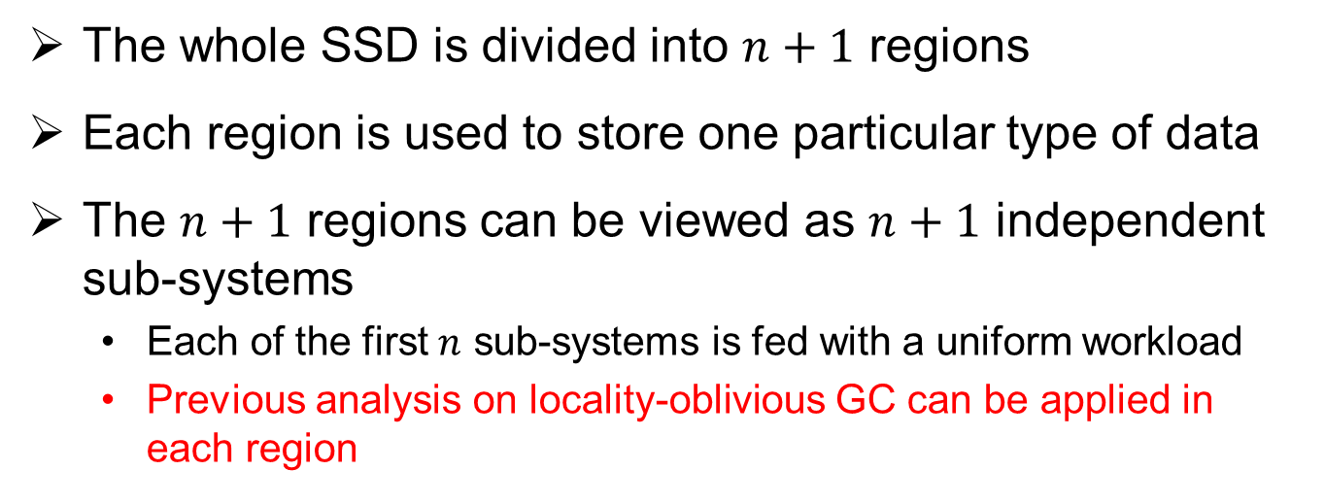
System Architecture
The whole SSD is divided into $n+1$ regions
Each region is used to store one particular type of data
The $n+1$ regions can be viewed as $n+1$ independent sub-systems
  Each of the first $n$ sub-systems is fed with a uniform workload
  Previous analysis on locality-oblivious GC can be applied in each region

Slide 19
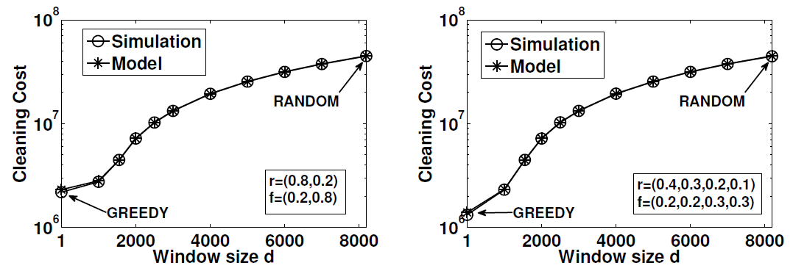

Model Validation
DiskSim + SSD extension developed by Microsoft
Workloads:
  Skewed workload: $f_{a}=0.1, n=2, r= \left(0.8,0.2\right), f = (0.2,0.8)$
  Fine-grained workload: $f_{a}=0.1, r=\left(0.4,0.3,0.2,0.1\right), f=(0.2,0.2,0.3,0.3)$
Skewed workload
Fine-grained workload
Our model matches simulation results

Slide 20
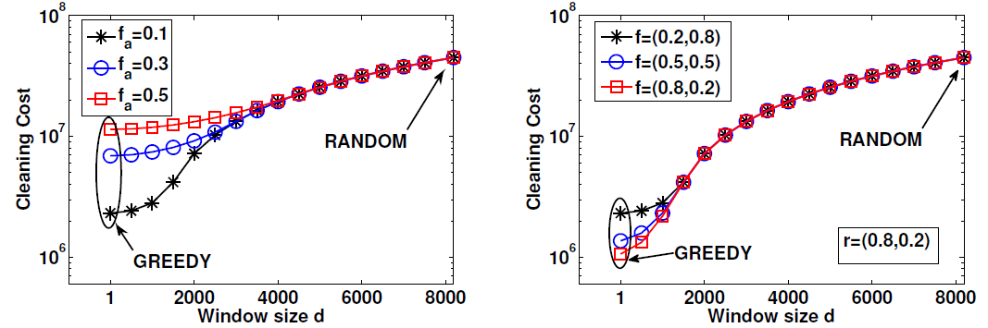
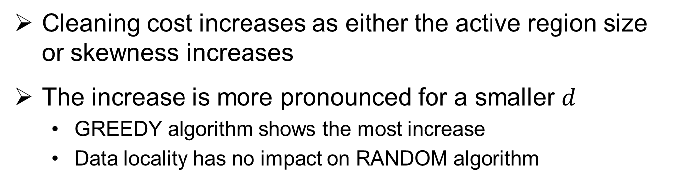
Impact of Data Locality on Locality-oblivious GC
Impact of clustering
Impact of skewness
Cleaning cost increases as either the active region size or skewness increases
The increase is more pronounced for a smaller $d$
  GREEDY algorithm shows the most increase
  Data locality has no impact on RANDOM algorithm

Slide 21
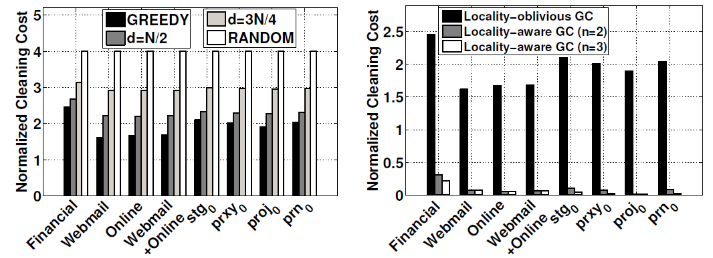
Trace-driven Evaluation
Locality-oblivious GC
Locality-aware GC
Locality-oblivious GC
  GREEDY (RANDOM) gives the best (worst) performance
  GREEDY has the most varying performance across workloads
Locality-aware GC
  Cleaning cost can be significantly reduced with data grouping
  The further reduction is marginal when data is classified into more types

Slide 22
Summary
Propose a general analytical model to study the impact of data locality on GC performance
  Analyze various locality-oblivious GC under different workloads
  Analyze the impact of locality-awareness with data grouping
  Conduct DiskSim simulation and trace-driven evaluations
Cleaning cost depends on clustering/skewness, and impact varies across algorithms
Data grouping efficiently reduces the cleaning cost
  Different spare block allocations show significant differences
Future work
  More validation beyond DiskSim simulations
  GC implementation in SSD-aware file systems

Slide 23
Thank You!
Contact:
  Patrick P. C. Lee
  http://www.cse.cuhk.edu.hk/~pclee

Slide 24
Backup

Slide 25
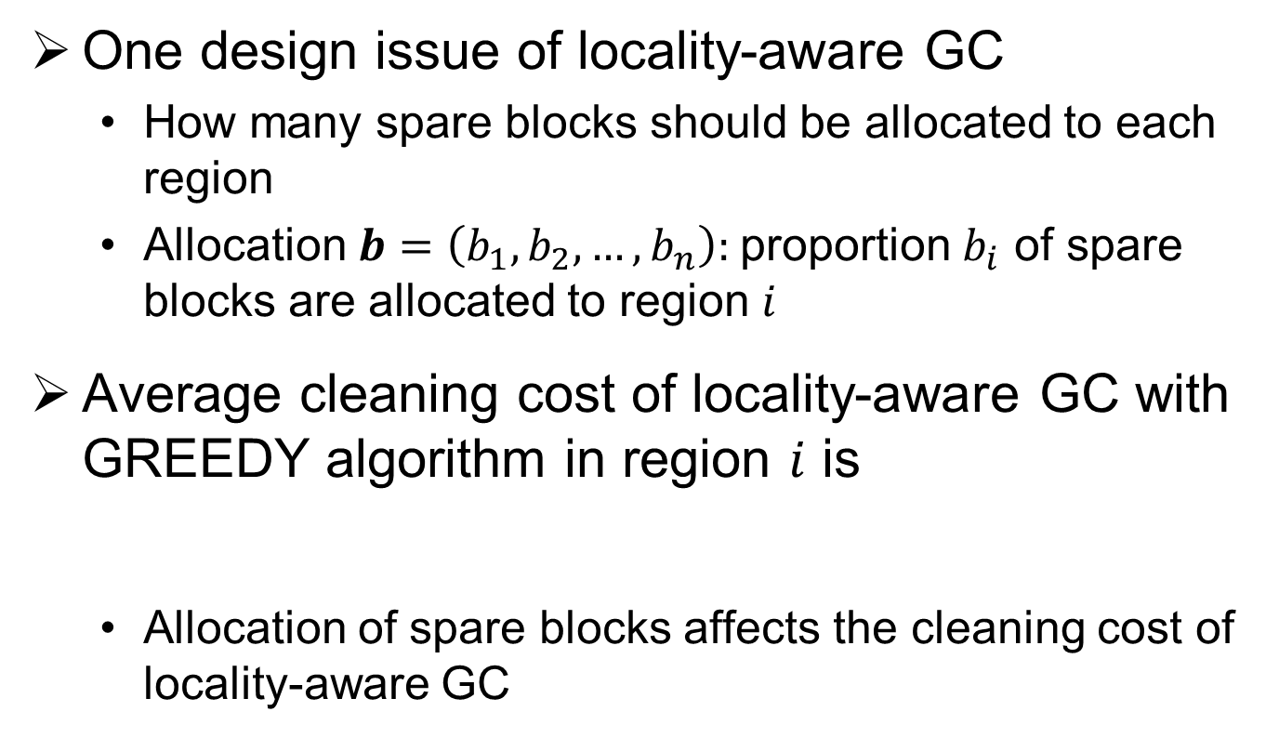
Analysis on locality-aware GC
One design issue of locality-aware GC
  How many spare blocks should be allocated to each region
  Allocation $b=\left(b_{1},b_{2},…,b_{n}\right):$proportion $b_{i}$ of spare blocks are allocated to region $i$
Average cleaning cost of locality-aware GC with GREEDY algorithm in region $i$ is
  Allocation of spare blocks affects the cleaning cost of locality-aware GC

Slide 26
Performance Gain with Locality Awareness
Data grouping effectively reduces GC cleaning cost
Spare block allocation has significant impact on the performance of locality-aware GC
  The impact decreases as the clustering increases
  The impact increases as the skewness increases
Notes:
What is the relationship between the amount of spare blocks and cleaning cost?
Why different spare block allocation show such a change of cleaning cost (see Figure (a))?

