Slide 1
DeltaINT: Toward General In-band Network Telemetry with Extremely Low Bandwidth Overhead
Siyuan Sheng^{1,3}, Qun Huang², and Patrick P. C. Lee³,
¹University of Chinese Academy and Sciences
²Peking University
³The Chinese University of Hong Kong
Notes:
(prepare laser pointer)
Hi, I am Siyuan Sheng from The Chinese University of Hong Kong.
I am going to present the work “DeltaINT: Toward General In-band
Network Telemetry with Extremely Low Bandwidth Overhead”.
This is a joint work with Qun Huang and Patrick P. C. Lee.

Slide 2
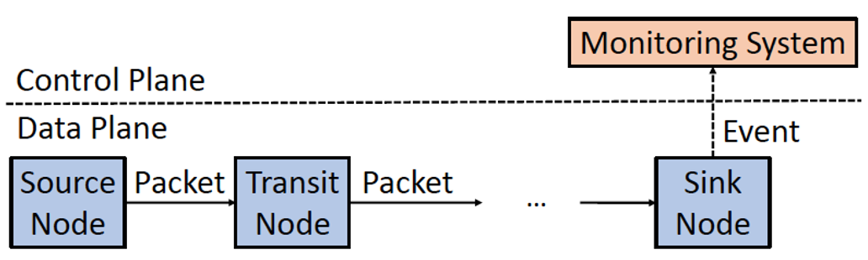
In-band Network Telemetry (INT)
Source pushes control information and device-internal states
Transit pushes states according to control information
Sink extracts INT information and reports an event
INT framework
Notes:
As an emerging technique in network measurement, In-band Network Telemetry (INT) aims to track per-node states for each packet in the data plane. Each node in INT plays one of the three roles: source, transit, and sink node.
The source node is the first node in the forwarding path of each packet. It pushes control information and device-internal states into packet.
The transit nodes are the intermediate nodes in the forwarding path. It pushes device-internal states into the packet according to the control information provided by source node.
The sink node is the last node in the forwarding path. It extracts INT information from the packet and reports it as an event to the monitoring system in control plane.

Slide 3
Limitations of INT
Significant bandwidth overhead
  Linearly grow with the length of forwarding path
  Reduce effective bandwidth for network applications
  Increase likelihood of IP-level fragmentation
Example
  5-node fat-tree topology in data center
  Trace device ID, ingress port, and egress port, of 4B each
  12B per-node states and 8B INT control information
  68B in total → at least 4.53% of 1,500B MTU in Ethernet
Notes:
However, original INT incurs significant bandwidth overhead. As mentioned before, as INT embeds the complete states of each node into each packet along its forwarding path, the bandwidth overhead grows linearly with the path length. It not only reduces the effective bandwidth for network flows of applications, but also increases the likelihood of IP-level fragmentation. Such bandwidth overhead could undermine the network performance.
Let me take an example. Consider a 5-node fat-tree topology in data center, which uses INT to trace device ID, ingress port, and egress port, of 4 bytes each. So each node needs to embed 12 bytes for the three states. Note that INT control information also costs bandwidth, which is usually 8 bytes. Therefore, original INT needs 68 bytes in this example, which accounts for at least 4.53% of the packet size under the MTU of Ethernet. If the packet size exceeds the MTU, IP-level fragmentation will be triggered.

Slide 4
Existing Studies
Sampling-based methods
  Embed INT information to only a subset of sampled packets
  Reduce bandwidth overhead yet with slow convergence
  Cannot retrieve INT information unless collecting sufficient packets
Other methods
  Designed for specific telemetry tasks
All existing methods suffer from low generality
  Cannot support all families of common applications
Notes:
To mitigate the bandwidth overhead of INT, many existing methods are proposed.
Some are sampling-based, which embed INT information to a subset of packets. It does reduce bandwidth overhead, however they suffer from slow convergence. Specifically, they cannot retrieve INT information unless collecting sufficient packets.
Other methods are designed for specific telemetry tasks
In fact, all existing methods compromise generality for bandwidth mitigation, which means that they cannot support all families of common applications. It is just our motivation of this work.

Slide 5
Our Contributions
DeltaINT, a general INT framework
  Extremely low bandwidth overhead
  High generality and convergence
Theoretical analysis on bandwidth mitigation guarantees
Software simulation for various applications
  For example, reducing up to 93% bandwidth cost in gray failure detection
P4-based hardware implementation
Open-source DeltaINT prototype
Notes:
This work makes the following contributions:
We propose a general INT framework with extremely low bandwidth overhead. It mainly aims for two goals: generality and convergence.
We analyze DeltaINT to provide theoretical guarantees on bandwidth mitigation.
We also perform software simulation for different families of applications and confirm the improvement of DeltaINT. For instance, DeltaINT reduces up to 93% bandwidth overhead in gray failure detection.
Furthermore, we provide P4-based hardware implementation and deploy it into Barefoot Tofino ASIC chips.
Finally, we open-source the prototype of this work.
[(1) generality, in which it supports both packet-level and flow-level applications. We will talk about the detailed families of applications later; and (2) convergence, in which it collects real-time INT information by monitoring each packet]

Slide 6
Four Families of Applications
Per-packet-per-node monitoring
  Collect per-node states for each packet (e.g., gray failure detection)
Per-packet aggregation
  Aggregate per-node states for each packet (e.g., congestion control)
Static per-flow aggregation
  Collect static per-node states for each flow (e.g., path tracing)
Dynamic per-flow aggregation
  Aggregate per-node states for each flow (e.g., latency measurement)
Notes:
Before talking about how we mitigate the bandwidth overhead, we first introduce the classification of common applications including four families. This works aims to cover all of them for high generality.
- Per-packet-per-node monitoring is the first family which corresponds to the original INT framework. It aims to collect the states for each packet in a per-node basis. An application is gray failure detection, which detects the node remaining functional yet underperforming.
The second family is per-packet aggregation, which summarizes per-node states for each packet with some aggregation function (e.g.. min and max). An application is congestion control, which collects the maximum link utilization for each packet along the forwarding path to adapt sending-rate.
Another family is static per-flow aggregation, which collects per-node states for each flow. In this family, we assume that the forwarding path and per-node states are static for each given flow. An application is path tracing, which collects the device ID of each node to trace the path of a flow.
The final family is dynamic per-flow aggregation, which summarizes per-node states for each flow with some aggregation function (e.g., median and quantile). An application is latency measurement, which collects latency statistics (e.g., 99th percentile latency) for flow-level monitoring.

Slide 7
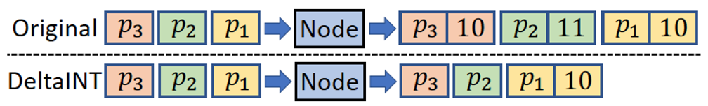
Our Solution
Key observation
  Delta, the change between current state and embedded state
  Delta is often negligible at most time in typical applications
    For example, relatively stable hop latency and static device IDs
Motivating example
Notes:
(be quick for the previous slides)
Our solution originates from a key observation about deltas. We define delta as the change between two states, current state and embedded state. Current state refers to the state provided by the node for each traversed packet, while embedded state is the state that has been recently embedded into a packet. We observe that delta is often negligible (i.e., within some predefined threshold) at most time in typical applications. For example, hop latency is relatively stable unless microbursts occur; some static states like device ID are well-defined and totally unchanged. It motivates us to mitigate bandwidth overhead by embedding the states only if delta is not negligible.
We give a motivating example to briefly show how we use the observation. Suppose that there are three packets, p1, p2, and p3, arriving at the node in order, and their current states are 10, 11, and 10, respectively. For original INT, it just embeds all the complete states. In contrast, DeltaINT only inserts state if its delta exceeds a predefined threshold, say 1 in this example. Specifically, DeltaINT first embeds the current state 10 into p1, and update the embedded state as 10. For packet p2 whose current state is 11, the delta between the current state and embedded state is 1, which does not exceed the threshold. So DeltaINT does not embed the current state of p2. The process of p3 is similar. In this example, DeltaINT can reduce bandwidth usage by around two-thirds.

Slide 8
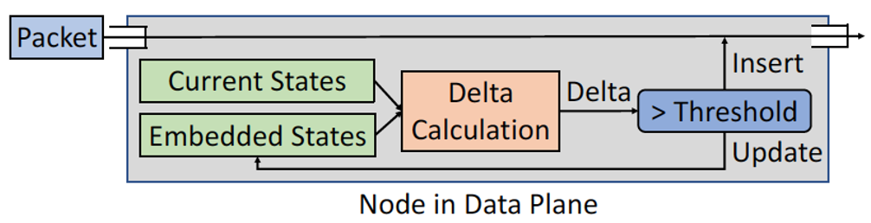
Per-node Architecture in DeltaINT
Per-node architecture
  Calculate the delta between current states and embedded states
  Only if the delta exceeds a threshold, we insert current states into a packet and update the embedded state
How to maintain embedded states efficiently in data plane?
Notes:
Here is the per-node architecture of DeltaINT. For each traversed packet, we first calculate the delta between the current state and the embedded state. Only if the delta exceeds the predefined threshold, we insert it into the packet and update the embedded state. Note that the current states are directly provided by underlying hardware, so we do not need to record them manually. However, how to maintain embedded states efficiently in the data plane with limited resources is a challenge.

Slide 9
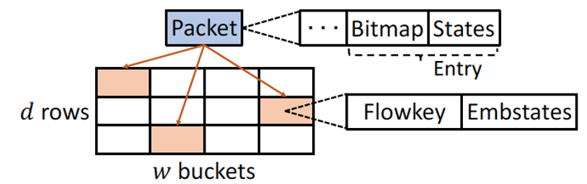
Sketching in DeltaINT
Sketch-based technique
  Store approximate information with limited memory and computations
  Track embedded states in the data plane with limited resources
Per-node sketch data structure
  Each bucket stores a flowkey and the embedded states
  Each entry of a packet includes a bitmap and the states being embedded
Notes:
To address the challenge, we exploit sketch-based techniques, which can store approximate information with limited memory and computations. Then, we can track embedded states in the data plane with limited resources. However, none of existing methods can support general INT applications. Therefore, we pose a sketch composed of d rows each with w buckets. We deploy such a sketch in each node. In each bucket, we store a flowkey, the identification of a flow (e.g., 5 tuples), and the embedded states. For each traversed packet carrying INT information, it consists of multiple entries. Each entry corresponds to a node, including a bitmap and the states being embedded. The length of bitmap equals the number of states being tracked. Each bit indicates whether the corresponding state is embedded in this node.

Slide 10
Primitives in DeltaINT
Four primitives to form DeltaINT workflow
  StateLoad
    Hash flowkey and load embedded states from the first bucket matching flowkey
  DeltaCalc
    Calculate the delta and compare with the predefined threshold
  StateUpdate
    Update flowkey and relevant embedded states in the hashed buckets
  MetadataInsert
    Insert a bitmap and the states with non-negligible deltas into the packet
Fit DeltaINT into applications with slight changes to primitives
Notes:
Based on the aforementioned sketch, we provide four primitives in DeltaINT framework to serve various INT applications, including StateLoad, DeltaCalc, StateUpdate, and MetadataInsert.
For StateLoad, it hashes the flowkey of the incoming packet to locate multiple buckets in the sketch. Then, it loads the embedded states from the first bucket storing the same flowkey as the current packet.
For DeltaCalc, it calculates the delta between the current state and the embedded state got by StateLoad. Then, it compares the delta with the predefined threshold to determine whether to embed it or not.
For StateUpdate, it updates the flowkey and the relevant embedded states of the hashed buckets in the sketch.
For MetadataInsert, it inserts INT information including a bitmap and the states with non-negligible deltas into the packet.
We can easily fit DeltaINT into different applications only with slight changes. For example, in per-packet aggregation, we just use DeltaCalc to calculate delta for aggregated state instead of original state.

Slide 11
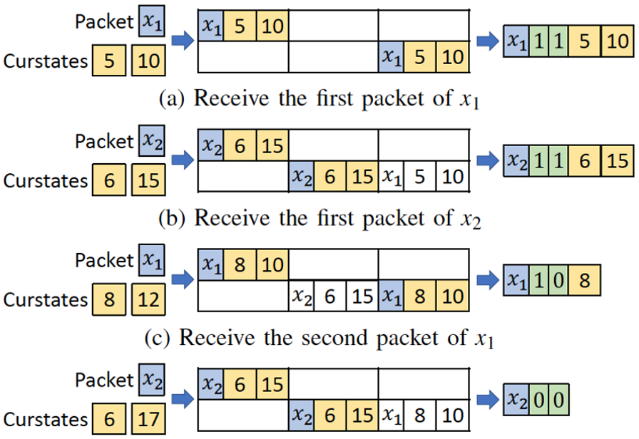

Update Example
Receive the first packet of $x_{1}$
Receive the first packet of $x_{2}$
Receive the second packet of $x_{1}$
Receive the second packet of $x_{2}$
Notes:
Let’s take an example to show how DeltaINT works. Suppose that there are four packets belonging to two flows x1 and x2. In this example, we focus on two states, whose thresholds are 0 and 2.
First, DeltaINT receives the first packet belonging to x1. Since no bucket matches x1, DeltaINT updates the hashed buckets with flowkey x1, and the current states, 5 and 10. Then, it directly embeds a bitmap with two bits of 1 and the complete current states.
Next, DeltaINT receives the second packet belonging to another flow x2. Since no bucket matches x2, DeltaINT performs similar process as the previous packet to update the sketch and the packet. Note that the first bucket in the sketch, which stored the INT information of x1, has been overwritten with the information of x2.
After that, DeltaINT receives the third packet belonging to x1. It loads the embedded states, 5 and 10, from the sketch, and calculates the deltas, 3 and 2. Since the delta of the first state exceeds the corresponding threshold, DeltaINT updates the embedded state and inserts the current state 8 into the packet. Note that the second bit of the bitmap is set as 0 to indicate that the second state is not embedded into the packet.
Finally, DeltaINT receives the last packet belonging to x2. After loading the embedded states, 6 and 15, it gets the deltas, 0 and 2. As both of them are within the thresholds, it only inserts a bitmap with two bits of 0 into the packet.

Slide 12
Evaluation
Methodology
  For software simulation, we use both bmv2 and NS3
  For hardware implementation, we compile P4 in Barefoot Tofino switch
  For sketch in the data plane, we keep 1MB memory and 1 hash function
Experiments
  Gray failure detection
  Congestion control
  Path tracing
  Latency measurement
  Hardware resource usage
Notes:
Finally, I talk about the evaluation of this work. We have both software simulation and hardware implementation. For the former, we use both bmv2 and NS3. For the latter, we compile P4 in Barefoot Tofino switch. For per-node sketch in the data plane, we keep 1MB memory and 1 hash function. We evaluate DeltaINT in the following experiments, gray failure detection, congestion control, path tracing, latency measurement, and hardware resource usage.

Slide 13
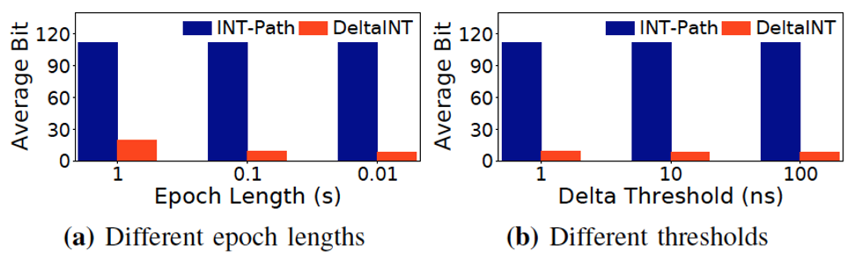
Gray Failure Detection
Tracked states
  8-bit device ID, 8-bit ingress port, 8-bit egress port, and 32-bit latency
Bandwidth usage
  DeltaINT (8.1 bits) mitigates 93% bandwidth usage of INT-Path (112 bits)
  Reason: DeltaINT only embeds critical states with non-negligible deltas
(a) Different epoch lengths
(b) Different thresholds
Notes:
In gray failure detection, we compare DeltaINT with INT-Path. In this application, we focus on three states: 8-bit device ID, 8-bit ingress port, 8-bit egress port, and 32-bit latency. For bandwidth usage, we concern average bit cost, the average number of bits used by each packet to carry INT information. The result is that DeltaINT can mitigate at most 93% bandwidth usage of INT-Path. The improvement holds under different epoch lengths and thresholds. The reason is that DeltaINT only embeds the critical states with non-negligible deltas, while INT-Path embeds all states for each packet.

Slide 14
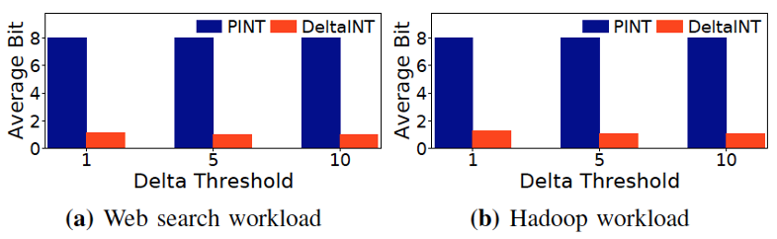

Congestion Control
Tracked state: 8-bit link utilization
Bandwidth usage
  DeltaINT ($≈$1 bit) is better than PINT (8 bits)
  Reason: DeltaINT only needs a 1-bit bitmap for negligible delta such that controller can be aware of the stable link utilization
(a) Web search workload
(b) Hadoop workload
Notes:
In congestion control, we use the state-of-the-art work, PINT, as the baseline. We track 8-bit link utilization. For bandwidth usage, we still consider average bit cost. The figures show that under both the web search workload and Hadoop workload, the average bit of PINT is always 8 bits, while that of DeltaINT decreases to nearly 1 bit. The reason is that DeltaINT only needs an 1-bit bitmap for non-negligible delta, such that the controller can be aware of the stable link utilization.

Slide 15
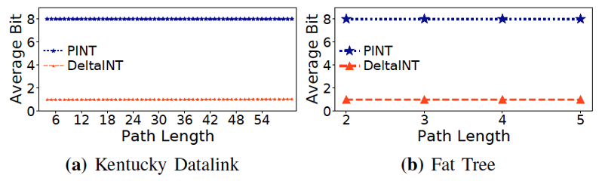
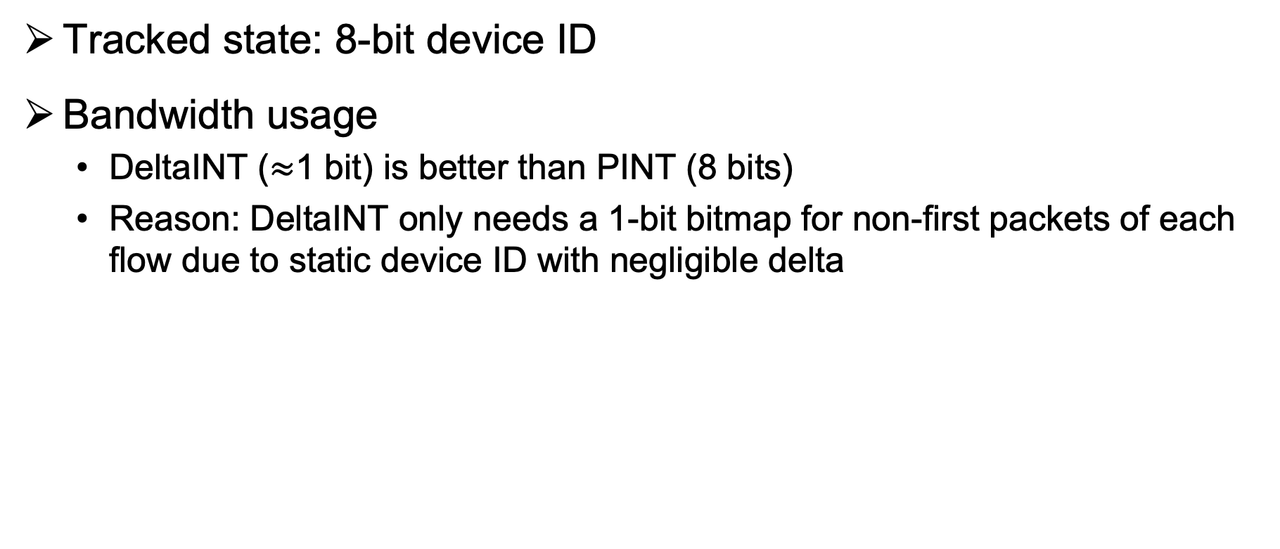
Path Tracing
Tracked state: 8-bit device ID
Bandwidth usage
  DeltaINT ($≈$1 bit) is better than PINT (8 bits)
  Reason: DeltaINT only needs a 1-bit bitmap for non-first packets of each flow due to static device ID with negligible delta
(a) Kentucky Datalink
(b) Fat Tree
Notes:
For path tracing, we track the 8-bit device ID. As PINT suggests, we take two topologies, Kentucky datalink and fat tree, to evaluate the bandwidth usage. The results shows that DeltaINT requires nearly 1 bit on average which is smaller than PINT of 8 bits. The reason is similar as the previous application, i.e., DeltaINT only needs an 1-bit bitmap for non-first packets of each flow due to static device ID with negligible delta

Slide 16
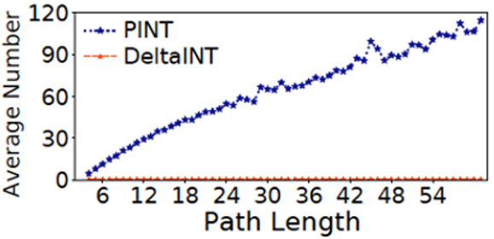
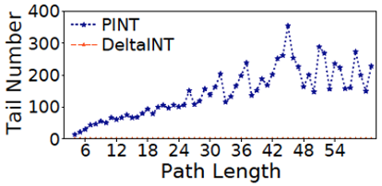
Path Tracing
Convergence
  Average number of required packets: DeltaINT (1) vs. PINT (120)
  Tail (99th percentile) number of required packets: DeltaINT (1) vs. PINT (350)
  Reason
    DeltaINT only embeds per-node device ID in the first packet of each flow
    PINT needs sufficient sampled packets to retrieve per-flow device IDs
Notes:
In path tracing, we also take another experiment to evaluate the convergence. Specifically, we consider the average and tail (aka 99th percentile) number of required packets sent by a flow to collect all static states. Here we take Kentuncky Datalink as an example. The results show that for PINT, the average number is 120 and the tail number is 350 in this topology. However, DeltaINT only needs a single packet. The reason is that DeltaINT just embeds the static states into the first packet of each flow, while PINT needs sufficient sampled packets to retrieve per-flow device IDs.

Slide 17
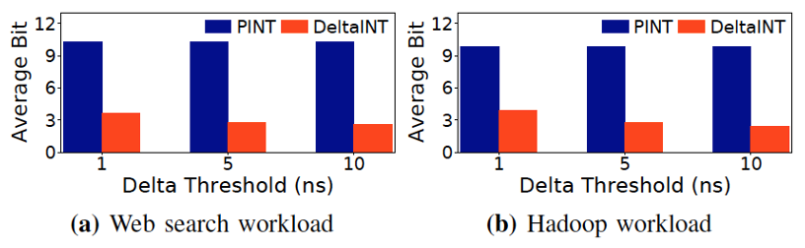
Latency Measurement
Tracked state: 8-bit latency
Bandwidth usage
  Web search workload: DeltaINT (2.6 bits) is better than PINT (10.3 bits)
  Hadoop workload: DeltaINT (2.4 bits) is better than PINT (9.9 bits)
  Reason: DeltaINT only embeds critical latency with non-negligible delta
(a) Web search workload
(b) Hadoop workload
Notes:
(be quick for this slide)
In the last application, latency measurement, the result is similar that DeltaINT is better than PINT in two workloads. The reason is also similar that DeltaINT only embeds critical latency with non-negligible delta.

Slide 18
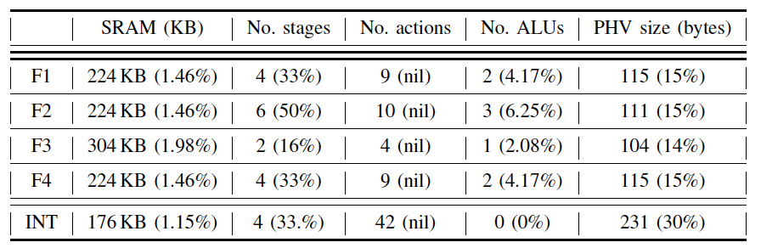
Hardware Resource Usage
Hardware resource usage
  Percentages in brackets are fractions of total resource usage
  DeltaINT incurs slightly more SRAM, stages, and stateful ALUs
    DeltaINT needs to track embedded states in the data plane
  INT incurs more PHV sizes and actions
    INT has larger bandwidth overhead and hence more information to process and transmit
Notes:
Finally, we evaluate hardware resource usage on Barefoot Tofino switch. F1 – F4 refers to DeltaINT in the four families of applications. We use the four representative applications mentioned before. INT refers to the original INT framework for F2, which incurs the most number of stages in DeltaINT. We compile them in the same testbed. Percentages in brackets are fractions of total resource usage. The result shows that DeltaINT incurs slightly more SRAM, stages, and stateful ALUs than the original INT. The reason is that DeltaINT needs to track embedded states in the data plane. However, original INT incurs more PHV sizes and actions. The reason is that INT has larger bandwidth overhead than DeltaINT, so it needs more information to process and transmit in the data plane.

Slide 19
Conclusion
DeltaINT, a novel INT framework to achieve extremely low bandwidth overhead
  Generality
  Convergence
Evaluation on various applications
  DeltaINT incurs less bandwidth usage than state-of-the-art methods
Source code:
  http://adslab.cse.cuhk.edu.hk/software/deltaint
Notes:
To conclude, we propose DeltaINT, a novel INT framework that achieves extremely low bandwidth overhead. It mainly aims for generality and convergence. Based on our evaluation on various applications, we confirm that DeltaINT can mitigate bandwidth usage. We also open-source our code in github, and here is the link.

Slide 20
Thank You!
Q & A
Notes:
Thank you. I’d like to take your questions and comments.

