Slide 1
UniKV: Toward High-Performance and Scalable KV Storage in Mixed Workloads via Unified Indexing
Qiang Zhang†, Yongkun Li†, Patrick P. C. Lee‡, Yinlong Xu†, Qiu Cui*, Liu Tang*
†University of Science and Technology of China
‡The Chinese University of Hong Kong
*PingCAP

Slide 2
Background
Data volume is growing exponentially
33 ZB in 2018 → 44 ZB in 2020 → 175 ZB in 2025^{[1]}
Various data types (structured, semi-structured and unstructured)
Key-value (KV) stores are widely used in many applications
Flexible data model & high scalability
LevelDB @ Google
RocksDB @ Facebook
Cassandra @ Apache
[1] Internet Data Center, Nov 2018, https://www.idc.com/.

Slide 3
Background
The most common design of KV stores is based on LSM-tree
Immutable
MemTable
MemTable
<key, value>
Multiple levels
Log-structured writes
Sorted in each level
memory
disk
flush
Log
Lowest
level
L0
…
compaction
kv pairs
…
bloom filter
data index
Footer
L1
…
L2
…
…
SSTable
Efficient writes, scans & high scalability
Highest
level
L6
…

Slide 4
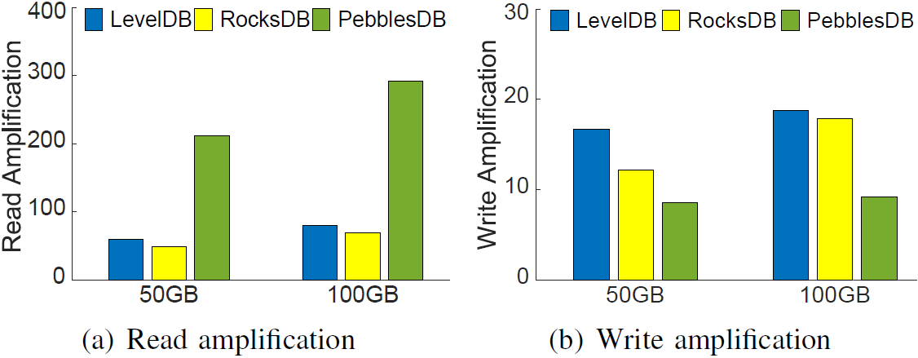
Background
Limitations of LSM-tree
Large read amplification (RA) and write amplification (WA)
RA: up to ~300X; WA: up to ~20X

Slide 5
Related Work
LSM-tree-based designs exhibit trade-offs
Fragmented LSM-tree^{[1]}
Relaxes the fully sorted nature in each level
Increases write performance, but sacrifices read performance
Trie-like structure^{[2]}
Hash-based design
Good for point query & write, but not support scan
KV separation^{[3]}
Separates the storage of keys and values
Reduces write amplification, incurs extra lookup & high GC cost
[1] Raju et al., “Pebblesdb: Building key-value stores using fragmented log-structured merge trees”, SOSP’17.
[2] Wu et al., “Lsm-trie: An lsm-tree-based ultra-large key-value store for small data”, ATC’15.
[3] Lu et al., “WiscKey: Separating Keys from Values in SSD-Conscious Storage”, FAST’16.

Slide 6
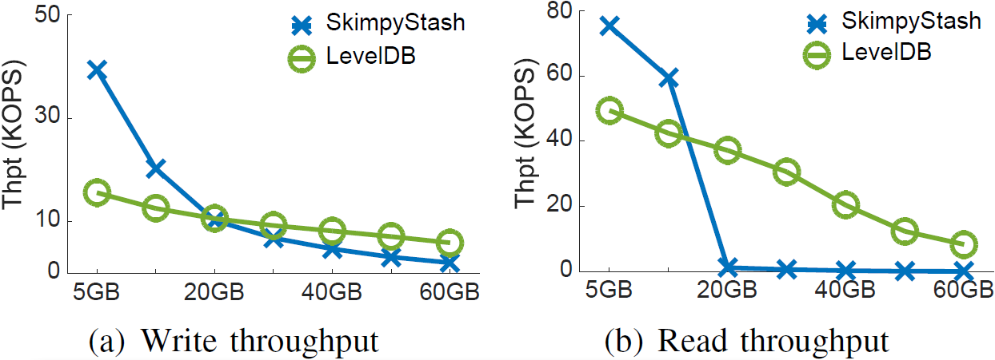
Motivation
Observation: Indexes possess trade-offs, so single index is hard to meet all performance requirements
Hash-based Design
Efficient read/write
(for small data size)
Bad scalability
Not support scan
High memory usage
LSM-tree-based Design
Good scalability
Efficient scan
Persistency
WA/RA problems
Question: can we unify hash indexing and LSM-tree
to simultaneously address reads, writes and scans
in a high-performance and scalable fashion?

Slide 7
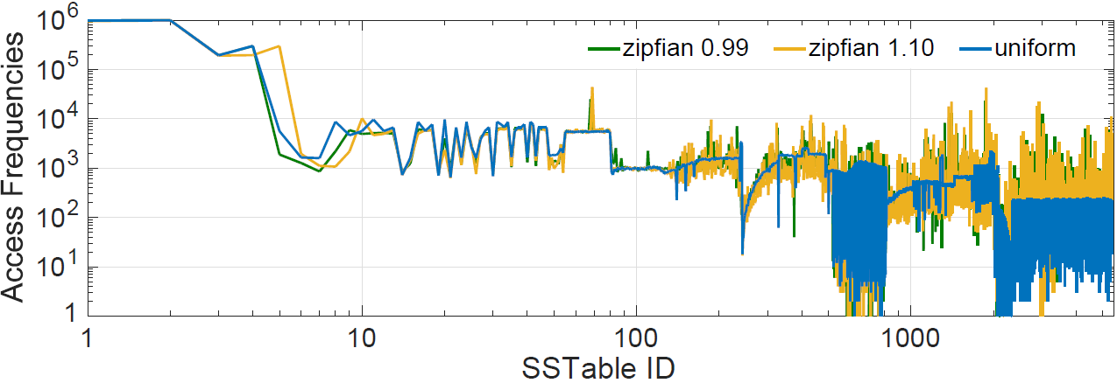
Motivation
Observation: Data locality is also very common in KV workloads
It offers an opportunity to unify multiple indexes in a single system to address their limitations
Lower levels
Small size
High access frequency
Higher levels
Large size
Low access frequency

Slide 8
Main Idea
UniKV: Unifies hash indexing and LSM-tree in KV stores
A two-layer architecture with differentiated indexing
UnsortedStore (small & hot data)
In-memory hash indexing (no sorting)
Reduce WA/RA
SortedStore (large & cold data)
LSM-tree-based design (fully sorted)
Limited memory overhead and scan support
Dynamic range partitioning
Support large KV stores with scale-out feature
UnsortedStore
<key,value>
…
Hash indexing
…
Merge
…
LSM-tree
SortedStore

Slide 9
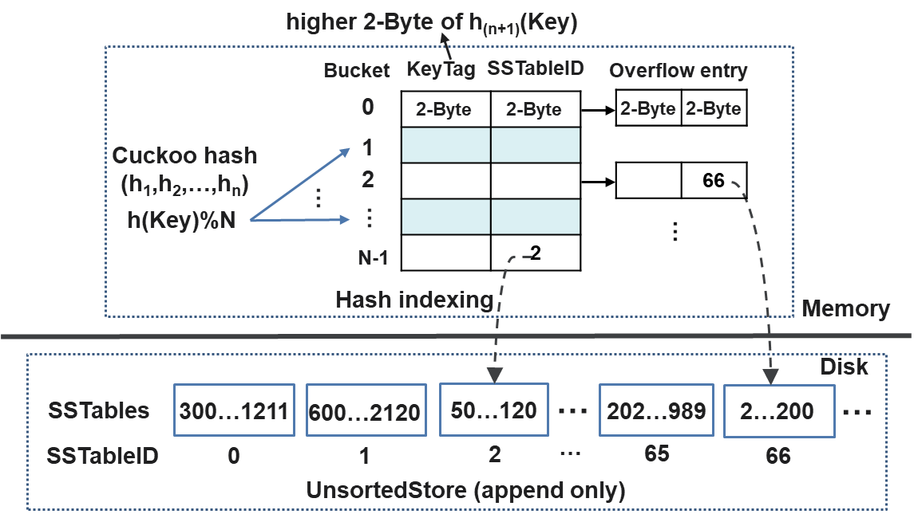
UniKV Design
Challenge 1: How to limit the memory overhead of hash indexing?
Light-weight two-level hash indexing
Combine cuckoo hashing and linked hashing to solve collisions & ensure high space utilization
~80% utilization & ~3 entries/bucket
2-Byte KeyTag (not the original key) to further reduce mem overhead
Each KV pair costs 8 bytes, 1GB UnsortedStore costs 10MB (1KB KV)
Mem overhead <1%

Slide 10
UniKV Design
Challenge 2: How to efficiently merge KV pairs to SortedStore?
KV separation for SortedStore only
Values are stored in separate logs→ only merge keys→ avoid movement of values
Partial KV separation
UnsortedStore
Hot and small
…
<key,value>
…
Merge with KV separation
Key and value location
LSM-tree: fully sorted
Efficient scan
<key,pointer>
…
…
SortedStore
Cold and large
value
…
Values
Append as new log files
Avoid large WA
…
…
Value log files

Slide 11
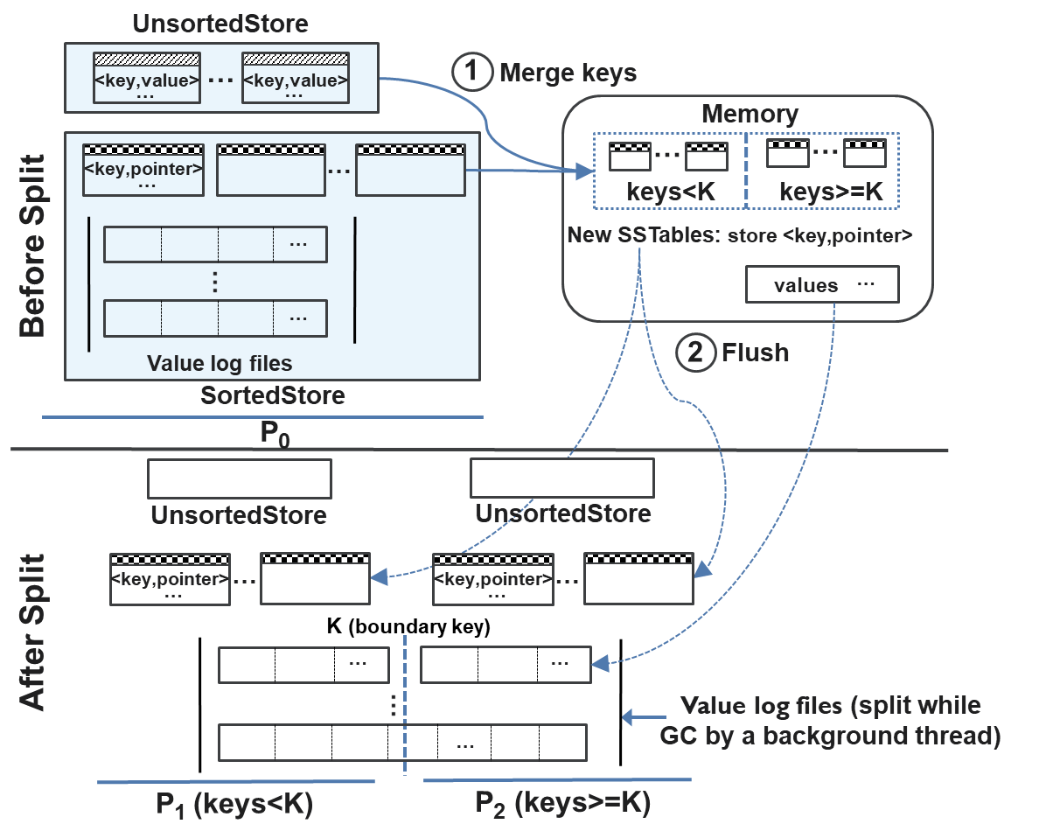
UniKV Design
Challenge 3: How to support large stores in a scale-out manner?
Dynamic range partitioning
Efficient scan
Key range based partition (benefits scan)
Efficient read
UnsortedStore: fast lookup with hash indexing
SortedStore: fast binary search
Efficient write/GC
Each partition contains two levels (benefits writes)
Compaction/GC between partitions are independent
Lazy split for values (during GC)

Slide 12
UniKV Design
Challenge 4: How to achieve efficient scan performance?
Scan optimizations for differentiated storage
UnsortedStore
Overlapped SSTables: many random reads
Size-based merge
<key,value>
…
…
…
30~1100
0~10000
50~1300
<key,pointer>
…
…
SortedStore
KV separation → random value reads
Multi-threading: I/O parallelization of SSDs
Read-ahead: Pre-fetching values
value
…
…
…
Value log files

Slide 13
Putting It All Together: Overall Architecture
Bucket
KeyTag
SSTableID
<key, value>
0
2-Byte
2-Byte
Unifies hash index and LSM-tree to realize differentiated indexing
Lightweight hashing
Partial KV separation
Dynamic range partitioning
2
3
…
MemTable
Immutable
MemTable
N-1
Hash indexing for UnsortedStore
Memory
1
WAL
4
Disk
On-disk
Log
UnsortedStore
…
Partition P₀
K₀ $≤$Keys $<$K₁
<key,value>
…
Merge and KV separation
Partition P₁
K₁ $≤$Keys $<$K₂
<key,pointer>
…
…
…
Simultaneously achieves
fast read, write, and scan for large KV stores
value
…
…
Value log files
Partition P_{n}
K_{n} $≤$Keys
…
SortedStore
SSTable (KV pairs)
SSTable (keys and pointers)

Slide 14
Performance Evaluation
Server configuration
Experimental configuration
Workloads: Generated by YCSB-C, the C++ version of YCSB
UniKV parameters
Partition size=40GB, UnsortedStore size=4GB
# of buckets in the hash table=4M, # of cuckoo hash functions=4
Common parameters
Machine | CPU | Memory | Disk | OS
Dell PowerEdge R730 | Intel(R) Xeon(R) E5-2650 v4 @ 2.20GHz 12-cores | 16-GB RAM Synchronous 2400 MHz | 500GB SSD | 16.04.1-Ubuntu 64-bit Linux 4.15.0
Size of KV pair | Request Distribution | memtable size | bloom_bits
1KB | Zipfian (0.99) | 64 MB | 10bits/key

Slide 15
Exp 1: Micro-benchmarks
Load 100M KV pairs, then operate 10M reads, 1M scans (length=50), 100M updates
UniKV achieves 1.7-9.6x write throughput, 3.1-6.6x read throughput,
1.6-8.2x update throughput, nearly the same scan throughput

Slide 16
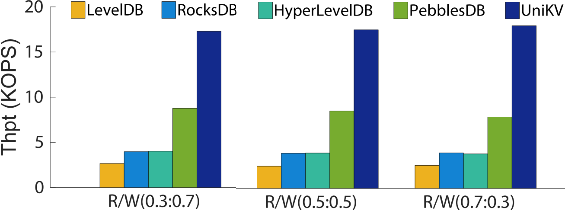
Exp 2: Performance under Mixed Workloads
Load 100M KV pairs, then run 100M read-write mixed operations
UniKV achieves 6.5-7.1x, 4.4-4.6x, 4.3-4.7x and 2.0-2.3x overall throughput,
compared to LevelDB, RocksDB, HyperlevelDB, and PebblesDB, respectively.

Slide 17
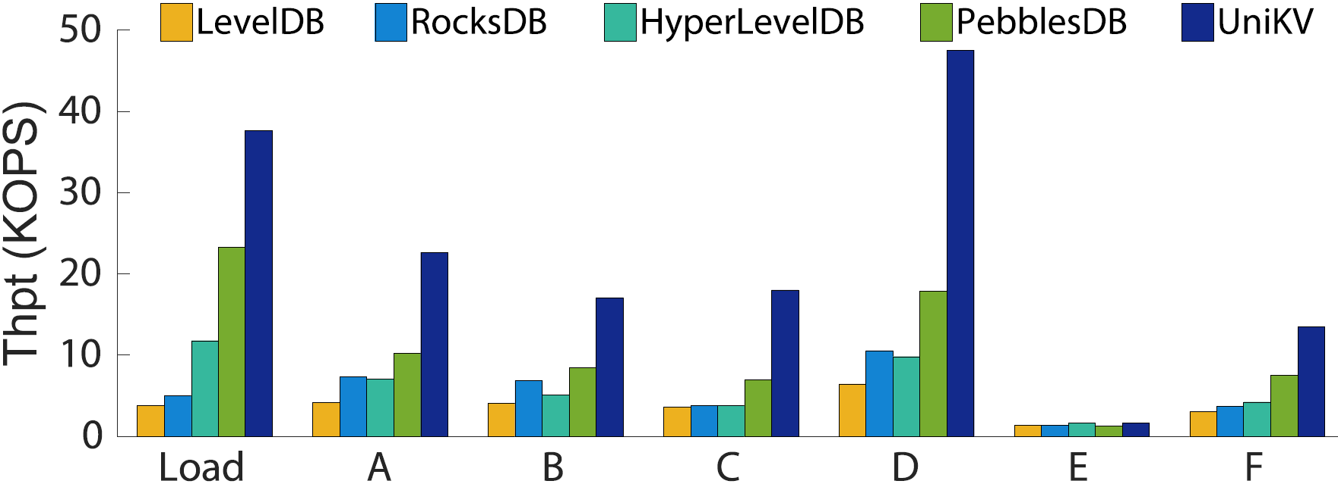
Exp 3: YCSB Performance
Load 100M KV pairs, then run each YCSB workload (50M ops)
UniKV achieves higher than 2x throughput for most workloads

Slide 18
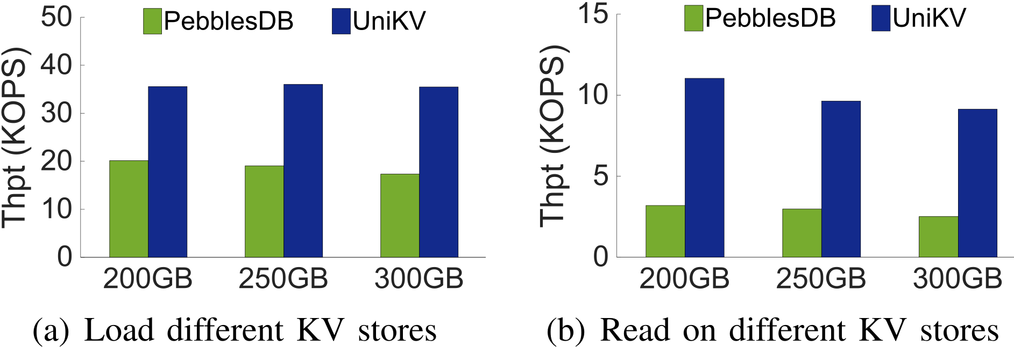
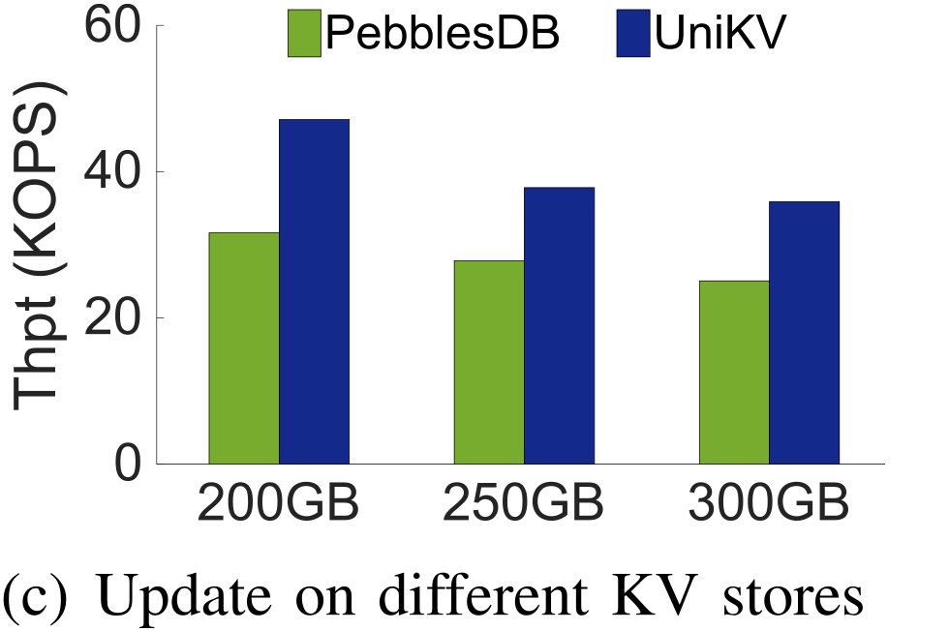
Exp 4: Performance on large KV stores
Load 200~300GB KV pairs, then run 10M reads, 100M updates
1.8-2.0x write
3.2-3.6x read
1.4-1.5x update
UniKV achieves consistent improvement in large KV stores

Slide 19
Conclusions
UniKV: unifies hash indexing and the LSM-tree in a single system to enable high-performance and scalable KV storage
A two-layer architecture with differentiated indexing
Lightweight hash index to limit memory usage
Partial KV separation to reduce merge overhead
Dynamic range partitioning to support large store
More evaluation results and analysis are in the paper
The source code is at https://github.com/ustcadsl/unikv

Slide 20
Thanks for your attention!
Q&A
Yongkun Li@USTC
http://staff.ustc.edu.cn/~ykli/

