Slide 1



StripeMerge: Efficient Wide-Stripe Generation for Large-Scale Erasure-Coded Storage
Qiaori Yao¹ , Yuchong Hu¹, Liangfeng Cheng¹,
Patrick P. C. Lee², Dan Feng¹ , Weichun Wang³ , Wei Chen³
¹ Huazhong University of Science and Technology
² The Chinese University of Hong Kong
³ HIKVISION
Notes:
Hi, everyone! My name is Yao Qiaori. And I come from Huazhong University of Science and Technology.
I’m excited to have a chance to introduce our work StripeMerge: XXX.
This is a joint work with The Chinese University of Hong Kong and HIKVISION.

Slide 2

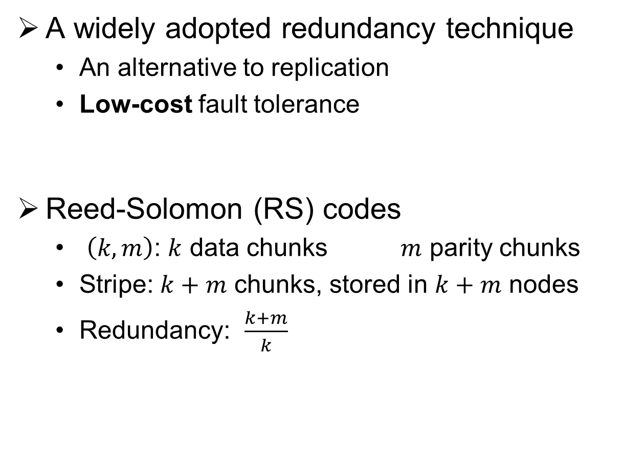

Erasure Coding
A widely adopted redundancy technique
  An alternative to replication
  Low-cost fault tolerance
Reed-Solomon (RS) codes
  $\left(k,m\right)$: $k$ data chunks $m$ parity chunks
  Stripe: $k+m$ chunks, stored in $k+m$ nodes
  Redundancy: $\frac{k+m}{k}$
Data
  Divide
D₁
D₂
D₃
……
D_{k}
  Encode
P₁
P₂
……
P_{m}
encoding matrix
  Distribute
……
$(k+m)$ nodes
Notes:
First of all, let’s review some basis of Erasure Coding.
Erasure Coding is xxx. Compared to replication, EC need much less space, so it can privode xxx.
Take Reed-Solomon codes, one of the most popular erasure codes, as example.
First, the data is divided into k chunks.
Second, these data chunks are encoded to generate m parity chunks.
All these chunks constitute a stripe.
Lastly we distribute them to k+m nodes.

Slide 3
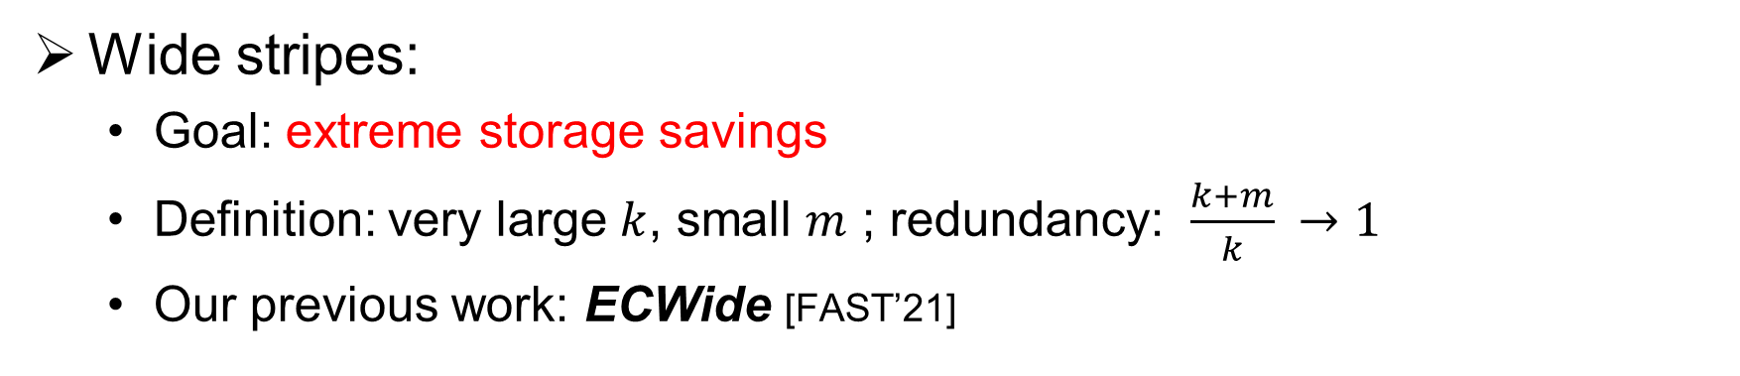
Wide-stripe Erasure Coding
Wide stripes:
  Goal: extreme storage savings
  Definition: very large $k$, small $m$ ; redundancy: $\frac{k+m}{k} →1$
  Our previous work: ECWide [FAST’21]
How to generate a wide stripe?
  Natural idea: direct generation
    Expensive repair: retrieve k chunks to repair one chunk
  Our idea: tiered generation
    Motivation: access frequency is high at first, but decreases as data age
Re-encode
Narrow stripes
(small k)
Wide stripes
(large k)
Original data
High access frequency
Low access frequency
Notes:
Recently, storage practitioners are interested in further redundancy reduction for extreme storage savings.
If we have a very large k, while m keeps relatively small, the redundancy will be substantially suppressed. Here come the wide stripes.
BTW, our previous work ECWide, appeared in FAST 21 few months ago.
Well, we keep thinking about this question: How to generate a wide stripe?
One natural idea is to generate it directly when data is first written. But we should take performance into consideration too. Actually it needs to retrieve k chunks to repair a single chunk.
So we tend to adopt a tiered approach to generate it. Our motivation is that xxx.
If the original data just enter the system, it is stored in narrow stripes, as it usually has high access frequency and we don’t want the frequent and expensive repair.
But when the data age, we can re-encode it into wide stripes then.
Seems like a good balance, right?

Slide 4
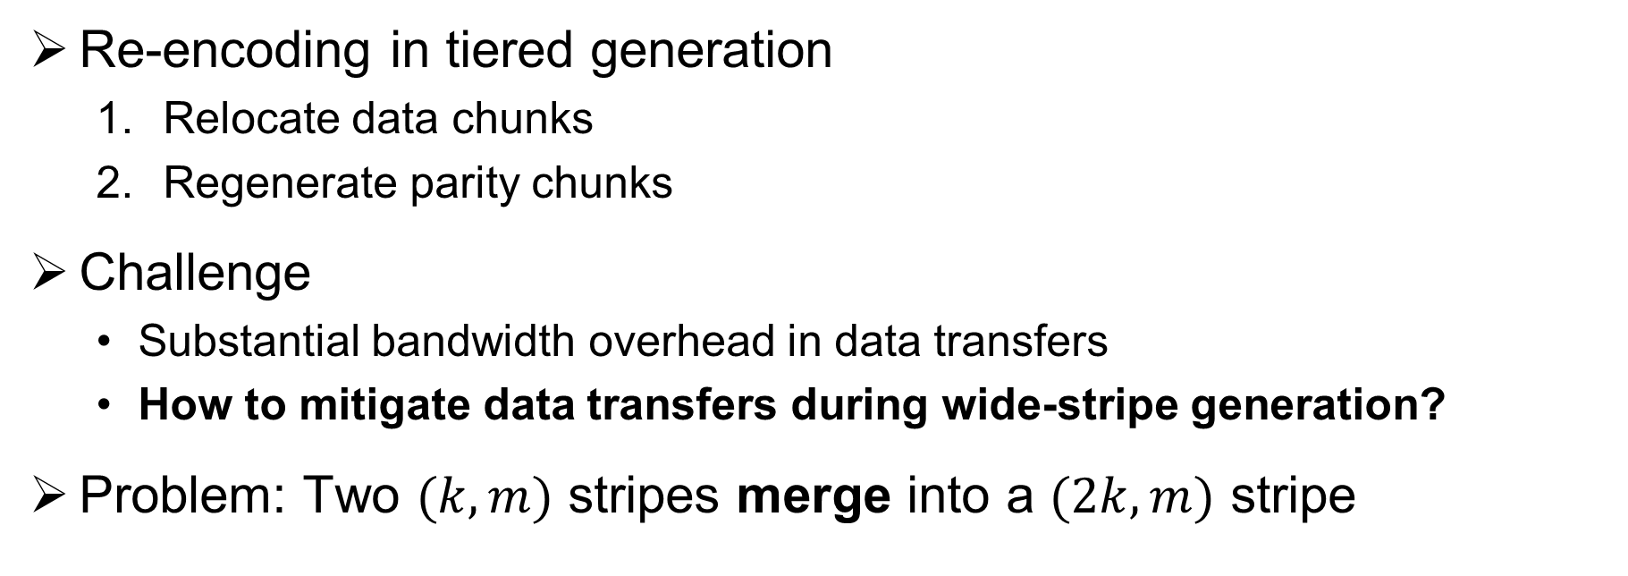
Problem
Re-encoding in tiered generation
  Relocate data chunks
  Regenerate parity chunks
Challenge
  Substantial bandwidth overhead in data transfers
  How to mitigate data transfers during wide-stripe generation?
Problem: Two $(k,m)$ stripes merge into a $(2k,m)$ stripe
a
b
P₁
P₂
a
b
c
d
Q₁
Q₂
c
d
P₁’
P₂’
Notes:
However, xxx need to XXXX. And these operations may incur xxx.
And xxx. It is a challenge.
Now, we specifically target in this problem: XXX. It is illustrated in this figure.

Slide 5
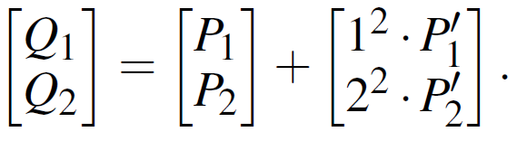
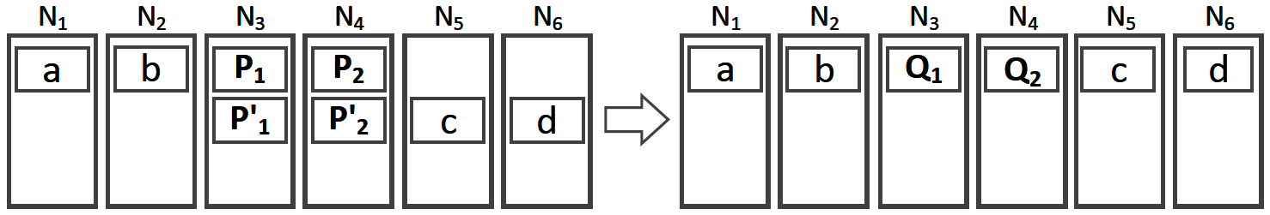
Perfect Merging
Generation without any transfer
  Idea: both data and parity chunks are locally generated
  Definition of Perfect Merging:
    Data chunks reside in different nodes
    Parity chunks have identical encoding coefficients and reside in the same nodes
  Insight: Vandermonde-based RS codes allow local generation of new parity chunks, by using old parity chunks as input
Notes:
So, we start to speculate that, is it possible to locally generate both data and parity chunks?
We found a case as shown below, if XXX, and XXX, we even do not need any transfer to finish a generation. We call it PM.
This idea is based on a key insight: XX
It is an important property for wide stripe generation.

Slide 6
Our Contributions
The first to address the wide-stripe generation problem
Model:
  Formulate this problem with bipartite graph model
  Prove the existence of an optimal scheme that exploits the perfect merging property, but it has prohibitive algorithmic complexity
Algorithm: StripeMerge
  A greedy heuristic algorithm that reduces the algorithmic complexity
  A parity-aligned heuristic algorithm that further enhances the former
Evaluation:
  Significantly reduces data transfers for wide stripe generation by up to 87.8% over a state-of-the-art storage scaling approach
Notes:
OK. Before stepping into the details, let’s glance what we had done.
We are xxxx.
We model the problem with Bipartite(baɪˈpɑːtaɪt) graph, making some formulation and proofs.
We design StripeMerge, which consists of two heuristic algorithm for the problem.
And in evaluation, we can see that our approach really works.

Slide 7
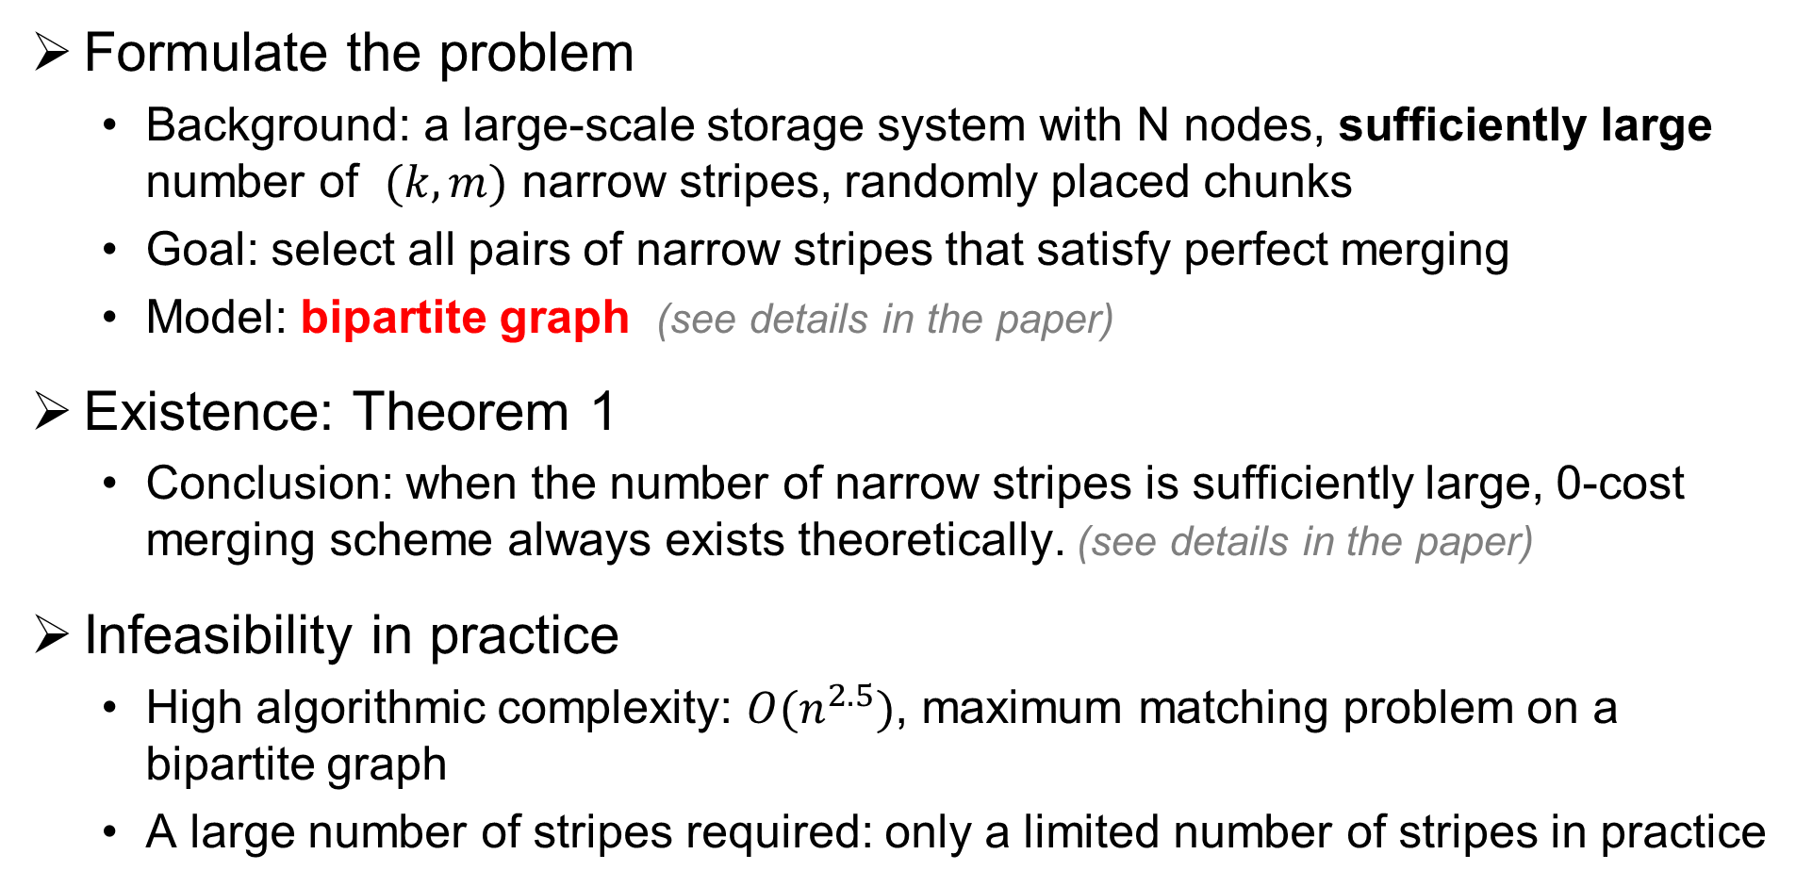
Bipartite Graph Model
Formulate the problem
  Background: a large-scale storage system with N nodes, sufficiently large number of $(k,m)$ narrow stripes, randomly placed chunks
  Goal: select all pairs of narrow stripes that satisfy perfect merging
  Model: bipartite graph (see details in the paper)
Existence: Theorem 1
  Conclusion: when the number of narrow stripes is sufficiently large, 0-cost merging scheme always exists theoretically. (see details in the paper)
Infeasibility in practice
  High algorithmic complexity: $O(n^{2.5})$, maximum matching problem on a bipartite graph
  A large number of stripes required: only a limited number of stripes in practice
Notes:
The model comes first. We formulate the wide stripe generation problem via bipartite(baɪˈpɑːtaɪt) graph modeling.
The details will not presented today.
But there’s one thing we can learn, is that xxx.
Well, interestingly, we find that there are some gaps between the theory and the reality.
Firstly, our problem can be transformed into a XXX, but its xxx may be an obstacle.
Secondly, it XXX, but XXx.

Slide 8
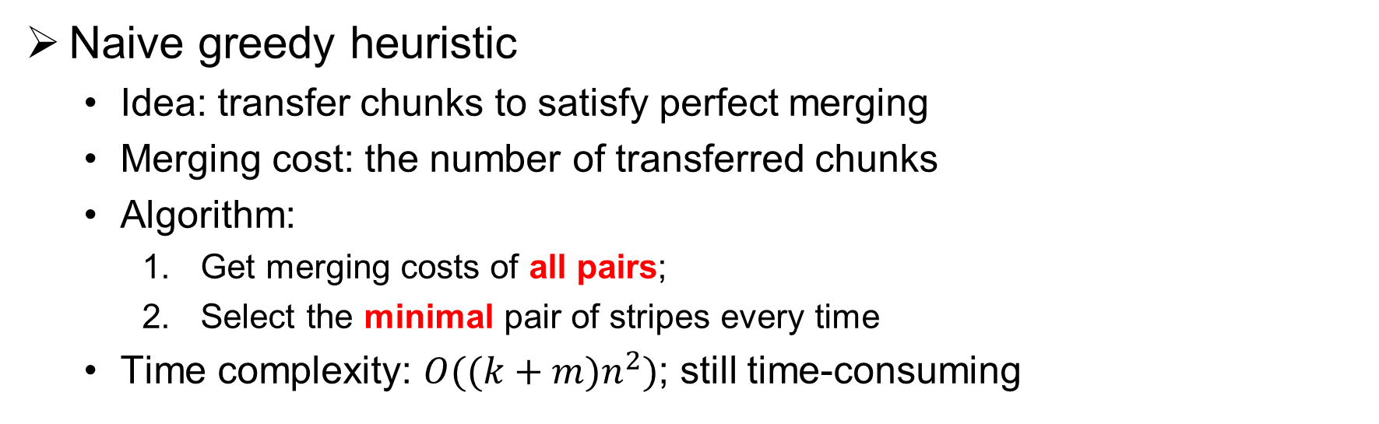
StripeMerge-G
Naive greedy heuristic
  Idea: transfer chunks to satisfy perfect merging
  Merging cost: the number of transferred chunks
  Algorithm:
    Get merging costs of all pairs;
    Select the minimal pair of stripes every time
  Time complexity: $O({(k+m)n}^{2})$; still time-consuming
cost=3
Notes:
OK, so time complexity seems like a major concern. But how about trying it in another way?
We decide to start from a XX.
We find that actually we can xxx, and then we will get the merging cost of this pair of stripes.
Here’s a simple algorithm: XXX.
We call it StripeMerge-G.
As you can see, the time complexity is lower to XX. But according to experiment, it XX in some cases.
So, Can we further improve the greedy heuristic?

Slide 9
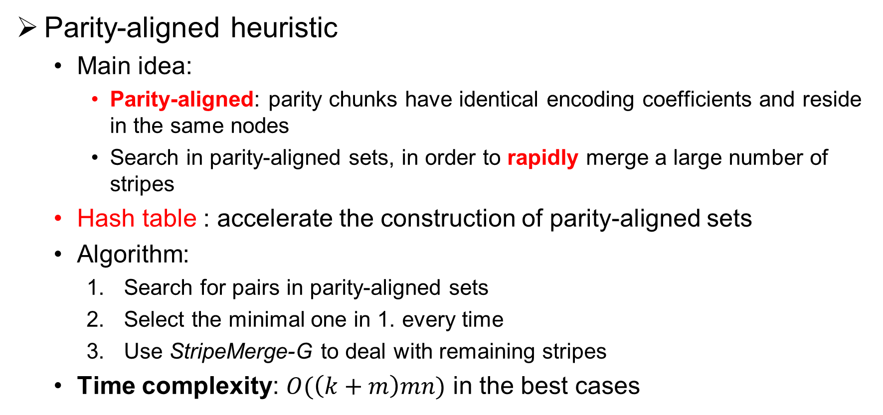
StripeMerge-P
Parity-aligned heuristic
  Main idea:
    Parity-aligned: parity chunks have identical encoding coefficients and reside in the same nodes
    Search in parity-aligned sets, in order to rapidly merge a large number of stripes
  Hash table : accelerate the construction of parity-aligned sets
  Algorithm:
    Search for pairs in parity-aligned sets
    Select the minimal one in 1. every time
    Use StripeMerge-G to deal with remaining stripes
  Time complexity: $O(\left(k+m\right)mn)$ in the best cases
  (see details in the paper)
Notes:
Sure. the parity-aligned property is the key. I mean, XXX.
Our main idea is to XX.
Additionally, xxx can help us XXX.
In this algorithm, we XXX.
We call it StripeMerge-P.
Then, we see that the algorithm can reduce the time complexity to XX.

Slide 10
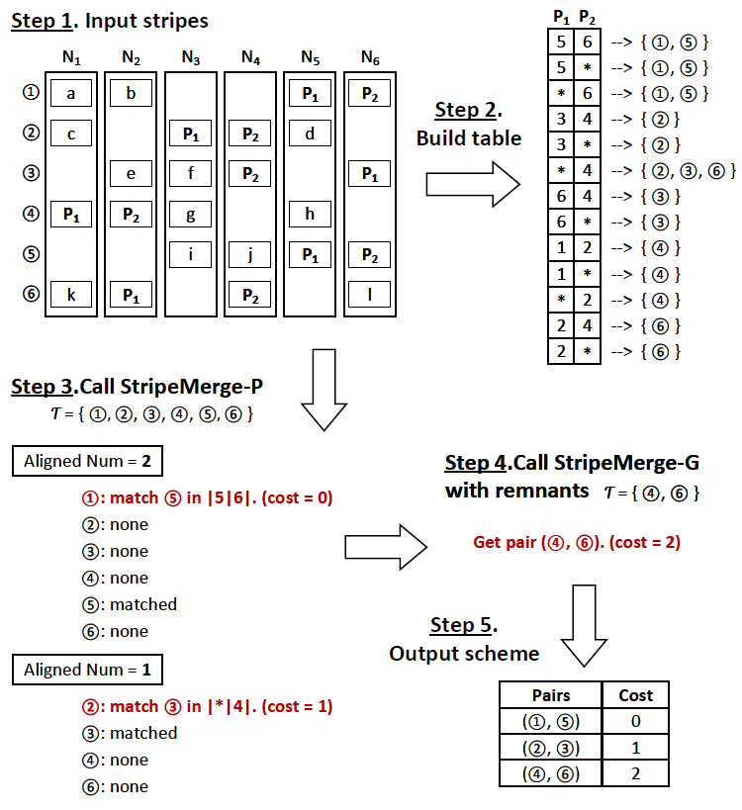
Example
Example of StripeMerge-P
  Get the stripes
  Build the hash table
  Call StripeMerge-P
  Call StripeMerge-G to deal with remaining stripes
  Get the scheme of merging narrow stripes into wide stripes
  (see details in the paper)
Notes:
Here’s an example of XXX.
It use 5 steps to get the scheme, but they will not be discussed here.
You can find more details in our paper.

Slide 11
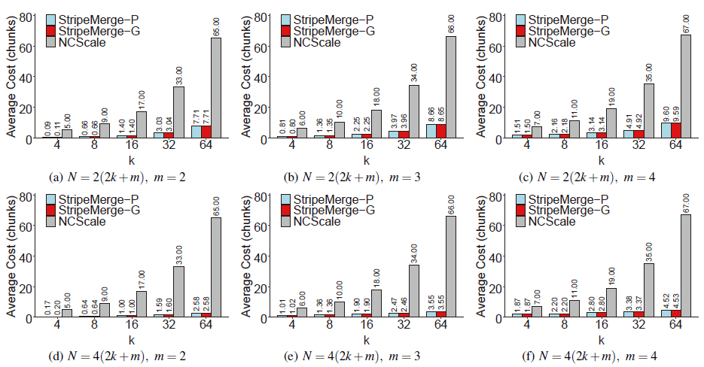
Evaluation - Simulations
  (see more in the paper)
  StripeMerge significantly reduces the wide-stripe generation bandwidth of the state-of-the-art storage scaling approach in all cases, up to 96%.
Notes:
Well, let’s check StripeMerge’s performance. As you can see, in simulations, XXX.

Slide 12
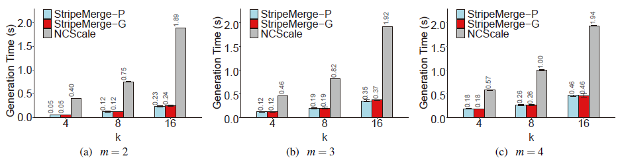
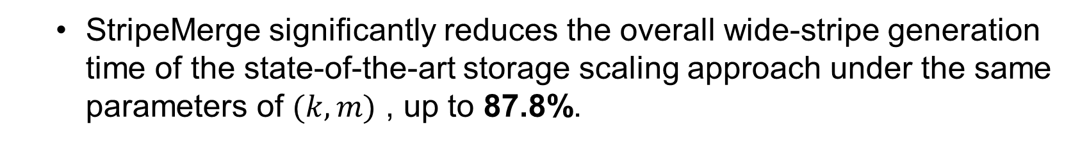
Evaluation - Experiments
  (see more in the paper)
  StripeMerge significantly reduces the overall wide-stripe generation time of the state-of-the-art storage scaling approach under the same parameters of $(k,m)$ , up to 87.8%.
Notes:
And it still maintains its advantage in experiments. More results of experiments are presented in the paper.

Slide 13
Conclusions
Propose StripeMerge, a novel mechanism that merges narrow stripes to efficiently generate wide stripes for large-scale erasure-coded storage
Prove the existence of an optimal scheme for wide-stripe generation via bipartite graph modeling
Two practical heuristics to realize efficient wide-stripe generation
Evaluations demonstrate the wide-stripe generation efficiency of StripeMerge over state-of-the-arts
Source code: https://github.com/yuchonghu/stripe-merge
Notes:
At last, we make a summary here. In this paper, we XXXX
Also our evaluations show its efficiency.
BTW, our source code is available on github now.

Slide 14
THANK YOU
  Contacts:
  Yuchong Hu yuchonghu@hust.edu.cn
  Patrick Lee pclee@cse.cuhk.edu.hk
  Qiaori Yao yaoqr@hust.edu.cn
Notes:
And that’s all for StripeMerge. Thanks for your watching! And welcome to follow our work.

