Slide 1
Toward Adaptive Disk Failure Prediction via Stream Mining
Shujie Han¹, Patrick P. C. Lee¹, Zhirong Shen²,
Cheng He³, Yi Liu³, and Tao Huang³
¹The Chinese University of Hong Kong
²Xiamen University ³Alibaba Group
Notes:
Hi, I am Shujie Han from The Chinese University of Hong Kong. I am going to present the work Toward Adaptive Disk Failure Prediction via Stream Mining.
This is a joint work with folks from Xiamen University and Alibaba Group.

Slide 2
Background
Challenges of modern data centers (DCs)
  Disk failures are prevalent
  Correlated disk failures lead to data loss and unavailable services
  Traditional redundancy mechanisms (e.g., replication, RAID) are insufficient for strong reliability guarantees
Proactive fault tolerance
  Predict imminent disk failures before actual failures happen based on machine learning
  Data: disk logs from SMART (Self-Monitoring, Analysis and Reporting Technology)
Notes:
Modern cloud-scale data centers are typically composed of thousands to millions of disks. In large-scale of disk deployment, disk failures are prevalent.
More severely, correlated disk failures can lead to data loss and unavailable services.
Thus, traditional redundancy mechanisms are no longer sufficient for providing strong reliability guarantees.
Prior studies have explored the proactive fault tolerance mechanism to predict imminent disk failures before the actual failures happen based on machine learning algorithms.
Such algorithms capture disk logs with performance and reliability statistics as the training data from a set of disks with known disk status.

Slide 3
Motivation
Existing disk failure prediction schemes are mostly offline
  All training data must be available before training any prediction model
In practice
  Disk logs are continuously generated from disks over time
  Disk population is enormous in production environments
Infeasible to keep all past data for training in a long-term use
Notes:
Existing disk failure prediction schemes are mostly offline, meaning that all training data must be available before training any prediction model.
However, in practice, disk logs are continuously generated from disks over time.
Also, the disk population is in the enormous scale in production environments.
Thus, it is infeasible to keep all past data for training in a long-term use.

Slide 4
Motivation
How to generalize online disk failure prediction for various machine learning algorithms?
  Impractical to identify the “best” learning algorithm for all disk models
  Concept drift: statistical patterns of disk logs vary over time
    Due to aging of disks, or addition/removals of disks in production
  Difficult to identify proper window size of samples for training
    Too few samples → insufficient samples to build an accurate prediction model
    Too many samples → old samples cannot capture current failure characteristics
Notes:
Also, how to generalize online disk failure prediction for various machine learning algorithms.
First, it is impractical to identify the “best” learning algorithm for all disk models.
Second, a phenomenon, namely concept drift, means that the statistical patterns of disk logs are varying over time due to the aging of disks, or the addition/removals of disks in production.
This implies that we must carefully identify the proper window size of samples for training:
If we choose too few samples, we have insufficient samples to build an accurate prediction model;
otherwise, the prediction model is disturbed by old samples which no longer correctly capture the current failure characteristics.

Slide 5
Our Contributions
StreamDFP, a general stream mining framework for disk failure prediction
  Complete design and prototype
Extensive measurement study on 5 SMART datasets
  Existence of concept drift
  Variations of concept drift across healthy/failed disks, disk models, and SMART attributes
Evaluation of 9 decision-tree-based algorithms on 5 datasets
  Improve F1-score by 26.8-53.2% through concept-drift adaptation
  Fast stream processing
Notes:
Our contributions are as follows:
We propose StreamDFP, a general stream mining framework for disk failure prediction with the complete design and prototype.
We also conduct an extensive measurement study on 5 SMART datasets to demonstrate the existence of concept drift and the variations of concept-drift existence across healthy/failed disks, disk models, and SMART attributes.
We finally evaluate both prediction accuracy and stream processing performance of 9 decision-tree-based algorithms on 5 datasets.

Slide 6
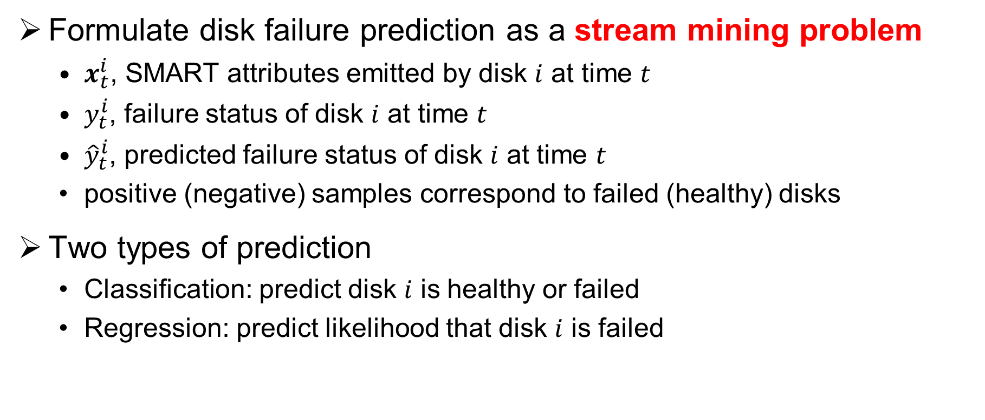
Disk Failure Prediction
Formulate disk failure prediction as a stream mining problem
  $x_{t}^{i}$, SMART attributes emitted by disk $i$ at time $t$
  $y_{t}^{i}$, failure status of disk $i$ at time $t$
  ${\hat{y}}_{t}^{i}$, predicted failure status of disk $i$ at time $t$
  positive (negative) samples correspond to failed (healthy) disks
Two types of prediction
  Classification: predict disk $i$ is healthy or failed
  Regression: predict likelihood that disk $i$ is failed
Notes:
We formulate disk failure prediction as a stream mining problem.
We introduce the following notations.
$x_{t}^{i}$ is SMART attributes emitted by disk $i$ at time $t$.
$y_{t}^{i}$ is failure status of disk $i$ at time $t$.
${\hat{y}}_{t}^{i}$ is predicted failure status of disk $i$ at time 𝑡.
Positive and negative samples correspond to failed and healthy disks, respectively.
We consider two types of prediction, classification and regression.
For classification, we predict if a disk is healthy or failed;
for regression, we predict the likelihood that a disk is failed.

Slide 7
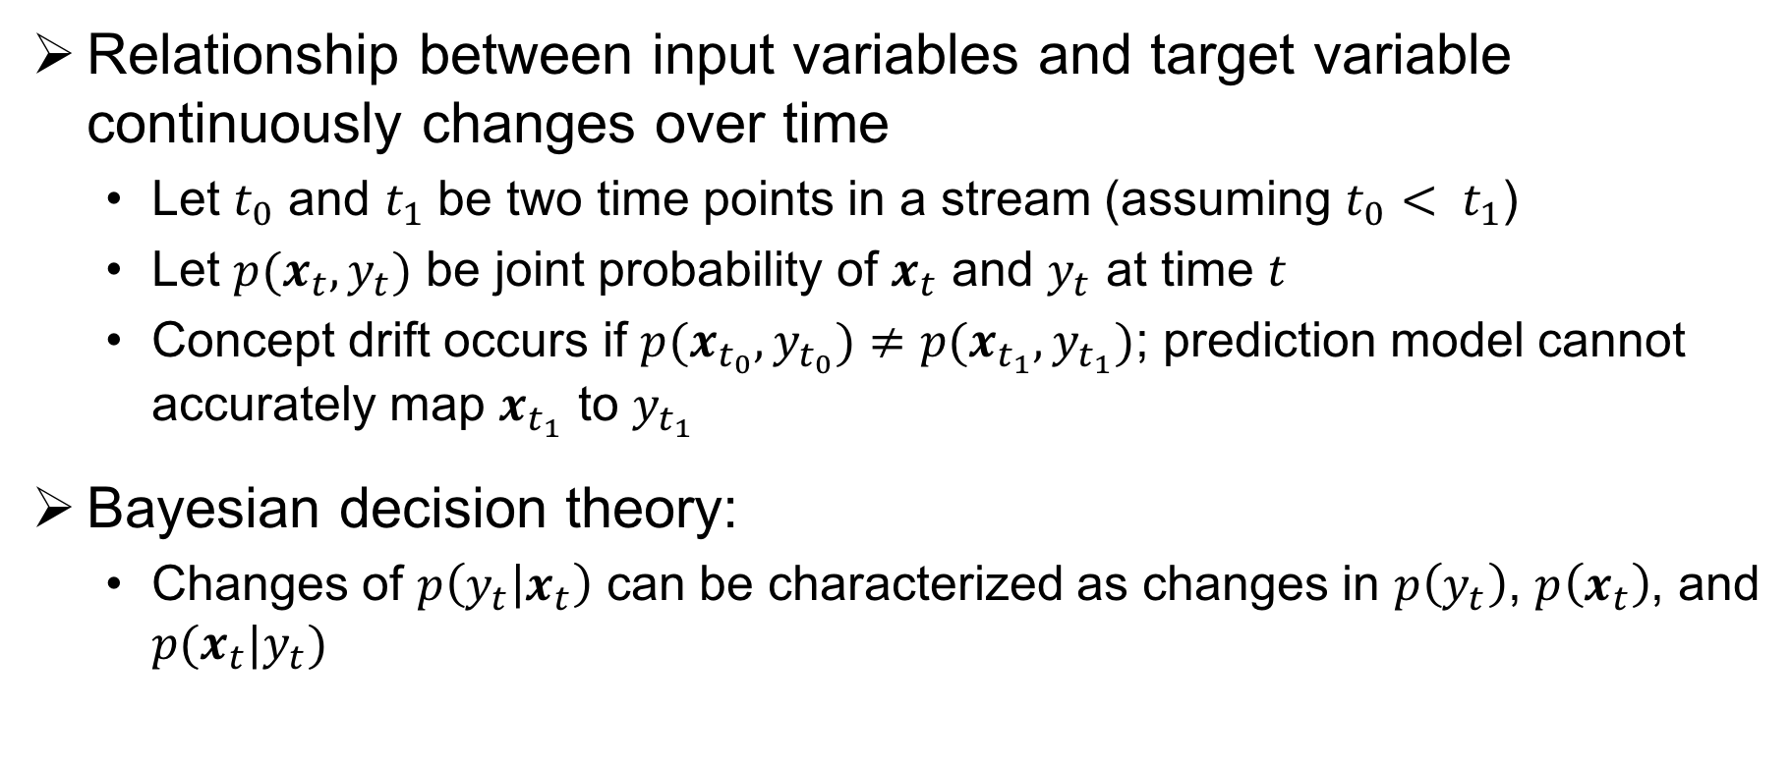
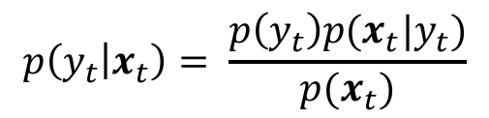
Concept Drift
Relationship between input variables and target variable continuously changes over time
  Let $t_{0}$ and $t_{1}$ be two time points in a stream (assuming $t_{0}< t_{1}$)
  Let $p(x_{t},y_{t})$ be joint probability of $x_{t}$ and $y_{t}$ at time $t$
  Concept drift occurs if $p(x_{t_{0}},y_{t_{0}})≠p(x_{t_{1}},y_{t_{1}})$; prediction model cannot accurately map $x_{t_{1}}$ to $y_{t_{1}}$
Bayesian decision theory:
  Changes of $p\left(y_{t} | x_{t}\right)$ can be characterized as changes in $p\left(y_{t}\right)$, $p\left(x_{t}\right)$, and $p(x_{t}|y_{t})$
$$p\left(y_{t} | x_{t}\right)= \frac{p\left(y_{t}\right)p(x_{t}|y_{t})}{p(x_{t})}$$
Notes:
Concept drift is the phenomenon that the relationship between the input variables and target variable continuously changes over time.
Let $t_{0}$ and $t_{1}$ be two time points in a stream (assuming $t_{0}< t_{1}$)
Let $p(x_{t},y_{t})$ be the joint probability of $x_{t}$ and $y_{t}$ at time $t$.
Concept drift occurs if the joint probability at$t_{0}$ is not equal to that at $t_{1}$; the prediction model can no longer accurately map $x_{t_{1}}$ to $y_{t_{1}}$.
Based on the Bayesian decision theory,
The change of $p\left(y_{t} | x_{t}\right)$ can be characterized as the changes in $p\left(y_{t}\right)$, $p\left(x_{t}\right)$, and $p(x_{t}|y_{t})$.

Slide 8
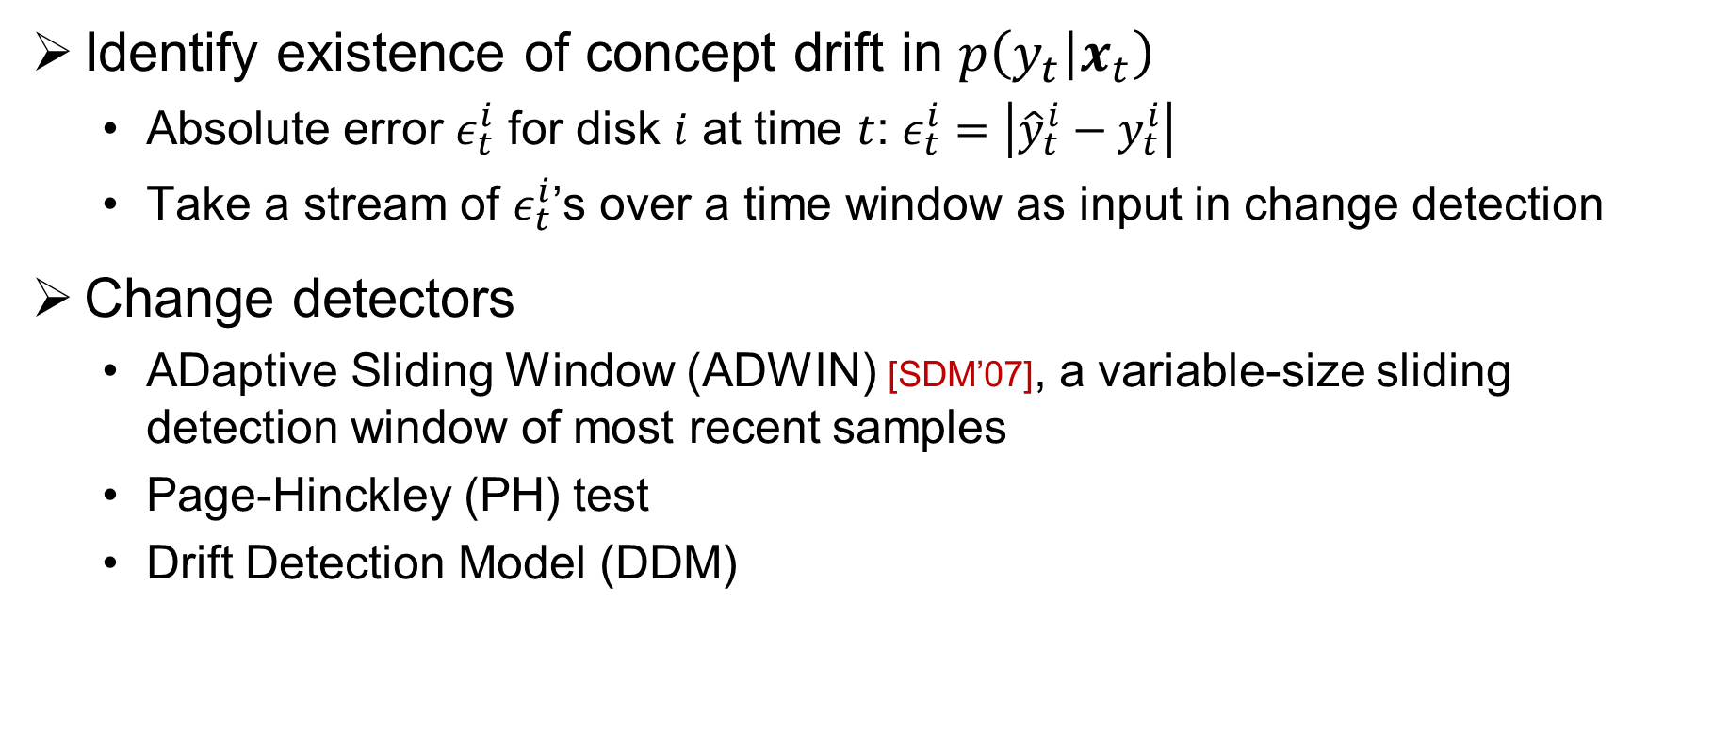
Change Detection
Identify existence of concept drift in $p\left(y_{t} | x_{t}\right)$
  Absolute error $ε_{t}^{i}$ for disk $i$ at time $t$: $ε_{t}^{i}=\left|{\hat{y}}_{t}^{i}−y_{t}^{i}\right|$
  Take a stream of $ε_{t}^{i}$’s over a time window as input in change detection
Change detectors
  ADaptive Sliding Window (ADWIN) [SDM’07], a variable-size sliding detection window of most recent samples
  Page-Hinckley (PH) test
  Drift Detection Model (DDM)
Notes:
We perform change detection in stream mining to identify the existence of concept drift in $p\left(y_{t} | x_{t}\right)$.
We define the absolute error, denoted by $ε_{t}^{i}$ for disk $i$ at time $t$, as the absolute difference between the predicted and true output for disk i at time t.
We take a stream of $ε_{t}^{i}$’s over a time window as input in change detection.
We apply different change detectors.
For example, ADWIN keeps a variable-size sliding detection window of the most recent samples to monitor whether a change happens.
If so, ADWIN drops the older sub-window and replaces the detection window with the newer sub-window.
Other change detectors include the Page-Hinckley test, and the Drift Detection Model.

Slide 9
Incremental Learning Algorithms
State-of-the-art algorithms based on decision trees
Category | Algorithm | Change detector
Classification tree | Hoeffding tree (HT) | None
 | Hoeffding adaptive tree (HAT) | ADWIN
Regression tree | Fast incremental model trees with drift detection (FIMT-DD) | PH test
Ensemble learning | Oza’s bagging (Bag) | None
 | Oza’s boosting (Boost) | None
 | Online random forests (RF) | None
 | Bagging with ADWIN (BA) | ADWIN
 | Boosting-like online ensemble (BOLE) | DDM
 | Adaptive random forests (ARF) | ADWIN
Notes:
The incremental learning algorithms perform prediction on an input data stream and continuously update the prediction model using the labeled samples.
This table summarizes 9 state-of-the-art incremental learning algorithms that we consider.
Such algorithms all build on decision trees to train the prediction model for classification and regression.
We classify the algorithms into two categories: single decision tree including classification and regression tree, as well as ensemble learning.
Instead of advocating a specific incremental learning algorithm for prediction, whose effectiveness highly varies across disk brands and models,
we focus on supporting general incremental learning algorithms for disk failure prediction.

Slide 10
Datasets
Overview of datasets
Dataset ID | Disk model | Capacity | Disk count | # failures | Period | Duration (months)
D1 | Seagate ST3000DM001 | 3 TB | 4,516 | 1,269 | 2014-01-31 to 2015-10-31 | 21
D2 | Seagate ST4000DM000 | 4TB | 37,015 | 3,275 | 2013-05-10 to 2018-12-31 | 68
D3 | Seagate ST12000NM0007 | 12TB | 35,462 | 740 | 2017-09-06 to 2019-06-30 | 22
D4 | Hitachi HDS722020ALA330 | 2TB | 4,601 | 226 | 2013-04-10 to 2016-12-31 | 45
D5 | Private disk model of Alibaba Cloud | 6TB | ~250 K | ~1,000 | 2019-01-01 to 2019-05-31 | 5
Notes:
Our analysis builds on 5 SMART datasets collected from two independent sources as shown in this table.
The datasets are diverse across disk models, manufacturers, and production environments.
The first group of datasets is collected from Backblaze including D1 to D4 which are among the largest disk populations with the highest disk failure rates.
The remaining dataset, D5 is a private disk model of Alibaba Cloud, with around 250 K disks, which are at least 6 times as many as D2 and D3.

Slide 11
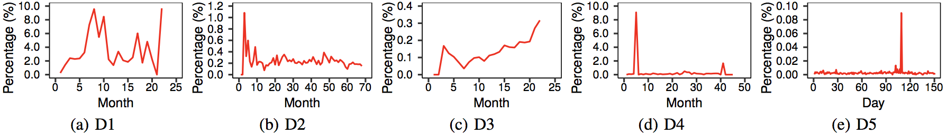

Measurement Analysis
Measurement of concept drift
  Measure changes of $p\left(y_{t}\right)$, $p\left(x_{t}\right)$, and $p(x_{t}|y_{t})$
Measurement of $p\left(y_{t}\right)$
  Percentages of failed disks (i.e., $y_{t}^{i}=1$) highly oscillate over time
Notes:
We study the existence of concept drift in each dataset and measure the changes of each of the three components to motivate the need of adapting to the change of $p\left(y_{t} | x_{t}\right)$.
First, we measure the change of $p\left(y_{t}\right)$ by measuring the percentage of failed disks over time.
We observe that percentages of failed disks highly oscillates over time.
For example, the percentages of failed disks of D1 and D4 can reach as high as 9.7% and 9.1%, respectively; for D5, its daily percentage of failed disks ranges from 0 to 0.09%.
One main reason for the highly varying failure rates is that new disks are kept being added, or old disks are kept being retired, over the entire measurement span, so the number of healthy disks varies significantly.

Slide 12
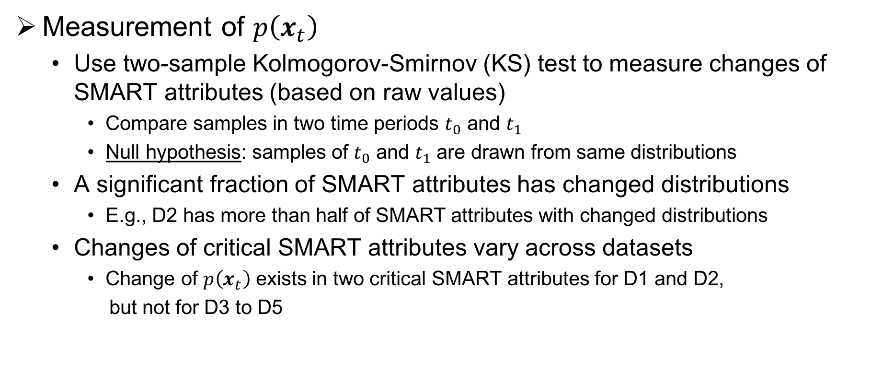
Measurement Analysis
Measurement of $p\left(x_{t}\right)$
  Use two-sample Kolmogorov-Smirnov (KS) test to measure changes of SMART attributes (based on raw values)
    Compare samples in two time periods $t_{0}$ and $t_{1}$
    Null hypothesis: samples of $t_{0}$ and $t_{1}$ are drawn from same distributions
  A significant fraction of SMART attributes has changed distributions
    E.g., D2 has more than half of SMART attributes with changed distributions
  Changes of critical SMART attributes vary across datasets
    Change of $p\left(x_{t}\right)$ exists in two critical SMART attributes for D1 and D2,
    but not for D3 to D5
Notes:
We next measure the change of $p\left(x_{t}\right)$ by using the two-sample KS test to measure the change of each SMART attribute.
Specifically, we compare the samples in two time periods $t_{0}$ and $t_{1}$ under the null hypothesis that the samples of $t_{0}$ and $t_{1}$ are drawn from the same probability distributions.
We see that a significant fraction of SMART attributes has changed distributions. For example, D2 has more than half of the SMART attributes with changed distributions.
Also, the changes of critical SMART attributes vary across the datasets.
For example, the change of $p\left(x_{t}\right)$ for D1 and D2 exists in two critical SMART attributes for most time periods,
while D3 to D5 do not show a change of $p\left(x_{t}\right)$ in all critical SMART attributes.

Slide 13
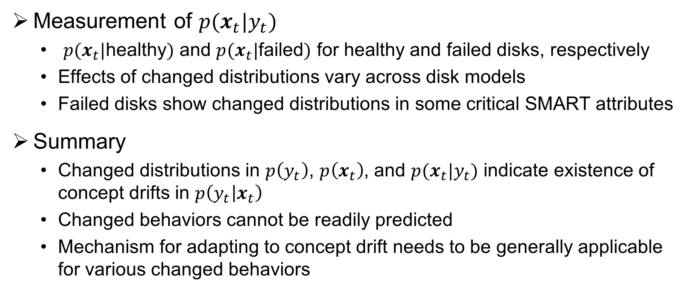
Measurement Analysis
Measurement of $p(x_{t}|y_{t})$
  $p(x_{t}|$healthy$)$ and $p(x_{t}|$failed$)$ for healthy and failed disks, respectively
  Effects of changed distributions vary across disk models
  Failed disks show changed distributions in some critical SMART attributes
Summary
  Changed distributions in $p\left(y_{t}\right)$, $p\left(x_{t}\right)$, and $p(x_{t}|y_{t})$ indicate existence of concept drifts in $p\left(y_{t} | x_{t}\right)$
  Changed behaviors cannot be readily predicted
  Mechanism for adapting to concept drift needs to be generally applicable for various changed behaviors
Notes:
We finally study the change of $p(x_{t}|y_{t})$. We consider two conditional probability distributions, $p(x_{t}|$healthy$)$ and $p(x_{t}|$failed$)$ for healthy and failed disks, respectively.
We see that the effects of changed distributions vary across disk models.
Also, failed disks generally show changed distributions in some critical SMART attributes.
To summarize,
The presence of changed distributions in the three components indicates that the concept drift also likely exists.
Also, the changed behaviors cannot be readily predicted, as they vary across healthy and failed disks, disk models, as well as SMART attributes.
Thus, the mechanism for adapting to concept drift needs to be generally applicable for various changed behaviors.

Slide 14
StreamDFP
A general stream mining framework for disk failure prediction with concept-drift adaptation
StreamDFP addresses following challenges:
  Online labeling
    Label samples on the fly based on current failure patterns
  Concept-drift-aware training
    Detect and adapt to concept drift in training
  General prediction
    Classification: answer if an unknown disk will remain healthy or will be failed
    Regression: determine likelihood that an unknown disk will fail
Notes:
We present the design of StreamDFP, a general stream mining framework for disk failure prediction with concept-drift adaptation.
StreamDFP aims to address the following challenges:
Online labeling. Unlike offline learning, it should accurately label the samples on the fly based on the current failure patterns.
Concept-drift-aware training. It should accurately detect and adapt to concept drift in training.
General prediction.
For classification, it should directly answer if an unknown disk will remain healthy or will be failed in near future.
For regression, it should determine the likelihood that an unknown disk will fail.

Slide 15
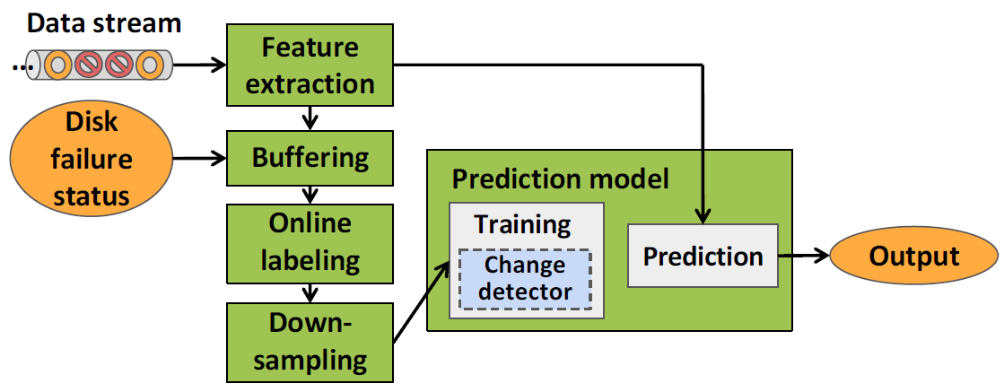
StreamDFP Architecture
Notes:
Let’s look at the architecture of StreamDFP.
Specifically, StreamDFP takes a stream of samples on each day as input. It extracts SMART attributes as learning features.
It configures a sliding window to buffer the recent samples and disk failure status, and then labels the disks on the fly.
It downsamples the negative samples and feeds the labeled samples into the prediction model for training.
With change detection enabled, StreamDFP detects concept drift explicitly during training and adapts the prediction model to concept drift.
In the prediction phase, it uses the prediction model to output the prediction results (for both classification and regression) for an unknown disk.

Slide 16
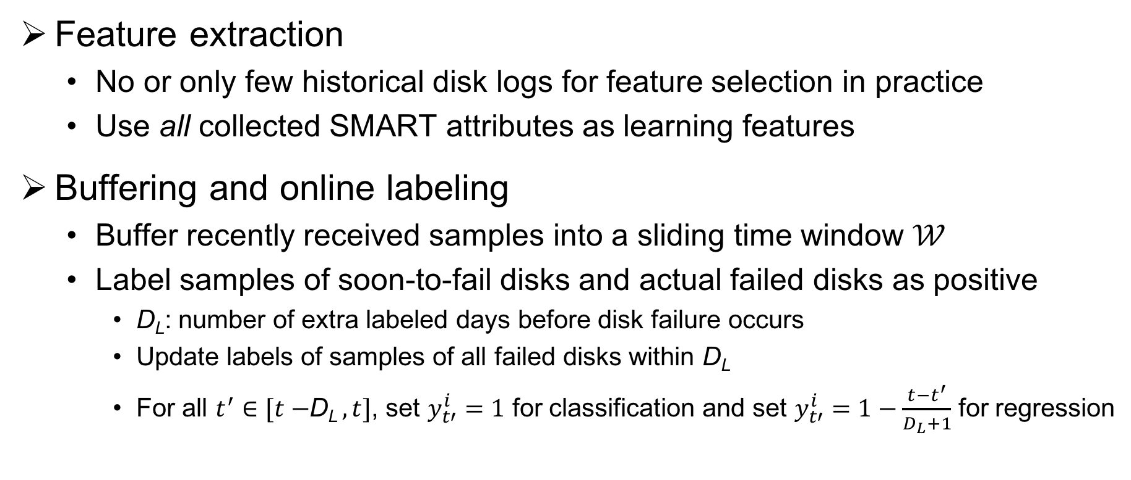
StreamDFP Design
Feature extraction
  No or only few historical disk logs for feature selection in practice
  Use all collected SMART attributes as learning features
Buffering and online labeling
  Buffer recently received samples into a sliding time window $𝒲$
  Label samples of soon-to-fail disks and actual failed disks as positive
    D_{L}: number of extra labeled days before disk failure occurs
    Update labels of samples of all failed disks within D_{L}
    For all $t^{′}∈[t−$D_{L}$, t]$, set $y_{t′}^{i}=1$ for classification and set $y_{t′}^{i}=1−\frac{t−t^{′}}{D_{L}+1}$ for regression
Notes:
Let’s go into the details of the design of StreamDFP.
Feature extraction.
In practice, we may have no or only few historical disk logs for feature selection.
Thus, we use all collected SMART attributes including raw and normalized values as learning features.
Buffering and online labeling.
StreamDFP needs to label the samples on the fly before feeding them into training.
To better reflect the disk failure characteristics, it buffers the recently received samples into a sliding time window and labels the samples of soon-to-fail disks and actual failed disks as positive.
In particular,
It configures the number of extra labeled days before the disk failure occurs, denoted by D_{L}
Then it updates the labels of the samples of all failed disks within D_{L}
Specifically, for classification, we set the target variables as one within D_{L}; for regression, we model the failure probability as a linear function that increases over time.

Slide 17
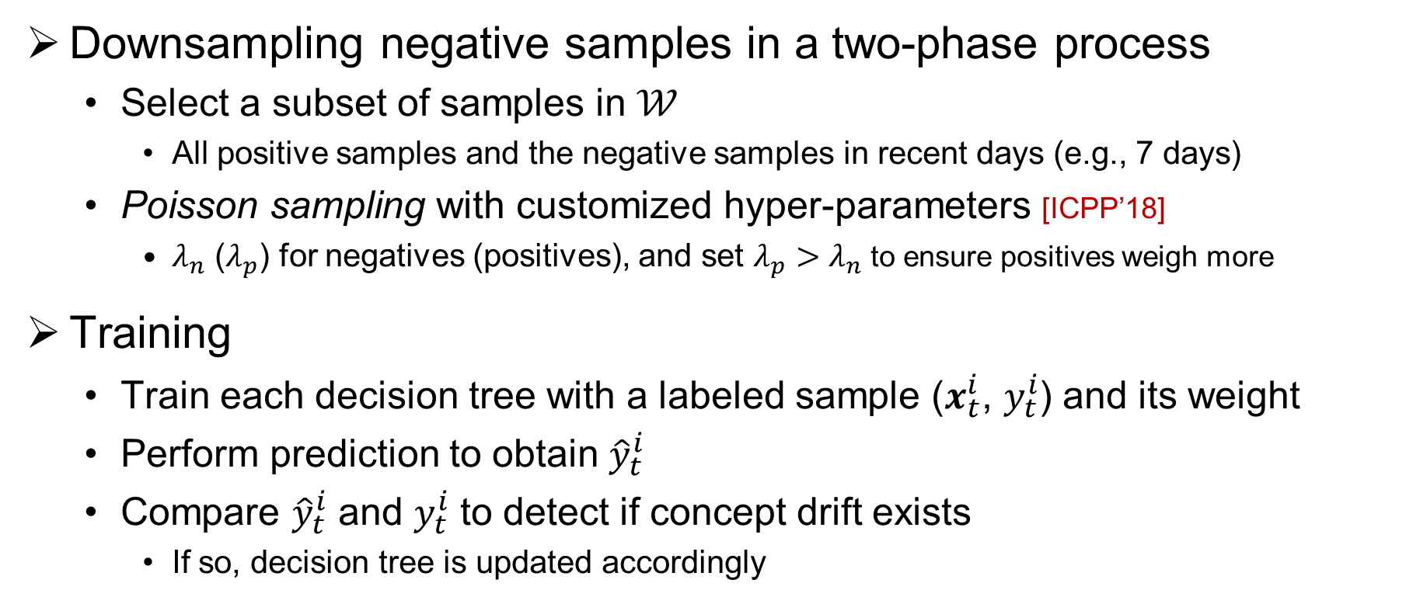
Design of StreamDFP
Downsampling negative samples in a two-phase process
  Select a subset of samples in $𝒲$
    All positive samples and the negative samples in recent days (e.g., 7 days)
  Poisson sampling with customized hyper-parameters [ICPP’18]
    $λ_{n}$ ($λ_{p}$) for negatives (positives), and set $λ_{p}>λ_{n}$ to ensure positives weigh more
Training
  Train each decision tree with a labeled sample ($x_{t}^{i}$, $y_{t}^{i}$) and its weight
  Perform prediction to obtain ${\hat{y}}_{t}^{i}$
  Compare ${\hat{y}}_{t}^{i}$ and $y_{t}^{i}$ to detect if concept drift exists
    If so, decision tree is updated accordingly
Notes:
To mitigate the data imbalance issue, in addition to labeling more samples as positive for soon-to-fail disks, StreamDFP downsamples the negative samples in a two-phase process.
It selects a subset of samples in the sliding window including all positive samples and the negative samples in the recent days.
It further downsamples the negative samples via Poisson sampling by assigning more weight to positive samples.
StreamDFP trains each decision tree associated with the change detector with a labeled sample and its weight.
Then it performs the prediction to obtain the predicted output.
It compares the predicted output and the true output to detect if concept drift exists.
If so, decision tree is updated accordingly based on incremental learning algorithms.

Slide 18
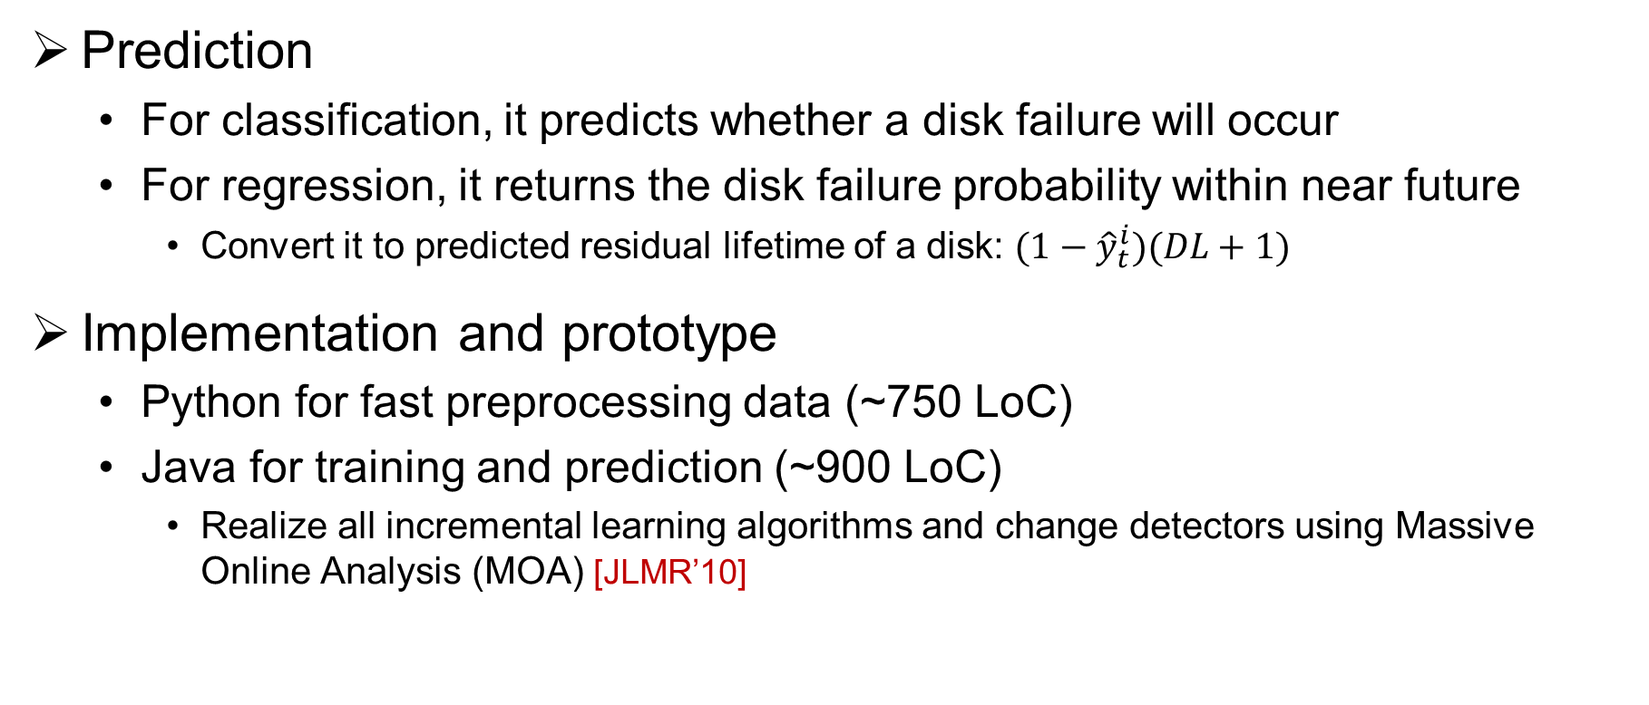
Design of StreamDFP
Prediction
  For classification, it predicts whether a disk failure will occur
  For regression, it returns the disk failure probability within near future
    Convert it to predicted residual lifetime of a disk: ${(1−\hat{y}}_{t}^{i})(DL+1)$
Implementation and prototype
  Python for fast preprocessing data (~750 LoC)
  Java for training and prediction (~900 LoC)
    Realize all incremental learning algorithms and change detectors using Massive Online Analysis (MOA) [JLMR’10]
Notes:
StreamDFP supports both classification and regression in prediction.
For classification, it predicts whether a disk failure will occur.
For regression, it returns the disk failure probability within near future. Also, we convert the predicted failure probability into the predicted residual lifetime of a disk by the product.
We implement StreamDFP with Python and Java for fast preprocessing data as well as training and prediction, respectively.
We realize all incremental learning algorithms and change detectors using MOA.

Slide 19
Evaluation
Methodology
  Warm-up prediction model from scratch using the first 30 days
  Predict disk failures in next 30 days on a daily basis
  Total durations of evaluation: 400 days for D1 to D4 and 90 days for D5
Metrics
  Classification
    Precision, recall, and F1-score
  Regression
    Average relative error of the residual lifetime (ARE)
Notes:
We conduct a trace-driven evaluation with the datasets.
For each dataset, we first warm up the prediction model from scratch using the first 30 days of samples.
We then predict disk failures in the next 30 days on a daily basis, and evaluate the accuracy for each day of prediction.
Thus, the total durations of evaluation last for 400 days for D1 to D4 and 90 days for D5.
Our evaluation addresses both classification and regression.
For classification, we consider the precision, recall, and F1-score.
For regression, we convert the disk failure likelihood into the number of days of residual lifetime for more intuitive evaluation. We report the average relative error of the residual lifetime.

Slide 20
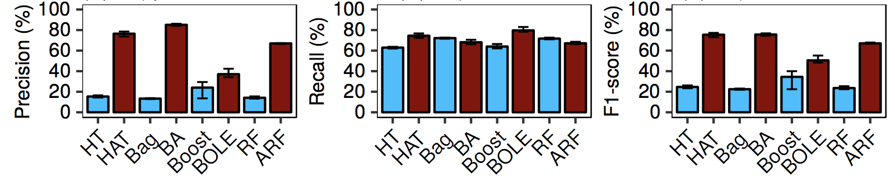
Evaluation
Effectiveness of concept-drift adaptation
  Evaluate eight algorithms for classification
    Four pairs before and after enabling concept-drift adaptation
  Take D2 as an example
    Concept-drift adaptation improves overall F1-score for each pair of algorithms by up to 53.2% and mainly improves precision
Notes:
We first evaluate the effectiveness of concept-drift adaptation.
We consider 8 algorithms for classification and divide the algorithms into four pairs corresponding to before and after enabling concept-drift adaptation.
Here, we take D2 as an example to show that concept-drift adaptation improves the overall F1-score for each pair of algorithms by up to 53.2% and mainly improves precision.

Slide 21
Evaluation
Sensitivity of extra labeled days (D2 as an example)
  Vary D_{L} from 0 to 30 days for BA, BOLE, and ARF
    Introducing extra labeled days (D_{L} > 0) increases prediction accuracy in general
    Optimal value of D_{L} varies across algorithms and datasets
Notes:
We next evaluate the sensitivity of extra labeled days.
We vary the extra labeled days D_{L} from 0 to 30 days for the three ensemble learning algorithms with concept-drift adaptation, i.e., BA, BOLE, and ARF.
We see that introducing extra labeled days increases the prediction accuracy in general.
Also, the optimal value of D_{L} varies across algorithms and datasets.
Thus, StreamDFP opts to allow users to flexibly tune D_{L} based on production needs.

Slide 22
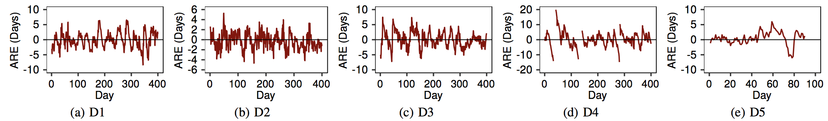
Evaluation
Accuracy of regression
  Evaluate ARE with FIMT-DD
    Predicted likelihood of disk failures is close to actual likelihood
      Means of ARE are -0.0014, -0.27, 0.13, 0.29, and 0.58 (in days)
    ARE for D4 is up to +20 days
      Failure symptoms (e.g., sector errors) for D4 last longer due to older average age
Notes:
We evaluate the accuracy of regression with the regression tree FIMT-DD.
We show that the predicted likelihood of disk failures is close to the actual likelihood since the means of ARE are close to zero.
On the other hand, the ARE for D4 is up to +20 days. The reason is that failure symptoms for D4 last longer than those for other disk models due to the older average age.

Slide 23
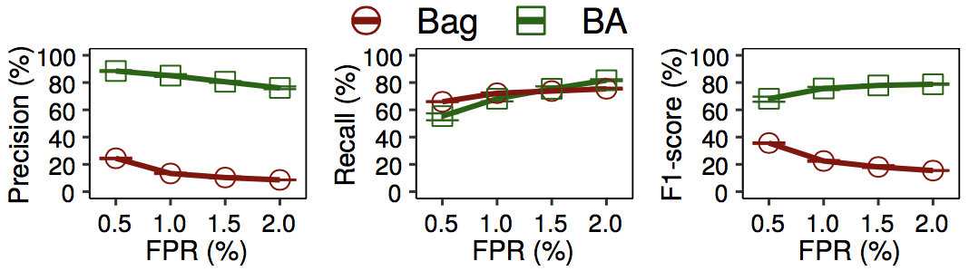
Evaluation
Impact of false positive rate (FPR) thresholds
  Prediction accuracy of Bag and BA for D2 vs. FPR threshold (0.5-2%)
    BA improves precision and F1-score significantly, while preserving recall
Notes:
We evaluate the impact of FPR thresholds by varying the FPR threshold from 0.5% to 2.0%.
We focus on D2 as the representative dataset and bagging (including Bag and BA) as the representative algorithms.
We see that BA improves the precision and F1-score significantly, while preserving the recall.

Slide 24
Evaluation
Execution performance
  Breakdown of per-day execution time for D2
  Standard deviations of all five runs are in brackets
  StreamDFP performs training and prediction within 13.5 seconds on daily SMART data of 37 K disks overall
Step | Feature extraction | Buffering | Online labeling | Downsampling | Training | Prediction
Time | 0.0055 s (0.069 ms) | 0.093 s (9.6 ms) | 0.42 s (30.8 ms) | 0.52 s (19.0 ms) | 10.6 s (0.75 s) | 1.9 s (0.14 s)
Notes:
We evaluate the stream processing performance of StreamDFP.
We show a breakdown of the per-day execution time for D2 with the standard deviations of five runs.
The most time-consuming step is training, as training has complicated computation in growing multiple trees with the samples in recent days.
Overall, StreamDFP performs training and prediction within 13.5 seconds on the daily SMART data of 37K disks.

Slide 25
Conclusion
StreamDFP is a general stream mining framework for disk failure prediction with concept-drift adaptation
  Prototype implementation of StreamDFP
Measurement study of concept-drift
  On 5 SMART datasets from Backblaze and Alibaba Cloud
Evaluation on prediction accuracy and processing performance
  Improve prediction accuracy significantly and support fast processing
Source code:
  http://adslab.cse.cuhk.edu.hk/software/streamdfp
Notes:
To conclude, we present StreamDFP, a general stream mining framework for disk failure prediction with concept-drift adaptation.
StreamDFP is motivated by the existence of concept drift, backed by our measurement study on 5 SMART datasets from Backblaze and Alibaba Cloud.
Our evaluation of 9 decision-tree-based algorithms shows that concept-drift adaptation improves the prediction accuracy significantly and StreamDFP supports fast processing performance.
We open-source our project for further research.

Slide 26
Thank You!
Q & A
Notes:
Thank you. I’d like to take your questions.

