Slide 1
Convergent Dispersal: Toward Storage-Efficient Security in a Cloud-of-Clouds
Mingqiang Li¹, Chuan Qin¹, Patrick P. C. Lee¹, Jin Li²
¹The Chinese University of Hong Kong, ²Guangzhou University
HotStorage ’14

Slide 2
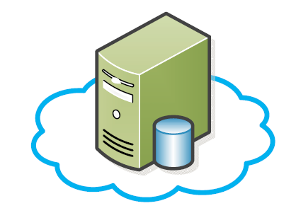
Single Cloud Problems
Single point of failure:
Vendor lock-in:
Costly Migration

Slide 3
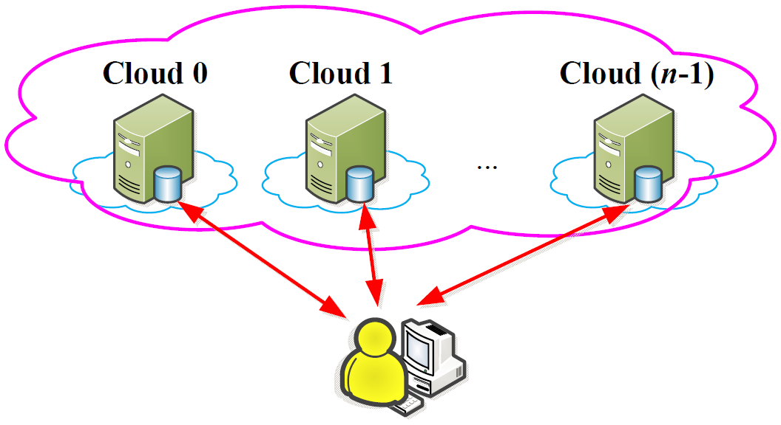
Cloud-of-Clouds
Exploits diversity of multiple cloud storage vendors:
Provides fault tolerance
Avoids vendor lock-in
Improves security
Notes:
Our work is applicable to general distributed storage systems.

Slide 4
Diversity → Security
Threat model: provides data confidentiality
Traditional encryption:
Encrypts data with a key and protects the key
Key management is challenging
Leveraging diversity:
Disperses data across multiple clouds
Data remains confidential even if a subset of clouds is compromised
Assumption: infeasible for attackers to compromise all clouds
Security is achieved without keys → keyless security

Slide 5
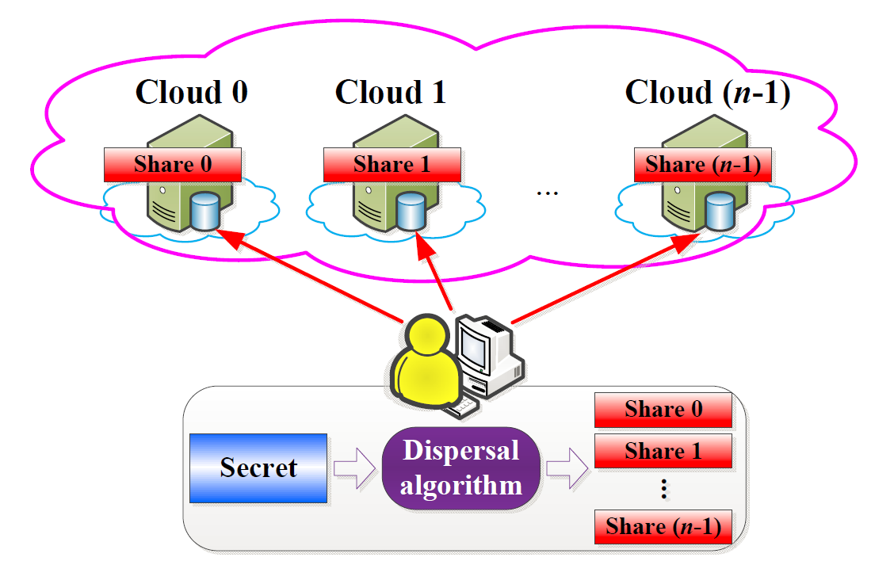
Keyless Security
Major building block: dispersal algorithm
Given a secret, outputs multiple shares
Secret remains inaccessible without enough shares

Slide 6
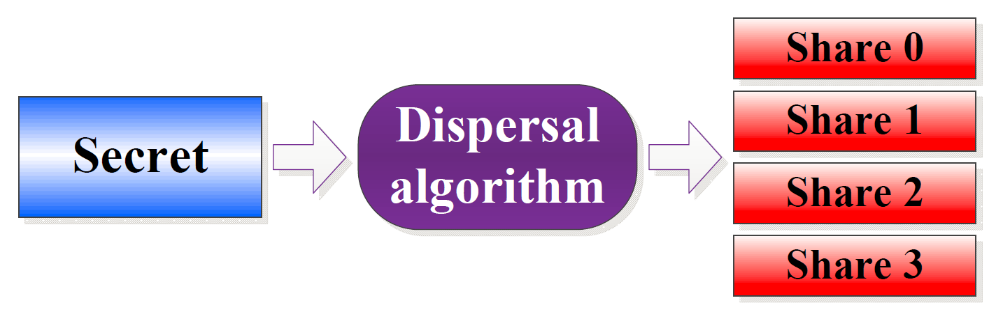
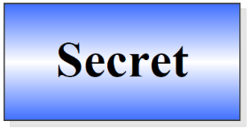
Dispersal Algorithm
(n, k, r) dispersal algorithm:
Secret is dispersed into n shares
Secret can be reconstructed from any k shares (k < n)
Secret cannot be inferred (even partially) from any r shares (r < k)
Example: (4, 3, 2)
Nothing!

Slide 7
State of the Art
Ramp secret sharing scheme (RSSS) [Blakley and Meadows, CRYPTO’84]
Combines Rabin’s information dispersal (r = 0) and Shamir’s secret sharing scheme (r = k-1)
Makes tradeoff between storage space and security
AONT-RS [Resch et al., FAST’11]
Combines all-or-nothing-transform and Reed-Solomon encoding
Main idea: embeds random information into dispersed data

Slide 8
Deduplication
Cloud storage uses deduplication to save cost
Deduplication avoids storing multiple data copies with identical content
Saves storage space
Saves write bandwidth
However, state-of-the-art dispersal algorithms break deduplication
Root cause: security builds on embedded randomness

Slide 9
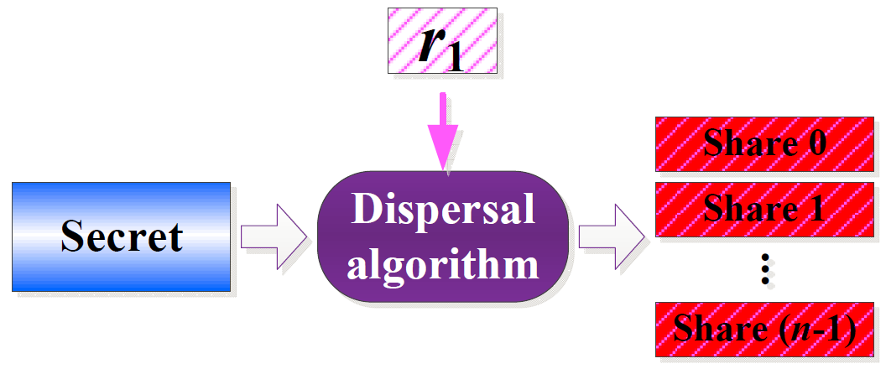
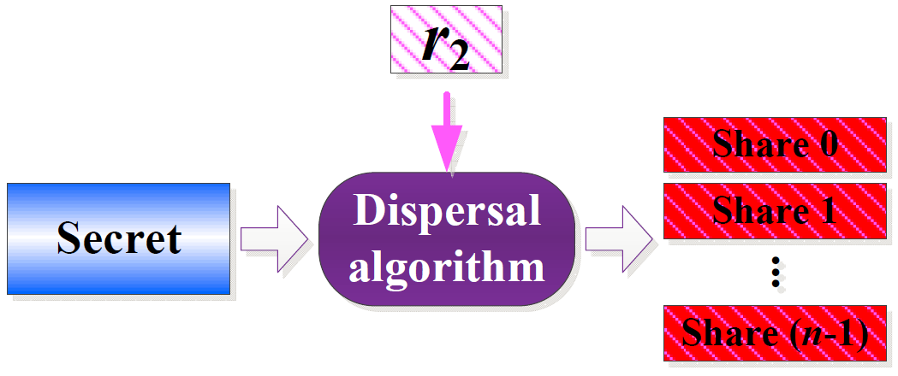
Deduplication
Random information
Identical content
Random information
Different shares!
Q: Can we preserve both deduplication and keyless security in dispersal algorithms?

Slide 10
Our Contributions
Convergent Dispersal: a data dispersal design that preserves both dedup and keyless security
Can be generalized for any distributed storage systems
Two implementations:
CRSSS: builds on RSSS [Blakley and Meadows, CRYPTO’84]
CAONT-RS: builds on AONT-RS [Resch et al., FAST’11]
Evaluation on computational performance
CRSSS and CAONT-RS are complementary in performance for different parameters
Best of CRSSS and CAONT-RS achieves ≥ 200MB/s

Slide 11
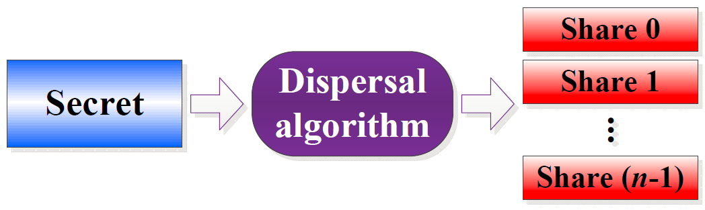
Key Idea
Inspired by convergent encryption [Douceur et al., ICDCS’02]
Key is derived from cryptographic hash of the content
Key is deterministic: same content → same ciphertext
Convergent dispersal:
Replace random information with secret’s hashes
Same secret → same shares

Slide 12
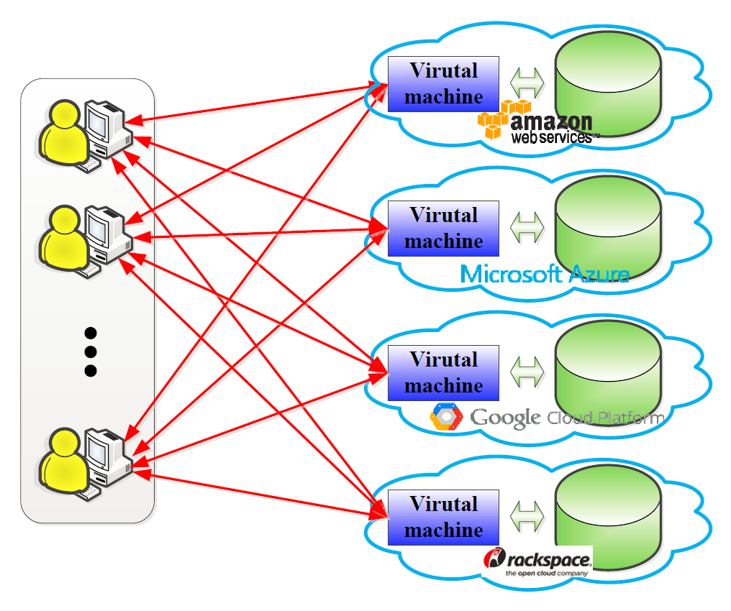
Deployment Scenario
Owned by organization
Organization
Single-user dedup before uploads
Cross-user dedup by VMs
Avoids cross-user dedup due to side-channel attacks [Harnik et al., IEEE S&P’10]
Notes:
Consider an organization in which users store their backup data in a cloud-of-clouds;
In each cloud, a virtual machine is rented by the organization for deduplication;
To reduce both storage and bandwidth overheads, each user deduplicates its own dispersed data by checking with each virtual machine for the existence of duplicate data;
But, cross-user deduplication should be avoided on the user side due to side-channel attacks;
Instead, cross-user deduplication can be performed by each virtual machine on the cloud side to achieve additional storage saving.

Slide 13
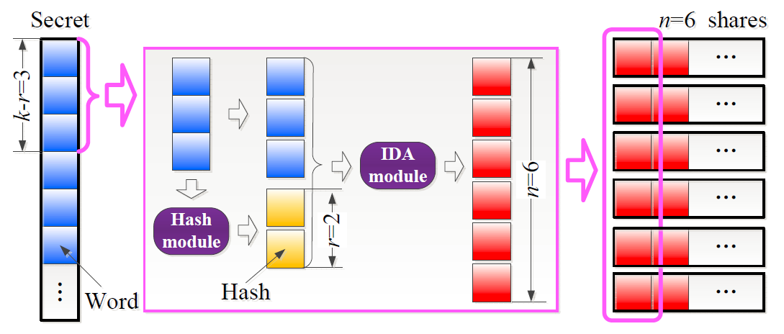
CRSSS
Example: n = 6, k = 5, r = 2
Replace r random words with r hashes
Notes:
To reduce computational overhead, hashes are generated from each group of k-r words of the secret rather than the whole secret

Slide 14
CRSSS
Generate r hashes from k-r secret words:
D = data block of the k-r secret words
i = index
H = cryptographic hash function (e.g., SHA-256)

Slide 15
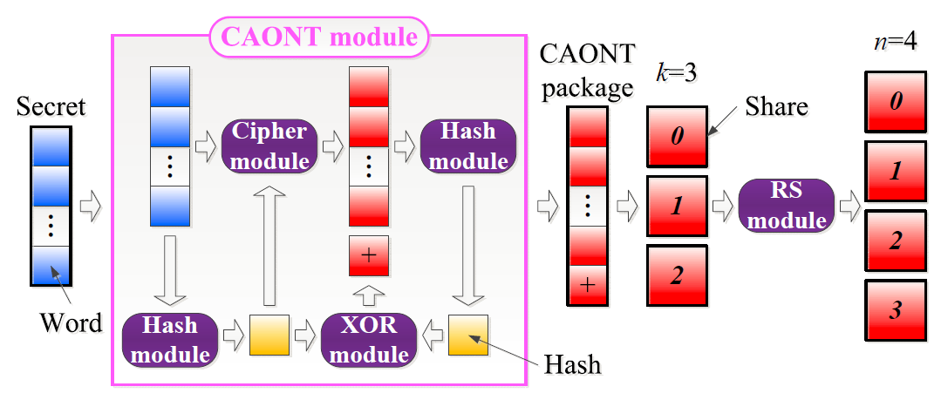
CAONT-RS
Example: n =4, k=3, r = k -1 = 2:
Replace the random key with a hash
Notes:
Nothing about the CAONT package can be inferred unless the whole package is obtained

Slide 16
CAONT-RS
Transform s secret words d₀, d₁, …, d_{s-1} into s+1 CAONT words c₀, c₁, …, c_{s}:
⊕ = XOR operator
h_{key} = hash key generated from the secret via a cryptographic hash function (e.g., SHA-256)
i = index
E = encryption function (e.g., AES-256)

Slide 17
Evaluation Setup
Evaluate the computational throughput of CRSSS and CAONT-RS
Setup:
OpenSSL for encryption (AES-256) and hash (SHA-256)
Jerasure [Plank, 2014] & GF-Complete [Plank, 2013] for encoding
Implementation in C
Compare:
RSSS vs. CRSSS
AONT-RS vs. CAONT-RS
CRSSS vs. CAONT-RS

Slide 18
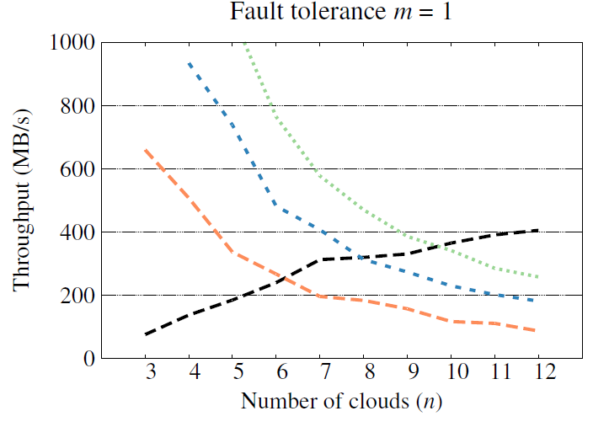
Evaluation
m = n - k
Notes:
Traditional dispersal algorithms with convergent dispersal

Slide 19
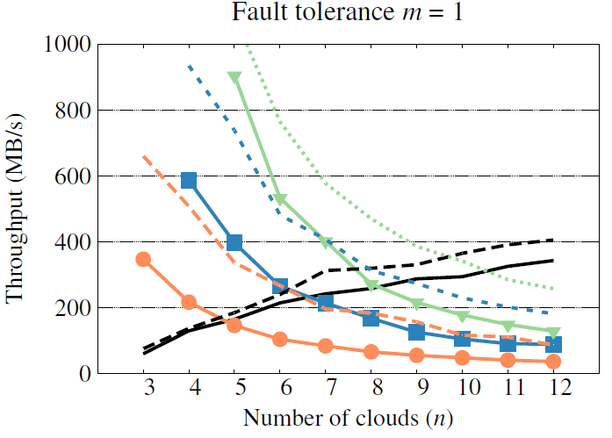
Evaluation
m = n - k
CRSSS has much higher overhead (~30%) than RSSS due to more hash computations; yet, CAONT-RS has limited overhead (~8%) over AONT-RS

Slide 20
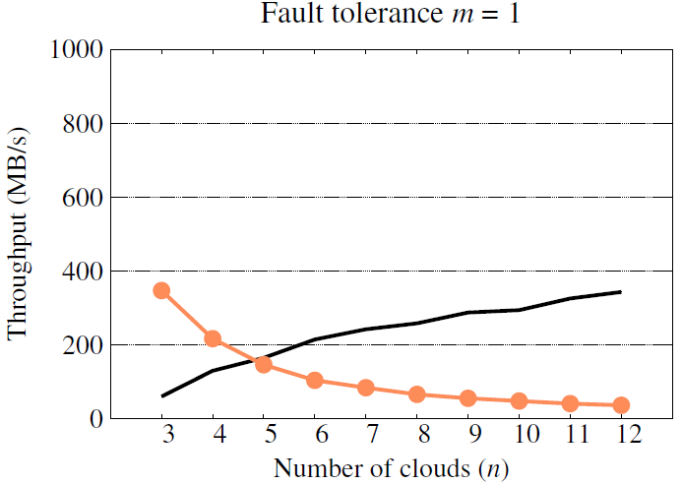
Evaluation
m = n - k
CRSSS and CAONT-RS are complementary in performance: CRSSS decreases in throughput due to more hashes, while CAONT-RS increases in throughput due to RS encoding

Slide 21
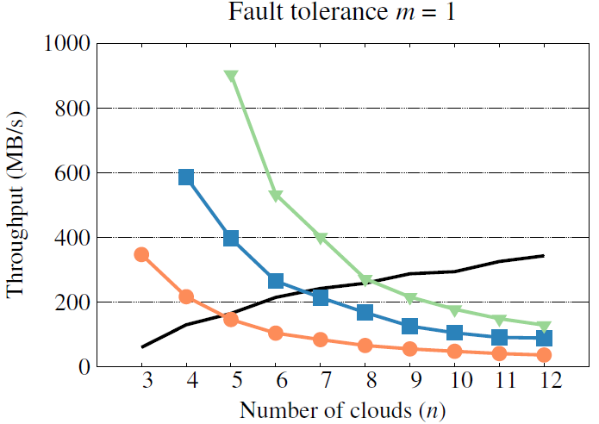
Evaluation
m = n - k
For smaller r, CRSSS achieves much higher throughput (>400MB/s), but with higher storage overhead → tradeoff between throughput and storage

Slide 22
Conclusions
Defines a framework of convergent dispersal that enables keyless security and deduplication
Two implementations based on state-of-the-art: CRSSS and CAONT-RS
Both are complementary in performance
Future work:
Complete cloud storage prototype
Cost-performance analysis
Security analysis
Evaluation in real-world deployment

