Slide 1
ELECT: Enabling Erasure Coding Tiering for LSM-tree-based Storage
Yanjing Ren¹, Yuanming Ren¹, Xiaolu Li², Yuchong Hu², Jingwei Li³, Patrick P. C. Lee¹
¹The Chinese University of Hong Kong ²Huazhong University of Science and Technology ³University of Electronic Science and Technology of China
USENIX FAST 2024

Slide 2
Brief Introduction of ELECT
ELECT: a distributed KV store that enables erasure coding tiering
LSM-tree-based redundancy transitioning
Hotness-aware redundancy transitioning and cold data offloading
Balancing storage-performance trade-off
Extensive experiments:
56.1% less hot-tier storage overhead over Cassandra
Similar performance in normal read/write operations
Reproducible on Chameleon Cloud

Slide 3
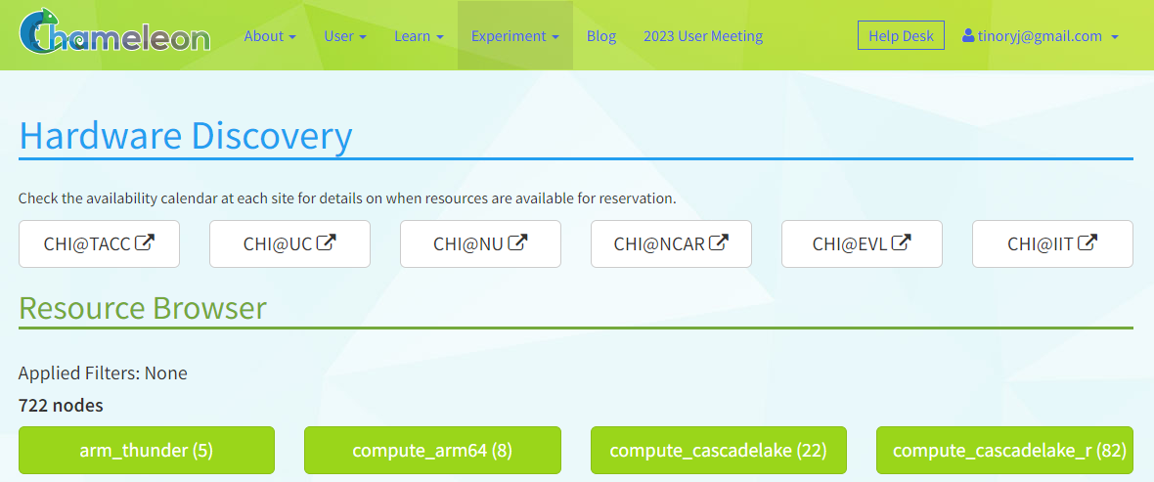
Chameleon Cloud
Chameleon Cloud provides bare metal access to heterogeneous cloud resources
Hardware: InfiniBand; NVMe; GPU; FPGA; Xeon/ARM processors…
Networking: Isolated layer-2 networks; SDN; OpenFlow…
Managed by different sites
Browser to find appropriate nodes

Slide 4
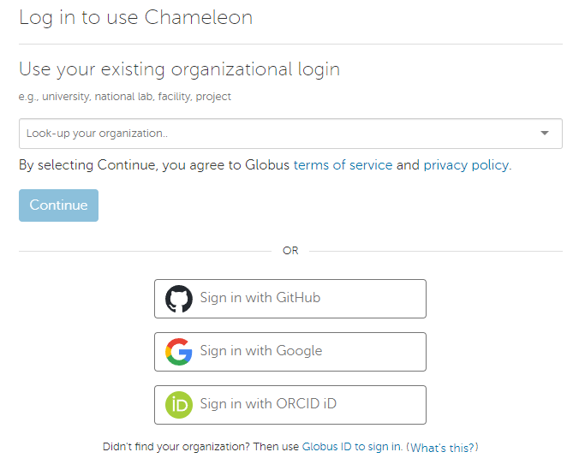
Registration and Sign-in
Chameleon Cloud supports various registration/sign-in methods
Google
ORCID
GitHub
…

Slide 5
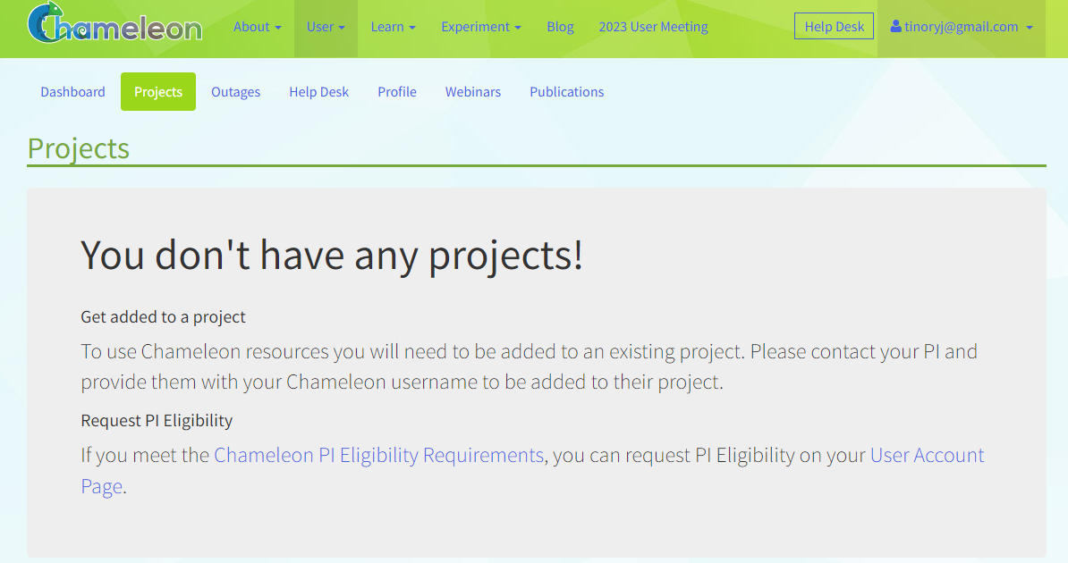
Access to Hardware
Hardware resources are available only if you have a qualified project
Ask the project owner to invite you via your email
Request PI eligibility and create a new project

Slide 6
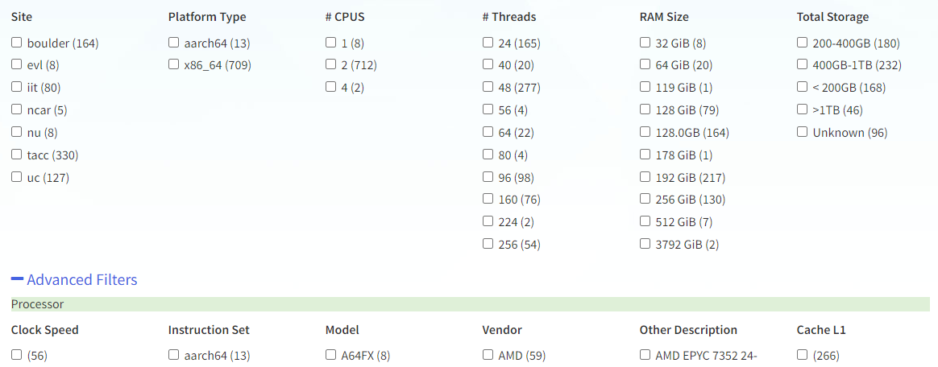
Selecting Hardware
Find specific hardware in “Experiment$→$Hardware Discovery”
Step 1: Find hardware with filters on platform/CPU/RAM/storage/network
Step 2: Find the site where the node you want is located
Note for Step 2:
Each site is independent of each other

Slide 7
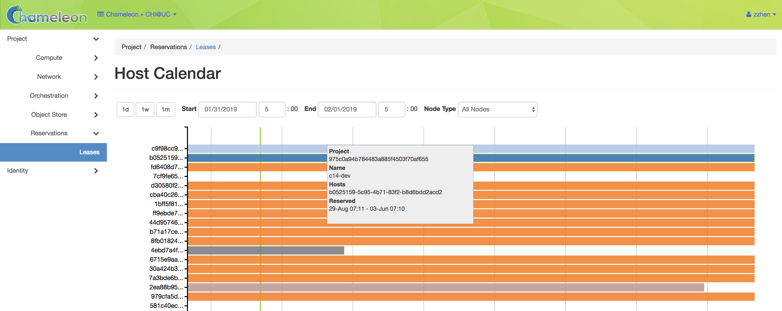
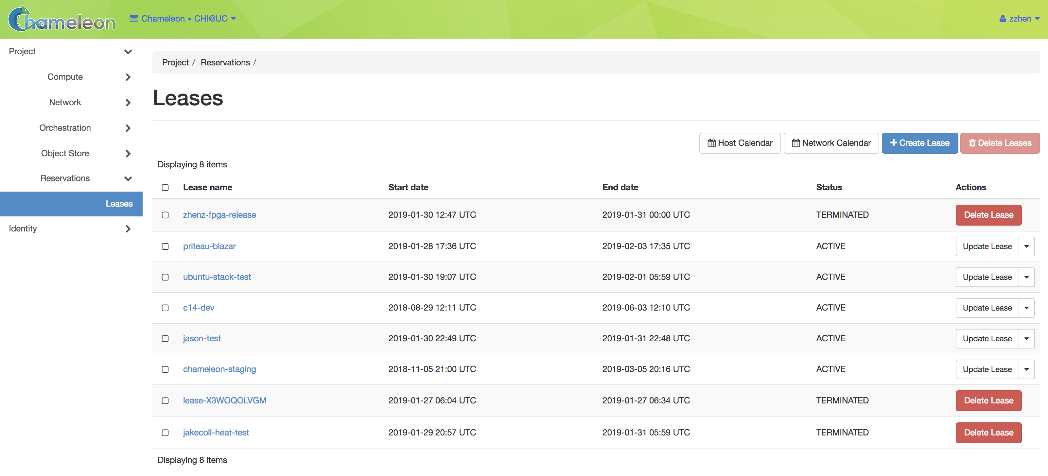
Reserving Resources
Visit the site for the nodes that you want to use
Check availability of the nodes via Host Calendar
Create a Lease to provision and manage resources

Slide 8
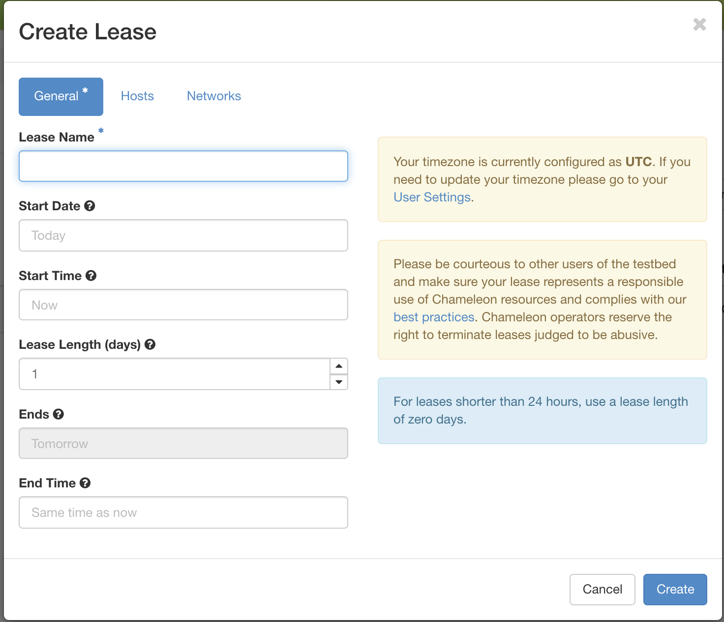
Reserving Resources
Tips on reserving resources
Maximum resource reservation time is 7 days
Renewal can be carried out within 48 hours before the resource expires
Extending the Lease does not require restarting or releasing existing resources
The status of the Lease may return “ERROR”
The Lease cannot be extended
It does not affect allocated resources
At least one floating IP is suggested
For remote access via SSH, etc.
The number of floating IPs is limited
Maybe less than the number of required nodes

Slide 9
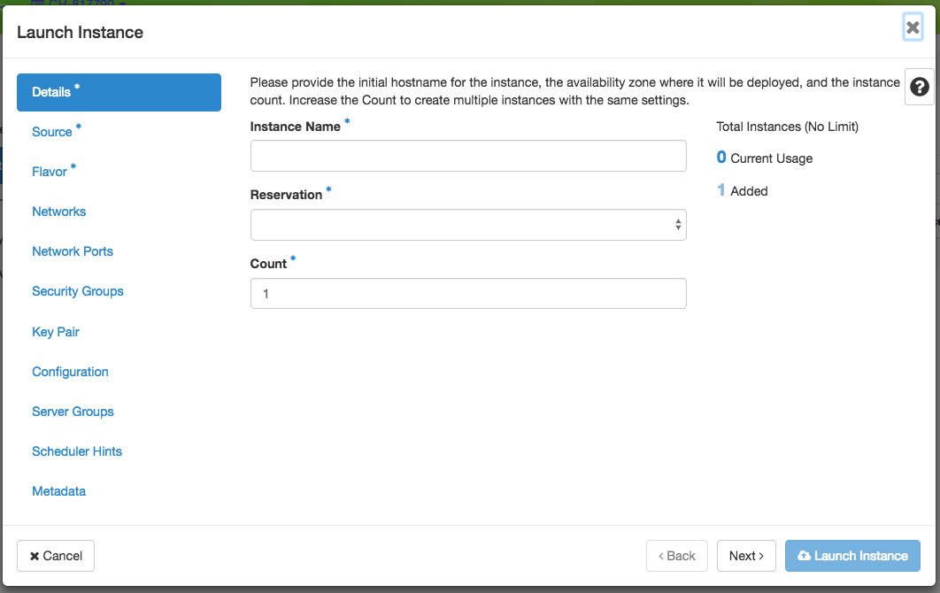
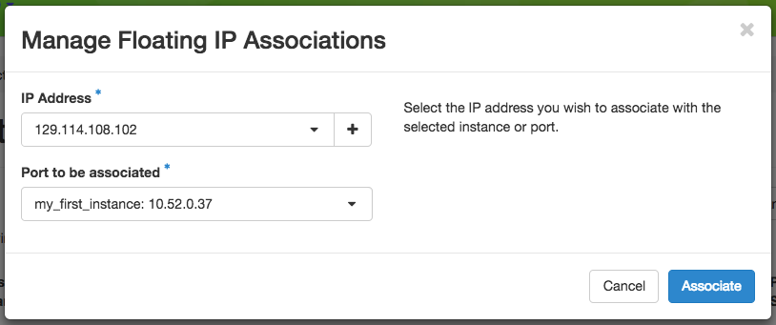
Launching Instances
Launch instance with available Lease
Notes on launching instances
CC-* series system image only allows SSH key login
Floating IP requires manual binding with a specific node after the instance is launched
The launch procedure requires a long time
Around 15 minutes in our case

Slide 10
Problems and Solutions When Using Chameleon Cloud
P1: Instance cannot be connected (Status returns ERROR)
Try hard reboot on the instance management site
Delete old instances and recreate the fault instance after serval minutes
P2: Status of the Lease returns ERROR
Delete the instances created with the Lease
Delete the Lease and create a new one
P3: Cannot extend the existing Lease
Change the hardware type as the available nodes may not be enough in the period requested

Slide 11
ELECT Artifact
Artifact of ELECT is published on Chameleon Trovi
Link: https://www.chameleoncloud.org/experiment/share/0babae70-ba32-4a35-8d77-f26116a28569

Slide 12
ELECT Artifact
ELECT is built atop Cassandra v4.1.0
Around 27 K LoC of modifications to Cassandra (with 1.25 M LoC)
Utilize Intel ISA-L library for erasure coding
Utilize Ansible to automatically run the evaluations
The artifact contains the implementation of the ELECT prototype, YCSB benchmark tool, and evaluation scripts
src/ : includes the prototype and a simple object storage backend
scripts/ : includes the setup and evaluation scripts, and the YCSB tool

Slide 13
Artifact Evaluation Settings
Setup within a single cluster
8 nodes (1 client node+ 1 cold-tier node+ 6 hot-tier nodes)
Deploy the simple object storage backend as the cold tier
Workloads: YCSB 0.17.0, 1 KiB KV pairs, Zipfian constant 0.99
Parameters: 3-way replication, (6,4) encoding, storage saving target $α=0.6$, write consistency level ALL, read consistency level ONE
Comparisons
Cassandra v4.1.0 vs. ELECT
Node configuration
Machine | Instance Type | CPU | Memory | Disk | OS
8 nodes | Chameleon Cloud: compute_icelake_r750 | Xeon Platinum 8380*2 (160-cores) | 256-GiB | 256 GiB SATA SSD | Ubuntu 22.04 LTS

Slide 14
Configuration
Launch 8 instances in Chameleon Cloud
Steps of configuration
Select one node as the client and connect to it
Download the artifact and configure the instance information in the scripts/settings.sh as described in AE_INSTRUCTION.md
Run the environment setup scripts in the artifact as follows:
bash scripts/setup.sh full
The configuration requires around 5 minutes in Chameleon Cloud

Slide 15
Reproducing Evaluation
We provide the evaluation scripts in the artifact, and they can be easily executed following AE_INSTRUCTION.md
8 days are required to reproduce all evaluations on Chameleon Cloud
Example evaluation on storage savings
It can be run by executing the following script
bash scripts/exp/Exp-simple.sh
Takes about 6 minutes to finish

Slide 16
Artifact Evaluation Result Analysis
On Chameleon, some results behave differently from our paper
Performance gain in YCSB core workload E is reduced from 3x to 0.1%
I/O throughput in Chameleon Cloud is 2.3x higher
I/O overhead no longer becomes a bottleneck during scans (95% of workload E)
Overhead of read in degraded mode is reduced from 5x to 1.2x
Network bandwidth in Chameleon Cloud is 8.3x higher
Recovery overhead of retrieving coding group is reduced
 | Chameleon Cloud | Alibaba Cloud (used in our paper)
Type | compute_icelake_r750 (Bare Metal) | ecs.i3g.2xlarge (Virtual Machine)
CPU | Xeon Platinum 8380 *2 (160 cores) | vCPU based on Xeon Platinum 8269CY (8 cores)
RAM | 256 GiB | 32 GiB
Storage | MICRON SATA SSD; ~540 MB/s | Virtual SSD; ~250 MB/s
Network | 25 Gbps | 3 Gbps

Slide 17
Q&A

