Slide 1
Separating Data via Block Invalidation Time Inference for Write Ampliﬁcation Reduction in Log-Structured Storage
Qiuping Wang^{1,2}, Jinhong Li¹, Patrick P. C. Lee¹,
Tao Ouyang², Chao Shi², Lilong Huang²
¹The Chinese University of Hong Kong (CUHK)
²Alibaba Group
Notes:
Hello everyone, I am Qiuping Wang from CUHK. I am going to present xxx, which is a joint work with our collaborators from CUHK and Alibaba Group.

Slide 2
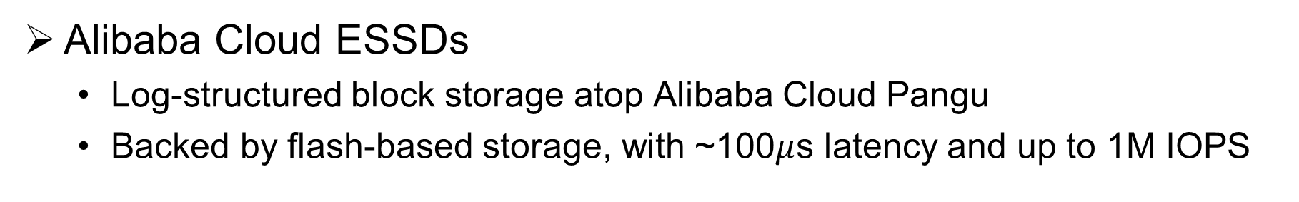
Log-Structured Storage
Alibaba Cloud ESSDs
  Log-structured block storage atop Alibaba Cloud Pangu
  Backed by flash-based storage, with ~100$μ$s latency and up to 1M IOPS
Abstraction
  Each ESSD is a block-level volume as an append-only log
  Each log contains segments (hundreds of MiB) composed of blocks (several KiB), each identified by logical block addresses (LBAs)
User
User
Log
Log
Log
Log
Segment
…
Segment
Block
Block
Segment
Notes:
We motivate our problem from our production cloud block storage system Alibaba Cloud Enhanced SSDs.
Alibaba Cloud ESSDs use the log-structured design atop a distributed storage platform named Pangu, which provides append interfaces for its upper-layer applications.
They are backed by flash-based storage and achieve around 100us latency and upto 1M IOPS.
Each ESSD is a block-level volume as an append-only log that is subscribed by the users.
Each log contains segments of hundreds of MiBs. And each segment is further composed of blocks of several KiB.
Those blocks are identified by logical block addresses (LBAs)

Slide 3
Garbage Collection
Space reclamation of invalid (stale) blocks
  Triggering: garbage proportion (GP) over a threshold, e.g., 15%
    Garbage proportion = #invalid blocks / (#invalid blocks + #valid blocks)
  Selection: select segments according to some algorithm, e.g., Greedy
  Rewriting: rewrite valid blocks, delete old segments and reuse space
Write amplification (WA): repeated rewrites of valid blocks
  Reduced flash lifespan and bandwidth at Alibaba Cloud ESSDs
Notes:
The log-structured storage needs garbage collection for space reclamation of the stale blocks invalidated by the updates
We abstract GC as a three-phase procedure.
Upon the system garbage proportion (i.e., the percentage of the invalid blocks in all blocks) exceed a threshold, the system triggers GC
GC selects segments according to some algorithm. For example, Greedy selects the segments with highest GP
GC rewrites the valid blocks inside the segments, and then deletes the old segments so that the occupied space can be reused.
This procedure incurs write amplification due to repeated rewrites of valid blocks, which further leads to reduced flash storage lifespan and provisioned bandwidth that can be sold to users at Alibaba Cloud ESSDs.

Slide 4
Data Placement
Each write/update to an LBA gives one user-written block and zero or multiple GC-rewritten blocks
  WA = 1 + #GC-rewritten blocks / #user-written blocks
Goal: separates blocks into groups by properties
  Produce high-GP segments for GC
User-Written Blocks
Data Placement
(Open) Segment
(Open) Segment
GC-
Rewritten Blocks
…
…
(Sealed) Segment
(Sealed) Segment
Log
Garbage Collection
Read Valid Blocks
Notes:
In this paper, we explore data placement for WA mitigation.
We assume each write/update in the workload to an LBA first introduces one user-written block.
GC may rewrite the block and introduces zero or multiple GC-rewritten blocks. Thus, the WA equals to.
As a result, data placement sees two types of blocks – user-written and GC-rewritten blocks. It assigns them to different open segments. The open segments do not exceed their maximum sizes and are appendable. GC will collect the sealed segments that reach their maxmium sizes and rewrites their valid blocks as GC-rewritten blocks.
The aim is to separate blocks into groups according to their properties, such that the blocks in the same group are more likely to be invalidated together, and thus the system can produce high GP segments for GC, i.e., less rewrites of valid blocks.

Slide 5
Contribution
SepBIT: Separates blocks via block invalidation time (BIT) inference [He, EuroSys’17]
  Effective BIT inference based on mathematical and trace analyses
    Separates each set of user-written blocks and GC-rewritten blocks by BIT inference
  Deployed at Alibaba Cloud ESSDs
Extensive trace analysis and prototype evaluation to validate SepBIT effectiveness
Notes:
We propose SepBIT, which separates blocks via the inferences of the block invalidation time (abbreviated to BIT)
Its method establishes on effective BIT inferences based on mathematical and trace analysis. It separates each set of user-written blocks and GC-rewritten blocks by BIT inference.
SepBIT is now deployed at Alibaba Cloud ESSDs.
We verify the its effectiveness via extensive trace analysis and prototype evaluation.

Slide 6
Ideal Data Placement and Limitations
Ideal data placement can achieve the minimum WA of 1
  Strictly places all written blocks based on their invalidation orders
  Selects segments whose blocks are earliest invalidated for GC
    No rewrites of valid blocks
Impractical assumptions:
  Future knowledge: the invalidation order (time) of each written block
  Space reservation: memory/storage reservation for all written blocks
Practical solution:
  Infers accurately the BIT for each written block
  Groups blocks of close BITs
Notes:
We first discover an ideal data placement scheme that achieves the minimum WA of 1 with the knowledge of BITs.
Its idea is to strictly place all written blocks based on their invalidation orders (i.e., the BITs), such that GC can select the segments whose blocks are the earliest invalidated with no rewrites of valid blocks.
We observe that the optimal result of the ideal data placement scheme stems from its two impractical assumptions.
First, it needs to know the invalidation order (time) of each written blocks
Second, it needs to reserve memory/storage for all the written blocks in advance.
As a result, an effective practical method needs accurate estimation the BIT of each written block
And in the face of limited memory/storage space, it has to group blocks of close BITs together.

Slide 7
Observations
Derive three observations based on lifespan analysis
  Lifespan: number of bytes written from when a block is written until it is invalidated (or until the end of the trace)
Focus on Alibaba Cloud block traces:
  186 out of 1000 volumes over one full month in January 2020
    Large write working set size (WSS) (# unique LBAs written x block size): 10GiB - 1TiB
    Large write trafﬁc size: 43GiB - 36.2TiB.
Also validated on Tencent Cloud block traces
Notes:
We further conduct trace-analysis based on the block lifespan to derive three observations.
The lifespan is defined as number of bytes written in the workload from when a block is written until it is invalidated (or until the end of the trace)
We use Alibaba cloud block traces that span one-month period in January 2020, and select 186 write-heavy volumes for validity of the analysis.
Those volumes have large write working set sizes and large write traffic sizes
Our observations are also validated on Tencent Cloud block traces.

Slide 8
Observations
O1: User-written blocks generally have short lifespans
  e.g., 10% of write WSS
  GC-rewritten blocks have long lifespans
O2: Frequently updated blocks have highly varying lifespans
  Large variations in different groups of frequently updated blocks
O3: Rarely updated blocks dominate with highly varying lifespans
  Spanning both long and short ranges
Temperature-based placement (e.g., via access frequencies) are ineffective in BIT inference
Notes:
Observation 1 that user-written blocks generally have short lifespans.
We find that majority of volumes have high percentages of user-written blocks whose lifespans are smaller than a small percentage, for example, only 10%, of their write working set sizes.
In contrast, GC-rewritten blocks generally have long lifespans, in that they survive after the GC to their corresponding segments.
Thus, the user-written blocks and GC-rewritten blocks have different BIT patterns.
Observation 2 says that Frequently updated blocks have highly varying lifespans
We see Large variations in different groups of frequently updated blocks in each volume
Observation 3 says Rarely updated blocks dominate with highly varying lifespans
We find that the lifespans the rarely updated blocks span both long and short ranges
We further find that the lifespans of …
The observations suggest that temperature-based placement, e.g., are ineffective in BIT inference

Slide 9
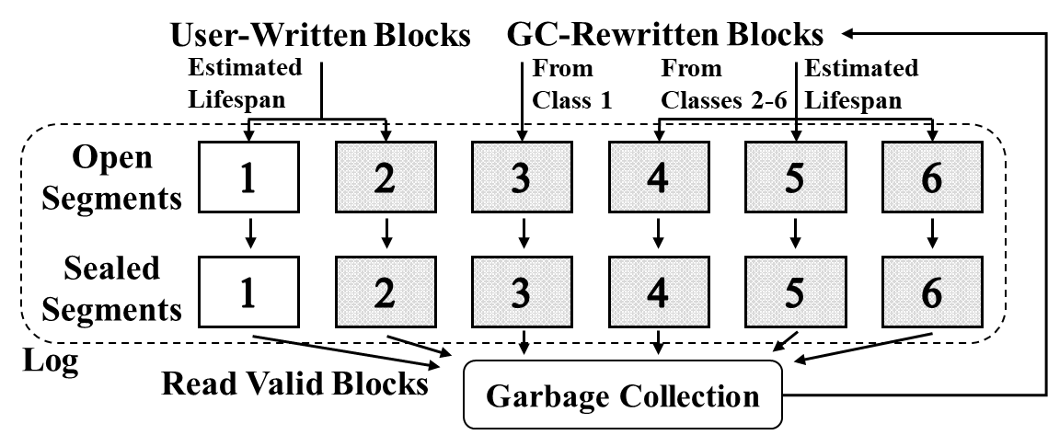
SepBIT Design
User-written blocks
  Short-lived blocks (Class 1) written near the same time have similar BITs
  Remaining long-lived blocks (Class 2) span large BIT ranges
GC-rewritten blocks
  Short-lived blocks (Class 3) identified in user-written blocks
  Blocks with similar BITs inferred are grouped to Classes 4-6
Note: WA reduction of SepBIT is less sensitive to # of classes
Notes:
Without using temperature-based metrics, SepBIT first separates all written blocks into two groups, user-written blocks and GC-rewritten blocks, because they have different BIT patterns.
SepBIT further separates each set of user-written blocks and GC-rewritten blocks into six classes in total.
1. For user-written blocks, Class 1 stores estimated short-lived blocks because they have similar BITs if they are written near the same time. Class 2 stores the remaining long-lived blocks because they span large BIT ranges.
2. For GC-rewritten blocks, Class 3 stores the estimated short-lived blocks that are identified in user-written blocks. For the remaining blocks, SepBIT groups them into three classes with similar BITs inferred.
Although we assume six classes here, we validate the WA migitation of SepBIT is not sensitive to the number of classes.

Slide 10
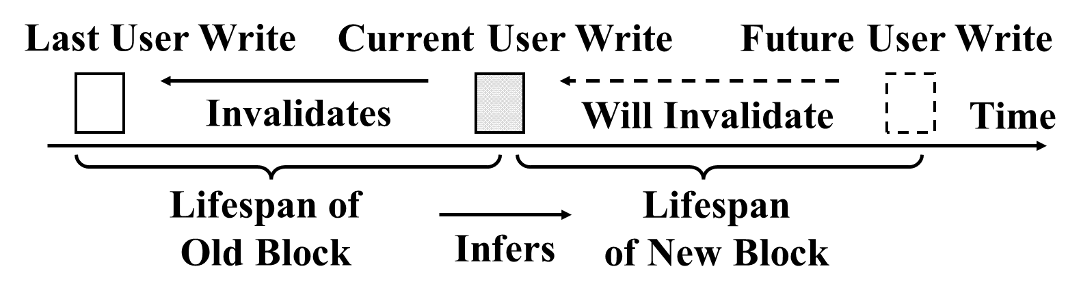
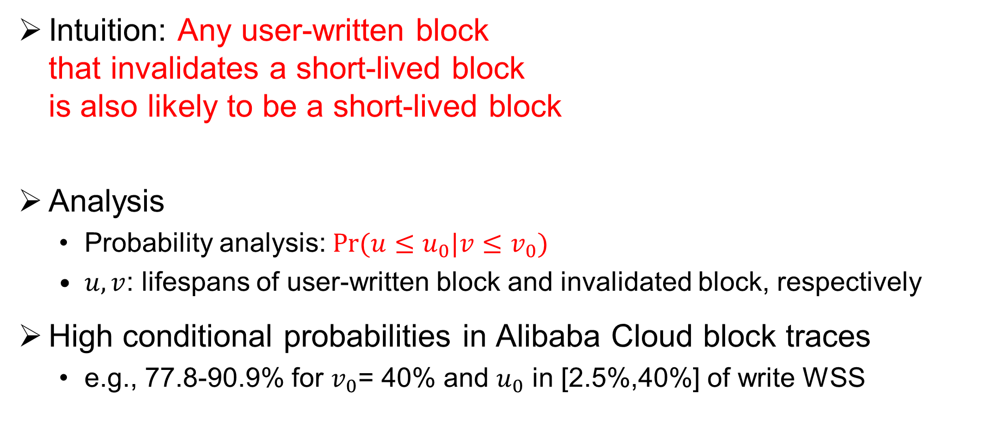
User-Written Block Separation
Intuition: Any user-written block
that invalidates a short-lived block
is also likely to be a short-lived block
Analysis
  Probability analysis: $\text{Pr}\text{(}u≤u_{0}|v≤v_{0}\text{)}$
  $u, v$: lifespans of user-written block and invalidated block, respectively
High conditional probabilities in Alibaba Cloud block traces
  e.g., 77.8-90.9% for $v_{0}$= 40% and $u_{0}$ in [2.5%,40%] of write WSS
Notes:
To estimate the lifespans and thus the BITs for each block, we conduct probability-based analysis for user-written blocks and GC-rewritten blocks.
For user-written blocks, we try to use the lifespan of the invalidated block to infer the lifespan of a user-written block. Our intuition is that ….
Specifically, we study the probability of the lifespan of a user-written block being smaller than u0 given the condition that the lifespan of its invalidated block is smaller than v0.
We find that the conditional probabilities are high for different combinations of small u0 and v0 in Alibaba Cloud block traces.
This finding indicates that the intuition holds. If the invalidated block has short lifespan, we can say that it is highly likely that the new user-written block also has short lifespan.

Slide 11
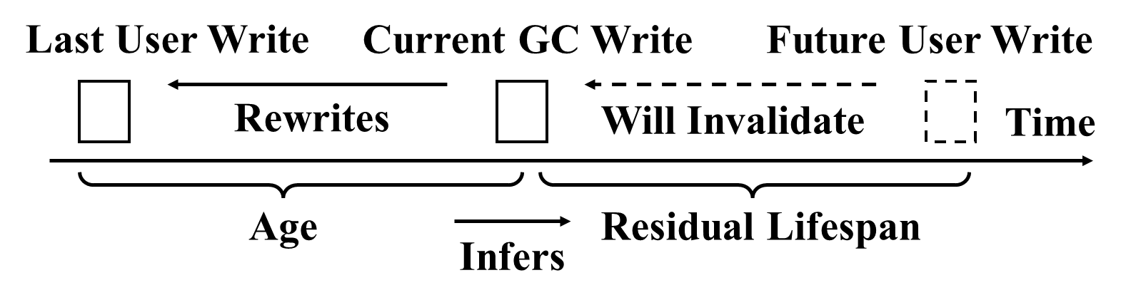
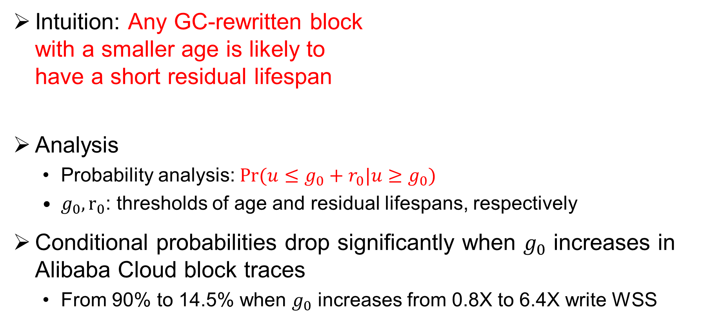
GC-rewritten Block Separation
Intuition: Any GC-rewritten block
with a smaller age is likely to
have a short residual lifespan
Analysis
  Probability analysis: $\text{Pr}\text{(}u≤g_{0}+r_{0}|u≥g_{0}\text{)}$
  $g_{0}, r_{0}$: thresholds of age and residual lifespans, respectively
Conditional probabilities drop significantly when $g_{0}$ increases in Alibaba Cloud block traces
  From 90% to 14.5% when $g_{0}$ increases from 0.8X to 6.4X write WSS
Notes:
For GC-rewritten blocks, we try to use the age of the GC-rewritten block to infer its residual lifespan. The residual lifespan is defined as the number of written bytes in the workload since the rewrite of the block until the invalidation of a GC-rewritten block. our intuition is that xxx.
Specifically, we study the probability of the residual lifespan of a GC-rewritten block being smaller than r0 given the condition that its age passes g0 when being rewritten.
We find that the conditional probabilities drop significantly when $g_{0}$ increases in Alibaba Cloud block traces.
This means that GC-rewritten blocks of different ages can indeed have distinguishable remaining lifespans, and thus we can effectively infer their residual lifespans via their ages.

Slide 12
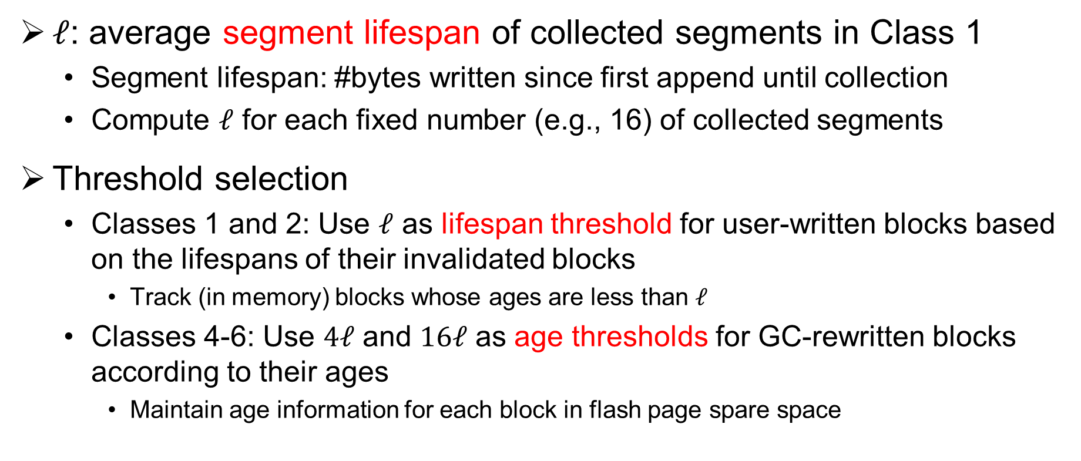
SepBIT Implementation
$ℓ$: average segment lifespan of collected segments in Class 1
  Segment lifespan: #bytes written since first append until collection
  Compute $ℓ$ for each fixed number (e.g., 16) of collected segments
Threshold selection
  Classes 1 and 2: Use $ℓ$ as lifespan threshold for user-written blocks based on the lifespans of their invalidated blocks
    Track (in memory) blocks whose ages are less than $ℓ$
  Classes 4-6: Use $4ℓ$ and $16ℓ$ as age thresholds for GC-rewritten blocks according to their ages
    Maintain age information for each block in flash page spare space
Notes:
We thus implement SepBIT as follows.
We set the thresholds of the separations according to the workload on-the-fly. Specifically, we monitor the segment lifespan, which is defined as the number of written bytes for a segment since its first append until its collection.
We compute a value ell that is the average segment lifespan of the collected segments in Class 1 for each 16 collected segments.
Then, for classes 1 and 2 which store estimated short-lived and long-lived blocks respecticaly, we use ell as the lifespan threshold according to the lifespans of the invalidated blocks of the user-written blcoks.
For Classes 4-6, which store the GC-rewritten blocks that are not previously from segments in Class 1, we use 4ell and 16ell as the age thresholds according to the ages of the rewritten blocks.
We thus achieve memory efficiency, in that we only need to track the blocks whose ages are less than ell in memory, with the age information of all the blocks in the flash storage and they can be retrieved along with the blocks during GC.

Slide 13
Evaluation
Trace analysis for per-volume WA
  186 volumes from Alibaba block traces
    Varying segment selection algorithms: Greedy and Cost-Benefit
    Varying segment sizes and GP thresholds for GC
  Schemes: 12 schemes, including 8 state-of-the-art placement schemes and FK (oracle scheme)
Prototype evaluation for throughput
  Build C++ prototype implementing SepBIT
  Use emulated zoned storage devices using Optane PM
    For reproducibility and best match with production storage at Alibaba
Notes:
We conduct both trace analysis and prototype evaluation.
We use 186 volumes in Alibaba Cloud block traces and vary segment selection algorithms, segment sizes, and GP threshold for GC. We compare SepBIT with 11 schemes including 8 existing schemes proposed in last two decades and Future Knowledge, which stems from our ideal data placement as an oracle scheme.
We also build a C++ prototype and use emulated zoned storage devices because it shares the same storage abstraction as Alibaba Cloud ESSDs and is easier to reproduce.

Slide 14
Trace Analysis on WA
SepBIT reduces overall WA of existing schemes by 9.1-20.2%
  Only 3.1% higher overall WA than Future Knowledge (FK)
SepBIT has lowest 75th percentile in per-volume WA
Overall WA of Cost-Benefit
Per-volume WA of Cost-Benefit
Notes:
SepBIT outperforms all existing schemes under all combinations of the settings.
We present the results under Cost-Benefit selection algorithm here, it reduces overall WA by 9.1-20.2%, it approaches the overall WA of the oracle scheme FK.
SepBIt also realizes the lowest 75th percentiles among all existing schemes.

Slide 15
Prototype Throughput
Throughput on 20 write-heavy volumes
SepBIT achieves the highest throughput
  25th and 50th percentiles: 28.3% and 20.4% higher than the second best, respectively
Absolute throughput
Normalized throughput
Notes:
We prototype SepBIT and compare it with the best candidates of existing schemes in our trace analysis results.
On 20 write-heavy volumes, SepBIT achieves the highest throughput for 25th and 50th percentiles, 20% higher than the second best.

Slide 16
Conclusion
SepBIT is a novel data placement scheme that mitigates WA in log-structured storage via BIT inference
  Infers BIT patterns based on trace analysis
  Deployed at Alibaba Cloud ESSDs
See paper, technical report, and source code for more details
Source code: http://adslab.cse.cuhk.edu.hk/software/sepbit
Notes:
Thank you so much for your interest and attention. I welcome all your questions.

