Slide 1
Exploiting Combined Locality for Wide-Stripe
Erasure Coding in Distributed Storage
Yuchong Hu¹, Liangfeng Cheng¹, Qiaori Yao¹,
Patrick P. C. Lee², Weichun Wang³ , Wei Chen³
¹Huazhong University of Science and Technology
²The Chinese University of Hong Kong, ³HIKVISION
Speaker: Yuchong Hu

Slide 2
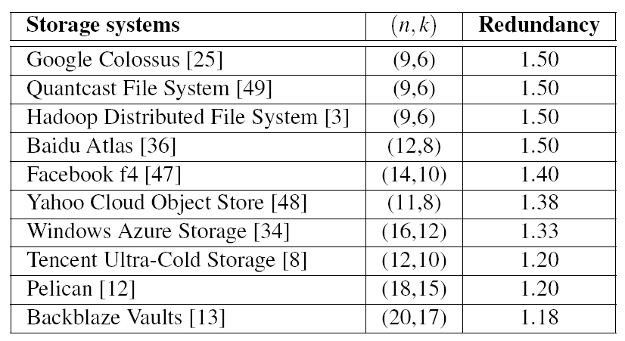
Erasure Coding
Low-cost redundancy while maintaining availability
  Parameters: n and k
  Stripe: k data chunks and n-k parity chunks
  Redundancy: n/k
State-of-the-art erasure coding
  Parameters: n ≤ 20, n-k = 3 or 4
  Stripe: medium range
  Redundancy: from 1.18 to 1.50

Slide 3
Wide-stripe Erasure Coding
Motivation
  Can we further reduce redundancy?
  Small redundancy reduction (e.g., from 1.5 to 1.33) can save millions of dollars in production _{[Plank and Huang, FAST’13]}
Wide stripes
  Parameters: n and k are very large while n-k = 3 or 4.
  Redundancy: n/k → 1 (near-optimal)
  Goal: Extreme storage savings
  Example: VAST considers (n,k) = (154,150) with redundancy = 1.027

Slide 4
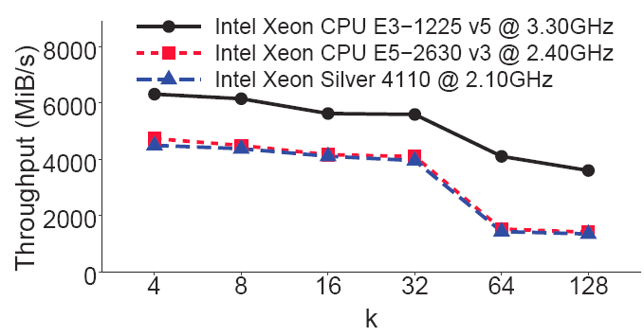
Challenges for Wide Stripes
Expensive repair
  (n,k) RS code repairs a chunk by retrieving k chunks
  Large k in wide stripes → more bandwidth and I/O
Expensive encoding
  Limited CPU cache: as k increases,
  more difficult to fit wide stripes in cache
Expensive updates
  Same as in traditional stripes: any updated data chunk causes all n-k parity chunks to be updated

Slide 5
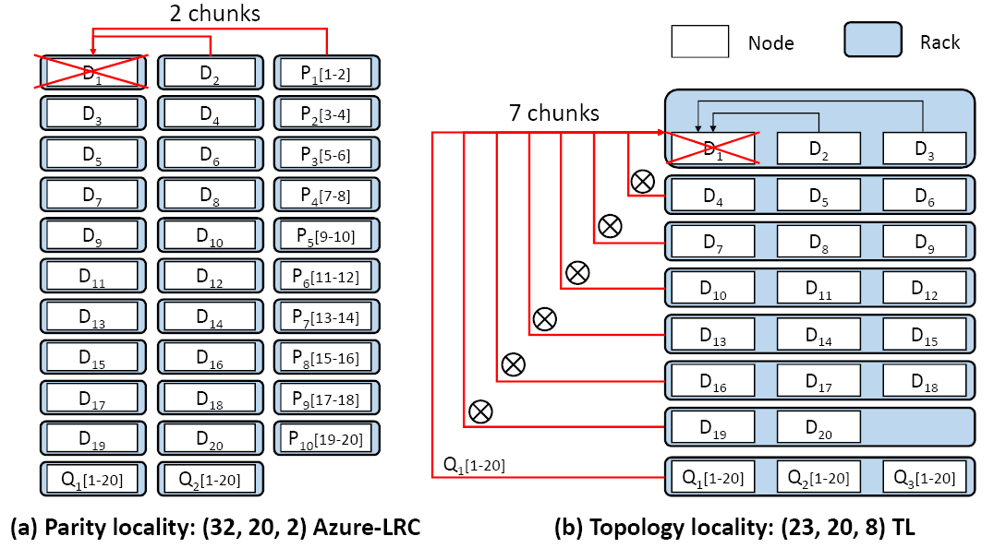
Locality in Erasure-coded Repair
Parity locality
  Locally repairable codes (LRCs): (n,k,r) Azure-LRC _{[Huang. ATC’12]}
  Reducing repair penalty: encodes every r data chunks into a parity chunk, so repairing a lost chunk only accesses r local chunks (r < k)
Repair bandwidth: 2 chunks
Redundancy: 1.6

Slide 6
Locality in Erasure-coded Repair
Topology locality
  (n,k) RS-coded chunks placed in z racks: (n,k,z) TL
  Reducing cross-rack repair bandwidth: splits a repair operation into local inner-rack repair and cross-rack repair sub-operations
Cross-rack repair
bandwidth: 7 chunks
Redundancy: 1.15 (optimal)

Slide 7
Existing locality schemes for wide stripes
Trade-off between redundancy and repair penalty
  Parity locality incurs high redundancy
  Topology locality incurs high cross-rack repair bandwidth
Redundancy: 1.6
Cross-rack repair
bandwidth: 2 chunks
Cross-rack repair
bandwidth: 7 chunks
Redundancy: 1.15 (optimal)

Slide 8
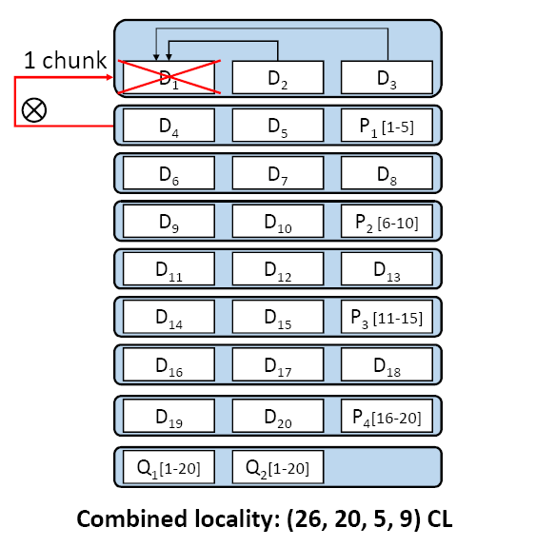
Motivating Example
Combined Locality: (n,k,r,z) CL
  Idea: combine parity locality and topology locality for better trade-off
  Example: (26,20,5,9) CL = (26,20,5) Azure-LRC placed in 9 racks
    Cross-rack repair bandwidth: only one chunk
      less than TL (7 chunks)
      less than LRC (2 chunks)
    The redundancy: 1.3
      lower than LRC (1.6)
      closer to TL (1.15)

Slide 9
Our Contributions
First systematic study on wide-stripe repair problem
  Construction details of combined locality
  Trade-off analysis between redundancy and cross-rack repair bandwidth
  Reliability analysis on combined locality
ECWide: design of a wide-stripe erasure-coded system
  Combined locality for single-chunk repair and full-node repair
  Efficient encoding via multi-node encoding
  Efficient updates via inner-rack parity updates
  Two ECWide prototypes: cold (ECWide-C) and hot (ECWide-H) storage
Evaluation: single-chunk repair time reduced by 90.5% with ultra-low storage (1.063×)

Slide 10
Combined Locality
Definition: (n,k,r,z) CL
  (n,k,r) LRC + (n,k,z) TL
  c: number of chunks of a stripe in a rack
  f: number of tolerable node failures of a stripe
  Requirement: c ≤ f; otherwise, a rack failure leads to data loss
Design idea:
  If c increases, a local inner-rack repair covers more chunks
  → reducing more cross-rack repair bandwidth
  Minimum cross-rack repair bandwidth: when c = f
  Selection of LRC: Azure-LRC has largest f under same (n,k,r)
  Construction of CL: Azure-LRC coded chunks placed in racks satisfying c = f

Slide 11
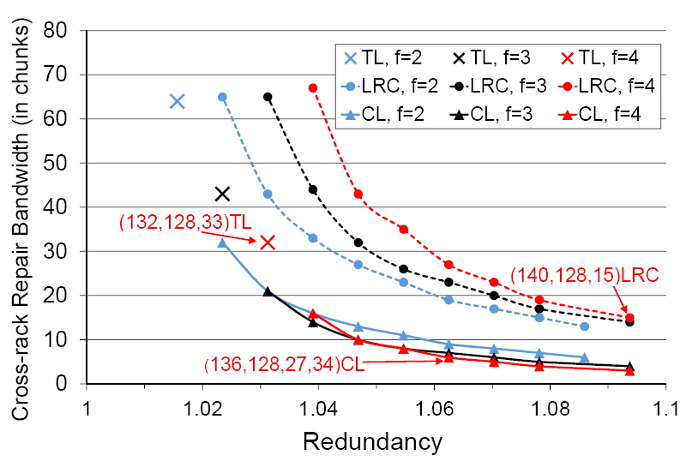
Trade-off Analysis
LRC: (n,k,r) Azure-LRC
TL: (n,k,z) Topology Locality
CL: (n,k,r,z) Combined Locality
CL outperforms TL and LRC in terms of trade-off of
redundancy and cross-rack repair bandwidth

Slide 12
ECWide
ECWide: a wide-stripe erasure-coded storage system
Goals:
  Minimum cross-rack repair bandwidth: realizes combined locality
  Efficient encoding: proposes a multi-node encoding design
  Efficient parity updates: proposes an inner-rack parity update design

Slide 13
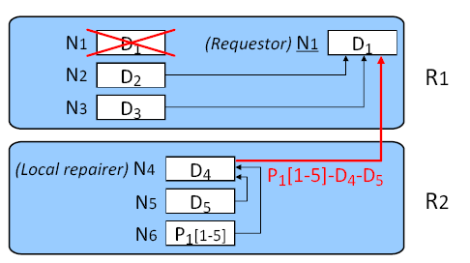
Repair in ECWide
Single-chunk repair:
ECWide selects one node N1 as
requestor to reconstruct lost chunk
ECWide selects one node N4 as local repairer to perform local repair

Slide 14
Repair in ECWide
Full-node repair:
  Multiple single-chunk repairs in parallel
  Problem: Different single-chunk repairs may choose identical nodes as requestors or local repairers → degraded parallel performance
  Method: Always select least-recently-selected (LRS) nodes as requestors or local repairers
    A doubly-linked list tracks which node has been recently selected
    A hashmap holds the node ID and the node address of the list

Slide 15
Implementation
Two ECWide prototypes:
  ECWide-C: for cold storage
    Large-sized chunks (e.g., 64MiB in HDFS)
    Mainly implemented in Java with about 1,500 SLoC
    Encoding implemented in C++ with about 300 SLoC on Intel ISA-L
  ECWide-H: for hot storage
    Small-size chunks (e.g. 4KiB _{[Zhang et al., FAST’16]})
    Built on Memcached
    Extending libMemcached with about 3000 SLoC in C

Slide 16
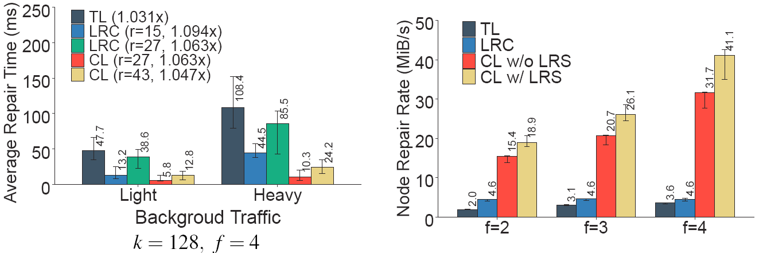
ECWide-H Experiments
CL shows lower single-chunk repair time than TL (up to 90.5%) and LRC (up to 87.9%) with ultra-low redundancy (1.063)
CL shows highest full-node repair rate; higher gain via LRS
Single-chunk repair
full-node repair
More experiments on ECWide-C and ECWide-H in the paper

Slide 17
Conclusions
Propose combined locality to first address the wide-stripe repair problem systematically
Design ECWide, a system that realizes combined locality, multi-node encoding, and inner-rack parity updates
Implement ECWide for both cold and hot storage systems
Show ECWide’s efficiency in repair, encoding, and updates
ECWide source code: https://github.com/yuchonghu/ecwide

Slide 18
THANK YOU
  Contacts:
  Yuchong Hu yuchonghu@hust.edu.cn
  Patrick Lee pclee@cse.cuhk.edu.hk

