Slide 1
STAIR Codes: A General Family of Erasure Codes for Tolerating Device and Sector Failures in Practical Storage Systems
Mingqiang Li and Patrick P. C. Lee
The Chinese University of Hong Kong
FAST ’14

Slide 2
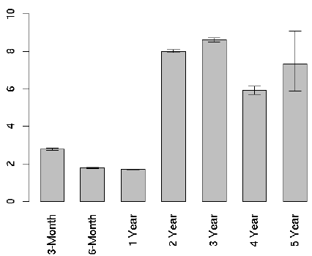
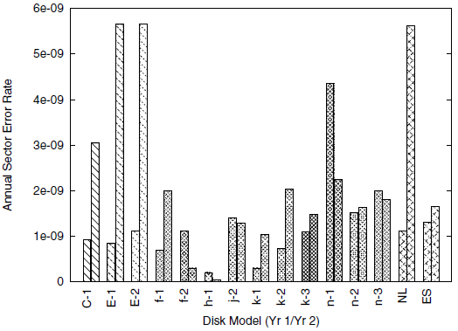
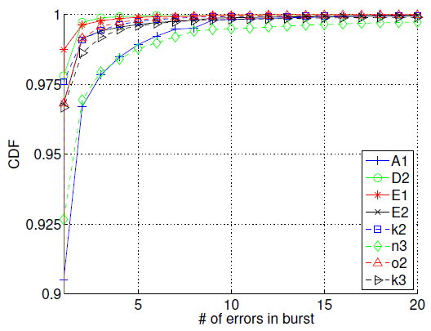
Device and Sector Failures
Storage systems susceptible to both device and sector failures
Device failure: data loss in an entire device
Sector failure: data loss in a sector
(a) Annual disk failure rate: 1~10%
(b) Sector failures can be more frequent than disk failures
(c) Sector failure bursts can be long (> 5)
× %
× 1e+09 for 500GB disks
Annual disk failure rate [Pinheiro et al., FAST’07]
Annual sector failure rate [Bairavasundaram et al., SIGMETRICS ’07]
Burstiness of sector failures [Schroeder et al., FAST ’10]

Slide 3
Erasure Coding
Erasure coding: adds redundancy to data
(N,K) systematic MDS codes
Encodes K data pieces to create N-K parity pieces
Stripes the N pieces across disks
Any K out of N pieces can recover original K data pieces and the N-K parity pieces → fault tolerance
Three erasure coding schemes:
Traditional RAID and erasure codes (e.g., Reed-Solomon codes)
Intra-Device Redundancy (IDR)
Sector-Disk (SD) codes

Slide 4
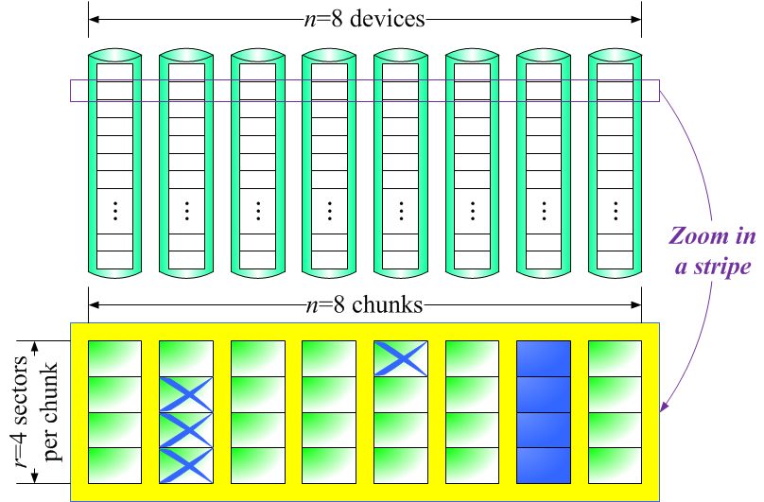
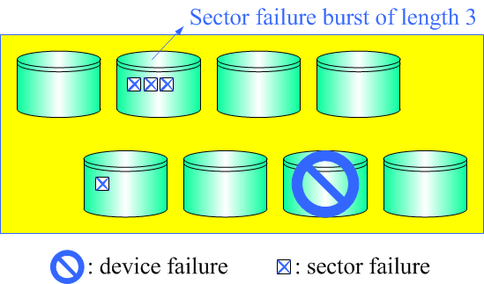
Mixed Failure Scenario
Consider an example failure scenario with
m=1 entirely failed device, and
m′=2 partially failed devices with 1 and 3 sector failures
Question: How can we efficiently tolerate such a mixed failure scenario via erasure coding?

Slide 5
Traditional RAID and Erasure Codes
3 parity devices to tolerate
m=1 entirely failed device
m′=2 partially failed devices
5 data devices
Overkill to use 2 parity devices to tolerate m′=2 partially failed devices
Device-level tolerance only

Slide 6
Intra-Device Redundancy (IDR)
[Dholakia et al., TOS 2008]
3 parity sectors per data device to tolerate a sector failure burst of length 3
m=1 parity
device
Still overkill to add parity sectors per data device

Slide 7
Sector-Disk (SD) Codes
[Plank et al., FAST ’13, TOS’14]
Simultaneously tolerate
m entirely failed devices
s failed sectors (per stripe) in partially failed devices
Construction currently limited to s ≤ 3
How to tolerate our mixed failure scenario?
m=1 entirely failed device, and
m′=2 partially failed devices with 1 and 3 sector failures
m parity devices
s parity sectors

Slide 8
Sector-Disk (SD) Codes
[Plank et al., FAST ’13, TOS’14]
s=4 global parity sectors to tolerate any 4 sector failures
m=1 parity
device
Such an SD code is unavailable

Slide 9
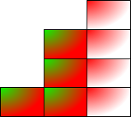
Our Work
Construct a general, space-efficient family of erasure codes to tolerate both device and sector failures
General: without any restriction on
size of a storage array,
number of tolerable device failures, or
number of tolerable sector failures
Space-efficient:
number of global parity sectors = number of sector failures (like SD codes)
STAIR
Codes

Slide 10
Key Ideas of STAIR Codes
Sector failure coverage vector e
Defines a pattern of how sector failures occur, rather than how many sector failures would occur
Code structure based on two encoding phases
Each phase builds on an MDS code
Two encoding methods: upstairs and downstairs encoding
Reuse computed parity results in encoding
Provide complementary performance gains

Slide 11
Sector Failure Coverage Vector
SD codes define s
Tolerate any combination of s sector failures per stripe
Currently limited to s ≤ 3
STAIR codes define sector failure coverage vector e = (e₀, e₁, e₂, …, e_{m′-1} )
Bounds # of partially failed devices m′
Bounds # of sector failures per device e_{l} (0 ≤ l ≤ m′ -1)
∑ e_{l} = s
Rationale: sector failures come in small bursts → Can define small m′ and reasonable size e_{l} for bursts

Slide 12
Sector Failure Coverage Vector
Set e=(1, 3):
At most 2 devices (aside entirely failed devices) have sector failures
One device has at most 3 sector failures, and
Another one has at most 1 sector failure

Slide 13
Parity Layout
m=1 parity
device
e=(1, 3) global parity sectors
Q: How to generate the e=(1, 3) global parity sectors and the m=1 parity device?
A: Use two MDS codes C_{row} and C_{col}

Slide 14
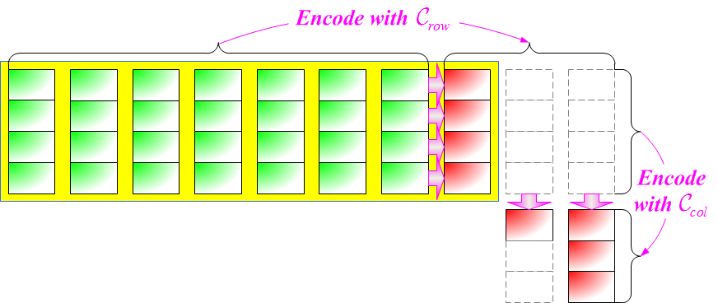
Two Encoding Phases
Phase 1
m=1 parity device
C_{row}: data → parity devices + intermediate parities
C_{col}: intermediate parities → global parity sectors
Phase 2
e=(1, 3) global parity sectors
Q: How to keep the global parity sectors inside a stripe?

Slide 15
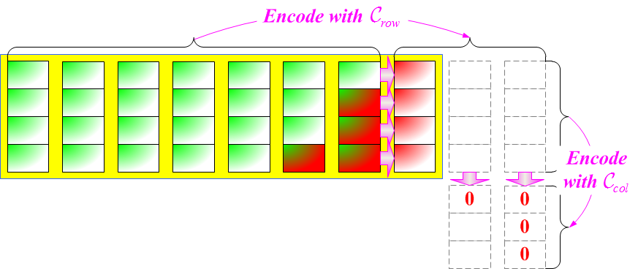
Two Encoding Phases
Phase 1
m=1 parity device
Phase 2
e=(1, 3) inside
global parity sectors
e=(1, 3) outside global parity sectors
A: set outside global parity sectors as zeroes; reconstruct inside global parity sectors

Slide 16
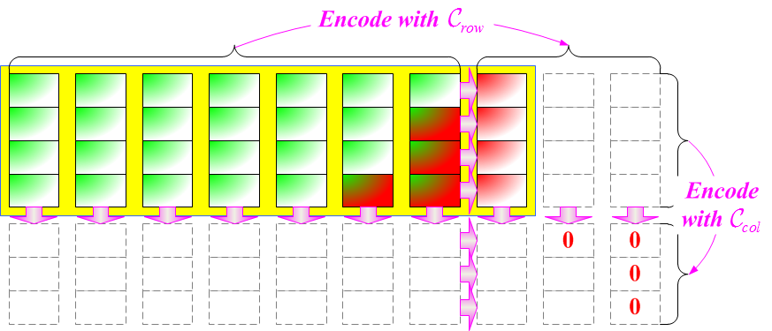
Augmented Rows
Q: How do we compute inside parity sectors?
A: Augment a stripe
Encode each column with C_{col} to form augmented rows
Generate virtual parities in augmented rows
Each augmented row is a codeword of C_{row}

Slide 17
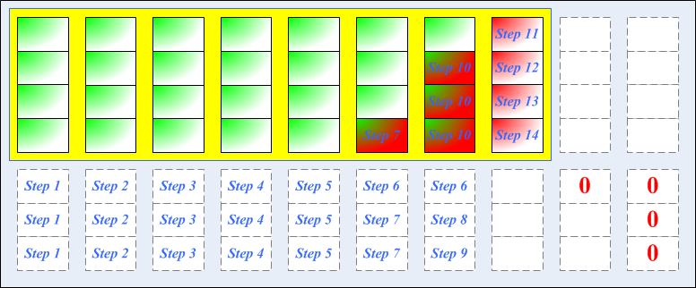
Upstairs Encoding
Idea: Generate parities in upstairs direction
Can be generalized as upstairs decoding for recovering failures

Slide 18
Upstairs Encoding
Detailed steps:
C_{row}: (10,7) code C_{col}: (7,4) code

Slide 19
Upstairs Encoding
Detailed steps:
C_{row}: (10,7) code C_{col}: (7,4) code

Slide 20
Upstairs Encoding
Detailed steps:
C_{row}: (10,7) code C_{col}: (7,4) code

Slide 21
Upstairs Encoding
Detailed steps:
C_{row}: (10,7) code C_{col}: (7,4) code

Slide 22
Upstairs Encoding
Detailed steps:
C_{row}: (10,7) code C_{col}: (7,4) code

Slide 23
Upstairs Encoding
Detailed steps:
C_{row}: (10,7) code C_{col}: (7,4) code

Slide 24
Upstairs Encoding
Detailed steps:
C_{row}: (10,7) code C_{col}: (7,4) code

Slide 25
Upstairs Encoding
Detailed steps:
C_{row}: (10,7) code C_{col}: (7,4) code

Slide 26
Upstairs Encoding
Detailed steps:
C_{row}: (10,7) code C_{col}: (7,4) code

Slide 27
Upstairs Encoding
Detailed steps:
C_{row}: (10,7) code C_{col}: (7,4) code

Slide 28
Upstairs Encoding
Detailed steps:
C_{row}: (10,7) code C_{col}: (7,4) code

Slide 29
Upstairs Encoding
Detailed steps:
C_{row}: (10,7) code C_{col}: (7,4) code

Slide 30
Upstairs Encoding
Detailed steps:
C_{row}: (10,7) code C_{col}: (7,4) code

Slide 31
Upstairs Encoding
Detailed steps:
Notes: parity computations reuse previously computed parities
C_{row}: (10,7) code C_{col}: (7,4) code

Slide 32
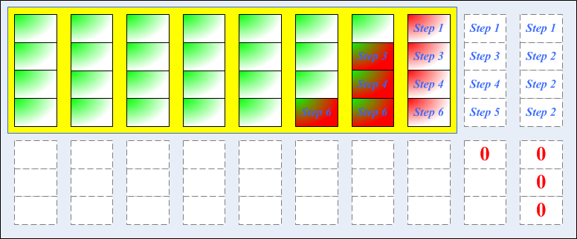
Downstairs Encoding
Another idea: Generate parities in downstairs direction
Cannot be generalized for decoding

Slide 33
Downstairs Encoding
Detailed steps:
C_{row}: (10,7) code C_{col}: (7,4) code

Slide 34
Downstairs Encoding
Detailed steps:
C_{row}: (10,7) code C_{col}: (7,4) code

Slide 35
Downstairs Encoding
Detailed steps:
C_{row}: (10,7) code C_{col}: (7,4) code

Slide 36
Downstairs Encoding
Detailed steps:
C_{row}: (10,7) code C_{col}: (7,4) code

Slide 37
Downstairs Encoding
Detailed steps:
C_{row}: (10,7) code C_{col}: (7,4) code

Slide 38
Downstairs Encoding
Detailed steps:
Like upstairs encoding, parity computations reuse previously computed parities
C_{row}: (10,7) code C_{col}: (7,4) code

Slide 39
Choosing Encoding Methods
The two methods are complementary
Intuition:
Choose upstairs encoding for large m′
Choose downstairs encoding for small m′
Details in paper
Upstairs
m′=2
e=(1, 3) with m′=2
Downstairs

Slide 40
Evaluation
Implementation
Built on libraries Jerasure [Plank, FAST’09] and GF-Complete [Plank, FAST’13]
Testbed machine:
Intel Core i5-3570 CPU 3.40GHz with SSE4.2
Comparisons with RS codes and SD codes
Storage saving
Encoding/decoding speeds
Update cost

Slide 41
Storage Space Saving
STAIR codes save devices compared to traditional erasure codes using device-level fault tolerance
s = # of tolerable sector failures
m′ = # of partially failed devices
r = chunk size
As r increases, # of devices saved ≈ m′

Slide 42
Encoding Speed
n = number of devices
r=16 (sectors per chunk)
Encoding speed of STAIR codes is on order of 1000MB/s
STAIR codes improve encoding speed of SD codes by ∼100%, due to parity reuse
Similar results for decoding

Slide 43
Update Cost
n=16 (devices) and r=16 (sectors per chunk)
(Update penalty: average # of updated parity sectors for updating a data sector)
Higher update penalty than traditional codes, due to global parity sectors
Good for systems with rare updates (e.g., backup) or many full-stripe writes (e.g., SSDs)
[Plank et al., FAST ’13, TOS’14]

Slide 44
Conclusions
STAIR codes: a general family of erasure codes for tolerating both device and sector failures in a space-efficient manner
Complementary upstairs encoding and downstairs encoding with improved encoding speed via parity reuse
Open source STAIR Coding Library (in C):
http://ansrlab.cse.cuhk.edu.hk/software/stair

