Slide 1
Parity Logging with Reserved Space: Towards Efficient Updates and Recovery in Erasure-coded Clustered Storage
Jeremy C. W. Chan*, Qian Ding*, Patrick P. C. Lee, Helen H. W. Chan
The Chinese University of Hong Kong
FAST’14
The first two authors contributed equally to this work.

Slide 2
Motivation
Clustered storage systems provide scalable storage by striping data across multiple nodes
e.g., GFS, HDFS, Azure, Ceph, Panasas, Lustre, etc.
Maintain data availability with redundancy
Replication
Erasure coding

Slide 3
Motivation
With explosive data growth, enterprises move to erasure-coded storage to save footprints and cost
e.g., 3-way replication has 200% overhead; erasure coding can reduce overhead to 33% [Huang, ATC’12]
Erasure coding recap:
Encodes data chunks to create parity chunks
Any subset of data/parity chunks can recover original data chunks
Erasure coding introduces two challenges: (1) updates and (2) recovery/degraded reads

Slide 4
Challenges
1. Updates are expensive
When a data chunk is updated, its encoded parity chunks need to be updated
Two update approaches:
In-place updates: overwrites existing chunks
Log-based updates: appends changes

Slide 5
Challenges
2. Recovery/degraded reads are expensive
Failures are common
Data may be permanently loss due to crashes
90% of failures are transient (e.g., reboots, power loss, network connectivity loss, stragglers) [Ford, OSDI’10]
Recovery/degraded read approach:
Reads enough data and parity chunks
Reconstructs lost/unavailable chunks

Slide 6
Challenges
How to achieve both efficient updates and fast recovery in clustered storage systems?
Target scenario:
Server workloads with frequent updates
Commodity configurations with frequent failures
Disk-based storage
Potential bottlenecks in clustered storage systems
Network I/O
Disk I/O

Slide 7
Our Contributions
Propose parity-logging with reserved space
Uses hybrid in-place and log-based updates
Puts deltas in a reserved space next to parity chunks to mitigate disk seeks
Predicts and reclaims reserved space in workload-aware manner
→ Achieves both efficient updates and fast recovery
Build a clustered storage system prototype CodFS
Incorporates different erasure coding and update schemes
Released as open-source software
Conduct extensive trace-driven testbed experiments

Slide 8
Background: Trace Analysis
MSR Cambridge traces
Block-level I/O traces captured by Microsoft Research Cambridge in 2007
36 volumes (179 disks) on 13 servers
Workloads including home directories and project directories
Harvard NFS traces (DEAS03)
NFS requests/responses of a NetApp file server in 2003
Mixed workloads including email, research and development

Slide 9
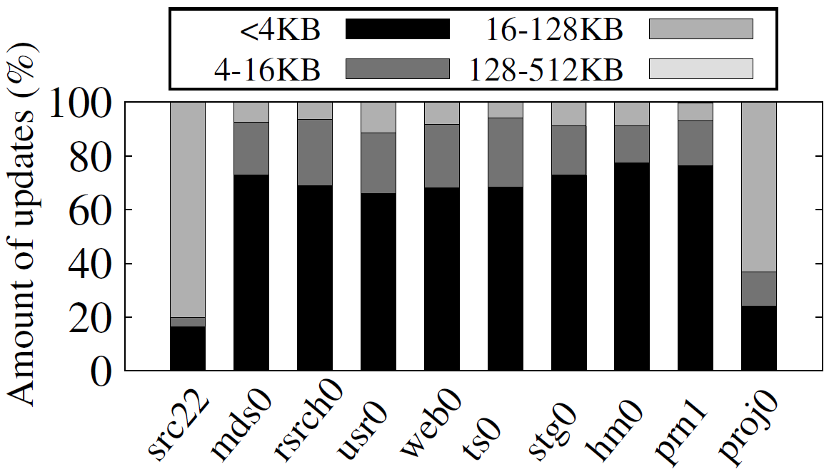
MSR Trace Analysis
Distribution of update size in 10 volumes of MSR Cambridge traces
Updates are small
All updates are smaller than 512KB
8 in 10 volumes show more than 60% of tiny updates (<4KB)

Slide 10
MSR Trace Analysis
Updates are intensive
9 in 10 volumes show more than 90% update writes over all writes
Update coverage varies
Measured by the fraction of WSS that is updated at least once throughout the trace period
Large variation among different workloads
need a dynamic algorithm for handling updates
Similar observations for Harvard traces

Slide 11
Objective #1: Efficient handling of small, intensive updates in an erasure-coded clustered storage

Slide 12
Saving Network Traffic in Parity Updates
Linear combination with some encoding coefficient
A
B
C
P
applying the same encoding coefficient
Update A
A’
B
C
P’
is equivalent to
P
P’
A’
parity delta (ΔA)
Make use of linearity of erasure coding
CodFS reduces network traffic by only sending parity delta
Question: How to save data update (A’) and parity delta (ΔA) on disk?

Slide 13
Update Approach #1: in-place updates (overwrite)
Used in host-based file systems (e.g., NTFS and ext4)
Also used for parity updates in RAID systems
Update A
Disk
A
B
C
Disk
B
C
Problem: significant I/O to read and update parities

Slide 14
Update Approach #2: log-based updates (logging)
Used by most clustered storage systems (e.g. GFS, Azure)
Original concept from log-structured file system (LFS)
Convert random writes to sequential writes
Update A
Disk
A
B
C
Disk
A
B
C
Problem: fragmentation to chunk A

Slide 15
Objective #2: Preserves sequentiality in large read (e.g. recovery) for both data and parity chunks

Slide 16
Parity Update Schemes
 | Data Update | Parity Delta
Full-overwrite (FO) | O | O
Full-logging (FL) | L | L
Parity-logging (PL) | O | L
Parity-logging with reserved space (PLR) | O | L
Our Proposal
O: Overwrite L: Logging

Slide 17
Parity Update Schemes
Data stream
FO
FL
PL
PLR
Storage Node 1
Storage Node 2
Storage Node 3

Slide 18
Parity Update Schemes
Data stream
a
b
FO
a
b
a+b
FL
a
b
a+b
PL
a
b
a+b
PLR
a
b
a+b
Storage Node 1
Storage Node 2
Storage Node 3

Slide 19
Parity Update Schemes
Data stream
a
b
a’
FO
a
b
a+b
FL
a
a’
b
a+b
Δa
PL
a
b
a+b
Δa
PLR
a
b
a+b
Δa
Storage Node 1
Storage Node 2
Storage Node 3

Slide 20
Parity Update Schemes
Data stream
a
b
a’
c
d
FO
a
c
b
d
a+b
c+d
FL
a
a’
c
b
d
a+b
Δa
c+d
PL
a
c
b
d
a+b
Δa
c+d
PLR
a
c
b
d
a+b
Δa
c+d
Storage Node 1
Storage Node 2
Storage Node 3

Slide 21
Parity Update Schemes
Data stream
a
b
a’
c
d
b’
FO
a
c
b
d
a+b
c+d
FL
a
a’
c
b
d
b’
a+b
Δa
c+d
Δb
PL
a
c
b
d
a+b
Δa
c+d
Δb
PLR
a
c
b
d
a+b
Δa
Δb
c+d
Storage Node 1
Storage Node 2
Storage Node 3

Slide 22
Parity Update Schemes
Data stream
a
b
a’
c
d
b’
c’
FO
a
c
b
d
a+b
c+d
FL
a
a’
c
c’
b
d
b’
a+b
Δa
c+d
Δb
Δc
PL
a
c
b
d
a+b
Δa
c+d
Δb
Δc
PLR
a
c
b
d
a+b
Δa
Δb
c+d
Δc
Storage Node 1
Storage Node 2
Storage Node 3

Slide 23
Parity Update Schemes
Data stream
FO: extra read for merging parity
a
b
a’
c
d
b’
c’
FL: disk seek for chunk b
FO
a
c
b
d
a+b
c+d
FL
a
a’
c
c’
b
d
b’
a+b
Δa
c+d
Δb
Δc
PL
FL&PL: disk seek for parity chunk b
a
c
b
d
a+b
Δa
c+d
Δb
Δc
PLR
a
c
b
d
a+b
Δa
Δb
c+d
Δc
PLR: No seeks for both data and parity
Storage Node 1
Storage Node 2
Storage Node 3

Slide 24
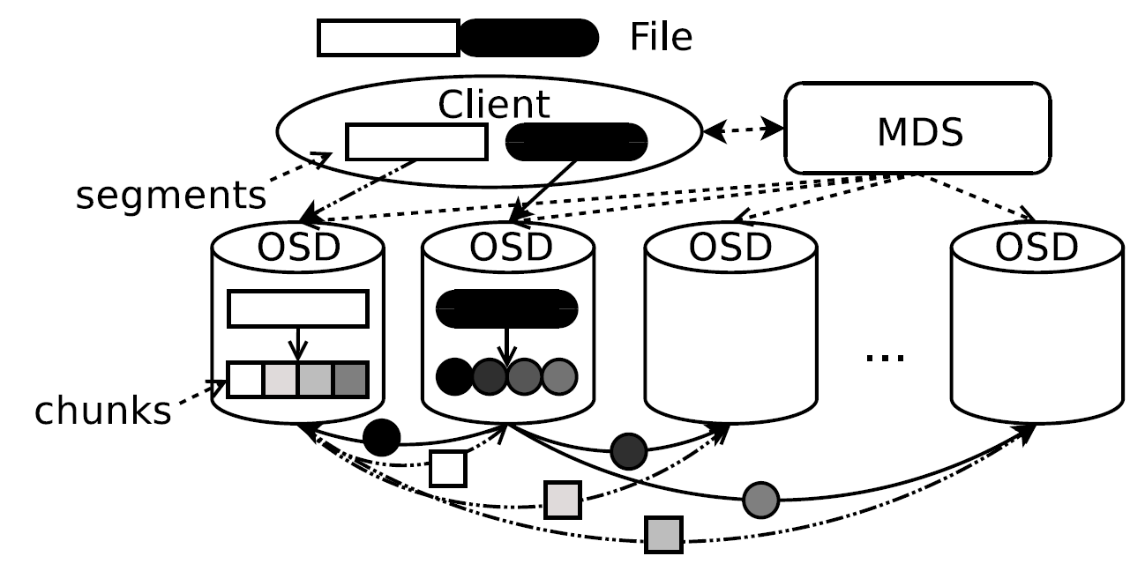
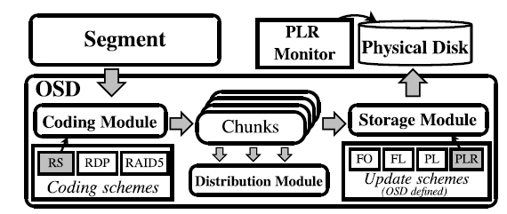
Implementation - CodFS
CodFS Architecture
Exploits parallelization across nodes and within each node
Provides a file system interface based on FUSE
OSD: Modular Design

Slide 25
Experiments
Testbed: 22 nodes with commodity hardware
12-node storage cluster
10 client nodes sending
Connected via a Gigabit switch
Experiments
Baseline tests
Show CodFS can achieve theoretical throughput
Synthetic workload evaluation
Real-world workload evaluation
Focus of this talk

Slide 26
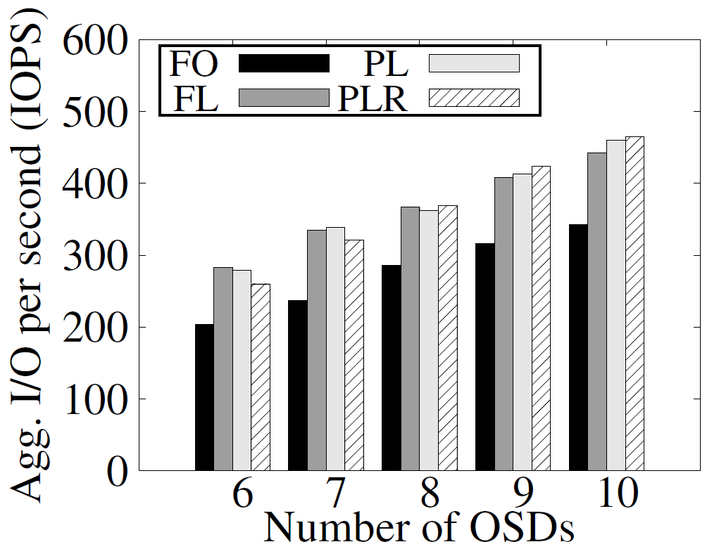
Synthetic Workload Evaluation
Random Write
Logging parity (FL, PL, PLR) helps random writes by saving disk seeks and parity read overhead
FO has 20% less IOPS than others
IOZone record length: 128KB
RDP coding (6,4)
Notes:
20% less

Slide 27
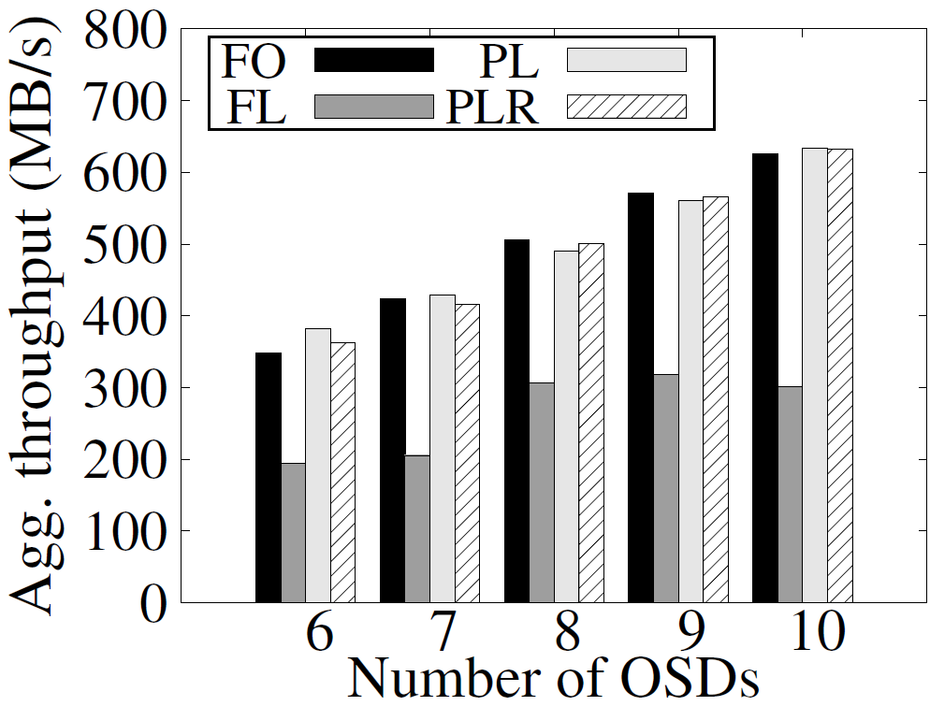
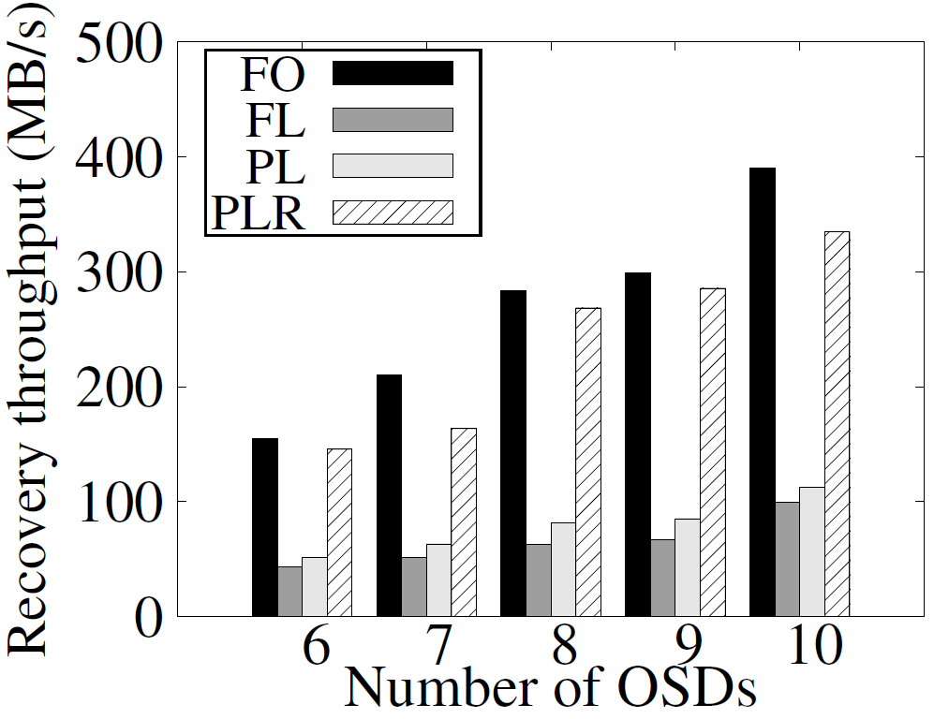
Synthetic Workload Evaluation
Sequential Read
Recovery
merge overhead
Only FL needs disk seeks in reading data chunk
No seeks in recovery for FO and PLR
Notes:
FL has ~50% loss
Recovery of PLR 3x better than PL, 9.2% worse than FO

Slide 28
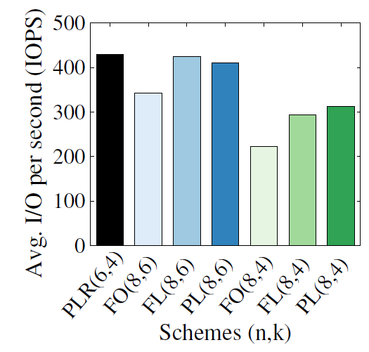
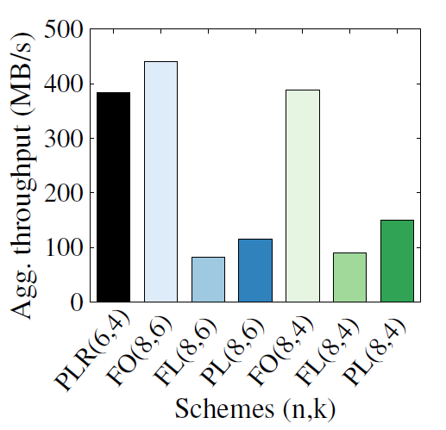
Fixing Storage Overhead
PLR (6,4)
FO (8,6) is still 20% slower than PLR (6,4) in random writes
PLR and FO are still much faster than FL and PL
FO/FL/PL (8,6)
FO/FL/PL (8,4)
Random Write
Recovery
Data Chunk
Parity Chunk
Reserved Space

Slide 29
Dynamic Resizing of Reserved Space
Remaining problem
What is the appropriate reserved space size?
Too small – frequent merges
Too large – waste of space
Can we shrink the reserved space if it is not used?
Baseline approach
Fixed reserved space size
Workload-aware management approach
Predict: exponential moving average to guess reserved space size
Shrink: release unused space back to system
Merge: merge all parity deltas back to parity chunk

Slide 30
Dynamic Resizing of Reserved Space
Step 1: Compute utility using past workload pattern
disk
shrink
smoothing factor
current usage
previous usage
disk
Step 2: Compute utility using past workload pattern
write new data chunks
disk
no. of chunk to shrink
shrinking reserved space as a multiple of chunk size avoids creating unusable “holes”
Step 3: Perform shrink

Slide 31
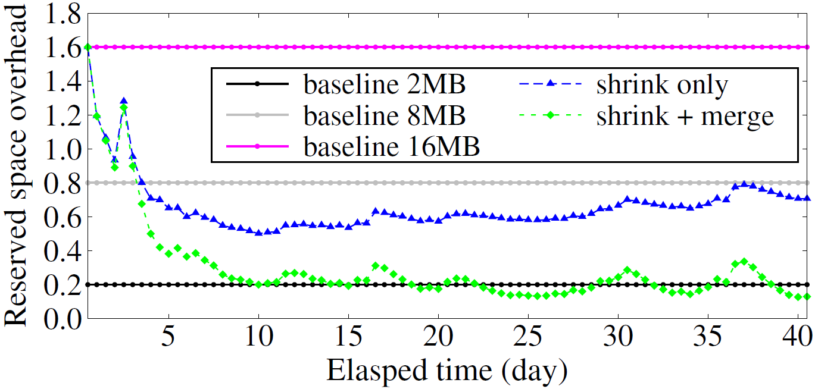
Dynamic Resizing of Reserved Space
Reserved space overhead under different shrink strategies in Harvard trace
16MB baseline
Shrink only performs shrinking at 00:00 and 12:00 each day
Shrink + merge performs a merge after the daily shrinking
*(10,8) Cauchy RS Coding with 16MB segments

Slide 32
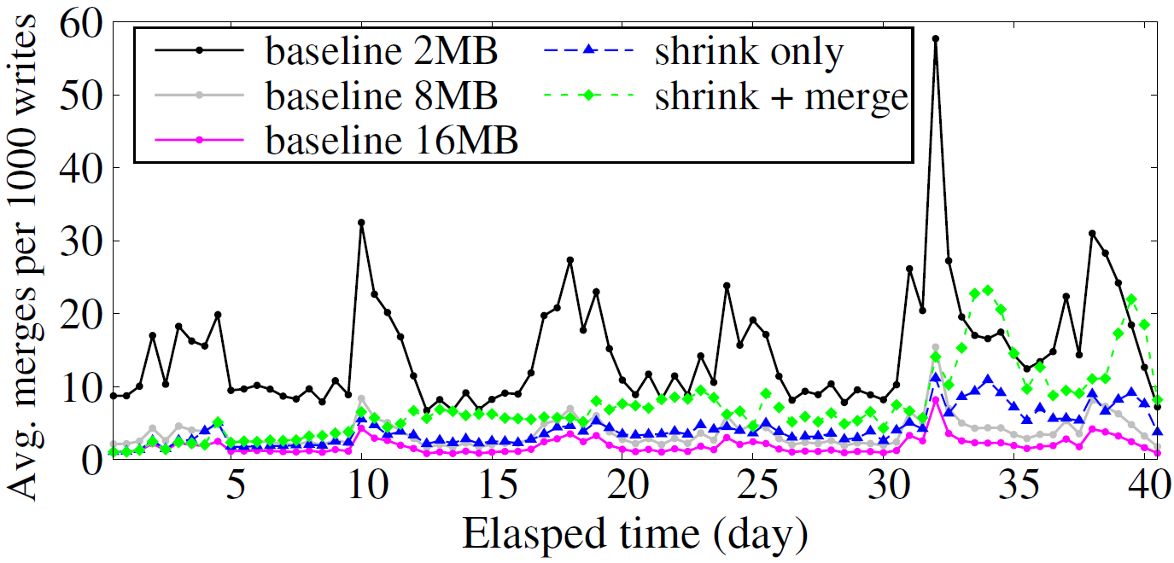
Penalty of Over-shrinking
Average number of merges per 1000 writes under different shrink strategies in the Harvard trace
Penalty of inaccurate prediction
Less than 1% of writes are stalled by a merge operation
*(10,8) Cauchy RS Coding with 16MB segments

Slide 33
Open Issues
Latency analysis
Metadata management
Consistency / locking
Applicability to different workloads

Slide 34
Conclusions
Key idea: Parity logging with reserved space
Keep parity updates next to parity chunks to reduce disk seeks
Workload aware scheme to predict and adjust the reserved space size
Build CodFS prototype that achieves efficient updates and fast recovery
Source code: http://ansrlab.cse.cuhk.edu.hk/software/codfs

Slide 35
Backup

Slide 36
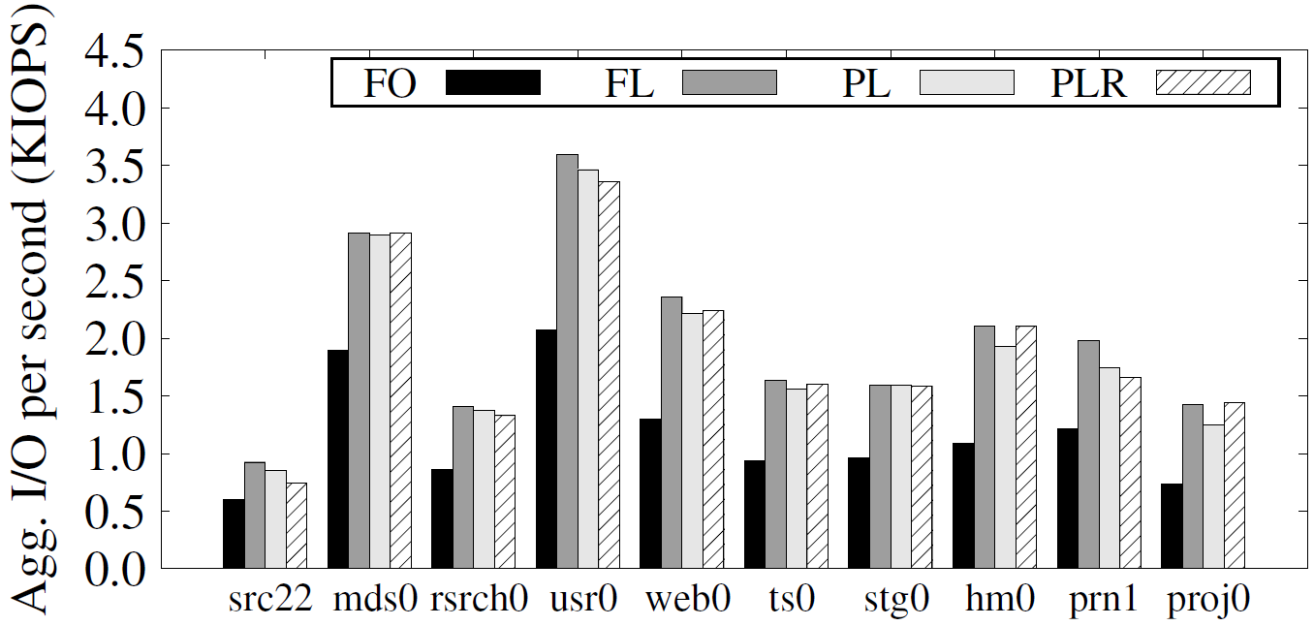
MSR Cambridge Traces Replay
PLR ~ PL ~ FL >> FO
Update Throughput

Slide 37
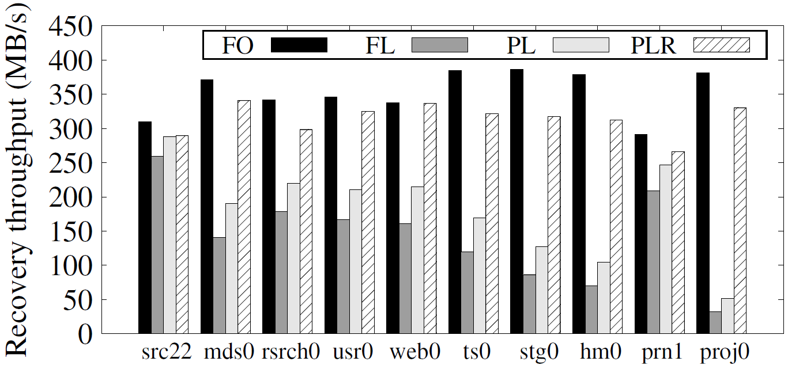
MSR Cambridge Traces Replay
PLR ~ FO >> FL ~ PL
Recovery Throughput

