Slide 1
General Feature Selection for Failure Prediction in Large-scale SSD Deployment
Fan Xu¹, Shujie Han², Patrick P. C. Lee²,
Yi Liu¹, Cheng He¹, and Jiongzhou Liu¹
¹Alibaba Group
²The Chinese University of Hong Kong
Notes:
Hi, I am Shujie Han from The Chinese University of Hong Kong.
I am going to present the work “General feature selection for
failure prediction in large-scale SSD deployment”.
This is a joint work with Fan Xu, Patrick Lee and
folks from Alibaba Group.

Slide 2
Motivation
Solid-state drive (SSD) failures are prevalent in production
Machine learning techniques complement traditional redundancy protection schemes
Self-Monitoring Analysis and Reporting Technology (SMART) logs
Feature selection for general SSD failure prediction
One feature selection approach may be inapplicable for all drive models
Various feature selection approaches may select different sets of features
Considering SSD characteristics, how to select features?
Notes:
Maintaining storage reliability is critical for large-scale data centers.
As solid-state drives have become the mainstream building blocks
in large-scale data centers, the storage reliability of data centers
depends on the reliability of SSDs.
However, large-scale SSD deployment is often challenged by prevalent
SSD failures.
To complement traditional redundancy protection schemes, we explore
SSD failure prediction with machine learning techniques as a proactive
fault tolerance mechanism based on SMART logs, instead of proprietary
attributes, so as to study general SSD failure prediction, which may be
applicable for general production environments.
The prerequisite of general SSD failure prediction is feature selection,
which aims to select the effective learning features.
In particular, some learning features are weakly correlated to failures
and bring noises into the failure prediction. Such uncorrelated learning
features may decrease the prediction accuracy. Thus, we need to select
the effective learning features and filter out uncorrelated ones.
However, there exist some challenges.
One feature selection approach may be inapplicable for all drive models.
Various feature selection approaches may select different sets of features.
Most existing studies select features based on statistical analysis, without
considering SSD characteristics.

Slide 3
Our Contribution
Measurement study on nearly 500K SSDs at Alibaba
Feature importance characterization
WEFR, general feature selection for SSD failure prediction
An automated and robust manner
Update features with wear-out degree
Evaluation on nearly 500K SSDs at Alibaba
Improve F0.5-score by 10% (4-6%) compared to no feature selection (existing approaches) with comparable runtime performance
Release our dataset for public use
Notes:
This work makes the following contributions:
We motivate our work via a measurement study on feature importance
characterization using a dataset of nearly 500K SSDs at Alibaba.
We find that the learning features have different correlations with
SSD failures across different drive models, and various feature
selection approaches select different sets of learning features.
Also, the selected learning features vary with the wear-out degree
for a drive model.
We then propose WEFR, which selects the SMART attributes as features
in an automated and robust manner and updates features with
the wear-out degree for a drive model. WEFR can be used for
large-scale SSD failure prediction of different drive models and vendors.
We conduct trace-driven evaluation on WEFR using our dataset. WEFR
improves F0.5-score by 10% and 4-6% compared to no feature selection
and existing approaches, respectively, with comparable runtime performance.
We also release our dataset for public use.

Slide 4
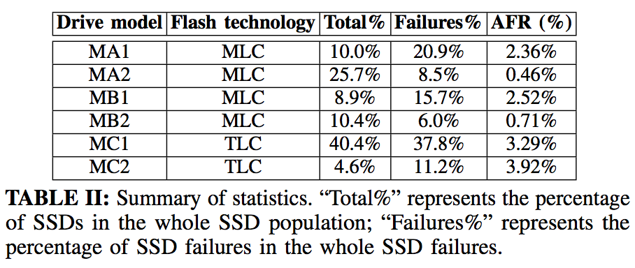
Data Collection
Collect nearly 500K SSDs of 6 drive models from 3 vendors over two-year span (Jan. 2018 - Dec. 2019) at Alibaba
Data types: SMART logs and trouble tickets
Notes:
We collect nearly 500K SSDs of six drive models from 3 vendors
over a two-year span from January 2018 to December 2019 at
Alibaba.
Our dataset includes two data types: SMART logs and trouble tickets.
We collect SMART logs for each SSD on a daily basis.
Each SMART attribute has both raw and normalized numerical values.
The dataset spans 22 SMART attributes.
Our maintenance system generates trouble tickets, once detecting
abnormal behaviors and failures. Our dataset covers 7K trouble tickets.
This table shows the basic statistics, including the flash technology,
percentage of SSDs in the whole SSD population, percentage of
SSD failures in the whole SSD failures, and annualized failure rates.

Slide 5
Background
SSD Failure prediction
Offline classification problem
View raw and normalized values of each SMART attribute as two features
Input variables: a vector of features
Output variable: drive status (0 means healthy and 1 means failed)
Feature selection approaches
Pearson correlation, Spearman correlation, J-index, Random forest (RF), and XGBoost
Notes:
We formulate SSD failure prediction as an offline classification
problem to predict whether an SSD will fail within near future
(e.g., within the next 30 days).
We view raw and normalized values of each SMART
attribute as two features and call a vector of features as input
variables. We view the drive status as an indicator variable
(called the output variable) (0 means healthy and 1 means failed).
We consider five state-of-the-art feature selection approaches
for SSD failure prediction, including Pearson correlation, Spearman
correlation, J-index, Random forest, and XGBoost.

Slide 6
Feature Importance Characterization
Feature importance for SSD failure prediction
Feature importance: effectiveness of features for predicting SSD failures
Feature importance scores for all features using Random forest
Different correlations between features and SSD failures
Trivial features as noises may decrease the prediction accuracy
Notes:
We next characterize the feature importance.
We regard the raw or normalized value of each SMART attribute
as a feature.
We refer to the effectiveness of features for predicting SSD
failures as feature importance. We calculate the feature
importance score of all features using Random Forest feature
importance evaluation.
This table shows the top and last three important features
to predict SSD failures for each drive model.
We observe that there are different correlations between
features and SSD failures. In addition to important features,
there also exist trivial features (e.g., the feature importance
scores of the last three important features are only 0.001).
Such trivial features may decrease the prediction accuracy as
noises. Thus, feature selection is necessary for predicting SSD
failures.

Slide 7
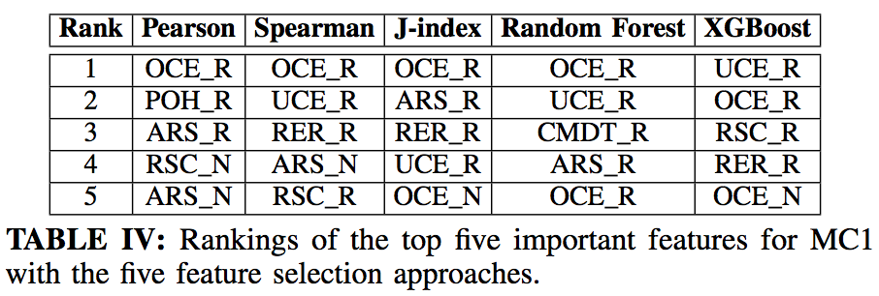
Feature Importance Characterization
Feature importance using different selection approaches
Rankings of top five important features vary across feature selection approaches
Which feature selection approach is more effective?
How many important features should we select?
Notes:
We measure the feature importance with the five
state-of-the-art feature selection approaches to
examine the selected features that are different
across feature selection approaches.
This table shows that the rankings of the top five
important features for MC1 vary across feature
selection approaches. This finding also holds for
the other drive models, which are not shown in the table.
Such different rankings bring the following issues:
Which feature selection approach is more effective?
How many important features should we select?
We will provide an automated and robust feature selection
method to address the issues.

Slide 8
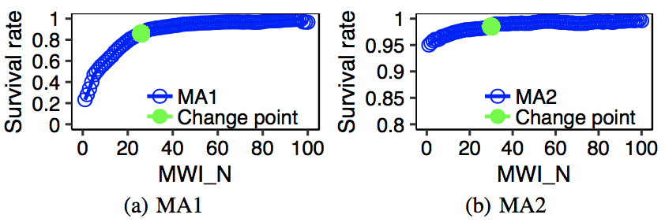
Feature Importance Characterization
Feature importance with different wear-out degrees
Use normalized value of media wear-out indicator (MWI_N)
Measure survival rate on each value in the range of MWI_N
Survival rate changes with MWI_N for MA1, MA2, MC1, and MC2
SSD characteristics may change with the wear-out degree
Fig. 1: Relationships between the survival rate and MWI_N. Green points are change points detected using the Bayesian change point detection. We omit MB1 and MB2 here due to a small range of MWI_N.
Notes:
As read/write workloads are correlated with SSD failures
via the media wear-out, we study the relationship between
the wear-out degree and SSD failures.
To quantify the wear-out degree, we use MWI_N, which
indicates the percentage of the remaining erase cycles for
an SSD; a lower MWI_N means a higher wear-out degree.
We measure the survival rate on each value in the range of MWI_N.
We observe that the survival rate changes with MWI_N for
MA1, MA2, MC1, and MC2, while it does not show a clear
trend for MB1 and MB2 due to a small range, which we omit
here. Also, SSD characteristics may change with the wear-out
degree.
We identify the changes of survival rate using the Bayesian
change point detection. Please refer to the details in the paper.
In this figure, the green points are the change points.

Slide 9
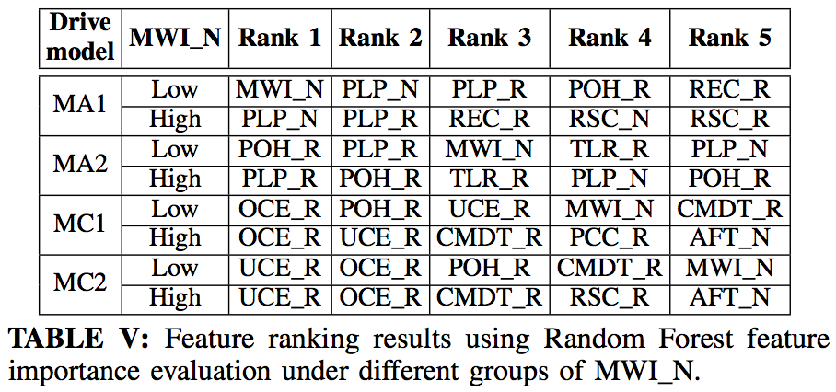
Feature Importance Characterization
Feature importance with different wear-out degrees
Divide SSDs into two groups by the threshold of MWI_N
Top five important features vary across different groups of MWI_N
Need to update features when predicting SSD failures with MWI_N
Notes:
We next divide SSDs into two groups of different values of MWI_N
by the threshold of MWI_N corresponding to the most significant
change point of survival rate.
We examine the feature importance with different groups of MWI_N.
This table shows that the top five important features vary across
different groups of MWI_N for the four drive models (note that there is
no change point for MB1 and MB2).
We observe that MWI_N and POH_R (i.e., raw value of power-on hours)
are more important for the groups
with low MWI_N values than those with high MWI_N values.
This observation indicates that MWI_N has greater impact on
predicting SSD failures with low MWI_N values.
Thus, we need to update features when predicting SSD failures with MWI_N.

Slide 10
WEFR
Wear-out-updating Ensemble Feature Ranking
General feature selection for SSD failure prediction
Challenges and key techniques
Robust feature selection
Combine different feature selection approaches
Automated feature selection
Determine the number of selected features automatically
Updating feature selection
Select features with different values of MWI_N
Update the selected features over time
Notes:
We propose Wear-out-updating Ensemble Feature Ranking,
a general feature selection approach for SSD failure prediction.
WEFR addresses the following challenges:
Robust feature selection. Different feature selection approaches
may select different features. Also, a feature selection is not
always the optimal for various drive models. Thus, WEFR
will combine different feature selection approaches to select
features in a robust manner.
Automated feature selection. The effectiveness of SMART
attributes as features and the optimal number of
selected features vary across drive models. Thus, WEFR
will determine the number of selected features automatically
for different drive models.
Updating feature selection. The selected features vary with
different wear-out degrees. Also, the wear-out degrees of
SSDs increase with time. Thus, WEFR will select features
for SSDs with different values of MWI_N and update the
selected features over time.

Slide 11
WEFR
Workflow
Input: all features of SMART attributes from the same drive model
Robust feature selection
Perform preliminary feature selection
Filter out the outlier feature selection approach by checking similarities of rankings
Automated feature selection
Automatically determine the feature count
Updating feature selection
Detect change points for survival rate
Update selected features with wear-out degree
Output: selected features
Notes:
Let's look at the workflow of WEFR.
It takes the features of SMART attributes from the same
drive model as inputs. It performs preliminary feature selection
approaches and ranks features with feature importance. To
prevent the bias of some ineffective feature selection approach,
it removes the rankings with large deviations from others and
obtains the final rankings by the mean of rankings.
It automatically determines the feature count and selects the
final features. If it detects change points for survival rate of
MWI_N, it updates the selected features for the SSD groups
with different groups of MWI_N. Finally, it outputs the selected features.

Slide 12
WEFR
Robust feature selection
Perform preliminary feature selection approaches
Examine the similarity between rankings of preliminary feature selection
Filter out the outlier feature selection approach
Automated feature selection
Measure feature effectiveness and determine feature count automatically
Updating feature selection
Detect change points of survival rate and divide SSDs into different groups of MWI_N
Update features for each group of MWI_N periodically
Notes:
Let’s look at the details of our design.
For robust feature selection, WEFR performs preliminary
feature selection with common feature selection approaches.
As the rankings of features for some feature selection
approaches may substantially differ from other feature selection
approaches, it is necessary to check and remove such outliers
of rankings automatically. Thus, WEFR first examines similarities
between the rankings from two feature selection approaches
with the Kendall Tau rank distance and next filters out the outlier
feature selection approach.
For automated feature selection, WEFR first measures the
effectiveness of a feature to classify different classes by applying
the ensemble of complexity measures and then determines the
feature count automatically by using the results of feature
effectiveness.
For updating feature selection, WEFR detects change points
of the survival rate using the Bayesian change point detection
and divides SSDs into different groups of MWI_N with the threshold
of MWI_N (i.e., the most significant change point of the survival rate
corresponding to the MWI_N).
Also, it periodically checks the change points of MWI_N (one week in
our case) and updates the selected features for each group of MWI_N.

Slide 13
Evaluation
Methodology
The first 21, 22, and 23 months as training phases for the 22th, 23th, and 24th month as testing phases
Set ratio of training period length to validation period length as 8:2
Use Random Forest as prediction model
Metrics
Precision, recall, F0.5-score
F0.5-score is to weigh precision twice as important as recall, so as to reduce the cost of replacing a healthy SSD
Notes:
For the evaluation, we divide the 24-month samples,
including positive and negative samples into the training
and testing phases by time.
We use the first 21, 22, and 23 months as training
phases for the 22th, 23th, and 24th month as testing phases,
respectively.
In the training phase, we set the ratio of training period
length to validation period length as 8:2. We use Random
Forest as the prediction model.
We evaluate the prediction accuracy of WEFR with the
precision, recall, and F0.5-score. From our practical
experience, we use the F0.5-score to weigh the precision
twice as important as recall, so as to reduce the cost of
replacing a healthy SSD.

Slide 14
Evaluation
Effectiveness of robust feature selection
Overall, WEFR improves F0.5-score by 10% compared to no feature selection
WEFR generally improves F0.5-score by 4-6% compared to the state-of-the-art feature selection approaches
Notes:
We first evaluate the effectiveness of robust feature
selection. We compare the prediction accuracy of
WEFR with no feature selection (i.e., using all features)
and five state-of-the-art feature selection approaches.
For the five state-of-the-art feature selection approaches,
we tune the percentage of selected features linearly from
10% to 100% to find the highest prediction accuracy.
This table shows that overall, WEFR improves
the F0.5-score by 10% compared to no feature
selection for all drive models.
Also, WEFR generally improves the F0.5-score by
4-6% compared to the state-of-the-art feature selection
approaches.

Slide 15
Evaluation
Effectiveness of automated feature selection
F0.5-score of WEFR is always higher than or equal to the highest F0.5-score when fixing the percentage of selected features
Notes:
We next evaluate the effectiveness of automated feature
selection in WEFR. Specifically, we compare WEFR with
using a fixed percentage of selected features
(varied linearly increasing from 10% to 100%).
This figure shows that the F0.5-score of WEFR
is always higher than or equal to the highest F0.5-score when
fixing the percentage of selected features for the six drive models.
Also, using automated feature selection is more flexible than
tuning for the appropriate percentage of selected features in production.

Slide 16
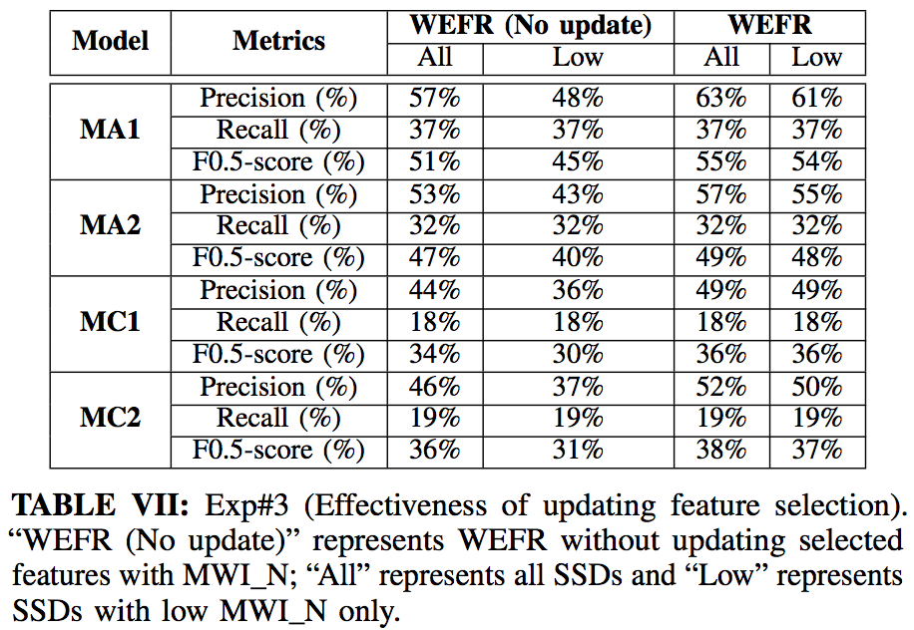
Evaluation
Effectiveness of updating feature selection
WEFR improves precision and F0.5-score with updating selected features for MA1, MA2, MC1, and MC2 compared to no updating feature selection
Notes:
We next evaluate the effectiveness of updating feature
selection. We compare WEFR with and without updating
feature selection for SSD failure prediction on MA1, MA2,
MC1, and MC2. Recall that there is no change point of
the survival rate for MWI_N for MB1 and MB2.
This table shows that WEFR improves the precision and
F0.5-score with updating selected features for MA1, MA2,
MC1, and MC2 compared to no updating feature selection.
It confirms that feature importance scores vary with MWI_N and
it is necessary to update the selected features with MWI_N.

Slide 17
Evaluation
Runtime of state-of-the-art feature selection and WEFR
Average runtime with MC1 over 20 rounds
Spearman correlation is the slowest one among state-of-the-art approaches
WEFR executes state-of-the-art approaches in parallel, so its runtime is comparable with those approaches
Notes:
We evaluate the runtime performance of the state-of-the-art
feature selection approaches and WEFR using MC1
(i.e., the drive model with the largest population).
This table shows the average runtimes with MC1 over 20
rounds. We observe that the Spearman correlation is the
slowest one among the state-of-the-art approaches.
WEFR executes the state-of-the-art approaches in parallel,
so its runtime is comparable with those approaches.

Slide 18
Conclusion
WEFR, general feature selection to select features from SMART attributes
Robust feature selection
Determine feature count automatically
Update features with wear-out degree
Evaluation on nearly 500K SSDs
WEFR generally improves the prediction accuracy across six drive models
Dataset:
https://github.com/alibaba-edu/dcbrain/tree/master/ssd_smart_logs
Notes:
To conclude, we propose WEFR, a general feature selection
to select features from SMART attributes. WEFR combines
different feature selection approaches for robust feature
selection, determines the feature count automatically, and
updates the selected features with changes of wear-out degrees.
Our evaluation on nearly 500K SSDs shows that WEFR
generally improves the prediction accuracy across the six
drive models. Our dataset is released for public validation.

Slide 19
Thank You! Q & A
Notes:
Thank you. I’d like to take your questions and comments.

