Slide 1
Information Leakage in Encrypted Deduplication via Frequency Analysis
Jingwei Li*, Chuan Qin#, Patrick P. C. Lee#, Xiaosong Zhang*
*University of Electronic Science and Technology of China
#The Chinese University of Hong Kong
DSN 2017

Slide 2
Data Explosion
Digital universe projected to grow from 4.4 ZB in 2013 to 44 ZB in 2020 ^{[1]} (Note: 1 ZB = 1 trillion GB)
Data outsourcing to public clouds is common to ease data management
Deduplication removes content duplicates to save storage space
50% space saving for Windows file system snapshots ^{[Meyer, FAST’11]}
98% space saving for backup data ^{[Wallace, FAST’12]}
[1] https://www.emc.com/leadership/digital-universe/2014iview/executive-summary.htm

Slide 3
Deduplication
Deduplication → coarse-grained compression
Unit: chunk (fixed- or variable-size)
Store only one copy of chunks with same content; other chunks refer to the copy by references (pointers)
Storage space saved by 5/12 = 42%!

Slide 4
Encryption vs. Deduplication
Securing outsourced data is critical
Traditional encryption is incompatible with deduplication
Alice’s key
Plaintext M₁
K
Ciphertext C₁
Can be
dedup’ed
Can’t be
dedup’ed
Plaintext M₂
K’
Ciphertext C₂
Bob’s key
Duplicate chunks encrypted by different keys → different ciphertext chunks

Slide 5
Encrypted Deduplication
Message-locked encryption (MLE) ^{[Bellare, EuroCrypt’13]}
A general framework using content-derived keys for encryption
Content-derived key
Plaintext M₁
K
Ciphertext C₁
Can be
dedup’ed
Can be
dedup’ed
Plaintext M₂
K
Ciphertext C₂
Content-derived key
Examples: Convergent encryption ^{[Douceur, ICDCS’02]}; Server-aided MLE ^{[Bellare, Security’13]}

Slide 6
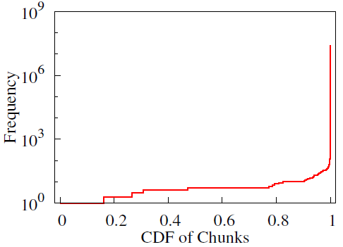
Is MLE Fully Secure?
(Server-aided) MLE is deterministic encryption
Same plaintexts lead to same ciphertexts
Leak frequency distribution of plaintext chunks
Practical storage workloads exhibit non-uniform frequency distribution
99.8% of chunks appear less than 100 times, while 30 chunks appear over 10,000 times
Frequency distribution of FSL dataset

Slide 7
Frequency Analysis
Frequency analysis was proposed by Al-Kindi, an Arab polymath, in 9th century
Break substitution ciphers
Frequency analysis against encrypted deduplication:
Acquire knowledge of frequency distribution of plaintext chunks (e.g., via unintended data release [*] or data breaches)
Count frequencies of ciphertext chunks
Infer their plaintext chunks from ciphertext frequency distribution
What is practical implication of frequency analysis against encrypted deduplication?
[*] https://techcrunch.com/2006/08/07/aol-this-was-a-screw-up/

Slide 8
Our Contributions
Propose locality-based attack to exploit chunk locality to increase attack severity
Ciphertext-only attack: infer 17.8% of data (vs. 0.0001% for classical frequency analysis)
Known-plaintext attack: infer 27.1% of data with only 0.2% of data leakage
Demonstrate MinHash encryption effectively resists frequency analysis
Suppress inference rate of a real-world dataset to below 0.45%, even with a small leakage (e.g., 0.2%)
Maintain deduplication saving as shown by prior work

Slide 9
Threat Model
Target backup workloads
High content redundancy for deduplication [Zhu, FAST’08; Wallace, FAST’12]
Chunk locality [Lillibridge, FAST’09; Xia, ATC’11]
Access to auxiliary information (ground truth)
Plaintext chunks of some prior backup
Access to logical order of ciphertext chunks of latest backup before deduplication
e.g., C = (C₁,C₂,C₅,C₂,C₁,C₂,C₃,C₄,C₂,C₃,C₄,C₄)
Provide both frequency and locality information of latest backup
Existing deduplication systems also process chunks in logical order (e.g., DDFS ^{[Zhu, FAST’08]})

Slide 10
Threat Model
Adversarial goal: infer the content of plaintext chunks given the ciphertext chunks of the latest backup
Ciphertext-only: only ciphertext chunks of latest backup known
Known-plaintext: some plaintext chunks of latest backup known
MLE protection
Dedup module
...
Chunk
Chunk
Disks
Tapped by adversary
Deduplication system

Slide 11
Security Implication
Infer critical files of an encrypted backup snapshot
e.g., system files, user databases
How-to: Given plaintext chunks of some critical files, identify the ciphertext chunks that are inferred to those plaintext chunks
The identified ciphertext chunks can be later attacked specifically (e.g., corruption or malicious attacks)

Slide 12
Basic Attack
Given prior backup M = {M}, apply frequency analysis to infer plaintext chunks in latest backup C = {C}
Sort chunks of M and C by chunk frequency
Infer that i-th frequent chunk in M = plaintext chunk of i-th frequent chunk in C
(Note: Numbers of chunks in M and C may differ)
Result: small inference accuracy
Sensitive to data updates
Many “ties” in frequency sorting

Slide 13
Locality-based Attack
Chunk locality: tendency of chunks and their neighbors to re-occur across backups
Example: if chunk M₁ is surrounded by M₂, M₃, M₄ in one backup, then M₁ is likely to be surrounded by M₂, M₃, M₄ in next backup
Improve deduplication indexing [Zhu, FAST’08; Lillibridge, FAST’09; Xia, ATC’11]
Adapt chunk locality to frequency analysis
If M is mapped to C, then neighbors of M are also probably mapped to neighbors of C
Iteratively infer more ciphertext-plaintext pairs

Slide 14
Locality-based Attack
Frequency analysis
top-frequent pairs
Frequency analysis
C
Associative arrays
L_{C} = left chunks of C
L_{M} = left chunks of M
R_{C} = right chunks of C
R_{M} = right chunks of M
inferred set
G = {(C, M)}
top-frequent pairs
(C, M)
M
main loop
Number of top-frequent pairs and size of inferred set are configurable

Slide 15
Example
M
C
M₁
M₂
M₁
M₂
M₃
M₄
M₂
M₃
M₄
C₁
C₂
C₅
C₂
C₁
C₂
C₃
C₄
C₂
C₃
C₄
C₄
map most freq chunks
M₁
M₂
M₁
M₂
M₃
M₄
M₂
M₃
M₄
C₁
C₂
C₅
C₂
C₁
C₂
C₃
C₄
C₂
C₃
C₄
C₄
map left/right chunks
M₁
M₂
M₁
M₂
M₃
M₄
M₂
M₃
M₄
C₁
C₂
C₅
C₂
C₁
C₂
C₃
C₄
C₂
C₃
C₄
C₄
map right chunks
M₁
M₂
M₁
M₂
M₃
M₄
M₂
M₃
M₄
C₁
C₂
C₅
C₂
C₁
C₂
C₃
C₄
C₂
C₃
C₄
C₄
C₁
C₂
C₅
C₂
C₁
C₂
C₃
C₄
C₂
C₃
C₄
C₄
Infer 4 out of 5 unique chunks

Slide 16
Attack Evaluation
Datasets
FSL ^{[Sun, MSST’16]}: 5 monthly backups from Jan 22 to May 21, 2013, covering 2.69 TB in total
Synthetic: 10 image snapshots derived from a Ubuntu image (4.28 GB space) via controlled modifications ^{[Lillibridge, FAST’13]}
Testbed: Quad-core 3.0GHz CPU and 16GB RAM
15 hours to process 500 GB of data

Slide 17
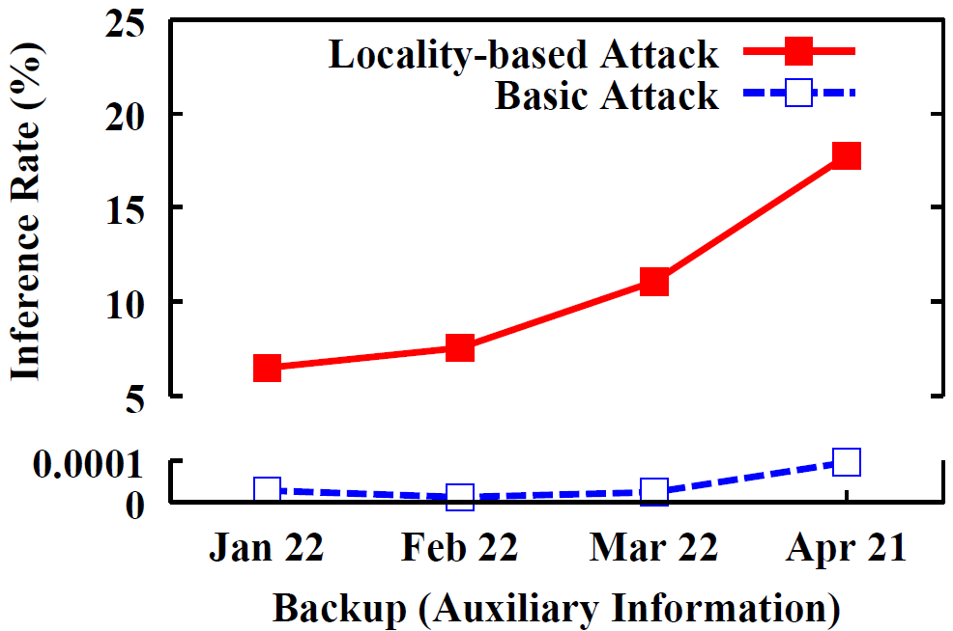
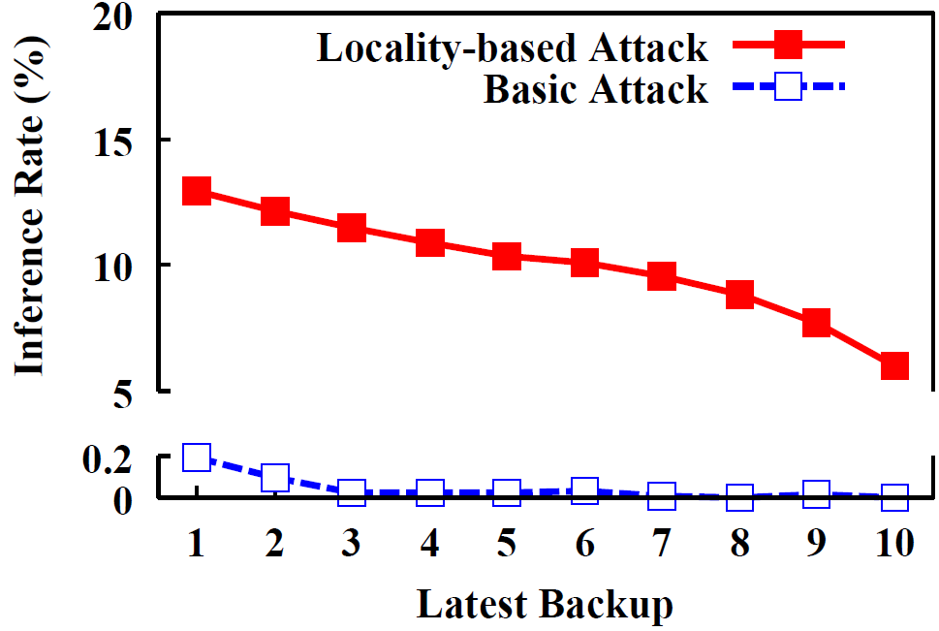
Ciphertext-only
FSL
Auxiliary: Prior backup in x-axis
Target: Backup on May 21
Synthetic
Auxiliary: Initial Ubuntu snapshot
Target: Latest backup in x-axis
Locality-based attack has much higher inference rate than basic attack (e.g., 17.8% vs 0.0001% in FSL)

Slide 18
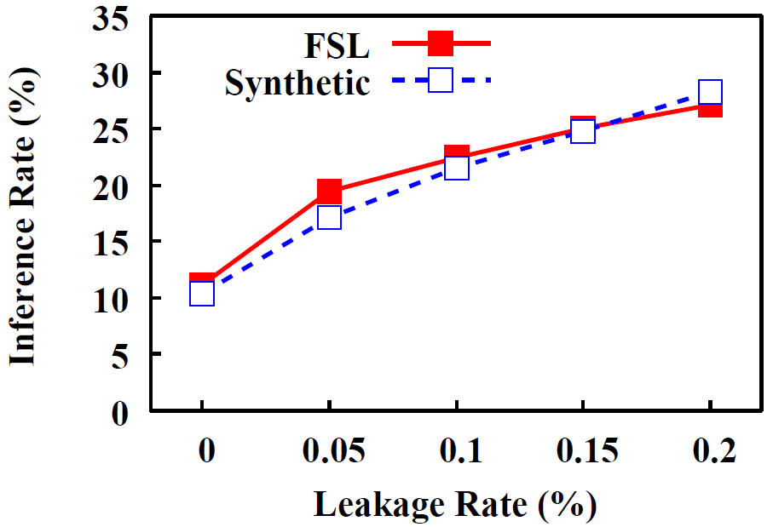
Known-plaintext
Slight increase in leakage rate → significant increase in inference rate
FSL: from 11.1% to 27.1%
Synthetic: from 10.3% to 28.3%

Slide 19
Defense: MinHash Encryption
MinHash deduplication shown to mitigate performance overhead [Bhagwat, MASCOTS’09; Xia, ATC’11; Qin, ToS’17]
Storage efficiency only slightly degrades, by Border’s theorem
MinHash encryption’s flow:
Group chunks into segments
Choose minimum-fingerprint (minHash) chunk of each segment
Derive encryption key from the minHash chunk
Encrypt every chunk in the segment with the derived key
Rationale:
Disturb frequency ranking to combat frequency analysis, while maintaining deduplication saving

Slide 20
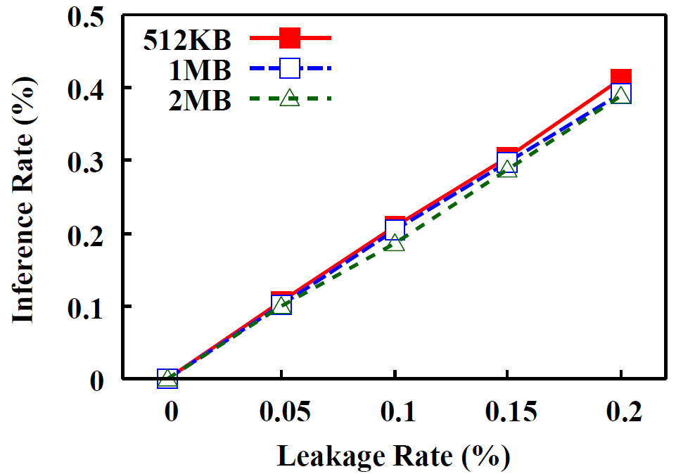
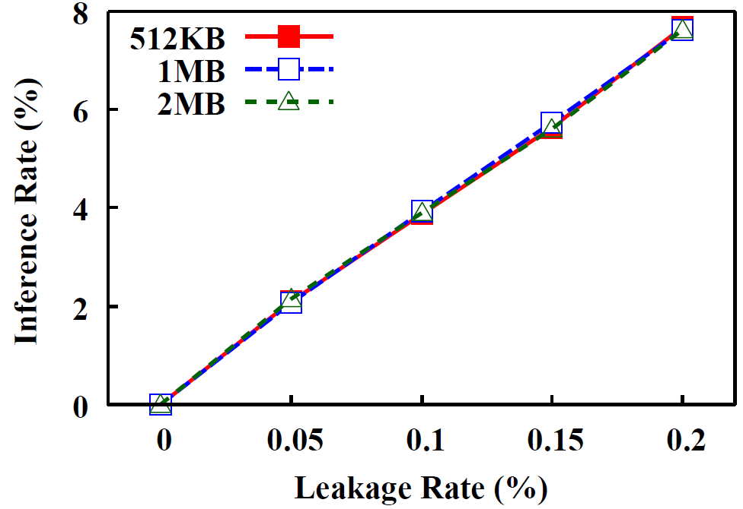
Defense Evaluation
FSL
Synthetic
MinHash encryption significantly reduces inference rate
FSL: from up to 27.1% to 0.45%
Synthetic: from up to 28.3% to 8%

Slide 21
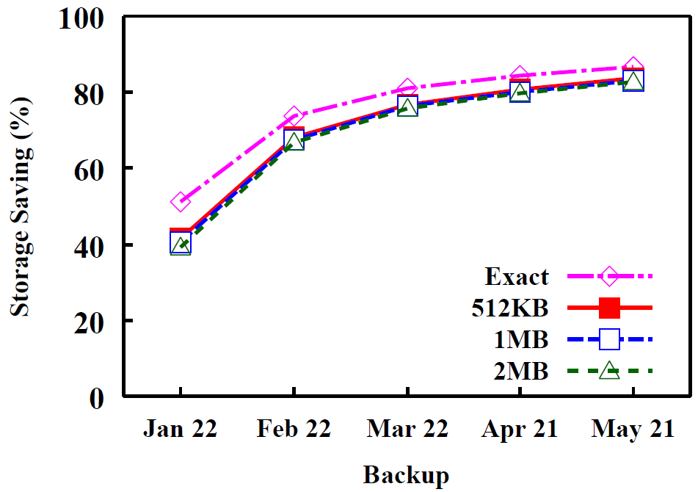
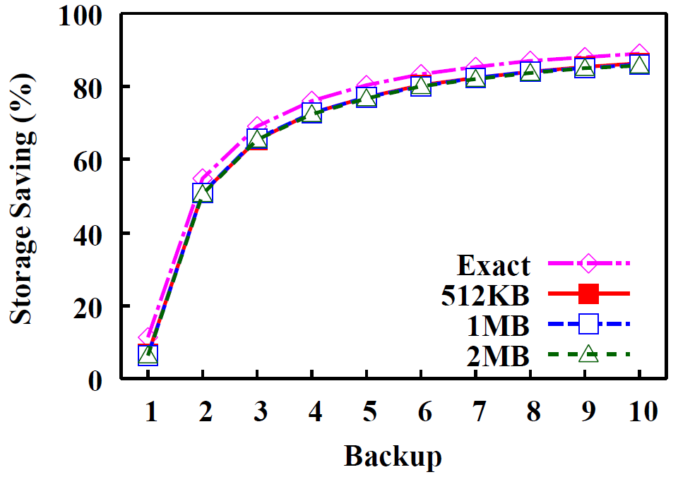
Storage Efficiency
FSL
Synthetic
Maintain storage saving
3-4% off from exact chunk-based deduplication

Slide 22
Conclusions
Locality-based attack is a new frequency analysis attack that severely compromises encrypted deduplication
MinHash encryption effectively defends against frequency analysis, with high storage efficiency
Many open questions on both attack and defense sides
Source code: http://adslab.cse.cuhk.edu.hk/software/freqanalysis

