Slide 1
Rekeying for Encrypted Deduplication Storage
Jingwei Li*, Chuan Qin*, Patrick P. C. Lee*, Jin Li#
*The Chinese University of Hong Kong
#Guangzhou University
DSN 2016

Slide 2
Cloud Storage
Outsourcing data management to public cloud storage is common today
Challenges:
Security in outsourced storage
Storage efficiency
Solutions:
Encryption: encrypts data before outsourcing
Deduplication: stores one message for redundant messages with same content
Compression can be further applied

Slide 3
Encryption vs. Deduplication
Message M1
K
C
Can be
dedup’ed
Can’t be
dedup’ed
Message M2
K’
C’
Traditional encryption prohibits deduplication
Same messages encrypted with different keys → different ciphers

Slide 4
Encrypted Deduplication
Message-locked encryption [Bellare, EUROCRYPT’13]
Derive encryption key from message itself
Same message → Identical cipher text
e.g., convergent encryption: key = message hash
DupLESS [Bellare, USENIX Security’13]
Realizes message-locked encryption
A dedicated key manager for key generation
MLE key generated by a derivation function
Same messages → same ciphers
Ciphers appear random

Slide 5
Rekeying
Rekeying renews security protection
Replaces an existing key with a new encryption key
Benefits:
Protects against key compromise
Revokes unauthorized users from accessing data
Challenges:
Renewing derivation function makes new data fail to be dedup’ed with old data
Cipher re-encryption is expensive

Slide 6
Rekeying Challenges
Renewing derivation function (e.g., K → K’): new data can’t be dedup’ed with old data:
Cipher re-encryption with new key K’:
Message
Message
K
K’
Old Cipher
New Cipher
K
Message
K’
Old Cipher
New Cipher

Slide 7
Our Contributions
Design REED, a Rekeying-aware Encrypted Deduplication storage system
Provides secure and lightweight rekeying
Preserves content similarity for deduplication
Two encryption schemes for REED
Basic: high performance (203MB/s)
Enhanced: resilient against key leakage (155MB/s)
Enabling dynamic access control
Testbed experiments

Slide 8
Threat Model
Honest-but-curious adversary, who can:
Compromise storage backend
Collude with any revoked client
Attempt to learn files beyond access scope
Monitor keys returned by key manager
Assumptions:
Encrypted and authenticated communication between client and key manager (e.g., by SSL/TLS)
Key manager cannot infer message content (OPRF)
Key manager is deployed in protected zone

Slide 9
Main Idea
Build security on two symmetric keys:
File key: renewable, controlling access for files
MLE key: unchanged, preserving deduplication
Extends convergent all-or-nothing transform (CAONT) [Li, USENIX ATC’15]
Encrypts entire message using MLE key; and further encrypts a small part (stub) using file key
Performs deduplication on large part; yet message is unrecoverable with any small part unavailable
Rekeying on stub (64 bytes, 0.78% for 8KB chunks)

Slide 10
REED Overview
Client
Cloud
File
Server
Chunk
…
Storage
Backend
…
File
Chunk
…
Client
Key Manager
Target workload: backup and archival storage
Notes:
Our work is applicable to general distributed storage systems.

Slide 11
CAONT
[Li, USENIX ATC’15]
Hash Key
Chunk
h
XOR
t
CAONT Package
M
M
C
G
H
XOR
Limitation:
Secure for unpredictable messages only (otherwise, vulnerable to brute-force dictionary attacks)

Slide 12
Basic Encryption
MLE Key
Chunk
K_{M}
XOR
t
Stub
M
M
C
G
H
Trimmed Package
XOR
c
Fix value canary
Two modifications to CAONT
Replaces hash key by MLE key from key manager
Add a canary for integrity checking
Limitation: vulnerable to MLE key compromise

Slide 13
Enhanced Encryption
MLE Key
Chunk
K_{M}
K_{M}
K_{M}
h
XOR
t
Stub
M
M
C₁
C₁
C₂
G
Self-XOR
E
Trimmed Package
XOR
MLE
CAONT
Resilient against MLE key leakage:
First applies MLE to form a ciphertext
Then applies CAONT to the MLE ciphertext
Rationale: MLE ciphertext is further protected by CAONT

Slide 14
Comparison
Basic encryption:
Vulnerable to MLE key compromise
Adversary can recover large part (trimmed package) of the original message with MLE key obtained
Faster encryption
Enhanced encryption:
Higher security level
Adversary needs both MLE key and file key to recover a message
Even if MLE key is disclosed, remains secure for unpredictable messages
Slower encryption

Slide 15
Dynamic Access Control
REED Client
MLE Key
File encryption
File key
File decryption
H
Key state
CP-ABE enc.
REED
Server
Key regression
CP-ABE dec.
Private Derivation Key
Private Access Key
Uses CP-ABE for access control [Bethencourt, S&P’07]
Uses key regression for lazy revocation [Kamara, NDSS’06]

Slide 16
Dynamic Access Control
Lazy revocation
Current key state can derive previous states
Revoked user cannot access future key states
Allows user to access not-yet-updated files
Defers file re-encryption (e.g. midnight update)
Active revocation
Re-encryption happens immediately with new key

Slide 17
Confidentiality
Level 1: same as DupLESS
Adversary can access all trimmed packages, encrypted stubs, and encrypted key states
Level 2: colluding with revoked users
Adversary can learn a set of private access keys from any revoked user
Level 3: monitoring key generation
Adversary can monitor a subset of revoked users and identify MLE keys returned by key manager

Slide 18
Integrity
Basic encryption
By checking the canary attached to recovered chunks
Enhanced encryption
By comparing the hash of MLE ciphertext

Slide 19
Implementation
Entities:
Client: chunking, encryption/decryption, upload/download
Key manager: MLE key generation
Server: deduplication, metadata storage
Cloud: file recipe, stub, key states
Optimization:
Batch key generation requests to mitigate I/O
Cache previous MLE keys to reduce computation
Parallelize key generation, encryption and upload via multi-threading

Slide 20
Evaluation
Datasets
Synthetic dataset (2 GB files with unique chunks)
FSL data trace (147 daily snapshots, 56.2 TB in total)
Testbed
Servers connected over a Gigabit LAN

Slide 21
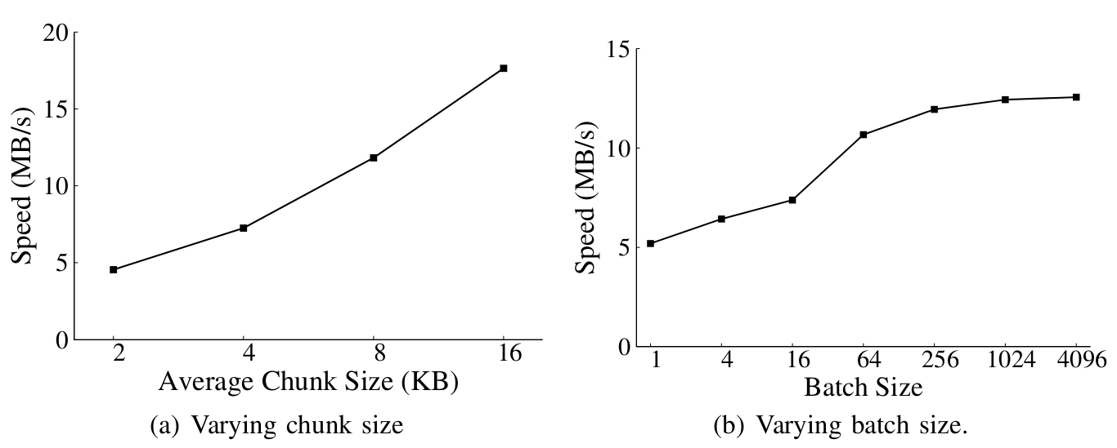
MLE Key Generation
Key generation is expensive (for unique data)
REED achieves 17.64 MB/s

Slide 22
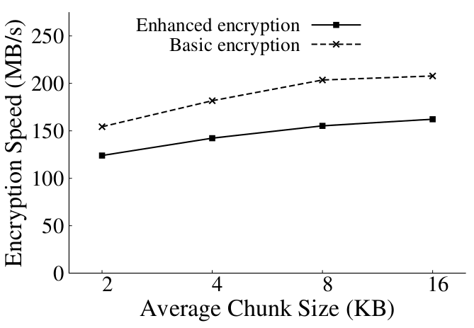
Encryption
Encryption is not a bottleneck
Basic: 203MB/s
Enhanced:155MB/s

Slide 23
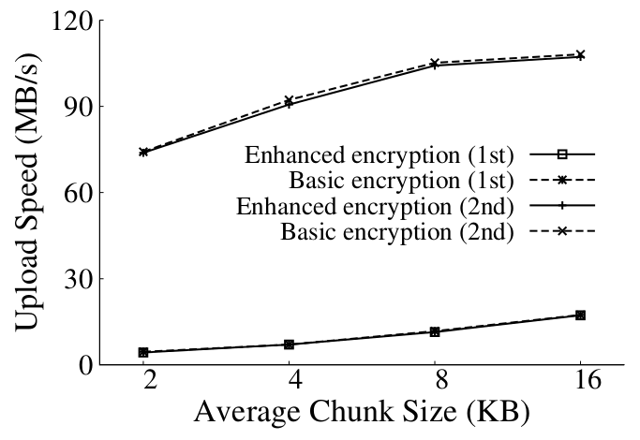
Data Transfer
Caching boosts overall performance
First upload bounded by key generation (17MB/s)
Second upload of identical data bounded by network (106MB/s)

Slide 24
Rekeying Performance
Rekeying delays remain small
3.4s for 8 GB data

Slide 25
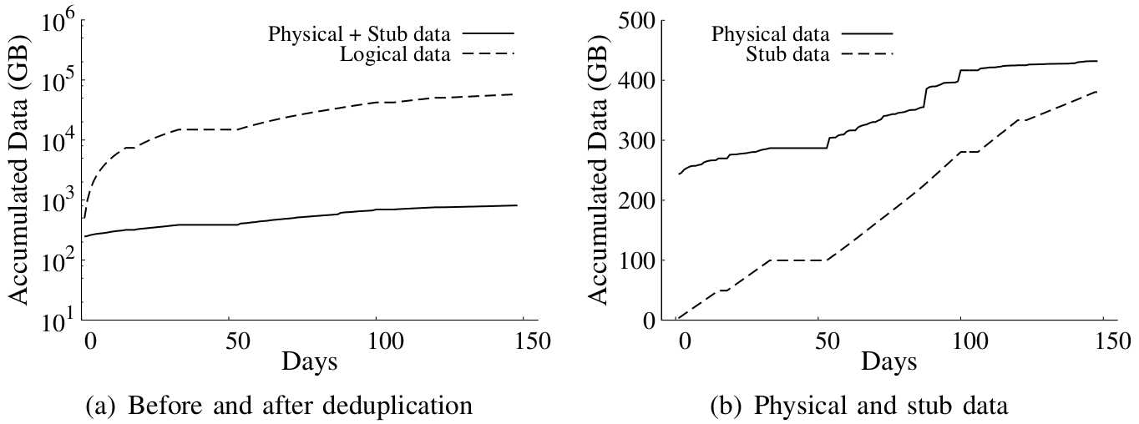
Storage Efficiency
Storage overhead of FSL traces
Storage saving of 98.6%
Reduces storage space for ~56 TB logical data to ~431 GB physical data plus ~380 GB stub data

Slide 26
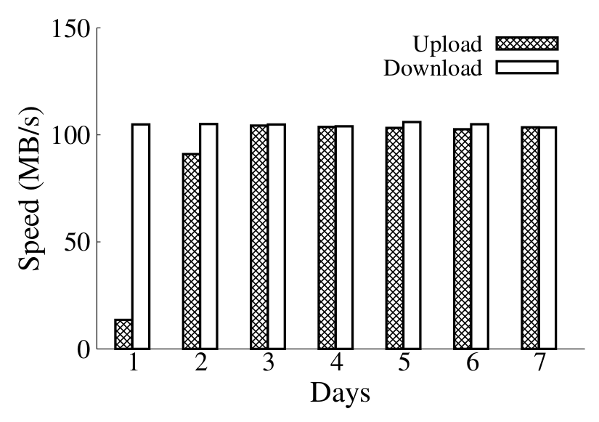
Trace-driven Upload/Download
7 consecutive daily backups
First day around 13.1 MB/s due to key generation
Later transfers reach around 105 MB/s

Slide 27
Conclusions
REED:
Enables rekeying for encrypted deduplication storage
Proposes two encryption schemes
Enables dynamic access control
Implements a prototype
Conducts extensive trace-driven evaluation
Software: http://ansrlab.cse.cuhk.edu.hk/software/reed

