Slide 1
Elastic Parity Logging for SSD RAID Arrays
Yongkun Li*, Helen Chan#, Patrick P. C. Lee#, Yinlong Xu*
*University of Science and Technology of China #The Chinese University of Hong Kong
DSN 2016

Slide 2
SSD Storage
Solid-state drives (SSDs) are widely deployed in desktops and data centers
Extensive field studies by Facebook [Meza, Sigmetrics’15], Google [Schroeder, FAST’16]
Better performance, shock resistance, and power efficiency than harddisks

Slide 3
How SSDs Work?
Basic operations:
Read and write: per-page basis (e.g., 4KB, 8KB)
Erase: per-block basis (e.g., 64 or 128 pages)
Out-of-place write for updates:
Write to a clean page and mark it as valid
Mark the original page as stale
Garbage collection (GC) reclaims stale pages
Erase blocks and relocate any valid page

Slide 4
Challenges
Reliability
Flash errors are commonplace
Error-correcting codes aren’t bullet-proof
Endurance
Blocks allow only limited P/E cycles
Performance
Poor random write performance
GC overhead

Slide 5
SSD RAID
RAID provides fault tolerance
Each stripe contains data chunks and parity chunks
Challenge:
Parity updates aggravate small writes
→ degrade performance and endurance
m1
m2
m3
c1
c1 = m1 + m2 + m3 ‘+’ means XOR
m4
m5
c2
m6
m7
c3
m8
m9
…
…
…
…
SSD₁
SSD₂
SSD₃
SSD₄

Slide 6
Our Contributions
EPLog: a new RAID design for SSD RAID arrays via elastic parity logging
Redirects writes to separate log devices
Constructs “elastic” stripes by new writes only
Maintains high reliability, endurance, performance
Prototype implementation
General fault tolerance with erasure coding
Deployable on commodity hardware
Reliability analysis + testbed experiments

Slide 7
Related Work
Improve parity updates for SSD RAID
Parity caching: requires non-volatile memory [HotDep’09,TC’11,SAC’11]
Elastic striping: incurs RAID-level GC [DSN’13,DSN’15]
Parity logging: needs pre-read and per-stripe computation [ISCA’93]
EPLog extends parity logging with two optimizations

Slide 8
Parity Logging
Original parity logging
Requests: {$A_{0}$, $B_{0}$, $C_{0}$ }, {$A_{1}$, $B_{1}$, $C_{1}$ }, {$B_{0}′$, $C_{0}′$, $A_{1}′$}
Drawbacks:
Pre-read: Extra reads
Per-stripe basis: Extra log chunks; Partial parallelism

Slide 9
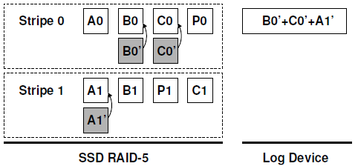
EPLog
Performs out-of-place updates at system level
Computes a log chunk based on new writes
Elastic parity logging:
No pre-reads of existing chunks
A log chunk may span across stripes

Slide 10
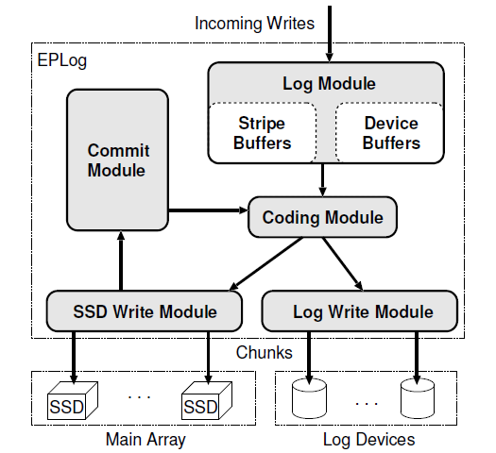
EPLog Architecture
User-level block device layer
SSD main array + harddisk log devices
Parity commit

Slide 11
Design Issues
Limitations:
Extra footprints for log devices
Extra space for multiple versions of chunks
Slow recovery before parity commit
Issues:
Write processing
Parity commit
Caching
Metadata management

Slide 12
Write Processing
Full-stripe new writes
Write directly data/parity chunks to SSD main array
Use k-of-n erasure coding
e.g., RAID-5: k = n - 1
Partial-stripe writes or updates
Write data chunks to SSD main array
Write log chunks to log devices in append-only mode
Log chunks: parity chunks for elastic stripes
Formed by k’-of-n’ erasure coding
k’ = number of data chunks in an elastic stripe
n’ – k’ = number of tolerable failed devices

Slide 13
Parity Commit
Commit latest updates to main array
Identify data stripes
Read latest versions of data chunks from SSDs
Re-compute parity chunks
Write back to SSDs
Release space
Performed regularly or during idle time
No need to access log devices

Slide 14
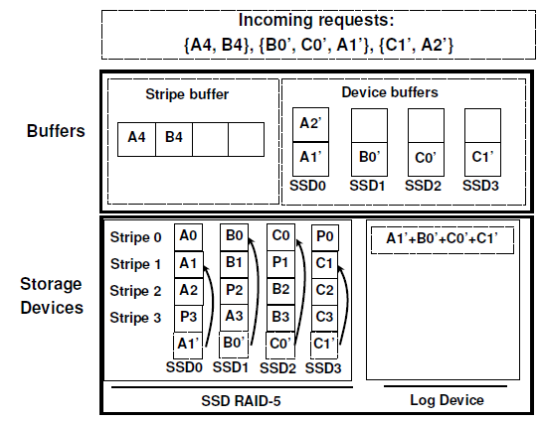
Caching
EPLog offers an optional caching feature
Stripe buffer: New writes
Device buffers: Updates
Notes:
Supports in-place updates

Slide 15
Implementation
Persistent metadata management
Full checkpoint: flushes all metadata
Incremental checkpoint: flushes modified metadata since the last checkpoint
Persistent metadata storage on SSDs
Separate data and metadata on SSDs
RAID-10 for metadata partitions
Multi-threaded writes for performance gains

Slide 16
Reliability Analysis
Question:
Reduced writes to SSDs slow down wearing → improves reliability
Extra harddisk log devices → degrades reliability
Reduced to SSDs slows down the wearing of SSDs and so improves reliability
Compare EPLog and conventional SSD RAID via Markov MTTDL analysis
Our key findings:
EPLog improves reliability in common settings

Slide 17
Experiments
Testbed
Linux Ubuntu 14.04 LTS with kernel 3.13
Plextor M5 Pro 128GB SSDs
Seagate ST1000DM003 7200RPM 1TB SATA HDDs
Four public block-level traces
Write-intensive; dominated by small random writes
Three schemes
Linux software RAID mdadm (MD)
Original parity logging (PL)
EPLog

Slide 18
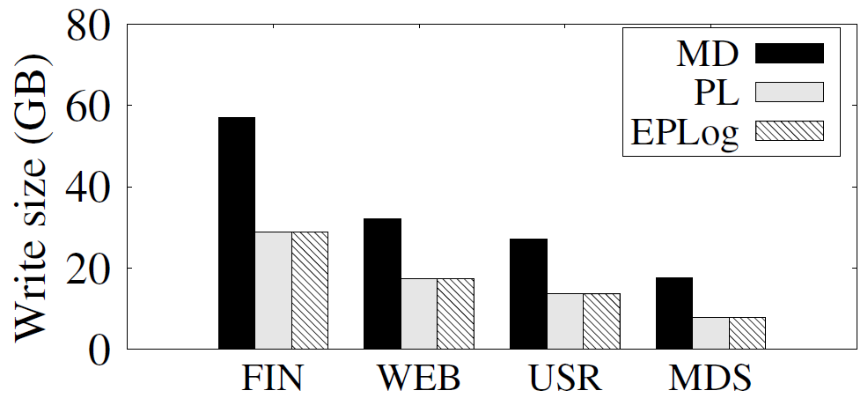
Write Size to SSDs
(6+2)-RAID-6
EPLog has ~50% less writes than MD

Slide 19
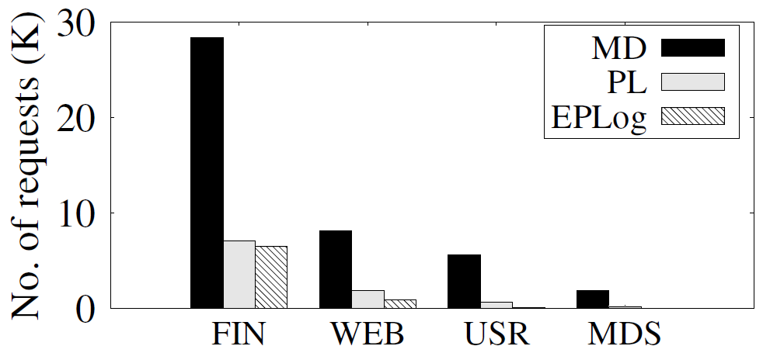
GC Overhead
(6+2)-RAID-6
EPLog has 77% fewer GC requests than MD
Slightly fewer GCs than PL due to better sequentiality
Notes:
Blktrace utilty
Feed into SSD simulator

Slide 20
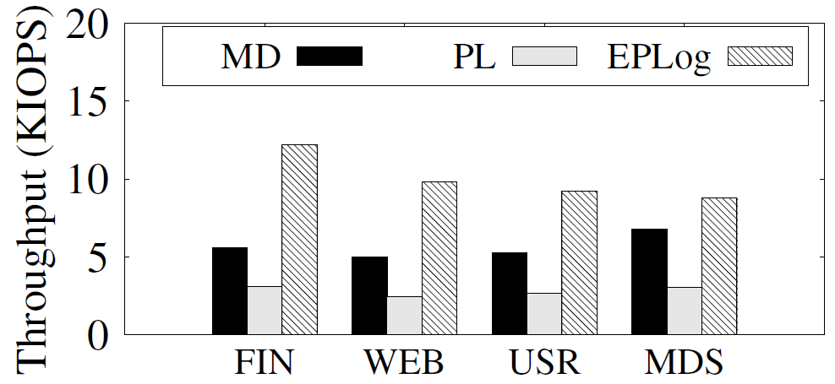
I/O Performance
(6+2)-RAID-6
EPLog outperforms MD by 30-120% and PL by 190-300%
No pre-reads
Fewer log chunks

Slide 21
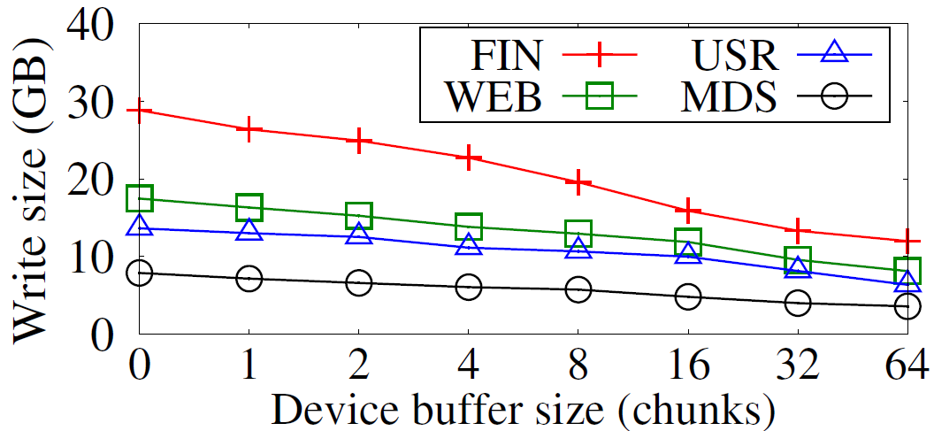
Caching
(6+2)-RAID-6
Caching reduces write size to SSDs with small cache

Slide 22
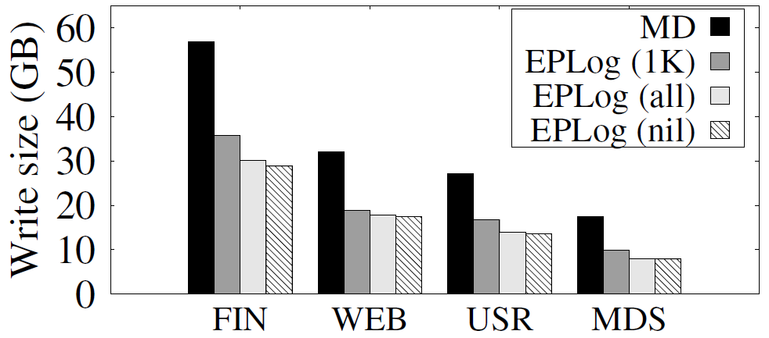
Parity Commit
(6+2)-RAID-6
Parity commit has limited overhead if it’s performed in groups of writes

Slide 23
Conclusions
EPLog is a new SSD RAID design with reliability, endurance, and performance in mind
Elastic parity logging
EPLog design is backed by implementation, reliability analysis, extensive experiments
Source code:
http://ansrlab.cse.cuhk.edu.hk/software/eplog

