Slide 1
Reconsidering Single Failure Recovery in Clustered File Systems
Zhirong Shen*, Jiwu Shu*, Patrick P. C. Lee#
*Tsinghua University #The Chinese University of Hong Kong
IEEE/IFIP DSN’16

Slide 2
Clustered File Systems
Clustered file systems (CFSes) provide unified storage service over multiple storage nodes
e.g., GFS, HDFS, Azure, Ceph, Panasas, Lustre, etc
Hierarchical Topology:
Nodes are grouped in racks
Failures are common
Network core

Slide 3
Redundancy
Solution: data redundancy
Replication: make duplicate copies
Erasure coding: encode data to parity
Enterprises (e.g., Google, Azure, Facebook) move to erasure coding to save footprints
Azure reduces overhead from 3x to 1.33x via erasure coding → over 50% cost saving [Huang, ATC’12]
Facebook reduces overhead from 3.6x to 2.1x via erasure coding for warm binary data [Muralidhar, OSDI’14]

Slide 4
Erasure Coding
Divide data to k data chunks (each with multiple elements)
Encode data chunks to additional m parity chunks
Distribute each stripe of data/parity chunks to k+m nodes
MDS property: any k out of k+m nodes can recover data
Nodes
A
A
B
B
C
C
Data
divide
A
encode
D
D
B
C
A+C
A+C
D
B+D
B+D
A+D
A+D
B+C+D
B+C+D
(k, m) = (2, 2)

Slide 5
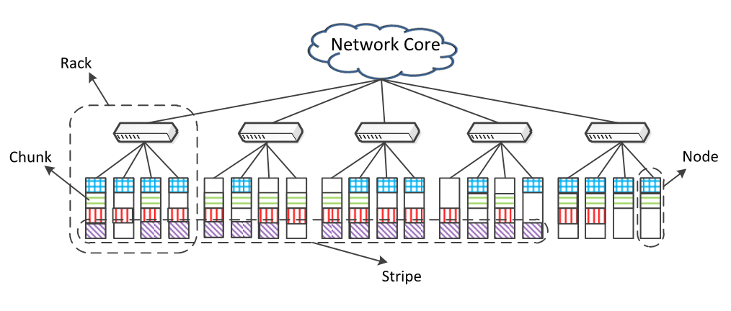
Erasure-Coded CFS
Architecture: 5 racks, 20 nodes
Erasure Coding: 4 stripes, 14 chunks

Slide 6
Single Failure Recovery
Single node failures are most common
Extensive work on optimizing single failure recovery by minimizing repair traffic
Xiang et al. [ACM SIGMETRICS’10]
Khan et al. [USENIX FAST’12]
Zhu et al. [IEEE MSST’12]
Fu et al. [IEEE SRDS’14]
Shen et al. [IEEE SRDS’15]
Are there any limitation of existing designs?

Slide 7
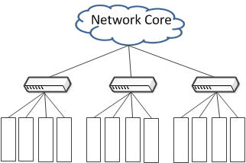
Limitations
#1: Neglecting bandwidth diversity
Oversubscription ratio: 5:1 - 20:1
Cross-rack connection
Intra-rack connection
Scarce resource
Sufficient resource

Slide 8
Limitations
#2: Incompatibility with Reed-Solomon (RS) Codes
RS codes provide general fault tolerance, and are used in Google and Facebook
Existing Solutions
Existing Solutions
XOR-based code
RS code
Selectively read elements from chunks
Read any k chunks; C(k+m-1,k) choices

Slide 9
Limitations
#3: Neglecting load balancing
Only focus on minimizing repair traffic, but ignore load balancing property
Can we minimize and balance cross-rack repair traffic for single failure recovery in a CFS deployed with RS Codes?

Slide 10
Our Contributions
Propose cross-rack-aware recovery (CAR):
Designed for single-failure recovery for RS codes in a CFS setting
Reduces cross-rack repair traffic for each stripe
Balances cross-rack repair traffic for multiple stripes
Evaluate CAR in a testbed cluster
Reduces 66.9% of cross-rack repair traffic and 53.8% of recovery time over baseline

Slide 11
Problem Formulation
Network core
t1,f
…
…
A1
A2
Af
Ar
Amount of cross-rack repair traffic from A1 to Af
Load balancing rate
$λ=\frac{}{ }$
MAX cross-rack repair traffic of all racks
AVERAGE cross-rack repair traffic of all racks

Slide 12
Objectives
Our Objective:
Minimize $λ$ (find the most balanced solution)
Subject to
min $\sum_{1≤i≠f≤r}{t_{i,f}}$ (cross-rack repair traffic minimized)
CAR’s approach:
#1: Minimizing number of accessed racks
#2: Intra-rack chunk aggregation
#3: Load Balancing
Minimize cross-rack repair traffic
Balance cross-rack repair traffic

Slide 13
Design of CAR
#1: Minimizing number of accessed racks
Question 1: how to minimize number of accessed racks?
Idea:
For each stripe, sort all racks (except $A_{f}$) by number of available chunks in each rack in descending order
Read chunks from the sorted list of racks, until the number of retrieved chunks plus the remaining chunks in $A_{f}$ is larger than k

Slide 14
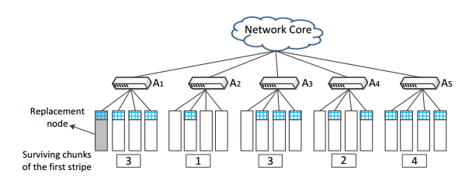
Design of CAR
#1: Minimizing number of accessed racks
Suppose k=8 and $A_{f}=A_{1}$. We can read chunks from $A_{3}$ and $A_{5}$, such that 3+4+3=10$≥$8.

Slide 15
Design of CAR
#1: Minimizing number of accessed racks
Question 2: how to find the “right” solution with minimum number of accessed racks?
Let $n_{i}$ be minimum number of accessed racks for the repair of i-th stripe. A solution is valid if it can repair the i-th stripe by accessing only $n_{i}$ racks
A stripe may have many valid recovery solutions

Slide 16
Design of CAR
#1: Minimizing number of accessed racks
We can also read chunks from $A_{3}$ and $A_{4}$, since 3+2+3=8$≥$8.

Slide 17
Design of CAR
#2: Intra-rack chunk aggregation
Chunks retrieved from a rack can be aggregated into a single chunk before transmitted across racks, due to linear property of RS code
Hi = i-th chunk to be read; H’ = repaired chunk
H’ = y₁ H₁ + y₂ H₂ + … + y_{k} H_{k}
Number of cross-rack transmitted chunks after aggregation is equal to number of accessed racks
Partial decoding within each rack

Slide 18
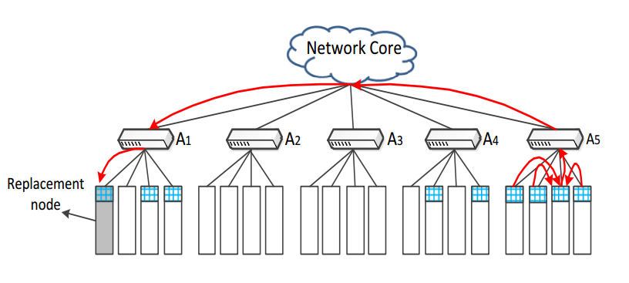
Design of CAR
#2: Intra-rack chunk aggregation
Four chunks in A5 are aggregated into one chunk. The aggregated chunk is sent to A1 for recovery

Slide 19
Design of CAR
#3: Load balancing
Use a greedy algorithm
Idea:
find the most loaded rack 𝐴_{𝑙} and another rack 𝐴_{𝑖}
find the stripe-level solution 𝑅_{𝑗} that reads data from 𝐴_{𝑙} for 𝑗-th stripe
find another valid solution 𝑅_{𝑗}′, such that the read chunks in 𝐴_{𝑙} can be substituted by those in 𝐴_{𝑖}

Slide 20
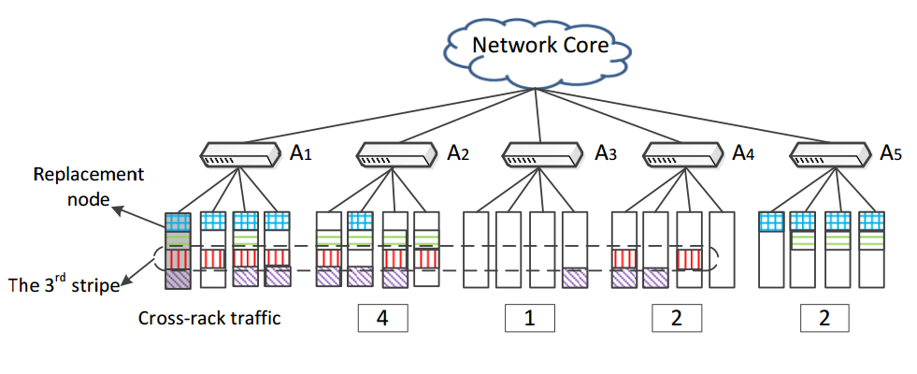
Design of CAR
#3: Load balancing
load balancing rate: $\frac{16}{9}$

Slide 21
Design of CAR
#3: Load balancing
most loaded rack

Slide 22
Design of CAR
#3: Load balancing
most loaded rack
another rack

Slide 23
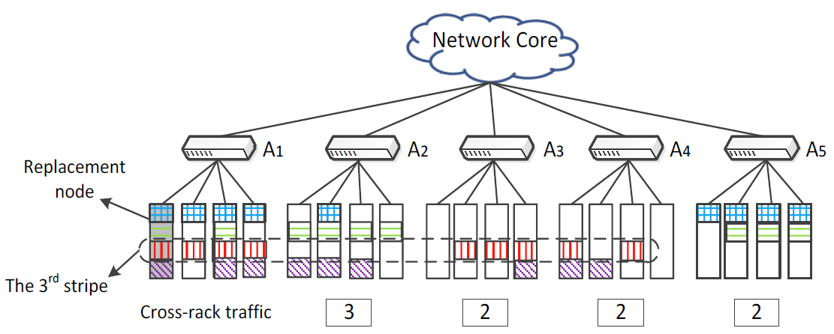
Design of CAR
#3: Load balancing
Find another valid solution in the 3rd stripe. It skips A2 and reads chunks in A3
load balancing rate: $\frac{12}{9}$

Slide 24
Evaluation
Three cluster settings
Chunk size: 4MB, 8MB, and 16MB
Compare CAR with random recovery (RR), which randomly reads k chunks from surviving nodes
Jerasure library: encoding/decoding operations
Clusters | Number of racks | Number of nodes | Erasure code parameters
CFS1 | 3 | 10 | (k=4,m=3)
CFS2 | 4 | 13 | (k=6,m=3)
CFS3 | 5 | 20 | (k=10,m=4)

Slide 25
Evaluation
# Cross-rack repair traffic:
CAR reduces cross-rack repair traffic by up to 66.9% over RR

Slide 26
Evaluation
# Load balancing rate:
Unbalanced solution: the solution found in CAR without load balancing
CAR effectively balances cross-rack repair traffic

Slide 27
Evaluation
# Recovery time:
CFS1
CFS2
CFS3
CAR reduces recovery time by up to 53.8%
Large k → long recovery time

Slide 28
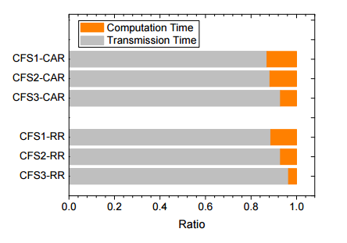
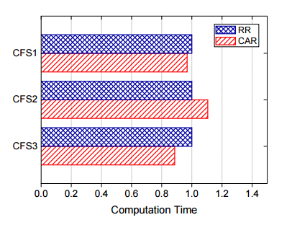
Evaluation
# Computation time and transmission time:
Transmission time dominates overall recovery time, especially for CFS3 with largest k
CAR won’t increase computation burden as it uses same coding

Slide 29
Recent Work on Partial Decoding
Partial-Parallel Repair [Mitra, EuroSys’16]
Partial decoding at different nodes
Double Regenerating Codes [Hu, ISIT’16]
Optimal regenerating code construction that provably minimizes cross-rack repair traffic
CAR focuses on Reed-Solomon codes, and addresses load balancing across stripes

Slide 30
Conclusions
Existing single failure recovery solutions are inadequate for CFS architectures
CAR: cross-rack-aware recovery
Minimizes number of accessed racks
Performs intra-rack chunk aggregation
Balances cross-rack repair traffic over multiple stripes
Experiments show performance gain of CAR

