Slide 1
Enabling Efficient and Reliable Transitions from Replication to Erasure Coding for Clustered File Systems
Runhui Li, Yuchong Hu, Patrick P. C. Lee
The Chinese University of Hong Kong
DSN’15

Slide 2
Motivation
Clustered file systems (CFSes) (e.g., GFS, HDFS, Azure) are widely adopted by enterprises
A CFS comprises nodes connected via a network
Nodes are prone to failures → data availability is crucial
CFSes store data with redundancy
Store new hot data with replication
Transit to erasure coding after getting cold → encoding
Question: Can we improve the encoding process in both performance and reliability?

Slide 3
Background: CFS
Network core
Rack 1
Rack 2
Rack 3
Nodes are grouped into racks
Nodes in one rack are connected to the same top-of-rack (ToR) switch
ToR switches are connected to the network core
Link conditions:
Sufficient intra-rack link
Scarce cross-rack link

Slide 4
Replication vs. Erasure Coding
Stripe
Node1
A
B
Node1
A
Node2
A
B
Node2
B
Node3
A
Node3
A+B
Node4
B
Node4
A+2B
$r$-way replication: $r$ replicas in $r$ nodes
3-way most commonly used
($n,k$) erasure code: (4,2) in the example
$k$ data blocks → $n−k$ parity blocks
$k$ data or parity blocks → original data
Replication has better read throughput while erasure coding has smaller storage overhead
Hybrid redundancy to balance performance and storage
Replication for new hot data
Erasure coding for cold old data
Notes:
Hot data accounts for a small proportion of stored data, thus the hybrid scheme achieves a good balance in performance and storage efficiency.

Slide 5
Encoding
Replication policy of HDFS:
3 replicas in 3 nodes from 2 racks
1
2
3
4
3
3
2
2
2
P
1
1
2
1
4
4
3
4
Rack 1
Rack 2
Rack 3
Rack 4
Rack 5
Consider 5-rack cluster and a 4-block file
Using 3-way replication
Encode with (5,4) code
3-step encoding:
Download
Encode and upload
Remove redundant replicas

Slide 6
Problem
Single rack failure tolerable →
For each stripe, AT MOST ONE block in each rack
1
2
3
4
1
3
3
1
2
2
2
P
1
4
4
3
4
4
Relocation!
Rack 1
Rack 2
Rack 3
Rack 4
Rack 5
Random replication (RR) → cross-rack downloads in subsequent encoding
Reliability requirements (node- and rack- levels)
In Facebook’s Hadoop-20, after encoding, $(n−k)$node or rack failures tolerable
Can we achieve efficient and reliable encoding with a new replication scheme?

Slide 7
Our Contributions
Propose encoding-aware replication (EAR), which enables efficient and reliable encoding
Eliminate cross-rack downloads during encoding
Guarantee reliability by avoiding relocation after encoding
Maintains load balance of RR
Implement an EAR prototype and integrate with Hadoop-20
Conduct testbed experiments in a 13-node cluster
Perform discrete-event simulations to compare EAR and RR in large-scale clusters

Slide 8
Related Work
Asynchronous encoding, DiskReduce [Fan et al. PDSW’09]
Erasure coding in CFSes
Local repair codes (LRC), e.g., Azure [Huang et al. ATC’12], HDFS [Rashmi et al. SIGCOMM’14]
Regenerating codes, e.g., HDFS [Li et al. MSST’13]
Replica placement
Reducing block loss probability, CopySet [Cidon et al. ATC’13]
Improving write performance by leveraging the network capacities, SinBad [Chowdhury et al. Sigcomm’13]
To the best of our knowledge, there is no explicit study of the encoding operation

Slide 9
Motivating Example
1
2
3
4
3
4
1
1
1
2
2
P
4
3
3
4
2
Rack 1
Rack 2
Rack 3
Rack 4
Rack 5
Consider the previous example of 5-rack cluster and 4-block file
Performance: eliminate cross-rack downloads
Reliability: avoid relocation after encoding

Slide 10
Eliminate Cross-Rack Downloads
Blk1: 1,2
Blk ID | Racks storing replicas
1 | Rack 1, Rack 2
2 | Rack 1, Rack 3
3 | Rack 1, Rack 2
4 | Rack 1, Rack 2
Blk2: 3,2
Stripe1:
Blk1, Blk4, Blk5, Blk6
Blk3: 3,2
Blk4: 1,3
Blk5: 1,2
Stripe2:
Blk2, Blk3, Blk7, Blk8
Blk6: 1,2
Blk7: 3,1
Core rack
Blk8: 3,2
Formation of a stripe: blocks with at least one replica stored in the same rack
We call this rack the core rack of this stripe
Pick a node in the core rack to encode the stripe → NO cross-rack downloads
We do NOT interfere with the replication algorithm, we just group blocks according to replica locations.

Slide 11
Availability Issues
Randomly placed replicas → availability issues
97% of stripes need relocation for $k=12$ and 16-rack cluster
Details in the paper
Question: how to guarantee the reliability requirements without relocation?

Slide 12
Modeling Reliability Problem
What makes a valid replica layout (do not need relocation)?
Node-level: $\left(n−k\right)$ node failure tolerable
At most ONE block per node
Max matching has $k$edges
Rack-level fault tolerance
A maximum of $c$ blocks in one rack after encoding → $\left\lfloor \frac{n−k}{c}\right\rfloor −$rack failure tolerable
At most $c$ edges are adjacent to the vertices in same rack
Block 1
Rack 1
Rack 2
Block 2
Rack 3
Block 3
Rack 4
Replica layout → bipartite graph
Left side: replicated block
Right side: node
Edge: replica
A replica layout is valid ↔
A valid max matching exists in the bipartite graph

Slide 13
Modeling Reliability Problem
Max matching in bipartite graph → a max flow problem
Extend to flow graph
Add rack vertices for rack-level fault tolerance
$c=1$ in example
The bipartite graph has a valid max matching ↔ Max flow of the flow graph is $k$
Determine a valid replica layout
1
1
1
$$c$$
S
T
Block
Node
Rack

Slide 14
Incremental Algorithm
core rack
Verify replica locations for ONE block → add edges to flow graph
After adding edges for the $i−th$ block, the max flow should be $i$
Attempt to re-generate replica layout if the above requirement is not met
The # of attempts is small: 20-rack cluster with $c=1$ and $k=10$, less than 1.9 attempts per block
Details in the paper
S
T
Block
Node
Rack
Max flow = 1
Max flow = 2
Max flow = 2
Max flow = 3

Slide 15
Implementation
NameNode
RaidNode
Stripe info:
blk list, etc.
EAR
Encoding MapReduce job
JobTracker
Task1 stripe1:rack1
Task2 stripe2:rack2
Slave 1
Slave 2
Slave 3
Slave 4
Rack 1
Rack 2
Leverage locality preservation of MapReduce
RaidNode: attaching locality information to each stripe
JobTracker: guarantee encoding carried out by slave in core rack

Slide 16
Testbed Experiments
13-node Hadoop cluster
Single master node and 12 slave nodes
Slaves grouped into 12 racks
Connected via one core switch with 1Gbps bandwidth
Equipped with 3.4GHz quad-core CPU, 8GB memory, 1TB HDD
Runs Ubuntu 12.04
64MB block size
Blocks first replicated to two racks
$(n−k)$ rack failure tolerable

Slide 17
Encoding Throughput
Encoding in clean network
Larger $k$, higher throughput gain
Rise from 19.9% to 59.9%
Encoding with UDP traffic
More injected traffic, higher throughput gain
Rise from 57.5% to 119.7%

Slide 18
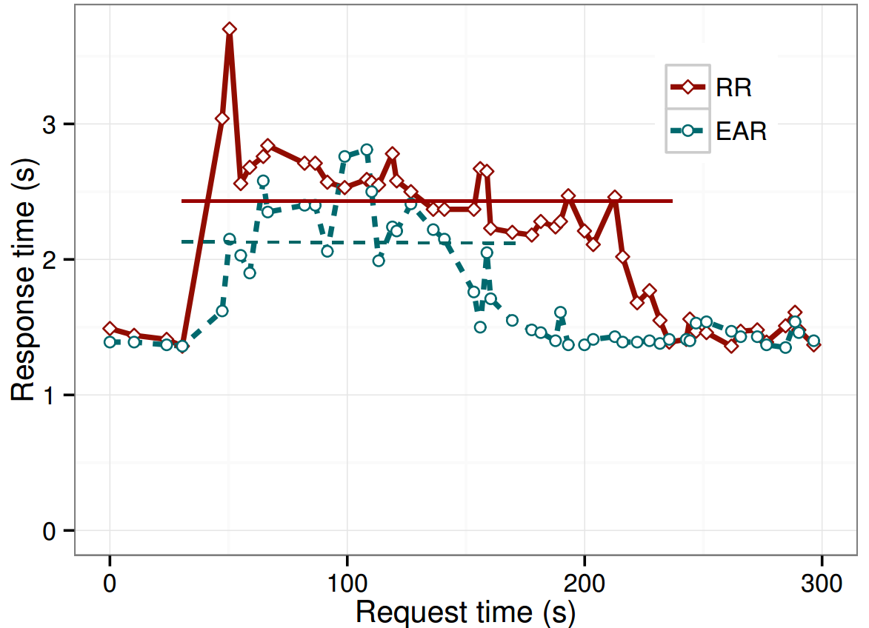
Write Response Time
Arriving intervals Poisson distribution
2 requests/s
Encoding starts at 30s
Each point : average response time of 3 consecutive write requests
Encoding operation with write requests
Compared with RR, EAR
Has similar write response time without encoding.
Reduces write response time during encoding by 12.4%
Reduces encoding duration by 31.6%

Slide 19
Impact on MapReduce Jobs
50-job MapReduce workload generated by SWIM to mimic a one-hour workload trace in a Facebook cluster
EAR shows very similar performance as RR

Slide 20
Discrete-Event Simulations
 |  | Write response time (s)
 |  | Testbed | Simulation
with encoding | RR | 2.45 | 2.35
 | EAR | 2.13 | 2.04
without encoding | RR | 1.43 | 1.40
 | EAR | 1.42 | 1.40
C++-based simulator built on CSIM20
Validate by replaying the write response time experiment
Our simulator captures performance of
both write and encoding operation precisely!

Slide 21
Discrete-Event Simulation
20-rack cluster, 20 nodes in each rack
64MB block size
By default:
1Gbps bandwidth for both ToR and core switches
3-way replication for hot data
(14,10) code for cold data
$n−k$ rack failure tolerance
Arrival intervals of write requests follow Poisson distribution with 1 request/s
Change ONE parameter each time and study its impact on encode/write throughput
Normalized throughput of EAR over RR

Slide 22
Simulation Results
($k+4,k$) code
$k$↑ encode gain ↑ write gain ↑
Encode throughput gain: up to 78.7%
Write throughput gain: up to 36.8%
($n,10$), $n=12,14,16,18$
$n$↑ encode gain − write gain ↓
Encode throughput gain: around 70%
Write throughput gain: up to 33.9%

Slide 23
Simulation Results
Bandwidth ↑ encode gain ↓ write gain −
Encode throughput gain: up to 165.2%
Write throughput gain: around 20%
Request rate ↑ encode gain ↑ write gain −
Encode throughput gain: up to 89.1%
Write throughput gain: between 25% to 28%

Slide 24
Simulation Results
Tolerable rack failures ↑ encode gain ↓ write gain ↓
Encode throughput gain: from 82.1% to 70.1%
Write throughput gain: from 34.7% to 20.5%
Number of replicas ↑ encode gain − write gain ↓
Encode throughput gain: around 70%
Write throughput gain: up to 34.7%

Slide 25
Load Balancing Analysis
20-rack cluster, 20 nodes per rack
3-way replication → (14,10) code
Monte Carlo simulations
Storage load balancing
1000 blocks
Read load balancing
Hotness value $H$
$$H=50\%$$
Rack ID | 1 | 2 | 3
Stored blk ID | 1,2 | 1 | 2
Request percent | 50% | 25% | 25%
Notes:
Smaller H means better performance
Simulation results over 1000 runs.

Slide 26
Conclusions
Build EAR to
Eliminate cross-rack downloads during encoding
Eliminate relocation after encoding operation
Maintain load balance of random replication
Implement an EAR prototype in Hadoop-20
Show performance gain of EAR over RR via testbed experiments and discrete-event simulations
Source code of EAR is available at:
http://ansrlab.cse.cuhk.edu.hk/software/ear/

