Slide 1



Boosting Full-Node Repair in Erasure-Coded Storage
Shiyao Lin*, Guowen Gong*, Zhirong Shen*,
Patrick P. C. Lee #, and Jiwu Shu * ,^
* Xiamen University #The Chinese University of Hong Kong ^Tsinghua University
Presented at USENIX ATC’21
Notes:
Hi everyone, I am Shiyao Lin from Xiamen University. it is my pleasure to present here. The title of our paper is Boosting Full-Node Repair
in Erasure-Coded Storage . This is a joint work with my dear co-authors from The Chinese University of Hong Kong and Tsinghua University.

Slide 2
Introduction
Data volume is growing explosively
  Failures arise unexpectedly yet prevalently
  Fault tolerance is critical
Redundancy techniques
  Replication: directly keep multiple copies across different nodes
    Triple replication requires 3x of storage redundancy
  Erasure coding: introduce slightly computational operations
    Lower storage overhead with the same reliability guarantee
    Deployed in Google, Facebook, etc.
Notes:
As we know that the data volume is growing explosively. making failures arise prevalently. Thus, the fault tolerance is critical.
To protect data against failures, the redundancy techniques are introduced. One is replication, which keeps multiple copies across different nodes but easily blow up storage overhead.
The other is erasure coding, which introduces slightly computational operations with lower storage overhead, and preserve the same reliability guarantee as replication. Erasure coding is now widely deployed in google and facebook, and etc.

Slide 3
Erasure Coding
Divide a data file to k data chunks
Encode k chunks to another redundant m parity chunks
Distribute k+m chunks (forming a stripe) across k+m nodes
Tolerate any m nodes failures
A
B
C
D
decode
file
A
B
divide
encode
A+C
B+D
-
C
D
=
A
B
A+C
B+D
C
D
A+D
B+C+D
(k, m) = (2, 2)
Notes:
Erasure coding operates data as follows. It first divides a data file into k chunks and encodes them to generate another m parity chunks.
It distributes the generated k+m chunks across k+m nodes to tolerate any m node failures.
For example, for(k, m)=(2,2), we can partition file into 2 chunks and encode them into four chunks. Once a chunk fails, we can repair the lost chunk by reading any two available chunks and decoding.

Slide 4
Erasure Coding
Drawback: substantial repair traffic
  Retrieve k chunks to repair a single failed chunk
Relieve the I/O amplification problem in repair
  Repair-efficient codes with reduced repair traffic (What to retrieve?)
    Locally Repairable Codes [ATC’12, PVLDB’13]
    Regenerating Codes [TIT’10, TIT’11]
  Efficient repair algorithms to parallelize the repair process (How to retrieve?)
    Partial-Parallel-Repair (PPR) [Eurosys’16]
    Repair pipelining (ECPipe) [ATC’17]
Notes:
However, erasure coding may induce substantial repair traffic. As it needs to take back k chunks to repair a failed chunk.
To relieve the I/O amplification problem, there are usually two ways. One is to design repair efficient codes with reduced repair traffic, such as locally repairable codes and regenerating codes. They want to address the problem of what to retrieve.
The other one is to propose efficient repair algorithms to parallelize the repair process, such as PPR and ECPipe. They want to address the problem of how to retrieve the wanted data.

Slide 5
Repair-Efficient Codes
Locally Repairable Codes (LRCs)
  Generate local parity chunks to facilitate repair at the expense of additional storage cost
D₁
D₂
D₃
D₄
P₅
P₆
D₁
D₂
D₁
L₁
L₂
L₁
Group 1
Group 2
Group 1
(k, l, m) = (4, 2, 2)
Retrieve two chunks
for repair
Notes:
And how do repair efficient codes reduce repair traffic?
Locally Repairable Codes adds a configuration parameter l, and organize the k data chunks into l groups and generate a local parity chunk for each group. The Figure shows a stripe of LRC(4, 2, 2), once chunk D1 failed, just retrieve other two chunks D2 and L1 in the same group for repair. LRCs reduce the number of retrieved chunks at the expense of additional storage cost.

Slide 6

Repair Algorithms
Single-chunk repair algorithm
  Accelerate the repair without reducing the repair traffic
  Introduce transmission dependency
T1: N₃ → N₂, N₅ → N₄
T2: N₄ → N₂
T3: N₂ → N₁
Switch
Congestion
Switch
❸
❶
❶
❷
I₁
I₂
D₁
D₂
D₃
D₄
P₅
D₁
D₂
D₃
D₄
P₅
N₁
N₂
N₃
N₄
N₅
N₁
N₂
N₃
N₄
N₅
Conventional Repair (CR)
Partial-Parallel-Repair (PPR)
☺
Repair time : 4 timeslots
Repair time : $\log_{2}\left(4+1\right)=3$ timeslots
☹
Introduce transmission dependency:
D₄ should wait for P₅ for aggregation
Notes:
repair algorithms focus on how to quickly retrieve the surviving chunks over the network.
The figure on the left shows the repair solution of D1 under the conventional repair when k=4. it transmits four surviving chunks at the same time to the destination node N1. because of the congestion of the download link of N1. it takes four timeslots to repair.
The figure on the right shows the PPR algorithm.PPR decompose the repair into multiple sub-stages and executes them in parallel.
Let we see how it works. (i) in the first timeslot, transmit D3 to D2 and generate an intermediate chunk I1, while at the same time sending P5 to D4 to generate intermediate chunk I2; (ii) in the second timeslot ,transmit I2 to I1 and restore the lost chunk D1; and (iii) in the third timeslot, deliver D1 to the destination node N1.
PPR completes the repair in three timeslots. However, PPR also introduces transmission dependency，as we can see that D₄ should wait for P₅ for aggregation.

Slide 7
Motivation
Limitation 1: Failing to utilize the full duplex transmission
N₁
N₂
N₃
N₄
N₅
N₁
N₂
N₃
N₄
N₅
Upload | 1 | 1 | 2 | 2
Download | 0 | 4 | 0 | 2
Upload | 1 | 1 | 2 | 2
Download | 2 | 2 | 0 | 2
(a) Unbalanced repair solutions
(b) Balanced repair solutions
Two chunks’ repair under the conventional repair (CR)
The repair time is determined by the most loaded node
Notes:
When existing attempts are directly used for full node repair, We identify the following limitations.
The first limitation is failing to utilize the full duplex transmission, so cannot properly balance the upload and download repair traffic in the full-node repair.
Take two chunks’ repair under the conventional repair as an example. solution a needs to download four chunks (at N3) to complete the repair. while solution b only uploads and downloads at most two chunks for repair.
It indicates that balancing the upload and download repair traffic has potential to reduce the overall repair time, which is determined by the most loaded node.

Slide 8
Motivation
Limitation 2: Failing to fully utilize the bandwidth at each timeslot
❶
❶
❶
❶
C₂
❷
C₄
C₃
C₂
C₄
C₃
❸
❷
❷
❸
❷
C₇
C₆
C₅
C₇
C₆
C₅

❸
N₁
N₂
N₃
N₄
N₅
N₁
N₂
N₃
N₄
N₅
(a) Repair using four timeslots
(b) Repair using three timeslots
Two chunks’ repair under the partial-parallel-repair (PPR)
Transmission scheduling affects bandwidth utilization
Notes:
The second limitation is failing to fully utilize the bandwidth at each timeslot. While existing repair algorithms can accelerate single-chunk repair, simply deploy them to cope with the full-node repair may cause link congestion again.
Let’s see an example. after the transmissions in the first timeslot, the transmissions of C3 and C7 compete for download link of N3.
Solution a and b gives different priorities for them and result in different repair time. As we can see that, 4 timeslots for solution a and 3 timeslots for solution b.
It indicates that the repair solutions in the full-node repair should be carefully scheduled.

Slide 9
Our Contributions
RepairBoost: a framework to speed up the full-node repair
  Tech#1: Repair abstraction (for generality and flexibility)
  Tech#2: Repair traffic balancing (for load balancing)
  Tech#3: Transmission scheduling (for saturating bandwidth utilization)
A prototype RepairBoost integrated with HDFS
Tackle multiple node failures and facilitate the repair in heterogeneous environments
Experiments on Amazon EC2
  Increase the repair throughput by 35.0-97.1%
Notes:
our main contributions include:
We propose a framework RepairBoost to speed up the full-node repair, which builds on three design techs. Repair abstraction, Repair traffic balancing and Transmission scheduling.
We implemented a prototype with C++ and integrated it into HDFS.
We also extended to tackle multiple node failures and boost the repair in heterogeneous environments.
We evaluate the performance on Amazon EC2, showing that it increase the repair throughput by 35.0-97.1%.

Slide 10
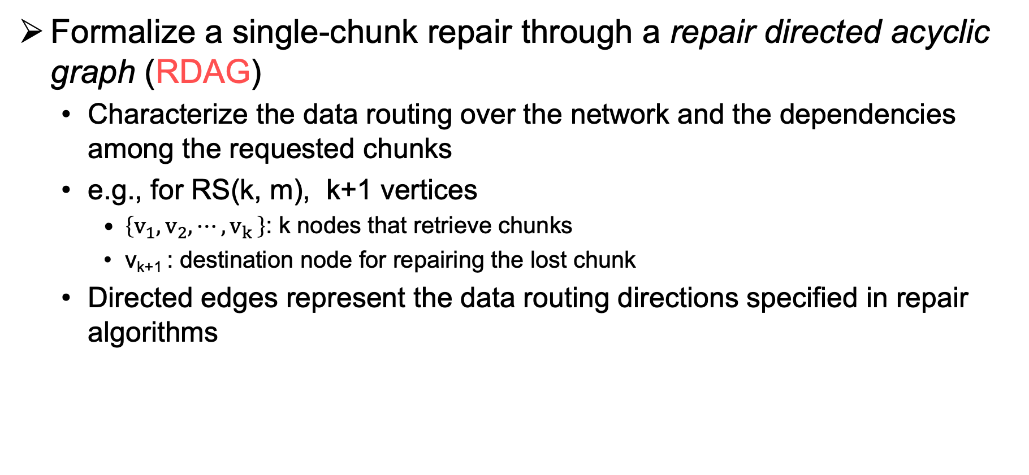
Repair Abstraction
Formalize a single-chunk repair through a repair directed acyclic graph (RDAG)
  Characterize the data routing over the network and the dependencies among the requested chunks
  e.g., for RS(k, m), k+1 vertices
    $\left\{v_{1},v_{2},{⋯,v}_{k}\right\}$: k nodes that retrieve chunks
    v_{k+1} : destination node for repairing the lost chunk
  Directed edges represent the data routing directions specified in repair algorithms
V₁
V₃
① V₃ is a child of V₄
② V₄ should collect all its children before sending its data to its parent (i.e., V₅)
An RDAG of PPR
when k=4
V₂
V₄
V₅
Notes:
let's Start with repair abstraction. We formalize a single-chunk repair through a repair directed acyclic graph which is called RDAG.
RDAG descripes the data routing over network and the dependencies among the requested chunks.
For RS(k,m), the RDAG of a lost chunk can be initialized over k+1 vertices.
See an RDAG of PPR when k=4. There are 4 nodes V1 to V4 to retrieve chunks, and V5 is the destination node.
The edge from v3 to v4 indicates that V3 is a child of V4, and V4 should collect all its children before sending data to V5.

Slide 11
Repair Abstraction
Repair process guided by RDAG
  The repair starts from the leaf vertices (without predecessor dependency)
  As the repair proceeds, iteratively remove edges and vertices from an RDAG
Leaf vertices
V₁
V₃
V₁
V₃
V₄
V₂
V₄
Update
V₂
V₄
Update
Update
V₂
V₄
V₅
V₅
V₅
V₅
Finish
❶
❷
❸
V₁ → V₂
V₃ → V₄
V₂ → V₄
V₄ → V₅
Notes:
With the previous definition, let’s take a look at how RDAG guides the repair process.
The repair starts from the leaf vertices without predecessor dependency. like V1 and V3 in the figure.
After V1 sends data to V2 and V3 sends data to V4 , the edges from V1 to V2 and V3 to V4 can be removed. Therefore V1 and V3 have no edge connecting to them, and can be removed.
Similarly, As the repair proceeds, the edges and vertices on the RDAG are iteratively removed.

Slide 12
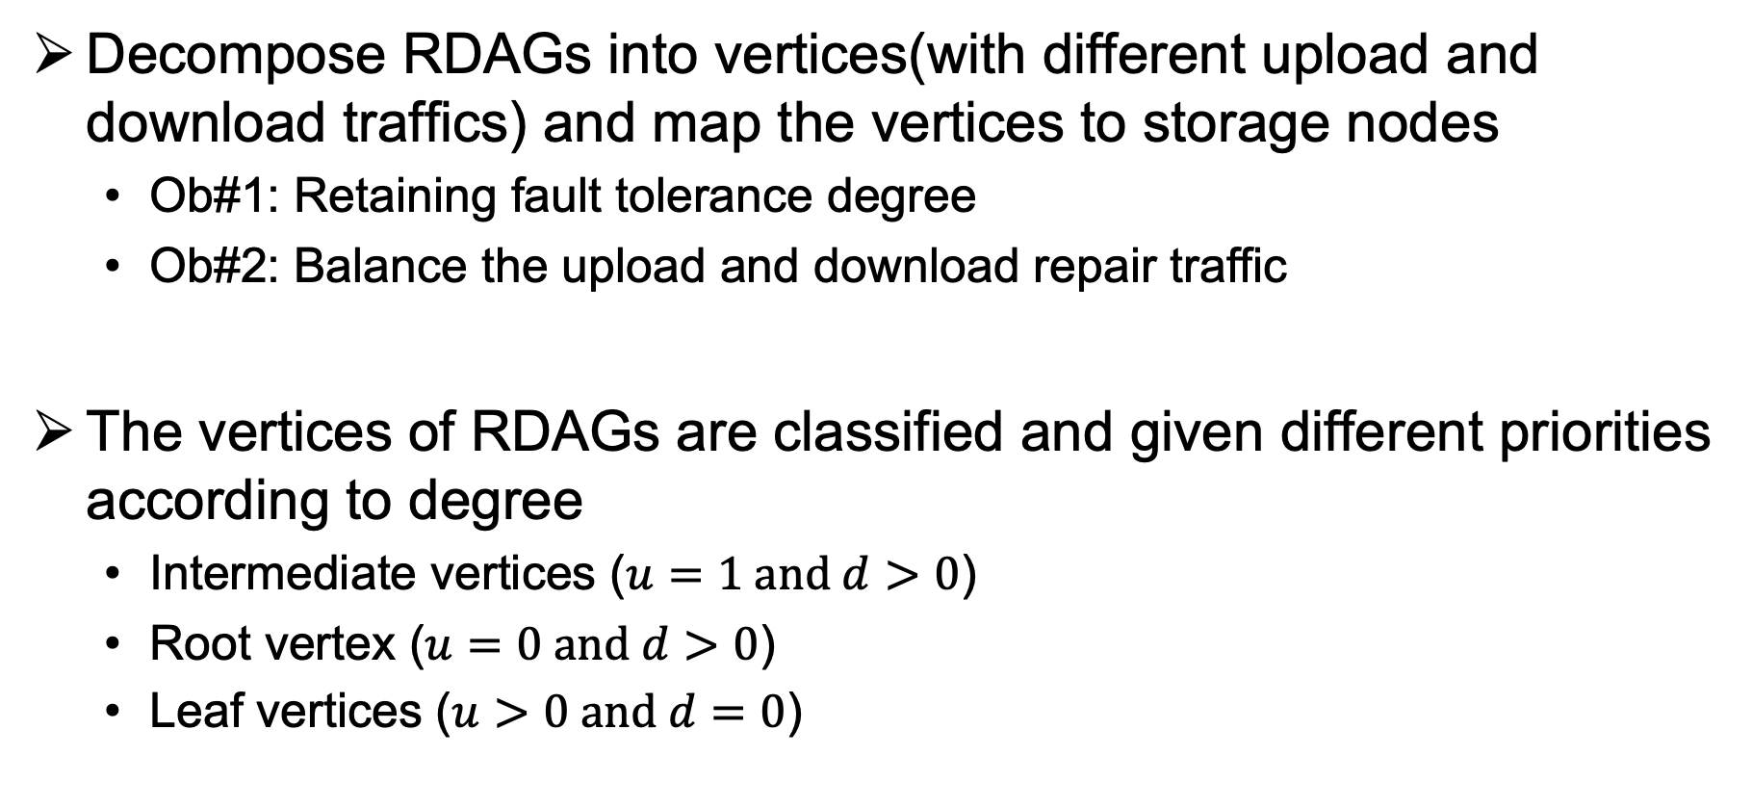
Repair Traffic Balancing
Decompose RDAGs into vertices(with different upload and download traffics) and map the vertices to storage nodes
  Ob#1: Retaining fault tolerance degree
  Ob#2: Balance the upload and download repair traffic
The vertices of RDAGs are classified and given different priorities according to degree
  Intermediate vertices ($u=1 and d>0$)
  Root vertex ($u=0 and d>0$)
  Leaf vertices ($u>0 and d=0$)
Notes:
After constructing the RDAGs for the lost chunks in a failed node, we decomposes multiple RDAGs into vertices and map the vertices to storage nodes, such that Retain fault tolerance degree and Balance the upload and download repair traffic.
The vertices of RDAGs are classified into three categories:
Intermediate vertices, which download chunks from its children and upload intermediate chunk to its parent
Root vertex, which only downloads data
Leaf vertices, which only uploads chunk for repair
and give different priorities to carefully assign vertices to storage nodes.

Slide 13
Repair Traffic Balancing
Example of mapping vertices of an RDAG to nodes
V₁
V₃
Vertex of an RDAG
❶
V₄ (1,2)
V₂ (1,1)
Nodes with surviving chunks
Decompose
V₂
V₄
V₅ (0,1)
V₁ (1,0)
V₃ (1,0)
V₅
❷
Map vertices
to nodes
❸
Data routing
among nodes
N₂
N₁
V₃
V₁
V₂
V₅
V₄
N₃
N₅
N₁
N₂
N₃
N₄
N₅
N₆
N₄
(u_{N}, d_{N})
(10,15)
(9, 23)
(19,14)
(17,20)
(17,13)
(17,20)
Before mapping
Notes:
Take an Example of how it works
we decompose the RDAG into vertices with upload and download load tuples. For example, V4 with tuple(1,2) means V4 uploads 1 chunk and downloads 2 chunks. We sort vertices by priorities.
then, map each vertix to an optional storage node with the lightest load and update traffics afforded by each storage node.
we map v4 to node N5 and update the tuple of N5
Repeate the process until all vertices are mapped.
Finally, we can learn the data routings among nodes

Slide 14
Transmission Scheduling
The bandwidth may not be utilized at each timeslot during the
repair (Limitation 2)
Formulate as a maxflow problem
  2n+2 vertices
    n senders: potentially send data for repair
    n receivers: potentially receive data at the same time
  Establish the connection between senders and receivers according to the RDAGs
s
N₁
N₂
N₃
N₄
N₅
Sender
N₁
N₂
N₃
N₄
N₅
Receiver
t
n = 5
Notes:
To further saturate the bandwidth utilization of each timeslot, we formulate the transmission scheduling as a maximum flow problem
Suppose there are n storage nodes involved in repair. We construct the network over 2n+2 vertices, with n senders and n receivers, and the edges between senders and receivers represent the network links
We Establish the connection between senders and receivers according to the RDAGs, and find a maximum flow over the network ,denotes the most chunks that can be transmitted simultaneously at this timeslot.

Slide 15
Transmission Scheduling
Example of repairing two chunks among five surviving nodes
s
s
N₂
N₁
N₄
N₂
N₁
N₂
N₃
N₄
N₅
N₁
N₂
N₃
N₄
N₅
Sender
❶
Sender
N₃
N₅
N₃
N₁
❷
N₄
N₅
N₁
N₂
N₃
N₄
N₁
N₂
N₃
N₄
N₅
N₅
Receiver
Receiver
RDAG of
Chunk 1
RDAG of
Chunk 2
❸
t
t
s
N₂
N₃
N₅
N₃
N₁

N₁
N₂
N₃
N₄
N₅
Sender
N₄
N₅
N₁
N₂
N₃
N₄
N₅
Receiver
RDAG of
Chunk 1
RDAG of
Chunk 2
t
Notes:
In the first step, We construct the network based on the edges that have no precursor dependencies in two RDAGs
In the second step, we find the maximum flow
In the third step, We update the RDAGs by removing the edges associated with the transmitted chunks and marking the leaf vertices
Then, We repeat the construction of the network and the finding of the maximum flow until all the lost chunks of the failed node have been repaired.

Slide 16
Implementation
RepairBoost serves as an independent middleware running atop existing storage
  The coordinator manages the metadata of stripes
  The agents are standby to wait for the repair commands and perform the repair operations cooperatively
Command
Repair traffic
Coordinator
Calculate (Solu.)
Interact (Agents)
Metadata Server
Coordinator
❶
❶
Agent
❷
❷
❷
Read (Local)
Recv (Sour.)
Decode
Send (Dest.)
Write (Local)
Agent
Agent
Agent
Agent
Node
Node
Node
Node
Notes:
We implement RepairBoost as an independent middleware running atop existing storage systems to instruct the repair operations on behalf of them.
The prototype comprises a coordinator and multiple agents. The coordinator manages the metadata of stripes and instructs the repair with agents. The agents are running on the storage nodes to read and write data, and repair the data cooperatively.

Slide 17
Evaluation Setup
Amazon EC2
  17 m5.large machines (1 coordinator and 16 agents)
Default configurations
  Chunk size: 64MB, Packet size: 1MB
  RS(6, 3)
Single-chunk repair algorithms
  Conventional repair (CR)
  Partial-Parallel-Repair (PPR)
  Repair pipelining (ECPipe)
Baseline: random selection
Metric: repair throughput (size of data repaired per time unit)
Notes:
We run experiments on Amazon EC2. We allocate 17 virtual machines, with one coordinator and 16 agents. The network bandwidth is set to 1Gb/s.
For default configurations: we set the chunk size to 64MB and the packet size to 1MB. We choose RS(6,3) as the erasure coding paradigm.
We consider following single-chunk repair algorithms, including conventional repair, partial-parallel repair, and repair pipelining.
We select the random selection approach as baseline, and mainly focus on repair throughput, which is defined as the size of data repaired per time unit.

Slide 18
Performance Results
(a) RS(6,3)
(b) LRC(6,2,2)
(c) Butterfly(4,2)
Ob#1: Butterfly(4,2) reaches the highest repair throughput
  as it needs to fetch only half of the data
Ob#2: RepairBoost can improve the repair throughput by an average of 60.4% for different erasure codes
Notes:
We first compare repairboost with the baseline when deployed for different erasure codes and repair algorithms.
We can see that the butterfly(4,2) code reaches the highest repair throughput, as it needs to fetch only half of the data.
In addition, repairboost can improve the repair throughput by an average of 60.4% for different erasure codes.

Slide 19
Breakdown Analysis
Ob#1: The effectiveness of RTB and TS varies across different repair algorithms.
Ob#2: RepairBoost achieves 45.7% and 19.8% higher repair throughput than RTB and TS, respectively.
Notes:
We also perform the breakdown analysis.
We can observe that RepairBoost achieves 45.7% and 19.8% higher repair throughput than repair traffic balancing and transmission scheduling, respectively.

Slide 20
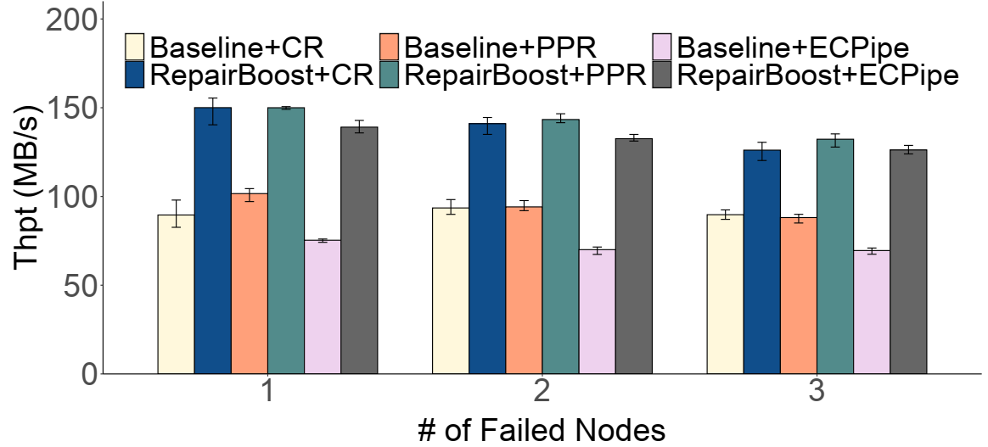
Multi-Node Repair
Ob#1: RepairBoost improves the repair throughput by 39.5% (a single node failure) and by 35.7% (triple node failures)
Ob#2: The repair throughput of RepairBoost drops slightly when more nodes fail
  Fewer selected nodes can participate in the repair
Notes:
We try to tackle multi-node repair. We vary the number of failed nodes from one to three, and measure the repair throughput.
We can see that the repair throughput of RepairBoost drops slightly when more nodes fail, as fewer nodes can be selected to participate in the repair.

Slide 21
Conclusion
RepairBoost, a scheduling framework that boosts the full-node repair for various erasure codes and repair algorithms
  Employ graph abstraction for single-chunk repair
  Balance the upload and download repair traffic
  Schedule the transmission of chunks to saturate unoccupied bandwidths
Source code:
  https://github.com/shenzr/repairboost-code
Notes:
To conclude, we propose repairboost, a scheduling framework that boosts the full-node repair for various erasure codes and repair algorithms. We employ graph abstraction for single-chunk repair. We then balance the upload and download repair traffic and schedule the transmission of chunks to saturate unoccupied bandwidths.
We release our repairboost prototype for public use and verification. Thank you for your attention.

Slide 22
Thank You!
Q & A

