Slide 1
Differentiated Key-Value Storage Management for Balanced I/O Performance
Yongkun Li¹, Zhen Liu¹, Patrick P. C. Lee², Jiayu Wu¹, Yinlong Xu^{1,3} Yi Wu⁴, Liu Tang⁴, Qi Liu⁴, Qiu Cui⁴
¹University of Science and Technology of China ²The Chinese University of Hong Kong ³Anhui Province Key Laboratory of High Performance Computing, USTC ⁴PingCAP
USENIX ATC 2021

Slide 2
Background
Real-world workloads are diverse and mixed
Value size varies in a large range
Writes, reads, and scans are common
Log-structured merge (LSM) tree
Transform random writes into sequential writes
Support efficient reads and range scans
Limitation: high write amplifications

Slide 3
LSM-tree: Basics
Store keys and values together
Keys and values are fully sorted in each level
Compaction across levels → high I/O amplifications
Immutable
MemTable
MemTable
Memory
Disk
L₀
…
…
L₁
…
· · · · ·
L_{n}
…
SSTable
Sorted Group

Slide 4
Relaxing Fully-Sorted Ordering
Each level is not necessarily fully sorted by keys
e.g., PebblesDB [SOSP’17], Dostoevsky [SIGMOD’18], etc.
Support efficient writes, but sacrifice reads and scans
Immutable
MemTable
MemTable
Memory
Disk
L₀
…
…
Fragmented LSM-tree in PebblesDB
L₁
..
…
L_{n}
· · · · · ·
…
…
…
SSTable
Sorted Group
Guard

Slide 5
KV Separation
Store keys and values separately
e.g., WiscKey, HashKV, Titan, Bourbon, etc.
Support efficient writes and reads, but have poor scan performance
Immutable
MemTable
MemTable
Memory
KV separation
<key,v_loc>
values
Disk
WiscKey
L₀
…
…
L₁
…
…
· · · · ·
Append-
only log
L_{n}
…
SSTable
Sorted Group

Slide 6
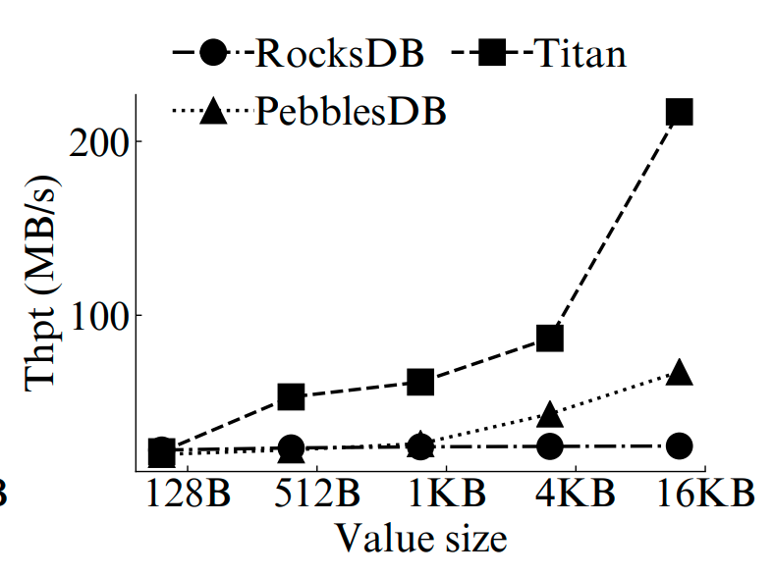
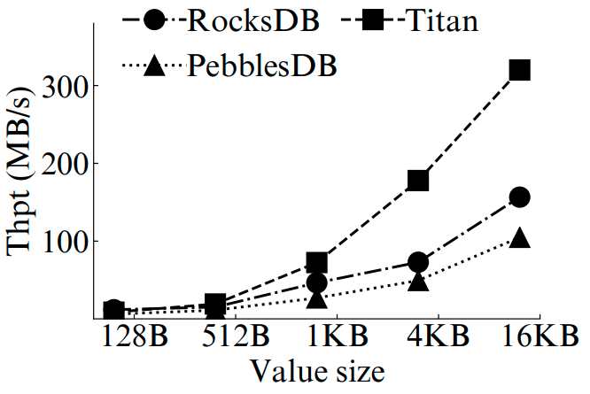
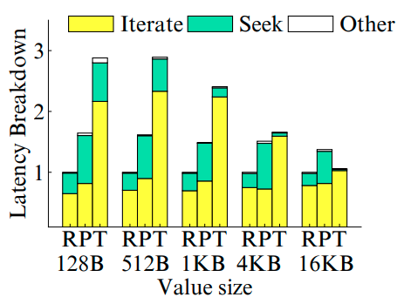
Trade-off Analysis
Are the optimizations suitable for all conditions?
Relax fully-sorted ordering
Efficient in small-to-medium values
KV separation
Suitable for large values
Trade-offs between reads/writes and scans

Slide 7
Our Contributions
DiffKV, a KV store realizing balanced I/O performance via differentiated KV management
Coordinate differentiated management of ordering for keys and values
Manage values with partially-sorted ordering
Merge optimization techniques
Fine-grained KV separation
Differentiate small, medium, and large KV pairs for mixed workloads
Implementation atop PingCAP Titan[*] and extensive evaluation
[*] https://github.com/tikv/titan

Slide 8
Differentiated KV Management
Decouple keys and values during flushing
vTree: a multiple-level tree; each level has multiple sorted groups
Each sorted group is a collection of vTables
Values in a level are not fully sorted and have overlapped key ranges
<Key, Value>
<key>
<Value>
MemTable
Manage the order of values!
Memory
Disk
L_{i}
…
vL_{i}
…
…
Partially sorted in each level
SSTable
SSTable
vTable
vTable

Slide 9
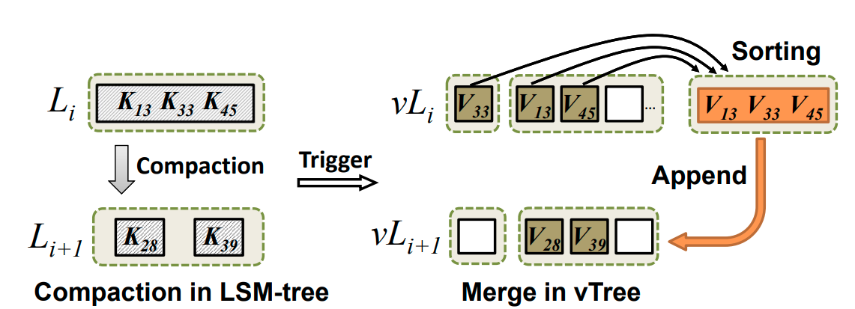
Differentiated KV Management
Compaction-triggered merge
Involve values whose keys participate in compaction
Be triggered when compaction happens in LSM-tree
Reorganize all compaction-related values in one level, and then append them to next level
Overhead of updating LSM-tree can be hidden!

Slide 10
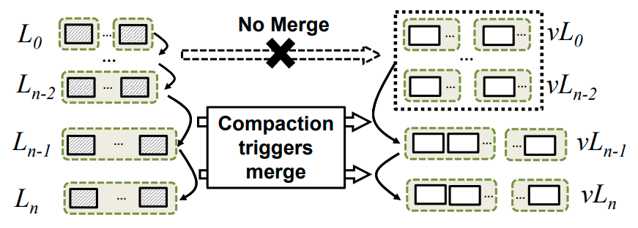
O1: Lazy Merge
Problem: frequent merge operations
Each compaction triggers a merge operation
Idea:
Values are delayed to merge until the target level is one of the last two levels
Lazy merge significantly reduces number of merge operations

Slide 11
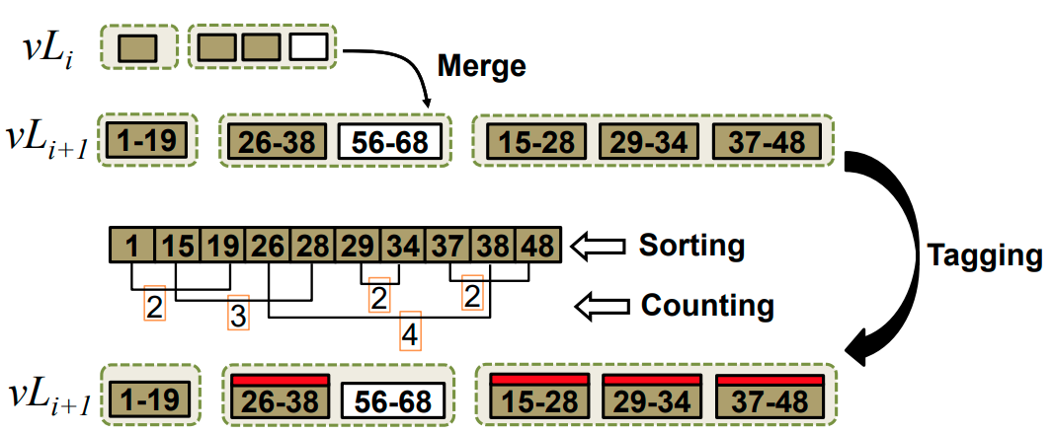
O2: Scan-optimized Merge
Problem: too many sorted groups within one level
Apply append-only merge policy
Idea:
Detect number of overlapping vTables after normal merge
Add a tag to indicate participation in the next merge
Carefully adjust the degree of ordering for values in vTree

Slide 12
Fine-grained KV Separation
KV separation is advantageous for large KV pairs, but has marginal benefits for small KV pairs
Selective approach:
Small values: stored entirely in LSM-tree
Medium values: stored in vTree
Large values: stored in vLogs
Hotness-awareness
Hot-cold separation scheme
Greedy garbage collection

Slide 13
Experiments
Testbed backed with a Samsung 860 EVO 480 GB SSD
KV stores
RocksDB, PebblesDB, Titan (no GC, background GC, foreground GC)
DiffKV: built on Titan to reuse KV separation
Workloads
Key size: 24 bytes
Value size: average 1KB (follow Pareto distribution)
(i) insert 10 GB KV pairs (ii) update 300 GB KV pairs
(iii) read 10 GB KV pairs (iv) scan 10 GB KV pairs

Slide 14
Microbenchmarks of DiffKV
Throughput
Average latency
Space usage
Compared to RocksDB and PebblesDB
2.7-3.8x inserts; 2.3-3.7x updates; 2.6-3.4x reads
Comparable scan performance
Compared to Titan
3.2x scans; up to 1.7x updates; 43.2% lower scan latency
DiffKV has acceptable space usage

Slide 15
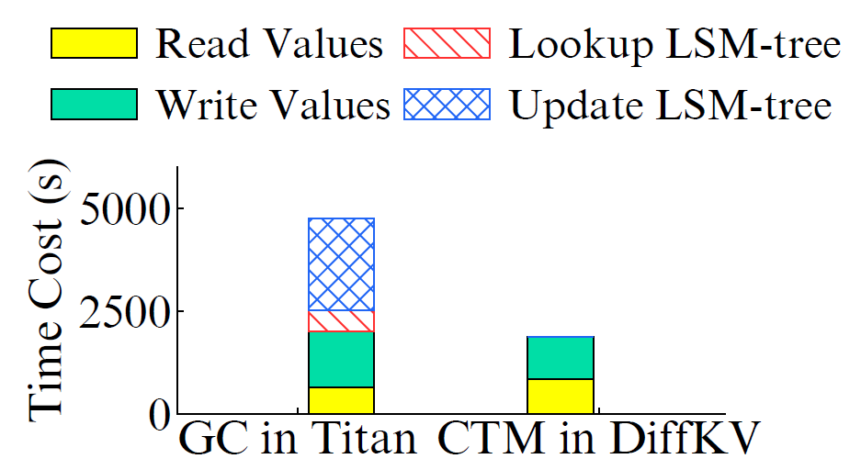
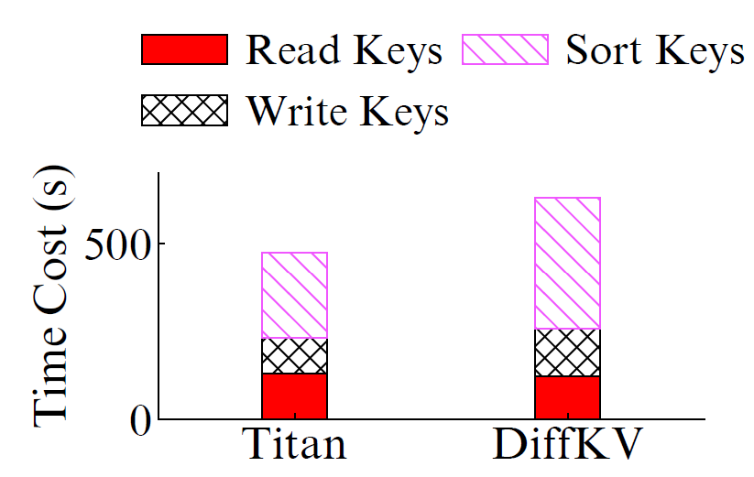
Impact of Merge Optimizations
Value GC/merge overhead
Key compaction overhead
Coordinated merge design
Reduce 60.7% of time cost of value management
Slightly increase key compaction overhead

Slide 16
Conclusions
DiffKV: differentiated key-value storage management for balanced I/O performance
More evaluation results and analysis in paper
Source code: https://github.com/ustcadsl/diffkv

Slide 17
Thanks for our attention!
For any questions, please feel free to contact
Prof. Yongkun Li@USTC
ykli@ustc.edu.cn
http://staff.ustc.edu.cn/~ykli/

