Slide 1
HashKV: Enabling Efficient Updates in KV Storage via Hashing
Helen H. W. Chan†, Yongkun Li‡, Patrick P. C. Lee†, Yinlong Xu‡
† The Chinese University of Hong Kong
‡ University of Science and Technology of China
USENIX ATC 2018

Slide 2
Background
Update-intensive workloads are common in key-value (KV) stores
  Online transaction processing (OLTP)
  Enterprise servers
  Yahoo’s workloads are shifting from reads to writes [*]
Log-structured merge (LSM) tree
  Transform random writes into sequential writes
  Support efficient range scans
  Limitation: high read and write amplifications during compaction
[*] Sears et al., “bLSM: A General Purpose Log Structured Merge Tree”, SIGMOD 2012

Slide 3
LSM-tree in LevelDB
Immutable
MemTable
MemTable
KV pairs
Memory
Read SSTables
Merge and sort by keys
Split into new SSTables
flush
Disk
SSTable
L₀
…
Compaction
KV pairs
(Sorted)
High I/O amplifications!
L₁
…
Metadata
…
L_{k – 1}
…

Slide 4
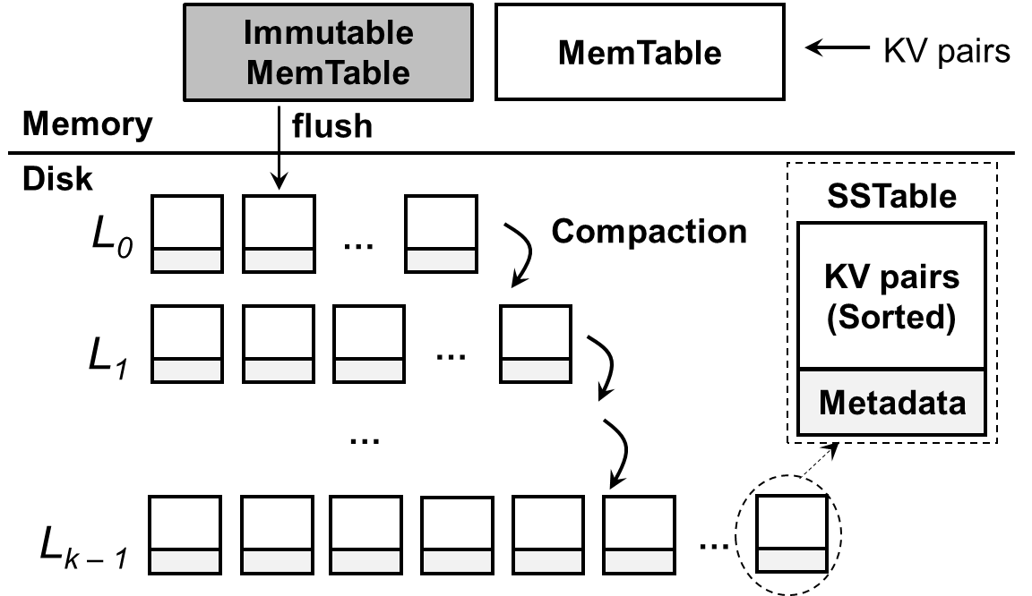
KV Separation[*]
Store values separately to reduce LSM-tree size
  LSM-tree: keys and metadata for indexing
  vLog: circular log for KV pairs
Key, value
Key, value
Log tail
KV pairs
Log head
Key, value
vLog
[*] Lu et al., “WiscKey: Separating Keys from Values in SSD-Conscious Storage”, FAST 2016
Notes:
Decouple key and value management

Slide 5
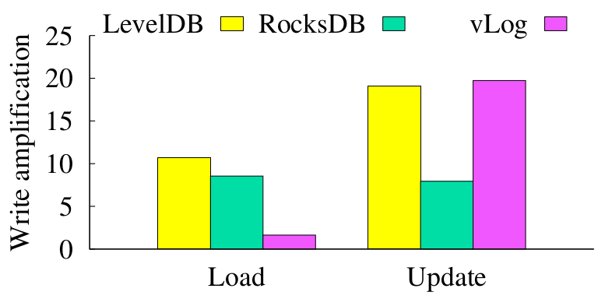
KV Separation
Does KV separation solve all problems?
  High garbage collection (GC) overhead in vLog management
    More severe if reserved space is limited
    Update-intensive workloads aggravate GC overhead
  GC needs to query the LSM-tree to check if KV pairs are valid
High write amplification of vLog if reserved space is filled
Reserved space not filled up yet
Filled
reserved space

Slide 6
Our Contributions
HashKV, an efficient KV store for update-intensive workloads
  Extend KV separation with hash-based data grouping for value storage
  Mitigate GC overhead with smaller I/O amplifications and without LSM-tree queries
Three extensions that adapt to workload characteristics
  E1: Dynamic reserved space allocation
  E2: Hotness awareness
  E3: Selective KV separation
Extensive prototype experiments
  4.6x throughput and 53.4% less write traffic over circular log

Slide 7
Hash-based Data Grouping
Hash values into fixed-size partitions by keys
  Partition isolation: all value updates of the same key must go to the same partition in a log-structured manner
  Deterministic grouping: instantly locate the partition of a given key
Allow flexible and lightweight GC
  Localize all updates of a key in the same partition
KV pairs
LSM-tree
(for indexing)
…
…
value store
What if a partition is full?

Slide 8
E1: Dynamic Reserved Space Allocation
Layout:
  Logical address space: main segments (e.g., 64 MiB)
  Reserved space: log segments (e.g., 1 MiB)
  Segment group: 1 main segment + multiple log segments
In-memory segment table tracks all segment groups
  Checkpointed for fault tolerance
Main segment
…
…
Reserved
space
Log segment
…
LSM-tree
Segment
group
Segment group

Slide 9
Group-Based Garbage Collection
Select a segment group for GC
  e.g., the one with largest amount of writes
  Likely to have many invalid KV pairs to reclaim free space
Identify all valid KV pairs in selected group
  Since each group stores updates in a log-structured manner, the latest version of each key must reside at the end of the group
  No LSM-tree queries required
Write all valid KV pairs to new segments
Update LSM-tree

Slide 10
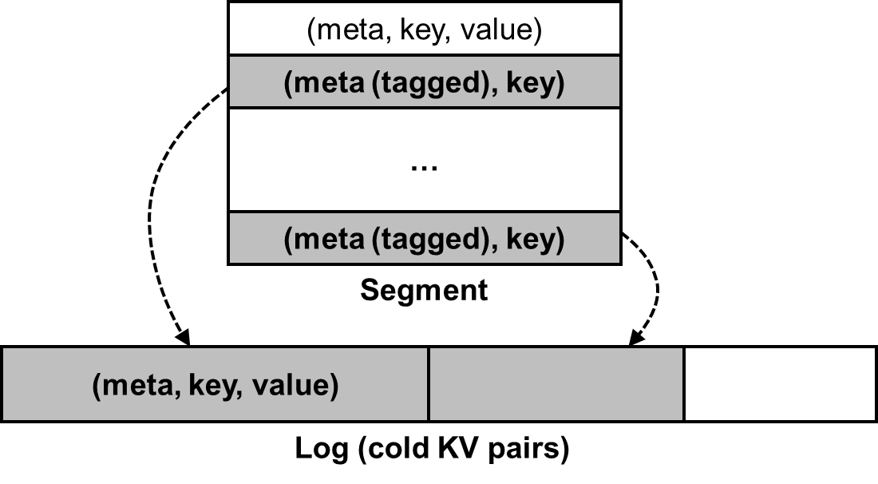
E2: Hotness Awareness
Problem: mix of hot and cold KV pairs
  Unnecessary rewrites for cold KV pairs
Tagging:
  Add a tag in metadata to indicate presence of cold values
  Cold values are separately stored
    Hot-cold value separation
GC rewrites small tags instead of values

Slide 11
E3: Selective KV Separation
KV separation for small values incurs extra costs to access both LSM-tree and value store
Selective approach:
  Large values: KV separation
  Small values: stored entirely in LSM-tree
Open issue: how to distinguish between small and large values?

Slide 12
Other Issues
Range scans:
  Leverage read-ahead (via posix_fadvise) for speedup
Metadata journaling:
  Crash consistency for both write and GC operations
Implementation:
  Multi-threading for writes and GC
  Batched writes for KV pairs in the same segment group
  Built on SSDs

Slide 13
Putting It All Together: HashKV Architecture
Segment table
Write cache
Group 1
(end pos, segments)
KV separation
Group 2
(end pos, segments)
(meta, key)
(meta, key, value)
…
LSM-tree
MemTable
Memory
Value store
Persistent
Storage
Main segment
…
Write journal
Reserved
space
Log segment
…
…
Segment
group
GC journal
Segment group
Cold data log

Slide 14
Experiments
Testbed backed with an SSD RAID array
KV stores
  LevelDB, RocksDB, HyperLevelDB, PebblesDB (default parameters)
  vLog (circular log) and HashKV: built on LevelDB for KV separation
Workloads
  40 GiB for main segments + 12 GiB (30%) reserved space for log segments
  Load: 40 GiB of 1-KiB KV pairs (Phase P0)
  Update: 40 GiB of updates for three phases (Phases P1, P2, P3)
    P1: reserved space gradually filled up
    P2 & P3: reserved space fully filled (stabilized performance)
Notes:
We didn’t try to tune the parameters

Slide 15
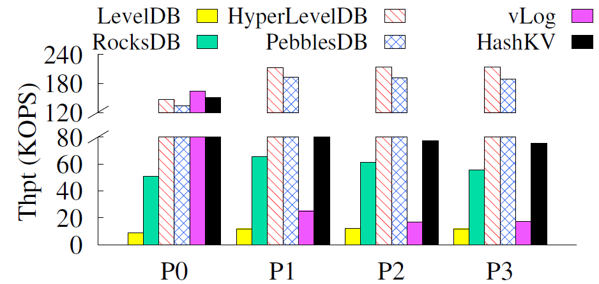
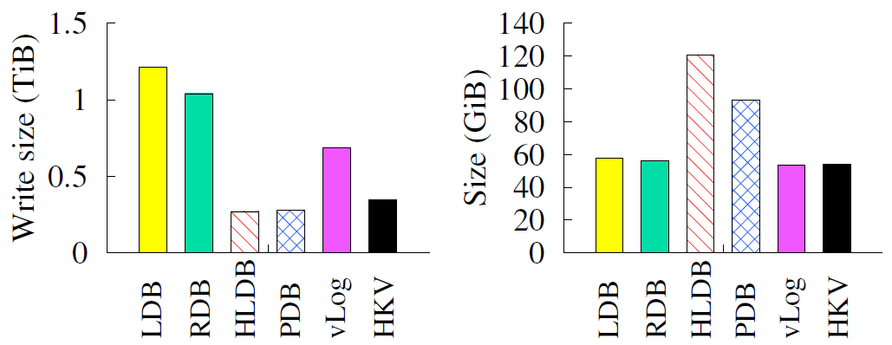
Update Performance of HashKV
Throughput
Write size
KV store size
Compared to LevelDB, RocksDB, and vLog:
  6.3-7.9x , 1.3-1.4x, and 3.7-4.6x throughput, resp.
  49.6-71.5% lower write size
Much lower KV store size than HyperLevelDB and PebblesDB

Slide 16
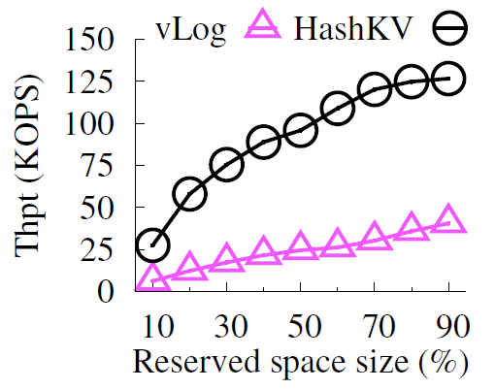
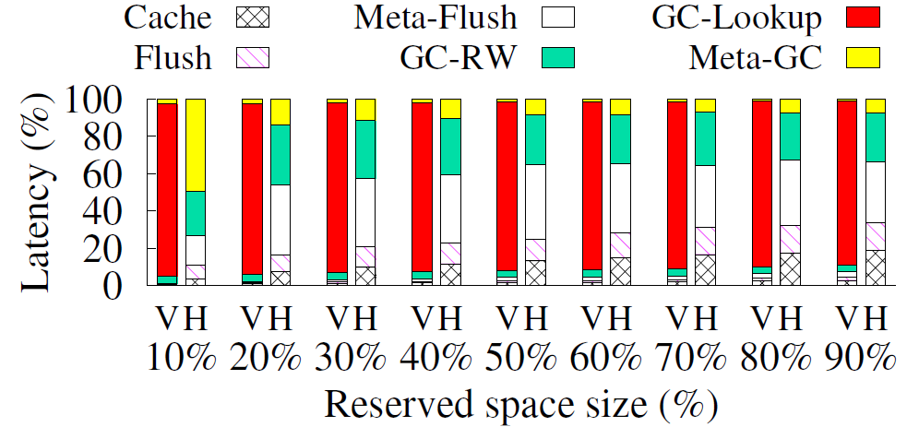
Impact of Reserved Space
Throughput
Latency breakdown (V = vLog; H = HashKV)
HashKV’s throughput increases with reserved space size
vLog has high LSM-tree query overhead (80% of latency)

Slide 17
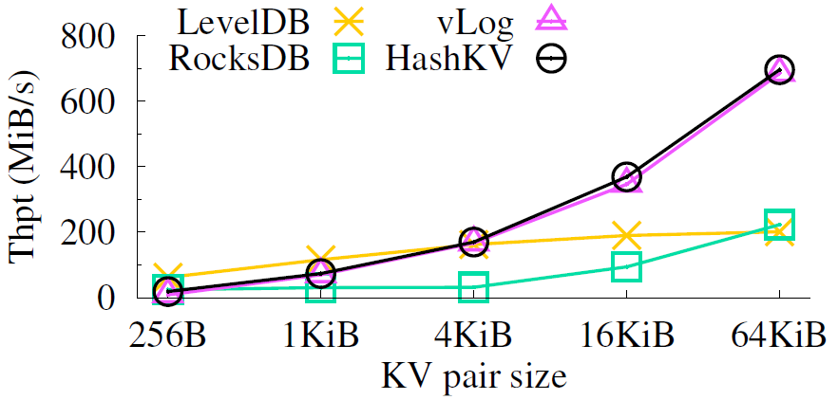
Range Scans
HashKV maintains high range scan performance

Slide 18
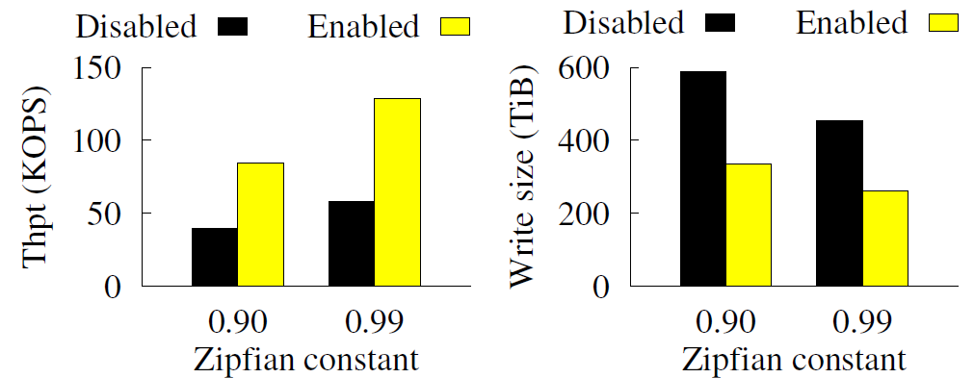
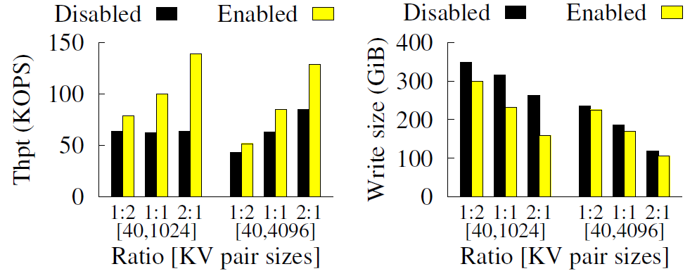
Optimization Features
Hotness awareness
Selective KV separation
Higher throughput and smaller write size with optimization features enabled

Slide 19
Conclusions
HashKV: hash-based data grouping for efficient updates
  Dynamic reserved space allocation
  Hotness awareness via tagging
  Selective KV separation
More evaluation results and analysis in paper and technical report
Source code: http://adslab.cse.cuhk.edu.hk/software/hashkv

