Slide 1
Repair Pipelining for Erasure-Coded Storage
Runhui Li, Xiaolu Li, Patrick P. C. Lee, Qun Huang
The Chinese University of Hong Kong
USENIX ATC 2017

Slide 2
Introduction
Fault tolerance for distributed storage is critical
Availability: data remains accessible under failures
Durability: no data loss even under failures
Erasure coding is a promising redundancy technique
Minimum data redundancy via “data encoding”
Higher reliability with same storage redundancy than replication
Reportedly deployed in Google, Azure, Facebook
e.g., Azure reduces redundancy from 3x (replication) to 1.33x (erasure coding) → PBs saving

Slide 3
Erasure Coding
Divide file data to k blocks
Encode k (uncoded) blocks to n coded blocks
Distribute the set of n coded blocks (stripe) to n nodes
Fault-tolerance: any k out of n blocks can recover file data
Nodes
A
A
B
B
A
C
C
File
divide
encode
D
D
B
C
A+C
A+C
D
B+D
B+D
A+D
A+D
B+C+D
B+C+D
(n, k) = (4, 2)
Remark: for systematic codes, k of n coded blocks are the original k uncoded blocks

Slide 4
Erasure Coding
Practical erasure codes satisfy linearity and addition associativity
Each block can be expressed as a linear combination of any k blocks in the same stripe, based on Galois Field arithmetic
e.g., block B = a₁B₁ + a₂B₂ + a₃B₃ + a₄B₄
for k = 4, coefficients a_{i}’s, and blocks B_{i}’s
Also applicable to XOR-based erasure codes
Examples: Reed-Solomon codes, regenerating codes, LRC

Slide 5
Erasure Coding
Good: Low redundancy with high fault tolerance
Bad: High repair penalty
In general, k blocks retrieved to repair a failed block
Mitigating repair penalty of erasure coding is a hot topic
New erasure codes to reduce repair bandwidth or I/O
e.g., Regenerating codes, LRC, Hitchhiker
Efficient repair approaches for general erasure codes
e.g., lazy repair, PPR

Slide 6
Conventional Repair
Single-block repair:
Retrieve k blocks from k working nodes (helpers)
Store the repaired block at requestor
Network
Bottleneck
N₁
N₂
N₃
N₄
R
k = 4 helpers
requestor
Repair time = k timeslots
Bottlenecked by requestor’s downlink
Uneven bandwidth usage (e.g., links among helpers are idle)

Slide 7
Partial-Parallel-Repair (PPR)
[Mitra, EuroSys’16]
Exploit linearity and addition associativity to perform repair in a “divide-and-conquer” manner
Timeslot 1:
N₁ sends a₁B₁ to N₂ → a₁B₁+a₂B₂
N₃ sends a₃B₃ to N₄ → a₃B₃+a₄B₄
Network
Timeslot 2:
N₂ sends a₁B₁+a₂B₂ to N₄ → a₁B₁+a₂B₂+a₃B₃+a₄B₄
N₁
N₂
N₃
N₄
R
Timeslot 3:
N₄ → R → repaired block
k = 4 helpers
requestor
Repair time = ceil(log₂(k+1)) timeslots

Slide 8
Open Question
Repair time of erasure coding remains larger than normal read time
Repair-optimal erasure codes still read more data than amount of failed data
Erasure coding is mainly for warm/cold data
Repair penalty only applies to less frequently accessed data
Hot data remains replicated
Can we reduce repair time of erasure coding to almost the same as the normal read time?
Create opportunity for storing hot data with erasure coding

Slide 9
Our Contributions
Repair pipelining, a technique to speed up repair for general erasure coding
Applicable for degraded reads and full-node recovery
O(1) repair time in homogeneous settings
Extensions to heterogeneous settings
A prototype ECPipe integrated with HDFS and QFS
Experiments on local cluster and Amazon EC2
Reduction of repair time by 90% and 80% over conventional repair and partial-parallel-repair (PPR), respectively

Slide 10
Repair Pipelining
Goals:
Eliminate bottlenecked links
Effectively utilize available bandwidth resources in repair
Key observation: coding unit (word) is much smaller than read/write unit (block)
e.g., word size ~ 1 byte; block size ~ 64 MiB
Words at the same offset are encoded together in erasure coding
words at the same offset are encoded together
…
word
n blocks of a stripe
Notes:
Eliminate bottleneck links: no link transmits more traffic than others
Utilize bandwidth resources Links should not be idle for most times

Slide 11
Repair Pipelining
Idea: slicing a block
Each slice comprises multiple words (e.g., slice size ~ 32 KiB)
Pipeline the repair of each slice through a linear path
Single-block repair:
a₁b₁₊a₂b₂
+a₃b₃
a₁b₁₊a₂b₂
+a₃b₃+a₄b₄
a₁b₁
a₁b₁+a₂b₂
k = 4
s = 6 slices
N₁
N₂
N₃
N₄
R
N₁
N₂
N₃
N₄
R
N₁
N₂
N₃
N₄
R
N₁
N₂
N₃
N₄
R
N₁
N₂
N₃
N₄
R
time
N₁
N₂
N₃
N₄
R
Repair time = 1 + (k-1)/s → 1 timeslot if s is large

Slide 12
Repair Pipelining
Two types of single-failure repair (most common case):
Degraded read
Repairing an unavailable block at a client
Full-node recovery
Repairing all lost blocks of a failed node at one or multiple nodes
Greedy scheduling of multiple stripes across helpers
Challenge: repair degraded by stragglers
Any repair of erasure coding faces similar problems due to data retrievals from multiple helpers
Our approach: address heterogeneity and bypass stragglers

Slide 13
Extension to Heterogeneity
Heterogeneity: link bandwidths are different
Case 1: limited bandwidth when a client issues reads to a remote storage system
Cyclic version of repair pipelining: allow a client to issue parallel reads from multiple helpers
Case 2: arbitrary link bandwidths
Weighted path selection: select the “best” path of helpers for repair

Slide 14
Repair Pipelining (Cyclic Version)
N₁
N₂
N₃
N₄
Send to requestor
R
N₂
N₃
N₄
N₁
N₃
N₄
N₁
N₂
N₄
N₁
N₂
Group 1
N₁
N₂
N₃
N₄
Send to requestor
R
N₂
N₃
N₄
N₁
N₃
N₄
N₁
N₂
N₄
N₁
N₂
Group 2
Requestor receives repaired data from k-1 helpers
Repair time in homogeneous environments → 1 timeslot for large s

Slide 15
Weighted Path Selection
Goal: Find a path of k + 1 nodes (i.e., k helpers and requestor) that minimizes the maximum link weight
e.g., set link weight as inverse of link bandwidth
Any straggler is associated with large weight
Brute-force search is expensive
(n-1)!/(n-1-k)! permutations
Our algorithm:
Apply brute-force search, but avoid search of non-optimal paths
If link L has weight larger than the max weight of the current optimal path, any path containing L must be non-optimal
Remain optimal, with much less search time

Slide 16
Implementation
ECPipe: a middleware atop distributed storage system
Coordinator
Requestor
control flow
Helper
Helper
Helper
datal flow
Node
Node
Node
Requestor implemented as a C++/Java class
Each helper daemon directly reads local blocks via native FS
Coordinator access block locations and block-to-stripe mappings
ECPipe is integrated with HDFS and QFS, with around 110 and 180 LOC of changes, respectively

Slide 17
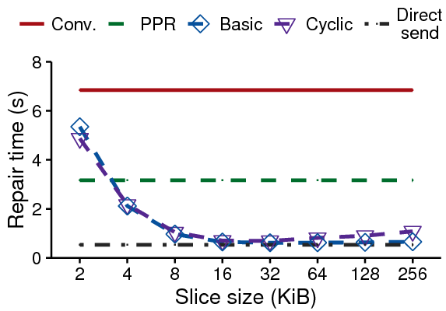
Evaluation
ECPipe performance on a 1Gb/s local cluster
Trade-off of slice size:
Too small: transmission overhead is significant
Too large: less parallelization
Best slice size = 32 KiB
Repair pipelining (basic and cyclic) outperforms conventional and PPR by 90.9% and 80.4%, resp.
Only 7% more than direct send time over a 1Gb/s link → O(1) repair time
Single-block repair time vs. slice size for (n,k) = (14,10)

Slide 18
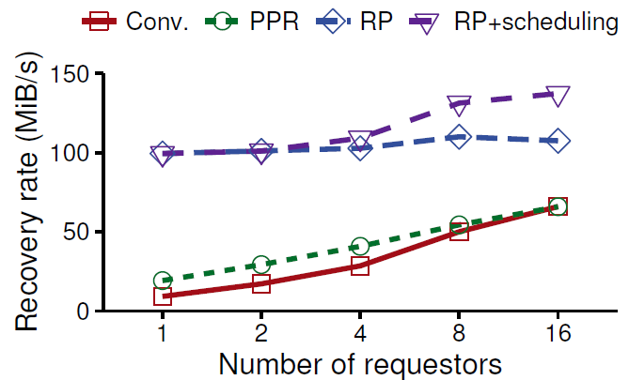
Evaluation
ECPipe performance on a 1Gb/s local cluster
Recovery rate increases with number of requestors
Repair pipelining (RP and RP+scheduling) achieves high recovery rate
Greedy scheduling balances repair load across helpers when there are more requestors (i.e., more resource contention)
Full-node recovery rate vs. number of requestors for (n,k) = (14,10)

Slide 19
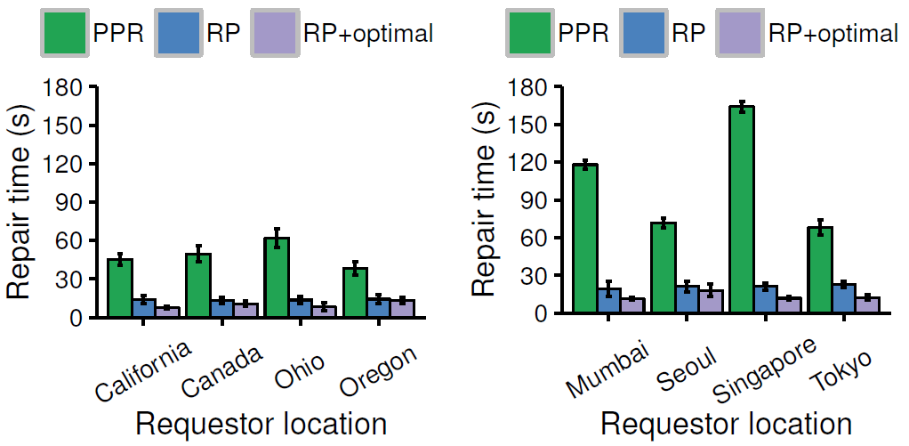
Evaluation
ECPipe performance on Amazon EC2
Weighted path selection reduces single-block repair time of basic repair pipelining by up to 45%

Slide 20
Evaluation
Single-block repair performance on HDFS and QFS
QFS: slice size
QFS: block size
HDFS: (n,k)
ECPipe significantly improves repair performance
Conventional repair under ECPipe outperforms original conventional repair inside distributed file systems (by ~20%)
Avoid fetching blocks via distributed storage system routine
Performance gain is mainly due to repair pipelining (by ~90%)

Slide 21
Conclusions
Repair pipelining, a general technique that enables very fast repair for erasure-coded storage
Contributions:
Designs for both degraded reads and full-node recovery
Extensions to heterogeneity
Prototype implementation ECPipe
Extensive experiments on local cluster and Amazon EC2
Source code:
http://adslab.cse.cuhk.edu.hk/software/ecpipe

