Slide 1
CDStore:
Toward Reliable, Secure, and Cost-Efficient Cloud Storage via Convergent Dispersal
Mingqiang Li, Chuan Qin, Patrick P. C. Lee
The Chinese University of Hong Kong
USENIX ATC’15

Slide 2
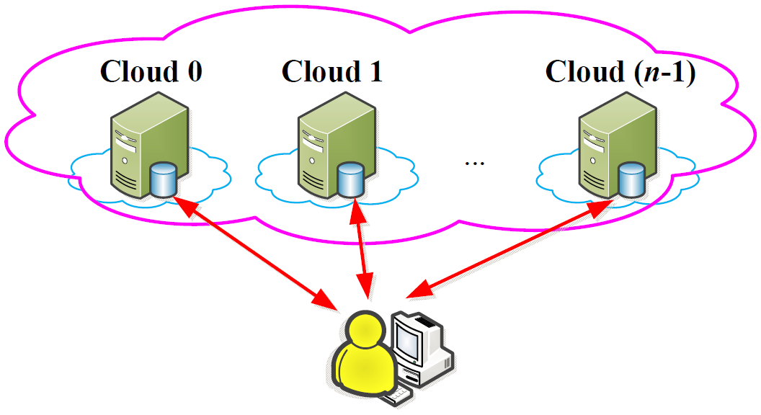
Multiple-Cloud Storage
Exploits diversity of multiple-cloud storage:
  Reliability
    Fault tolerance
    No vendor lock-in [Abu-Libdeh, SOCC’10]
  Security

Slide 3
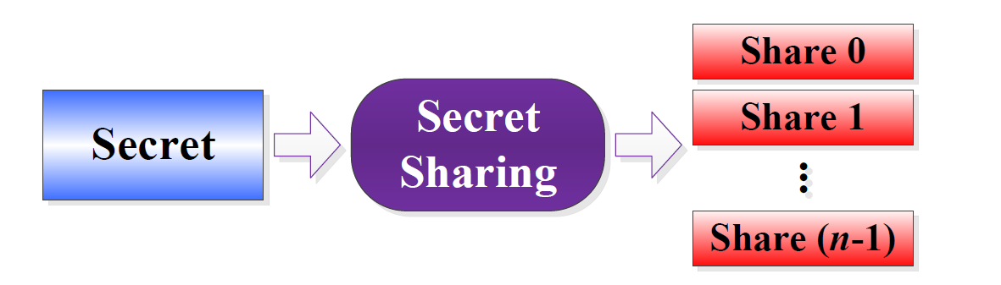
Secret Sharing
Input: secret; output: multiple shares
Properties:
  Reliability: secret is recoverable from enough shares
  Security: secret is inaccessible without enough shares
Examples:
  Shamir’s [CACM’79]; Ramp’s [Crypto’84]; AONT-RS [FAST’11]

Slide 4
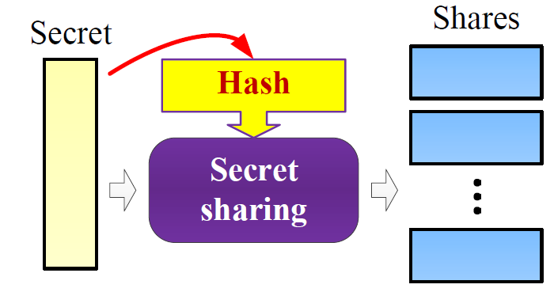
Challenges
Secret sharing prohibits deduplication
  Reason: Security builds on embedded randomness
  Identical secrets lead to different shares
  High bandwidth and storage overhead
Our HotStorage’14 paper convergent dispersal:
  Replaces random input with deterministic hash derived from original secret
How to deploy in a real system?

Slide 5
Our Contributions
CDStore: a unified multi-cloud storage system with reliability, security, and cost efficiency
  Also applicable for distributed storage systems
A new instantiation of convergent dispersal
  Higher throughput than our prior approach
Two-stage deduplication
  Bandwidth and storage savings
  Secure
Trace-driven experiments and cost analysis

Slide 6
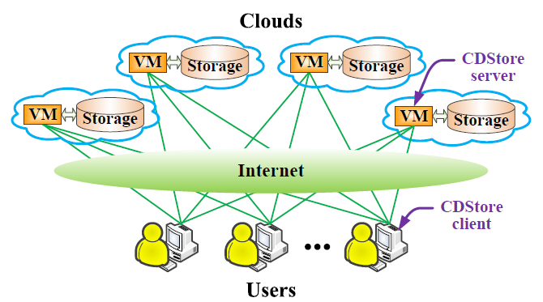
CDStore Architecture
Client-server model
For whom? an organization that needs storage outsourcing for users’ data
For what workload? backup and archival

Slide 7
Goals
Reliability:
  Availability if some clouds are operational
  No metadata loss if CDStore clients fail
Security:
  Confidentiality (i.e., data is secret)
  Integrity (i.e., data is uncorrupted)
  Robust against side-channel attacks
Cost efficiency:
  Low storage cost via deduplication
  Low VM computation and metadata overheads

Slide 8
Assumptions
Reliability:
  Efficient repair is not considered
Security:
  Secrets drawn from large message space, so brute-force attacks are infeasible [Bellare, Security’13]
  Encrypted and authenticated client-server channels
Cost efficiency:
  No billing for communication between co-locating VMs and storage

Slide 9
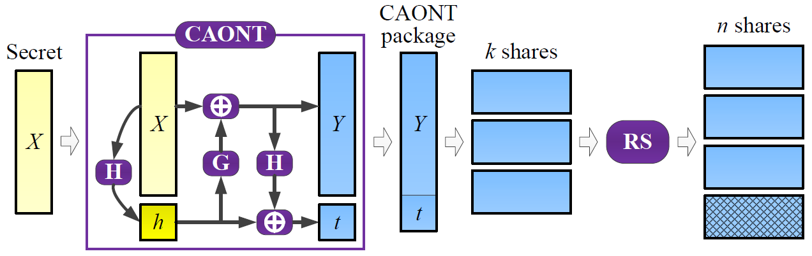
Convergent AONT-RS (CAONT-RS)
n = 4, k = 3
random key → secret’s hash
Extension of AONT-RS [Resch, FAST’11]
Optimal asymmetric encryption padding (OAEP) AONT
  Single encryption on a large block
Other instantiations in our prior HotStorage’14 paper on Ramp’s and Rivest’s AONT

Slide 10
CAONT-RS Encoding
n = 4, k = 3
Generate CAONT package (Y, t):
  h = H(X)
  Y = X ⊕ G(h)
  G(h) = E(h, C)
  t = h ⊕ H(Y)
Encode CAONT package with Reed-Solomon codes
H(.): hash function (e.g., SHA-256)
G(.): generator function
E(.): encryption function (e.g., AES-256)
C: constant value block

Slide 11
Deduplication
Deduplication at the secret level
  Same secret → same shares that are dedup’ed
  Ensure the same share in the same cloud
    Share i stored in cloud i, where i = 0, 1, …, n-1
Naïve approach: client-side global deduplication
  Saves most upload bandwidth and storage
  Susceptible to side-channel attacks
    Attackers can infer if other users have stored same data

Slide 12
Two-Stage Deduplication
Decomposes deduplication into two stages:
  Client-side intra-user deduplication
    Each CDStore client uploads unique shares of same user
    Effective for backup workloads
  Server-side Inter-user deduplication
    Each CDStore server dedups same shares from different users
    Effective if many users share similar data (e.g., VM images)
Fingerprint index maintained by CDStore servers

Slide 13
CDStore Implementation
C++ implementation on Linux
Features:
  Content-defined chunking (avg size = 8KB)
  Parallelization of encoding and I/O operations
  Batched network and storage I/Os
Open issues:
  Storage reclaim via garbage collection and compression
  Multiple CDStore servers per cloud
  Consistency due to concurrent updates

Slide 14
Experimental Setup
Testbeds:
  Local machines: Xeon 2.4GHz (slow), i5 3.4GHz (fast)
  LAN: Multiple i5 machines via 1Gb switch
  Cloud: Google, Azure, AWS and Rackspace
Datasets:
  Synthetic unique and fully duplicate data
  FSL dataset from Stony Brook University
    Weekly file system snapshots
  Our own 156 VM images in a programming course
    Weekly VM image snapshots

Slide 15
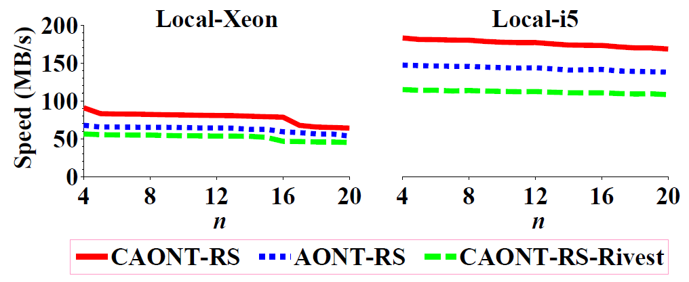
Encoding Speeds
Largest k
with k/n ≤ 3/4
OAEP-based AONT brings high performance gain
  CAONT-RS achieves 183MB/s on Local-i5
Encoding speed slightly decreases with n
  RS coding has small overhead
Multi-threading boosts speed (details in paper)

Slide 16
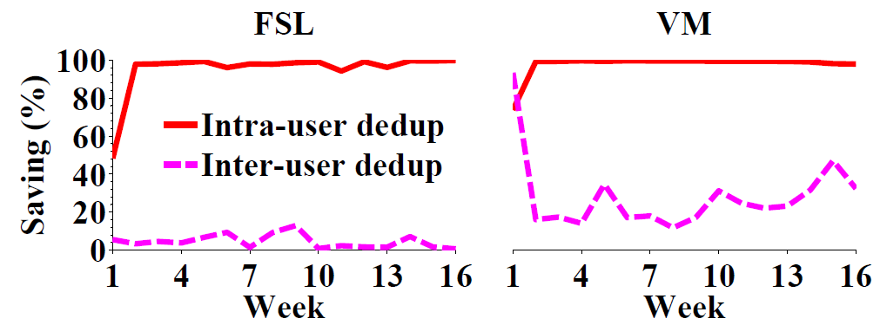
Storage Savings
Intra-user dedup achieves high saving
  At least 98% after Week 1
Inter-user dedup is effective for VM dataset
  Week 1: 93.4%
  After Week 1: 11.8% - 47.0%

Slide 17
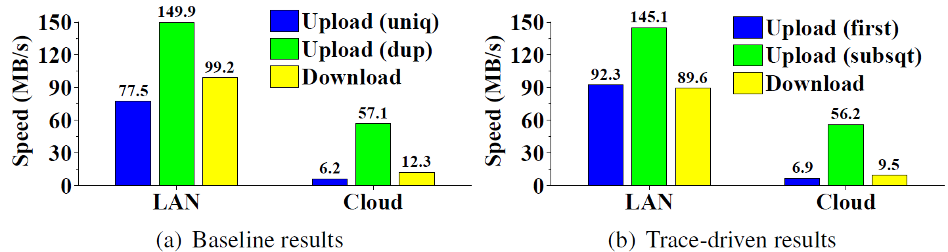
Transfer Speeds
(Single-client) upload speeds in LAN:
  Unique data ~ 77MB/s (network bound)
  Duplicate data ~ 150MB/s (bounded by encoding + chunking)
Performance in cloud bounded by Internet bandwidth
Aggregate upload speeds increase with number of clients (details in paper)

Slide 18
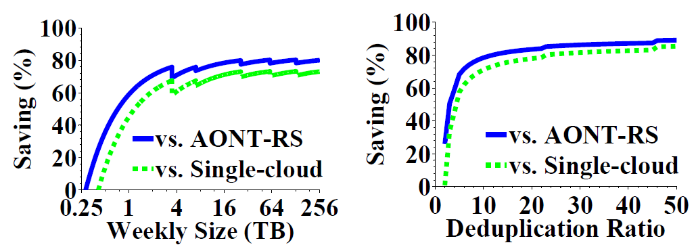
Cost Analysis
Compared to solutions w/o dedup:
  (1) single cloud; (2) multiple clouds with AONT-RS
At least 70% savings when dedup ratio is 10x – 50x
Jagged curves due to switching cheapest VM instances

Slide 19
Conclusions
CDStore: a unified multi-cloud storage system with three goals in mind: reliability, security, and cost efficiency
Building blocks:
  Convergent dispersal
  Two-stage deduplication
Source code:
  http://ansrlab.cse.cuhk.edu.hk/software/cdstore

