Slide 1
ZapRAID: Toward High-Performance RAID for ZNS SSDs via Zone Append
Qiuping Wang Patrick P. C. Lee
The Chinese University of Hong Kong
APSys 2023

Slide 2
ZNS SSDs
Conventional SSD block interface is a mismatch with flash
Expensive device-level garbage collection and address translation
Zoned Namespace (ZNS) SSDs
Abstract flash SSDs as append-only zones
Eliminate flash translation layer (FTL) and device-level costly operations
Shift storage management to host
Higher write throughput, lower tail read latencies, and less device-level DRAM than conventional SSDs [*]
[*] “ZNS: Avoiding the Block Interface Tax for Flash based SSDs”, ATC’21

Slide 3
Write Primitives in ZNS SSDs
Zone Write
Each zone has a write pointer to track the next write offset
Host specifies the block offset when writing a block (append-only)
Writes must be issued serially → limited intra-zone parallelism
Zone Append
Offloads address management to device
Host only specifies the zone to issue writes; block offsets aren’t needed
Device decides write positions and ordering
Writes can be issued concurrently → high intra-zone parallelism

Slide 4
Challenges to RAID for ZNS SSDs
RAID forms an array of ZNS SSDs for higher capacity, performance, and reliability
Basics of RAID
Encodes k data blocks into m parity blocks to form a stripe
Static mapping: assigns blocks of same stripe at same offsets in SSDs
Efficient repair – any lost block is recoverable by any k blocks of same stripe at the same offsets
Zone Append complicates RAID address management
Block offsets of writes to each SSD can be different
Needs dedicated address mapping in host (i.e., static mapping infeasible)

Slide 5
Our Contributions
ZapRAID: a high-performance software RAID layer for ZNS SSDs via Zone Append
Extensions to log-structured RAID (Log-RAID)
Group-based data layout:
Partitions stripes into stripe groups
Issues Zone Append to stripes within same stripe group with coarse-grained ordering and lightweight group-based management
2.34x write throughput gain from ZapRAID through prototype experiments on real ZNS SSDs

Slide 6
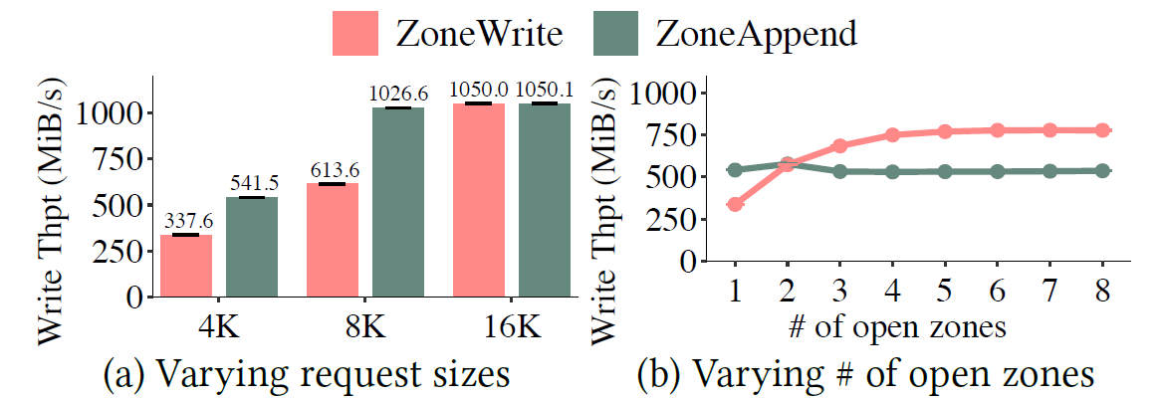
When Will Zone Append Be Useful?
Evaluation on a Western Digital ZN540 ZNS SSD
We target single-zone small writes (where Zone Append excels)
Small writes are common (e.g., production servers, cloud block storage)
Single zones provide performance isolation in shared storage

Slide 7
Log-RAID
Log-RAID manages stripes in append-only segments
Each segment holds a number of stripes, spanning k+m contiguous areas (i.e., zones) in k+m SSDs
Static mapping is still maintained
Each stripe of k+m blocks is written to same offsets of k+m zones
Zone Write is still needed for static mapping to work
ZapRAID extends Log-RAID with Zone Append

Slide 8
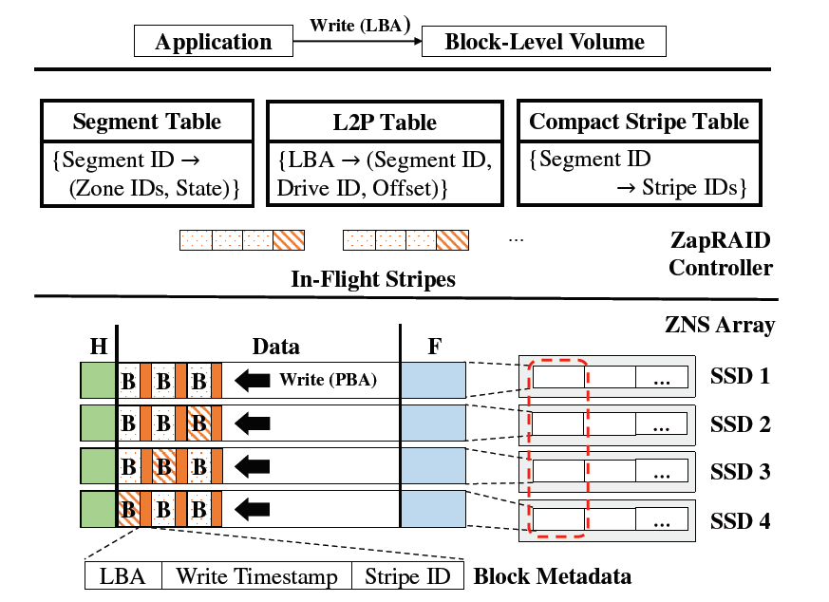
ZapRAID Architecture
Each segment is mapped to k+m zones with three regions
Header: segment IDs, zone IDs, RAID scheme
Data: data/parity blocks
Footer: block metadata (LBA, write timestamp, stripe ID)
Header/footer are for fast recovery
Block metadata is also stored in out-of-band area of each block for write persistence
(3+1) RAID-5 in ZapRAID

Slide 9
In-Memory Items for ZapRAID
In-flight stripes
Each in-flight stripe stays in memory until all k data blocks and m parity blocks are persisted
ZapRAID acknowledges the write of an in-flight stripe until the whole stripe is persisted (ack’ing individual block writes compromises durability)
Index structures
Segment table: mapping segment IDs to zone IDs and segment state
L2P table: mapping LBAs to PBAs (segment ID, drive ID, offsets)
Compact stripe table: mapping segment IDs to stripe IDs
Both segment table and L2P table are found in Log-RAID; compact stripe table is specific for ZapRAID

Slide 10
Group-Based Data Layout
Partitions a segment into stripe groups with G stripes each
G is configurable
For each stripe group
Issues Zone Append to G-1 stripes concurrently
Issues Zone Write to the last stripe for explicit ordering
Each stripe group is in the same offset ranges across zones,
Offset ranges can be identified via static mapping
ZapRAID tracks stripes on a per-group basis, using fewer bits of metadata than tracking stripes for whole drives

Slide 11
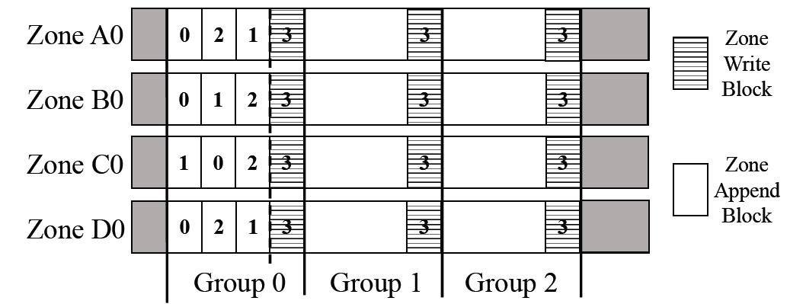
Group-Based Data Layout
Each block is labeled with its stripe ID
Last stripe (issued by Zone Write) can store block checksum and intra-device redundancy for higher fault tolerance
Limited performance overhead

Slide 12
Trade-Off Analysis
A larger G means higher intra-zone parallelism, but has higher stripe management overhead
Memory size of compact stripe table
(k+m) * S * Z * ceil(log₂G) bits
S = total # of stripes per segment; Z = total # of zones per device
G = 256 (default) → 3.77 GiB memory (4-TiB ZN540 SSDs; (3+1)-RAID-5)
G = S → 8.95 GiB memory
Query overhead
k * G entries to access in compact stripe table during degraded reads
1 us from our experiments for G = 256 (much higher when G = S)

Slide 13
Experiments
Implemented ZapRAID as an SPDK user-level block device
Supports writes, reads, degraded reads, full-drive recovery
Testbed:
Ubuntu 22.04 LTS, Linux kernel 5.15
16-core Intel Xeon Silver 4215 2.5 GHz CPU, 96 GiB RAM, four 4-TiB ZN540 ZNS SSDs
Comparisons:
ZapRAID, with G = 256
ZoneWrite-Only, with G = 1
ZoneAppend-Only, with G = S

Slide 14
Writes
Write throughput
Write 95p latency
ZapRAID achieves 2.34x write throughput gain and 52.3% lower write 95p latency than ZoneWrite-Only
ZapRAID has similar performance to ZoneAppend-Only, with less memory usage

Slide 15
Normal and Degraded Reads
Read throughput
Read 95p latency
Normal reads and degraded reads have similar performance (< 5% difference) due to parallel data reads
ZapRAID has similar performance to Log-RAID in degraded reads
Recall that Log-RAID uses static mapping

Slide 16
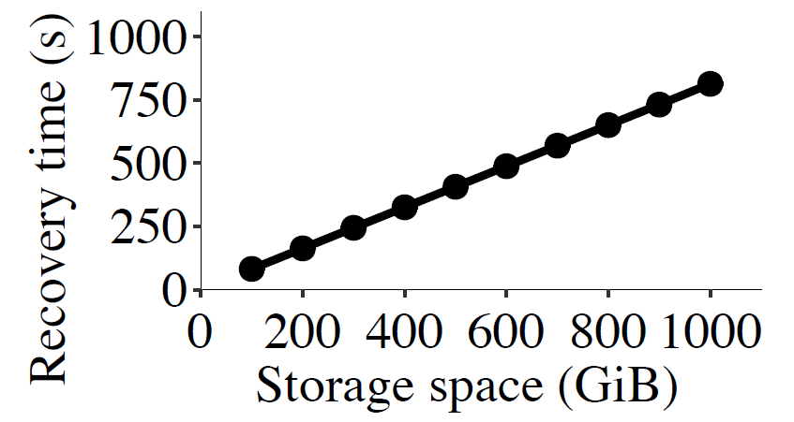
Full-Drive Recovery
Full-drive recovery: recovering erased data of one drive
Recovery time is proportional to logical space size (i.e., limited CPU and metadata access overhead)
Crash recovery time: < 20s for 1000-GiB space (not in paper)

Slide 17
Future Work
Combining inter-zone parallelism with Zone Append for various request sizes (beyond 4KiB)
Optimizing memory usage of index structures
Detailed analysis on crash consistency
Enhanced evaluation (e.g., CPU/memory overhead, impact of stripe group size, impact of queue depth, RAID scheme, cleaning overhead, etc.)
Impact of application workloads

Slide 18
Conclusions
Made a case for applicability of Zone Append for RAID
Built ZapRAID, a software RAID layer for ZNS SSDs with performance and reliability in mind
Presented preliminary evaluation results on real ZNS SSDs and showed the effectiveness of ZapRAID
Open-source code: https://github.com/fallfish/zapraid
* We found typos in our published version. Corrected version is at http://www.cse.cuhk.edu.hk/~pclee/www/pubs/apsys23.pdf. We apologize for the mistakes.

