Slide 1
RevDedup: A Reverse Deduplication Storage System Optimized for Reads to Latest Backups
Chun-Ho Ng, Patrick P. C. Lee
The Chinese University of Hong Kong
APSYS’13

Slide 2
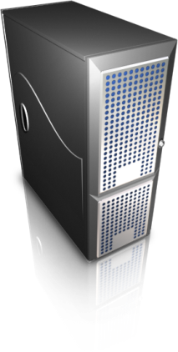
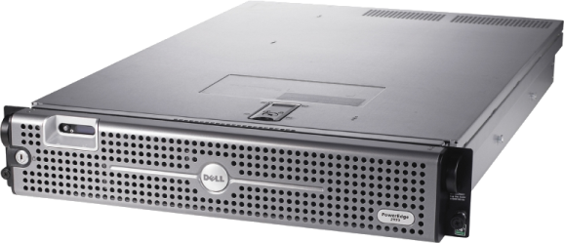
Virtual Machine Backup
Virtual machines (VMs) widely deployed
Reduce hardware footprints
Regular backups for VM disk images critical for disaster recovery
Disk-based backup
Storage explosion!
Many VM images
Many versions per VM
Virtual Machine Environment
Snapshot Backup
VM Backup Storage

Slide 3
Deduplication
Disk prices drop, but data grows much faster
1.8 trillion GB new data in the wild in 2011 [IDC, 2011]
Deduplication removes content redundancy to improve storage efficiency
Store one copy of chunks with same content
Effective for VMs [Jin, SYSTOR’09]
Two types:
Inline: redundancy removed on write path
Out-of-order: redundancy removed after data stored
Extra I/O cost

Slide 4
Fragmentation
Fragmentation in inline deduplication
VM₁
A
B
C
D
E
F
G
H
VM₂
A
B
C
D’
E
F’
G
H
Latest backup → most fragmented
VM₃
A
B’
C
D’
E’
F’’
G
H’
VM₁
VM₂
VM₃
A
B
C
D
E
F
G
H
D’
F’
B’
E’
F’’
H’

Slide 5
Related Work
Optimized for reads in dedup systems:
Selective rewrites [Kaczmarczyk, SYSTOR’12; Nam, MASCOTS’12]
Rewrite duplicate data to mitigate fragmentation
Container capping and prefetching [Lillibridge, FAST’13]
Their designs are based on inline deduplication
→ remove duplicates from new data
Another open issue: empirical performance?

Slide 6
Our Work
RevDedup: a deduplication system optimizing reads for latest VM backups
Goal: mitigate fragmentation for latest backups
Rationale: latest data more likely to read
Contributions:
Hybrid approach of inline and out-of-order deduplication
Prototype and evaluation on real VM dataset
low memory usage
high storage efficiency
GB/s of read/write throughput

Slide 7
Key Idea
Two-phase deduplication
Coarse-grained global deduplication
Inline deduplication to different VMs
Removes duplicates on the write path
Fine-grained reverse deduplication
Out-of-order deduplication to different versions of the same VM
Remove duplicates from old backup versions
Shift fragmentation to old data

Slide 8
Preliminaries
Definitions:
Backup: a single snapshot of a VM disk image
Versions: different snapshots of the same VM
Deduplication basics:
Chunking: divide data into chunks
Fixed-size chunking; simple and effective for VM image dedup
Fingerprinting: compute crypto hashes for chunks
Comparison: two chunks with same fingerprints are the same (assuming no hash collisions)

Slide 9
Global Deduplication
Inline deduplication on large fixed-size units called segments
Several MB of size
Global: eliminate duplicates in different levels:
In the same version
In different versions of the same VM
In different version of different VMs
Small memory usage for indexing
1PB data, 8MB segment size, 32 byte entry → memory usage for indexing 4GB

Slide 10
Global Deduplication
Mitigate fragmentation by amortizing disk seeks on reading segments
Seek time of locating segments is reduced compared to reading segment contents
Still effective in dedup efficiency:
Idea: changes confined in small regions
Challenge: dedup efficiency not as good as conventional inline approaches

Slide 11
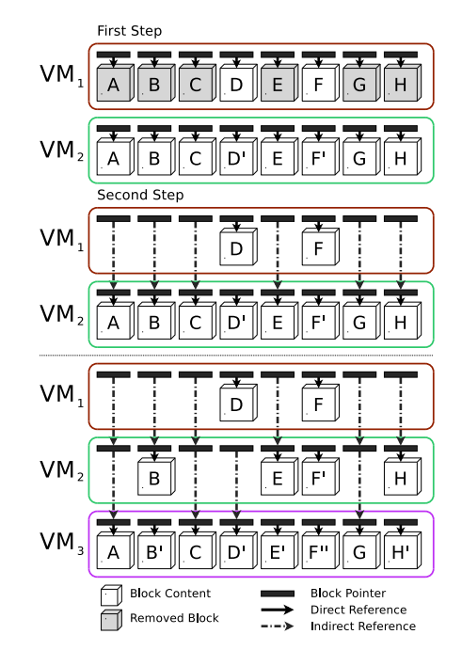
Reverse Deduplication
Finer-grained deduplication to further remove duplicates
Blocks: sub-segment of KBs (e.g., 4KB for FS blocks)
Compare two versions of the same VM; remove duplicate blocks in the earlier version
Accessing earlier blocks follow references to future versions

Slide 12
Reverse Deduplication
Shift fragmentation to earlier versions by eliminating earlier blocks
VM₃ is sequential
VM₁ is the most fragmented
VM₁
VM₂
VM₃
D
F
B
E
F’
H
A
B’
C
D’
E’
F’’
G
H’

Slide 13
Shared Segments
Block reference counts
Add 1 for all blocks in a segment when referenced by a VM version
Minus 1 when a block refers to a future version in reverse deduplication
Remove blocks when reference counts dropped to zero

Slide 14
Shared Segments: Example
VMA₁
A
B
C
D
E
F
G
H
VMB₁
A
B
C
D
E
F
G
H
VMA₂
A
B
C
D’
E
F
G
H
VMB₂
A
B
C
D’
E’
F’
G
H’
1
0
1
0
2
2
2
2
1
2
0
2
3
3
3
2
3
3
3
3
2
2
2
2
VMA₁
A
B
C
D
E
F
G
H
VMB₁
A
B
C
D
2
2
2
1
1
1
1
2
1
1
1
1
VMA₂
VMB₂
A
B
C
D’
E’
F’
G
H’
Typo in the paper: Block G of segment EFGH should have refcnt = 2 instead of 1

Slide 15
Removal of Duplicate Blocks
Block punching
fallocate() to release space to native file system
Generate free-space fragmentation
Segment compaction
Copy all remaining blocks to another segment and delete old one
Incur I/O overhead
Threshold-based block removal mechanism
Few blocks removed → block punching
Many blocks removed → segment compaction

Slide 16
Evaluation
Virtual Machine Environment
Client-server implementation
RevDedup server mounted on ext4
Dataset
160 VMs x 12 versions for students to work on assignments over 12 weeks
total 1920 versions
Testbed
RAID-0 disk array with 8 SATA disks
1.37GB/s raw write
1.27GB/s raw read
Evaluate storage efficiency and backup/restore throughput
Backup
Restore
RevDedup
Storage

Slide 17
Space Usage
RevDedup matches deduplication savings of conventional deduplication (96.8% for 128KB)

Slide 18
Backup Throughput
RevDedup achieves 3-5x speedup of raw writes

Slide 19
Restore Throughput
RevDedup shifts fragmentation to earlier versions

Slide 20
Summary of Results
RevDedup achieves:
similar storage savings as conventional deduplication
high backup throughput
high restore throughput for latest versions by shifting fragmentation to earlier versions
Tech. report shows additional evaluation results
Different rebuild thresholds
Tracing indirect references

Slide 21
Open Issues
How to make effective tradeoff?
Fixed size vs. variable size chunking
Backup throughput vs. restore throughput
Storage efficiency vs. throughput
What about different workloads?
Unstructured data
Primary storage data
Any new applications?

Slide 22
Conclusions
Advocate the importance of read optimization in deduplication system
Propose RevDedup for VM image backups
Low memory usage
High storage efficiency
High backup performance
High restore performance on latest backups
Source code:
http://ansrlab.cse.cuhk.edu.hk/software/revdedup

