Slide 1


Rolling Guidance Filter
Qi Zhang¹, Xiaoyong Shen¹, Li Xu², Jiaya Jia¹
¹ The Chinese University of Hong Kong
² Image & Visual Computing Lab, Lenovo R&T

Slide 2
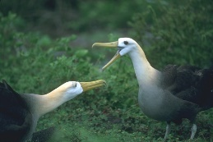
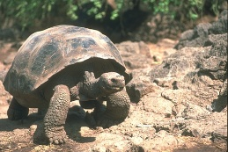
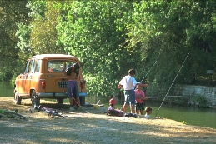
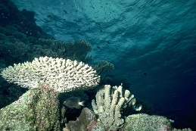
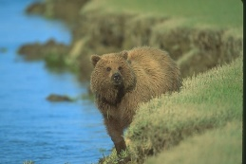
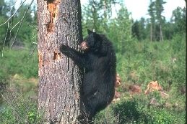
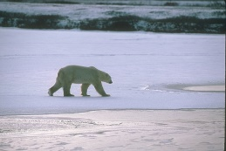
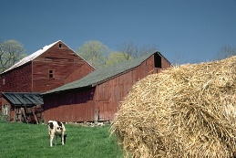
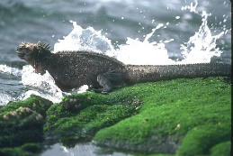
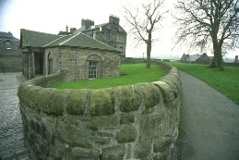
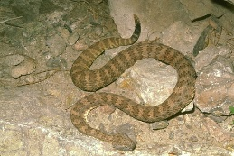


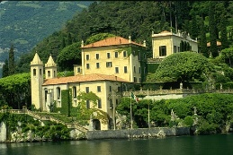
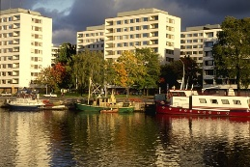
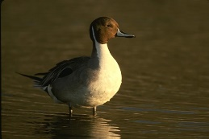
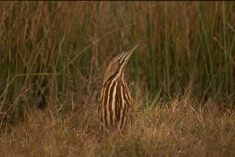

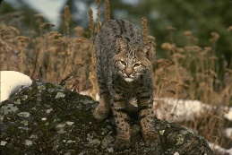
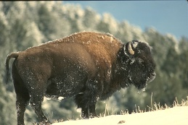
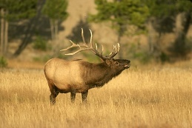
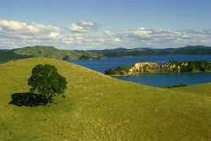
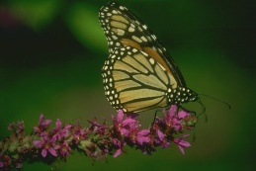
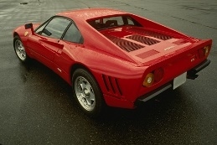
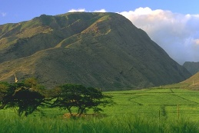
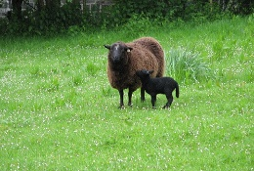

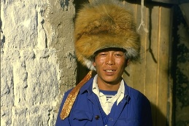

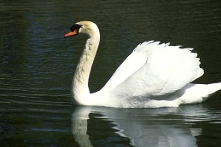
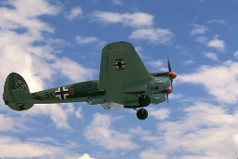
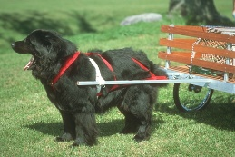
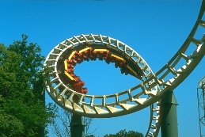
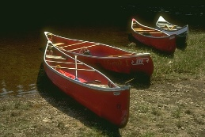

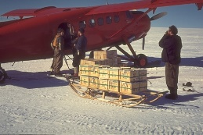
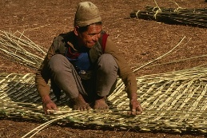
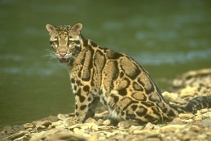
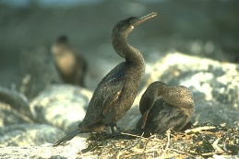

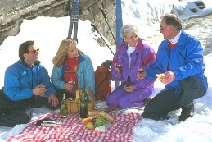



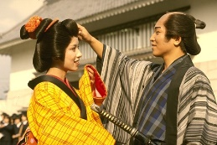
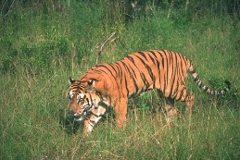
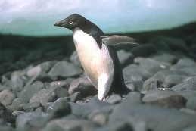
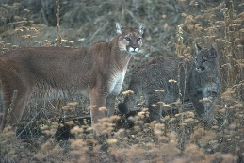
Notes:
The community of computer vision has seen a huge amount of images and videos. They contain different types of objects and structures.

Slide 3
Notes:
The community of computer vision has seen a huge amount of images and videos. They contain different types of objects and structures.

Slide 4
















































Deblurring
Segmentation
Optical flow
Color analysis
Intrinsic image
Saliency
Features
Edge detection
Image abstract
Super resolution
Noise removal
Image filter
Image filter
Notes:
[press]
And there has been extensive research to extract information from these visual data to achieve many goals in computer vision.
[press]
Image filter is an important tool among them.

Slide 5

Image Filtering
Anisotropic Diffusion
Percentile Filter
Weighted Least Square Filter
Bilateral Filter
Domain Transform Filter
Local Extrema Filter
Local Mode Filter
Gaussian Filter
Guided Filter
Gabor Filter
Laplacian Filter
Min/Max Filter
Geodesic Filter
Median Filter
Sobel Filter
Dominant Filter
Weighted Median Filter
Recursive Bilateral Filter
Notes:
[press]
If we search documents in google scholar, we can find millions of items related to filter.
[press]
They include Gaussian filter, bilateral filter, median filter and many others.

Slide 6
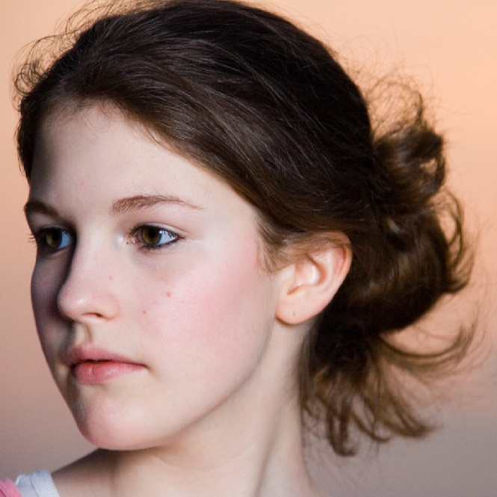



An Important Steam: Edge Preserving
1998, Bilateral Filter
2008, WLS Filter
2010, Guided Filter
2011, Domain Transform
Weak Edge
Strong Edge
Notes:
[press]
Most filters we are familiar with are edge preserving ones.
[press]
This set of filters remove weak edges while preserving strong ones.
[press]
They are used in many applications. They are also famous in human face beautification due to the smoothing effect.

Slide 7
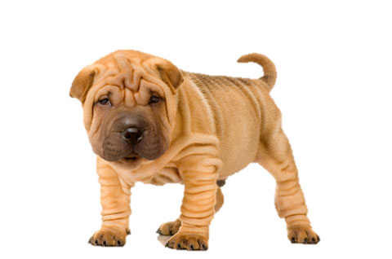
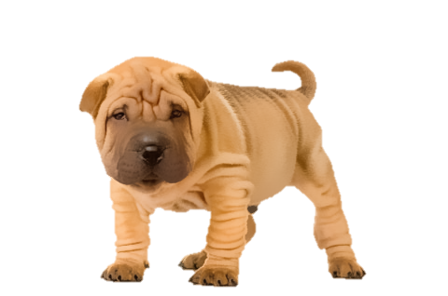
Edge preserving may not work for pet beatification
Notes:
These edge-preserving filters inevitably have their limitation. For example, these methods won’t work if you want to beautify your dog by removing their deep wrinkles,. It is because these wrinkles are actually edges.

Slide 8
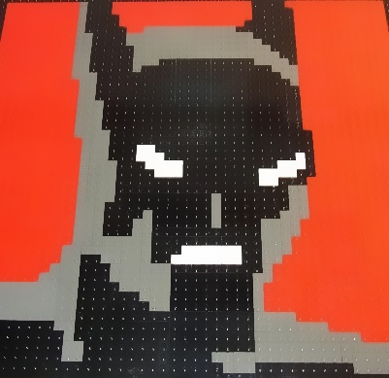

Edge preserving also fails the batman
Edge-aware filter (bilateral filter)
Notes:
These filters also can’t please this batman by removing the ugly dots in his face.
[press]
Look, the dots are still there after bilateral filtering.

Slide 9
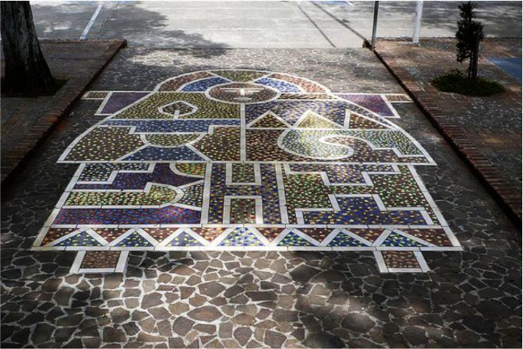
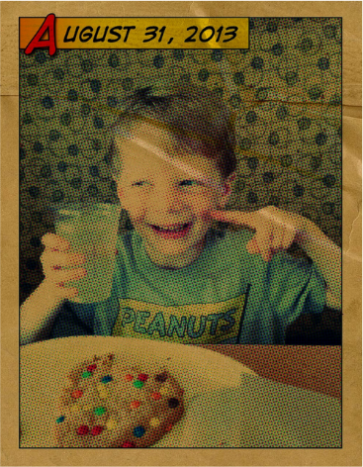
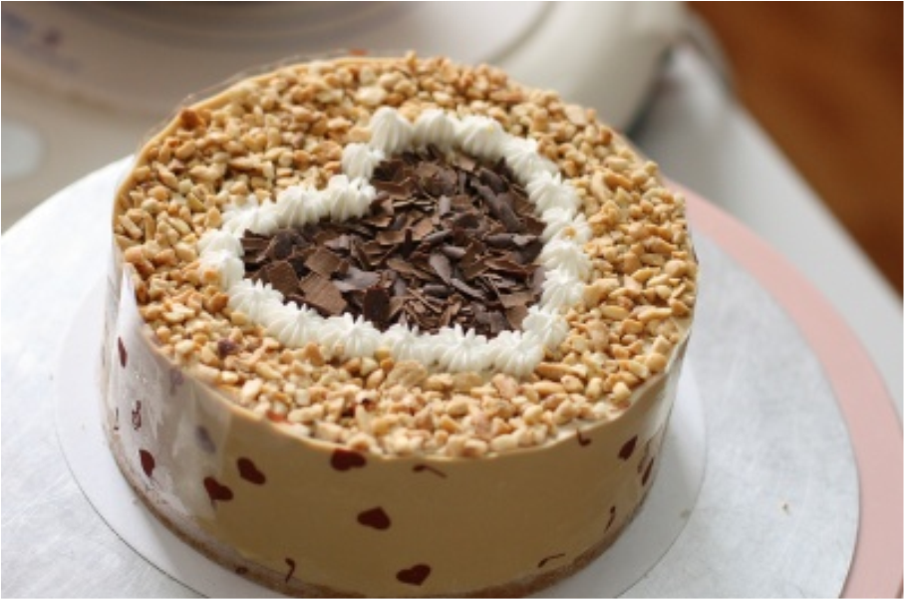
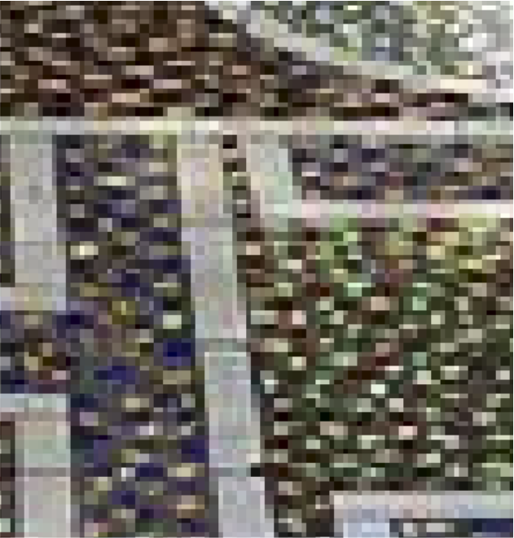
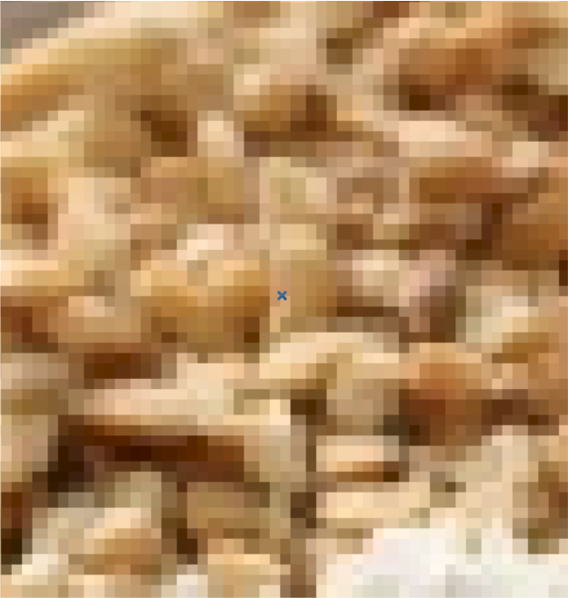
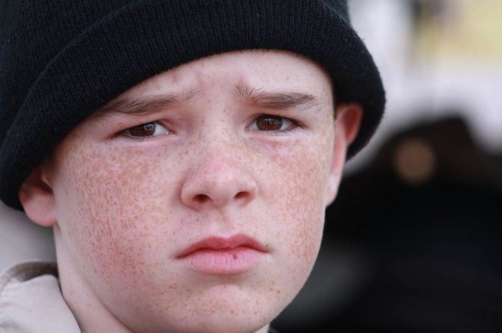
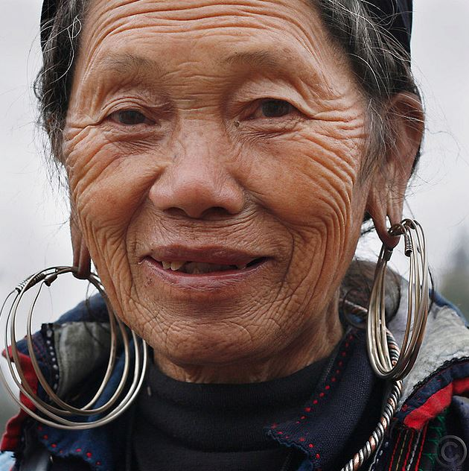
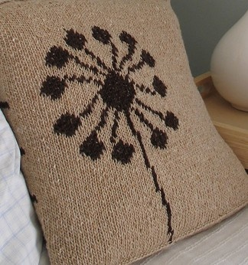

Many tiny contents are strong
Notes:
Why don’t edge-preserving filters work in these examples? It is because many natural images contain small-resolution patterns with strong boundaries.
[press]
These rock, freckle, and wrinkle patterns cannot be removed by common filters due to the large magnitudes.

Slide 10
What better characters them?
Scale!
Notes:
So how can we characterize these patterns in a better way?
[press]
The answer is to use scale.

Slide 11
Scale in Computer Vision
A Multi-Scale Tikhonov Regularization Scheme for Implicit Surface Modelling
Robust Real-Time Visual SLAM Using Scale Prediction and Exemplar Based Feature Description
Estimating Scale of a Scene from a Single Image Based on Defocus Blur and Scene Geometry
Multi-scale Structural Saliency for Signature Detection
Multi-scale Features for Detection and Segmentation of Rocks in Mars Images
The Scale of a Texture and its Application to Segmentation
A Discriminatively Trained, Multi-scale, Deformable Part Model
Face Illumination Normalization on Large and Small Scale Features
Scale Invariance without Scale Selection
Efﬁcient Scale Space Auto-Context for Image Segmentation and Labeling
Scale-Hierarchical 3D Object Recognition in Cluttered Scenes
The Scale of Edges
On SIFTs and their Scales
Hierarchical Saliency Detection
Separating Signal from Noise using Patch Recurrence Across Scales
Multi-Scale Curve Detection on Surfaces
Multi-Source Multi-Scale Counting in Extremely Dense Crowd Images
The Scale of Geometric Texture
Multi-Scale Clustering of Frame-to-Frame Correspondences for Motion Segmentation
Scale Invariant Optical Flow
Dilated Divergence Based Scale-Space Representation for Curve Analysis
Scale Robust Multi View Stereo
Detecting and Localizing Activities at Different Scales under Budget
Finding People Using Scale, Rotation and Articulation Invariant Matching
Efficient Computation of Scale-Space Features for Deformable Shape Correspondences
Texture Regimes for Entropy-Based Multi-scale Image Analysis
Nonlocal Multi-scale Hierarchical Decomposition on Graph
Segmentation
Object Detection
Saliency Detection
Feature Extraction
Video Analysis
Edge Detection
Optical Flow & Stereo
Scene Understanding
Action Recognition
…
Scale
Hierarchical
Scale-invariant
Pyramid
Scale-space
Multi-scale
Large-scale
Notes:
Scale has long been an essential concept in computer vision.
[press]
We can easily find hundreds or thousands of important papers related to this concept
[press]
and they come from almost all fields in computer vision, including segmentation, detection, and recognition.

Slide 12
Scale + Image filter = ?
Notes:
[press]
Now what if we combine scale with image filter? We can achieve many things.

Slide 13

Notes:
Intriguingly, we can make this batman happy with a clean face.

Slide 14

Notes:
And we can remove all wrinkles and beatify this dog. Of course, there are many other ways to use this filter in computer vision. I will show them later.

Slide 15


Scale-Aware Filtering
Small Scale
Large Scale
Notes:
Here we define the effect of scale-aware filtering based on this challenging example.
[press]
For small scale structures, we completely remove them.
[press]
For large ones, we preserve them in their original appearance.

Slide 16


Related Work
Texture Smoothing
  Relative Total Variation [Xu et al., 2012]
  Region Covariance [Karacan et al., 2013]
  Weighted Median Filter [Zhang et al., 2014]
  Bilateral Texture Filtering [Cho et al., 2014]
Notes:
There are only a few related methods. In texture smoothing, global optimization based approaches or filters to handle Repeating texture were proposed.
(texture smoothing methods are normally complex and runs slowly. They also assume that the texture has repeating patterns, which is not the case for our filter.)
(Compared with ours
They are more complex and inefficient.
Repeating property of textures are used in those methods, but not in ours.)

Slide 17


Related Work
Iterated Filtering Method
  Iterated Non-local Means (INM) [Brox & Cremers, 2007]
Notes:
Another method that is related to ours is iterated non-local means. It aimed at texture-preserving denoising.

Slide 18
Related Work
Iterated Filtering Method
  Iterated Non-local Means (INM) [Brox & Cremers, 2007]
Comparison
  Similar iteration scheme
  Different objective and functionality
    Remove texture vs preserve texture
  Different usage of iteration
    Edge recovery vs energy minimization
Notes:
There are also several major differences between this method and ours including objective and iteration procedure.

Slide 19

Interesting Fact
Our main algorithm has only 1 line of code
Notes:
Before we describe our method, I need to tell one interesting fact. That is our code is the shortest among all papers presented in this ECCV.
[press] This is because we only need to write one line of code given existing joint filter implementation in opencv or other libraries. [press] Theoretically, you can’t find shorter implementation.
[press] When putting the algorithm into a function with initialization, it is still quite short.

Slide 20


Main Idea
Scale Space Theory [Lindeberg, 1994]:
  An object of size $t$, will be largely smoothed away with Gaussian filter of variance $t2$.
Notes:
Our algorithm makes use of scale space theory, which says that an object of size t will be largely smoothed away with Gaussian filter of variance t square.
[press] Accordingly, when we smooth this image by Gaussian,
[press] Small scale structures are completely removed.
[press] But large-scale structures are also blurred in this process, which is not what we expect to accomplish.

Slide 21



Our Scale-aware Filter
Step 1
Small Structures Removal
Step 2
Edge Recovery
Notes:
So our constructed filter has two steps.
[press]
The first step is to remove small structures according to scale space theory.
[press]
and the second step is to recover only the large-scale edges.

Slide 22



Step 1: Small Structures Removal
Gaussian Filter
  $$J\left(p\right)= \frac{\sum_{q ∈R(p)}{exp⁡(−\frac{\left|p−q\right|2}{2σ_{s}^{2}})∙I(q)}}{\sum_{q ∈R(p)}{exp⁡(−\frac{\left|p−q\right|2}{2σ_{s}^{2}}) }}$$
Notes:
The first step is easy [press] we apply a Gaussian, which makes image blurred everywhere.

Slide 23



Step 2: Edge Recovery
A rolling guidance
Original Input
The output of Step 1
Use it as new guidance
Input
Guidance
Joint Bilateral Filter
Repeat the iteration
Output
Notes:
Step 2 is important in our framework. [press] It involves a rolling guidance process to restore necessary sharp edges.
[press] With the blurred image from step 1, we use it together with the original input image in a joint filter process, where the blurred image is taken as the guidance. [press] After joint filter, the result is less blurred than the original guidance image. I will explain why in following slides. [press] Then we take the joint filter output as the new guidance image, and perform the joint filter again.
[press] We repeat this process until the guidance image converges with necessary edges restored.

Slide 24
Rolling Guidance
Unchanged
Changing
Rolling Guidance
Input
Guidance
Joint Bilateral Filter
Notes:
In this procedure,
[press] the input image is always the same.
[press] And we keep updating the guidance image.
[press] This is why we call it rolling guidance.

Slide 25

Guidance for the 1st iteration
Notes:
Let’s see what happens in the iterations. Initially, the guidance image is quite blurry.

Slide 26

Guidance for the 2nd iteration
Notes:
In the second iteration, it is sharpened a bit.

Slide 27

Guidance for the 3rd iteration
Notes:
It becomes sharper in more iterations.

Slide 28

Guidance for the 5th iteration
Notes:
And converges in only 5 iterations where large scale structures are restored with sharp boundaries.

Slide 29

Input
Output
Small structures are removed.
Large structure are NOT blurred.
Notes:
Compare the result with the input, the small structures are removed, and large structures stay clear.

Slide 30
Why does rolling guidance work?
Notes:
[press]
Why does rolling guidance work? We give the following analysis.

Slide 31











Small Structure
Input $I$
Guidance $G$ (output of step 1)
$$p$$
$\left|G(p)−G(q)\right|≈0$
$$q$$
$$G(q)$$
$$G(p)$$
$$≈1$$
$$J\left(p\right)= \frac{1}{Kp}\sum_{q ∈ R(p)}{exp⁡(−\frac{\left|p−q\right|2}{2σ_{s}^{2}})∙exp⁡(−\frac{\left|G(p)−G(q)\right|2}{2σ_{r}^{2}})∙I(q)}$$
$$∙I(q)$$
It becomes a Gaussian filter
Joint Bilateral Filter
Same
Notes:
We first study small scale structures that change quickly in a short range. [press] After the first Gaussian filter step, it is flattened. [press] In the second step, we apply joint filter. [press] The first term measures the difference between p and q in the input image, which is large in this case. [press] The second term is called range term. [press] It measures the difference between g(p) and g(q) in the guidance image G. The difference is close to zero. [press] So the range term approaches 1, which can be ignored in this joint filter. [press] Then this function boils down to the original Gaussian using only the input image information. [press] So the result is almost the same as the initial guidance image. This means no matter how many iterations we perform, small scale structure is always removed and cannot be restored.

Slide 32



Large Structure
Input Image
Result of Step 1
$$≠1$$
$$J\left(p\right)= \frac{1}{Kp}\sum_{q ∈ R(p)}{exp⁡(−\frac{\left|p−q\right|2}{2σ_{s}^{2}})∙exp⁡(−\frac{\left|G(p)−G(q)\right|2}{2σ_{r}^{2}})∙I(q)}$$
Due to this range weight
It generates sharper results than Gaussian!
Notes:
Now we study the large-scale structures. They span a wide range steadily.
[press] In the first step Gaussian filtering, it is blurred instead of removed.
[press] Taking this as the guidance image in joint filter,
[press] the range term does not approach 1. So the range weight is functional now using the guidance image information. It creates a different effect, which is sharpening, on this guidance image.

Slide 33
Input Image
Guidance Image
Joint Bilateral Filter
Input
Intermediate iterations
Previous guidance image
<
<
Smoothing
Range weight
Notes:
This is the illustration. After joint filter, we produce an intermediate result in each iteration.
[press] It is theoretically guaranteed that this intermediate result is sharper than the guidance image in previous iterations due to the involvement of range weight.
[press] At the same time, it won’t be sharper than the original input due to the inevitable smoothing effect. So over-sharpening is avoided. This relationship makes the intermediate results for large-scale structure approach the original input sharp image without exception.

Slide 34
Input Image
Guidance Image
2nd Iteration
3rd Iteration
1st Iteration
Notes:
So the guidance image is getting sharper and sharper, but no more than the original sharpness.
[press] This is the iteration two result.
[press] Result from iteration 3 is already very similar to the original input.

Slide 35
Large Structure
Recovered
Take-home message
  Rolling guidance recovers an edge as long as it still exists in the blurred image after Gaussian smoothing.
Notes:
[press]
Here comes a claim. An edge can be recovered by rolling guidance procedure as long as
[press]
the intensity disparity still exists in the blurred image.

Slide 36



Rolling Guidance Filter
Step 2
Rolling
Guidance
Step 1
Gaussian
Remove
Small
Structures
Edge
Recovery
Large Structure
Small Structure
Notes:
To give the short summary,
[press]
In step 1, structures are smoothed or removed depending on their scales.
[press]
In step 2, only large scale structures are restored by rolling guidance.

Slide 37
Comparison
Notes:
We compare our method with previous work in terms of their effect and performance.

Slide 38
Result Comparison
Result comparison with related work
Input
[Subr et al.]
  [Karacan et al.]
[Xu et al.]
  Ours
Notes:
Given the input with many details,
[press]
Previous methods produce results possibly with remaining structure or ringing artifacts.
[press]
While our results are free of these artifacts.

Slide 39
Performance Comparison
Performance comparison with related works
For 4 Megapixel Image
  2
  seconds
  1044 seconds
  478 seconds
  58
  seconds
Input
  Ours
[Xu et al., 2012]
[Subr et al., 2009]
  [Karacan et al., 2013]
Notes:
In terms of running time, for a 4 megapixel image,
[press]
This smoothing method proposed in 2009 takes more than 400 seconds.
[press]
This recent approach uses more than 1000 seconds.
[press]
Our prior work using global optimization uses 58 seconds.
[press]
In comparison, our rolling guidance method only uses 2 seconds to get the result.

Slide 40
Performance Comparison
Performance comparison
Algorithms | Time (seconds/Megapixel)
Local Extrema [Subr et al., 2009] | 95
RTV [Xu et al., 2012] | 14
Region Covariance [Karacan et al., 2013] | 240
Ours | 0.05
(Real-time)
Notes:
For one megapixel image in one channel, our performance is almost real-time.

Slide 41
Results & Application
Notes:
There are many applications for this filter in computer vision and other areas.

Slide 42


Texture Removal
Notes:
First it removes texture from natural images and separate images into different scale layers.

Slide 43

Texture Removal
Notes:
See how the texture is handled by our method

Slide 44


Texture Removal
Notes:
This is another challenging example. All small lego dot patterns are removed while edges of the letter are sharply maintained in their original appearance.

Slide 45


Halftone Image
Notes:
Our method works amazingly well on halftone images, which are produced when scanning magazine or newspaper. The halftone patterns are formed by many mixing red and blue color dots.
Our method can easily remove them while not damaging the underlying structure.

Slide 46
Halftone Image
Notes:
We note the result is difficult to be accomplished similarly by denoising or other filter methods.

Slide 47


Small Text Removal
Remove Text
Notes:
If you want to separate small text from object surface. No problem, our filter makes it done in real time.

Slide 48






Virtual Edge Detection
Notes:
I also present you a virtual edge application. It is to prove how our method can simulate higher-level human perception.
[press] These natural images contain objects with no clear boundary edges.
[press] But for our human, it is easy to imagine these virtual edges as if they were born there.
[press] In fact, when we apply edge detectors, these edges do not exist at all.

Slide 49






Virtual Edge Detection
Notes:
With our scale-aware filter, it is easy and natural to restore these high level structures from images even without sophisticated semantic segmentation.
[press]
Based on our results, even the simplest edge detectors can successfully get these object boundaries. The virtual edges become real.

Slide 50


Natural Images
Usable for
  Segmentation
  Saliency
  Scene understanding
  Background
  subtraction
  Layer separation
  Outlier removal
  …
Notes:
Our method can be widely applied to natural images.
The results are usable in …

Slide 51




Input
Boundary Detection
Filtered Input
Boundary Detection

Slide 52


Determining Scales
Step 1
$$J\left(p\right)= \frac{1}{Kp}\sum_{q ∈ R(p)}{exp⁡(−\frac{\left|p−q\right|2}{2σ_{s}^{2}})∙I(q)}$$
Gaussian
$$J\left(p\right)= \frac{1}{Kp}\sum_{q ∈ R(p)}{exp⁡(−\frac{\left|p−q\right|2}{2σ_{s}^{2}})∙exp⁡(−\frac{\left|G(p)−G(q)\right|2}{2σ_{r}^{2}})∙I(q)}$$
Joint filter
Step 2
$σs$ determine the scale.
Notes:
Our method can also be adopted to perform multi-scale filtering.
[press] In these two steps, Gaussian and joint filters are involved.
[press] Both of them have a standard deviation parameter sigma.
[press] It controls the scale in our filter.

Slide 53













Multi-Scale Filtering
$σs$ = 10
$σs$ = 30
Input
$σs$ = 2
$σs$ = 3
$σs$ = 4
$σs$ = 6
Notes:
Now let’s see one example to understand how varying sigma_s produces different results.
[press] When we set sigma_s to 2, it removes only tiny sun flowers from afar.
[press] With a growing sigma, more and more flowers in different scales are removed from the image. When sigma goes to 10, only the largest sun flower is kept.
[press] We push this to extreme. When sigma is as large as 30, only three largest layers are preserved. They semantically correspond to sky, mountain, and flower field in scene understanding.

Slide 54











Multi-Scale Filtering
$σs$ = 40
$σs$ = 80
$σs$ = 160
$σs$ = 320
Input
$σs$ = 20
Notes:
Another example. This is the input.
[press]
With the increasing sigma, more and more rectangles are removed.
This is multi-scale filtering.

Slide 55





…
…
Input
A New Type of
Image Pyramid
Content of all scales
Content of only current scale
Laplacian Pyramid
(generated with Gaussian)
Texture Pyramid
(generated with Rolling Guidance Filter)
Notes:
Our method also creates a new form of pyramid.
[press] Laplacian pyramid is widely used for multi-scale image manipulation and analysis.
[press] By replacing the Gaussian filter with our filter, we can generate the new type of rolling guidance pyramid.
[press] There are many differences. The major one is that each layer in our new pyramid only contains patterns in certain scales or frequency bands.
[press] We believe it will be very useful for many tasks due to its unique scale property.

Slide 56











Summary
Traditional Filters
Gaussian
Our Filter
Rolling Guidance Filter
Scale-aware
Multi-scale
Simple
  Fast
Notes:
To conclude this talk, we have proposed a new type of image filter based on scales. It is essentially different from conventional edge-preserving filter according to our analysis.
[press]
It has several special properties as shown here.

Slide 57

Code Available Online
Notes:
To mark our method and use or update it in future,
[press] just remember it has only one line of code given existing joint filter library.
[press] It runs in near real-time.
[press] And most importantly, it can beautify your dog nicely.

Slide 58
Debluring
Segmentation
Optical Flow
Color analysis
Intrinsic image
Saliency
Features
Edge Detection
Image abstract
Super Resolution
Noise removal
Image Filtering
Image Filtering
Our Contribution
Low
Level
Notes:
Although our contribution is just a simple image filter,
[press]
we believe its new property can benefit the development of other fields of low level vision.

Slide 59
















































High
Level
Patches
Gradients
Histograms
Features
Segmentations
Low
Level
Notes:
Furthermore, we also believe
[press]
it will deliver a new idea to high level vision and provide more useful features and properties for practical use.

Slide 60


Thank You
Notes:
That’s it. Thanks.

Slide 61
Limitations
Sharp corners could be rounded
  It is because sharp corner presents high frequency change.
  In other words, sharp corners are small-scale structures.

