Slide 1
Computer-aided Drafting (SolidWorks)
Tutorial (Basics in SolidWorks)
小明 in ERB106

Slide 2
Today’s Outline
Modeling
2D
Sketching
Dimensioning
Mirror/Pattern
Trim/Extend
Fillet/Chamfer
3D
Extruded/ Extruded Cut
Revolved
Fillet/Chamfer

Slide 3
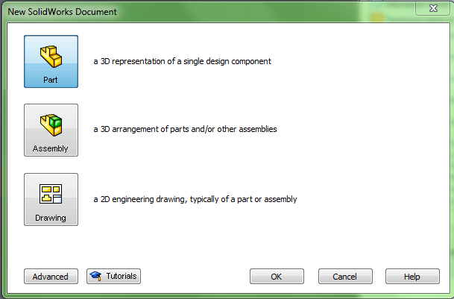
Getting Started
Open Software
Start > All programs > SolidWorks 2011 > SolidWorks 2011
New Document
Choose “Part‟ and then “OK‟ / ”Enter”
Create parts (File format -.sldprt)Assembly parts (File format -.sldasm)2D Engineering Draws (File format -.slddrw)

Slide 4
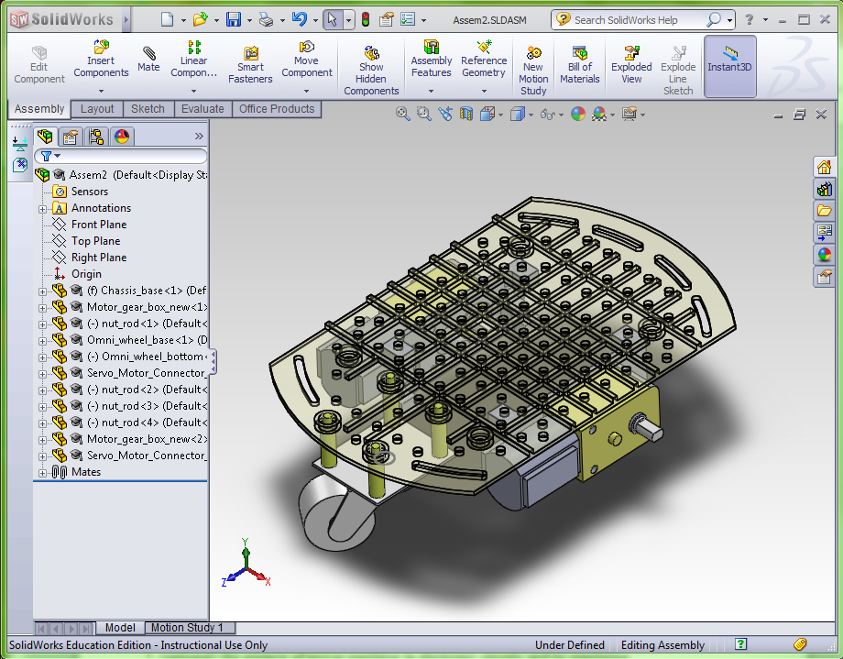
Basic Interface
Drawing tools
Design tree
Drawing region

Slide 5
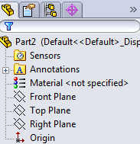
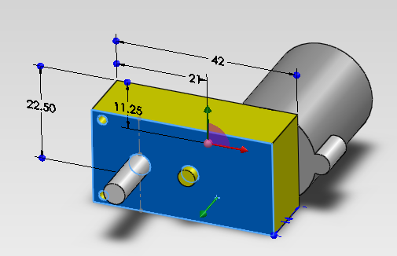
Basic procedures on sketching
Select plane for sketch
Invisible planes, planer surface on parts
Create sketch(2-D)
Draw features on sketch(3-D)

Slide 6
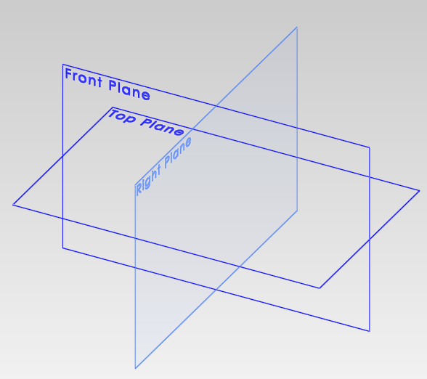
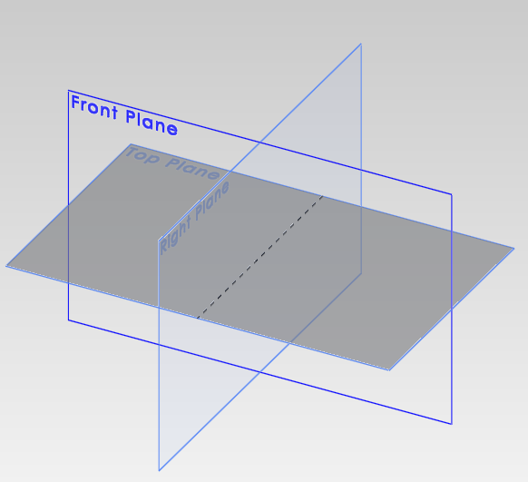
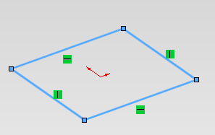
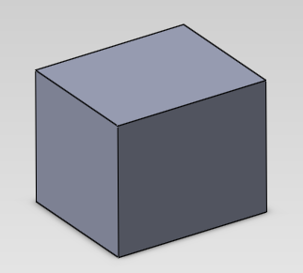
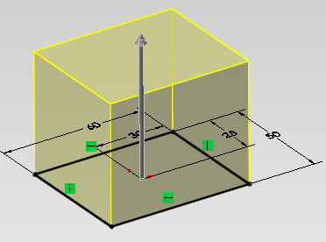
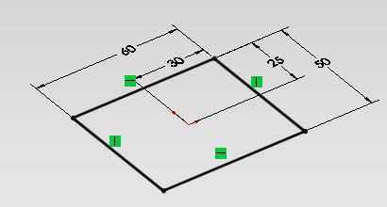
Basic steps
Sketch on the plane
Nothing
Select a plane
Dimensioning
Finish a feature
Create features (extrude)

Slide 7
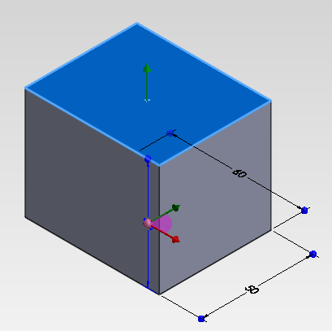
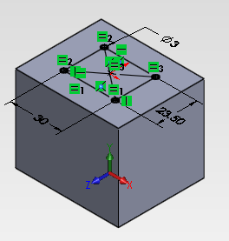
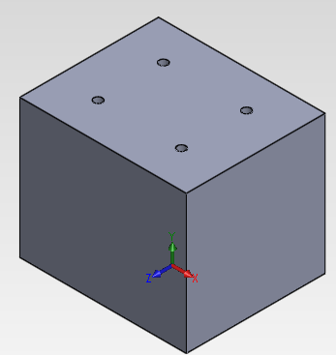
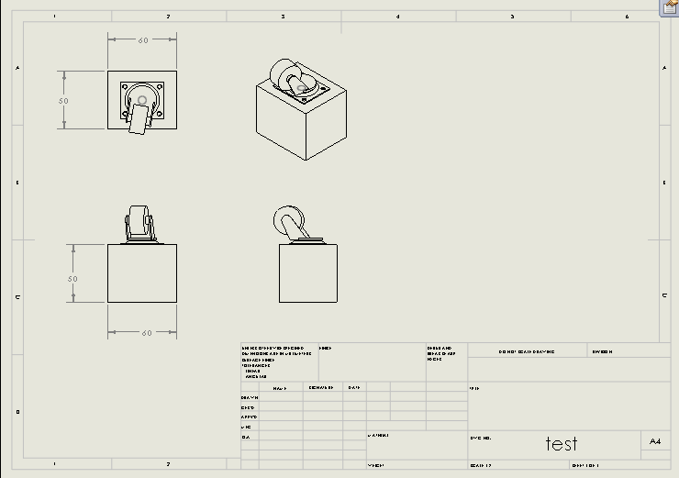
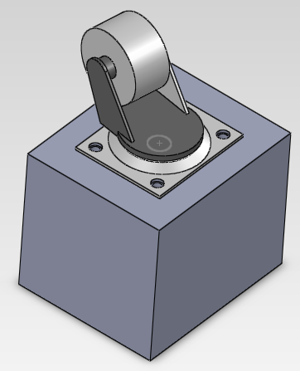
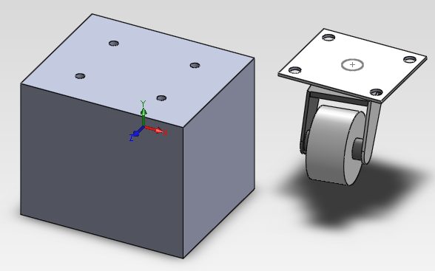
Basic steps [Con’t]
Create more features
Select other planes
Create more sketches
Assembly done, or modify if necessary
Assemble with other parts
Create engineering drawing

Slide 8
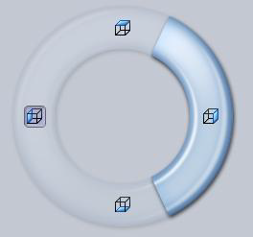
Control
Standard View -Right click and hold
(View>Toolbars>Standard View)
Shading and background
Others
Rotating –Middle click and hold
Panning –Ctrl + Middle click and hold
Zooming –Scroll Wheel
Fast views –Ctrl + 1,2,3,4,5,6,7
Many others…….(this tutorial covers only the basics)

Slide 9
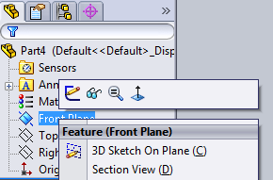
2-D sketch
Select a plane and right click.
In dialog box, click “sketch”
Or click “sketch” and select a plane
Exit the sketch before you move on. (at the top of the right side)
Confirm
Discard
Debug: if you stuck somewhere, check this!!

Slide 10
2-D
Basic sketching
Lines
Circles
Rectangles
Arcs
Modifications
Dimensions (many types)
Fillets/Chamfers
Mirrors
Patterns
Linear
Circular
Trims

Slide 11
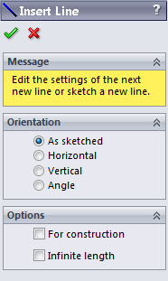
2-D lines
Enter / Create Sketch
Click line
ESC : leave the current command
Delete elements: select the elements and click delete button
button
As sketch: click to define arbitrary first point, second point,…etc
Horizontal:click to draw horizontal line only
Vertical:click to draw vertical line only
Angle:click to draw line by defining angle with respect to horizontal line
Usually use this and further define the line by dimension
For construction: can change the elements for reference
Infinite length: can draw line with infinite length
Sometimes useful for later drawings

Slide 12
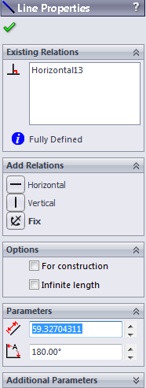
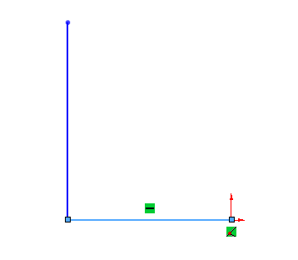
2-D lines
Tell you its existing relation/the relation with other elements
You can add relations here
Modify options (normally you can set “for construction” after all necessary lines are drawn
Intersections
Horizontal
Define parameter of current element. E.g. length of line

Slide 13
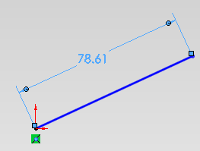
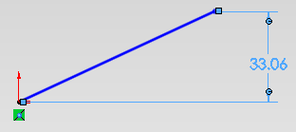
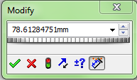
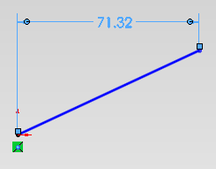
2-D lines (dimensions)
Click Smart Dimension
Click on the line: define the line by length only
Pull the dimension to different directions
Along line
Vertical
horizontal
Then type in the value to modify the line
Click ‘tick’ when done
Click on 2 points: define the line by 2 end points (similar)

Slide 14
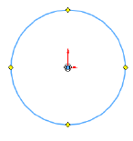
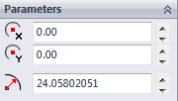
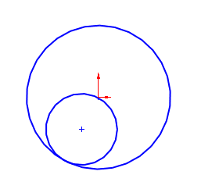
2-D circles
Select circle
Click a point(center), then click another point(radius)
Select Perimeter circle
Select three points to define a circle
Radius and Center
Useful when you want to draw tangent circle

Slide 15
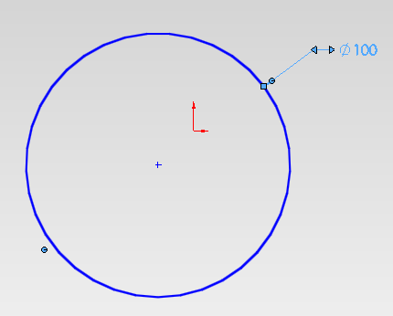
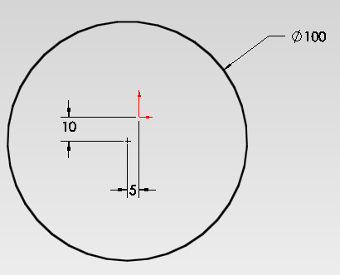
2-D circles (dimensions)
Usually it is defined by its center and radius
Not yet fully defined (blue)
Fully defined (Black)
Or use the mouse to force set the relations of the center with some reference (e.g. the origin)

Slide 16
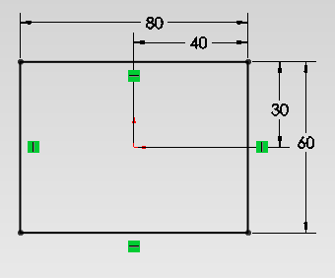
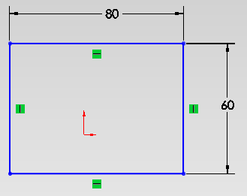
2-D rectangles
Select rectangle
Click 2 more points to define it
Usually it is defined by 2 sides
Not yet fully defined (blue)
Fully defined (Black)

Slide 17
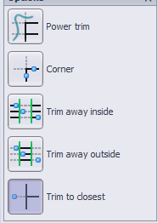
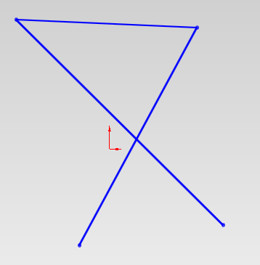
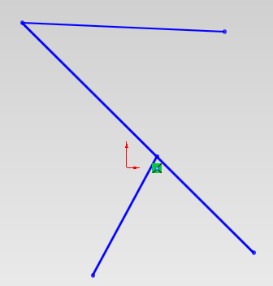
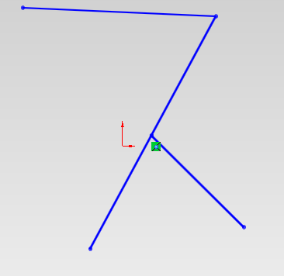
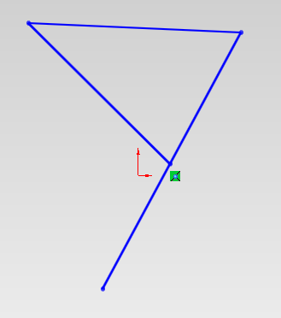
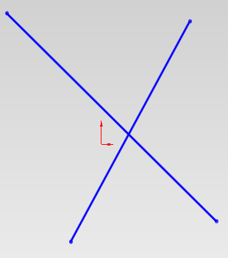
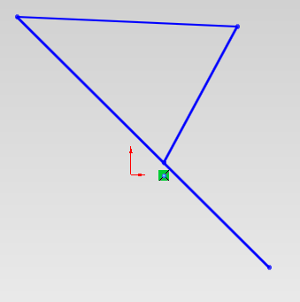
2-D Trim (cutting lines)
Click trim and select “trim to closest”
Trim the line between 2 (intersecting) points

Slide 18
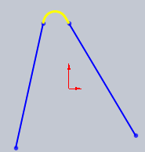
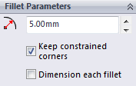
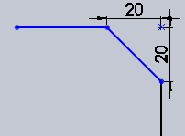
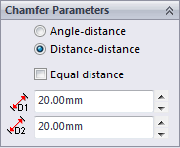
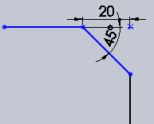
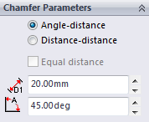
2-D fillets / chamfers
Click fillet
Fillet the corner at the intersection of two sketch (choose a corner)
Click chamfer
Set corner radius

Slide 19
3-D
Extrude / extrude cut
Revolve / revolve cut
Fillets / chamfers
Mirror
Patterns
Linear
Circular
Many others
Loft base
Sweep base
Etc.

Slide 20
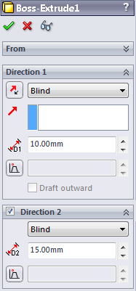
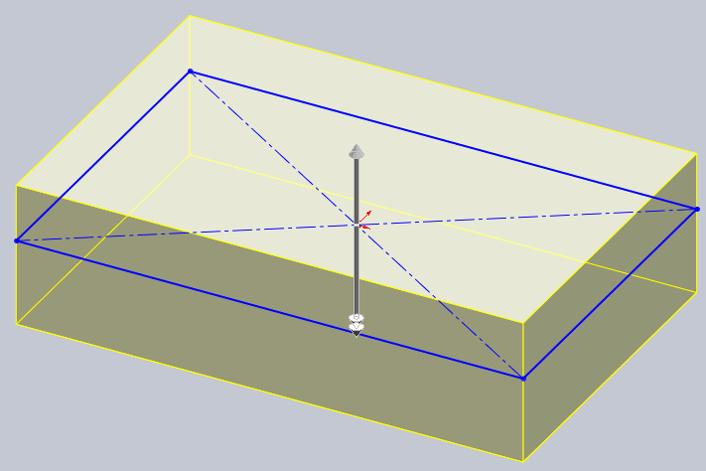
3-D extrudes
Select a sketch (must be close-loop)
Click
Extrude type
Extrude thickness

Slide 21
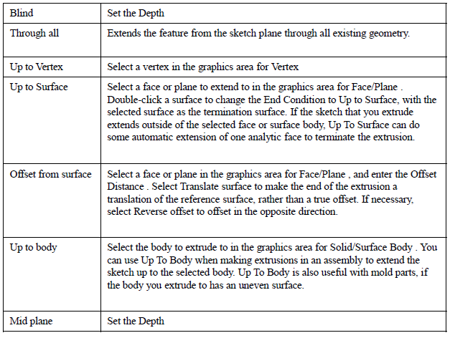
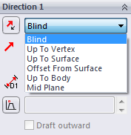
3-D extrudes
Frequently used

Slide 22
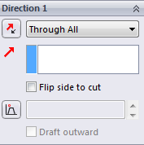
3-D extrude-cut
Select a plane on feature
Sketch on that plane
Click Features >Extruded Cut
Select this plane and sketch first!!!

Slide 23
3-D fillets
Select edge/face of feature and click
Constant radius
Radius

Slide 24
Assembly
Assemble virtually before manufacturing!

Slide 25
Assembly
Open new assembly
Insert new component
Browse a new part

Slide 26
Assembly
Open the first (fixed) component
Click to place the component
In the “Assembly” tab, click “Insert Components” and browse more components

Slide 27
Assembly
Take one part for each component (totally 5 more parts)
Duplicate parts: Press Ctrl + mouse (left) key on the motor (yellow part), pull away from it.

Slide 28
Assembly
The prefixes:
(f) Fixed: position of this component is fixed,
i.e., it CANNOT be moved / rotated.
(-) Float: position of this component has NOT been defined,
i.e., it can be moved / rotated freely.
You can right-click it, and set to float if necessary

Slide 29
Assembly
Adding relations, click Mate

Slide 30
Assembly
Most commonly used!
Standard Mates
Coincident
configure two items(faces, edges or planes) so that they touch each other.
Parallel
configure two items so that they remain a specified distance from one another.
Perpendicular
configure two items so that they’re 90 degrees from one another.
Tangent:
configure a curve and another item so that they meet at a single point. One of the selected items must be a cylindrical, conical or spherical face.
Concentric:
configure two items so that they share the same center axis.
Distance:
configure two items at a specified distance from one another.
Angle:
configure two items at a specified angle to one another.
Mate can only handle 2 features each time!!!

Slide 31
Assembly (omni-wheel)
Click “Mate”, select 2 faces

Slide 32
Assembly (omni-wheel)
Reverse mating directions

Slide 33
Assembly (omni-wheel)
Mate (coincident), click 2 surfaces, then “Mate”, finally click “tick”

Slide 34
Assembly (screw rods)
Mate (coincident) with all 4 surfaces,
Mate (concentric) the rods and the holes on the chassis,

Slide 35
Assembly (screw rods)
Mate (coincident) with 2 surfaces,
Mate (concentric) the holes on the “omni-wheel” with the 4 rods, (either 2 holes are enough in this case)
Mate (coincident) the head of the rods with the flat surface on the omni-wheel

Slide 36
Rapid Prototyping (RP)
Flows of RP:
1. Design some parts
2. Save as “part_name.stl” format
3. Send to RP machine for fabrication
4. Post-treatment such as supporting materials removal
Demonstration of the rapid prototyping process:
http://www.youtube.com/watch?feature=player_embedded&v=bpcwBQKUqK4

Slide 37
Thank you!
Good luck with your study!

