Slide 1
ENGG1100 Introduction to Engineering Design I Engineering Faculty The Chinese University of Hong Kong
Tutorial 1: Computer Aided Drafting (Concepts in Engineering Designs)
小明 in ERB106
SolidWorks Reference (Online resources)
http://help.solidworks.com/HelpProducts.aspx

Slide 2
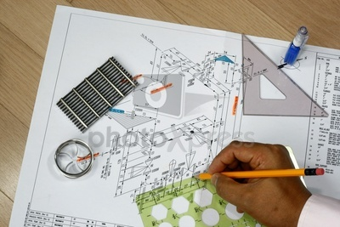
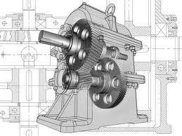
Computer-Aided Design (CAD)
Computer-aided design (CAD), also known as computer-aided design and drafting (CADD), is the use of computer systems to assist in the creation, modification, analysis, or optimization of a design.
Engineering drawings in the past (by hand)
Engineering drawings now (CAD)

Slide 3
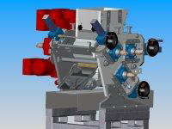
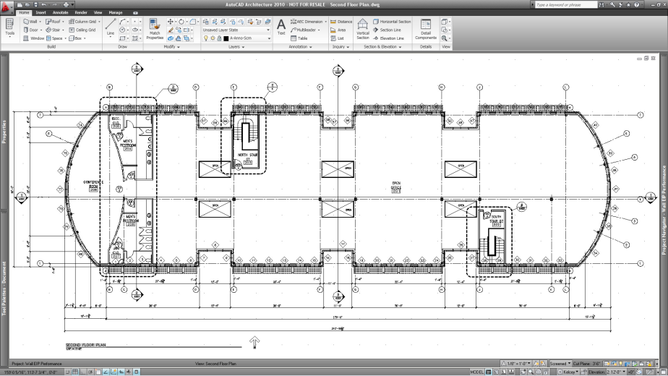
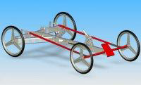
Computer-Aided Design (CAD)
Architectural, Engineering and Construction (AEC)

Slide 4
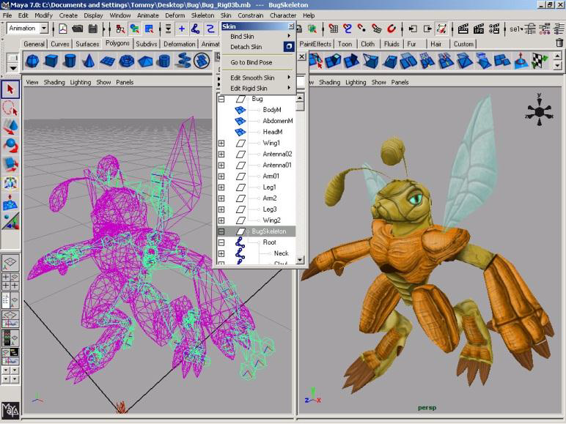
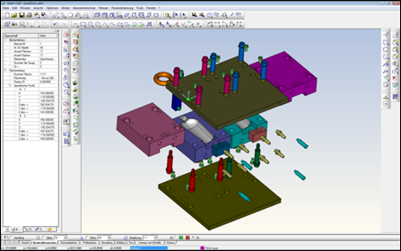
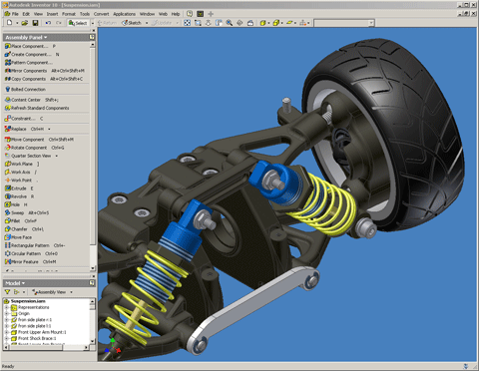
Computer-Aided Design (CAD)
Products design
Multimedia

Slide 5
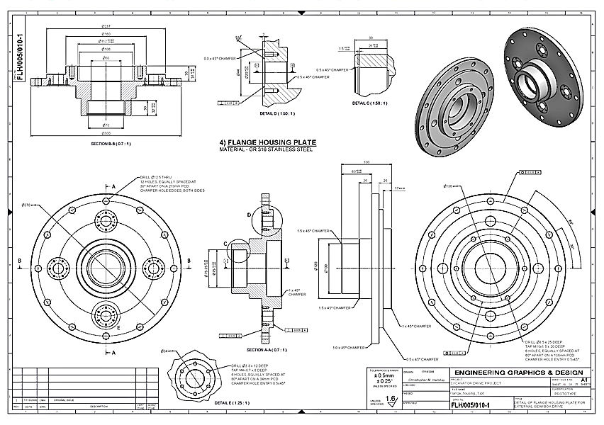
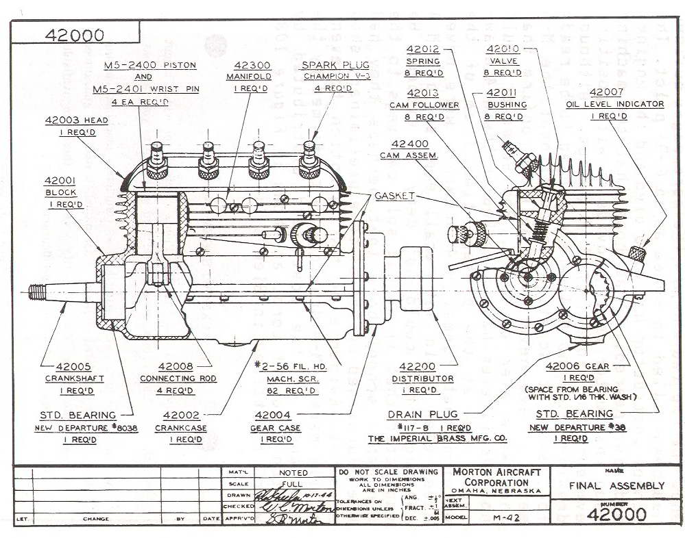
Engineering Drawings
Communications between engineers
Details of your designs
Examples of Engineering drawings:

Slide 6
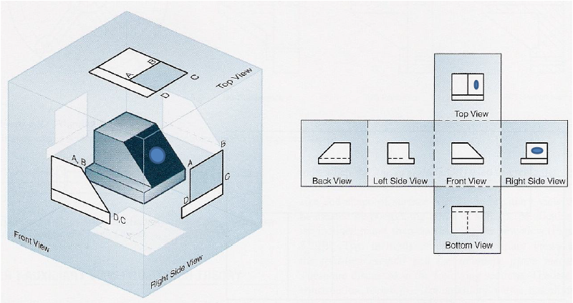
Engineering Drawings
Basics in Engineering drawings:
Principle View
Reference materials are from notes in course MAEG2010

Slide 7
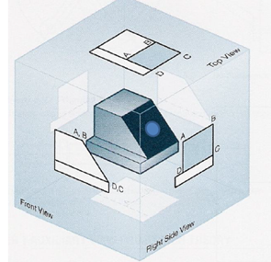
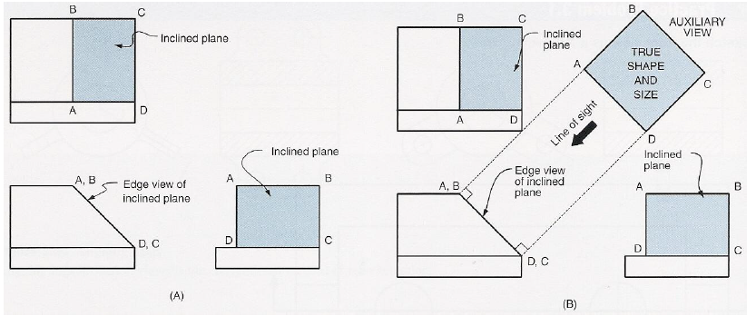
Engineering Drawings
Basics in Engineering drawings:
Auxiliary View
Reference materials are from notes in course MAEG2010

Slide 8
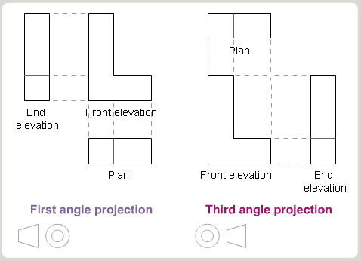
Engineering Drawings
Basics in Engineering drawings:
First angle projection / Third angle projection
sign
Reference materials are from notes in course MAEG2010

Slide 9
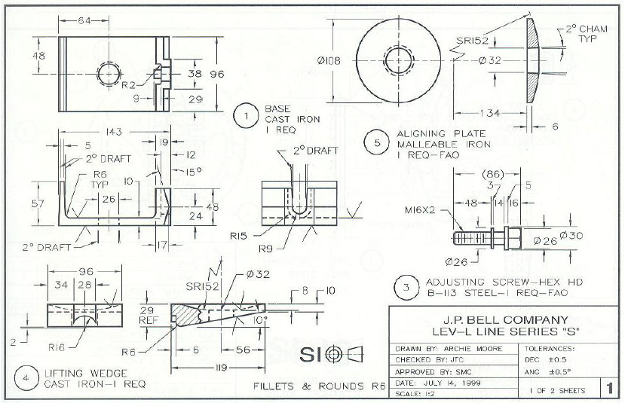
Engineering Drawings
Basics in Engineering drawings:
First angle projection / Third angle projection
sign
Reference materials are from notes in course MAEG2010

Slide 10
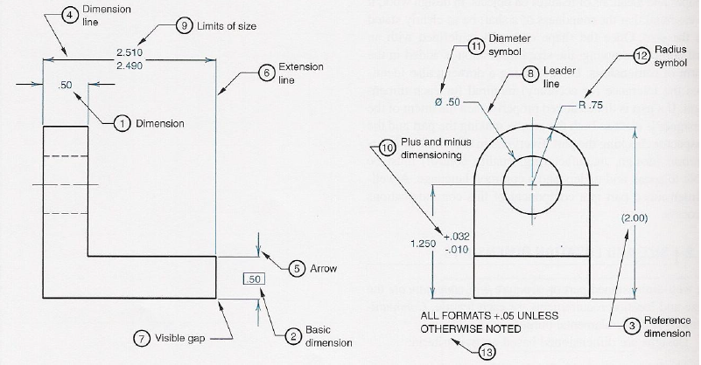
Engineering Drawings
Basics in Engineering drawings:
Dimensioning: Dimensions in a drawing provides the necessary information for fabricating a part

Slide 11
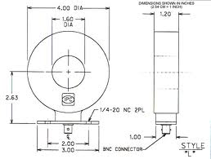
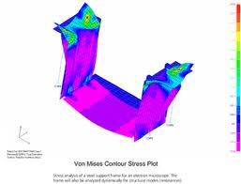
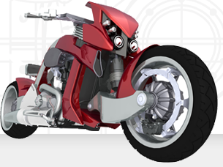
A CAD software: SolidWorks
What is SolidWorks used for?
Create 3-D design for products
Create Engineering Drawings for communications and manufacturing
Do analysis on your design

Slide 12
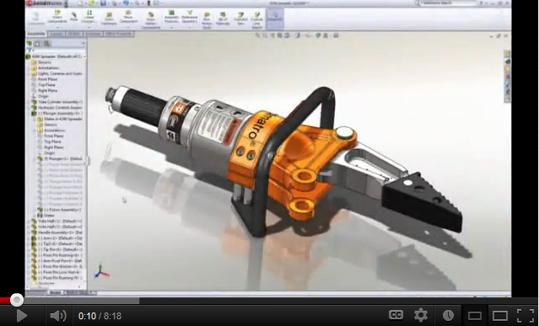
Using SolidWorks
http://www.youtube.com/watch?v=cPB7R8U8x_Q

Slide 13
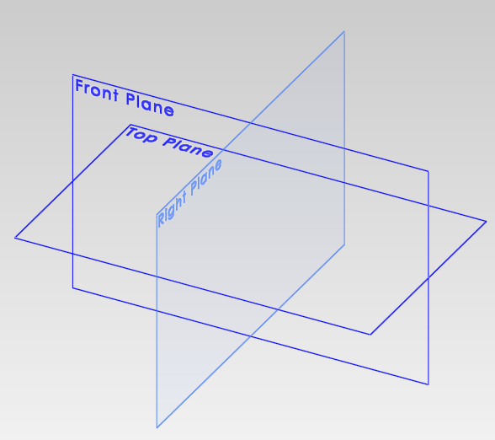
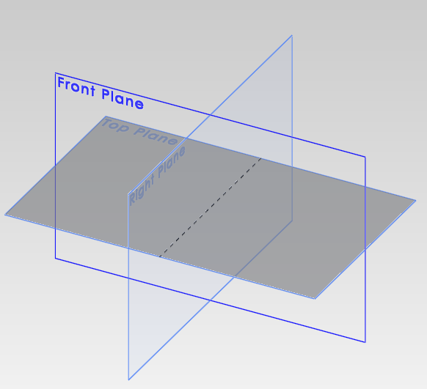
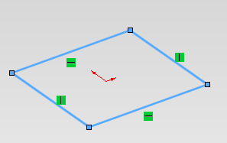
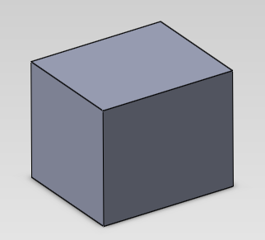
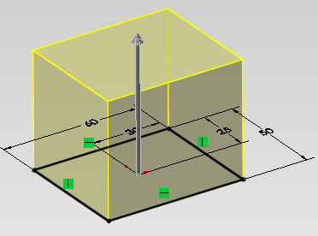
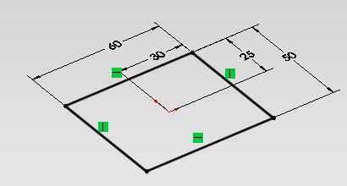
Basic steps
Sketch on the plane
Nothing
Select a plane
Dimensioning
Finish a feature
Create features (extrude)

Slide 14
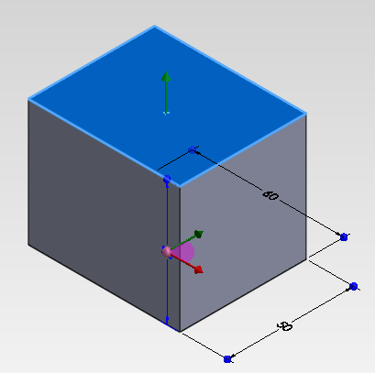
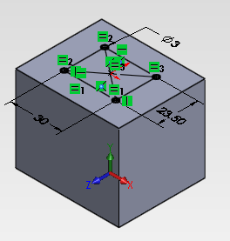
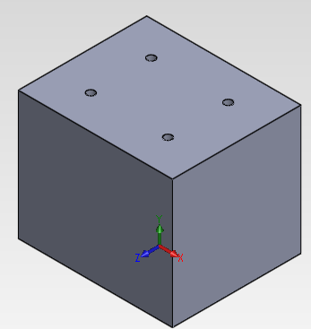
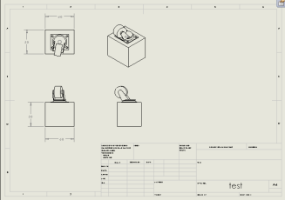
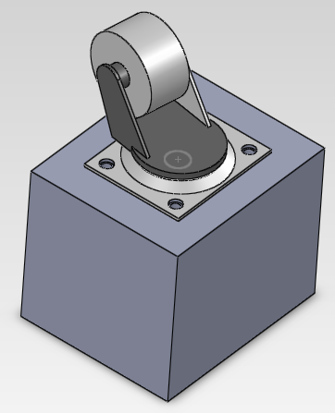
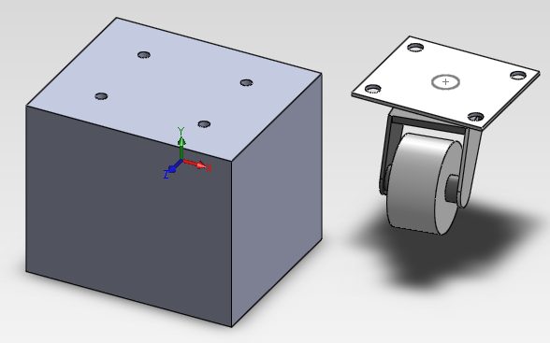
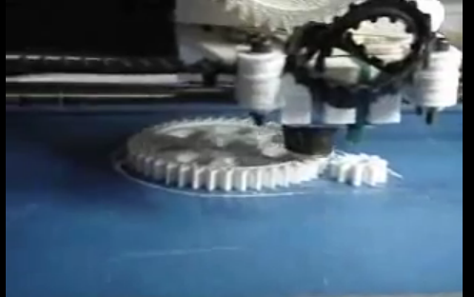
Basic steps [Con’t]
Create more features
Select other planes
Create more sketches
Create engineering drawing
Assembly done, or modify if necessary
Assemble with other parts
Send to fabrication

Slide 15
Rapid Propotyping
Rapid prototyping can be defined as a group of techniques used to quickly fabricate a scale model of a physical part or assembly using three-dimensional computer aided design (CAD) data.
It is usually constructed by 3-D printing technology
Examples on 3-D printing:
http://www.youtube.com/watch?v=iB5i5SA6rKQ&feature=related
Your project cars will need it to fabricate the parts!

Slide 16
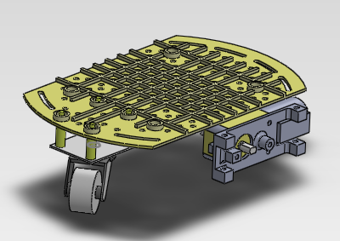
Quick demonstrations (by tutor)

Slide 17
End
Any enquiries on SolidWorks, please find tutor in
ERB106, siu ming 小明
SolidWorks Reference (Online resources)
http://help.solidworks.com/HelpProducts.aspx

