Slide 1
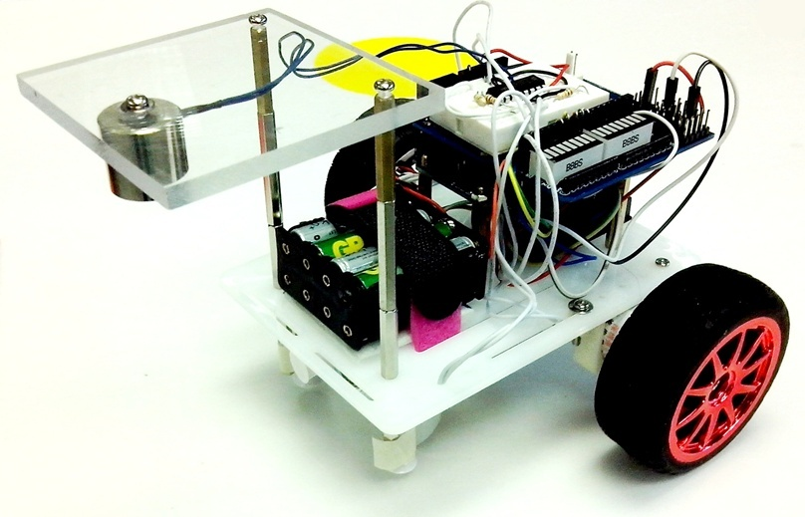
ENGG1100
Lecture7: Introduction To Engineering Design (Digital Logic)
Part 2
Kin Hong Wong

Slide 2
Overview
Part 1 (late week): Introduction
  1.1 What is Digital logic?
  1.2 Digital operations (AND, OR, NOT)
  1.3 Truth table
  1.4 Robot Hardware
  1.5 Software implement of digital operations
Part 2 : Hardware/software Implementation
  2.1 Robot system
  2.1 Use of If-then-else (software method 1)
  2.2 Use of switch case (software method 2)
  2.3 Finite state machines

Slide 3
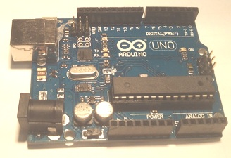
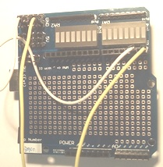
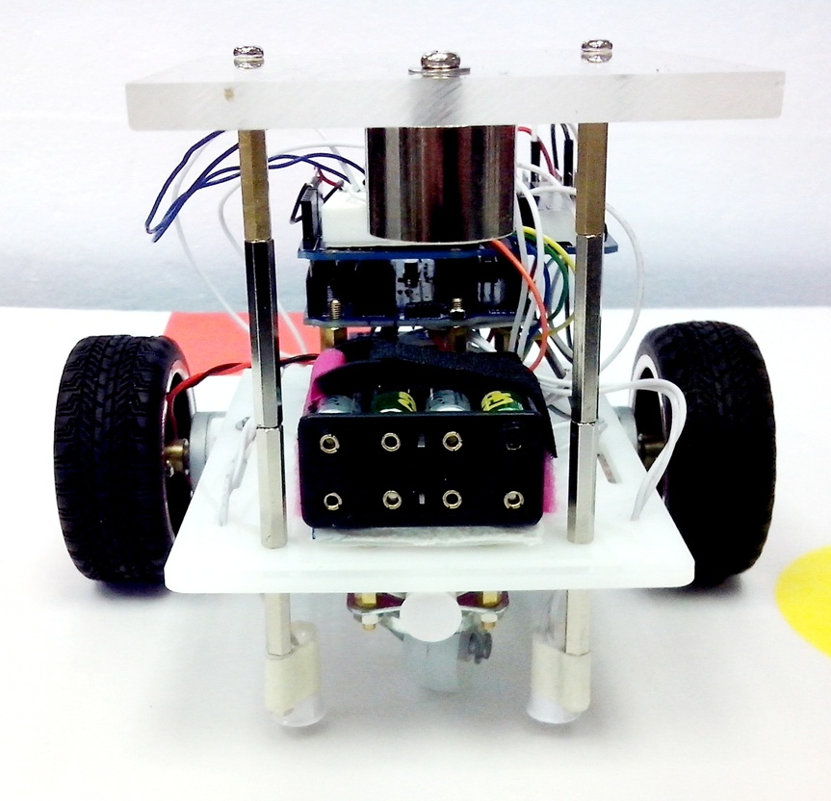
2.1 The Intelligent Robot system
USB cable
Programmer to update the program
Magnetic strips
Magnetic sensors
S1, S2
Our debug
interface
Board
Arduino board
(programs to be run in the Arduino computer):
:
Loop
{
If ….
then….
else….
}
In1
In2
In3
In4
Motor drivers
Out1
Out2
Out3
Out4
L293D
H-bridge
RM1
RM2
LM1
LM2
S2 S1

Slide 4
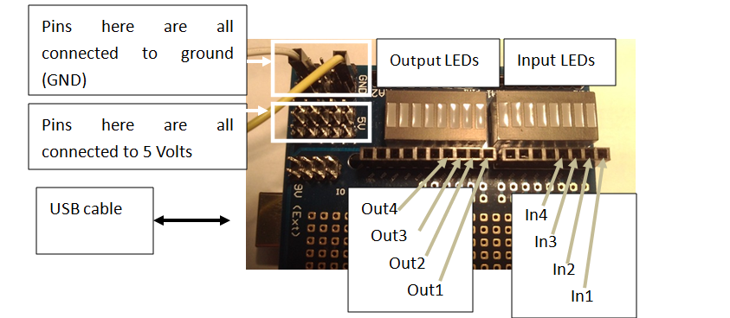
Our debug (interface) board
You may use the debug board provided to connect input/output signals to the Arduino board

Slide 5
Sensors of our robot
Magnetic Switch Sensors
  S1,S2,S3 each can be ‘1’ or ‘0’
  Magnetic field detected =>Si=0
  No Magnetic field detected =>Si=1
The robot is facing you
5
S2 S3 S1

Slide 6
Motors of our robot
The robot is facing you
Motors: LM1, LM2, RM1 and RM2
  Instruction LM1(0) sets LM1 to be 0
  Instruction LM1(1) sets LM1 to be 1
Motor control method
  {LM1=1 and LM2=0}=> Left-motor moves forward
  {LM1=0 and LM2=1} => Left-motor moves backward
  {LM1=0 and LM2=0} => Left-motor stops
  Similar for the right-motor
RM1
RM2
LM1
LM2
6

Slide 7
Software: Programing procedures
Document about the use of Arduino
  eLearning: https://elearn.cuhk.edu.hk/webapps/login/
  Workshop 2: Introduction to Arduino
  http://www.arduino.cc/en/Main/Documentation
Edit program
Compile
Download to the SMART-car-board
Run the program

Slide 8
2.2 Method 1: to implement logic operations in a program using
  Logic Formula (use of IF-Then-Else)

Slide 9
Using two sensors S2,S1 to follow a magnetic stripe
Sensors: S2 S1
Terminal
Magnetic sensors
S1, S2
Top down view
Forward
  Magnetic field detected =>Si=0
  No Magnetic field detected =>Si=1
9
S2 S1

Slide 10
Method 1 (Use of If-then-else): This program will enable the robot to follow the magnetic path
The program segment:
Void loop()
{
LM1(0);LM2(0);RM1(0);RM2(0);
//comment :LM1 =S1 AND S2
If (S1()==1 && S2()==1) LM1(1);
Else LM1(0);
//comment :LM2 = S1 OR S2
If (S1()==1 || S2()==1) LM2(1);
Else LM2(0);
}
Notations used in the program
Void Loop ( )= repeated the execution of the lines inside { }
LM1(0) sets the digital output LM1 to 0
LM1(1) sets the digital output LM1 to 1
== means condition
&& means logic operation AND
|| means logic operation OR
! means logic operation NOT
//comment, for you to put in your own notes
RM1
RM2
LM1
LM2
You may need to write
S1(),S2(),LM1(),LM2(), etc. for your own system
S2 S1

Slide 11
2.2 Software Method 2 : to implement logic operation in a program using
truth table (Use of Switch-Case)

Slide 12
Exercise2.1: Truth table example to make our robot to follow the magnetic strip
Case
  S1=1 (no mag. strip detected) , S2=1 (no mag. strip detected) on both sides of magnetic strips: Robot should move forward
  S1=1, S2=0 (robot deviates to the left side of the magnetic strip): Robot should turn right
  S1=0, S2=1 (robot deviates to the right side of the magnetic strip): Robot should turn left
  S1=0,S2=0 (robot reaches the terminal) : Robot should stop
Magnetic strip
Robot
Fill in the table (control truth table)
S1 S2
Case | Inputs |  | Outputs
 | S1 | S2 | LM1 | LM2 | RM1 | RM2
1) | 1 | 1 | 1 | 0 | 1 | 0
2) | 1 | 0 | ?__ | ?__ | ?__ | ?__
3) | 0 | 1 | ?__ | ?__ | ?__ | ?__
4) | 0 | 0 | ?__ | ?__ | ?__ | ?__
S1 S2
S1 S2
forward:LM1, LM2, RM1, RM2=“1010”
turn right:LM1, LM2, RM1, RM2=“1000”
turn left:LM1, LM2, RM1, RM2=“0010”
S1 S2
  Magnetic field detected =>Si=0
  No Magnetic field detected =>Si=1

Slide 13
After the truth table is obtained we will use “Switch – case” in a program to implement it
You may treat it as a table lookup method
In English it means:
  If INPUT is code1, result 1 will occur
  If INPUT is code2, result 2 will occur
  If INPUT is code3, result 3 will occur
  Etc……
switch (INPUT)
{
case code1 : result 1;
break;
case code2 : result 2;
break;
case code3 : result 3;
break;
:
}
Code_i=inputs for row i of a truth table
Result_i=output for row i of a truth table

Slide 14
Program example for our robot
You only need to edit the program to change the desired truth table
The program segment that produces the truth table on the right
void LogicTable()
{
// S2,S1 are the least significant 4 bits of IN_sensor in the program
switch (IN_sensor) // 0b00FEDCBA
{
case 0bxxxxxx11 : LM1(1);LM2(0);RM1(1);RM2(0);
break;
case 0bxxxxxx10 : LM1(1);LM2(0);RM1(0);RM2(0);
break;
case 0bxxxxxx01 : LM1(0);LM2(0);RM1(1);RM2(0);
break;
  default : LM1(0);LM2(0);RM1(0);RM2(0);
break;
}
}
Inputs |  | Outputs
S2 | S1 | LM1 | LM2 | RM1 | RM2
0 | 0 | 0 | 0 | 0 | 0
0 | 1 | 0 | 0 | 1 | 0
1 | 0 | 1 | 0 | 0 | 0
1 | 1 | 1 | 0 | 1 | 0
Magnetic sensors
S1, S3 S2
S2 S3 S1

Slide 15
2.3 Introduction to Finite State Machines
We will have three examples here:
  Simple finite state machine (no sensor). E.g.: The dancing robot
  An finite state machine uses 2 sensors. E.g. The robot that follows the magnetic strip
  An finite state machine uses 3 sensors. E.g. The robot that follows the magnetic strip, and stops when it detects a magnet in the front.

Slide 16
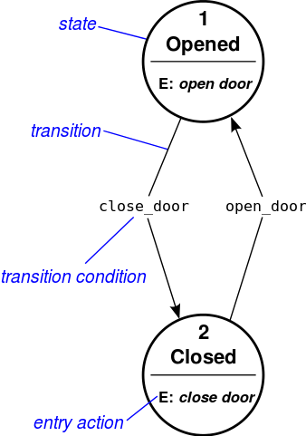
Understanding finite state machines
Example of a door
  State
  Transition
  Transition condition
  Entry action
http://en.wikipedia.org/wiki/State_diagram

Slide 17
Example in life
State1:Year 1
Reg. 12
course
  go to state 2 after 1 year
State of a student at CUHK
Start: go to state 1
State 1=Year 1:
  entry action: register 12 courses
  Transition: go to state 2 after 1 year
State 2=Year 2:
  entry action: register 12 courses
  Transition: go to state 3 after 1 year
State 3=Year 3:
  entry action: register 12 courses
  Transition: go to state 4 after 1 year
State 4=Year 4:
  entry action: register 8 courses and FYP Final_year_project
  Transition: go to stop after 1 year
Stop: Graduation
State2:Year 2
Reg. 12
course
  go to state 3 after 1 year
State3:Year 3
Reg. 12
course
  go to state 4 after 1 year
State4:Year 4
Reg. 8
Course & FYP
  after 1 year
graduation

Slide 18
2.3a) The simple state machine
(no transition condition )
The robot that dances with a pattern
  Forward 2 seconds, turn left 2 seconds and turn right 2 seconds, stop and repeat the pattern again
Video demo:
http://youtu.be/iyakbVyoafI

Slide 19
Simple finite state machine for (3a) :
No sensor input (no transition condition)
Entry actions
Start
Transition
Output: LM1,LM2,RM1,RM2=1010
State1
Entry action:
Move
Forward
Transition: After 2 seconds
Transition: After 2 seconds
State2
State4
E: Turn
Left
E:Stop
Output: LM1,LM2,RM1,RM2=0000
After 2 seconds
After 2 seconds
Output: LM1,LM2,RM1,RM2=0010
State3
E:Turn
Right
Output: LM1,LM2,RM1,RM2=1000
Flow diagram
Baisc form

Slide 20
Implementation of the finite state machine for (3a)
Use of DELAY:
DELAY_TIME=2000
motors(LM1,LM2,RM1,RM2,SPEED,SPEED,DELAY_TIME);
Part of the sample source code is shown below:
switch(state)
{
case STATE1:
LM1=1;LM2=0;RM1=1;RM2=0;SPEED=200; //entry action
DELAY_TIME=2000; // transition :delay 2 seconds
motors(LM1,LM2,RM1,RM2,SPEED,SPEED,DELAY_TIME);
state=STATE2; // next state will be state2
break; //end of the current state
case STATE2:
LM1=0;LM2=0;RM1=1;RM2=0;SPEED=200;DELAY_TIME=2000; // delay 2 seconds
motors(LM1,LM2,RM1,RM2,SPEED,SPEED,DELAY_TIME);
state=STATE3; //next state will be state3
break; //end of the current state
// to be continued on next page
Set motor to run forward with speed=200
You may need to write
the function motors( ) for your project
Exercise: explain the meaning of state 2

Slide 21
Continue from last page
Exercise 2.2
case STATE3:
(fill in by students)
break;
case STATE4:
(fill in by students)
break;
default: //none of above will be forced to run state4
state=STATE4;
break;
}
Exercise2.2: Fill in the missing programs in state 3 and 4

Slide 22
2.3b) A finite state machine uses 2 sensors
(with transition condition)
E.g. The robot that follows the magnetic strip

Slide 23
Example in life
(with transition condition : study hard)
State of a student at CUHK
Start：go to state1
State 1=Year 1:
  entry action: register 12 courses
  Transition: if (study hard) promote to state2 (year2) else go back to state 1
State 2=Year 2:
  entry action: register 12 courses
  Transition: if (study hard) promote to state3 (year3) else go back to state 2
State 3=Year 3:
  entry action: register 12 courses
  Transition: if (study hard) promote to state4 (year4) else go back to state 3
State 4=Year 4:
  entry action: register 12 courses
  Transition: if (study hard) promote to stop(graduation) else back go to state4
Stop: Graduation

Slide 24
Demo for 2.3b) An finite state machine uses 2 sensors
The robot can follow the magnetic strip
Video Demo:
http://youtu.be/NWHjWrq_VoY
  Demo programs may be available from the
  eLearning: https://elearn.cuhk.edu.hk/webapps/login/
  Workshop 2: Introduction to Arduino
  Two-State FSM demo 7.4b

Slide 25
2.3c) Add another sensor at the front to detect the target object
Sensors: S2, S1 are facing the ground to detect the magnetic stripe
S3 is facing the front, used to detect the target object
  S3=1 if no object is detected
  S3=0 if an object is detected
Magnetic sensors
S1, S3 S2
25
S2 S3 S1

Slide 26
A finite state machine uses 3 sensors
E.g. Follow the magnetic strip, find the CAN and stop
Video Demo : http://youtu.be/JEQkuax7lKE
  The robot finds the CAN using the magnetic strip placed under the testing board and stops
End point
S1
Obstacle
LM1,LM2
S3
S2
Start point
RM1,RM2

Slide 27
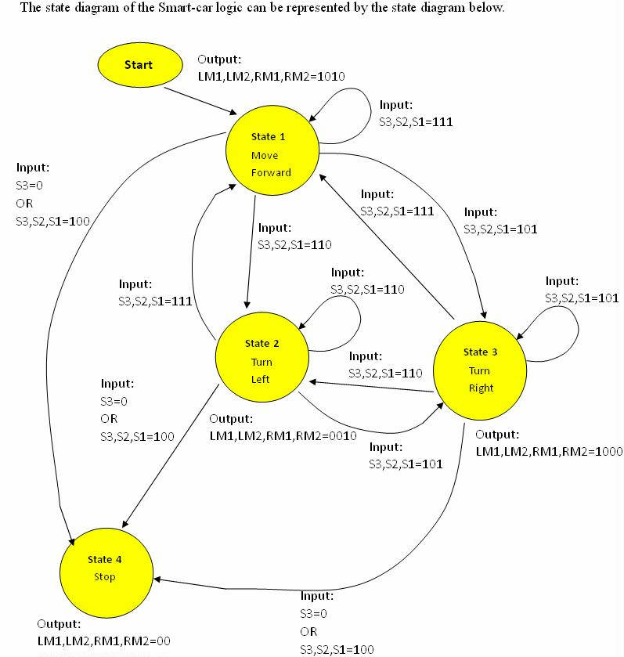
Finite state machine using 3 sensors (s1, s2, s3)with transition conditions for (3c)
Flow diagram
Basic form

Slide 28
Program 3c (S1, S2, S3 are used) S1, S2 for following the magnetic strip
S3 for detecting the CAN
The sample source code (program_segment3) is shown below:
switch(state)
{
case STATE1: // forward for 1 second
LM1=1;LM2=0;RM1=1;RM2=0;
SPEED=200;DELAY_TIME=10;
motors(LM1,LM2,RM1,RM2,SPEED,DELAY_TIME);
//
if ( S3()==1 && S2()==1 && S1()=0 ) state=STATE2;
else if(S3()==1 && S2()==0 && S1()=1) state=STATE3;
else if((S3==0) || (S3()==1 && S2()==0 && S1()=0)) state=STATE4;
break;
case STATE2: //robot turns left
LM1=0;LM2=0;RM1=1;RM2=0;SPEED=200;DELAY_TIME=10;
motors(LM1,LM2,RM1,RM2,SPEED,DELAY_TIME);
//
if ( S3()==1 && S2()==1 && S1()=1 ) state=STATE1; //back to state 1
else if(S3()==1 && S2()==0 && S1()=1) state=STATE3;
else if((S3==0) || (S3()==1 && S2()==0 && S1()=0)) state=STATE4;
break;
Move forward for 1 second
If S3=0, a CAN is detected, next state is state4
Robot deviated to the right, goto state 2
Robot deviated to the left
goto state 3

Slide 29
case STATE3: //robot turns right
// To be filled by students as an exercise
case STATE4: //stop
// To be filled by students as an exercise
default: //none of above states
state=STATE4;
LM1=0;LM2=0;RM1=0;RM2=0;
SPEED=200;DELAY_TIME=10;
motors(LM1,LM2,RM1,RM2,SPEED,DELAY_TIME);
break;
}

Slide 30
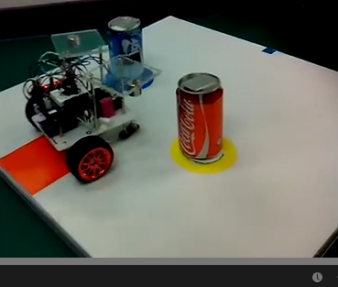
Demos
A demo of a robot carrying two CANs and bring them simultaneously to the destination.
http://www.youtube.com/watch?v=-ze2rwpXVXY&feature=youtu.be
Arduino software: http://arduino.cc/en/Main/Software#toc1

Slide 31
Overall summary
In digital logic part 1 and 2, we learned
  What is digital logic
  Digital logic operations represented by
    Digital logic formula method
    Truth table method
    Their implementation methods using programs
  Finite state machines
    Theory and implementations
  Use the above to control a robot for specific tasks

Slide 32
End

Slide 33
Appendix A : Answer: Exercise 2.1:Truth table example to make our robot follow the magnetic strip
Case
  S1=1 (no mag. strip detected) , S2=1 (no mag. strip detected) on both sides of magnetic strips: Robot should move forward
  S1=1, S2=0 (robot deviates to the left side of the magnetic strip): Robot should turn right
  S1=0, S2=1 (robot deviates to the right side of the magnetic strip): Robot should turn left
  S1=0,S2=0 (robot reaches the terminal) : Robot should stop
Magnetic strip
Robot
Fill in the table
S1 S2
Case | Inputs |  | Outputs
 | S1 | S2 | LM1 | LM2 | RM1 | RM2
1) | 1 | 1 | 1 | 0 | 1 | 0
2) | 1 | 0 | 1 | 0 | 0 | 0
3) | 0 | 1 | 0 | 0 | 1 | 0
4) | 0 | 0 | 0 | 0 | 0 | 0
S1 S2
S1 S2
forward:LM1, LM2, RM1, RM2=“1010”
turn right:LM1, LM2, RM1, RM2=“1000”
turn left:LM1, LM2, RM1, RM2=“0010”
S1 S2
  Magnetic field detected =>Si=0
  No Magnetic field detected =>Si=1

Slide 34
Appendix B: Answer for Ex2.3
case STATE3:
LM1=1;LM2=0;RM1=0;RM2=0;DELAY_TIME=2000;
motors(LM1,LM2,RM1,RM2,SPEED,SPEED,DELAY_TIME);
state=STATE4;
break;
case STATE4:
LM1=0;LM2=0;RM1=0;RM2=0;SPEED=200;DELAY_TIME=2000;
motors(LM1,LM2,RM1,RM2,SPEED,SPEED,DELAY_TIME);
state=STATE1;
break;
default: //none of above will be forced to run state4
state=STATE4;
break;
}
Exercises: explain the meaning of state 3 and 4

