Slide 1
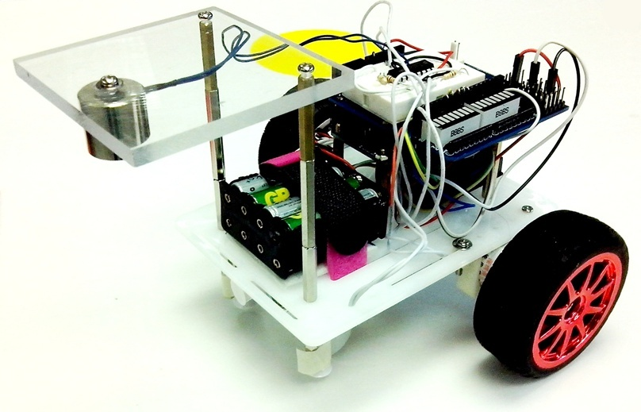
ENGG1100
Lecture 6: Introduction To Engineering Design (Digital Logic)
Part 1
Kin Hong Wong

Slide 2
Overview
Part 1: Introduction
  1.1 What is Digital logic?
  1.2 Digital operations (AND, OR, NOT)
  1.3 Truth table
  1.4 Robot Hardware
  1.5 Software implementation of digital operations
Part 2 (next week): Hardware/software Implementation
  2.1 Robot system
  2.1 Use of If-then-else (software method 1)
  2.2 Use of switch case (software method 2)
  2.3 Finite state machines

Slide 3
Motivations and plans
The brain of our robot is a set of digital logic functions
We will introduce three techniques in digital logic design
  Logic formula
  Truth table
  Finite state machine
We will use a program in a Micro-controller system to implement these techniques

Slide 4
Example
How to keep the robot to move forward? Method:
  If the robot deviates to the left, turn right
  If the robot deviates to the right, turn left
The above rules are logic functions and operations.
Terminal
Magnetic sensors
S1 S2

Slide 5
1.1 What is digital logic ?
  Understanding the difference between Digital and Analog operations

Slide 6
Analog and digital signals
Analog signals: the signal can be any values within the valid range
  Example: Range =0 → 10 Volts
  E.g. The signal can be 1.356 Volts or 2.432 Volts
Digital signals: It can only be HIGH (or called ‘1’ )or LOW (or called ‘0’). Examples:
  In TTL Transistor-transistor-logic standard:
    High=‘1’ ≈ 5 volts
    Low=‘0’ ≈ 0 Volt
Voltage
10 V
0 V
Analog
1
Time (ms)
Voltage
Digital
5 V
0 V
1
Time (ms)

Slide 7
What is the meaning of digital logic?
A signal is represented by ‘1’ or ‘0’
In some digital electronics:
  High=‘1’ ≈ 5 volts
  Low=‘0’ ≈ 0 Volt
  Advantages:
    Easy to be implemented in a circuit.
    Less likely to be interfered by noise, temperature and radiation.

Slide 8
1.2 Digital Operations
AND
OR
NOT

Slide 9
Digital operations
Study how to combine inputs to generate outputs
  In arithmetic operations: 2 Add 3= 5, result is 5
  In digital operations: we need a truth table to see the result
3 popular digital operations you will learn here
  AND
  OR
  NOT (Negation )
Digital
Input1
Digital
Input2
Digital operation
Digital
Output

Slide 10
Exercises
Multiple choice questions
Are these values digital or analog?
  Temperature : Ans: _________?
  Humidity : Ans: _________?
Are you a Chinese Univ. student,
  the answer is : Ans_____?
  Is the above answer Analog or digital? : Ans:_________?
Do you have a mobile phone in your pocket,
  the answer is : Ans:______?
  Is the above answer Analog or digital? Ans: ________?
What is the temperature in this room,
  the answer is Ans:___?
  Is the above answer Analog or digital? Ans: ________?
Answers:
Analog, analog
Yes, digital
Yes, digital
20 Degrees, analog

Slide 11
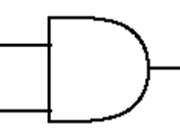
AND operation, example in real life
You get a Degree from CUHK if you take 123 units and your GPA is greater than 1.5
  You may write a formula
    (X=take 123 units) AND (Y=GPA>1.5) then you can get a Degree from CUHK (W)
You must eat and drink in order to live
  You may write a formula
    (X=eat ) AND (Y=drink) then you can live (W)
Notation
X
Y
W=X AND Y

Slide 12
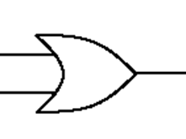
OR operation, example in real life
If you live in Mongkok, you either take a bus or train to come to the university
  You may write a formula
    (X=take bus) or (Y=take train) then you can come to the University (W)
You can ride on a bus if you pay cash or pay using octopus
  You may write a formula
    (X=pay by cash) or (Y=pay by octopus) then you can ride on the bus (W)
Notation
X
Y
W=X OR Y

Slide 13
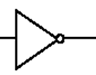
NOT operation, example in real life
I don’t love you = Not (I love you)
  You may write a formula
    NOT (X=I love you) means I don’t love you (W)
You are not rich = NOT (you are rich)
  You may write a formula
    NOT(X=you are rich) that means you are poor (W)
Notation
X
W=NOT X

Slide 14
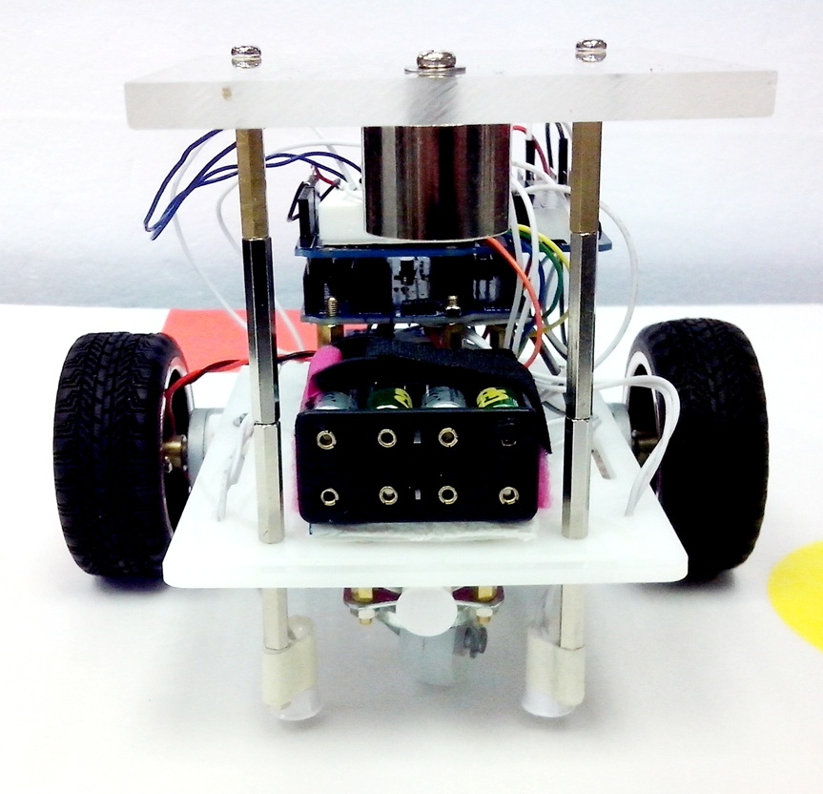
Exercise for robot control to follow the magnetic path
Terminal
Sensors: S2 S1
If S2 detects the magnetic strip, but not S1, is the robot deviate to the right or left of the path:
Answer (right or left) : ______?
Magnetic sensors
S1 S2
14
S2 S1
Answer: left

Slide 15
1.3 Truth table
A method to represent logic functions for digital signals

Slide 16
Truth table
The idea is to have all different combinations of inputs arranged in a table
Each combination gives one output
For n digital inputs , there will be 2^{n} different combinations
The truth table has 2^{n} rows
Example:
  n=2 (X and Y as inputs), so there are 2^{n}=4 rows
  You can see that no two rows have the same combination of inputs
Example
Input: X | Input: Y | W= Output For the operation
0 | 0 | ?
0 | 1 | ?
1 | 0 | ?
1 | 1 | ?
? = depends on the operation

Slide 17
Truth table example for “AND” operation
X
Y
W=
X AND Y
X , Y are 2 digital input signals
We can use a “Truth table” to find the output
Because there are n=2 inputs: X,Y
So there are 2^{n}=4 rows in the truth table
Steps to fill in the table
  Fill in Y: 0,1,0,1 (from top)
  Fill in X: 0,0,1,1
  Fill in the outputs
  Output=1 only when
    both inputs are 1
Input : X=eat | Input: Y=drink | Output W= X AND Y =live
0 | 0 | 0
0 | 1 | 0
1 | 0 | 0
1 | 1 | 1

Slide 18
Truth table example for “OR” operation
X
Y
W=
X OR Y
X , Y are 2 digital input signals
We can use a “Truth table” to find the output
Because there are n=2 inputs: X,Y
So there are 2^{n}=4 rows in the truth table
Steps:
  Fill in Y: 0,1,0,1(from top)
  Fill in X: 0,0,1,1
  Fill in the outputs
  Output=1 only when
    either input is 1
Input: X(pay by cash) | Input: Y (pay by Octopus) | Output W= X OR Y= (ride on a bus)
0 | 0 | 0
0 | 1 | 1
1 | 0 | 1
1 | 1 | 1

Slide 19
NOT (or called negation)
W=
NOT X
X is a digital input signal
We can use a “Truth table” to find the output
Because there are n=1 input: X
So there are 2^{n}=2 rows in the truth table
Step:
  Fill in X: 0,1
  Fill in the outputs
  Output=Reverse the input
X
X= you are rich | NOT X (you are not rich)
0 | 1
1 | 0

Slide 20
Exercises
How many rows are required in the truth table for 3 inputs?
Give examples of
  AND
  OR
  NOT
Answer: 2^3=8 rows

Slide 21
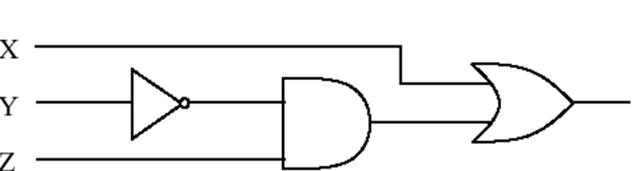
Combinational logic
(Combine NOT , AND , OR)
X , Y , Z are 3 digital input signals
We can use a “Truth table” to find the output
Because there are n=3 inputs: X,Y,Z
So there are 2^{n}=8 rows in the truth table
Fill in Z: 0,1,0,1,0,1,0,1
Fill in Y: 0,0,1,1,0,0,1,1
Fill in X: 0,0,0,0,1,1,1,1
W

Slide 22
Truth table
W
We want to find : W=X OR (NOT (Y) AND Z)
Step 1: fill in different combinations of inputs
2 inputs, so 2^3=8 rows
X | Y | Z |  |  | W=X OR (NOT ( Y) AND Z)
0 | 0 | 0 |  |  | ?
0 | 0 | 1 |  |  | ?
0 | 1 | 0 |  |  | ?
0 | 1 | 1 |  |  | ?
1 | 0 | 0
1 | 0 | 1
1 | 1 | 0
1 | 1 | 1

Slide 23
We can solve it step by step
Step2
W
X | Y | Z | NOT(Y)
0 | 0 | 0 | 1
0 | 0 | 1 | 1
0 | 1 | 0 | 0
0 | 1 | 1 | 0
1 | 0 | 0 | 1
1 | 0 | 1 | 1
1 | 1 | 0 | 0
1 | 1 | 1 | 0
Produce NOT (Y)
From Y first.
X,Z are not used in this step.
input
output

Slide 24
We can solve it step by step
Step3
W
X | Y | Z | NOT(Y) | Z AND (NOT(Y))
0 | 0 | 0 | 1 | 0
0 | 0 | 1 | 1 | 1
0 | 1 | 0 | 0 | 0
0 | 1 | 1 | 0 | 0
1 | 0 | 0 | 1 | 0
1 | 0 | 1 | 1 | 1
1 | 1 | 0 | 0 | 0
1 | 1 | 1 | 0 | 0
Then, produce
[Z AND (NOT (Y))].
X , Y are not used directly in this step.
input
input
output

Slide 25
We can solve it step by step
W=X OR (Z AND (NOT(Y)))
Step4
X | Y | Z | NOT(Y) | Z AND (NOT(Y) | W=X OR (Z AND (NOT(Y)))
0 | 0 | 0 | 1 | 0 | 0
0 | 0 | 1 | 1 | 1 | 1
0 | 1 | 0 | 0 | 0 | 0
0 | 1 | 1 | 0 | 0 | 0
1 | 0 | 0 | 1 | 0 | 1
1 | 0 | 1 | 1 | 1 | 1
1 | 1 | 0 | 0 | 0 | 1
1 | 1 | 1 | 0 | 0 | 1
input
input
output

Slide 26
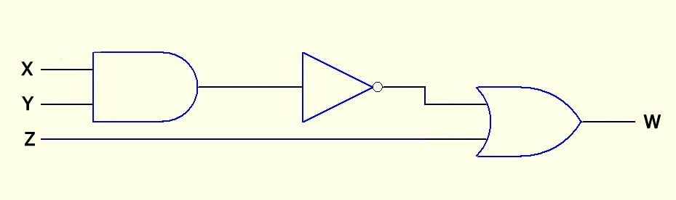
Exercise 1.1:
Use a truth table to find the output of
NOT( X AND Y ) OR Z

Slide 27
Exercise1.1: NOT( X AND Y ) OR Z
Fill the blanks in X,Y, Z columns
X | Y | Z | X AND Y | NOT (X AND Y) | W=(NOT (Z AND Y)) OR Z
0 |  | 0
 |  | 1
 |  | 0
 |  | 1
 |  | 0
 |  | 1
 |  | 0
 |  | 1

Slide 28
Exercise1.1: NOT( X AND Y ) OR Z
Fill the blanks
The answer is in the appendix
X | Y | Z | X AND Y | NOT (X AND Y) | W=(NOT (Z AND Y)) OR Z
0 | 0 | 0
0 | 0 | 1
0 | 1 | 0
0 | 1 | 1
1 | 0 | 0
1 | 0 | 1
1 | 1 | 0
1 | 1 | 1

Slide 29
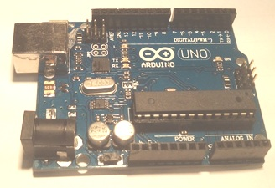
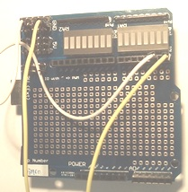
1.4 Robot Hardware
  Arduino computer
    Write programs and download here to run
  Debug Board
    Build your circuit here
    E.g. Motor driver circuit etc.
    Such as MOSFET , H-bridge L293

Slide 30
The Intelligent Robot system
USB cable
Programmer to update the program
Magnetic strips
Magnetic sensors
S1, S2
Our interface
Board
Arduino board
(programs to be run in the Arduino computer):
:
Loop
{
If ….
then….
else….
}
In1
In2
In3
In4
Motor drivers
Out1
Out2
Out3
Out4
L293D
H-bridge
RM1
RM2
LM1
LM2
S2 S1

Slide 31
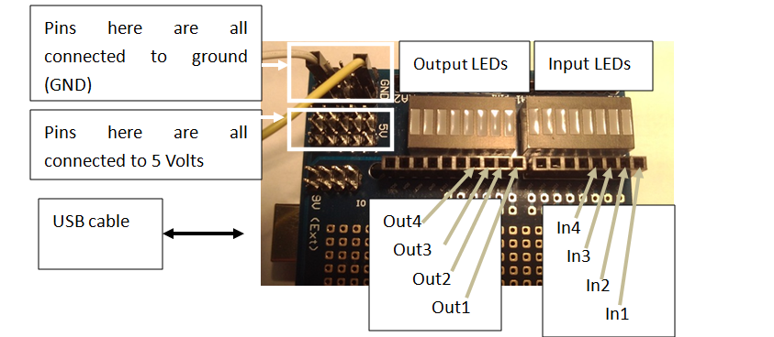
Our debug (interface) board
You may use the debug board provided to connect input/output signals to the Arduino board
Personal computer PC

Slide 32
1.5 Software implementation
Document about the use of Arduino
  elearninghttps://elearn.cuhk.edu.hk/webapps/login/
Edit program
Compile
Download to the SMART-car-board
Run the program

Slide 33
How to use “If-then-else”
IF (condition) then output is result 1, else output is result 2
Example1: //just to illustrate the idea, not a runnable program
  If (“you_eat” and “you_drink”) you _can_live;
  Else “you_die”;
Example2: // && means “AND”
if(Din1() && Din3()) Out1(1); // same as if(Din1()==1 && Din3()==1) Out1(1);
else Out1(0);
The above program means: if Din1 is 1 AND Din3 is 1, then Out1 is 1. Else Out1 is 0
Example3: // || means “OR”
If (Din1() || Din3()) Out3(1); // same as if(Din1()==1 || Din3()==1) Out1(1);
Else Out3(0));
The above program means: if Din1 is 1 OR Din3 is 1, then Out3 is 1. Else Out3 is 0

Slide 34
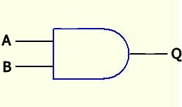
You will learn this in Lab6.
You are given: An Arduino computer with the debug board
In here, inputs are represented as In1=A, In3=B and output Out1=Q.
//program segment in the main loop of Lab6.ino
void loop()
{ // Experiment 1.3 Out1=In1 AND In3
//that means if In1 and In3 are ‘1’, Out1 is ‘1’. Otherwise Out1 is ‘0’
if(Din1() && Din3()) Out1(1); //&& means logic function AND
else Out1(0);
:
}
In1
In3
Out1

Slide 35
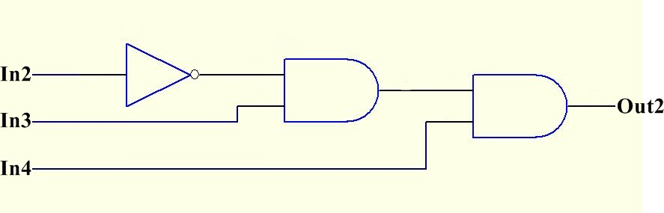
A more complex function
You will test it in Lab 6.
//Program segment in the main loop of Lab6.ino
void loop()
{ :
// Experiment 2.1 Out2=(NOT(In2) AND In3) AND In4
if((!(Din2()) && Din3()) && Din4()) Out2(1);
else Out2(0);
:
}

Slide 36
Summary
Learned
  digital logic
  the use of the truth table
  our robot system design
  to implement logic functions using if-then-else

Slide 37
End

Slide 38
Appendix part1.A:
ANSWER1.1: W=(NOT( X AND Y )) OR Z
Fill the blanks
X | Y | Z | X AND Y | NOT (X AND Y) | W=(NOT (X AND Y)) OR Z
0 | 0 | 0 | 0 | 1 | 1
0 | 0 | 1 | 0 | 1 | 1
0 | 1 | 0 | 0 | 1 | 1
0 | 1 | 1 | 0 | 1 | 1
1 | 0 | 0 | 0 | 1 | 1
1 | 0 | 1 | 0 | 1 | 1
1 | 1 | 0 | 1 | 0 | 0
1 | 1 | 1 | 1 | 0 | 1

