Slide 1
ENGG 1100 Introduction to Engineering Design
Lecture 4: Measurement and Instrumentation
Professor Hon Ki Tsang
Department of Electronic Engineering
February 10, 2014

Slide 2
Measurement, units and uncertainty
Reference
Halliday Resnick and Walker, Principles of Physics, (9th edition)
Chapter 1, and sections 18.2, 38.8, Appendix A1

Slide 3
SI Base System of Units
Every measurement may be quantified in units that can be derived from the 7 Base units of Système international d'unites (SI System of units):
Dimension | unit
Mass | kilogram | kg
Length | meter | m
Time | second | s
Temperature | kelvin | K
Electric Current | ampere | A
Amount of substance | mole | mol
Luminous intensity | candela | cd

Slide 4
Example: Some common derived units
Let M=mass, T=time, L = Length, A= current, K=temperature
Force = mass x acceleration = M LT⁻²
Hence 1 newton = 1 kg m/ s²
Energy = force x distance = ML²T⁻²
1 joule = 1 kg m²/ s²
Electric potential = energy per coulomb = ML²T⁻²/(AT)= ML²A⁻¹T⁻³
1 volt = 1 kg m² s⁻³A⁻¹
Question: Express the units of electrical resistance, electrical power and capacitance in terms of the SI base units
1 ohm= 1 volt/ampere = 1 kg m² s⁻³A⁻²
1 watt = 1 joule/second = 1 kg m²/ s³
1 farad = 1 coulomb/volt = (A s) / (kg m² s⁻³A⁻¹)=A² s⁴ kg⁻¹ m⁻²

Slide 5
Dimensional Analysis
Dimensional analysis is a technique to analyze experiments or physical phenomena in terms of the dimensions of its parameters, and to simplify the analysis by grouping parameters together to form dimensionless parameters.
Grouping of parameters to dimensional variables can help reduce the number of unknown variables: Buckingham’s pi theorem: A function F(a₁, a₂, … , a_{n}) = 0 may be converted to f(k₁, k₂, … k_{r} < n) = 0
where, F = function of dimensional variables, and f is the function in terms of dimensionless parameters k_{i}; if m = number of relevant dimensions, n = number of dimensional variables, then r = n – m .
Useful in analysis of experiments and modeling of experiments

Slide 6
Example: Period of a pendulum
How does the period of the pendulum T depend on its length and mass?
θ
L
m
Guess that T will depend on gravity acceleration g, mass m, length L and intial angle θ
$T=C\left(θ\right)m^{a}L^{b}g^{c}$
where a, b and c are unknown integers
Consider the dimensions
$$T=M^{a}L^{b}L^{c}T^{−2c}$$
Equation must have same dimensions on both sides
Hence: a=0, c=-1/2 , b=-c=1/2
$$T=C\left(θ\right)\sqrt{\frac{L}{g}}$$

Slide 7
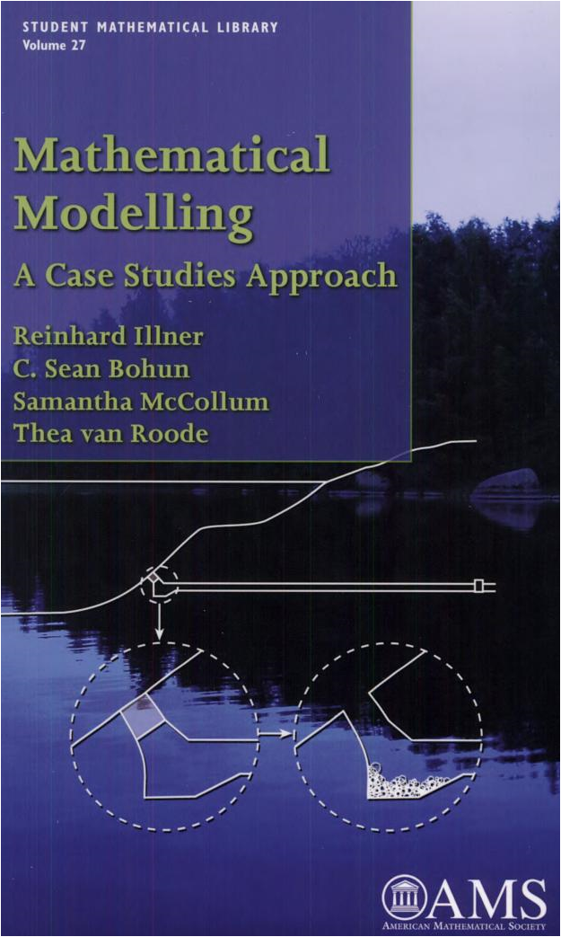
More examples on dimensional analysis
For some interesting examples of applications of dimensional analysis to problems such as cooking time for a turkey, estimating the energy in an atomic bomb explosion refer to: preview of the examples are available by searching books.google.com)

Slide 8
Uncertainty in measurements: errors

Slide 9
Measurement Uncertainty and Errors
Every measurement M has some uncertainty, which is usually described by an error range M$±∆$ where $∆$has the same units as M and is an estimate of the uncertainty in the measurement (or it may be defined in terms of one standard deviations from the mean of a set of the same measurement repeated a number of times)
Repeating the same measurements M_{i} at different time and taking the average $\overline{\text{M}}$ of n measurements may help to reduce the uncertainty by a factor $\sqrt{n}$
CAUTION: Taking the average does not reduce systematic errors from mis-calibration of the instrument and assumes that the parameter being measured does not change from one observation to the next
Sources of measurement uncertainty in electronic instrumentation comes from electrical noise, finite resolution of analog to digital converters, deviations from linear response of electrical amplifiers, and ageing of electronic components (affecting instrumentation calibration).

Slide 10
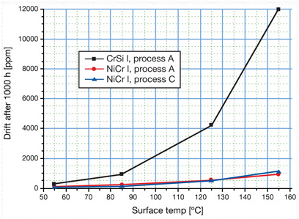
Example: Resistor Ageing
Improved stability of thin-film resistors
Reiner W. Kuehl, Vishay Draloric, EDN June 15, 2011
http://www.edn.com/design/components-and-packaging/4368133/Improved-stability-of-thin-film-resistors

Slide 11
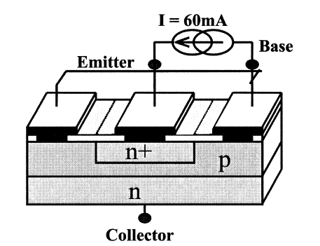
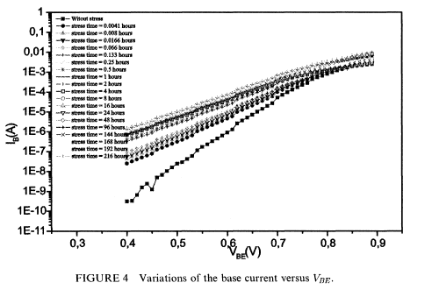
Electrical ageing of transistors
After 216 hours @ 60mA
No stress
N. Toufik, Active and Passive Elec. Comp., 2001, Vol. 24, pp. 155-163

Slide 12
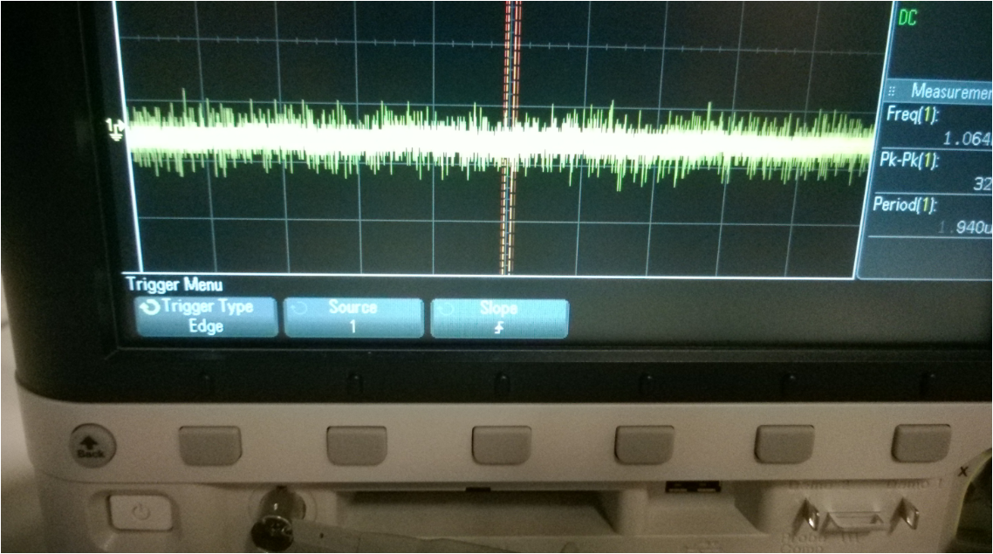
Electrical Noise
Thermal Noise (also called Johnson noise) is due to random thermal motion of electric charge in conductors
Similar at all frequencies ie “white noise” and hence noise power scales with bandwidth of the measurement
Mean of the square of the noise current (variance of the noise) is
Where
k= Boltzman constant =1.38x10⁻²³ m² kg s⁻² K⁻¹
T = Temperature (kelvin), B= bandwidth (Hz), R = resistance of the conductor

Slide 13
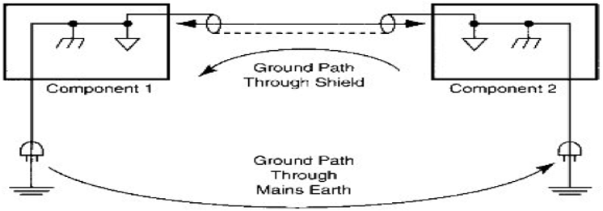
Ground Loops
Ground loops exist when there is more than one connection to “ground” and the ground currents are not equal leading to small voltage differences between the local grounds
I₁
I₂

Slide 14
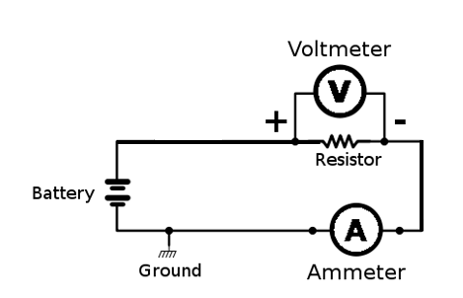
Measurements affect system being measured
Voltage across the resistor and the current in the cicuit is not changed by the measurement only if the volmeter has infinite resistance and ammeter has zero resistance. In practice the voltmeter may have ~10Mohm resistance and ammeter may have a few ohms resistance

Slide 15
HEISENBERG UNCERTAINTY PRINCIPLE
HEISENBERG UNCERTAINTY PRINCIPLE.
Cannot make precise measurement of both “conjugate” parameters such as position and momenta, energy and time.

Slide 16
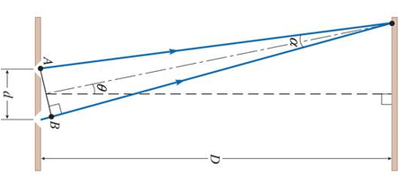
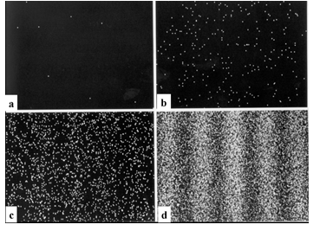
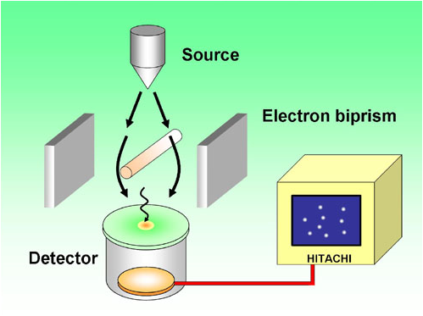
Example: Double slit experiment and interference of matter waves
Wave particle duality: wavelength of electrons
$$λ=\frac{h}{p}$$
p = momentum
h = 6.6x10⁻³⁴Js
Young’s double slit interference with electrons
Interference pattern of electrons
http://www.hitachi.com/rd/portal/research/em/doubleslit.html

Slide 17
Quantum Teleportation

Slide 18
Electronic Instrumentation: OSCILLOSCOPE

Slide 19
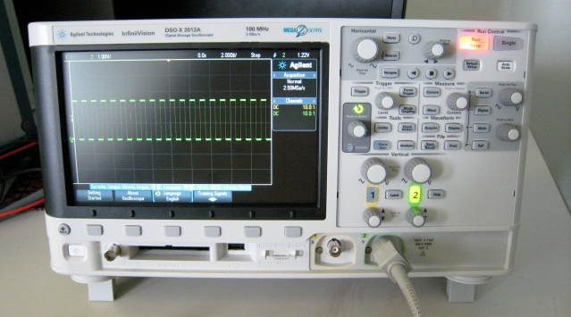
Oscilloscope
The oscilloscope measures voltage (vertical) against time (horizontal).
Measurement is periodic and starts from a trigger signal
Trigger input may be from the signal itself (internal trigger) or external trigger input
Trigger input is at back panel of this model

Slide 20
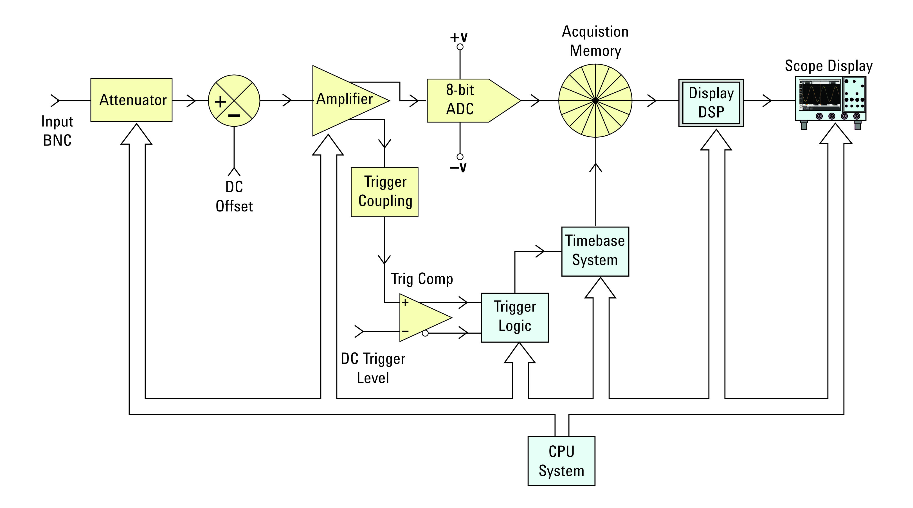
Oscilloscope – working principle
Digital Oscilloscope
Analogue to Digital converter (ADC) samples the input voltage and stores it as a number (quantization error may be present because of finite number of discrete levels)
Number is stored in memory and processed digitally (DSP_
Source:
“Oscilloscope Fundamentals” by Agilent Technology

Slide 21
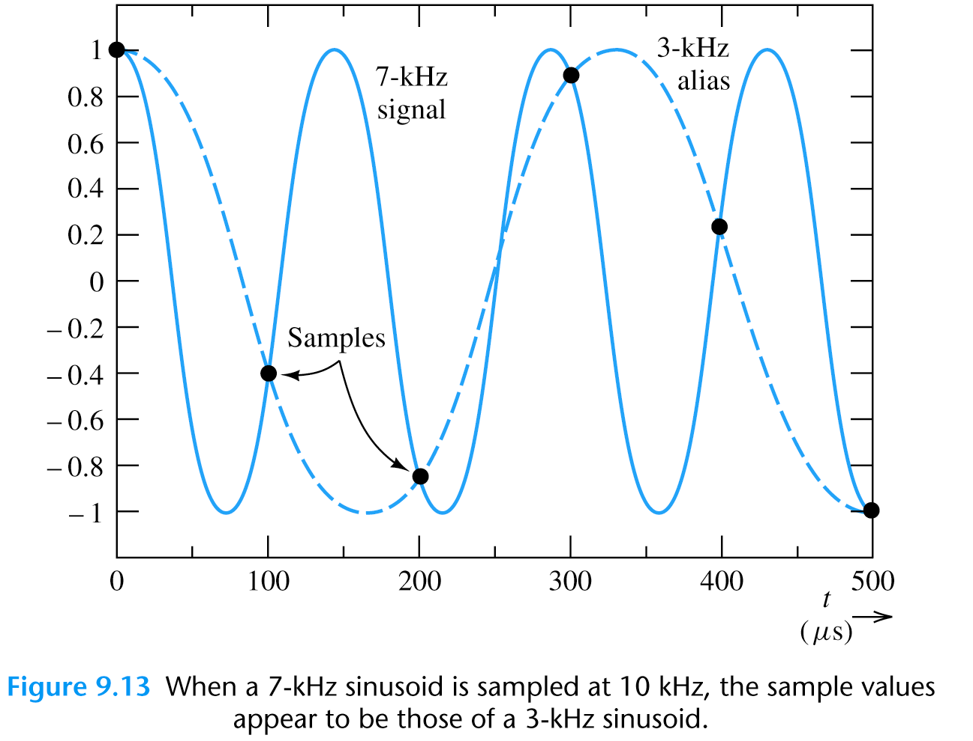
Aliasing

Slide 22
Aliasing
Aliasing may be prevented by sampling above the Nyquist frequency (2x F_{max})
Spatial aliasing on oscilloscope display may be seen if the time scale is too slow

Slide 23
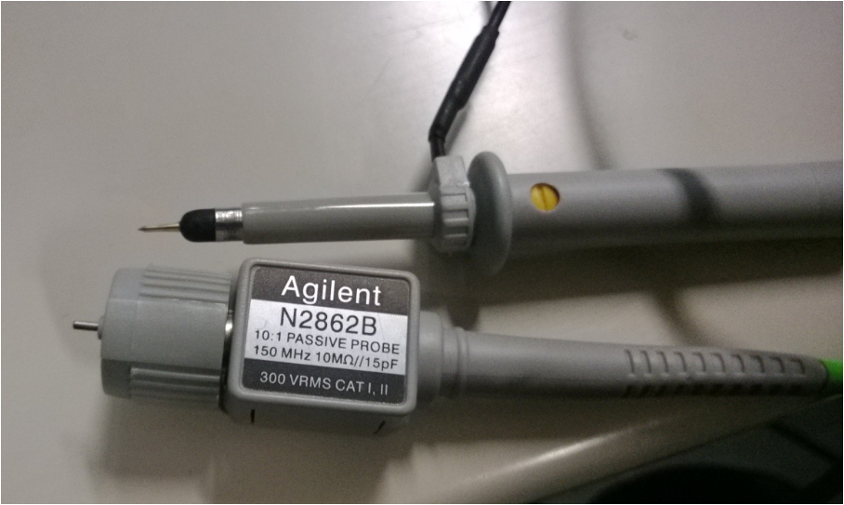
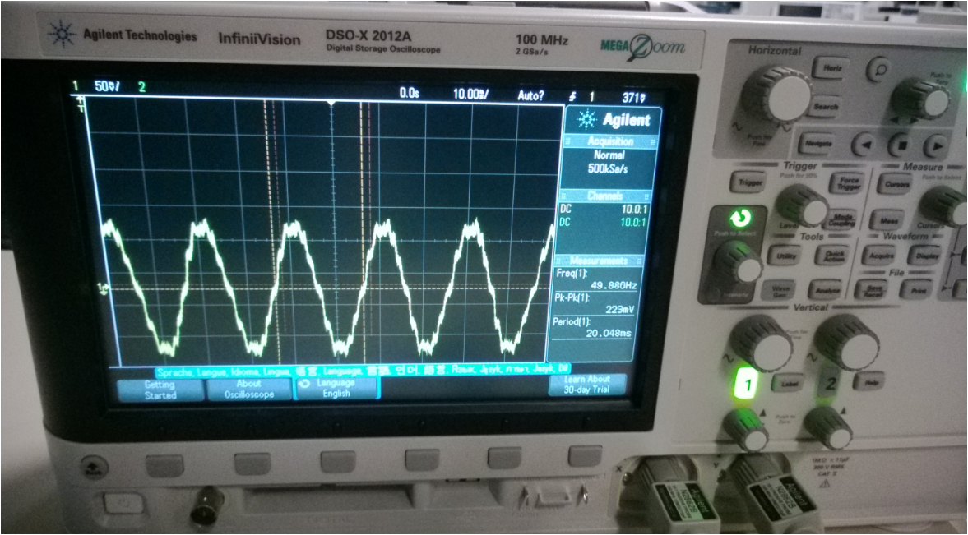
Oscilloscope probes
x10 Probe reduces loading of probe on circuit

Slide 24
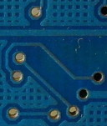
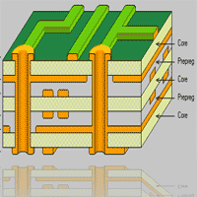
Printed Circuit Boards (PCB)
Vias - connecting tracks from one layer to another
Multilayer PCB – for making more
complicated circuits
Via

