Slide 1
ENGG 1100 Introduction to Engineering Design
Lecture 3: Basic Electronics & Lab Safety
Prof. Wing-Kin (Ken) Ma
Department of Electronic Engineering
Acknowledgement: those who helped develop this slide over the years, particularly, Mr. Hoi-To Wai (now with UC Davis), and Dr. Matthew Tang (now with Queen Mary University of London); also Prof. Alex Leung at electronic engineering, CUHK.
Some of the pictures were obtained from the internet.
January 27, 2014

Slide 2
Objectives
To understand basic circuits concepts, namely, voltage, current and resistors.
To introduce to you how voltage and current are measured.
To talk about lab safety.
Note that
these concepts are relevant to Lab 2 (today’s lab);
you may have learnt these basic concepts in secondary school physics courses, but you need to better understand them in this course (or perhaps you might have never truly understood them).

Slide 3
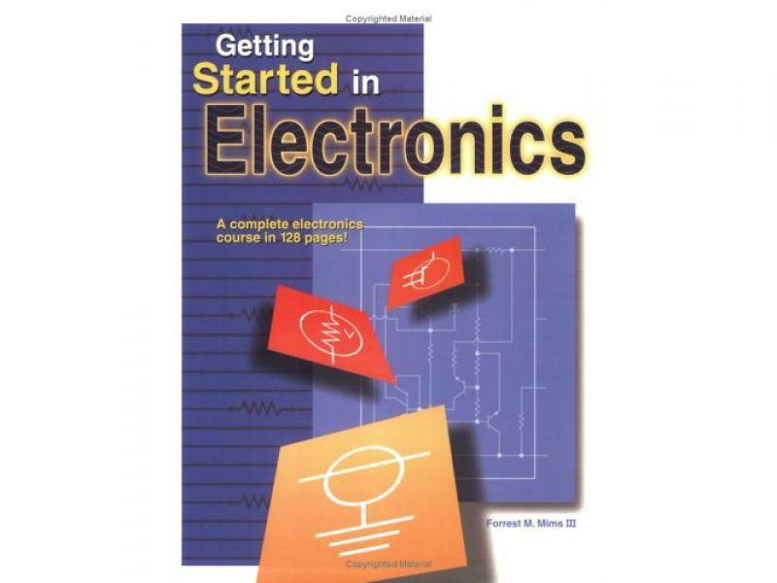
References
An optional, very friendly, reference:
Forest M. Mims III, Getting Started in Electronics

Slide 4
BASIC Electronics:
A ROUGH INTRODUCTION

Slide 5
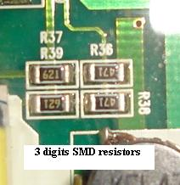
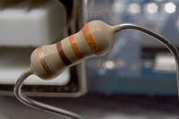
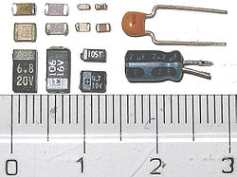
Some Electronic Components
Resistors – providing resistance (actually every matter on earth is a resistor)
Capacitors – storehouse for charges
Source:
http://en.wikipedia.org/wiki/Resistor
Source:
http://www.electronicrepairguide.com/smd-resistor-code.html
Source:
http://en.wikipedia.org/wiki/Capacitor

Slide 6
Electronic Component Symbols
Electronic components are represented using standardized symbols:

Slide 7
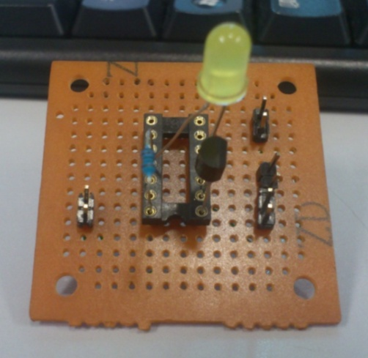
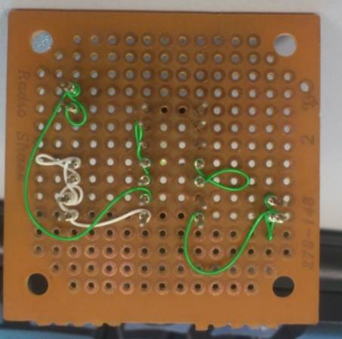
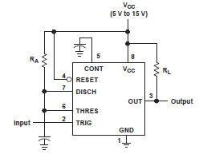
Circuits & Schematics
What do the real circuits & schematics look like…
A circuit is a connection of different electronic components.

Slide 8
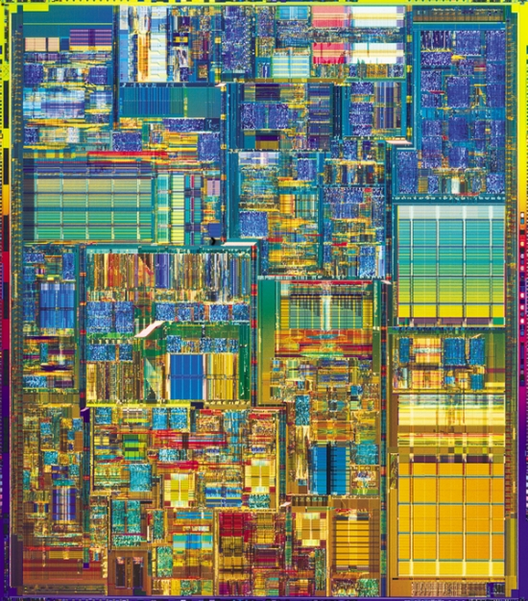
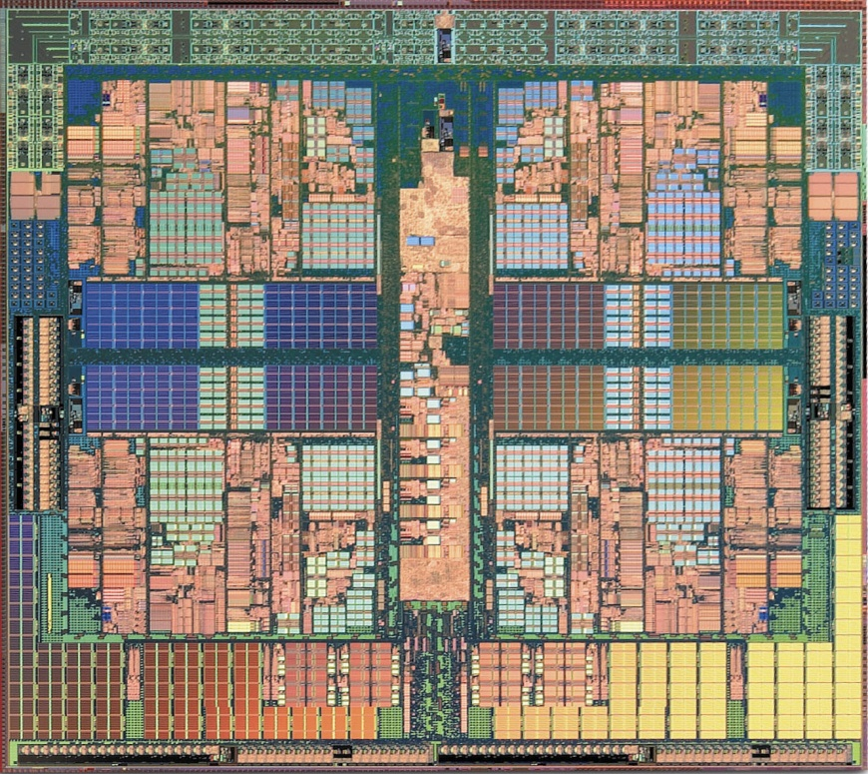
These are also circuits, in a much more complex way
Quad-core CPU
Pentium 4 CPU

Slide 9
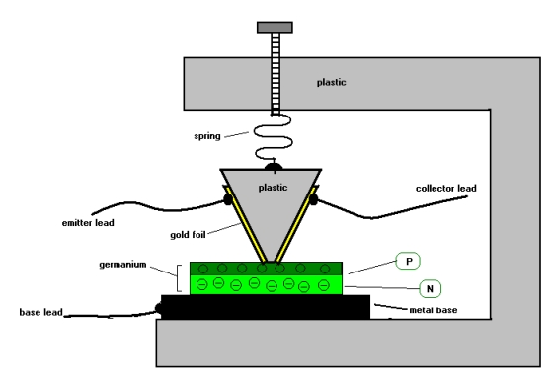
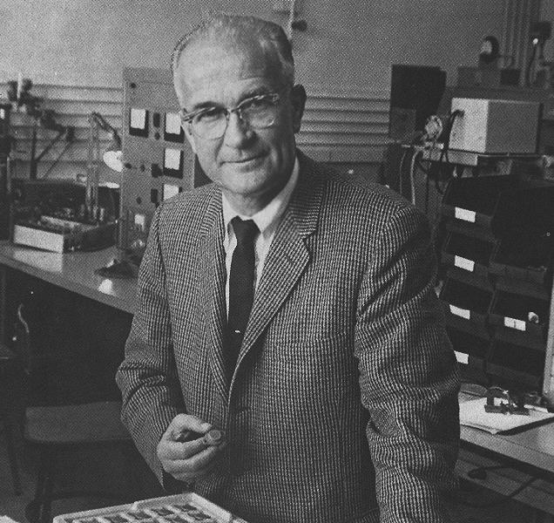
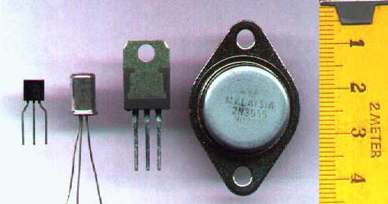
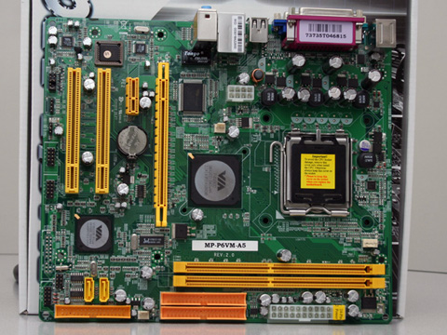
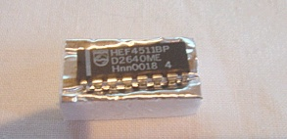
Transistors and integrated circuits (ICs)
William Schockley (Inventor of transistor)
Point-contact transistor invented in 1947 at Bell lab.
Transistors
Scaling down the size of the components and put all components in a small area
IC =

Slide 10
What does a transistor do?
Transistors play an indispensable role in electronics and other areas.
Simply speaking, a transistor works like an electronic switch (It can also perform signal amplification, e.g. in HiFi).
press/release
transistor
switch
or

Slide 11
Okay, so what’s the big deal?
Transistors, together with other components, like resistors, capacitors, inductors, diodes, …, enable us to build many different circuits.
Example: Use of transistors enables digital logics.
With digital logistics, we can compute (without doing it ourselves)…
And with the ability to compute, we have modern computers (and that includes your iPhone).
A
AND
Out
A
OR
Out
B
B
A
A
B
B

Slide 12

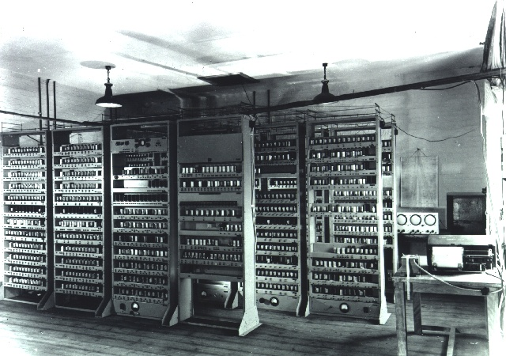


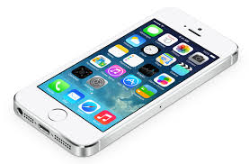
So we build things bigger and bigger to compute, and yet size smaller and smaller
Electronic Delay Storage Automatic Calculator in 1949
(addition, subtraction, multiplication, square, prime numbers, etc.)
(You do know what these gadgets are, don’t you)

Slide 13
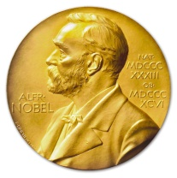
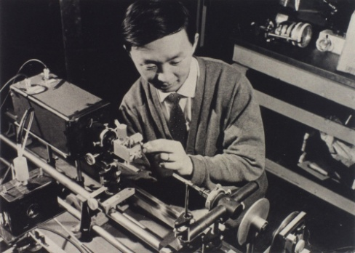
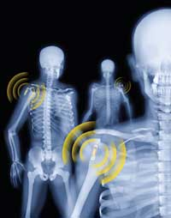
Electronics provides “primal elements” behind almost all modern technology.
Roughly speaking, it gives us the key building blocks for fields like wireless communications, optical communications, information technology, biomedical engineering, and many, many more.
Without electronic and associated engineering technologies, we may not have mobile, internet, FB or Whatsapps (which some of you might be using in my lecture). Oh, wash you own clothes (by hand), too!
Who is he?

Slide 14
RESISTORS, VOLTAGE AND CURRENT

Slide 15
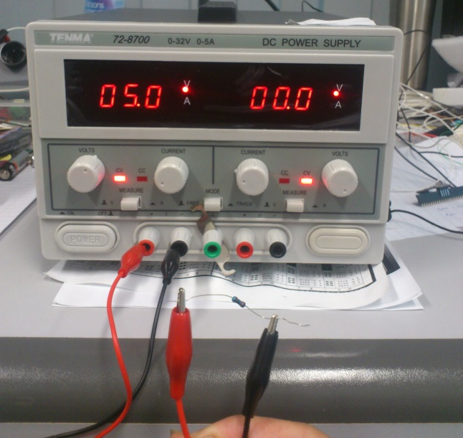
Resistor Circuits
Consider the following simple resistor circuit:
Power supply
Resistor
The famous Ohm’s Law:

Slide 16
A Circuit and its water analogy
Note: do not take these analogies too far.
Water level – Voltage (V)
Slit/opening – Resistance (R)
Water – Charge (Q)
Stream – Current (I)
The famous Ohm’s Law:

Slide 17
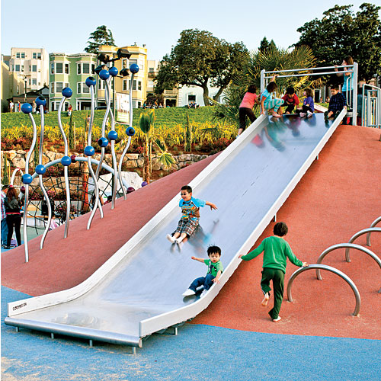
Another (awkward) analogy I might use
Note: again it could be misleading!

Slide 18
Voltage, Current and Resistance
  Current
    describes the flow of positive charges through the circuit
    measured in units of Amperes (A)
    is, by theory, defined as
    where I is the current, and Q is the charge, in Coulombs (C).

Slide 19
Voltage, Current and Resistance
  Voltage
    describes the potential for current to flow in the circuit
    measured in units of Volts (V)
    Voltage is related to energy, measured in Joules.
    The energy required to move a particle with Q Coulombs from a place of 0 V to a place with V V is
    where E represents the energy (in Joules).

Slide 20
Voltage, Current and Resistance
  Resistor
    is a device that resists the flow of current
    allows current to flow, but the amount depends on the value of the resistor and the voltage applied
    The value of the resistor, or simply resistance, is measured in units of Ohms (Ω)
    By Ohm’s law, we have
    where R represents the resistance (in Ω).

Slide 21
Voltage, Current and Resistance
Power
    is the rate of energy dissipation with respect to time
    is in units of Joules per second, or Watts (W)
    is given by
    where P represents the power (in W).
    By Ohm’s law, we have

Slide 22
Basic circuit analysis
The Ohm’s law
Don’t be afraid of the equations

Slide 23
Resistors in series
We have
Equivalent resistance:

Slide 24
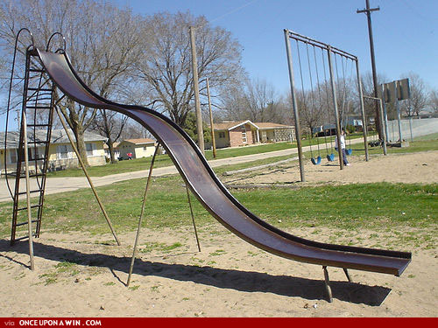
Analogy for resistors in series

Slide 25
Resistors in parallel
Voltage on each resistor = the same:
Current coming in = current coming out:
Equivalent resistance

Slide 26
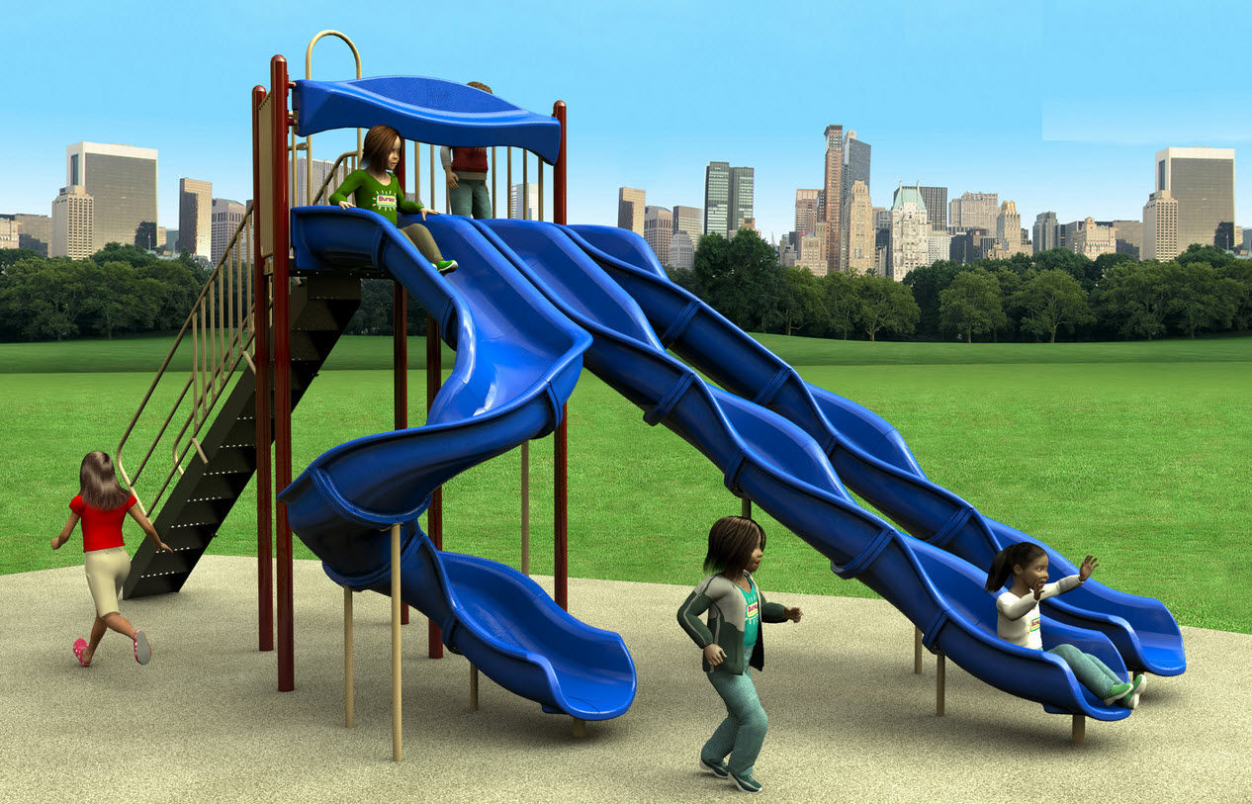
Analogy for resistors in parallel

Slide 27
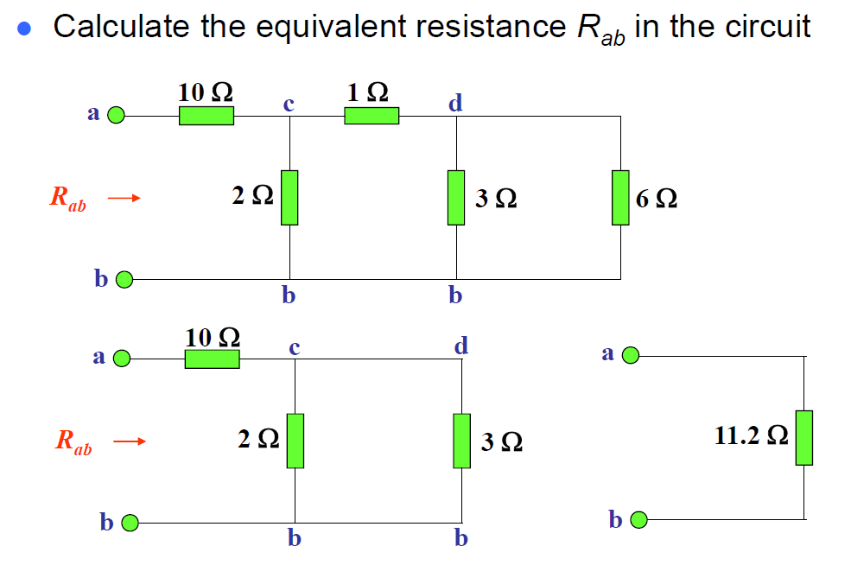
Example

Slide 28
Kirchhoff’s circuit laws
Two important theorems for circuit analysis
Kirchhoff’s current law (KCL)
Kirchhoff’s voltage law (KVL)
Net current entering a node = 0
Net voltage in a loop = 0
(CAUTION: mind the direction/sign of current and voltage)

Slide 29
Application -- voltage divider
We probably don’t need something as complex as the last example
Consider the resistors in series again: (let N=2)
The supplied voltage V is divided into two parts
This principle is called the Voltage Divider

Slide 30
Application – current divider
Consider the resistors in parallel : (let N=2)
The current I is divided into two parts
More current flows in the branch with less resistance
This principle is called the Current Divider

Slide 31
ADDITIONAL NOTE

Slide 32
Units and dimensions
International System of Units (SI) takes the convenience of the base 10 (decimal) system.
A prefix may be added to a unit to produce a multiple (powers of ten) of the original unit.
Name | deca- | hecto- | kilo- | mega- | giga- | tera- | peta-
Symbol | da | h | k | M | G | T | P
Factor | 10¹ | 10² | 10³ | 10⁶ | 10⁹ | 10¹² | 10¹⁵
Name | deci- | centi- | milli- | micro- | nano- | pico- | femto-
Symbol | d | c | m | μ | n | p | f
Factor | 10⁻¹ | 10⁻² | 10⁻³ | 10⁻⁶ | 10⁻⁹ | 10⁻¹² | 10⁻¹⁵
Example 1: 10 mA = 10 x 10⁻³ A = 0.01A
Example 2: 0.3 MΩ = 0.3 x 10⁶ Ω = 300 000 Ω

Slide 33
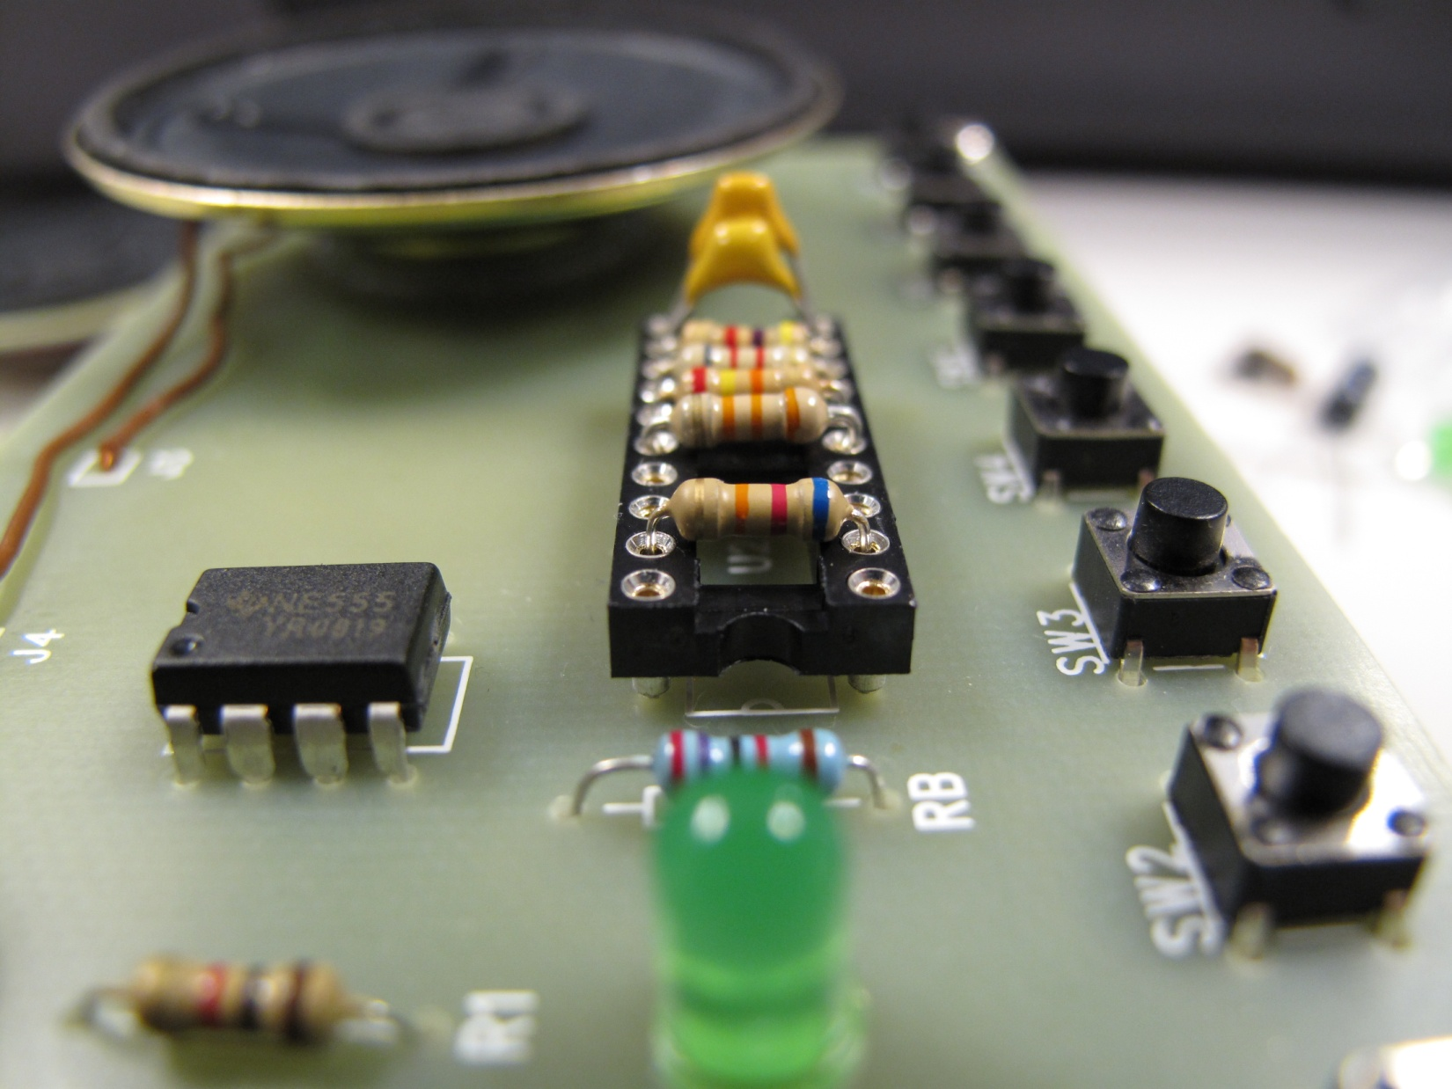
Electronic Color Code
Resistor
a
b
c
× 10 + (
) ] ×
)
Resistance = [ (
)
(
‘s value
‘s value
c
a
b
‘s multiplier
Color | Value | Multiplier
Black | 0 | ×1
Brown | 1 | ×10
Red | 2 | ×100
Orange | 3 | ×1 000
Yellow | 4 | ×10 000
Green | 5 | ×100 000
Blue | 6 | ×1 000 000
Purple | 7 | ×10 000 000
Grey | 8 | ×100 000 000
White | 9 | ×1 000 000 000
Example:
Resistance = Blue Red Orange
= 6 2 × 1000
= 62000Ω

Slide 34
Basic rules for connecting a circuit
RULE #1 – a circuit must contain a closed loop
Without a closed loop, a circuit is said to be open
An open circuit cannot function as there is no returning path for current

Slide 35
Basic rules for connecting a circuit
RULE #2 – a circuit (usually) contains a power source
The power source provides power to make the circuit function
Showing different ways of representing a power source

Slide 36
Basic rules for connecting a circuit
RULE #3 – electronic components are connected to a node
The lines in a schematic serve only one purpose – to make connections between components
Three seemingly different schematics.
They are actually describing the same circuit.

Slide 37
MEASUREMENT OF VOLTAGE, CURRENT and resistance

Slide 38
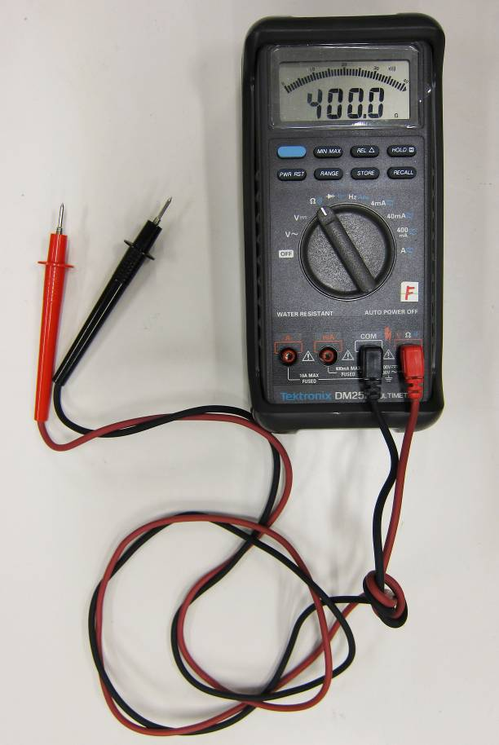
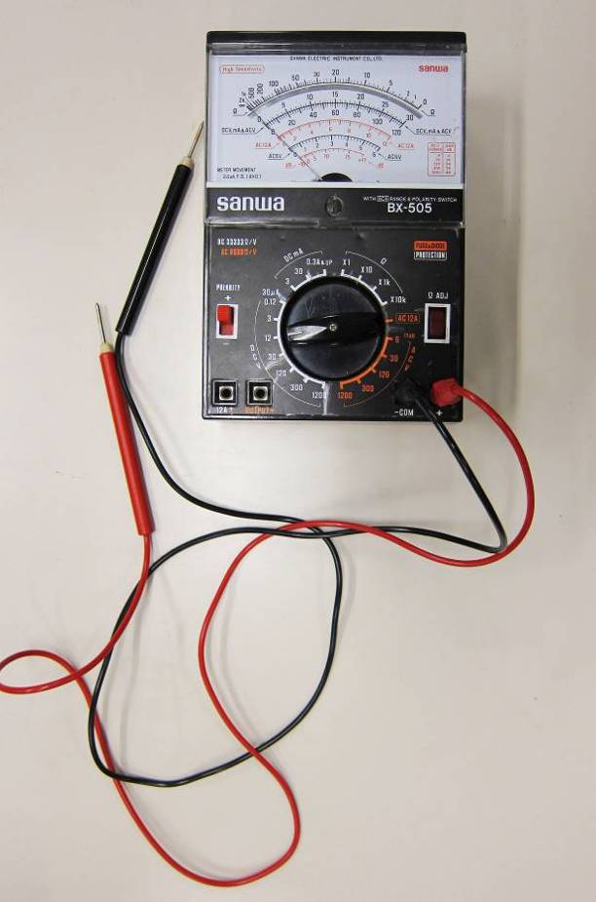
Measurement of Voltage and Current
Multimeters are all-in-one devices that measure different electrical quantities
  Current (I), voltage (V), resistance (R) in one device

Slide 39
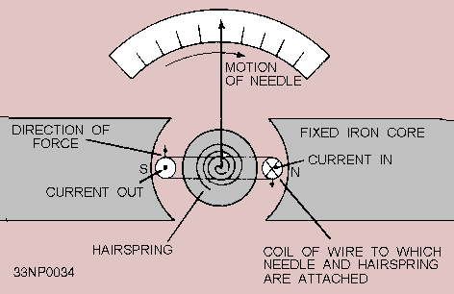
Application -- ammeter
Ammeters are devices that measure the Current (I)
Galvanometer (found in the analog ammeters)
  The needle movement is proportional to the current I
  Typical range: from 0A to 1mA
Source:
http://www.tpub.com/neets/book16/68.htm

Slide 40
Application -- ammeter
Using an ammeter to measure current at a point:
  “Break” the circuit and insert the ammeter
Equivalent model of an ammeter
-- the internal resistance of
the galvanometer
-- can be adjusted for range selection
(current divider)

Slide 41
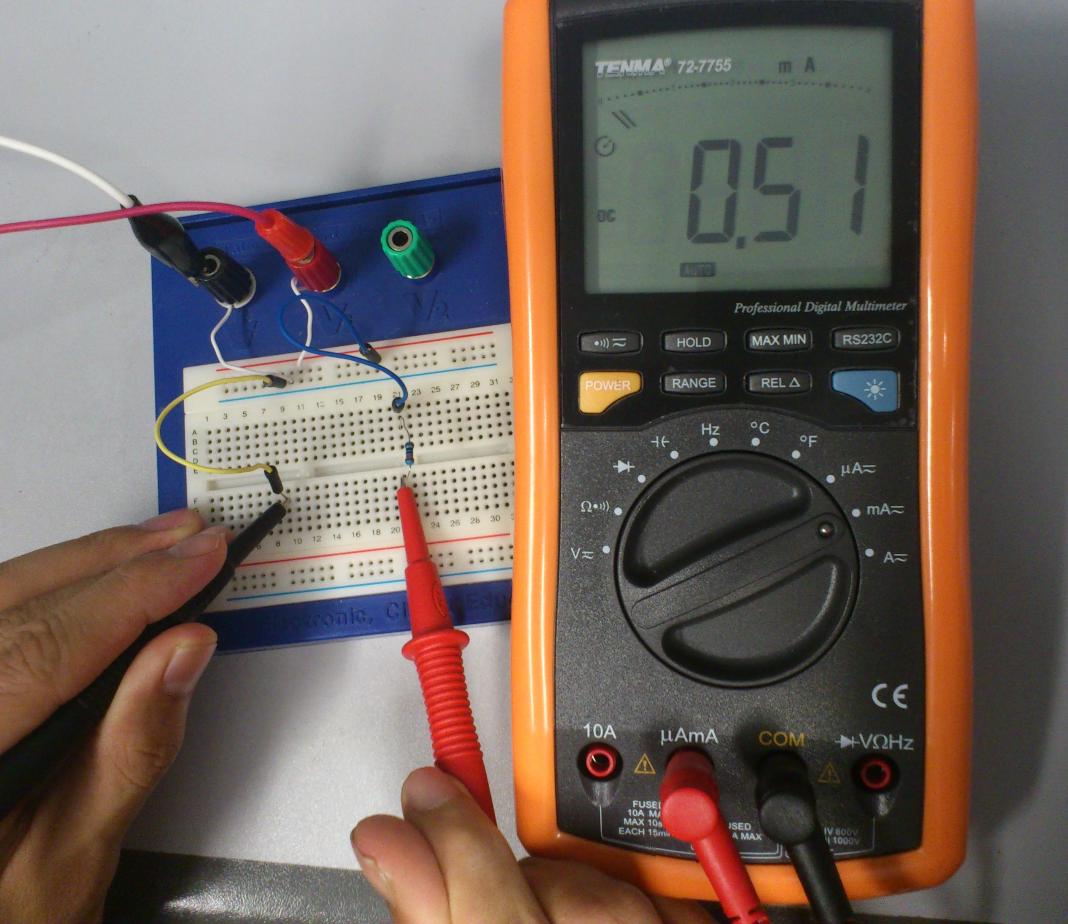
Application -- ammeter
The current reading is 0.51 mA
Circuit connected in series

Slide 42
Application -- voltmeter
Voltmeters are devices that measure the Voltage (V):
  Voltage is defined relatively → must be measured “between two points”
Equivalent model of a voltmeter
Very large, typical range = 200k Ω - 1M Ω
  only a small current will flow through
  the voltmeter (current divider)
can be adjusted to select the range

Slide 43
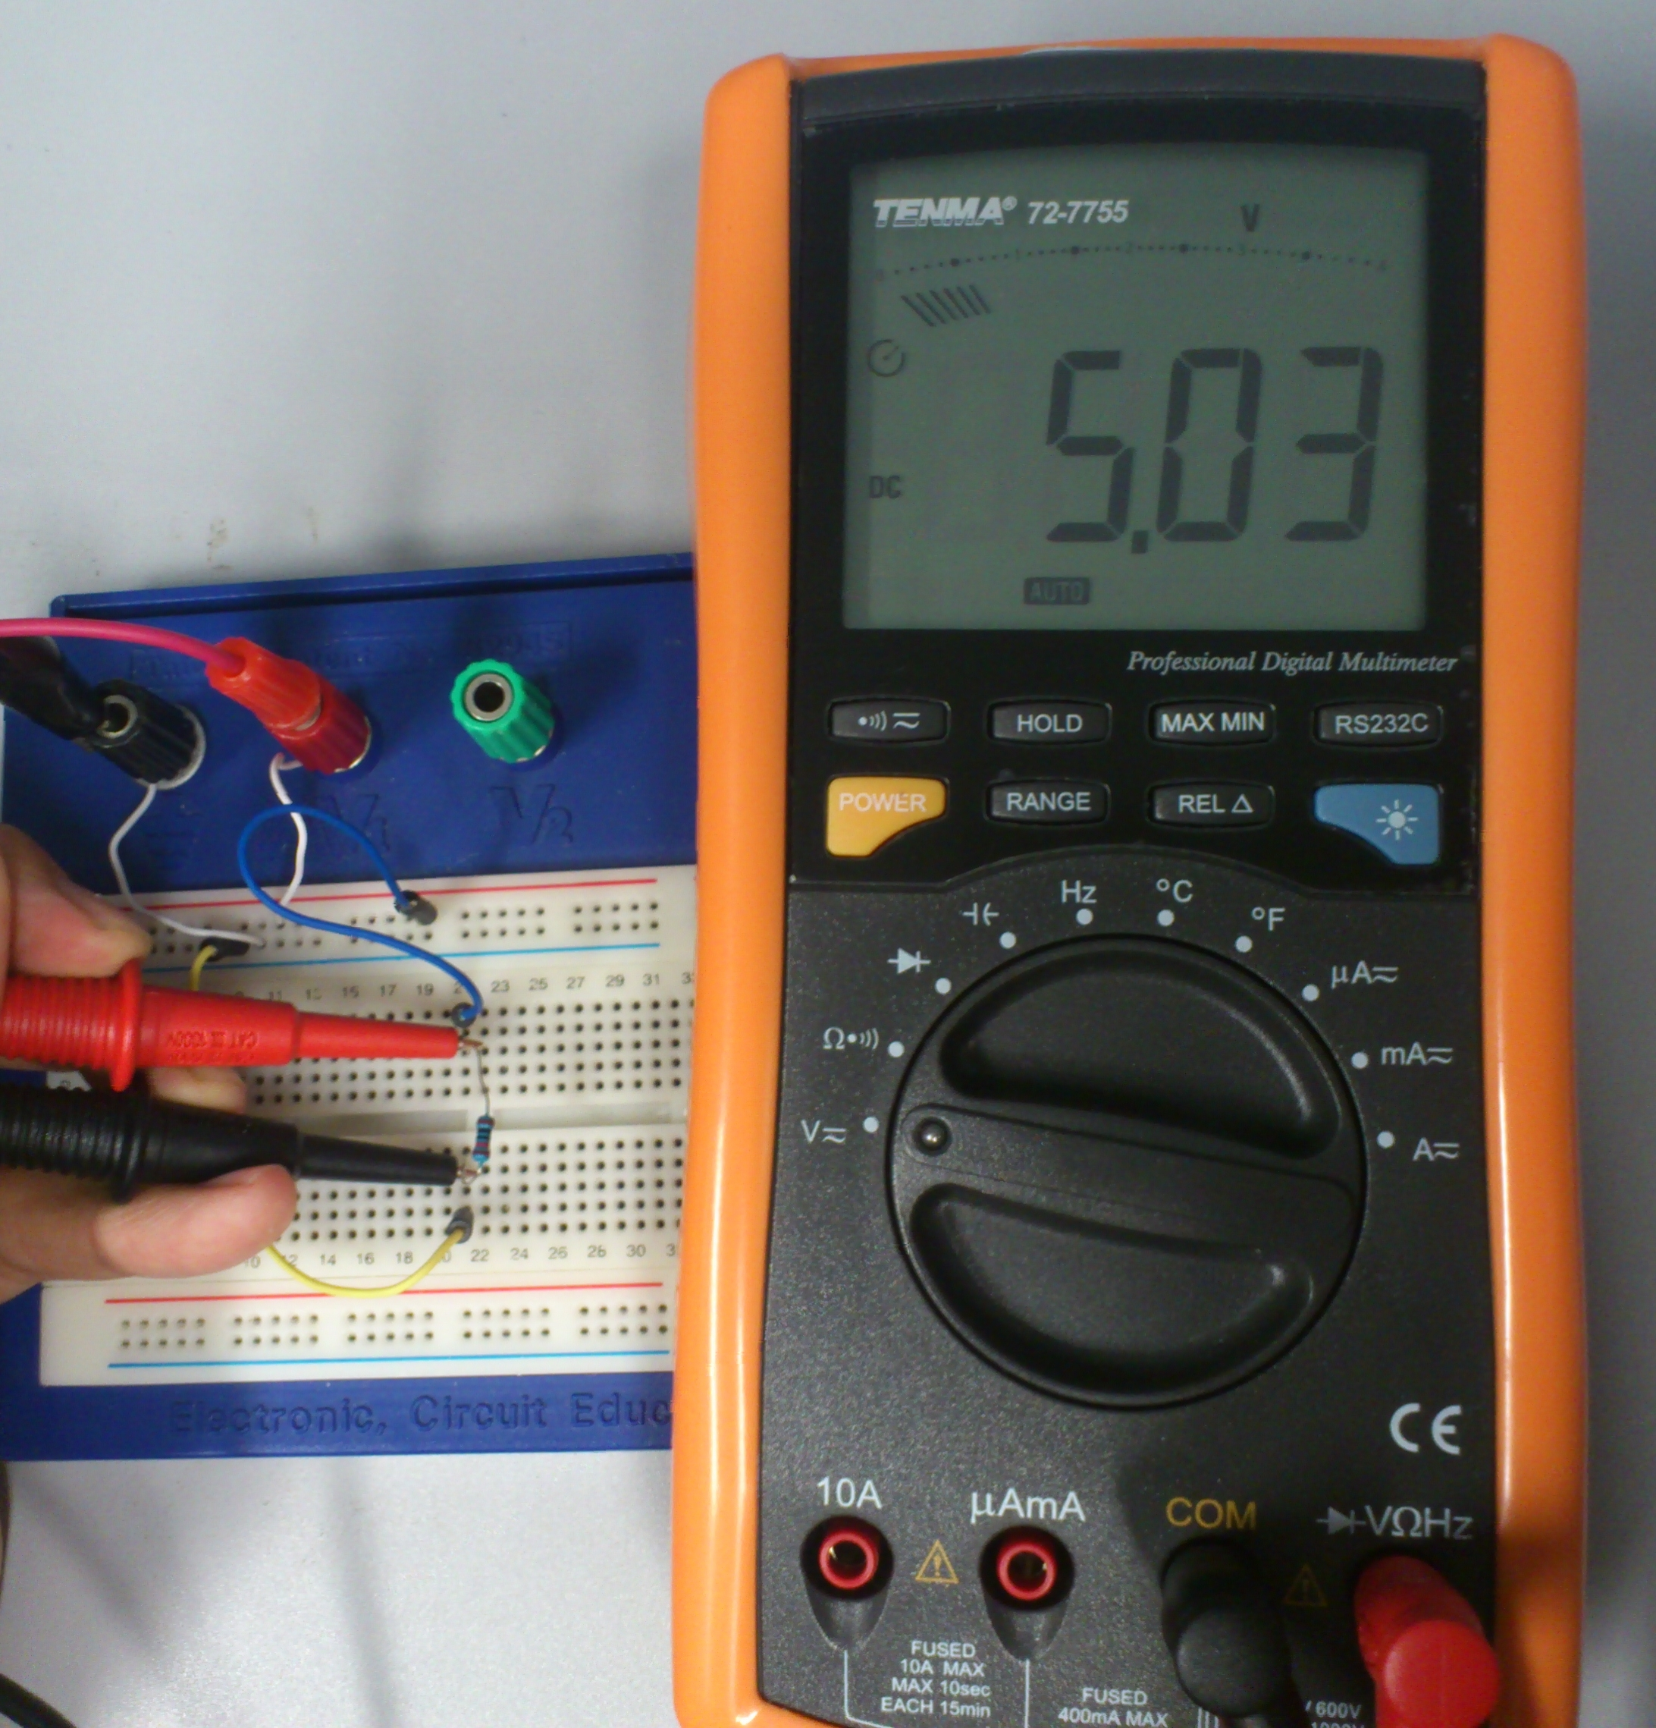
Application -- voltmeter
The voltage reading is 5.03 V
Circuit connected in parallel

Slide 44
Application -- ohmmeter
Ohmmeters are devices that measure the Resistance (R):
  Resistance is also defined between two points
  Just like the voltmeter
An ohmmeter = an ammeter + battery
From Ohm’s Law,
Equivalent model of an ohmmeter

Slide 45
TAKE-HOME EXECRISES

Slide 46
Question 1
Express the voltage V_{a} as a function of V, R₁ and R₂

Slide 47
Question 2
What is the current measured by the ammeter?

Slide 48
Question 3
What is the resistance measured by the ohmmeter?

Slide 49
Lab Safety

Slide 50
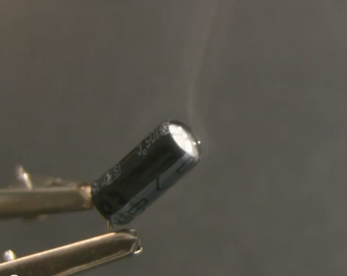
You (probably) don’t want to do this in the lab…
http://www.youtube.com/watch?v=JCPXckfT-6g

Slide 51
Appropriate dressing
Hair: long hair must be tied or restrained to prevent accidental contact with lab equipment
Loose or hanging clothing must not be worn (ties, scarves)
Footwear: due to the risk of electric shock, bare feet are never allowed in any lab area at any time
Soldering: Anyone doing any soldering work in the laboratory areas must wear a shirt, long pants or long skirt, socks, and covered shoes
Prevent the possibility of severe burns resulting from the splashing or dripping of hot liquefied solder

Slide 52
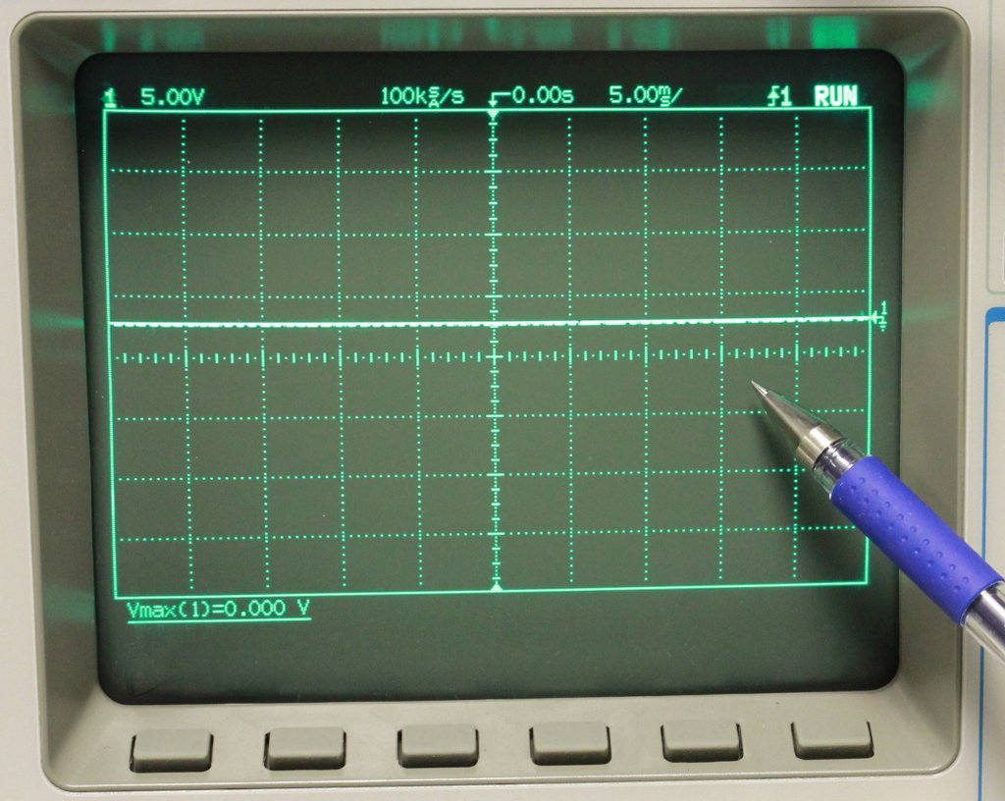
Proper attire
Lab benches must be kept in neat order and returned to the condition found when you are finished
We are sharing the labs with other courses and students. Don’t be selfish
No food and drink should be consumed at the lab benches
Do not use a pen as a pointer when reading meters or oscilloscope
No horseplay!
Beware of slips, trips and falls

Slide 53
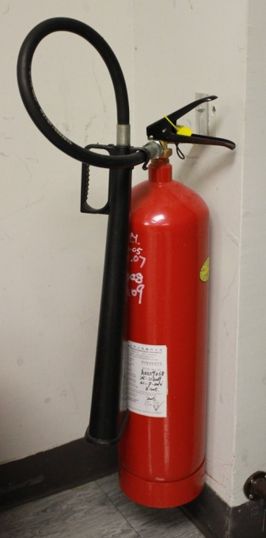
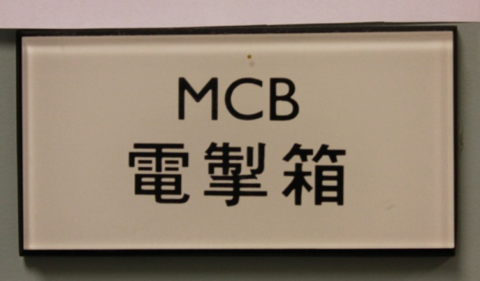
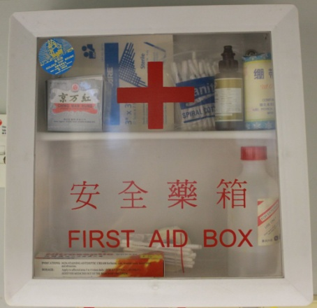
Understand the floor plan of your lab
Fire Extinguisher
bench
bench
bench
Circuit breaker panel
bench
bench
bench
bench
bench
bench
First Aid Box

Slide 54
Know your equipment
Always study the lab manual before coming to the Lab, ask your TAs if you have questions
Do not drop any equipment
Make circuit connections with all the power sources off
Activate adjustable power sources at a low level when powering an untested circuit
Make sure that all components and instrumentation have the proper ratings and are used on the appropriate range

Slide 55
Minor injury
Turn off any equipment/machinery involved
Perform appropriate first aid
Inform lab instructor/personnel, seek medical assistance as appropriate
  Call the University Health Center (UHS) on 3943 6423 on weekdays

Slide 56
Emergency procedure: electrical shock
Do no touch someone who is being electrocuted.
If it is possible to do so safely, turn off the power supply.
Otherwise, use a piece of lumber or other non-conducting material to separate the person from the energized conductor.
Check the afflicted person for pulse and respiration.
Only qualified individuals should attempt CPR.
In cases of electrocution, medical assistance should be summoned immediately.

Slide 57
Emergency procedure: fire
Turn on a fire alarm if you have any doubt that you may fail to put out the fire. Turn on a fire alarm for any serious emergency such as toxic gas release or explosion.
Use a laboratory fire extinguisher on incipient fires. When possible, use CO2 units instead of dry chemical units where instruments are involved to minimize damage.
Take an extinguisher with you to check out an area where there may be a fire.
After using a fire extinguisher, turn it in for replacement.
If an individual's clothing is on fire, roll them on the floor and wrap them in a coat or blanket if possible.
If you hear a fire alarm in your building, leave the building immediately.

Slide 58
Emergency : Medical Assistance
For urgent medical attention, go straight to the Accident & Emergency Department of any major hospitals
The nearest Accident & Emergency Department to the Chinese University is the Prince of Wales Hospital in Shatin, NT
  Telephone: 2632 3250
  For ambulance service, dial 2735 3355 (Fire Services Department) or 999. Identify yourself and give your exact location
It is advisable to notify the Security Office at 3943 7999 so that the ambulance may be directed to the exact location more readily

Slide 59
References
University Safety & Environment Office (USEO)
http://www.cuhk.edu.hk/useo
University Health Service
http://www.cuhk.edu.hk/uhs
Laboratory safety guidelines (Arizona State University)
ECE Department Undergraduate Laboratory: Safety and Operations Manual (Clarkson University)

