Slide 1
ENGG 1100 Introduction to Engineering Design
Lecture 2: Engineering Design & Management
Helen Meng
Professor and Chairman
Department of Systems Engineering & Engineering Management
hmmeng@se.cuhk.edu.hk

Slide 2
Engineer and Engineering Design
The word engineer has Latin roots in ingeniare (i.e. “to contrive, devise”) and ingenium (i.e. “cleverness”).
An engineer is a professional practitioner of engineering, who has mathematical and scientific training and can apply such knowledge, together with ingenuity, to design and build complicated products, machines, structures or systems and thus develops solutions for technical problems.
An engineering design pulls together (i.e. synthesizes) something new or arranges existing things in a new way to satisfy a recognized need of society. Engineering designs considers the limitations imposed by practicality, regulation, safety, and cost.

Slide 3
Design
Discovery versus Design
  Discovery is getting the first knowledge of something
  Design is the creation of new things
Science versus Engineering
  Science is knowledge based on observed facts and tested truths arranged in an orderly system that can be validated and communicated to other people.
  Engineering is the creative application of scientific principles used to plan, build, direct, guide, manage, or work on systems to maintain and improve our daily lives
Scientists versus Engineers
  Scientists see things as they are and ask, WHY?
  Engineers see things as they could be and ask, WHY NOT?

Slide 4
Challenges of Engineering Design
Creativity: creation of something that has not existed before
Complexity: requires decisions on many variables and parameters
Choice: requires making choices between many solutions at all levels, from basic concepts to the smallest detail
Compromise: requires balancing multiple and sometimes conflicting requirements

Slide 5
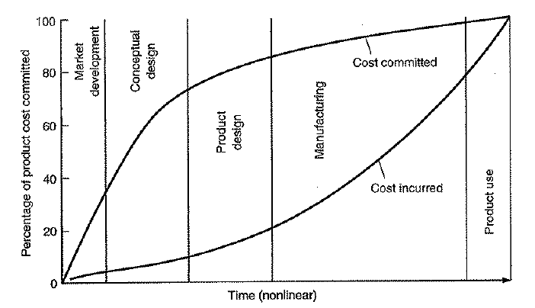
Importance of Engineering Design
[Source: Dieter & Schmidt 2013]

Slide 6
Engineering Design Process
Involves analysis and synthesis
Analysis
  Decompose problem into manageable parts
  Calculate as much about the part’s behavior as possible, using appropriate disciplines in science, engineering and computational tools, before the part exists in physical form
Synthesis
  Identification of the design elements that comprise the product, how it is decomposed into parts and the combination of the part solutions into a total workable system
Requires Systems Thinking!

Slide 7
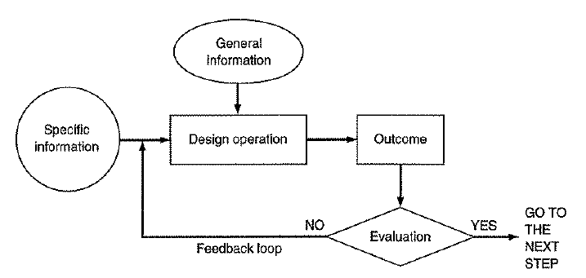
Iterative Engineering Design Process
Complex systems can be decomposed into a sequence of design processes
Iteration → repeated trials
  Gives opportunity to improve design on basis of preceding outcome
  More knowledgeable team may arrive at acceptable solutions faster
  Requires high tolerance of failure
  Requires determination to persevere and work out the problem
  Often involve tradeoffs and arrive at near-optimal solutions
[Source: Asimov 1962]

Slide 8
Problem-solving Methodology for
Engineering Design
Defining the problem
  Needs analysis, a difficult task
  True problem not always what it seems at first
  Requires iterative reworking as the problem is better understood
  Problem statement must be as specific as possible
Gathering the information
  Understand state of the art
  Many sources of information, unstructured, unordered
  Ask questions
    What do I need to find out?
    Where can I find it?
    How can I get it?
    How credible and accurate is the information?
    How do I interpret the information for my specific need?
    When do I have enough information?
    What decisions result from this information?
Notes:
5 steps

Slide 9
Problem-solving Methodology for
Engineering Design (cont-1)
Generation for alternative solutions / design concepts
  Use of creativity, simulation
  Apply scientific principles, use qualitative reasoning
  Need to generate high-quality alternative solutions
Evaluation of alternatives and decision making
  Selecting the best among several concepts
  Often under incomplete information
  May consider simulations
  Very important → checking, including mathematical check, engineering-sense checks (intuition)
  Consider all conditions / situations (e.g. humdity, vibration, temperature…) in selecting “optimal” solution
Communication of the results
  Oral / written communication,
  Engineering drawings, 3D computer models, software, etc.

Slide 10
Problem-solving Methodology for
Engineering Design (cont-2)
Iterative nature
  Back and forth among the 5 steps
  Understanding grows → evolve from preliminary to detailed design
Define Problem
Gather Information
??
Generate Alternative Solutions
Evaluate Alternatives and Make Decision
Communicate Results

Slide 11
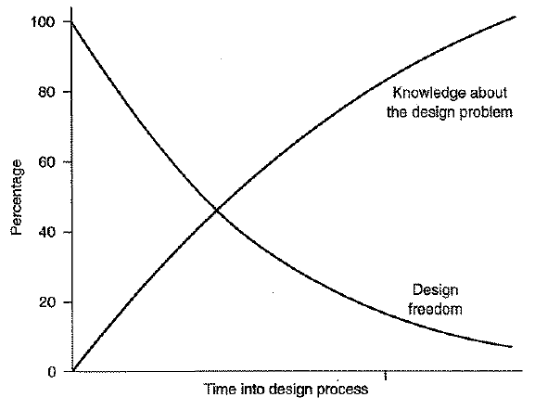
Problem-solving Methodology for
Engineering Design (cont-2)
Paradox
  Design knowledge grows as design freedom diminishes
[Source: Dieter & Schmidt 2013]

Slide 12
Considerations of Good Design
Performance Requirements
  Functional Requirements – for components, sub-assemblies, assemblies
  Aesthetic Requirements – shapes, size, touch and feel
  Environmental Requirements – operations conditions, e.g. temperature, humidity, dirt, vibration, noise, corrosive conditions, energy conservation, chemical emissions, (hazardous) waste production, recycling requirements
  Human Factors
  Cost, e.g. price-performance considerations
Regulatory and Social Issues
  Code of ethics require engineers to protect public health and safety
  Regulating agencies include: Occupation, Safety and Health Council, Consumer Council, Environmental Protection Department, etc.

Slide 13
Considerations of Good Design (cont)
Design Review
  Vital aspect of the design process
  Retrospective study of a design up to that point in time
  Systematic method to identify problems with the design determining subsequent courses of action, initiate action to correct problem areas

Slide 14

Computer-Aided Engineering
Engineering drawing, facilitating visualization, supported by computer graphics and modeling, e.g. AutoCAD, SolidWorks, etc.
Spreadsheets and mathematical tools, e.g. MatLab, Mathematica, etc.
Enabled concurrent engineering design to minimize time – all aspects of the design and development are represented in a closely communicating team,

Slide 15
Engineering Project Management
Mastery of engineering specialty no longer enough
Project success requires collaboration across technical disciplines, organizational elements, stakeholder interest
Must think of a project as a cohesive whole and not separate parts!

Slide 16
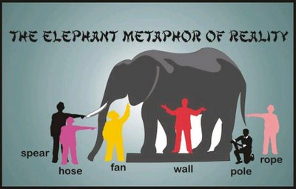

Slide 17
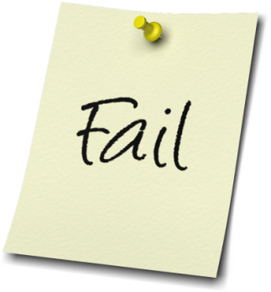
Engineering Project Management (cont)
Initial planning crucial
  NASA Rule # 15: a review of most failed project problems indicates that the disasters were well-planned to happen from the start. The seeds of the problem were laid down early. Initial planning is most vital [Madden, 100 Rules of NASA Project Managers]
  Project economics, e.g. NASA’s study of software development projects show that the cost of fixing a defect increases:
    fixing at design phase
    → fixing at coding phase (10x)
    → fixing at testing phase (100x)
Lesson
  Invest sufficient planning time and effort early because the cost savings are huge

Slide 18
6 Dangerous Planning Mistakes
Tolerating vague objectives
Ignoring environmental context
Using limiting tools and process
Neglecting stakeholder interests
Mismanaging people dynamics
One shot planning

Slide 19

4 Fundamental Questions
What are we trying to accomplish and why? (Objectives)
How will we measure success? (Measures and Verification)
What conditions must exist? (Assumptions)
How do we get there? (Inputs)

Slide 20
Q1. Setting Objectives
Goal: The high level, big picture Objective to which
the project contributes
Purpose: The impact we anticipate by doing the project,
the change expected from producing Outcomes
Outcomes: The specific results that the project team must
deliver by managing Inputs
Inputs: The activities and the resources necessary to produce
Outcomes
If we manage Inputs, then we can produce Outcomes
If we produce Outcomes, then we will achieve the Purpose
If we achieve the Purpose, then we can contribute to the Goal

Slide 21
Setting Objectives – Example 1
Goal
Ensure smooth operations in disaster recovery
Purpose
Recover quickly from a disaster
Outcomes
Emergency power systems in place
Data backed up safely
Inputs
Install power systems, data backup systems
Test systems
Identify critical data
Backup data in real-time

Slide 22
Setting Objectives – Example 2
Goal
Build a good career. Contribute to society,
enjoy my work, earn good income
Purpose
Increase my market value
Outcomes
Develop professional skills
Expand professional network
Inputs
Do well in school
Read more books related to profession
Attend professional seminars
Be more active in professional community
and society
Notes:
Personal example

Slide 23
Objective Tree
Goal
Purpose 1
Purpose 2
Purpose 3
Outcome 1
Outcome 2
…..
Outcome N
Input 1
Input 2
…..
Input M

Slide 24

Q2. Measuring Success
Measures and Verification
  Quantity
  Quality
  Time
  Customers /Users
  Cost

Slide 25
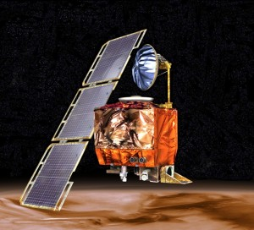
Q3. Assumptions
Objectives
Goal If
Purpose If
Outcomes If
Inputs If
Assumptions
and
and
and
If Inputs plus valid Assumptions, Then Outcomes
If Outcomes plus valid Assumptions, Then Purpose
If Purpose plus valid Assumptions, Then Goal
NASA's Climate Orbiter was lost September 23, 1999
[Source: Wikipedia]

Slide 26
Q4. Inputs
Actions and activities to produce Outcomes
Associated with resources
  Time
  People
  Money
  Etc.

Slide 27
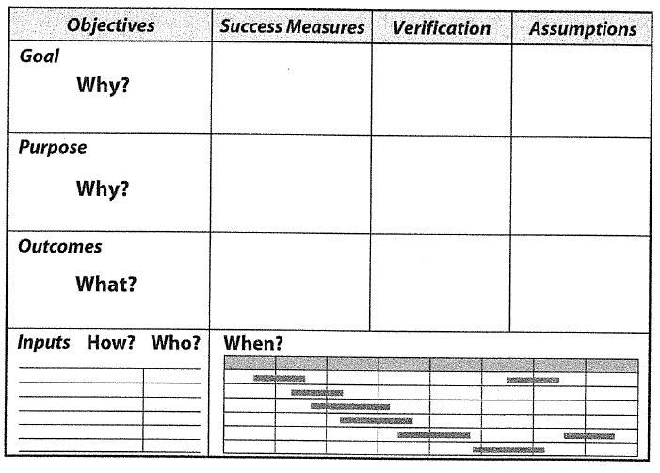
Integration
[Source: Schmidt 2009]

Slide 28
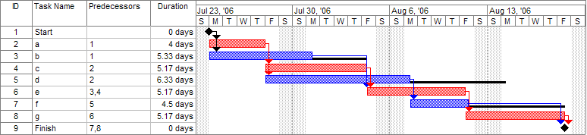
Project Scheduling
[Source: Wikipedia]
Gantt Chart
  Introduced by Henry Gantt, 1910
  Visualizes the project schedule

Slide 29
Budget and Resource Planning
Time value of money (TVM)
  Capital budgets are essential for supporting project activities over the project duration; but the value of money changes with time (because of interest/discount rates) with the concepts of present value (PV), future value (FV), and discounted cash flow.
  The starting time and finishing time of a scheduled project activity can have a significant impact on budget planning

Slide 30
Example: Saving the World
God’s memo: Noah, I have decided to make it rain for 40 days and 40 nights. I want you to build a big ark to hold a pair of all animals on earth, and people, so you can survive the flood. After the flood, you can restore life on earth and ensure the long-term survival of human and animal life. Get everything ready before the big rain starts in six months.
[Source: Schmidt 2009]
Notes:
God: rain for 40 days and

Slide 31
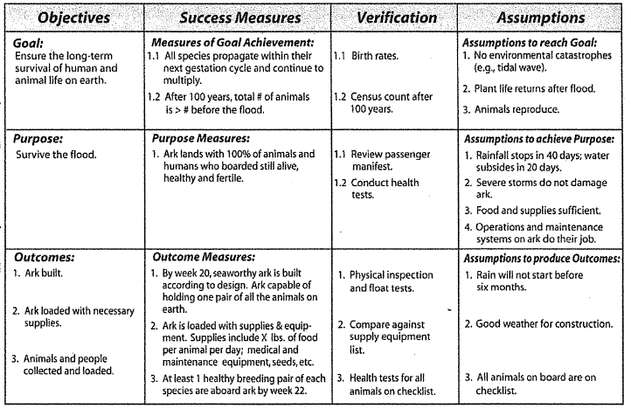
Noah’s Ark Project Management
[Source: Schmidt 2009]

Slide 32
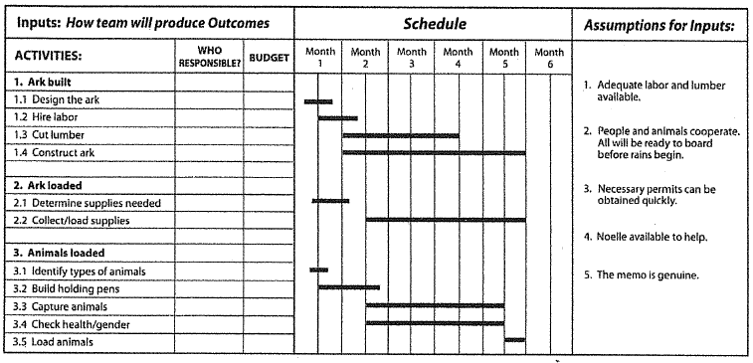
Noah’s Ark Project Inputs
[Source: Schmidt 2009]

Slide 33
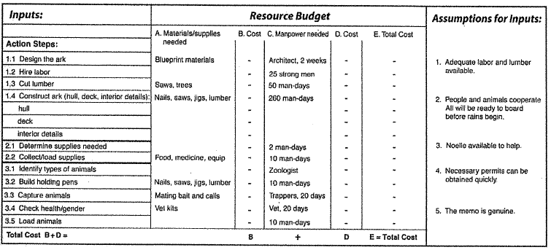
Noah’s Ark Project Resource Budget Details
[Source: Schmidt 2009]

Slide 34
Team Responsibility and Communication
The Confused Project Team
  Four people named Everybody, Somebody, Anybody and Nobody worked together.
  An important Outcome needed managing, and Everybody was sure that Somebody would do it.
  Anybody could have done it, but Nobody actually did it.
  Somebody got angry because it was really Everybody’s job.
  Everybody thought that Anybody could do it, but Nobody realized that Somebody wouldn’t.
  As it turned out, Everybody blamed Somebody when Nobody did what Anybody could have done!
[Source: Schmidt 2009]

Slide 35
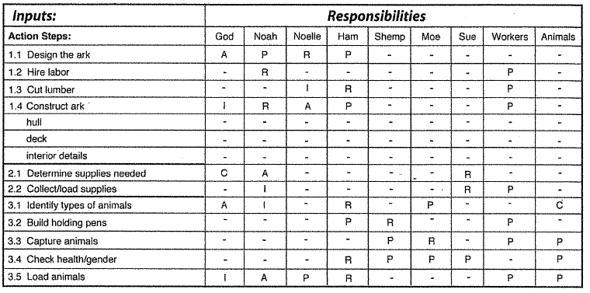
Noah’s Ark Responsibility Chart
R: Responsible (may delegate), P: Participants,
C: may be Consulted, A: Approves, I: must be informed
[Source: Schmidt 2009]

Slide 36
Project Reporting
Clearly tell others
  Your Objectives
  What you have done
  Why decisions are taken
  Lessons learned
  Results
  Future opportunities
Use proper quotations, citations and references

Slide 37
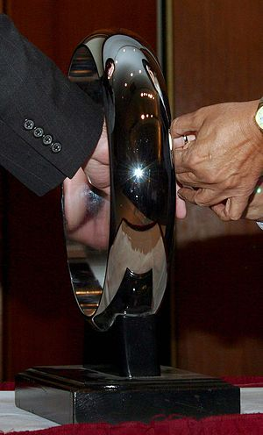
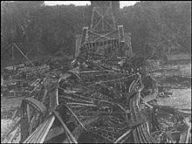
Engineering Ethics
Order of the Engineer: association for graduate and professional engineers in North America emphasizing the pride and responsibility in the engineering profession
Code of ethics called The Obligations of an Engineer
The Engineer’s Ring
Quebec Bridge: Wreckage of the 1907 collapse
[Source: Wikipedia]

Slide 38
Engineering Ethics (cont)
Code of ethics: The Obligations of an Engineer
I am an engineer, in my profession I take deep pride.
To it I owe solemn obligations.
Since the stone age, human progress has been spurred by the engineering genius.
Engineers have made usable nature's vast resources of material and energy for humanity's benefit.
Engineers have vitalized and turned to practical use the principles of science and the means of technology.
Were it not for this heritage of accumulated experience, my efforts would be feeble.
As an engineer, I pledge to practice integrity and fair dealing, tolerance, and respect, and to uphold devotion to the standards and the dignity of my profession, conscious always that my skill carries with it the obligation to serve humanity by making the best use of Earth's precious wealth.
As an engineer, I shall participate in none but honest enterprises.
When needed, my skill and knowledge shall be given without reservation for the public good.
In the performance of duty and in fidelity to my profession, I shall give the utmost.

Slide 39
References
  M. Asimov, “Introduction to Design,” Prentice-Hall, Englewood Cliffs, NJ. 1962.
  C.S. Park, Contemporary Engineering Economics, Prentice Hall, 2002
  C. L. Dym, P. Little, E. J. Orwin, and R. Erik Spjut, “Engineering Design: A Project-Based Introduction”, Third Edition, Wiley, 2009.
  T. Schmidt, “Strategic Project Management Made Simple,” Wiley 2009.
  E. A. Stephan, D. R. Bowman, W. J. Park, B. L. Sill, and M. W. Ohland, “Thinking Like an Engineer: An Active Learning Approach”, Pearson, 2012.
  G. Dieter and L. Schmidt, “Engineering Design,” 5/e, McGraw Hill, 2013.
  IET publication: “A Guide to Technical Report Writing”, online www.theiet.org
  Personal communication, Dr. Dorbin Ng, CUHK SEEM

Slide 40
END

Slide 41
Importance of Engineering Design
Design costs very little in terms of the overall product cost but its decisions has major event on the overall cost
Defects introduced in the design phase cannot be compensated in the manufacturing phase
Design process should be conducted to develop quality, cost-competitive products in the shortest time possible

Slide 42
Problem-solving Methodology for
Engineering Design (cont-2)
Paradox
  Design knowledge grows, design freedom diminishes
  Sometimes have forced decisions, e.g. long lead time equipment
[Source: Dieter & Schmidt 2013]

Slide 43
Design Process as a Process of Questioning
Suppose your client wants you to “design a safe ladder”.
There will be a lot of questions arising:
  Why do you want another ladder?
  How will it be used?
  How much can it cost?
  What do you mean by “safe”?
  ….
Similar sets of questions arise if I simply ask you to “design an automated guided vehicle (AGV)”, without further specifications.
The designer’s first task is to clarify what the client wants so as to be able translate wishes into meaningful objectives and constraints.
Notes:
43

Slide 44
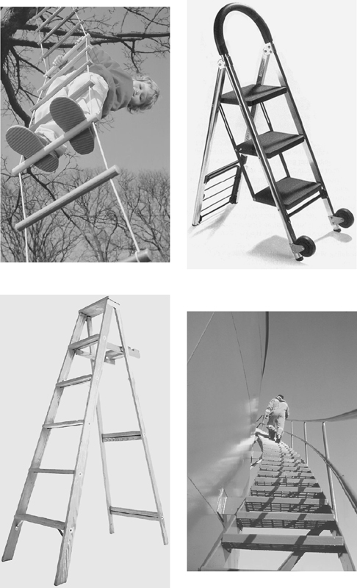
Example: Design a Safe Ladder
Questions like
  Why do you want another ladder?
  How will it be used?
  How much can it cost?
  ➔ help clarify and establish the client’s objective.
Questions like
  What does “safe” mean?
  What’s the most you’re willing to spend?
  ➔ help identify the constraints that govern the design.
Notes:
44

