Slide 1
Lab7: Introduction to Arduino
ENGG1100 Engineering Design I
Study this document before coming to the lab
Demonstrate your results of the following exercises to a TA before the lab ends.
  Part (b) of Exercise 7.1 (page 28)
  Part (b) of Exercise 7.2 (page 33)
  Exercise 7.3 (page 41)
  Exercise 7.4d (page 52)
This material is based on various resources

Slide 2
Overview
Theory
  Introduction to Arduino
  Hardware system structure
  Programming structure
Practice
  Experiment1: LED control
  Experiment1: Input/output functions
  Experiment2: Pulse width modulation (PWM)
  Experiment3: Finite State machines (FSM)

Slide 3
Introduction to Arduino
Arduino is a computation tool for sensing and controlling signals
It is more convenient and cost effective than using a personal computer PC.
It's an open-source system in terms of hardware and software.
You can download the Integrated Development Environment (IDE) for your own OS from http://arduino.cc/en/Main/Software
  Follow the instruction to install the IDE

Slide 4
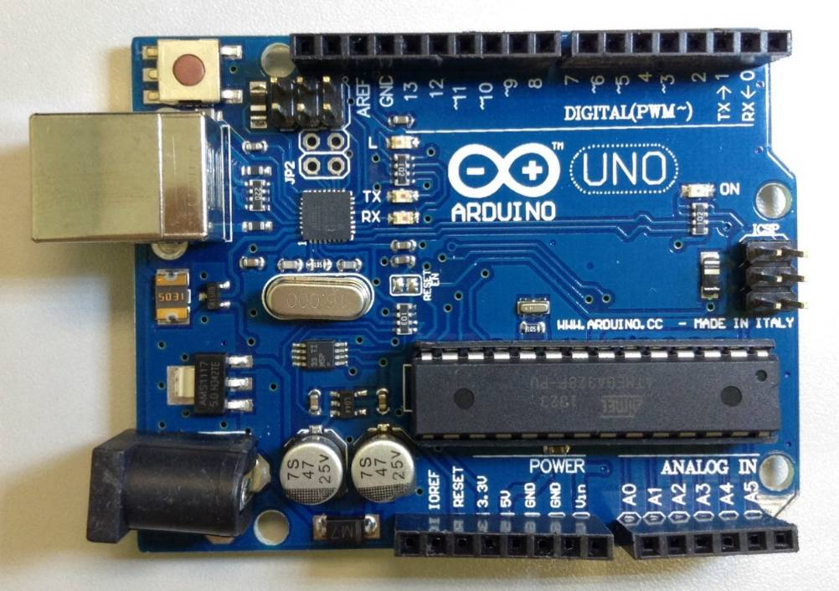
Arduino UNO
Microcontroller is based on ATmega328
  If needed , download Arduino Integrated Development Environment IDE http://arduino.cc/en/Main/Software#toc1
14 digital input/output (I/O) pins plus
6 analog input pins (these pins can also be programmed to be digital I/O pins)
A 16 MHz ceramic resonator
14 digital input/output (I/O) pins
13,12,… ………2,1,0
A0-→A5
6 Analog inputs, they can also be used as digital I/O pins

Slide 5
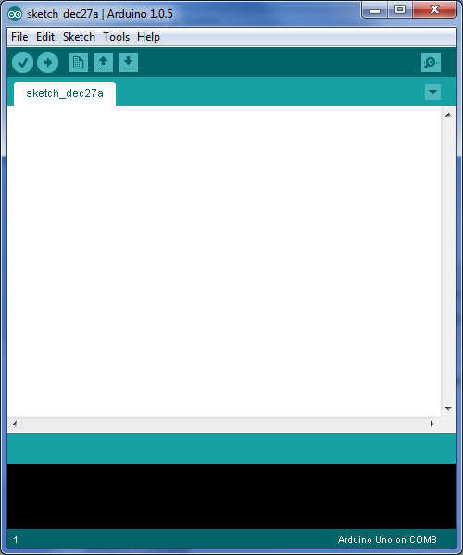
Start to use the Arduino IDE
To start Arduino IDE, click Start Menu → All Programs → Arduino
Make sure the board model (Arduino Uno) and connected port (depends on your PC) are correct
Your board Model
The port that your board connected to

Slide 6
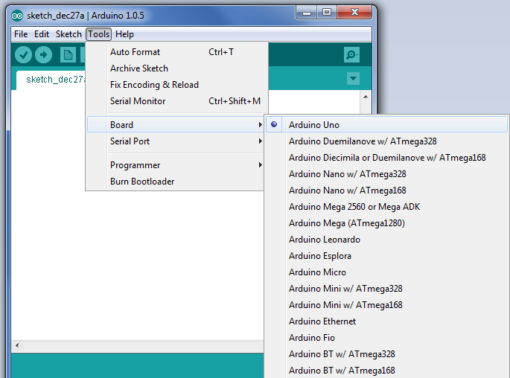
Select Board
Select a correct board

Slide 7
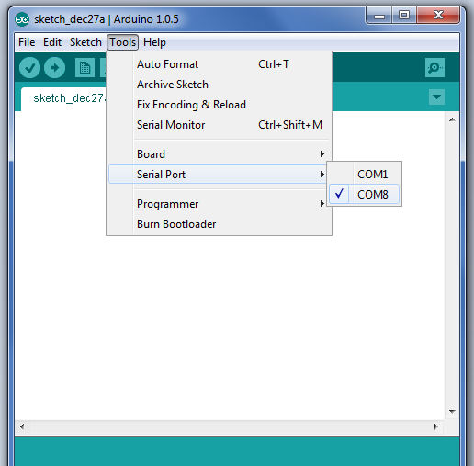
Select Port
Select a correct port.
The actual number depends on your system.

Slide 8
Arduino IDE
Tool Bar
Serial monitor,
Can use this to issue commands to the board, and read outputs from the board.
This programming Area
is called “Sketch”.
The program code are placed here.
Status Message
Messages from the system

Slide 9
Toolbar
Verify
  Checks code for errors
Upload
  Compiles and uploads code to the Arduino I/O board
New
  Creates a new sketch
Open
  Open sketch
Save
  Save sketch
Serial Monitor
  Display serial data being sent from the Arduino board

Slide 10
Arduino Code
To run a program in Arduino, your sketch should contain two methods
void setup()
{
// initialization of variables, pin modes, libraries
// run once after each power up or reset
}
void loop()
{
// loops the content consecutively
// allowing the program to change and respond
}

Slide 11
Basic software functions
Hardware related
  pinMode(), setup the functions of hardware pins
  digitalWrite(), set a pin to a digital level : ‘1’ or ‘0’
  digitalRead(), read the digital level of a pin: ‘1’ or ‘0’
  delay()
Software related
  If-then-else
  For
  Switch-case

Slide 12
System setup procedures
(Step 1) Setup the direction of the pins:
  using pinMode(),
(Step 2) Then you can set a pin to : HIGH or LOW
  (Step 2a) digitalWrite(), //set pin to : HIGH ‘1’ or LOW ‘0’
  or
  (step 2b) digitalRead(), //read state of pin: HIGH ‘1’ or LOW ‘0’

Slide 13
Basic Function (step1) – pinMode()
pinMode() is used to configure the specified pin to behave either as an input or output, or input_pullup
Syntax
  pin: the index number of the pin whose mode you wish to set
  mode: INPUT, OUTPUT, INPUT_PULLUP
  Example:
    pinMode(1, OUTPUT)//setup pin1 =digital out
    pinMode(3, INPUT)//setup pin3 =digital in
    pinMode(A3, INPUT)//setup A3 for digital in
    pinMode(A3, OUTPUT)//setup A3 for digital out
    If no PinMode applied to A0->A5, they are analog_in by default.
Pin =0,..,13, or A0,A1,..,A5
for Digital I/O, or
Write comment for you to read
pinMode(pin, mode) // comment

Slide 14
  Meaning of INPUT, OUTPUT, INPUT_PULLUP
INPUT:
OUTPUT:
INPUT_PULLUP: When the pin is not connect to anything, it is HIGH
HIGH(5V) or LOW(0V)
Arduino
Arduino
HIGH(5V) or LOW (0V)
High(5V))
1KΩ
Arduino
HIGH(5V) or LOW)
or not_connected_to_anything

Slide 15
Basic Function(step2a) – digitalWrite()
digitalWrite() is used to write a HIGH or a LOW value to a digital pin
Syntax
  pin: the number of the pin whose value you wish to set
  value: HIGH (5 V) or LOW (Ground)
  Example:
    digitalWrite(pin, value) // comment
    E.g
    digitalWrite(1, HIGH)//set pin1 to HIGH
digitalWrite(pin, value) // comment

Slide 16
Basic Function(step2b) – digitalRead()
digitalWrite() is used to read the value from a specified digital pin, either HIGH or LOW
Syntax
  pin: the number of the pin whose mode you want to read (integer)
  Example:
    digitalRead(pin)// read the state of the
    // it can be “HIGH” or “LOW”
digitalRead(pin)

Slide 17
Some other basic Function – delay()
delay() is used to pause the program for the amount of time (in milliseconds)
Syntax
  ms: the number of milliseconds to pause (unsigned long)
delay(ms)

Slide 18
Basic Control Structure – IF
Syntax
IF(condition1){
// do stuff if condition1 is true
}ELSE IF (condition2){
// do stuff only if condition1 is false
// and conition2 is true
}ELSE{
// do stuff when both condition1 and
// condition2 are false
}

Slide 19
Basic Control Structure – FOR
Syntax
FOR(initialization; condition; increment){
// statement(s);
}

Slide 20
Basic Control Structure
– SWITCH-CASE
switch (var) {
case label1:
// statements when var=label1
break;
case label2:
// statements when var=label2
break;
default:
// statements
}

Slide 21
More Functions
Please visit http://arduino.cc/en/Reference/ for Arduino Language Reference

Slide 22
Experiment 7.1:
Blinks an LED
Turns on/off an Active-LOW LED

Slide 23
Start Arduino IDE
  Stack the debug board on the Arduino board, connect it to the PC via a USB cable and start the Arduino IDE
To start Arduino IDE, click Start Menu → All Programs → Arduino
Make sure
  Tools→board→Arduino Uno
  Tools →serial port → com? (choose a correct one)
This area is called the “Sketch”
Your board Model
The port that your board connected to

Slide 24
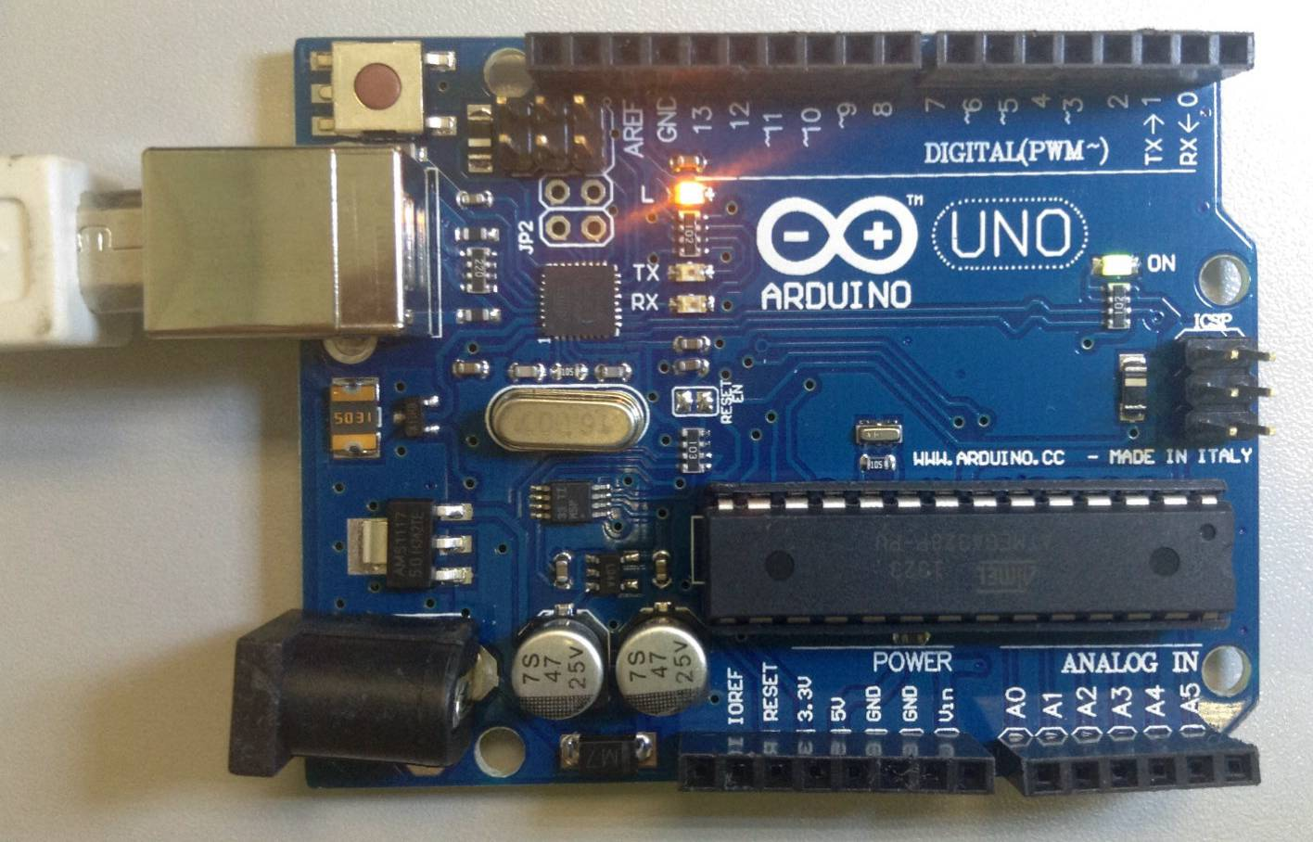
Connect Arduino UNO to PC
14 digital input/output (I/O) pins
13,12,… ………2,1,0
Success Connection: LED will be ON
Connect to PC through USB Cable
24
6 Analog inputs (or Digital I/O)
A5←A0
Can be used as digital I/O too

Slide 25
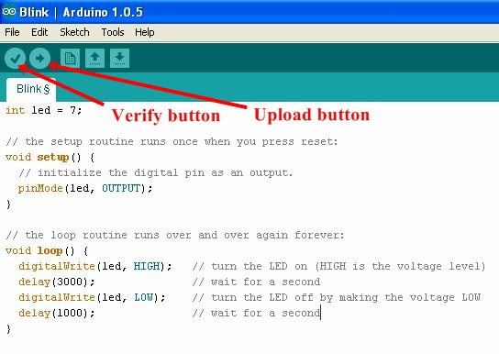
File/Load the Code to Arduino(or cut and paste to the “sketch” area)
Click verify to check whether your code is correct. After verification, you can upload the code to the Arduino board

Slide 26
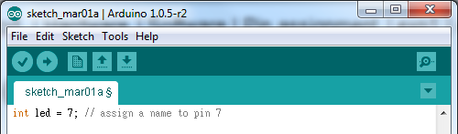
Circuit and Code
Cut and paste the code below to the sketch area of the Arduino IDE , and click on
demo71a.ino
//demo71a.ino
int led = 7; // assign a name to pin 7
// This setup routine runs once when reset is pressed
void setup () {
pinMode (led, OUTPUT); // assign the pin as an output
}
// This loop routine runs over and over again forever
void loop() {
  digitalWrite (led, HIGH); // turn off the LED
  delay (3000); // wait for three second
  digitalWrite (led, LOW); // turn on the LED
  delay (1000); // wait for a second
}

Slide 27
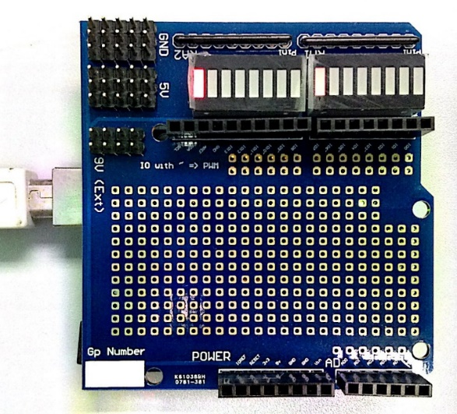
Result of the program
LED7 is ON for a second and OFF for three second
LED 7 should be blinking

Slide 28
Exercise 7.1
Write a program to turn on and off each of the LEDs (LED0,… LED7) one at a time. Such that, LED0 is turn on for a second and off for one second, then it will be the turn for LED1 and so on till LED7 is selected. After that, start again with LED0.
Why all LEDs light up at the beginning? Change your program to solve this problem?
Advanced exercise (to be done in your spare time if you are interested): Display the state of the LED using the serial monitor. See http://arduino.cc/en/Serial/Print#.UxFaulPYFCs

Slide 29
Hints
X start value
Test for
X stop condition
X increment (use x++) or decrement (use x--)
//setup pinMode
void setup() {
for (int x=0; x<8; x++)
{
pinMode(x, OUTPUT);
}
}
void loop() {
//to be filled by students
}

Slide 30
Experiment 7.2:
Get Input
Use an input value to control an LED

Slide 31
demo72.ino
Use an integer variable “InputPin” to hold the pin number: 2
Use an integer variable “ledPin” to hold the led number: 7
//demo72.ino
int inputPin = 2; // the number of the input pin
int ledPin = 7; // the number of the LED pin
int inputState = 0; //variable for reading the input status
void setup () {
pinMode (ledPin, OUTPUT); //assign the pin as an output
pinMode (inputPin, INPUT); //assign the pin as an input
}
void loop() {
  inputState = digitalRead(inputPin); //get status
  if (inputState == LOW) { // GND is connected
  digitalWrite(ledPin, HIGH); // turn off LED
  }
  else {
  digitalWrite(ledPin, LOW); //turn on LED
  }
  }

Slide 32
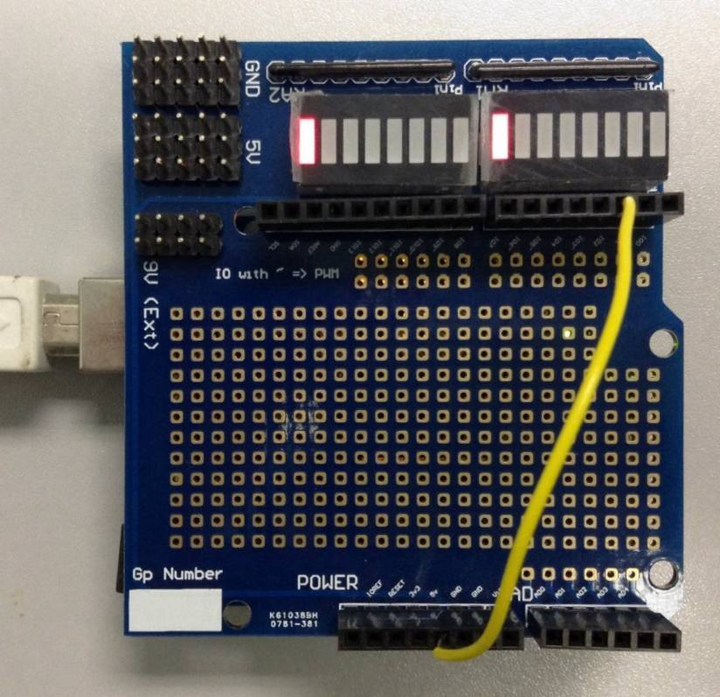
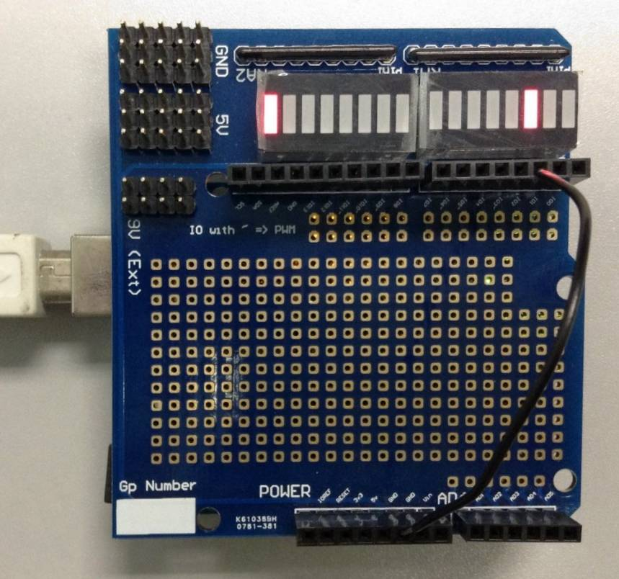
demo (7.2) Expected Results (verify this using your setup)
5 V is connected to Pin 2
GND is connected to Pin 2
LED7 is ON
To show the output
LED2 is OFF
To show the input
LED7 is OFF
LED2 is ON
Input/output
13 12 11 10 9 8 7 6 5 4 3 2 1 0
5-Volt
GND (0-Volt)

Slide 33
Exercise 7.2
Explain what you see after running demo72.ino
Modify the code so that the input pin is 3 (instead of 2) and output LED is 6 (instead of 7). Run the code to verify your result.
Advanced exercise (to be done in your spare time if you are interested): Use the keyboard of your PC to control the on and off of the LEDS. See http://arduino.cc/en/Serial/read#.UxFdTPmSxIE

Slide 34
Experiment 7.3:
Pulse Width Modulation (PWM)
Use PWM to control the intensity an LED

Slide 35
Pulse Width Modulation (PWM)
PWM is a modulation technique that obtains analog results by digital means
The duration of “ON” is called the pulse_width
  Create an analog output by changing the pulse_width for a fixed frequency signal
Can be used to control the speed of a motor
  The longer the switch is ON compared to the OFF periods, the higher the power supplied to the load
Advantage: easy to use and implement, low power loss.

Slide 36
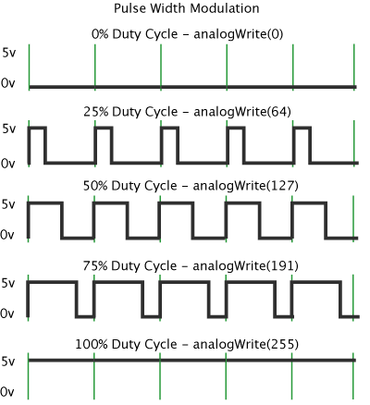
PWM in Arduino
The green lines represents a regular time period i.e. inverse of PWM frequency
  Arduino’s default PWM frequency is approximately 500 Hz i.e. a period is 2 ms
Use analogWrite() to control the pulse width
  Varying LED’s brightness
  Varying motor’s speed
Only pin 3, 5, 6, 9, 10, and 11 can be used for PWM
Courtesy of Arduino.cc

Slide 37
Arduino PWM pins
Only pins
3, 5, 6, 9, 10, and 11 can be used for PWM
PWM outputs
13 12 11 10 9 8 7 6 5 4 3 2 1 0
5-Volt
GND (0-Volt)

Slide 38
analogRead()
analogRead() is used to read the value from the specified analog pin
  The input voltage between 0 V and 5 V will be mapped into integer values between 0 and 1023 i.e. 4.9 mV/unit
Syntax
  pin: the number of the analog input pin to read from 0 V to 5 V
  return: integer from 0 to 1023
return = analogRead(pin)

Slide 39
analogWrite()
analogWrite() is used to set the duty cycle of a PWM pulse
  After a call to analogWrite(), the pin will generate a steady square wave of the specified duty cycle until the next call to analogWrite(), digitalRead() or digitalWrite() on the same pin
Syntax
  pin: the pin to write to
  value: the duty cycle between 0 (always OFF) and 255 (always ON)
analogWrite(pin, value)

Slide 40
Run this Demo73.ino and explain what you see
//demo73.ino
int ledPin = 3; // must be one of 3, 5, 6, 9, 10, or 11 for PWM
void setup () {
pinMode (ledPin, OUTPUT); // assign the pin as an output
}
void loop() {
int dtwait = 1000;
analogWrite (ledPin, 255-0); //LED OFF,when value=255,LED=off
delay (dtwait);
analogWrite (ledPin, 255-100); // a dimmer LED
delay (dtwait);
analogWrite (ledPin, 255-255); // full bright LED, when value=0
delay (dtwait);
}

Slide 41
Exercise 7.3
Write the program to control the intensity of LED5 continuously and repeatedly from dark to full and dark again within a period of five seconds.
  Hint: Change intensity every 0.5 seconds, put the statements inside: Void Loop( ) { Your code }
Advanced exercise (to be done in your spare time if you are interested): Use the 7 LEDS as an intensity ramp: intensity changes from low to high for LED0 to LED7 at the beginning and then gradually reverse the pattern continuously and repeatedly at 1Hz. (Hints: may need to use for())

Slide 42
Experiment 7.4:
Finite State Machine (FSM)
Use FSM to control a system

Slide 43
Logic Control
Logic control is an essential part to develop an intelligence device
Logic control can be developed by
  Truth table
    You only need to know the corresponding input/output relation
    As there is no memory, only simple operations can be achieved
  Finite State Machine
    Decision is based on what it has done i.e. the system has memory, the performance can be more complex

Slide 44
A FSM demo74a.ino
(FSM with no input)
  Transition condition: delay 1 second
start
State:
State 1
Entry action: LED3 is OFF
LED4 is ON
State:
State 2
Entry action: LED3 is ON
LED4 is OFF
  Transition condition: delay 2 seconds

Slide 45
//demo74a.ino
Try this code
void loop() {
switch(state) {
case STATE1:
digitalWrite(3, HIGH); // LED OFF
digitalWrite(4, LOW); // LED OFF
delay(1000);
state=STATE2;
break;
case STATE2:
digitalWrite(3, LOW); // LED ON
digitalWrite(4, HIGH); // LED OFF
delay(2000);
state=STATE1;
break;
case STATE_END: // turn off the LEDs, this state is not used here
digitalWrite(3, HIGH); // LED OFF
digitalWrite(4, HIGH); // LED OFF
break;
default:
state=STATE_END;
break;
} }
//demo74a.ino
#define STATE1 1
#define STATE2 2
#define STATE_END 100
unsigned char state=1; //init. to state1
void setup() {
pinMode (3, OUTPUT);
pinMode (4, OUTPUT);
}

Slide 46
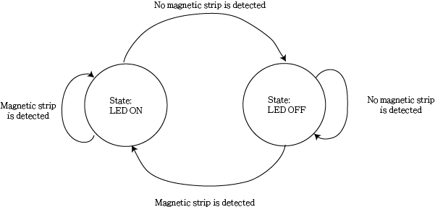
Demo 7.4b:
Two-State FSM with input
When a magnetic strip is detected, the LED is ON
When there is no magnetic strip, the LED is OFF
State Transition Table
State Diagram
Input | Current State | Next State
Magnetic strip is detected | ON | ON
Magnetic strip is detected | OFF | ON
No magnetic strip is detected | ON | OFF
No magnetic strip is detected | OFF | OFF

Slide 47
Two-State FSM demo7.4b
Circuit
  Connect one leg of a magnetic sensor to GND and another leg to pin 7
Code demo74b.ino
  When a magnet is near the magnetic switch sensor (if you don’t have a magnetic switch, connect Pin7 to ground to simulate the effect), then LED5=ON,LED6=OFF
  When a magnet is NOT near the magnetic switch sensor (or leave pin7 unconnected), then LED5=OFF,LED6=ON
Try demo74b.ino

Slide 48
//demo74b.ino
#define STATE1 1
#define STATE2 2
#define STATE_END 100
int magnetic = 7;
int ledPin_S1 = 5;
int ledPin_S2 = 6;
unsigned char state=1;
void setup() {
pinMode (magnetic, INPUT);
pinMode (ledPin_S1, OUTPUT); pinMode (ledPin_S2, OUTPUT);
}
void loop() {
switch(state) {
case STATE1:
digitalWrite(ledPin_S1, HIGH); // LED OFF
digitalWrite(ledPin_S2, LOW); // LED ON
if (digitalRead(magnetic) == LOW)
state=STATE2; break;
case STATE2:
digitalWrite(ledPin_S1, LOW); // LED ON
digitalWrite(ledPin_S2, HIGH); // LED OFF
if (digitalRead(magnetic) == HIGH)
state=STATE1; break;
case STATE_END:
digitalWrite(ledPin_S1, HIGH); // LEDOFF
digitalWrite(ledPin_S2, HIGH); // LED OFF break;
default:
state=STATE_END;
break; }}

Slide 49
Exercise 7.4c
Write a FSM program that controls two LEDs through two input signals, the specification is shown in flow diagram 7.4c in the next slide
  Use inputs
    pin0 for sensor1, and
    pin1 for sensor2.
    The values of input signals (sensor 1 and sensor 2) can be either GND (LOW) or 5V (HIGH)
  Use outputs
    pin5 for LED1 and
    pin6 for LED2

Slide 50
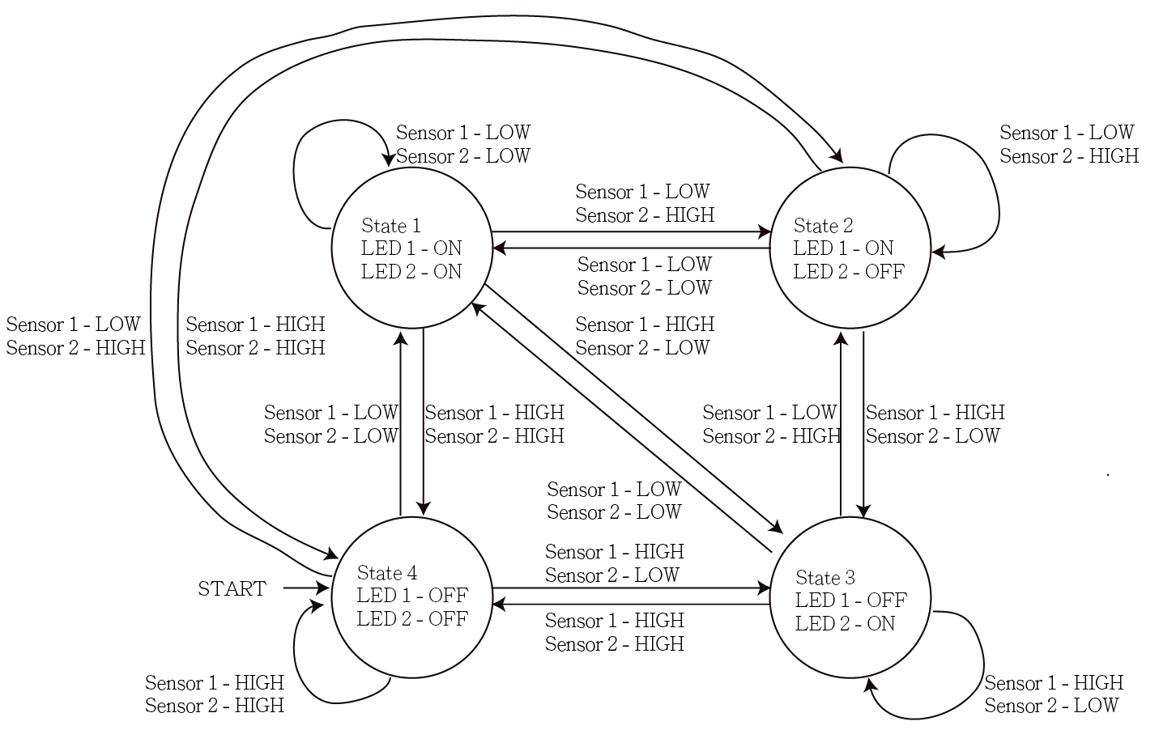
Exercise 7.4c
State Diagram 7.4c

Slide 51
Hints
void loop() {
switch(state) {
case STATE1:
digitalWrite(led1, LOW);
digitalWrite(led2, LOW);
if ((digitalRead(sensor1) == LOW) && (digitalRead(sensor2) == HIGH)) state=STATE2;
else if ((digitalRead(sensor1) == HIGH) && (digitalRead(sensor2) == LOW)) state=STATE3;
else if ((digitalRead(sensor1) == HIGH) && (digitalRead(sensor2) == HIGH)) state=STATE4;
break;
// …………To be filled in by students
//hint for ans74.c
#define STATE1 1
#define STATE2 2
#define STATE3 3
#define STATE4 4
#define STATE_END 100
int sensor1 = 0;
int sensor2 = 1;
int led1 = 5;
int led2 = 6;
unsigned char state=4;
void setup() {
pinMode (sensor1, INPUT);
pinMode (sensor2, INPUT);
pinMode (led1, OUTPUT);
pinMode (led2, OUTPUT);
}

Slide 52
Exercise 7.4d
Improve the previous exercise with the following conditions
  When both LEDs are ON, they should be in full brightness
  When either LED is lighted up, the brightness of that LED should be as low as 10 %
    Hint use: analogWrite(led1, 255-25); //will give 10% LED light

Slide 53
Summary
Learned the use of
  the Arduino microcontroller
  digital input / outputs functions
  some basic functions
  if-then-else and switch-case control statements in programs
  Finite state machines

