Slide 1
A tutorial on using mirror to calibrate non-overlapping view cameras
K.H. Wong

Slide 2
Overview
Introduction and Problem definition
Theory
3D Rotation using axis-angle representation
Axis-angle representation
The geometric median problem to be solved by the Weiszfeld algorithm
Find the average rotation
Explanation of the algorithm
Experiments
Simulation
Real data
Conclusion and discussion

Slide 3
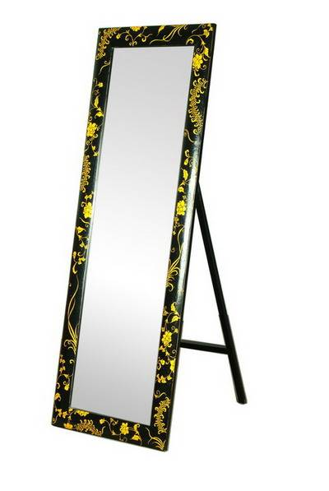
Introduction
Two cameras do not have overlapping view are difficult to find pose (R,T) between them.
Using a mirror, the other camera sees the calibration object (checker board) for Pose calibration
Need to work out the reflection formulations
Pose (R,T)

Slide 4
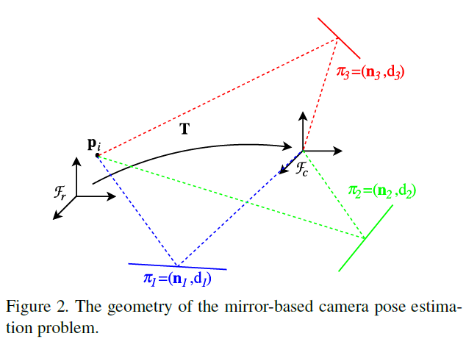
Problem definition Multiple camera calibration with overlapping views:
Problem:
A camera is at Fr and another camera is at Fc, both camera has no overlapping view. A calibration object P is used, then R,T between the calibration object and camera fr can be found by a pose estimation algorithm.
Use the same calibration object P, for each mirror, the R~i between P and the camera Fc can be found. This will lead to the result of Rotation between P and Fc.
The Rotation between Fr and Fc can be found.

Slide 5
Inputs and outputs
Setup
Mirror planes at π1, π2, π3,.. etc
Pose estimation tools such as sfm1 of ba (ch 11)or camera calibration tool boxes
Find R between P and Fc
Inputs:
R~i=1,2,3…n (found by pose estimation)
Initialize R
Output
Optimal R between P and Fc

Slide 6
Theory

Slide 7
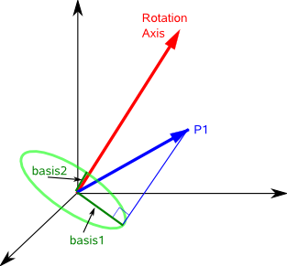
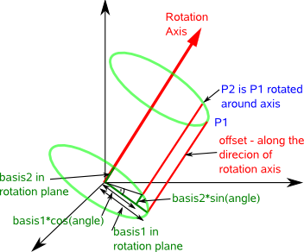
Theory: 3D Rotation using axis-angle representation
n
Definition: R is a 3x3 matrix that transforms a vector P1 to P2 such that P2=R*P1.
axis=Rotation axis is a unit vector (u) of vector n
angle=Angle of rotation θ
Rn(θ)_{(3x3)} =I+Nsinθ+N²(1-cosθ) , where N=[u]_{x}, []_{x}=skew symmetric matrix, u is the unit vector of n
http://www.memphys.sdu.dk/~besold/INDEX/axis-angle.pdf
http://www.euclideanspace.com/maths/geometry/rotations/conversions/angleToMatrix/
https://en.wikipedia.org/wiki/Rotation_matrix

Slide 8
Axis-angle representation
Rn(θ)_{(3x3)} =I+N_{(3x3)}sinθ+N²_{(3x3)} (1-cosθ) , where N=[u]_{x}
θ = an angle which is a scalar, N is a 3x3 matrix
The above equation can be expressed as a power series described by an Exponential function EXP( ), hence
Rn(θ)_{(3x3)}=Exp(θ⋅N_{(3x3)})=Exp(θ⋅[u]_{x})=I+Nsinθ +N²(1-cosθ) .
Rn(θ) is the rotation matrix to rotate a vector P1 to P2, such that P2=Rn(θ)*P1. The rotational axis is the vector n (the unit vector of n is u), and the rotation is θ around the circle perpendicular to u (see the picture in the previous slide). So
Log[Rn_{3x3}(θ)]=θ⋅N_{3x3} , (θ is a scalar) or
Rn_{3x3}(θ)=exp(θ⋅N_{3x3})
In matlab exponential of a matrix can be found by Expm(). Use >>help expm in matlab to find out more. E.g. expm(A_{3x3})= B_{3x3}

Slide 9
The geometric median problem
First suggested by Pierre de Fermat
Problem definition: Give a set of points $x_{i}$ in some metric space, find mean($\overline{x}$) that the sum of distance $d()$ from $x_{i}$to $\overline{x}$ is a minimum
$\overline{x}=\underset{x}{argmin}{\sum_{i=1}^{n}{d(x,x_{i})}}$
No simple direct solution , can be solved by
Weiszfeld algorithm (To be discussed)

Slide 10
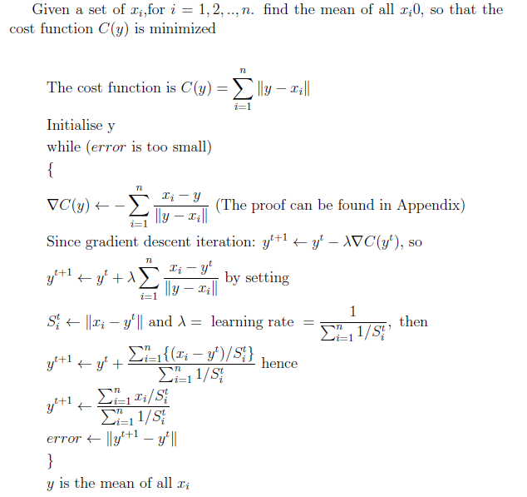
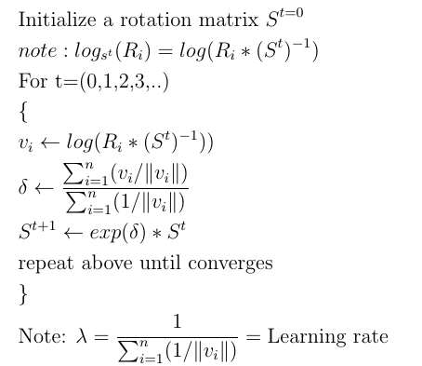
The original Weiszfeld algorithm with explanation [2]
The algorithm with explanation
The actual algorithm
Notes:
%http://www.sciweavers.org/free-online-latex-equation-editor
\documentclass[12pt]{article}
\usepackage{amsmath, enumitem}
\begin{document}
Given a set of $x_i$,for $i=1,2,..,n$. find the mean of all $x_i0$, so that the cost function $C(y)$ is minimized\\
\begin{align*}
&\text{The cost function is } C(y)=\sum_{i=1}^{n}\| y-x_i\| \\
%&C(y)=\sum_{i=1}^{i=n}\| y-x_i\|\\
&\text{Initialise y}\\
&\text{while ($error$ is too small)}\\
&\{\\
&\nabla C(y)= -\sum_{i=1}^{n} \frac{x_i-y}{\| y-x_i\|} \text{ (The proof can be found in Appendix)}\\
&\text{Since gradient descent iteration: } y^{t+1}=y^{t} - \lambda \nabla C(y^t) \text{, so}\\
&y^{t+1}=y^{t}+ \lambda \sum_{i=1}^{n} \frac{x_i-y^t}{\| y-x_i\|} \text { by setting}\\
&S_{i}^{t}=\| x_i-y^t \| \text{ and } \lambda =\text { learning rate }=\frac{1}{\sum_{i=1}^{n}{1}/{S_i^t}}, \text{ then }\\
&y^{t+1}=y^t+\frac{\sum_{i=1}^{n}\{(x_i-y^t)/S_i^t\}}{\sum_{i=1}^{n}{1}/{S_i^t}} \text{ hence }\\
%&y^{t+1}=\frac{\sum_{i=1}^{n} {x_i}/{S_i^t}} {{\sum_{i=1}^{n}({1}/{S_i^t})}}
%&y^{t+1}=\frac{ \sum_{i=1}^{n} {x_i}/{S_i^t} } { {\sum_{i=1}^{n}({1}/{S_i^t})} }
%&y^{t+1}=\frac{ \sum_{i=1}^{n} {x_i}/{S_i^t} } { 2}
&y^{t+1}=\frac{\sum_{i=1}^{n} {x_i}/{S_i^t}}{{\sum_{i=1}^{n}{1}/{S_i^t}}}\\
&error=\| y^{t+1}-y^{t}\|\\
&\}\\
& y \text{ is the mean of all } x_i\\
\end{align*}
\end{document}
&error=\| y^{t+1}-y^{t}\|\\
&\}\\
& y \text{ is the mean of all } x_i\\
\end{align*}
\end{document}
%http://www.sciweavers.org/free-online-latex-equation-editor
\documentclass[12pt]{article}
\usepackage{amsmath, enumitem}
\begin{document}
Given a set of $x_i$,for $i=1,2,..,n$. find the mean of all $x_i0$, so that the cost function $C(y)$ is minimized\\
\begin{align*}
&\text{The cost function is } C(y)=\sum_{i=1}^{n}\| y-x_i\| \\
%&C(y)=\sum_{i=1}^{i=n}\| y-x_i\|\\
&\text{Initialise y}\\
&\text{while ($error$ is too small)}\\
&\{\\
%&\nabla C(y)= -\sum_{i=1}^{n} \frac{x_i-y}{\| y-x_i\|} \text{ (The proof can be found in Appendix)}\\
%&\text{Since gradient descent iteration: } y^{t+1}=y^{t} - \lambda \nabla C(y^t) \text{, so}\\
%&y^{t+1}=y^{t}+ \lambda \sum_{i=1}^{n} \frac{x_i-y^t}{\| y-x_i\|} \text { by setting}\\
%\text{ and } \lambda =\frac{1}{\sum_{i=1}^{n}{1}/{S_i^t}}, \text{ then }\\
%&y^{t+1}=y^t+\frac{\sum_{i=1}^{n}\{(x_i-y^t)/S_i^t\}}{\sum_{i=1}^{n}{1}/{S_i^t}} \text{ hence }\\
&S_{i}^{t}=\| x_i-y^t\| \\
&y^{t+1}=\frac{\sum_{i=1}^{n} {x_i}/{S_i^t}}{{\sum_{i=1}^{n}{1}/{S_i^t}}}\\
&error=\| y^{t+1}-y^{t}\|\\
&\}\\
& y \text{ is the mean of all } x_i\\
\end{align*}
\end{document}

Slide 11
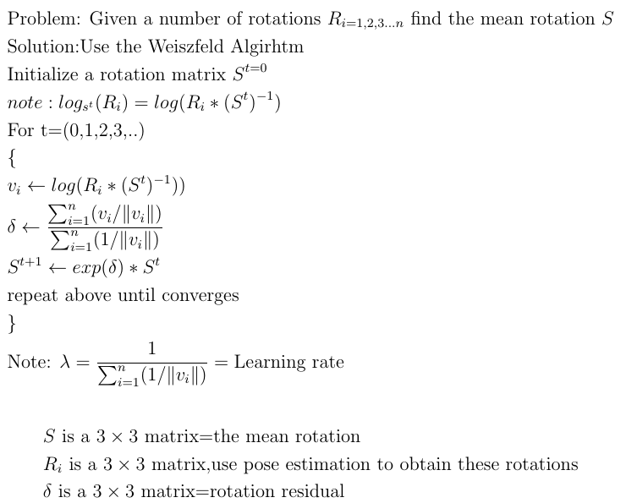
Find the average rotation using the Weiszfeld algorithm (geometric median)
Note use expm to find the exponentials of matrices
>>help expm in matlab to find out more.
E.g. expm(A_{3x3})= B_{3x3}
Also: if A is a rotation matrix B is a 3x3 real matric, otherwise B may contain complex values.
%Testing matlab code
r_rand=rand(3,3)
r_rotate=rpymat([1,2,3])
v_rand=logm(r_rand)
v_rotate=logm(r_rotate)
Cost function
Notes:
%http://www.sciweavers.org/free-online-latex-equation-editor
\documentclass[12pt]{article}
\usepackage{amsmath, enumitem}
\begin{document}
\begin{align*}
&\text{Problem: Given a number of rotations } R_{i=1,2,3...n} \text{ find the mean rotation } S\\
&\text{Solution:Use the Weiszfeld Algirhtm}\\
&\text{Initialize a rotation matrix } S^{t=0}\\
& note: log_{s^t}(R_i) = log(R_i*(S^t)^{-1})\\
&\text{For t=(0,1,2,3,..)}\\
&\{\\
&v_i \gets log(R_i*(S^t)^{-1})) \\
&\delta \gets \frac{\sum_{i=1}^{n}( v_i/\| v_i\|)} {\sum_{i=1}^{n} (1/\| v_i\|)} \\
&S^{t+1} \gets exp(\delta )* S^t \\
&\text{repeat above until converges }\\
&\}\\
&\text{Note: } \lambda=\frac{1} {\sum_{i=1}^{n} (1/\|v_i\|)}= \text{Learning rate}
\end{align*}
%%%%%%%%%%%%%%%%%%%%%%%%%%%%%%%%%%%%
\begin{align*}
&S \text{ is a } 3 \times 3 \text{ matrix=the mean rotation}\\
&R_i \text{ is a } 3 \times 3 \text{ matrix,} \text{use pose estimation to obtain these rotations}\\
&\delta \text{ is a } 3 \times 3 \text{ matrix=rotation residual}\\
\end{align*}
\end{document}

Slide 12
Further explanation of the algo.
To show the cost function C(R_{i})=
Please refer to equation 23 of
Huynh, Du Q. "Metrics for 3D rotations: Comparison and analysis." Journal of Mathematical Imaging and Vision 35.2 (2009): 155-164.
Notes:
%http://www.sciweavers.org/free-online-latex-equation-editor
\documentclass[12pt]{article}
\usepackage{amsmath, enumitem}
\begin{document}
\begin{align*}
\| \log_s(R_i)\|=\| \log(R_i,S^{-1}) \|
\end{align*}
\end{document}

Slide 13
Implementation: Demo program
Demo program in the attached ppt note
need functions (all in the attached notes)
rpyAng
rpymat
axis_angle2R
unit_vector
Notes:
Ri %just to show what we get
% set some values close to the truth. ?? may need to find a better selection
%[R_init,anxyz]=axis_angle2R(axis_angle+0.05,[axis_x+0.01,axis_y+0.02,axis_z+0.03])%small
[R_init,anxyz]=axis_angle2R(axis_angle+0.5,[axis_x+0.01,axis_y+0.02,axis_z+0.03])%small
R=R_init
err=10000,n_loop=0
max_loop=100
%while(err<0.01 && n_loop <max_loop)%repeat until err is small
while(err>0.001 & n_loop < max_loop)%repeat until err is small
for i=1:n %n measurements of mirror positions.
[eig_vec,eig_val]=eig(R'*Ri(:,:,i))
Ri(:,:,i)
ni(:,i)=eig_vec(:,1) %??should find the eig_vector correspond to -1 eign value
%pause
end %end_for
clear delta temp1 temp2 temp3 temp4
delta=zeros(3,3)
temp3=zeros(3,3)
temp4=0
for i=1:n %n measurements of mirror positions.
temp1= logm(R'*Ri(:,:,i)*(eye(3)-2*ni(:,i)*ni(:,i)'))
temp2= norm(temp1)
temp3= temp3 + (temp1/temp2)
temp4= temp4 + (1/temp2)
end %end_for
delta=temp3/temp4
R_old=R
R=expm(delta)*R %new guessed R
err=norm(R*R_old' - eye(3)) %error should be close to eye(3)
%err=norm(logm(R*R_old'))
n_loop=n_loop+1
pause
end %while
'done--------------------------------'
'R found'
R
'R_true'
R_true

Slide 14
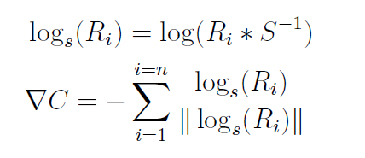
Explanation 1
Using the metric C(R_{i})=
The proof is in the next slide
When ∇C is found we can use the similar treatment in the original Weiszfeld algorithm to find δ (derivation to be added)
Weiszfeld algorithm for mean rotation
Notes:
%http://www.sciweavers.org/free-online-latex-equation-editor
\documentclass[12pt]{article}
\usepackage{amsmath, enumitem}
\begin{document}
\begin{align*}
&\log_s(R_i)=\log(R_i*S^{-1})\\
&\nabla C=-\sum_{i=1}^{i=n} \frac{\log_s(R_i)}{\|\log_s(R_i)\|}
\end{align*}
\end{document}
%http://www.sciweavers.org/free-online-latex-equation-editor
\documentclass[12pt]{article}
\usepackage{amsmath, enumitem}
\begin{document}
\begin{align*}
&\log_s(R_i)=\log(R_i,S^{-1})
\end{align*}
\end{document}
%http://www.sciweavers.org/free-online-latex-equation-editor
\documentclass[12pt]{article}
\usepackage{amsmath, enumitem}
\begin{document}
\begin{align*}
&\text{Problem: Given a number of rotations } R_{i=1,2,3...n} \text{ find the mean rotation } S\\
&\text{Solution:Use the Weiszfeld Algirhtm}\\
&\text{Initialize a rotation matrix } S^{t=0}\\
&\text{For t=(0,1,2,3,..)}\\
&\{\\
&v_i=log_{s^t}(R_i)=log(R_i*(S^t)^{-1})\\
&\delta=\frac{\sum_{i=1}^{n}( v_i/\| v_i\|)} {\sum_{i=1}^{n} (1/\| v_i\|)} \\
&S^{t+1}=exp(\delta )* S^t \\
&\text{repeat above until converges }\\
&\}\\
&\text{Note: } \lambda=\frac{1} {\sum_{i=1}^{n} (1/\|v_i\|)}= \text{Learning rate}
\end{align*}
%%%%%%%%%%%%%%%%%%%%%%%%%%%%%%%%%%%%
\begin{align*}
&S \text{ is a } 3 \times 3 \text{ matrix=the mean rotation}\\
&R_i \text{ is a } 3 \times 3 \text{ matrix,} \text{use pose estimation to obtain these rotations}\\
&\delta \text{ is a } 3 \times 3 \text{ matrix=rotation residual}\\
\end{align*}
\end{document}

Slide 15
http://math.stackexchange.com/questions/84331/does-this-derivation-on-differentiating-the-euclidean-norm-make-sense

Slide 16
Explanation 2
Using the metric
Assume you have selected a guess S, your measurement is log_{s}(R_{i})
Using the Weiszfeld algorithm your next guess is s^{t+1}
Because in the metric space (cost function)
log(s^{t+1} (s^{t})⁻¹)=δ, hence
(s^{t+1} (s^{t})⁻¹) =exp(δ)
S^{t+1}=exp(δ) (s^{t}) (to be proved in the next slide)
Weiszfeld algorithm for mean rotation
Notes:
%http://www.sciweavers.org/free-online-latex-equation-editor
\documentclass[12pt]{article}
\usepackage{amsmath, enumitem}
\begin{document}
\begin{align*}
&\log_s(R_i)=\log(R_i*S^{-1})
\end{align*}
\end{document}
%http://www.sciweavers.org/free-online-latex-equation-editor
\documentclass[12pt]{article}
\usepackage{amsmath, enumitem}
\begin{document}
\begin{align*}
&\text{Problem: Given a number of rotations } R_{i=1,2,3...n} \text{ find the mean rotation } S\\
&\text{Solution:Use the Weiszfeld Algirhtm}\\
&\text{Initialize a rotation matrix } S^{t=0}\\
&\text{For t=(0,1,2,3,..)}\\
&\{\\
&v_i=log_{s^t}(R_i)=log(R_i*(S^t)^{-1})\\
&\delta=\frac{\sum_{i=1}^{n}( v_i/\| v_i\|)} {\sum_{i=1}^{n} (1/\| v_i\|)} \\
&S^{t+1}=exp(\delta) * S^t \\
&\text{repeat above until converges }\\
&\}\\
&\text{Note: } \lambda=\frac{1} {\sum_{i=1}^{n} (1/\|v_i\|)}= \text{Learning rate}
\end{align*}
%%%%%%%%%%%%%%%%%%%%%%%%%%%%%%%%%%%%
\begin{align*}
&S \text{ is a } 3 \times 3 \text{ matrix=the mean rotation}\\
&R_i \text{ is a } 3 \times 3 \text{ matrix,} \text{use pose estimation to obtain these rotations}\\
&\delta \text{ is a } 3 \times 3 \text{ matrix=rotation residual}\\
\end{align*}
\end{document}

Slide 17
Explanation 3: to proof the update rule: S_{t+1} =exp(δ) *S_{t}
Starring from Tayler series expansion, by definition
f(x)=f(x0)+f’(x0)(x-x0) ---(i)
In (i) x0 is the guess, x is the next better guess, f()=cost, f’=df()/dx
If we set f(x)=cost, and ∇C =f’(x)(x-x0)=f’(x) λ =δ, where f’(x) =gradient of f(), and λ=step size (or learning rate) =(x-x0), so
from (i) we get an iterative procedure cost C_new=C_old+∇C---(ii)
Since cost is a log function log(S) here, where cost=log(S_{t}), from (ii)
log(S_{t+1})-log(S_{t})=log(S_{t+1}/S_{t})=δ--(iii)where S_{t}=quess rotation at iteration t.
Take exponential on both sides
S_{t+1} /S_{t} =expm(δ) or S_{t+1} =exp(δ) *S_{t} (proved)
Notes:
Since δ is a matrix , note: we use expm( ) instead of exp in MATLAB
For rotation S_{t} , the rotation axis is u, hence [u]_{x}=N, θ_{t}is the angle of rotation such that S_{t} =exp(θ_{t}*[u]_{x})=exp(θ_{t}*N)

Slide 18
Ago.1:Rotation averaging for paper5
Rjk_old=Rjk;
Rjk=Rjk*expm(delta); %new guessed R
err=norm(Rjk*Rjk_old' - eye(3))
n_loop=n_loop+1
err
end %while
Rjk
end
while(err>1*10^-3 && n_loop < max_loop)%repeat until err is small
clear delta temp1 temp2 temp3 temp4
delta=zeros(3,3);
temp3=zeros(3,3);
temp4=0
for i=1:n %
temp1= logm(Rjk'*Rj(:,:,i)*Rk(:,:,i));
temp2= norm(temp1);
temp3= temp3 + (temp1/temp2);
temp4= temp4 + (1/temp2);
end %end_for
delta=temp3/temp4;

Slide 19
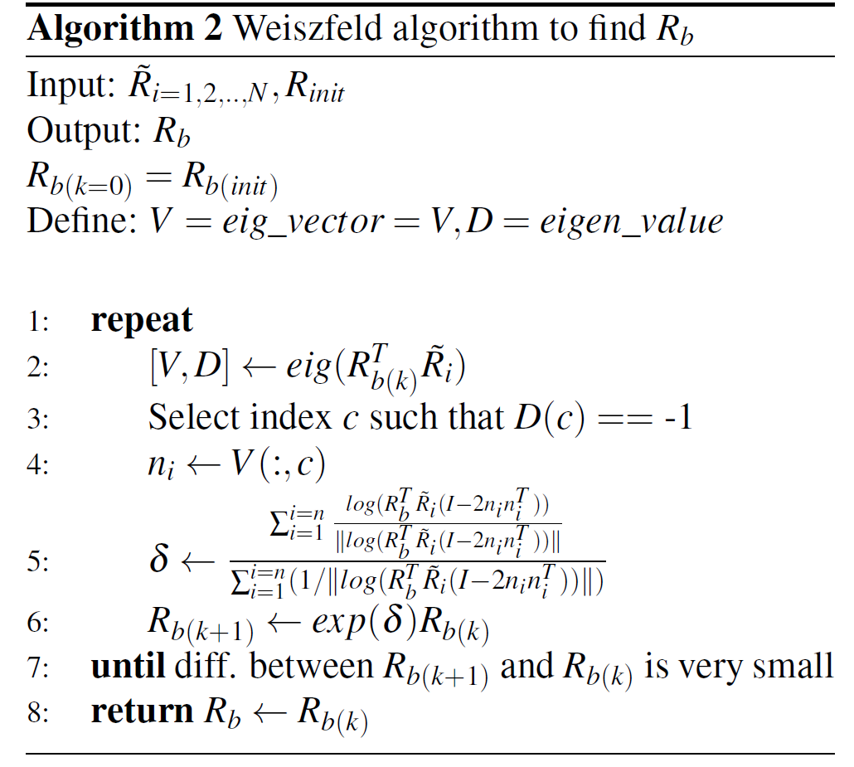

Slide 20
Algo2: Rotation averaging with mirror (paper1)
while(err>1*10^-4&& n_loop < max_loop)%repeat until err is small
clear ni rr cc
for i=1:n %n measurements of mirror positions.
%--inside Algo 1---------------------------
[eig_vec,eig_val]=eig(R'*Ri(:,:,i));
clear rr cc
[rr,cc]=find(eig_val < -0.5);
ni(:,i)=eig_vec(:,cc(1)); %
end %end_for
clear delta temp1 temp2 temp3 temp4
delta=zeros(3,3);
temp3=zeros(3,3);
temp4=0;
for i=1:n %n measurements of mirror positions.
temp1= …
logm(R'*Ri(:,:,i)*(eye(3)- 2*ni(:,i)*ni(:,i)'));
temp2= norm(temp1);
temp3= temp3 + (temp1/temp2);
temp4= temp4 + (1/temp2);
end %end_for
delta=temp3/temp4;
R_old=R;
R=R*expm(delta); %new guessed R
err=norm(R'*R_old - eye(3)) ;%error ≈eye(3)
n_loop=n_loop+1
end %nn_noise

Slide 21
Results

Slide 22
References
Long, Gucan, et al. "Simplified Mirror-Based Camera Pose Computation via Rotation Averaging." Proceedings of the IEEE Conference on Computer Vision and Pattern Recognition. 2015.
Hartley, Richard, Khurrum Aftab, and Jochen Trumpf. "L1 rotation averaging using the Weiszfeld algorithm." Computer Vision and Pattern Recognition (CVPR), 2011 IEEE Conference on. IEEE, 2011.
Hartley, Richard, et al. "Rotation averaging." International journal of computer vision 103.3 (2013): 267-305.
Aftab, Khurrum, Richard Hartley, and Jochen Trumpf. "Generalized Weiszfeld algorithms for Lq optimization." Pattern Analysis and Machine Intelligence, IEEE Transactions on 37.4 (2015): 728-745.
Huynh, Du Q. "Metrics for 3D rotations: Comparison and analysis." Journal of Mathematical Imaging and Vision 35.2 (2009): 155-164.

Slide 23
Appendices

Slide 24
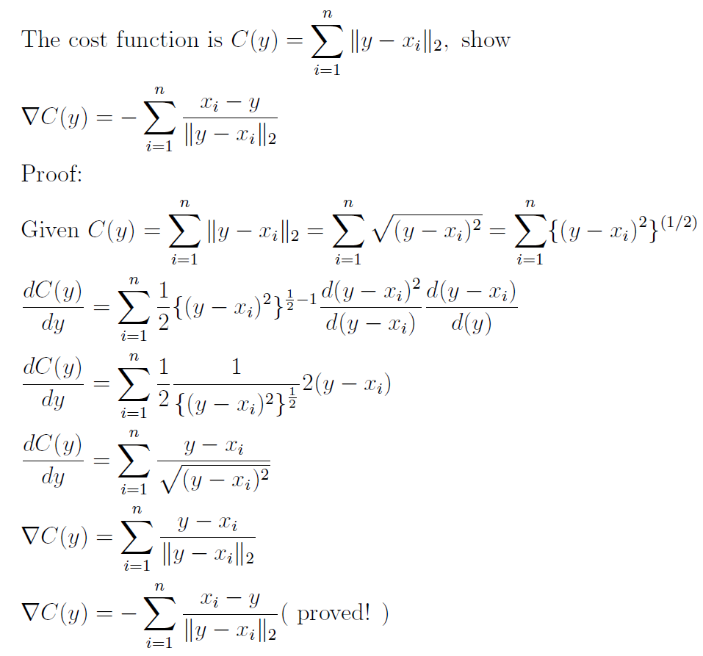
Appendix 1: The derivative ∇C(y) of the cost function C(y)
Notes:
%http://www.sciweavers.org/free-online-latex-equation-editor
\documentclass[12pt]{article}
\usepackage{amsmath, enumitem}
\begin{document}
\begin{align*}
&\text{The cost function is } C(y)=\sum_{i=1}^{n}\| y-x_i\|_2 , \text { show }\\
&\nabla C(y)= -\sum_{i=1}^{n} \frac{x_i-y}{\| y-x_i\|_2} \\
&\text{Proof:}\\
&\text{Given } C(y)=\sum_{i=1}^{n}\| y-x_i\|_2=\sum_{i=1}^{n} \sqrt{ (y-x_i)^2}=\sum_{i=1}^{n} \{ (y-x_i)^2\}^{(1/2)}\\
&\frac{dC(y)}{dy}=\sum_{i=1}^{n}\frac{1}{2} \{(y-x_i)^2\}^{\frac{1}{2}-1}\frac{d(y-x_i)^2}{d(y-x_i)}\frac{d(y-x_i)}{d(y)}\\
&\frac{dC(y)}{dy}=\sum_{i=1}^{n}\frac{1}{2} \frac{1}{ \{ (y-x_i)^2 \}^{\frac{1}{2}} }2(y-x_i) \\
&\frac{dC(y)}{dy}=\sum_{i=1}^{n}\frac{y-x_i}{\sqrt{(y-x_i)^2}} \\
&\nabla C(y)=\sum_{i=1}^{n}\frac{y-x_i}{\| y-x_i\|_2} \\
&\nabla C(y)=-\sum_{i=1}^{n}\frac{x_i-y}{\| y-x_i\|_2} \text {( proved! )} \\
\end{align*}
\end{document}
\end{align*}
\end{document}

Slide 25
Demo program
Demo program in the attached ppt note
need these functions( )
rpyAng( )
rpymat ( )
axis_angle2R ( )
unit_vector ( )
All in the notes
Open the notes: cut and paste to matlab and run
Notes:
%by kh wong 2016 jan 6 version: demo_cal_mirror3b
%implement the mirror based camera pose comp via rotation averaging
%http://www.cv-foundation.org/openaccess/content_cvpr_2015/papers/Long_Simplified_Mirror-Based_Camera_2015_CVPR_paper.pdf
%new ideas: translation is not inside this formulation, if we put that in,
%it may enhance the robustness of the approach.
%algorithm 1 in the paper
%Input : Ri(i=1,..n), R_init
%Result: Optimal R
function cal_mirror()
'starts'
%make up some ri, it shodul be found by sfm1 or the matlab camera
%calibration toolbox or cam cal tool of opencv etc.
%n= number of mirror positions
n=15 %n mirror positions
%%% gen R_true
%Assume your R_true (To be found) is the R by axis=axis_x,axis_y,axis_z
axis_x=1
axis_y=2
axis_z=3
axis_angle=10 *(pi/180) %10 degrees
[R_true,anxyz]=axis_angle2R(axis_angle,[axis_x,axis_y,axis_z])
%%% gen Ri
for i=1:n %n measurements of mirror positions.
%make up some relected normals, make -ve z axis, ?? may need to find
%out how to make reflection normals.
ni_true(:,i)=unit_vector([axis_x,axis_y,-1*axis_z]'+0.5 * rand(3,1)); %generate the true Ri (improper rotation) mirror rot
%ni_true(:,i)=([axis_x,axis_y,-1*axis_z]'+0.1 * rand(3,1)); %generate the true Ri (improper rotation) mirror rot
e=ni_true(:,i);
Ri(:,:,i)=R_true*(eye(3)-2*e*e')
end %for
size(ni_true)
size(Ri)
Ri %just to show what we get
% set some values close to the truth. ?? may need to find a better selection
%[R_init,anxyz]=axis_angle2R(axis_angle+0.05,[axis_x+0.01,axis_y+0.02,axis_z+0.03])%small
[R_init,anxyz]=axis_angle2R(axis_angle+0.5,[axis_x+0.01,axis_y+0.02,axis_z+0.03])%small
R=R_init
err=10000,n_loop=0
max_loop=100
%while(err<0.01 && n_loop <max_loop)%repeat until err is small
while(err>0.001 & n_loop < max_loop)%repeat until err is small
for i=1:n %n measurements of mirror positions.
[eig_vec,eig_val]=eig(R'*Ri(:,:,i))
Ri(:,:,i)
ni(:,i)=eig_vec(:,1) %??should find the eig_vector correspond to -1 eign value
%pause
end %end_for
clear delta temp1 temp2 temp3 temp4
delta=zeros(3,3)
temp3=zeros(3,3)
temp4=0
for i=1:n %n measurements of mirror positions.
temp1= logm(R'*Ri(:,:,i)*(eye(3)-2*ni(:,i)*ni(:,i)'))
temp2= norm(temp1)
temp3= temp3 + (temp1/temp2)
temp4= temp4 + (1/temp2)
end %end_for
delta=temp3/temp4
R_old=R
R=expm(delta)*R %new guessed R
err=norm(R*R_old' - eye(3)) %error should be close to eye(3)
%err=norm(logm(R*R_old'))
n_loop=n_loop+1
pause
end %while
'done--------------------------------'
'R found'
R
'R_true'
R_true
% Author: Rodrigo Carceroni
% Disclaimer: This code comes with no guarantee at all and its author
% is not liable for any damage that its utilization may cause.
%khw added 3.3002 , output angs is a 1x3 matrix,
% angs(1) is yaw angle about x-axis
% angs(2) is pitch angle about y-aixs
% angs(3) is roll angle about z-axis
%then X'=RX+T; X,T are 3X1 matrixes for [X,Y,Z]' 3D corrd. and translations.
%
function angs = rpyAng (R)
% Returns a set of Roll, Pitch and Yaw angles that describe a certain 3x3
% transformation matrix. The magnitude of the Pitch angle is constrained
% to be not bigger than pi/2.
sinB = -R(3,1);
cosB = sqrt (R(1,1) .* R(1,1) + R(2,1) .* R(2,1));
if abs (cosB) > 1e-15
sinA = R(2,1) ./ cosB;
cosA = R(1,1) ./ cosB;
sinC = R(3,2) ./ cosB;
cosC = R(3,3) ./ cosB;
angs = [atan2(sinC,cosC); atan2(sinB,cosB); atan2(sinA,cosA)];
else
sinC = (R(1,2) - R(2,3)) ./ 2;
cosC = (R(2,2) + R(1,3)) ./ 2;
angs = [atan2(sinC,cosC); pi./2; 0];
if sinB < 0
angs = -angs;
end;
end;
% Author: Rodrigo Carceroni
% Disclaimer: This code comes with no guarantee at all and its author
% is not liable for any damage that its utilization may cause.
%khw added 3.3002 , input angs is a 1x3 matrix,
% angs(1) is yaw angle about x-axis
% angs(2) is pitch angle about y-aixs
% angs(3) is roll angle about z-axis
%then X'=RX+T; X,T are 3X1 matrixes for [X,Y,Z]' 3D corrd. and translations.
function R = rpyMat (angs)
% Return the 3x3 rotation matrix described by a set of Roll, Pitch and Yaw
% angles.
cosA = cos (angs(3));
sinA = sin (angs(3));
cosB = cos (angs(2));
sinB = sin (angs(2));
cosC = cos (angs(1));
sinC = sin (angs(1));
cosAsinB = cosA .* sinB;
sinAsinB = sinA .* sinB;
R = [ cosA.*cosB cosAsinB.*sinC-sinA.*cosC cosAsinB.*cosC+sinA.*sinC ;
sinA.*cosB sinAsinB.*sinC+cosA.*cosC sinAsinB.*cosC-cosA.*sinC ;
-sinB cosB.*sinC cosB.*cosC ];
%return R and anxys, anxyz is in fact yaw,pitch,roll in radian
function [R,anxyz]=axis_angle2R(theta,vnormal)
% theta=acos(dot(vnormal,[0 1 0]));
%See p334 Truco
nn=sqrt(vnormal(1)*vnormal(1)+vnormal(2)*vnormal(2)+vnormal(3)*vnormal(3))
n1 = vnormal(1)/abs(nn); %form unit vector
n2 = vnormal(2)/abs(nn);
n3 = vnormal(3)/abs(nn);
R=eye(3)*cos(theta)+(1-cos(theta))*[n1^2 n1*n2 n1*n3; n2*n1 n2^2 n2*n3; n3*n1 n3*n2 n3^2]+...
sin(theta)*[0 -n3 n2; n3 0 -n1; -n2 n1 0];
anxyz=rpyAng(R)*180/pi;
return
%FFFFFFFFFFFFFFFFFFFFFFFFFFFFFFFFFFFFFFFFFFFFFFFFFFFFFFFFFFFFFFFFFFFFFFFFFFFFFFFFFFFF
%convert a vector inot its unit vector, norm2 =1 ,norm(out_unit_vector,2)is 1
function [out_unit_vector]=unit_vector(iv)
length=sqrt(dot(iv,iv));
out_unit_vector=iv./length;

Slide 26
Demo (require rpyMat.m)
%This demos shows the angle of logm(r1^T*r2), and the angle of logm(r2^T*r1) are same'
r1=rpymat([1.1 2.1 3.1])
r2=rpymat([3.2 2.2 1.3])
dr1=logm(r1'*r2)
vrrotmat2vec(dr1)
axis_angle1=vrrotmat2vec(dr1)
angle1=axis_angle1(4)
dr2=logm(r2*r1')
axis_angle2=vrrotmat2vec(dr2)
angle2=axis_angle2(4)
'show result, the axis may not the same'
axis_angle1
axis_angle2
disp('its shows the angle of logm(r1^T*r2), and the angle of logm(r2^T*r1) are same')
angle1
angle2
% Author: Rodrigo Carceroni
% Disclaimer: This code comes with no guarantee at all and its author
% is not liable for any damage that its utilization may cause.
%khw added 3.3002 , input angs is a 1x3 matrix,
% angs(1) is yaw angle about x-axis
% angs(2) is pitch angle about y-aixs
% angs(3) is roll angle about z-axis
%then X'=RX+T; X,T are 3X1 matrixes for [X,Y,Z]' 3D corrd. and translations.
function R = rpyMat (angs)
% Return the 3x3 rotation matrix described by a set of Roll, Pitch and Yaw
% angles.
cosA = cos (angs(3));
sinA = sin (angs(3));
cosB = cos (angs(2));
sinB = sin (angs(2));
cosC = cos (angs(1));
sinC = sin (angs(1));
cosAsinB = cosA .* sinB;
sinAsinB = sinA .* sinB;
R = [ cosA.*cosB cosAsinB.*sinC-sinA.*cosC cosAsinB.*cosC+sinA.*sinC ;
sinA.*cosB sinAsinB.*sinC+cosA.*cosC sinAsinB.*cosC-cosA.*sinC ;
-sinB cosB.*sinC cosB.*cosC ];

