Slide 1
Chapter 3: Image processing and computer vision Edge detection and image filtering
by K.H. Wong,
Computer Science and Engineering Dept. CUHK
khwong@cse.cuhk.edu.hk

Slide 2
Introduction:
You will learn
Edge detection by differentiation and threshold
The Convolution math tool
Edge mask : edge detection by convolution
Image Filtering: smoothing, high pass etc.
Laplacian method : 2nd order derivative method.
Laplacian of Gaussian :LOG smoothing and edge detection together
Canny Edge Detection: Most popular method

Slide 3
Topics
Edge detection
First order derivative G(I)
Second order derivative ∇²I
A gray level image I
has many sharp edges

Slide 4
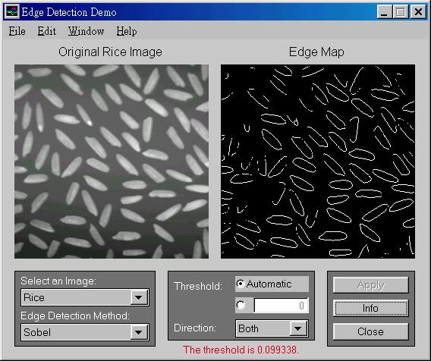
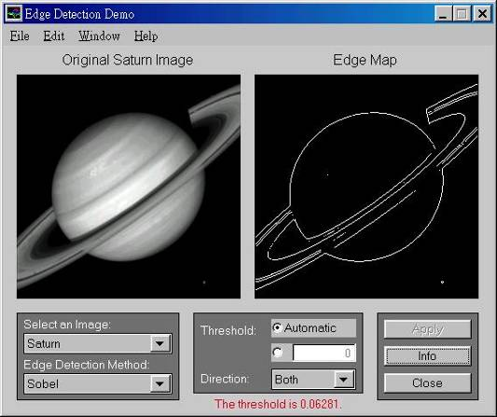
What are edges and why we need them?
Features have many applications: recognition, tracking etc.
The most common are
Point edges
Shape intensity change positions
Boundary edges
Shape intensity changing lines

Slide 5
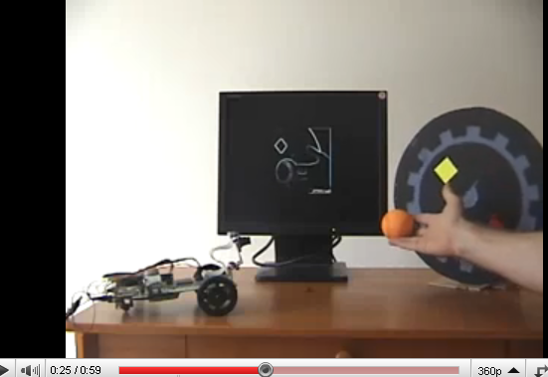
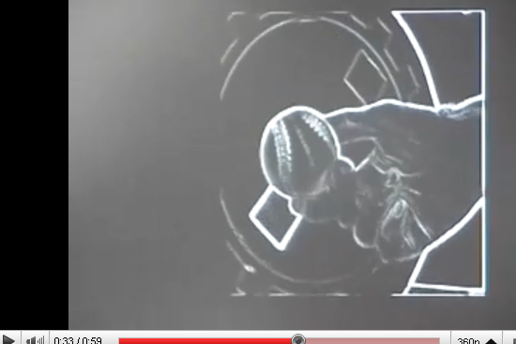
Sobel Demo
http://www.youtube.com/watch?v=z_a6e30aOXo

Slide 6
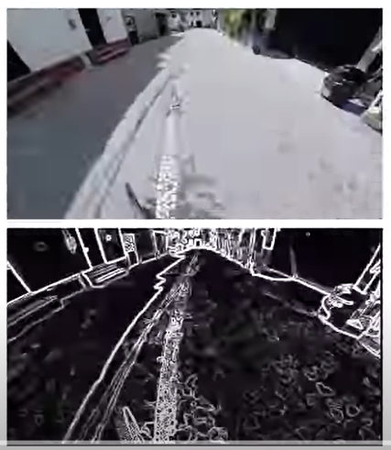
Edge detection
Demo
https://www.youtube.com/watch?v=UMsJNC3dCIA

Slide 7
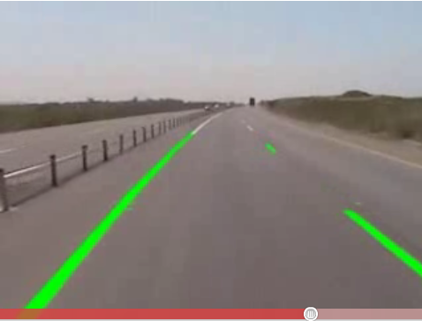
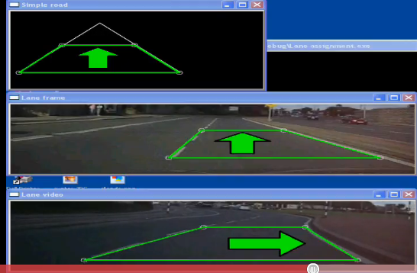
Application of edges
Lane detection
http://www.youtube.com/watch?v=Al4DnNkZUeA&feature=related
http://www.youtube.com/watch?v=9F3_6xL8hEY&feature=related

Slide 8
How to obtained edges?
I(x,y+1) I(x+1,y+1)
I(x,y) I(x+1,y)
Use gradient G of intensity [I(x,y)] change, two methods
First order gradient
I(x,y) is an edge if
Second order gradient (Laplacian operator)
I(x,y) is an edge if
I(x,y)
$$\left|G(I(x,y))\right|≈\sqrt{{\left(\frac{∂I(x,y)}{∂x}\right)}^{2}+{\left(\frac{∂I(x,y)}{∂y}\right)}^{2}}≥Threshold$$
y
x
$$∇^{2}I(x,y)=\frac{∂^{2}I(x,y)}{∂x^{2}}+\frac{∂^{2}I(x,y)}{∂y^{2}}=0$$
Notes:
\documentclass{article}
\usepackage{amsmath}
\begin{document}
edge, Slide 8\\
\begin{flalign}
\label{eq4}
\begin{aligned}
\sqrt{nm}\\
|G(x,y)|&= \sqrt{ \frac{\partial I(x,y)}{\partial x} + \frac{\partial I(x,y)}{\partial x} }
\geq \text{Threshold}\\
\nabla^2I(x,y)&= \frac{\partial I(x,y)}{\partial x} + \frac{\partial I(x,y)}{\partial x}=0
%%%%%%%%%%%%
%|G(I(x,y)|=\sqrt(\left( \frac{\partial I(x,y)}{\partial x} = \frac{\partia I(x,y)}{\partial y} \right) ))
%|G(I(x,y)|=\sqrt(\left( \frac{\partial I(x,y)}{\partial x} = \frac{\partia I(x,y)}{\partial y} \right) ))
%G(I(x,y)=\sqrt((Z\right) )
\end{aligned}
\end{flalign}
\end{document}

Slide 9
Edge detection using First order gradient G > threshold
Edges are at positions of rapid change of intensity levels
If (intensity gradient G(I(x,y))> threshold)
{
pixel(x,y) is an edge point;
}
$$\left|G(I(x,y))\right|≈\sqrt{{\left(\frac{∂I\left(x,y\right)}{∂x}\right)}^{2}+{\left(\frac{∂I\left(x,y\right)}{∂x}\right)}^{2}}> Threshold$$
I(x,y)
G[I(x,y)] > threshold, Pixel position (x,y) has an edge
First order derivative

Slide 10
Edge detection using second order gradient ∇²I=0
Edges are at ∇²I =0
If (intensity gradient ∇²I =0)
{
pixel(x,y) is an edge point;
}
$$∇^{2}I(x,y)=\frac{∂^{2}I(x,y)}{∂x^{2}}+\frac{∂^{2}I(x,y)}{∂x^{2}}=0$$
I(x,y)
I(x,y)
G[I(x,y)]> threshold is an edge
∇²I(x,y)= 0 is an edge
x
First order derivative
(gradient of I(x,y))
Second order derivative
(gradient of gradient of I(x,y))
x
x

Slide 11
Practical computational methods (discrete method for finding first order gradient)
First order gradient operators
Roberts operator
Prewiit operator
Sobel operator

Slide 12
Convolution method
Convolution is an important and popular technique in signal processing
Edges can be found by convoluting an image with a mask

Slide 13
Gradient calculation by convolution*
Differentiate an image I w.r.t x
G(I)=gradient of I= dI/dx
It is the same as
dI/dx ≈ (d/dx)*I
Gradient mask
Or filter mask
*=Convolution operator
$$\text{Graident} \text{mask} \text{Example}\text{ −}\text{horizontal} \text{direction}\text{:} \\ \text{h}\text{_}\text{A}=\left[\begin{matrix}0 & 0 & 0 \\ \text{1} & 0 & −1 \\ 0 & 0 & 0\end{matrix}\right]$$

Slide 14
Assume Gx,Gy are separable, the total gradient Gm becomes
Horizontal
direction
Horizontal gradient =G_{x}(i,j)= h_x * I(i,j)
vertical gradient= G_{y}(i,j)= h_y * I(i,j),
vertical
direction
$$\text{Horizontal}\text{_}\text{edge}\text{_}\text{filter}\text{_}\text{mask}\text{: }$$
$$\text{h}\text{_}\text{x}=\left[\begin{matrix}0 & 0 & 0 \\ \text{1} & 0 & −1 \\ 0 & 0 & 0\end{matrix}\right]$$
$$\text{Vertical}\text{_}\text{edge}\text{_}\text{filter}\text{_}\text{mask}\text{:}$$
$$\text{h}\text{_}y=\left[\begin{matrix}0 & 1 & 0 \\ 0 & 0 & 0 \\ 0 & \text{−1} & 0\end{matrix}\right]$$
$$\left|G_{m}(i,j)\right|=\sqrt{G_{x}(i,j)^{2}+G_{y}(i,j)^{2}}$$
$$=\sqrt{{\left\{h_x∗I(i,j)\right\}}^{2}+{\left\{h_y∗I(i,j)\right\}}^{2}}$$
$$edge_direction(θ_{e})=\tan^{−1}\left(\frac{G_{y}}{G_{x}}\right) \text{in} \text{degrees}$$
* is the
convolution operator
θ_{e}
An edge is found
and direction is tan⁻¹(Gy/Gx)=θ_{e}

Slide 15
What is convolution ? Discrete convolution C=I*h
By definition (http://en.wikipedia.org/wiki/Convolution)
$$C(m,n)=\sum_{j=−∞}^{j=∞}{\sum_{k=−∞}^{k=∞}{h(m−j,n−k)×I(j,k)}}$$
X=multiplication
*=convolution
Notes:
\begin{flalign}
\label{eq:convolution_01}
\begin{aligned}
C(m,n)=
\sum_{j=-\infty}^{j=\infty}
\sum_{k=-\infty}^{j=\infty}
h(m-j,n-k) \times I(j,k)
%%%%%%%%%%%%
\end{aligned}
\end{flalign}\\

Slide 16
Convolution is
Commutative : g(n)*h(n)=h(n)*g(n)
associative: {x(n)*g(n)}*h(n)=x(n)*{h(n)*g(n)}
Distributive
x(n)*{g(n)+h(n)}=x(n)*g(n)+x(n)*h(n)
Application: edge finding
In practice : only accept convoluted values obtained when edge mask and image are fully overlapped.

Slide 17
1-D convolution examples
http://en.wikipedia.org/wiki/Convolution
Example 1
Example 2

Slide 18
Another demo
http://www.fourier-series.com/fourierseries2/flash_programs/Convolution/index.html

Slide 19
We first learn discrete (cross) correlation
h=[1 3 4
2 7 1
0 5 2]
F=[4 1
2 7]
G =
convulve(h*F)
7 23 34 8
15 60 37 18
2 50 53 8
0 5 22 8
4 | 1
2 | 7
1 | 3 | 4
2 | 7 | 1
0 | 5 | 2
4 | 1
2 | 7
4 | 1
2 | 7
4 | 1
2 | 7
4*5+2*1=22
1*4+2*2+3*1+7*7=60
0*1=0
4*0+5*1=5
https://www.youtube.com/watch?app=desktop&v=C3EEy8adxvc

Slide 20
Discrete convolution: Correlation is more intuitive
so we use correlation of the flipped version of h to implement convolution[1]
$$I=\left[\begin{matrix}1 & 4 & 1 \\ 2 & 5 & 3\end{matrix}\right],h=\left[\begin{matrix}1 & 3 \\ 2 & −4\end{matrix}\right],\text{find} I∗h$$
convolution
$$C(m,n)=\sum_{j=−∞}^{j=∞}{\sum_{k=−∞}^{k=∞}{h(m−j,n−k)×I(j,k)}} \\ =\sum_{j=−∞}^{j=∞}{\sum_{k=−∞}^{k=∞}{h^{(flip)}(−m+j,−n+k)×I(j,k)}}$$
Flipped h
correlation
Notes:
\documentclass{article}
\usepackage{amsmath}
\begin{document}
edge, Slide 20\\
\begin{flalign}
\label{eqxx}
\begin{aligned}
C(m,n)=\sum_{j=-\infty}^{j=\infty}\sum_{k=-\infty}^{k=\infty}{h(m-j,n-k)\times I(j,k)}\\
=\sum_{j=-\infty}^{j=\infty}\sum_{k=-\infty}^{k=\infty}{h^{(flip)}(-m+j,-n+k)\times I(j,k)}
\end{aligned}
\end{flalign}
\end{document}

Slide 21
Matlab (octave) code for convolution
I=[1 4 1;
2 5 3]
h=[1 3 ;
2 -4]
conv2(I,h)
pause
disp('It is the same as the following');
conv2(h,I)
pause
disp('It is the same as the following');
xcorr2(I,fliplr(flipud(h)))
Flipped h=h(flip)=
-4 | 2
3 | 1

Slide 22
Steps to find C(m,n)
Step1:
C(0,0)
=2x2=4
Step 2:
C(1,0)
= -4*2+2*5=2
Step 3:
C(2,0)
= -4*5+2*3
=-14
Step 4:
C(3,0)
= -4*3
=-12
1 | 4 | 1
2 | 5 | 3
1 | 4 | 1
2 | 5 | 3
-4 | 2
3 | 1
-4 | 2
3 | 1
Flipped h
1 | 4 | 1
2 | 5 | 3
1 | 4 | 1
2 | 5 | 3
-4 | 2
3 | 1
-4 | 2
3 | 1
C(0,0) | C(1,0) | C(2,0) | C(3,0)
C(0,0) | C(1,0) | C(2,0) | C(3,0)
C(0,0)=4 | C(1,0)=2 | C(2,0)=-14 | C(3,0)=-12
C(m,n)=

Slide 23
Steps continue
1 | 4 | 1
2 | 5 | 3
Step 5:
C(0,1)
=1*2+2*1
=4
Step 6:
C(1,1)
= 1*-4+2*3+4*2+5*1
=15
Step 7:
C(2,1)
= -4*4+5*3+1*2+3*1
=4
Step 8:
C(3,1)
= -4*1+3*3
=5
1 | 4 | 1
2 | 5 | 3
-4 | 2
3 | 1
-4 | 2
3 | 1
1 | 4 | 1
2 | 5 | 3
-4 | 2
3 | 1
1 | 4 | 1
2 | 5 | 3
-4 | 2
3 | 1
C(0,2) | C(1,2) | C(2,2) | C(3,2)
C(0,1)=4 | C(1,1)=15 | C(2,1)=4 | C(3,1)=5
C(0,0)=4 | C(1,0)=2 | C(2,0)=-14 | C(3,0)=-1
C(m,n)=

Slide 24
Find all elements
-4 | 2
3 | 1
-4 | 2
3 | 1
-4 | 2
3 | 1
-4 | 2
3 | 1
1 | 4 | 1
2 | 5 | 3
1 | 4 | 1
2 | 5 | 3
1 | 4 | 1
2 | 5 | 3
1 | 4 | 1
2 | 5 | 3
n
$$=\left[\begin{matrix}1 & 7 & 13 & 3 \\ 4 & 15 & 4 & 5 \\ 4 & 2 & −14 & −12\end{matrix}\right]$$
C(m,n)
n
m
m

Slide 25
Cmsc5711, Worksheet 3.1
Which answer is correct?
x=[2 6 7;
4 6 9
1 3 2]
h=[1 -2
-3 4]
Z=x*h ; % * is the convolution operator
Find z. (Fully overlapping and half overlapping of x and h are considered, this is the formal definition of convolution)
What is the size of Z?
What is the value of h*x?
Multiple choice question
Answer 1: Z=
1 2 -5 -14
-2 -12 0 10
-11 -1 -7 32
-3 -5 6 8
Answer 2: Z=
2 2 -5 -14
-2 -12 0 10
-11 -1 -7 32
-3 -5 6 8
Hints:
h after 2D flip is
flipud(fliplr(h))=
4 -3
-2 1
Answer 3: Z=
3 5 -5 -14
-2 -12 0 10
-11 -1 -7 32
-3 -5 6 8

Slide 26
Answer 3.1
Hints:
h after 2D flip is
flipud(fliplr(h))=
4 -3
-2 1
Z=x*h
Find z. (Fully overlapping and half overlapping of x and h are considered, this is the formal definition of convolution):
ANSWER (2) is correct: Z=
2 2 -5 -14
-2 -12 0 10
-11 -1 -7 32
-3 -5 6 8
What is the size of Z? : answer: 4x4
What is the value of h*x (reversed order of h,x)?
Same as z
%Matlab
x=[2 6 7;
4 6 9
1 3 2]
h=[1 -2
-3 4]
flipud(fliplr(h))
conv2(x,h)
conv2(h,x)
Answer 2 is correct:
ans =
2 2 -5 -14
-2 -12 0 10
-11 -1 -7 32
-3 -5 6 8

Slide 27
Worksheet 3.2: Find edge image Gx, Gy using filter masks h_x Horizontal edge mask, h_y Vertical edge mask MC question
Answer (1)
Gx=conv2(J,h_x)
%horizonatal edge image
= 0 0 0 0 0 0
0 0 0 0 0 0
0 0 0 0 0 0
0 0 -1 -1 1 1
0 0 -1 -1 1 1
0 0 0 0 0 0
Gy=conv2(J,h_y)
%vertical edge image
ans =
0 0 0 0 0 0
0 0 0 0 0 0
0 0 0 1 1 0
0 0 0 1 1 0
0 0 0 -1 -1 0
0 0 0 -1 -1 0
Answer (2)
Gx=conv2(J,h_x)
%horizonatal edge image
= 0 0 0 0 0 0
0 0 0 0 0 0
0 0 0 0 0 0
0 0 1 -1 1 1
0 0 -1 -1 1 1
0 0 0 0 0 0
Gy=conv2(J,h_y)
%vertical edge image
ans =
0 0 0 0 0 0
0 0 0 0 0 0
0 0 0 -1 1 0
0 0 0 1 1 0
0 0 0 -1 -1 0
0 0 0 -1 -1 0
$$I=\left[\begin{matrix}0 & 0 & 0 & 0 \\ 0 & 0 & 0 & 0 \\ 0 & 0 & 1 & 1 \\ 0 & 0 & 1 & 1\end{matrix}\right]$$
h $_x =\left[\begin{matrix}0 & 0 & 0 \\ −1 & 0 & 1 \\ 0 & 0 & 0\end{matrix}\right]$
$$h_y=\left[\begin{matrix}0 & 1 & 0 \\ 0 & 0 & 0 \\ 0 & −1 & 0\end{matrix}\right]$$

Slide 28
Answer5711, 3.2
Answer (1) is correct
Gx=conv2(J,h_x)
%horizonatal edge image
= 0 0 0 0 0 0
0 0 0 0 0 0
0 0 0 0 0 0
0 0 -1 -1 1 1
0 0 -1 -1 1 1
0 0 0 0 0 0
Gy=conv2(J,h_y)
%vertical edge image
ans =
0 0 0 0 0 0
0 0 0 0 0 0
0 0 0 1 1 0
0 0 0 1 1 0
0 0 0 -1 -1 0
0 0 0 -1 -1 0
J=[0 0 0 0
0 0 0 0
0 0 1 1
0 0 1 1]
h_x=[0 0 0
-1 0 1
0 0 0]
h_y=[0 1 0
0 0 0
0 -1 0]
conv2(J,h_x)
conv2(J,h_y)

Slide 29
Edge direction
Θ(x,y) = tan⁻¹(Gy(x,y) / Gx(x,y))

Slide 30
Edge mask
Convolution is useful in many image processing applications
For each application what you need is to design a mask for that task
You can use different masks for various applications
E.g. Edge detection masks
Prewitt, Sobel etc.
Image smoothing
High pass: Edge highlighting

Slide 31
Other simple 3x3 gradient operators (In practice : only accept convoluted values obtained when edge mask and image are fully overlapped. The size of the image is usually much bigger than the masks)
Two popular operators
$$\operatorname{Pr}{e}witt−operator:$$
$$x_{window}=\left[\begin{matrix}1 & 0 & −1 \\ 1 & 0 & −1 \\ 1 & 0 & −1\end{matrix}\right],y_{window}=\left[\begin{matrix}1 & 1 & 1 \\ 0 & 0 & 0 \\ −1 & −1 & −1\end{matrix}\right]$$
$$Sobel−operator:$$
$$x_window=\left[\begin{matrix}1 & 0 & −1 \\ 2 & 0 & −2 \\ 1 & 0 & −1\end{matrix}\right],y_window=\left[\begin{matrix}1 & 2 & 1 \\ 0 & 0 & 0 \\ −1 & −2 & −1\end{matrix}\right]$$

Slide 32
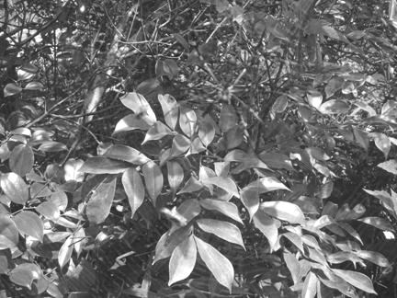
Convolution of a mask to a picture
In theory all overlapped and non-overlapped areas are considered.
But in practice: Non-fully-overlapped areas are usually ignored. Only fully overlapped mask and Image I is considered.
The effect of this is small
Size of the convolution result of a 3x3 mask and I_{1024x768} is (1024-2)x(768-2)
* I
Mask=3x3
I_{1024x768} =a 1024x768 image

Slide 33
Edge detection procedure
Input: Image I() , h_A, h_B
Output: edge_image edge()
For m=1,..,M
For n=1,…,N
Find Horizontal gradient =G_{x}(m,n)= h_A * I(m,n)
Find vertical gradient =G_{y}(m,n)= h_B * I(m,n)
Find overall_edge(m,n)=Gt(m,n)=sqrt{G_{x}(m,n)²+G_{y} (m,n)²}
If ( overall_edge(m,n)>threshold )
edge(m,n) is an edge
Else
edge(m,n) is not an edge.
End
End

Slide 34
Example to find edges, e.g. use Prewitt edge filter on image I
In practice outside or at m=1 and m=M-1 are not considered, because it is where image/mask are not fully overlapped. Same for n.
For m=2..,M-2
For n=2..,N-2
Gx(m,n)=h_A*I(m,n)
Gy(m,n)=h_B*I(m,n)
Gt(m,n)=sqrt{Gx(m,n)²+Gy(m,n)²}
If Gt(m,n)>Threshold
Edge(m,n)=1, else =0
End
End
done
$$h_A=\left[\begin{matrix}1 & 0 & −1 \\ 1 & 0 & −1 \\ 1 & 0 & −1\end{matrix}\right],h_B=\left[\begin{matrix}1 & 1 & 1 \\ 0 & 0 & 0 \\ −1 & −1 & 1\end{matrix}\right],$$
$$Gt( )=\left[\begin{matrix}Gt(0,N) & . & . & . & Gt(M,N) \\ . & . & . & . & . \\ . & . & Gt(m,n) & . & . \\ . & . & . & . & . \\ Gt(0,0) & Gt(1,0) & . & . & Gt(M,0)\end{matrix}\right] \\ \text{where} \text{total} \text{gradient} Gt(m,n)=\sqrt{Gx^{2}(m,n)+Gy^{2}(m,n)} \\ \text{Also} \text{if} Gt(m,n)>threshold \text{then} edge(m,n)=1 \text{else} edge(m,n)=0$$

Slide 35
Sobel masks
$$sobel_masks \\ h_{A}=\left[\begin{matrix}1 & 0 & −1 \\ 2 & 0 & −2 \\ 1 & 0 & −1\end{matrix}\right],$$
$$h_B=\left[\begin{matrix}1 & 2 & 1 \\ 0 & 0 & 0 \\ −1 & −2 & −1\end{matrix}\right],$$
Sobel mask approximation
of a horizontal edge
Sobel mask approximation
of a vertical edge

Slide 36
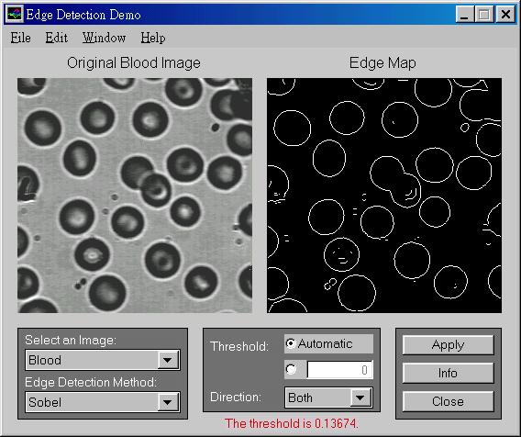
Using Sobel edge masks
Example

Slide 37
Another example

Slide 38
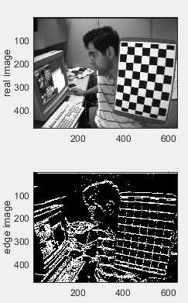
Find edge of real images (tested on octave too)
%ws3_3b.m find edge image of a real image, (2022.1.19)
%put test.jpg in c:\images\ ,tested ok on octave
clear
ii=imread('c:\\images\\test.jpg');
prew_x=[1 1 1; 0 0 0; -1 -1 -1]
ex=conv2(ii, prew_x);
prew_y=[1 1 1; 0 0 0; -1 -1 -1]
ey=conv2(ii, prew_y);
%If edge image is required:
etemp=sqrt(ex.*ex+ey.*ey);
e=etemp;
threshold=mean(mean(etemp))% set threshold
e(e<=threshold)=0; %< threshold, set to 0
e(e>threshold)=255;%> threshold, set to 255
figure(1),clf
subplot(2,2,1)
colormap(gray(256))
image(ii)
ylabel('real image')
subplot(2,2,3)
colormap(gray(256))
image(e)
ylabel('edge image')

Slide 39
%Worksheet 3.3: Intensity gradient of an image
ii=[ 0 0 50 10
0 0 128 255
0 0 128 255
0 0 128 255]
prewitt_x =[1 1 1
0 0 0
-1 -1 -1]
prewitt_y =[1 0 -1
1 0 -1
1 0 -1]
ex=conv2(ii, prewitt_x )
ey=conv2(ii, prewitt_y )
ex =
0 0 50 60 60 10
0 0 128 383 383 255
0 0 78 323 323 245
0 0 0 0 0 0
0 0 -128 -383 -383 -255
0 0 -128 -383 -383 -255
ey =
0 0 50 10 -50 -10
0 0 178 265 -178 -265
0 0 306 520 -306 -520
0 0 384 765 -384 -765
0 0 256 510 -256 -510
0 0 128 255 -128 -255
G(x,y)
GI(x,y) =
0 0 70.7107 60.8276 78.1025 14.1421
0 0 219.2442 465.7403 422.3423 367.7635
0 0 315.7847 612.1511 444.9326 574.8261
0 0 384.0000 765.0000 384.0000 765.0000
0 0 286.2167 637.8001 460.6788 570.1973
0 0 181.0193 460.1239 403.8230 360.6245 Find a formula to relate G(x,y) and ex and ey using the results as shown above
Answer:__________________________?
Question 3.3a)MC question
G(x,y)=sqrt(|ex|+|ey|)
G(x,y)=sqrt(ex^2+ey^2)
G(x,y)=sqrt(ex^0.5+ey^0.5)
Question 3.3a)MC question
Write the edge image (255= edge, 0=no edge) if the threshold is 500.
Answer (1) e=
0 0 0 0 0 0
0 0 0 0 0 0
0 0 0 255 0 255
0 0 0 255 0 255
0 0 0 255 0 255
0 0 0 0 0 0
Answer (2) e=
0 0 0 0 0 0
0 0 0 0 0 0
0 0 0 255 255 255
0 0 0 255 255 255
0 0 0 255 255 255
0 0 0 0 0 0

Slide 40
%Answer: Worksheet 3.3: Intensity gradient of an image
ii=[ 0 0 50 10
0 0 128 255
0 0 128 255
0 0 128 255]
prewitt_x =[1 1 1
0 0 0
-1 -1 -1]
prewitt_y =[1 1 -1
1 0 -1
1 0 -1]
ex=conv2(ii, prewitt_x )
ey=conv2(ii, prewitt_y )
ex =
0 0 50 60 60 10
0 0 128 383 383 255
0 0 78 323 323 245
0 0 0 0 0 0
0 0 -128 -383 -383 -255
0 0 -128 -383 -383 -255
ey =
0 0 50 10 -50 -10
0 0 178 265 -178 -265
0 0 306 520 -306 -520
0 0 384 765 -384 -765
0 0 256 510 -256 -510
0 0 128 255 -128 -255
G(x,y)
GI(x,y) =
0 0 70.7107 84.8528 84.8528 14.1421
0 0 181.0193 541.6438 541.6438 360.6245
0 0 110.3087 456.7910 456.7910 346.4823
0 0 0 0 0 0
0 0 181.0193 541.6438 541.6438 360.6245
0 0 181.0193 541.6438 541.6438 360.6245
Find a formula to relate G(x,y) and ex and ey using the results as shown above
Q3.3a ,anwer2 is correct:_G(x,y)=sqrt(ex^2+ey^2)
Write the edge image (255 =edge, 0= no edge) if the threshold is 500.
Answer:? __
Answer:? __
etemp=sqrt(ex.*ex+ey.*ey);
e=etemp;
threshold=500
e
%threshold=mean(mean(etemp))% set threshold
e(e<=threshold)=0; %< threshold, set to 0
e(e>threshold)=255;%> threshold, set to 255
e=
Q3.3a ,
Answer1 is correct, e=
0 0 0 0 0 0
0 0 0 0 0 0
0 0 0 255 0 255
0 0 0 255 0 255
0 0 0 255 0 255
0 0 0 0 0 0

Slide 41
Image filtering You may design a mask for Low pass filtering (smoothing filter)
Low pass

Slide 42
Other image processing operators
Low pass (or called smoothing filter, blurring filter pixel or averaging filter)
$$h_{low_pass}=\frac{1}{9}\left[\begin{matrix}1 & 1 & 1 \\ 1 & 1 & 1 \\ 1 & 1 & 1\end{matrix}\right],or \\ h_{low_pass}=\frac{1}{10}\left[\begin{matrix}1 & 1 & 1 \\ 1 & 2 & 1 \\ 1 & 1 & 1\end{matrix}\right],etc$$
This term is to normalize the pixel value after the operation
Notes:
\documentclass{article}
\usepackage{amsmath}
\begin{document}
edge, Slide 42\\
\begin{flalign}
\label{eq4}
\begin{aligned}
h_{low_{pass}}=\frac{1}{9}\left[\begin{matrix}1&1&1\\1&1&1\\1&1&1\\\end{matrix}\right],\\
or\ h_{low_pass}=\frac{1}{10}\left[\begin{matrix}1&1&1\\1&2&1\\1&1&1\\\end{matrix}\right],etc
\end{aligned}
\end{flalign}
\end{document}

Slide 43
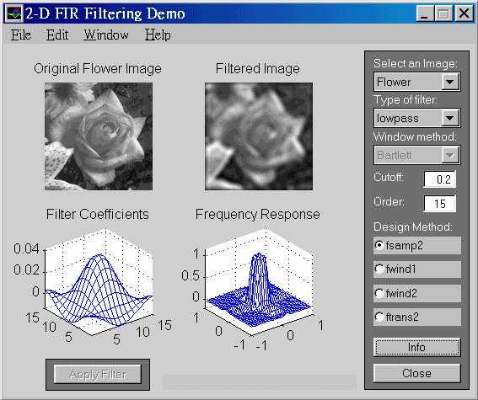
Low pass filtering result

Slide 44
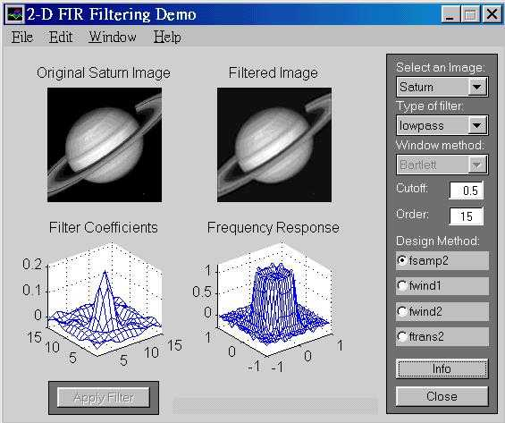
Low pass filtering result

Slide 45
Smooth an image kernal size is 11x11
%smooth an image ws3_5.m,
%put test.jpg in c:\images\
clear
ii=imread('c:\\images\\test.jpg');
%smooth_kernal=[1 1 1 ; 1 2 1; 1 1 1];
%smooth_kernal=[0.1 0.1 0.1 ; 0.1 0.1 0.1; 0.1 0.1 0.1 ]
smooth_kernal=ones(11,11)
%optional:trust middle element more
%smooth_kernal(5,5)=11*11;
%this is to normalize the pixels
smooth_kernal=smooth_kernal/sum(sum(smooth_kernal))
smooth_ii=conv2(ii, smooth_kernal);
figure(1),clf
colormap(gray(256))
subplot(2,2,1)%----------------------
image(ii)
ylabel('real image')
subplot(2,2,3)%--------------------
image(smooth_ii)
ylabel('smoothed image')

Slide 46
Worksheet 3.4:Can you comment on what is the function of this convolution?
$$I=\left[\begin{matrix}0 & 0 & 100 & 100 \\ 0 & 0 & 120 & 120 \\ 0 & 0 & 200 & 200 \\ 0 & 0 & 255 & 255\end{matrix}\right],h_{lp}=\left(\frac{1}{10}\right)\left[\begin{matrix}1 & 1 & 1 \\ 1 & 2 & 1 \\ 1 & 1 & 1\end{matrix}\right]$$
I*h_{lp}=
0 0 10.0000 20.0000 20.0000 10.0000
0 0 22.0000 54.0000 54.0000 22.0000
0 0 42.0000 96.0000 96.0000 42.0000
0 0 57.5000 135.0000 135.0000 57.5000
0 0 45.5000 116.5000 116.5000 45.5000
0 0 25.5000 51.0000 51.0000 25.5000
MC question:
Find the edge
Smooth the image
Extract features
Notes:
\documentclass{article}
\usepackage{amsmath}
\begin{document}
edge, Slide 46\\
\begin{flalign}
\label{eq4}
\begin{aligned}
I=\left[\begin{matrix}0&0&100&100\\0&0&120&120\\0&0&200&200\\0&0&255&255\\\end{matrix}\right],h_{lp}=\left(\frac{1}{10}\right)\left[\begin{matrix}1&1&1\\1&2&1\\1&1&1\\\end{matrix}\right]
\end{aligned}
\end{flalign}
\end{document}

Slide 47
Answer 3.4:Can you comment on what is the function of this convolution?
%Matlab
I=[ 0 0 100 100
0 0 120 120
0 0 200 200
0 0 255 255]
h_low_pass=0.1*[1 1 1
1 2 1
1 1 1]
conv2(I,h_low_pass)
$$I=\left[\begin{matrix}0 & 0 & 100 & 100 \\ 0 & 0 & 120 & 120 \\ 0 & 0 & 200 & 200 \\ 0 & 0 & 255 & 255\end{matrix}\right],h_{lp}=\left(\frac{1}{10}\right)\left[\begin{matrix}1 & 1 & 1 \\ 1 & 2 & 1 \\ 1 & 1 & 1\end{matrix}\right]$$
I*h_{lp}=
0 0 10.0000 20.0000 20.0000 10.0000
0 0 22.0000 54.0000 54.0000 22.0000
0 0 42.0000 96.0000 96.0000 42.0000
0 0 57.5000 135.0000 135.0000 57.5000
0 0 45.5000 116.5000 116.5000 45.5000
0 0 25.5000 51.0000 51.0000 25.5000
ANSWER2 s correct : It is low pass filtering; the function is to smooth (or blur) the image.

Slide 48
Worksheet 3.5: Example for intensity gradient calculation
%Given
ii=[ 0 0 50 10
0 0 128 255
0 0 128 255
0 0 128 255]
prewitt_x =[1 1 1
0 0 0
-1 -1 -1]
prewitt_y =[1 0 -1
1 0 -1
1 0 -1]
ex=conv2(ii, prew_x)
ey=conv2(ii, prew_y)
Q3.5a: Write a formula to find the direction of the edge image at pixel (x,y).
////// Question 3.5a , MC question /////
Answer1:Θ(x,y) = tan⁻¹(ex(x,y) / ey(x,y))
Answer2 :Θ(x,y) = tan⁻¹(ey(x,y) / ex(x,y))
Q3.5b: Find the edge direction at (x1,y1)
/////// Question 3.5b , MC question ////
Answer1 :Θ(x,y) = atan(265/383)
Answer2 :Θ(x,y) = acos(265/383)
At (x1,y1)
Underlined
cell
ex=ii*prewitt_x=
0 0 50 60 60 10
0 0 128 383 383 255
0 0 78 323 323 245
0 0 0 0 0 0
0 0 -128 -383 -383 -255
0 0 -128 -383 -383 -255
ey=ii*prewitt_y =
0 0 50 10 -50 -10
0 0 178 265 -178 -265
0 0 306 520 -306 -520
0 0 384 765 -384 -765
0 0 256 510 -256 -510
0 0 128 255 -128 -255

Slide 49
Answer :Worksheet 3.5: Example for intensity gradient calculation
%Given
ii=[ 0 0 50 10
0 0 128 255
0 0 128 255
0 0 128 255]
prewitt_x =[1 1 1
0 0 0
-1 -1 -1]
prewitt_y =[1 0 -1
1 0 -1
1 0 -1]
ex=conv2(ii, prewitt_x)
ey=conv2(ii, prewitt_y )
Q3.5a: Write a formula to find the direction of the edge image at pixel (x,y).
////// Question 3.5a , MC question /////
Answer2 :Θ(x,y) = tan⁻¹(ey(x,y) / ex(x,y))
Is correct
Q3.5b: Find the edge direction at (x1,y1)
/////// Question 3.5b , MC //////////////
Answer1 :Θ(x,y) = atan(265/383)= 0.605 rad
Is correct
At (x1,y1)
Underlined
cell
ex=ii*prewitt_x=
0 0 50 60 60 10
0 0 128 383 383 255
0 0 78 323 323 245
0 0 0 0 0 0
0 0 -128 -383 -383 -255
0 0 -128 -383 -383 -255
ey=ii*prewitt_y =
0 0 50 10 -50 -10
0 0 178 265 -178 -265
0 0 306 520 -306 -520
0 0 384 765 -384 -765
0 0 256 510 -256 -510
0 0 128 255 -128 -255

Slide 50
A small summary
If you convolve an image I with an edge mask, you get an edge image.
If you convolve an image I with a smoothing mask, you get a smoothed image.

Slide 51
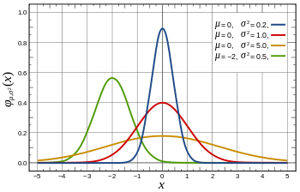
A more formal smoothing filter is the Gaussian filter
Smoothing_image(I)= Gaussian (I)
= Gaussain_mask*I
How to get the Gaussian mask?
See following slides
Probability density function
Standard Normal distribution:
Red line, when mean(μ)=0, Sigma (σ)=1)
http://en.wikipedia.org/wiki/Normal_distribution

Slide 52
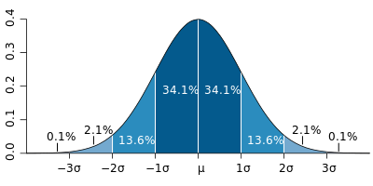
Properties of Gaussian (Normal) distribution
$$1−\text{D} \text{Gaussian} \\ σ=\text{standard} \\ \text{deviation}\text{,} \\ σ^{2}=\text{variance}\text{,} \\ μ=\text{mean} \\ G(x)=\frac{1}{\sqrt{2πσ^{2}}}e^{\frac{−{\left(x−μ\right)}^{2}}{2σ^{2}}} \\ \int_{−∞}^{∞}{G(x)dx=1}$$
Standard Normal distribution (1-dimension):
Red line, when mean(μ)=0, Sigma (σ)=1
At (x-μ)=0, σ =1
G(x) =1/sqrt(2*pi)=0.3989
At x=1*σ, drops off to
(1/sqrt(2*pi))*exp(-1^1/2)=0.2420
Area covered 68.2%
At x=2*σ, drops off to
(1/sqrt(2*pi))*exp(-2^2/2)= 0.0540
Area covered 95.44%
At x=3*σ, drops off to
(1/sqrt(2*pi))*exp(-2^2/2)= ?? (exercise)
Area covered 99.73%
Probability density function
G
sets the horizontal shift
Controls the shape
G
Standard Normal distribution
Area covered
(total=
100%)
http://en.wikipedia.org/wiki/Normal_distribution
So called 95% confident value µ(+/-)2σ

Slide 53
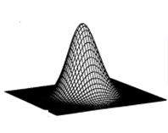
Gaussian (Normal) functions 1D,2D
$$1−\text{D} \text{Gaussian} \\ σ=\text{standard} \text{deviation}\text{,} \\ μ=\text{mean} \\ G(x)=\frac{1}{\sqrt{2πσ^{2}}}e^{\frac{−{\left(x−μ\right)}^{2}}{2σ^{2}}}$$
G(x)
1-D Gaussian
$$peak1D=1/\sqrt{2πσ^{2}}$$
x
μ
$$2−\text{D} \text{Gaussian} \\ G(\text{x}\text{,}\text{y})=G(x)G(y) \\ =\frac{1}{2πσ^{2}}e^{−\frac{{\left(x−μ_{x}\right)}^{2}+{\left(y−μ_{y}\right)}^{2}}{2σ^{2}}}$$
$$Peak2D=1/2πσ^{2}$$
2-D Gaussian
y
x
μ_{y}
μ_{x}
Notes:
%%%%%%%%%%%% slide 54 %%%%%%%%%%%%%%%%%%%%
%%% eeeeee eq:filtering_01A eeeeeeeeeeeeeeeeeeeeeeeeeeeeeeeeee
%%%
1st order (A) Gaussian
\begin{flalign}
\label{eq:filtering_01a}
\begin{aligned}
G(x) = \frac{1}
{\sqrt{2\pi{\sigma^2 }}}
e^{-
\frac{(x-\mu)^2}
{2\sigma^2}
}
\end{aligned}
\end{flalign}
%%% eeeeee eq:filtering_01B eeeeeeeeeeeeeeeeeeeeeeeeeeeeeeeeee
1st order (B) Gaussian\\
\begin{flalign}
\label{eq:filtering_01b}
\begin{aligned}
G(x) = \frac{1}
{\sqrt{2\pi{\sigma^2 }}}
exp\left({-
\frac{(x-\mu)^2}
{2\sigma^2}
}\right)
\end{aligned}
\end{flalign}
%%%%%%%%%%%%%%%%%%%%%%%%%%%%%%%%%
%%% eeeeee eq:filtering_02A eeeeeeeeeeeeeeeeeeeeeeeeeeeeeeeeee
%%%%%%%%%%%%%%%%%%%%%%%%%%%%%%%%%
2nd order (A) Gaussian\\
\begin{flalign}
\label{eq:filtering_02A}
\begin{aligned}
G(x,y) =G(x)G(y)= \frac{1}
{{2\pi{\sigma^2 }}}
e^{-
\frac{(x-\mu_x)^2+(y-\mu_y)^2}
{2\sigma^2}
}
\end{aligned}
\end{flalign}
%%%
2nd order (B) Gaussian
%%% eeeeee eq:filtering_02B eeeeeeeeeeeeeeeeeeeeeeeeeeeeeeeeee
\begin{flalign}
\label{eq:filtering_02B}
\begin{aligned}
G(x,y) =G(x)G(y)= \frac{1}
{{2\pi{\sigma^2 }}}
exp\left({-
\frac{(x-\mu_x)^2+(y-\mu_y)^2}
{2\sigma^2}
}\right)
\end{aligned}
\end{flalign}

Slide 54
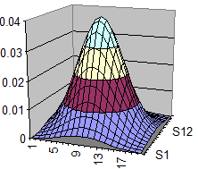
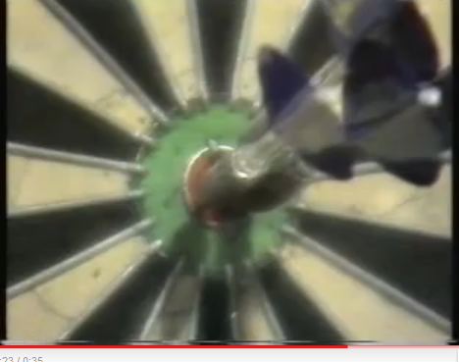
Intuition of Gaussian (Normal) distribution?
(mean_x,mean_y)
Standard
Deviation (SD) (σ)
Week3
Like you play dart many times (e,g, 1000)
Aim at (mean_x,mean_y)
If you are good player , standard deviation (σ) is small. If you are bad, deviation (σ) is large.
The distribution is the counts of your dart landed at (x,y)
The distribution is Gaussian --It is governed by mean and Standard Deviation (SD)
x
y
Mean_x
mean_y
http://www.youtube.com/watch?v=2-EPvfFK1zw

Slide 55
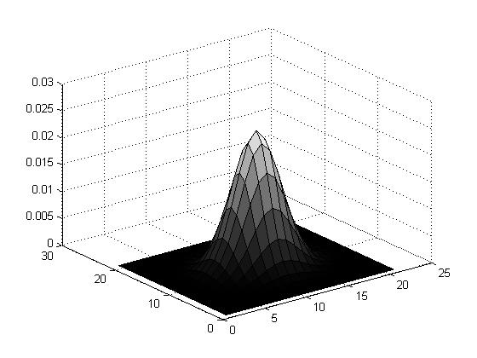
To generate a discrete (2N+1)x(2N+1) Gaussian mask
Knowing that at +/-3 σ it drops off to 0.1%
Set Sigma=SD=σ =N/4 will give a useful Gaussian Mask (it drops off to 0 at borders)
Example: N=10, mask size= (2N+1)x(2N+1) =21x21
σ=10/4=2.5; Peak2D is at 1/(2*pi*2.5^2)=0.0255
Sum_all_elements=1
$$Peak2D is at$$
$$1/2πσ^{2}$$
function demo_gauss_mask1 %matlab code
clear, N=10
[X,Y]=meshgrid(-N:N,-N:N);sigma =N/4;
G=1/(2*pi*sigma^2)*exp(-(X.^2+Y.^2)/(2*sigma^2));
G=G./sum(G(:)) %normalise it
'sigma is ', sigma
'sum(G(:)) is ',sum(G(:))
'max(max(G(:))) is',max(max(G(:)))
figure(1), clf
surfc(G)

Slide 56
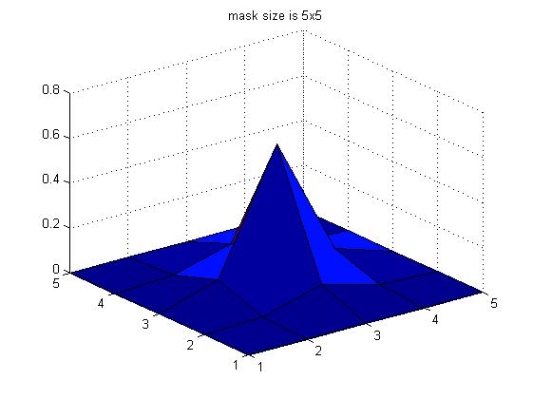
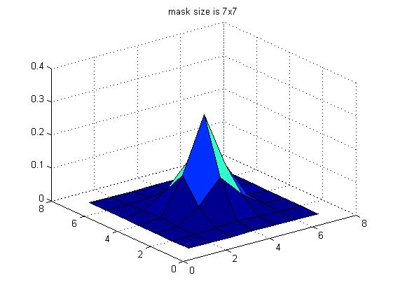
Example: Gaussian Masks calculated by Matlab
function demo_gauss_mask1b %matlab code
clear, N=2
[X,Y]=meshgrid(-N:N,-N:N);sigma =N/4;
G=1/(2*pi*sigma^2)*exp(-(X.^2+Y.^2)/(2*sigma^2));
G=G./sum(G(:)) %normalise it
'sigma is ', sigma
'sum(G(:)) is ',sum(G(:))
'max(max(G(:))) is',max(max(G(:)))
figure(2), clf
surfc(G)
title ('mask size is 5x5')
%%%%%%%%%%%%%%%%%%%%%%%%%%%%%%%%%%%%%%%%%%%%%%%%%%%%%%%%
clear, N=3
[X,Y]=meshgrid(-N:N,-N:N);sigma =N/4;
G=1/(2*pi*sigma^2)*exp(-(X.^2+Y.^2)/(2*sigma^2));
G=G./sum(G(:)) %normalise it
'sigma is ', sigma
'sum(G(:)) is ',sum(G(:))
'max(max(G(:))) is',max(max(G(:)))
figure(3), clf
surfc(G)
title ('mask size is 7x7')
[X,Y]=meshgrid(-2:2,-2:2);sigma =0.5;
5x5 Gussian Mask
[X,Y]=meshgrid(-3:3,-3:3);sigma =0.75;
7x7 Gussian Mask

Slide 57
Worksheet 3.6
Calculate the value of G(x,y) when μ_{x}= μ_{y}=0 and
X=-3*σ,y=0,G(x,y)=_____?
MC question3.6
Answer 1: G(x,y)=0.0071
Answer 2: G(x,y)=0.0862
Answer 3: G(x,y)=0.3861
X=-2*σ,y=0,G(x,y)=_____?
X=-1*σ,y=0,G(x,y)=_____?
X=0*σ,y=0,G(x,y)=_____?
X=1*σ,y=0,G(x,y)=____?
X=2*σ,y=0,G(x,y)=____?
X=3*σ,y=0,G(x,y)=____?
Sketch G(x,y=0), assume y=0
For the 5x5 2-D, Gaussian mask ,
σ =0.5
$$2−\text{D} \text{Gaussian} \\ G(\text{x}\text{,}\text{y})=G(x)G(y) \\ =\frac{1}{2πσ^{2}}e^{−\frac{{\left(x−μ_{x}\right)}^{2}+{\left(y−μ_{y}\right)}^{2}}{2σ^{2}}}$$
G(x,y=0)
x
-3σ -2σ -1σ 0 1σ 2σ 3σ
Notes:
%%%%%%%%%%%% slide 54 %%%%%%%%%%%%%%%%%%%%
%%% eeeeee eq:filtering_01A eeeeeeeeeeeeeeeeeeeeeeeeeeeeeeeeee
%%%
1st order (A) Gaussian
\begin{flalign}
\label{eq:filtering_01a}
\begin{aligned}
G(x) = \frac{1}
{\sqrt{2\pi{\sigma^2 }}}
e^{-
\frac{(x-\mu)^2}
{2\sigma^2}
}
\end{aligned}
\end{flalign}
%%% eeeeee eq:filtering_01B eeeeeeeeeeeeeeeeeeeeeeeeeeeeeeeeee
1st order (B) Gaussian\\
\begin{flalign}
\label{eq:filtering_01b}
\begin{aligned}
G(x) = \frac{1}
{\sqrt{2\pi{\sigma^2 }}}
exp\left({-
\frac{(x-\mu)^2}
{2\sigma^2}
}\right)
\end{aligned}
\end{flalign}
%%%%%%%%%%%%%%%%%%%%%%%%%%%%%%%%%
%%% eeeeee eq:filtering_02A eeeeeeeeeeeeeeeeeeeeeeeeeeeeeeeeee
%%%%%%%%%%%%%%%%%%%%%%%%%%%%%%%%%
2nd order (A) Gaussian\\
\begin{flalign}
\label{eq:filtering_02A}
\begin{aligned}
G(x,y) =G(x)G(y)= \frac{1}
{{2\pi{\sigma^2 }}}
e^{-
\frac{(x-\mu_x)^2+(y-\mu_y)^2}
{2\sigma^2}
}
\end{aligned}
\end{flalign}
%%%
2nd order (B) Gaussian
%%% eeeeee eq:filtering_02B eeeeeeeeeeeeeeeeeeeeeeeeeeeeeeeeee
\begin{flalign}
\label{eq:filtering_02B}
\begin{aligned}
G(x,y) =G(x)G(y)= \frac{1}
{{2\pi{\sigma^2 }}}
exp\left({-
\frac{(x-\mu_x)^2+(y-\mu_y)^2}
{2\sigma^2}
}\right)
\end{aligned}
\end{flalign}

Slide 58
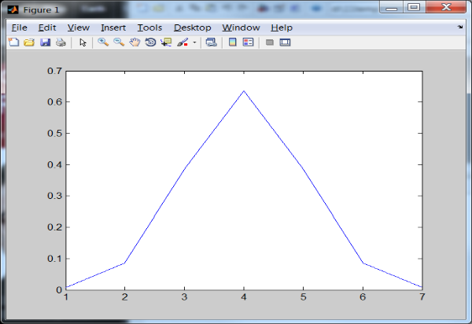
Answer: 3.6
%Calculate the value of G(x,y) when μx= μy=0,
%matlab, assume y is always at 0 (becomes 2D)
Clear, sigma=0.5 , mean_x=0 , mean_y=0
for (i=1:7)
x=(i-4)*sigma
%will make x=-3,-2,-1,0, 1 ,2 ,2, 3
g(i)=(1/(2*pi*sigma^2))*...
exp(-(x- mean_x)^2/(2*sigma^2))
end
image (1),clf, plot(g)
Asnwer g(x=-3σ), g(x=-2σ), g(x=-1 σ), g(x=0), g(x=1 σ), g(x=2σ), g(x=3σ), =
g = 0.0071 0.0862 0.3861 0.6366 0.3861 0.0862 0.0071 (left / right mirror image)
For the 5x5
2-D Gaussian mask ,
σ =0.5
$$2−\text{D} \text{Gaussian} \\ G(\text{x}\text{,}\text{y})=G(x)G(y) \\ =\frac{1}{2πσ^{2}}e^{−\frac{{\left(x−μ_{x}\right)}^{2}+{\left(y−μ_{y}\right)}^{2}}{2σ^{2}}}$$
G(x,y) in 2D
MC 3.6
Answer 1: G(x,y)=0.0071
Is correct
-3σ -2σ -1σ 0 1σ 2σ 3σ
58

Slide 59
Worksheet 3.7
x=m_{x}
y=m_{y}
x=1+m_{x}
y=m_{y}
Fill in the blanks of this Gaussian mask of size 9x9 , sigma (σ)=2
MC question 3.7
G(m_{x} ,m_{y})= 0.0351
G(m_{x} ,m_{y})= 0.0398
G(m_{x} ,m_{y})= 0.0213
Sketch the function
G(x,y)=
0.0007 0.0017 0.0033 0.0048 0.0054 0.0048 0.0033 0.0017 0.0007
0.0017 0.0042 0.0078 0.0114 0.0129 0.0114 0.0078 0.0042 0.0017
0.0033 0.0078 0.0146 0.0213 0.0241 0.0213 0.0146 0.0078 0.0033
0.0048 0.0114 0.0213 0.0310 0.0351 0.0310 0.0213 0.0114 0.0048
0.0054 0.0129 0.0241 0.0351 ____? ____? 0.0241 0.0129 0.0054
0.0048 0.0114 0.0213 0.0310 0.0351 ____? 0.0213 0.0114 0.0048
0.0033 0.0078 0.0146 0.0213 0.0241 0.0213 0.0146 0.0078 0.0033
0.0017 0.0042 0.0078 0.0114 0.0129 0.0114 0.0078 0.0042 0.0017
0.0007 0.0017 0.0033 0.0048 0.0054 0.0048 0.0033 0.0017 0.0007
$$2−\text{D} \text{Gaussian} \\ G(\text{x}\text{,}\text{y})=G(x)G(y) \\ =\frac{1}{2πσ^{2}}e^{−\frac{{\left(x−m_{x}\right)}^{2}+{\left(y−m_{y}\right)}^{2}}{2σ^{2}}}$$

Slide 60
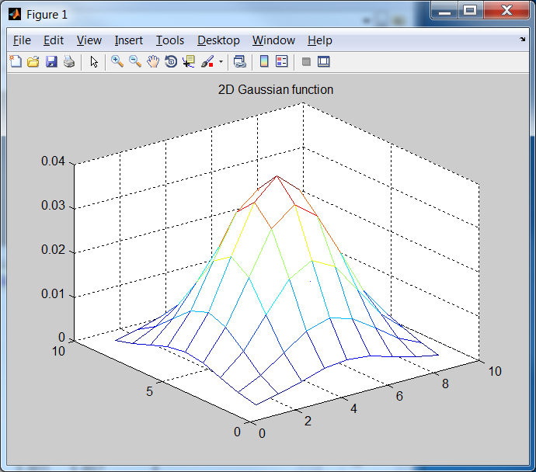
Answer: Worksheet 3.7 M.C. 3.7: answer 2: G(m_{x} ,m_{y})= 0.0398 is correct
1/(2*pi*2^2)*exp(-1/8)
x=m_{x}
y=m_{y}
x=1+m_{x}
y=m_{y}
1/(2*pi*2^2)
1/(2*pi*2^2)*exp(-2/8)
Fill in the blanks Gaussian mask of size the 9x9 , sigma (σ)=2
0.0007 0.0017 0.0033 0.0048 0.0054 0.0048 0.0033 0.0017 0.0007
0.0017 0.0042 0.0078 0.0114 0.0129 0.0114 0.0078 0.0042 0.0017
0.0033 0.0078 0.0146 0.0213 0.0241 0.0213 0.0146 0.0078 0.0033
0.0048 0.0114 0.0213 0.0310 0.0351 0.0310 0.0213 0.0114 0.0048
0.0054 0.0129 0.0241 0.0351 0.0398 0.0351 0.0241 0.0129 0.0054
0.0048 0.0114 0.0213 0.0310 0.0351 0.0310 0.0213 0.0114 0.0048
0.0033 0.0078 0.0146 0.0213 0.0241 0.0213 0.0146 0.0078 0.0033
0.0017 0.0042 0.0078 0.0114 0.0129 0.0114 0.0078 0.0042 0.0017
0.0007 0.0017 0.0033 0.0048 0.0054 0.0048 0.0033 0.0017 0.0007
clear %matlab
sigma=2 % in matlab , no -ve index for looping, so shift center to (5,5)
mean_x=5 , mean_y=5
for y=1:9
for x=1:9
g(x,y)=(1/(2*pi*sigma^2))*exp(-((x-mean_x)^2+(y-mean_y)^2) /(2*sigma^2))
end
end
mesh(g)
title('2D Gaussian function')
$$2−\text{D} \text{Gaussian} \\ G(\text{x}\text{,}\text{y})=G(x)G(y) \\ =\frac{1}{2πσ^{2}}e^{−\frac{{\left(x−m_{x}\right)}^{2}+{\left(y−m_{y}\right)}^{2}}{2σ^{2}}}$$

Slide 61
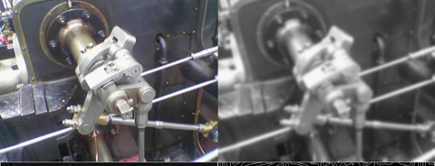
Result of smoothing an image by a Gaussian filter
Gaussain_filter * I = Guassian_filter (I)
Image I
Guassian_filter (I)

Slide 62
Laplacian filter
Second order derivative method

Slide 63
Second order edge detection method
I(x,y+1) I(x+1,y+1)
I(x,y) I(x+1,y)
We use gradient G of intensity [I(x,y)] change
First order gradient
I(x,y) is an edge if
Second order gradient (Laplacian operator), I(x,y) is an edge if
I(x,y)
$$\left|G(I(x,y))\right|≈\sqrt{{\left(\frac{∂I\left(x,y\right)}{∂x}\right)}^{2}+{\left(\frac{∂I\left(x,y\right)}{∂y}\right)}^{2}}>Threshold$$
y
x
$$∇^{2}I(x,y)=\frac{∂^{2}I(x,y)}{∂x^{2}}+\frac{∂^{2}I(x,y)}{∂y^{2}}=0$$
Notes:
Slide 62 \\
Laplacian method\\
edge, Slide 62\
\begin{flalign}
\label{eq:laplacian_62}
\begin{aligned}
|G(x,y)|&= \sqrt{ \frac{\partial I(x,y)}{\partial x} + \frac{\partial I(x,y)}{\partial x} }
\geq \text{Threshold}\\
\nabla^2I(x,y)&= \frac{\partial I(x,y)}{\partial x} + \frac{\partial I(x,y)}{\partial x}=0\\
\nabla^2I(x,y)&=0
\end{aligned}
\end{flalign}

Slide 64
Edge detection using second order gradient ∇²I=0
Edges are at ∇²I =0
If (intensity gradient ∇²I =0)
{
pixel(x,y) is an edge point;
}
$$∇^{2}I(x,y)=\frac{∂^{2}I(x,y)}{∂x^{2}}+\frac{∂^{2}I(x,y)}{∂x^{2}}=0$$
I(x,y)
I(x,y)
G[I(x,y)]> threshold is an edge
∇²I(x,y)= 0 is an edge
x
First order derivative
(gradient of I(x,y))
Second order derivative
(gradient of gradient of I(x,y))
x
x

Slide 65
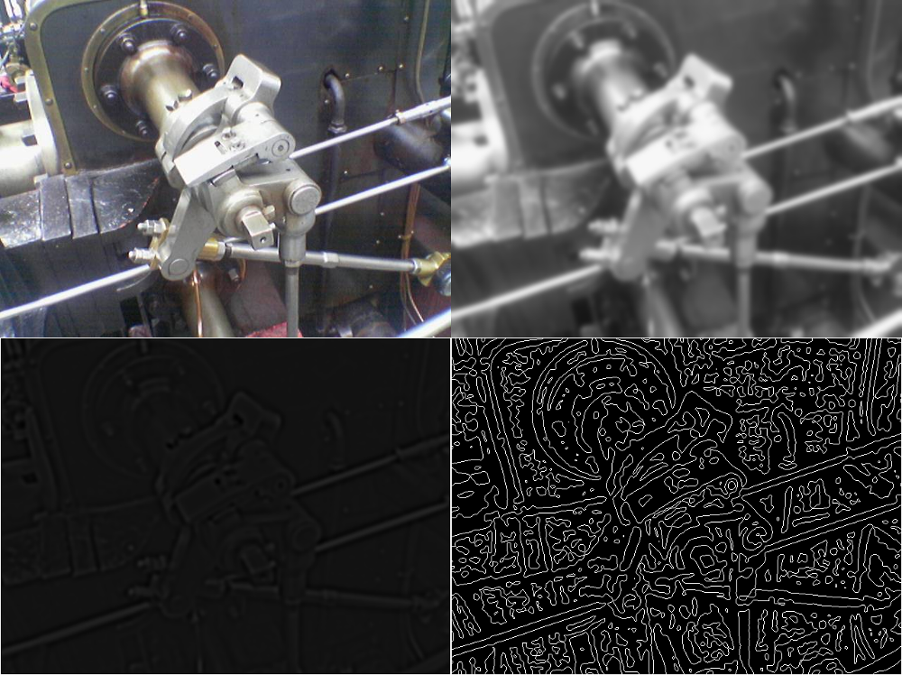
Result of applying second order filter (Laplacian filter)
Top left: Orginal image. Top right: After Gaussian blur filter. Bottom Left: Apply Laplacian filter on the blurred image. Bottom right: Edge after zero crossing

Slide 66
∇²I calculation by convolution*
Second order derivative of an image I w.r.t x and y
Similar to using a 2nd-order-derivative filter to I
Or convolves a 2nd-order-derivative filter mask with I
That means: ∇²I =∇²*I
When ∇²I(x,y) =0, it is an edge
$$\text{Second} \text{order} \text{edge} \\ (\text{Lapalcian}) \text{masks}$$
$$\frac{∂^{2}}{∂x^{2}}=\left[\begin{matrix}0 & 0 & 0 \\ 1 & −2 & 1 \\ 0 & 0 & 0\end{matrix}\right]$$
$$\frac{∂^{2}}{∂y^{2}}=\left[\begin{matrix}0 & 1 & 0 \\ 0 & −2 & 0 \\ 0 & 1 & 0\end{matrix}\right]$$
$$∇^{2}I(x,y)=∇^{2}∗I(x,y)=\frac{∂^{2}I}{∂x^{2}}+\frac{∂^{2}I}{∂y^{2}}=\left(\frac{∂^{2}}{∂x^{2}}\right)∗I+\left(\frac{∂^{2}}{∂y^{2}}\right)∗I$$ =$\left[\begin{matrix}0 & 0 & 0 \\ 1 & −2 & 1 \\ 0 & 0 & 0\end{matrix}\right]∗I+\left[\begin{matrix}0 & 1 & 0 \\ 0 & −2 & 0 \\ 0 & 1 & 0\end{matrix}\right]∗I$
$$=\left[\begin{matrix}0 & 1 & 0 \\ 1 & −4 & 1 \\ 0 & 1 & 0\end{matrix}\right]∗I=0$$
2nd-order-derivative filter : http://homepages.inf.ed.ac.uk/rbf/HIPR2/log.htm
Notes:
%%%%% eq 65 eeeeeeeeeeeeeeeeeeeeeeeeeeeeeeeeeeeeeee
edge, Slide 65\\
\begin{flalign}
\label{eq:laplacian_65}
\begin{aligned}
\nabla^2I(x,y)&=\nabla^2*I(x,y)=\frac{\partial I(x,y)}{\partial x} + \frac{\partial I(x,y)}{\partial y}=\left( \frac{\partial^2}{\partial x^2} \right)*I(x,y) +\left( \frac{\partial^2}{\partial y^2} \right)*I(x,y)\\
&=\begin{bmatrix}
0 &0 &0\\
1 &-2 &1\\
0 &0 &0\end{bmatrix}*I+
\begin{bmatrix}
0 &1 &0\\
0 &-2 &0\\
0 &1 &0\end{bmatrix}*I\\
&=\begin{bmatrix}
0 &1 &0\\
1 &-4 &1\\
0 &1 &0\end{bmatrix}\\
\end{aligned}
\end{flalign}

Slide 67
Noise removal using Gaussian
∇²I(x,y) =0 is sensitive to noise (is a problem), so we use ∇²G(I(x,y)) =0 , smooth first then find edge
In convolution you can
∇²G(I(x,y)) = (∇²G)*I(x,y) =0
Convolve a Laplacian operator (∇²G) with I
Idea: Second order differentiation of Gaussian distribution. Combine ∇² and G together
Application: smoothing and edge finding at one go

Slide 68
LoG (Laplacian of Gaussian) Put smoothing and edge detection together for better performance. Second order differentiation of Gaussian Application: smoothing and edge finding at one go
G(x)
$$1/\sqrt{2πσ^{2}}$$
Gaussian G
First order differentiation of G (Divergence of G) ∇G
Second order differentiation of G (Laplacian of G LOG) ∇²G
G(x)
x
m
∇G(x)
x
∇²G(x)
x

Slide 69
How to get the LOG (Laplacian of Gaussian) mask?
$$1−\text{D} \text{Gaussian} \\ σ=\text{standard} \text{deviation}\text{,} \\ m=\text{mean} \\ G(x)=\frac{1}{\sqrt{2πσ^{2}}}e^{\frac{{\left(x−m\right)}^{2}}{2σ^{2}}}$$
G(x)
1-D Gaussian
$$peak1D=1/\sqrt{2πσ^{2}}$$
x
μ
$$2−\text{D} \text{Gaussian} \\ G(\text{x}\text{,}\text{y})=G(x)G(y) \\ =\frac{1}{2πσ^{2}}e^{−\frac{{\left(x−m_{x}\right)}^{2}+{\left(y−m_{y}\right)}^{2}}{2σ^{2}}}$$
$$Peak2D=1/2πσ^{2}$$
2-D Gaussian
y
x
μ_{y}
μ_{x}
Notes:
%%%%%%%%%%%% slide 54/68 %%%%%%%%%%%%%%%%%%%%
%%% eeeeee eq:filtering_01A eeeeeeeeeeeeeeeeeeeeeeeeeeeeeeeeee
%%%
1st order (A) Gaussian
\begin{flalign}
\label{eq:filtering_01a}
\begin{aligned}
G(x) = \frac{1}
{\sqrt{2\pi{\sigma^2 }}}
e^{-
\frac{(x-\mu)^2}
{2\sigma^2}
}
\end{aligned}
\end{flalign}
%%% eeeeee eq:filtering_01B eeeeeeeeeeeeeeeeeeeeeeeeeeeeeeeeee
1st order (B) Gaussian\\
\begin{flalign}
\label{eq:filtering_01b}
\begin{aligned}
G(x) = \frac{1}
{\sqrt{2\pi{\sigma^2 }}}
exp\left({-
\frac{(x-\mu)^2}
{2\sigma^2}
}\right)
\end{aligned}
\end{flalign}
%%%%%%%%%%%%%%%%%%%%%%%%%%%%%%%%%
%%% eeeeee eq:filtering_02A eeeeeeeeeeeeeeeeeeeeeeeeeeeeeeeeee
%%%%%%%%%%%%%%%%%%%%%%%%%%%%%%%%%
2nd order (A) Gaussian\\
\begin{flalign}
\label{eq:filtering_02A}
\begin{aligned}
G(x,y) =G(x)G(y)= \frac{1}
{{2\pi{\sigma^2 }}}
e^{-
\frac{(x-\mu_x)^2+(y-\mu_y)^2}
{2\sigma^2}
}
\end{aligned}
\end{flalign}
%%%
2nd order (B) Gaussian
%%% eeeeee eq:filtering_02B eeeeeeeeeeeeeeeeeeeeeeeeeeeeeeeeee
\begin{flalign}
\label{eq:filtering_02B}
\begin{aligned}
G(x,y) =G(x)G(y)= \frac{1}
{{2\pi{\sigma^2 }}}
exp\left({-
\frac{(x-\mu_x)^2+(y-\mu_y)^2}
{2\sigma^2}
}\right)
\end{aligned}
\end{flalign}

Slide 70
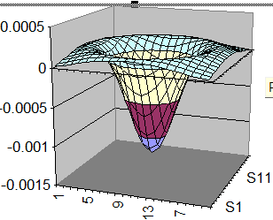
2nd derivative of G (x,y)=∇²G(x,y) =Laplacian of Gaussian (LoG)
$$∇^{2}$$
$\text{}\text{2}\text{G}\text{(}\text{x}\text{,}\text{y}\text{)}$=
$$\text{LoG}(\text{x}\text{,}\text{y})=$$
$$−\frac{1}{πσ^{4}}\left[1−\frac{x^{2}+y^{2}}{2σ^{2}}\right]e^{−\frac{x^{2}+y^{2}}{2σ^{2}}}$$
$$σ=\text{standard} \text{deviation}$$
$$2−\text{D} \text{Gaussian} \\ G(\text{x}\text{,}\text{y})=G(x)G(y) \\ =\frac{1}{2πσ^{2}}e^{−\frac{{\left(x−m_{x}\right)}^{2}+{\left(y−m_{y}\right)}^{2}}{2σ^{2}}}$$
Notes:
%%%%%%%%%%%% slide 69 %%%%%%%%%%%%%%%%%%%%%
%%% eeeeee eq:filtering_02A eeeeeeeeeeeeeeeeeeeeeeeeeeeeeeeeee
%%%%%%%%%%%%%%%%%%%%%%%%%%%%%%%%%
2nd order (A) Gaussian\\
\begin{flalign}
\label{eq:filtering_02A}
\begin{aligned}
G(x,y) =G(x)G(y)= \frac{1}
{{2\pi{\sigma^2 }}}
e^{-
\frac{(x-\mu_x)^2+(y-\mu_y)^2}
{2\sigma^2}
}
\end{aligned}
\end{flalign}
%%%
2nd order (B) Gaussian
%%% eeeeee eq:filtering_02B eeeeeeeeeeeeeeeeeeeeeeeeeeeeeeeeee
\begin{flalign}
\label{eq:filtering_02B}
\begin{aligned}
G(x,y) =G(x)G(y)= \frac{1}
{{2\pi{\sigma^2 }}}
exp\left({-
\frac{(x-\mu_x)^2+(y-\mu_y)^2}
{2\sigma^2}
}\right)
\end{aligned}
\end{flalign}
%%%%% eq 69 eeeeeeeeeeeeeeeeeeeeeeeeeeeeeeeeeeeeeee
%%% eeeeee eq:filtering_69A LOG eeeeeeeeeeeeeeeeeeeeeeeeeeeeeeeeee
\begin{flalign}
\label{eq:filtering_69A_LoG}
\begin{aligned}
LoG(x,y) = \frac{1}
{\pi \sigma^4}
\left[1-\frac{x^2+y^2}{2 \sigma^2} \right]
e^{\left({-
\frac{(x)^2+(y)^2}
{2\sigma^2}
}\right)}
\end{aligned}
\end{flalign}
%%% eeeeee eq:filtering_69B LOG eeeeeeeeeeeeeeeeeeeeeeeeeeeeeeeeee
\begin{flalign}
\label{eq:filtering_69B_LoG}
\begin{aligned}
LoG(x,y) = \frac{1}
{\pi \sigma^4}
\left[1-\frac{x^2+y^2}{2 \sigma^2} \right]
exp\left({-
\frac{(x)^2+(y)^2}
{2\sigma^2}
}\right)
\end{aligned}
\end{flalign}

Slide 71
Laplacian of Gaussian (LoG) method -- LoG = 2nd order differentiation mask
2-D Mask
$$∇^{2}Gaussian(I(x,y))=\frac{∂^{2}Gaussian(I)}{∂x^{2}}+\frac{∂^{2}Gaussian(I)}{∂y^{2}} \\ \left(\frac{∂^{2}Gaussian}{∂x^{2}}+\frac{∂^{2}Gaussian}{∂y^{2}}\right)∗I=LoG_mask∗I(x,y)$$
$$\text{LoG}(\text{x}\text{,}\text{y})= \\ −\frac{1}{πσ^{4}}\left[1−\frac{x^{2}+y^{2}}{2σ^{2}}\right]e^{−\frac{x^{2}+y^{2}}{2σ^{2}}} \\ where σ=\text{standard} \text{deviation}$$
Laplacian of Gaussian (LoG) mask
Looks like a Mexican Hat

Slide 72
Laplacian of Gaussian (LOG) by excel (cut and paste to excel to view plot)

Slide 73
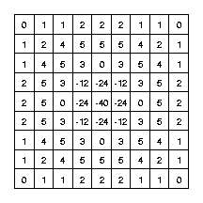
Method to reduce noise: Laplacian of Gaussian (LOG) method
Second derivative is sensitive to noise , so smooth it with a Gaussian smoothing filter first
It is like first blurring the image to remove noise then extract edges
$$\text{LoG}(\text{x}\text{,}\text{y})= \\ −\frac{1}{πσ^{4}}\left[1−\frac{x^{2}+y^{2}}{2σ^{2}}\right]e^{−\frac{x^{2}+y^{2}}{2σ^{2}}} \\ σ=\text{standard} \text{deviation}$$
$$∇^{2}Gaussian(I(x,y))=\frac{∂^{2}Gaussian(I)}{∂x^{2}}+\frac{∂^{2}Gaussian(I)}{∂y^{2}} \\ \left(\frac{∂^{2}Gaussian}{∂x^{2}}+\frac{∂^{2}Gaussian}{∂y^{2}}\right)∗I=LOG_mask∗I(x,y)$$
LOG mask
http://homepages.inf.ed.ac.uk/rbf/CVonline/LOCAL_COPIES/OWENS/LECT6/node2.html

Slide 74
Canny Edge Detector
A practical non-linear filtering method
Very popular

Slide 75
Motivation
Using 1st derivative and 2nd derivative alone are not good enough to locate edges
1st derivate method gives “thick” edges.
2nd derivate method gives too much noise--“rings”.
First order method with thresholding is good but too simple. It cannot handle a wide range of images.
A threshold works for one image usually won’t work for another image.

Slide 76
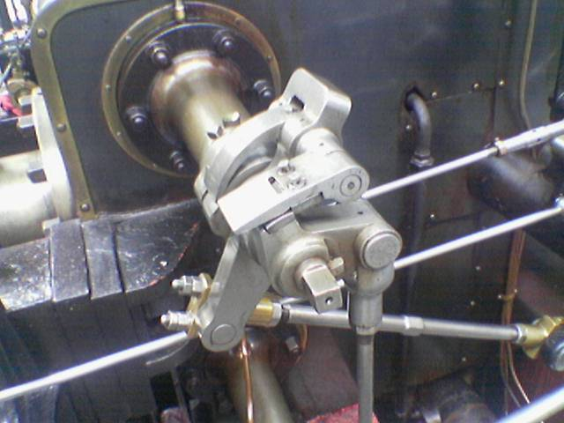
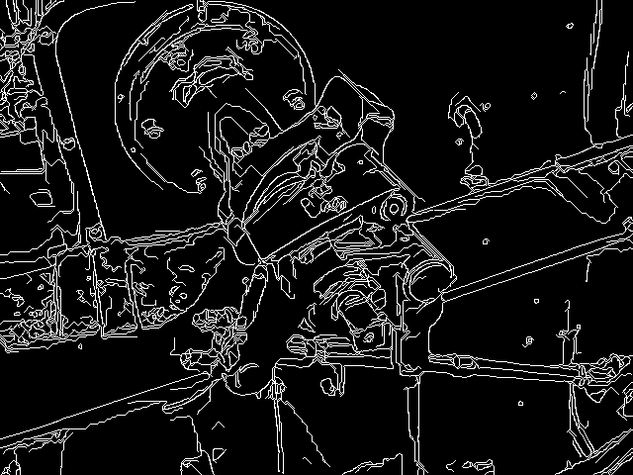
Goal
Mark as many real edges as possible.
The detected edges should be as close as the real edges.
All edges are of one pixel width.
Ref: http://en.wikipedia.org/wiki/Canny_edge_detector
Source image
Good result obtained by the canny-edge-detector

Slide 77
Canny Edge Detector
It is first proposed by John F. Canny in 1986.
Use multiple stages to detect a wide range of edges.
It uses the 1st derivative of an image.
It takes a gray-level image as input.
Still one of the most used edge detectors in the world.

Slide 78
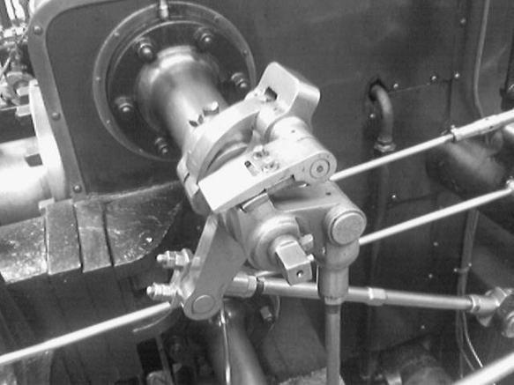
1st stage: Noise Reduction
Since it uses the 1st derivative of an image, it would be better to smooth the image first.
Usually, we convolve the image with a Gaussian filter to smooth the image.
$$\frac{1}{159}\left[\begin{matrix}2 & 4 & 5 & 4 & 2 \\ 4 & 9 & 12 & 9 & 4 \\ 5 & 12 & 15 & 12 & 5 \\ 4 & 9 & 12 & 9 & 4 \\ 2 & 4 & 5 & 4 & 2\end{matrix}\right]$$
*
=
Gaussian filter
Original Image
Smoothed Image
Notes:
\documentclass{article}
\usepackage{amsmath}
\begin{document}
edge, Slide 78\\
\begin{flalign}
\label{eq4}
\begin{aligned}
\frac{1}{159}\left[\begin{matrix}2&4&5&4&2\\4&9&12&9&4\\5&12&15&12&5\\4&9&12&9&4\\2&4&5&4&2\\\end{matrix}\right]
\end{aligned}
\end{flalign}
\end{document}

Slide 79
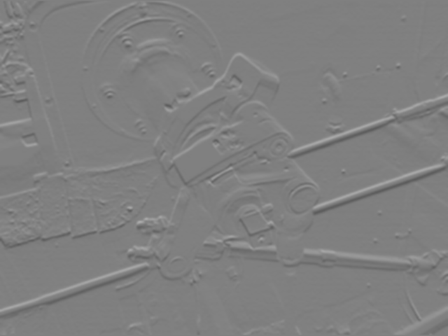
2nd stage: Find intensity gradient
Use some gradient operators (e.g. Prewitt, Sobel) to find Gx and Gy using the first order method, which requires a threshold set by the user.
Gx
Gy
*The image are scaled to show negative value for display purposes. You should notice that Gx responses to the vertical edges while Gy for horizontal edges.

Slide 80
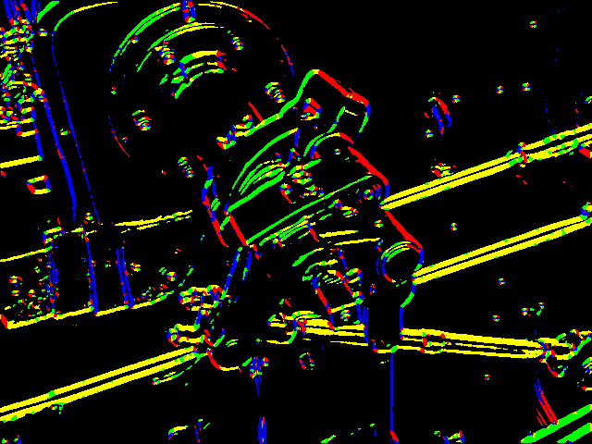
2nd stage: Find intensity gradient
Find the magnitude G and direction Θ of the gradient by:
That is: G = |Gx| + |Gy| Θ = tan⁻¹(Gy / Gx)
G
90
Θ (4 different colors)
135
45
0
0
Θ is rounded to 4 directions!!
0°, 45°, 90° and 135°!!!
45
135
90

Slide 81
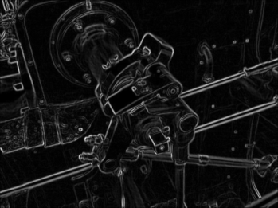
3rd stage: Non-maximum suppression
The gradient magnitude G gives us the edges of the image. But they are thick.
Let’s thin the lines in G.

Slide 82
3rd stage: Non-maximum suppression
Real edges are located at the maximum of the lines in G.
For each point (x,y), we compare the G(x,y) with its two neighbors along the Gradient Vector direction.
E.g. 25, 50, 17 in this example
The gradient vector direction is perpendicular to the edge direction.
Along gradient vector
direction
Gradient Vector
direction
G(x,y)
25
-----
50
-----
17
Edge
direction

Slide 83
3rd stage: Non-maximum suppression
If G(x,y) is greater than its two neighbors along the gradient direction, then (x,y) is set to remain. Non-maximum points are removed (suppressed ) in this process.
E.g we know G(x,y)’s direction (gradient vector direction) from Θ(x,y) and it is 90° because Gy is much bigger than Gx, Θ=tan⁻¹(Gy/Gx)≈90 °. Note:Θ is rounded to 4 directions!! : 0°, 45°, 90° and 135°
Then, we have to compare G(x,y) values along (the gradient vector direction) 25,50,17. G(x,y) =50 is found because 50 > 25 and 50 > 17.
Set the edge for position (x,y) as ‘1’. The others are ‘0’, so this edge is thin (one pixel wide) .
Along gradient vector
direction
G(x,y)
25
-----
50
------
17

Slide 84
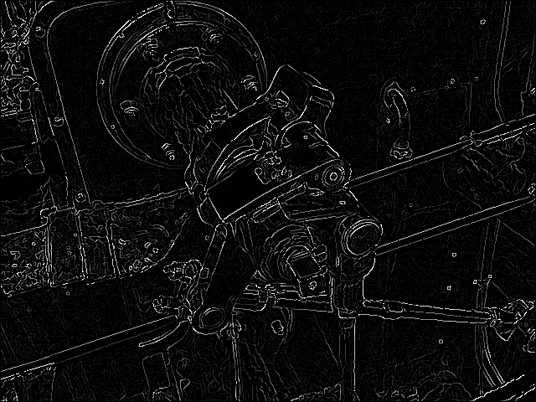
3rd stage: Non-maximum suppression
The lines are thinned into 1 pixel.
Before after non-maximum

Slide 85
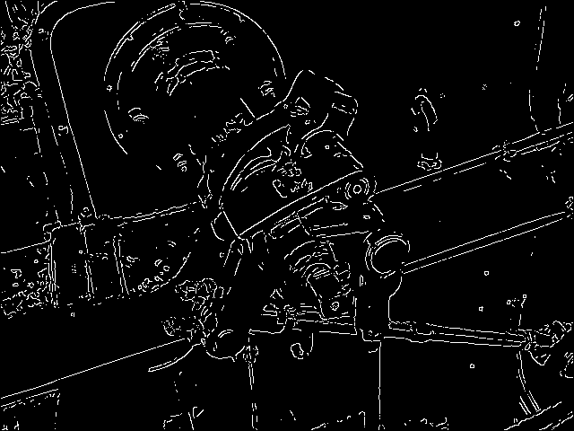
4th stage: Hysteresis Thresholding
We do thresholding (set in stage1) on the image twice with two different thresholds, t_{High} and t_{Low}.
t_{High} is applied first to remove edges that produced by noise (G(x,y)>T_{High}). Only edges with high gradient magnitude can survive. So many long edges are broken
Threshold
with t_{High}
Many broken edges
here

Slide 86
4th stage: Hysteresis Thresholding
For each remaining edges after threshold with t_{High}, we trace along the EDGE direction (perpendicular to gradient vector direction) and check whether its two neighbors are above t_{Low}, (G(x,y)>T_{low}).
If any of the neighbors is above t_{Low}, we mark this neighbor as an edge point and recursively check its neighbor using the same logic.
Gradient Vector
direction
Edge
direction

Slide 87
4th stage: Hysteresis Thresholding
Tracing along the edge with t_{Low} will connect the broken edges or restore segments removed by t_{High}.
Final result of Canny edge detection: one-pixel edges and few broken edges
After high thresholding

Slide 88
OpenCV
Since Canny edge detector is so popular, Intel’s Computer Vision library, namely OpenCV, has included this detector.
You can just call the build-in function Canny() and put corresponding parameters (e.g. the two thresholds) in it.
It is highly optimized and can be run in real time with a normal PC and Webcam.
More information: http://opencv.willowgarage.com/documentation/cpp/feature_detection.html?highlight=canny#Canny
http://www.pages.drexel.edu/~weg22/can_tut.html
Demos:
https://www.youtube.com/watch?v=GIAa3ETmUpU
Real-time Canny edge detection using OpenCV and CUDA – YouTube

Slide 89
Writing your own Canny edge detector
If you want to implement it yourself, you can still use OpenCV since it provides a lot of useful functions like Sobel() and gaussianBlur().

Slide 90
Worksheet 3.8
What are the features of the Canny edge detector?
MC question.
Output one-pixel wide edges, easy to implement, cannot run in real time by a common personal computer.
Output one-pixel wide edges, easy to implement, can run in real time by a common personal computer.
Output one-pixel wide edges, difficult to implement, can run in real time by a common personal computer.
Can you describe what is a Gaussian distribution?
Answer:_____________________
Write the algorithm for the Canny edge detector.
Answer:___________________

Slide 91
Answer: Worksheet 3.8
Why the Canny edge detector is so popular in image processing? MC question.
Answer 2 is correct: Output one-pixel wide edges, easy to implement, can run in real time by a common personal computer.
Can you describe what is a Gaussian distribution?
Answer:_in lecture notes
Write the algorithm for the Canny edge detector.
Answer:_in lecture notes

Slide 92
Conclusion
Studied first order and second order edge detection techniques
Studied the Gaussian operator
Studied the Canny edge detection algorithm

Slide 93
Appendix

Slide 94
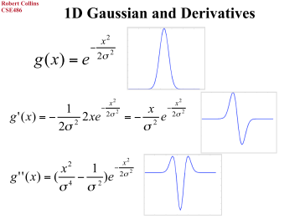
1d and 2d

Slide 95
Latex 5711 ch03 edge
\documentclass{article} %for testing formulas ppt cam, dec8, 2019
\usepackage{amsmath}
\begin{document}
5711 03 edge\\
Convolution method\\
\begin{flalign}
\label{eq:convolution_01}
\begin{aligned}
C(m,n)=
\sum_{j=-\infty}^{j=\infty}
\sum_{k=-\infty}^{j=\infty}
h(m-j,n-k) \times I(j,k)
%%%%%%%%%%%%
\end{aligned}
\end{flalign}\\
%%% eeeeee eq:filtering_01A eeeeeeeeeeeeeeeeeeeeeeeeeeeeeeeeee
%%%
1st order (A) Gaussian
\begin{flalign}
\label{eq:filtering_01a}
\begin{aligned}
G(x) = \frac{1}
{\sqrt{2\pi{\sigma^2 }}}
e^{-
\frac{(x-\mu)^2}
{2\sigma^2}
}
\end{aligned}
\end{flalign}
%%% eeeeee eq:filtering_01B eeeeeeeeeeeeeeeeeeeeeeeeeeeeeeeeee
1st order (B) Gaussian\\
\begin{flalign}
\label{eq:filtering_01b}
\begin{aligned}
G(x) = \frac{1}
{\sqrt{2\pi{\sigma^2 }}}
exp\left({-
\frac{(x-\mu)^2}
{2\sigma^2}
}\right)
\end{aligned}
\end{flalign}
%%%%%%%%%%%%%%%%%%%%%%%%%%%%%%%%%
%%% eeeeee eq:filtering_02A eeeeeeeeeeeeeeeeeeeeeeeeeeeeeeeeee
%%%%%%%%%%%%%%%%%%%%%%%%%%%%%%%%%
2nd order (A) Gaussian\\
\begin{flalign}
\label{eq:filtering_02A}
\begin{aligned}
G(x,y) =G(x)G(y)= \frac{1}
{{2\pi{\sigma^2 }}}
e^{-
\frac{(x-\mu_x)^2+(y-\mu_y)^2}
{2\sigma^2}
}
\end{aligned}
\end{flalign}
%%%
2nd order (B) Gaussian
%%% eeeeee eq:filtering_02B eeeeeeeeeeeeeeeeeeeeeeeeeeeeeeeeee
\begin{flalign}
\label{eq:filtering_02B}
\begin{aligned}
G(x,y) =G(x)G(y)= \frac{1}
{{2\pi{\sigma^2 }}}
exp\left({-
\frac{(x-\mu_x)^2+(y-\mu_y)^2}
{2\sigma^2}
}\right)
\end{aligned}
\end{flalign}
\end{document}

Slide 96
Obtain a LOG mask by DoF Difference of Gaussian
Want to remove noise with low frequency (low fluctuation) and high frequency (high fluctuation).
That means band pass filtering
Solution
Difference of Gaussians DoG=
(Blurred version of I) – (Less blurred version of I)
DoG=G(kσ)- G(σ)

Slide 97
Intuition DoG (Difference of Gaussian) and LoG (Laplacian of Gaussian)
Using difference of 2 Gaussians to approx. 2nd derivative of G
Consider
G(σ) ≈ ∇ G(kσ)
DoG=G(kσ) - G(σ)
≈ G(kσ)- ∇ G(kσ)
≈ ∇² G(kσ) (2nd derivative)
G(x)
σ (less blurred)
kσ (blurred)
x
m
1-D DoG
See http://www.cse.yorku.ca/~kosta/CompVis_Notes/DoG_vs_LoG.pdf

Slide 98
Applying DOG Difference of Gaussian
Example
Using 2 Gaussian masks of standard deviations (σ=1 and kσ= 1.6) for the two blurred versions
$$∇^{2}Gaussian(I(x,y)) \\ =\frac{∂^{2}Gaussian(I)}{∂x^{2}}+\frac{∂^{2}Gaussian(I)}{∂y^{2}} \\ =\left(\frac{∂^{2}Gaussian}{∂x^{2}}+\frac{∂^{2}Gaussian}{∂y^{2}}\right)∗I \\ =∇^{2}Gaussian∗I=LOG_mask∗I(x,y) \\ =∇^{2}Gaussian=differnce_between_two_Gaussians(DOG)$$

Slide 99
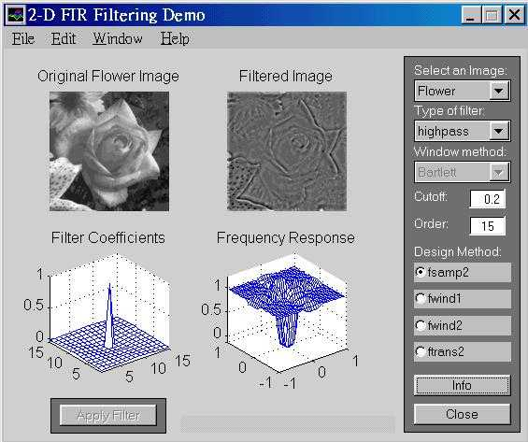
High pass filtering result

Slide 100
Use excel to plot a Gaussian distribution (cut and paste to excel to view plot)

Slide 101
Edge detection: essential Formulas
1st order edge gradient $\left|G(I(x,y))\right|≈\sqrt{{\left(\frac{∂I\left(x,y\right)}{∂x}\right)}^{2}+{\left(\frac{∂I\left(x,y\right)}{∂y}\right)}^{2}}>Threshold$.
$$\text{2}\text{nd} \text{order} \text{edge}\text{ (}\text{Laplacian} \text{operator}\text{), }\text{I}\text{(}\text{x}\text{,}\text{y}\text{)} \text{is} \text{an} \text{edge} \text{if}$$
$$∇^{2}I\left(x,y\right)=\frac{∂^{2}I\left(x,y\right)}{∂x^{2}}+\frac{∂^{2}I\left(x,y\right)}{∂y^{2}}=0.\text{I}\text{(}\text{x}\text{,}\text{y}\text{)=}\text{image}$$
$2−\text{D} \text{Gaussian}$:$G\left(\text{x}\text{,}\text{y}\right)=G\left(x\right)G\left(y\right)=\frac{1}{2πσ^{2}}e^{−\frac{{\left(x−m_{x}\right)}^{2}+{\left(y−m_{y}\right)}^{2}}{2σ^{2}}}$

