Slide 1
Chapter 2: Image processing and computer vision
Camera models and parameters
Notes:
In this chapter we will learn the mathematical model of a computer and how to use the parameters involved.

Slide 2
Will Learn these in this chapter
Mathematical model of a camera
Intrinsic (static) parameters of a camera (Mint_{3x3})
  Focal length (f) for fixed focal length, non-zoomed cameras
  Image center (Ox,Oy), skew factor
  Pixel width/height (Sx,Sy)
Extrinsic parameters of a camera (Mext_{3x4})
  Rotation (R) and Translation (T) of a camera
  Characteristics of R and T
Projection matrix P_{3x4}
Camera calibration

Slide 3
Motivations
Digital cameras are everywhere.
Develop applications for cameras.
Help to choose a good camera.
Notes:
Before we learn how to use a camera for various applications we need to know the parameters and their characteristics.

Slide 4
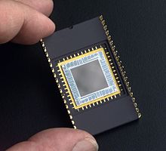

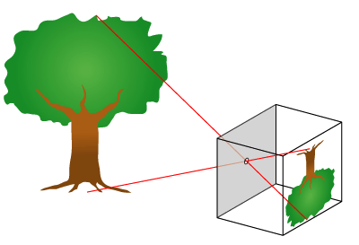
3D to 2D projection
http://upload.wikimedia.org/wikipedia/en/8/81/Pinhole-camera.png
Pinhole
Camera
Perspective model
u=F*X/Z
v=F*Y/Z
Virtual
Screen
or CCD
https://en.wikipedia.org/wiki/Charge-coupled_device
sensor
World
center
Y
v
v
F
Z
F
Real
image
Plane Or
CCD
sensor
Virtual
Image
plane
Thin lens
or a pin hole
Notes:
From your secondary school physics, you probably have learn this mode, if you place a lens in front of a screen you get the inverted image. A pin hoe camera and a thin lens camera are similar. The image is a 2D projection of the 3D world.

Slide 5
Perspective model
Pin hole camera

Slide 6
Perspective
Projective
World Coordinates
Z_{w}
Y_{w}
Virtual image
plane or simply
call it image
X_{w}
Model M at t=1
O_{W}=(0,0,0)
(World center)
(X,Y,Z)
v-axis
R_{c},
T_{c}
Yc-axis
Camera
Coordinates.
(u,v)
Zc-axis
Principal axis
O_{c}=(0,0,0)
(Camera center)
c (Image center, o_{x},o_{y})
u-axis
F=focal length
Xc-axis
Notes:
There are many useful parameters that you need to know.
The most important parameters are:
Focal length
Camera center
Other useful parameters are:
Principal axis
Image center

Slide 7
Inspection exercise
Explain what are these variables.
  F =(focal length)
  C=(ox,oy)
  Zc = principal axis
  Oc =Camera center
  (u,v) image 2-D axes
  (Xc,Yc,Zc) 3-D axes
Focal length is the length between the lens and the image (screen)
Camera center is the origin of the camera coordinate system
Principal axis is the vector perpendicular to the image and intersects with the camera center
Image Center is the center the 2D image , or the point that the principal axis intersects with the image

Slide 8

The most important concept for a camera is the image formation process
3D Object points (X_{w},Y_{w},Z_{w}): world coordinates
Step1:
Motion of camera (R_{cam}=R_{c}⁻¹,T_{cam})
Camera Coordinates(rotated, translated)
result → X_{c},Y_{c},Z_{c}
Step2:
Projection of camera (F)
Result → image (x,y)
Notes:
\documentclass{article} %for testing formulas ppt cam,
\usepackage{amsmath}
\begin{document}
%%%###### slide 7 ################
\begin{flalign}
\begin{aligned}
R_{cam} = R_c^{-1}, T_{cam}
\end{aligned}
\end{flalign}
\end{document}

Slide 9
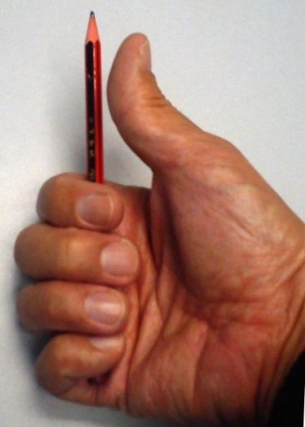
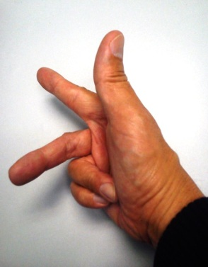
Step1 of image formation
Motion of camera (R_{cam},T_{cam}) Camera Coordinates
result → Xc,Yc,Zc
Positive rotation angle about an axis: The thumb is pointing to the axis direction; a positive rotation angle is the same direction as the other fingers.
Y_{c}
Camera coordinates
R_{cam}=(R_{c})⁻¹, and T_{cam}=T_{c}
Thumb pointing Axis direction
X_{c}
Y_{w}
Z_{w}
Z_{c}
θ_{y}
θ_{z}
world coordinates using the Right-hand coordinate system
X_{w}
θ_{x}
Notes:
We have two coordinate systems,
(i) Camera coordinate system and (ii) world coordinate system.
The realtion between these two systems is Rc and Tc as shown

Slide 10
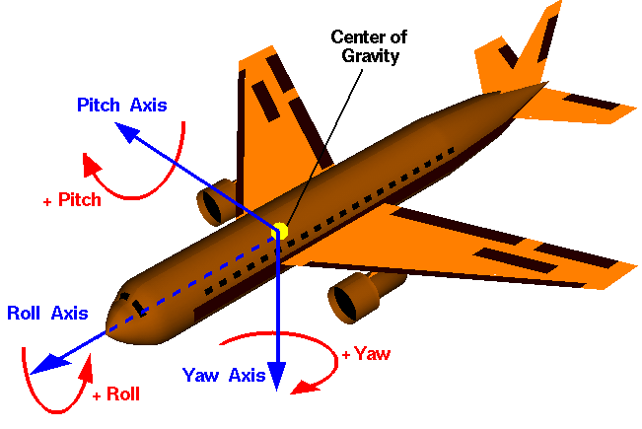
Rotation notations: Roll pitch yaw in aviation systems
They are the same systems– (you will see it if you turn the plane up side down). It is called the Right hand coordinate system.
http://www.grc.nasa.gov/WWW/k-12/airplane/rotations.html
http://planning.cs.uiuc.edu/node102.html
Yw (Pitch angle)
Y_{w}
Z_{w}
θ_{y}
Xw (Roll angle)
θ_{z}
Right-hand coordinates
Zw (Yaw angle)
X_{w}
θ_{x}

Slide 11
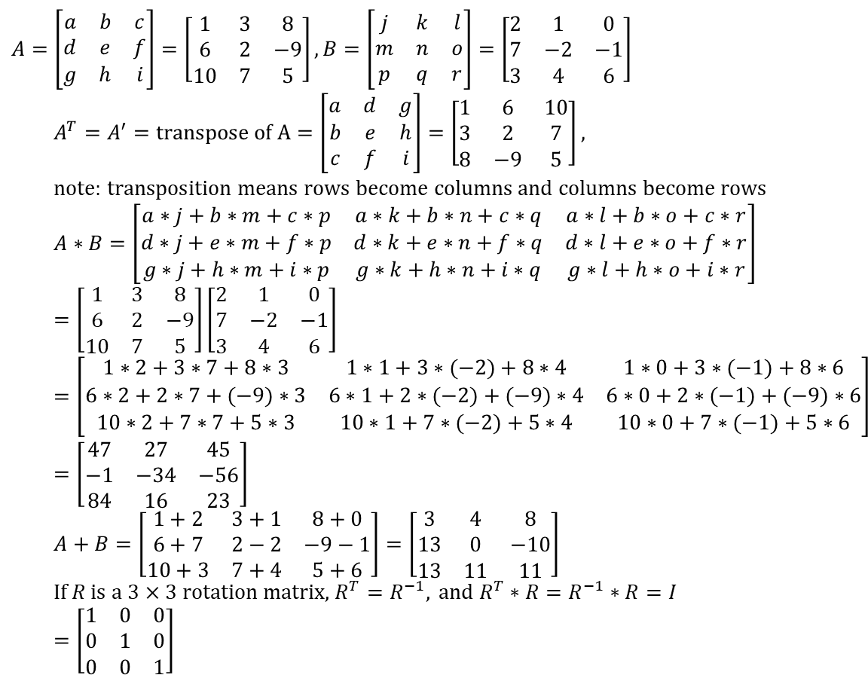
A revision of basic matrix operations in case you forgot
%matlab
A=[1 3 8
6 2 -9
10 7 5]
B=[2 1 0
7 -2 -1
3 4 6]
A’
A*B
A+B
Answer:>>
A’=
1 6 10
3 2 7
8 -9 5
A*B=
47 27 45
-1 -34 -56
84 16 23
A+B=
3 4 8
13 0 -10
13 11 11
$$A=\left[\begin{matrix}a & b & c \\ d & e & f \\ g & h & i\end{matrix}\right]=\left[\begin{matrix}1 & 3 & 8 \\ 6 & 2 & −9 \\ 10 & 7 & 5\end{matrix}\right],B=\left[\begin{matrix}j & k & l \\ m & n & o \\ p & q & r\end{matrix}\right]=\left[\begin{matrix}2 & 1 & 0 \\ 7 & −2 & −1 \\ 3 & 4 & 6\end{matrix}\right] \\ A^{T}=A^{′}=\text{transpose} \text{of} \text{A}=\left[\begin{matrix}a & d & g \\ b & e & h \\ c & f & i\end{matrix}\right]=\left[\begin{matrix}1 & 6 & 10 \\ 3 & 2 & 7 \\ 8 & −9 & 5\end{matrix}\right], \\ \text{note}\text{: }\text{transposition} \text{means} \text{rows} \text{become} \text{columns} \text{and} \text{columns} \text{become} \text{rows} \\ A∗B=\left[\begin{matrix}a∗j+b∗m+c∗p & a∗k+b∗n+c∗q & a∗l+b∗o+c∗r \\ d∗j+e∗m+f∗p & d∗k+e∗n+f∗q & d∗l+e∗o+f∗r \\ g∗j+h∗m+i∗p & g∗k+h∗n+i∗q & g∗l+h∗o+i∗r\end{matrix}\right] \\ =\left[\begin{matrix}1 & 3 & 8 \\ 6 & 2 & −9 \\ 10 & 7 & 5\end{matrix}\right]\left[\begin{matrix}2 & 1 & 0 \\ 7 & −2 & −1 \\ 3 & 4 & 6\end{matrix}\right]=\left[\begin{matrix}1∗2+3∗7+8∗3 & 1∗1+3∗(−2)+8∗4 & 1∗0+3∗(−1)+8∗6 \\ 6∗2+2∗7+(−9)∗3 & 6∗1+2∗(−2)+(−9)∗4 & 6∗0+2∗(−1)+(−9)∗6 \\ 10∗2+7∗7+5∗3 & 10∗1+7∗(−2)+5∗4 & 10∗0+7∗(−1)+5∗6\end{matrix}\right] \\ =\left[\begin{matrix}\text{47} & \text{27} & \text{45} \\ −1 & \text{−34} & \text{−56} \\ 84 & \text{16} & \text{23}\end{matrix}\right] \\ A+B=\left[\begin{matrix}1+2 & 3+1 & 8+0 \\ 6+7 & 2−2 & −9−1 \\ 10+3 & 7+4 & 5+6\end{matrix}\right]=\left[\begin{matrix}3 & 4 & 8 \\ 13 & 0 & −10 \\ 13 & 11 & 11\end{matrix}\right] \\ \text{If} R \text{is} \text{a}\text{ 3}×\text{3 }\text{rotation} \text{matrix}\text{, }R^{T}=R^{−1}, \text{and} R^{T}∗R=R^{−1}∗R=I=\left[\begin{matrix}1 & 0 & 0 \\ 0 & 1 & 0 \\ 0 & 0 & 1\end{matrix}\right]$$

Slide 12
Object/Vector rotation and Translation
A revision

Slide 13
Point / Vector
Point:
  A 2D point can be described by [x,y]’
  E.g. p1=[x1,y1]’=[0,0,]’, or p2=[x2,y2]’=[1,2]’
Vector:
  Va=from p1 to p2
  Va=p2-p1=[x2-y1,y2-y1]’=[1-0,2-0]’=[1,2]’
  Unit vector of Va=Va/|Va|=
  [1,2]’/sqrt(1^2+2^2)
  Or
  Vb=from p3 tp p4
  Vb=p4-p3=[4-2,4-2]’=[2,2]’
  Unit vector of Vb=Vb/|Vb|=
  [2,2]’/sqrt(2^2+2^2)
y
P4=(4,4)
P3=(2,2)
P2=(1,2)
x
P1=(0,0)

Slide 14

2D Rotation around z-axis (the vector out of paper)
V’=Rotate vector V (a vector from [0,0] to p) by θ clockwise
Length of V and V’ are same =r
Prove V’=[x’;y’]= R(θ)*V, where
Rz(θ)=[cos(θ) –sin(θ)
sin(θ) cos(θ)]
Proof:
x’=r*cos(α+θ)---(i), since
x=r*cos(α)---(ii), and
y=r*sin(α)---(iii)
Cosine rule: cos(α+θ)=cos(α) cos(θ) -sin(α) sin(θ)
(i) becomes
x’=r*cos(α) cos(θ) -r*sin(α)sin(θ),
put (ii) and (iii) into the above
x’=x*cos(θ)-y*sin(θ)
V’
y-axis
V
r
y’
r
θ
y
α
Also
y’=r*sin(α+θ)---(iv)
Sine rule: sin(α+θ)=cos(α)sin(θ) + sin(α)cos(θ)
(iv) becomes
y’=r*cos(α) sin(θ) + r* sin(α) cos(θ)
Put (ii) and (iii) in above
y'=x*sin(θ)+y*cos(θ)
X-axis
x’
(0,0)
x
Z-axis direction is going into the paper
Clockwise rotation direction is +ve
Now, we obtained
x’=x*cos(θ)-y*sin(θ)
y’=x*sin(θ)+y*cos(θ)
Write in matrix form
[x’;y’]=Rz(θ)*[x,;y]
Rz(θ)=[cos(θ) –sin(θ)
sin(θ) cos(θ)]
Done!

Slide 15
Extend the previous result to 3D coordinates, rotation in 3 axes
Assume the Z-axis (principal axis) of your camera is the vector V, so Rotation of the camera (R_{cam}) is the same as rotating the vector V.
Rules to rotate a vector in 3 3-D:
Center of rotation is at (0,0,0), if there is no translation the rotation center is at (0,0,0).
Rotation result depends on rotation sequence:
  E.g. If Rotate Rx first, then Ry, finally Rz. The overall rotation matrix is R_{cam}=Rz*Ry*Rx
  E.g. If Rotate Rz first, then Rx, finally Ry. The overall rotation matrix is R’_{cam} =Ry*Rx*Rz
Rx=[1 0 0
0 cos(theta_x) -sin(theta_x)
0 sin(theta_x) cos(theta_x)]
Ry=[cos(theta_y) 0 sin(theta_y)
0 1 0
-sin(theta_y) 0 cos(theta_y)]
Rz=[cos(theta_z) -sin(theta_z)0
sin(theta_z) cos(theta_z) 0
0 0 1]
Proved earlier

Slide 16

Relate “world 3D” and “camera 3D” coordinates
P_{w}=a point in “World 3D coordinates”=[X_{w},Y_{w},Z_{w}]^{T}
P_{c}= the same point in “Camera 3D coordinates” =[X_{c},Y_{c},Z_{c}]^{T}
R_{cam}=Rotate of the camera in world coord.
T_{cam}=T_{c}=Translation of the camera in world coord.
$$P_{c}={\left(R_{cam}\right)}^{−1}(P_{w}−T_{cam})=R_{c}(P_{w}−T_{c}) \\ R_{c}=\left(\begin{matrix}r_{11} & r_{12} & r_{13} \\ r_{21} & r_{22} & r_{23} \\ r_{31} & r_{32} & r_{33}\end{matrix}\right),$$
$$T_{cam}=\left(\begin{matrix}t_{1} \\ t_{2} \\ t_{3}\end{matrix}\right)=T_{c}$$
(R_{cam})⁻¹=R_{c,} It is more convenient to use R_{c} rather than (R_{cam})⁻¹ even they are the same
Notes:
%%###### slide 11 #############
slide 11\\
$P_w$=World 3D coordinates=$[X_w,Y_w,Z_w]^T$.\\
$P_c$= Camera 3D coordinates =$[X_c,Y_c,_Zc]^ T$.\\
$R_{cam}$=Rotate of the camera in world coord. \\
$T_{cam}$=$T_c$=Translation of the camera in world coord.
%------------------------------
\begin{flalign}
\begin{aligned}
R_{cam} &= R_c^{-1}, T_{cam}\\
P_c&=(R_{cam})^{-1}(P_w-T_{cam})=R_c(P_w-T_c)\\
R_c&=
\begin{bmatrix}
r_{11} & r_{12} & r_{13}\\
r_{21} & r_{22} & r_{33}\\
r_{31} & r_{32} & r_{33}
\end{bmatrix}, T_{cam}=
\begin{bmatrix}
t_{1}\\
t_{2}\\
t_{3}
\end{bmatrix}=T_c
\end{aligned}
\end{flalign}

Slide 17

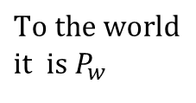
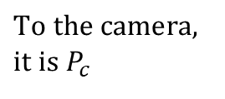

Step1:Motion of camera from world to camera coordinates
Camera motion (rotation=R_{cam}=R_{c}⁻¹, translation=T_{c}) will cause change of pixel position (x,y), See p156[1]
Y_{c-axis}
$$\left[\begin{matrix}X_{c} \\ Y_{c} \\ Z_{c}\end{matrix}\right]=R_{c}\left(\left[\begin{matrix}X_{w} \\ Y_{w} \\ Z_{w}\end{matrix}\right]−T_{c}\right)\text{ −−}(i)\text{,}$$
$$\text{where} \\ R_{c}=\left(\begin{matrix}r_{11} & r_{12} & r_{13} \\ r_{21} & r_{22} & r_{23} \\ r_{31} & r_{32} & r_{33}\end{matrix}\right),T_{c}=\left(\begin{matrix}t_{1} \\ t_{2} \\ t_{3}\end{matrix}\right)$$
Camera 3-D center
R_{cam},Tc
X_{c-axis}
Y_{w-axis}
Z_{c-axis}
Z_{w-axis}
θ_{y}
$$P_{w}=\left[\begin{matrix}X_{w} \\ Y_{w} \\ Z_{w}\end{matrix}\right],P_{c}=\left[\begin{matrix}X_{c} \\ Y_{c} \\ Z_{c}\end{matrix}\right]$$
$$\text{To} \text{the} \text{camera}\text{, } \\ \text{it} \text{is} P_{c}$$
θ_{z}
X_{w-axis}
World 3-D center
$$\text{To} \text{the} \text{world} \\ \text{it} \text{is} P_{w}$$
Note: R_{cam}⁻¹=R_{c} and R_{c}⁻¹=R_{cam}
Since R_{cam} is an orthogonal matrix
θ_{x}
Cameras v.3d
Notes:
%%%%% p 12 %%%%%%%%%%%%%%%%%%
\[
R_c=
\begin{bmatrix}
r_{11} & r_{12} & r_{13}\\
r_{21} & r_{22} & r_{33}\\
r_{31} & r_{32} & r_{33}
\end{bmatrix}, T_{c}=
\begin{bmatrix}
t_{1}\\
t_{2}\\
t_{3}
\end{bmatrix}
\]

Slide 18

To learn more about : Rotation and Translation
$${\left[\begin{matrix}X_{c} \\ Y_{c} \\ Z_{c}\end{matrix}\right]}_{(3×1)}={\left[{R_{c}}_{(3×3)}{\left({\left[\begin{matrix}X_{w} \\ Y_{w} \\ Z_{w}\end{matrix}\right]}_{(3×1)}−{T_{c}}_{(3×1)}\right)}_{(3×1)}\right]}_{(3×1)}−−−(i) \\ \text{where} {R_{c}}_{(3×3)}={\left(\begin{matrix}r_{11} & r_{12} & r_{13} \\ r_{21} & r_{22} & r_{23} \\ r_{31} & r_{32} & r_{33}\end{matrix}\right)}_{(3×3)},T_{c}={\left(\begin{matrix}t_{1} \\ t_{2} \\ t_{3}\end{matrix}\right)}_{(3×1)} \\ {\left[\begin{matrix}X_{c} \\ Y_{c} \\ Z_{c}\end{matrix}\right]}_{(3×1)}={\left[{R_{c}}_{(3×3)}{\left({\left[\begin{matrix}X_{w} \\ Y_{w} \\ Z_{w}\end{matrix}\right]}_{(3×1)}−{T_{c}}_{(3×1)}\right)}_{(3×1)}\right]}_{(3×1)}={R_{c}}_{(3×3)}{\left[\begin{matrix}X_{w} \\ Y_{w} \\ Z_{w}\end{matrix}\right]}_{(3×1)}−{R_{c}}_{(3×3)}{T_{c}}_{(3×1)} \\ {\left[\begin{matrix}X_{c} \\ Y_{c} \\ Z_{c}\end{matrix}\right]}_{(3×1)}={\left({R_{c}}_{(3×3)}{\left[\begin{matrix}X_{w} \\ Y_{w} \\ Z_{w}\end{matrix}\right]}_{(3×1)}\right)}_{(3×1)}−{\left({R_{c}}_{(3×3)}∗{T_{c}}_{(3×1)}\right)}_{(3×1)},$$
$\text{add}\text{ 1 }\text{at} \text{the} \text{bottom} \text{for} \text{both} \text{sides}$ to make it a linear matrix equation
$${\left[\begin{matrix}X_{c} \\ Y_{c} \\ Z_{c} \\ 1\end{matrix}\right]}_{(4×1)}={\left[\begin{matrix}{R_{c}}_{(3×3)} & −{\left({R_{c}}_{(3×3)}∗{T_{c}}_{(3×1)}\right)}_{(3×1)} \\ 0_{(1×3)} & 1_{(1×1)}\end{matrix}\right]}_{(4×4)}{\left[\begin{matrix}X_{w} \\ Y_{w} \\ Z_{w} \\ 1\end{matrix}\right]}_{(4×1)},$$
$//\text{th}\text{e} \text{above} \text{equation} \text{is} \text{the} \text{same} \text{as} (i)$, just 1 more row of value1 on both sides
$$\text{The}\text{ 4}\text{x}\text{1 }\text{vector} {\left[\begin{matrix}X & Y & Z & 1\end{matrix}\right]}^{T}\text{is} \text{in}\text{ 3−}\text{D} \text{homogeneous} \text{coordinates}\text{.}$$
The advantage of using the homogenous coordinates(or projective coordinates) is to make the transform from world to camera coordinates a linear one. Note: now the 3D coordinates of a point is 4x1, instead of 3x1
Notes:
%%%%% p 13 %%%%%%%%%%%%%%
slide 13
%--1 -----------------------------
\[
\begin{bmatrix}
X_{c}\\
Y_{c}\\
Z_{c}\end{bmatrix}_{(3\times1)}=R_c \left(
\begin{bmatrix}
X_{w}\\
Y_{w}\\
Z_{w}
\end{bmatrix}_{(3\times1)}-T_{c(3\times1)}
%\begin{bmatrix}
%t_{1}\\
%t_{2}\\
%t_{3}
%\end{bmatrix}
\right)_{3\times1}
\]
%--2 -----------------------------
where \[
R_c=
\begin{bmatrix}
r_{11} & r_{12} & r_{13}\\
r_{21} & r_{32} & r_{33}\\
r_{31} & r_{32} & r_{33}
\end{bmatrix}, T_{c}=
\begin{bmatrix}
t_{1}\\
t_{2}\\
t_{3}
\end{bmatrix}
\]
%--3 -----------------------------
\[
\begin{bmatrix}
X_{c}\\
Y_{c}\\
Z_{c}\end{bmatrix}=R_c \left(
\begin{bmatrix}
X_{w}\\
Y_{w}\\
Z_{w}
\end{bmatrix}-T_c
\right)=R_c
\begin{bmatrix}
t_{1}\\
t_{2}\\
t_{3}
\end{bmatrix}-R_c T_c
%\right)
%\]=R_c\begin{bmatrix}
%X_{w}\\
%Y_{w}\\
%Z_{w}
%\end{bmatrix}-R_c * T_c, add 1 to the bottom for both sides
\] add 1 to the bottom for both sides
%--4 -----------------------------
\[
\begin{bmatrix}
X_{c}\\
Y_{c}\\
Z_{c}\\
1 \end{bmatrix}_{(4 \times 1)}= \left(
\begin{bmatrix}
R_{c(3 \times 3)} & -(R_c*T_c)_{(3 \times 1)}\\
0_{(1 \times 3)} & 1_{(1 \times 1)}
\end{bmatrix}
\right)_{(4 \times 4)}
\begin{bmatrix}
X_{w}\\
Y_{w}\\
Z_{w}\\
1
\end{bmatrix}_{(4 \times 1)}
\]This the same as (i)
The 4x1 vector $[X, Y, Z, 1]^T$ is in 3-D homogeneous coordinates

Slide 19
Step2 of image formation
Projection of camera
(through focal length F)
Result → image (x,y)

Slide 20
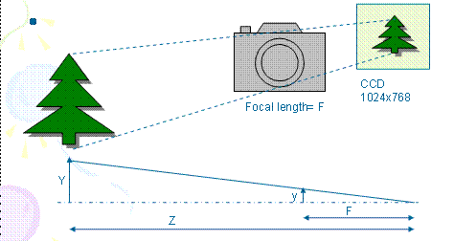
Step2: Camera coordinates to image plane
(Perspective projection of camera in meters)
x=F*X_{c} /Z_{c}---(1)
y=F*Y_{c} /Z_{c}---(2)
F=focal length in meters
A Point in 3D space (camera reference space) is [X_{c},Y_{c},Z_{c}]^{T} in meters
The 2D image point is [x,y]^{T} in meters
Notes:
Step2 is about projection.

Slide 21

Worksheet 1
F=5mm
Z=1 meter
A tree is 2 meters high,0.5 meters wide. What is the value of the height (y) of the tree appearing in the image?
MC question, choices:
(1) y=5mm; (2) y=10mm; (3) y=15mm, (4) y=20mm,
Sketch the diagram.

Slide 22
Answer: Worksheet 1
F=5mm
Z=1 meter
A tree is 2 meters high,0.5 meters wide. What is the value of the height of the tree appearing in the image?
Answer: using y=F*Y_{c} /Z_{c}
height=y=F*Y/Z=5x10⁻³x2 meters/1 meter=10mm
  or 5*2*10^-3/1 =10mm
MC question, choices:
(1) y=5mm; (2) y=10mm; (3) y=15mm, (4) y=20mm.
Answer (2) y=10mm is correct
also
Width=x=F*X/Z=5x10⁻³x0.5 meters/1 meter=0.0025 meter=2.5mm,
  or =5*0.5*10^-3*1 =2.5mm

Slide 23
Picture element (Pixel) based image
[x,y]^{T} is in meters, []^{T} is transposition in matrix
[u,v]^{T} in pixels which is easy to be measured by the camera
Each pixel is Sx wide and Sy high
Example, Sx = Sy =5.46 μm (1μm=1x10^-6m=1 micron)
Image=
1024x768
pixels
1 pixel
Sx =5.46 μm
Sy=5.46 μm
CCD Charge-coupled device
Sensor: http://en.wikipedia.org/wiki/Charge-coupled_device
Notes:
Of course we can measure everything in meters, but it would be easier if we measure them in picture elements (pixels), because pictures are turned into pixels in picture files.
I.e. a picture file is 1024x768 , meaning 1024 pixels horizontally and 768 pixels vertically.
Each pixel is a point on the image CCD sensor, it responses to the light received at that picture element pixel position.

Slide 24

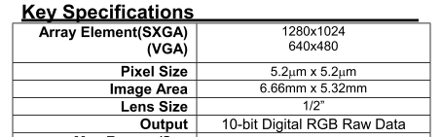
Worksheet 2
For an image of 1280x1024 Sx = Sy =5.2um.
What is the size of the image (CMOS or CCD sensor)?
Find the pixel size of your favorite camera.
MC choices: Choices:
(1) Dx= 4.66mm; (2) Dx= 5.66mm;
(3) Dx= 6.66mm; (4) Dx= 7.66mm;
Answer:________________
Dx
Image
(CMOS sensor)
Dy
Hint:
Image
(CMOS
sensor)
www.ovt.com
OVT CameraChip OV9620/9120 webcam camera chip
Notes:
You can check with www.ovt.com
To see the specifications of various cameras.

Slide 25
Answer: Worksheet 2
For an image of 1280x1024, Sx = Sy =5.2um.
What is the size of the image (CMOS or CCD sensor)?
1280*5.2um =1280*5.2*10^-6 = 0.00666m=6.66mm
1024X5.2um =1024*5.2*10^-6 = 0.00532m=5.32mm
MC choices: Choices:
(1) Dx= 4.66mm; (2) Dx= 5.66mm;
(3) Dx= 6.66mm; (4) Dx= 7.66mm;
Answer (3) is correct
Dx
Image
(CMOS sensor)
Dy
www.ovt.com
OVT CameraChip OV9620/9120 webcam camera chip

Slide 26
Image center
In picture files, usually no negative pixel is used because the origin is at one of the corners (e.g. the right bottom (1,1))
Center of CCD is placed at C= (Ox,Oy)
v (pixels)
CCD
768
(O_{x},O_{y})=
(512,384) in pixels
x
u (pixels)
1024
1,1
Notes:
The image center is at the mid-point of the CCD, so if the CCD is 1024x768, image center is (1024/2,768/2)=(512,384)
But it is not always true because, placing the center of the CCD at the center of the projected image precisely is difficult if the cameras are mass produced. We will deal with this problem later in this chapter.

Slide 27
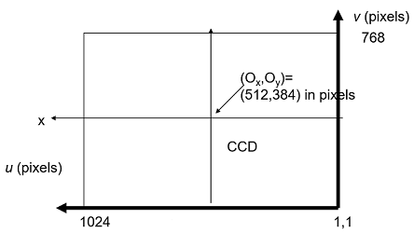
CCD Pixel (u,v) based Perspective Projection
Example
(o_{x},o_{y)}
(o_{x},o_{y}) in pixels is the image center
Equ. (1), (2) is divided by s_{x} ,s_{y,} resp.
Recall x=F*X_{c} /Z_{c}---(1)
y=F*Y_{c} /Z_{c}---(2)
u=(F/s_{x})*(X_{c}/Z_{c}) + o_{x} -------(3),F is in meter, F/Sx is in pixels
v=(F/s_{y})*(Y_{c}/Z_{c}) + o_{y} -------(4), F/Sx is in pixels
u=x/s_{x} + o_{x} , v=y/ s_{x}+ o_{y} (in pixels)
A Point in 3D space is [X_{c},Y_{c},Z_{c}]^{T} in meters (or pixels , still ok, because X_{c} /Z_{c} and Y_{c} /Z_{c} are ratios.
The 2D image point is [u,v]^{T} in pixels
Notes:
%%%%%%% p20 %%%%%%%%%%%%%%%%%%%%%%%%%%
Recall that
\begin{equation}
\label{eq:t}
\begin{aligned}
x & =F*X_c/Z_c \\
y & =F*Y_c/Z_c\\
\text{therefore}\\
u & =(F/s_x)(X_c/Z_c) + o_x\\
v & =(F/s_y)(Y_c/Z_c) + o_y\\
\text{hence}\\
u & =x/s_x*(X_c/Z_c) + o_x\\
v & =y/s_y*(Y_c/Z_c) + o_y
\end{aligned}
\end{equation}

Slide 28
Examples, center of CCD is at image center (right hand coordinate system with ideal CCD)
y
Z
v (pixels)
CCD
768
(O_{x},O_{y})=
(512,384) in pixels
x
u (pixels)
1024
1,1

Slide 29
A summary
The focal length can be expressed in pixels, f=F/Sx (assume Sx=Sy, horizontal and vertical lengths are the same, f=fx=fy )
A 3D feature point is at P=(Xc,Yc,Zc)
The center of the CCD sensor is placed at Ox,Oy in pixels of the image.
The projected image point of P=(Xc,Yc,Zc) is at (u,v)
Normally, we assume skew=0;
We can use Intrinsic parameters to represent all these.

Slide 30
Camera parameters
Intrinsic parameters
  Focal length (F) in meters,
  pixel width, height are s_{x} s_{y} in meters, resp.
  image (or principal) center (o_{x},o_{y}) in pixels
  lens-distortion (K) (assume no distortion , ignored here).
Extrinsic parameters
  Position of the camera such as
  (Rc -- rotation, Tc -- translation)

Slide 31
Intrinsic parameters from camera coordinates to image coordinates
M_{int} ( a 3x3 matrix)
(Current discussion assumes
center of camera=center of world)
Notes:
We now summarize all parameters that concerns the static part of the camera and call them intrinsic parameters.
They are called intrinsic parameters because they describe the internal parts of the camera after it is produced, they are fixed if the camera is a fixed focal length camera.
But for a zoomed camera (not fixed focal length camera) the focal length may change dynamically by the user during operations.

Slide 32
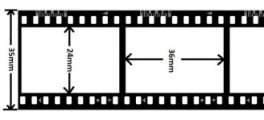
Typical camera Intrinsic parameters
Fixed focal length (web cam or pin hole camera model)
  E.g. s_{x} =s_{y} ≈ 5.46um (1um=1x10^-6 m=1 micron)
  For a CCD of 1024x768 , the image center or principal center is at (o_{x},o_{y})=(512x384)
  lens-distortion (K) for fixed lens. (ignore to simplify)
Variable focal length (zoom lens)
  focal length (e.g. f ≈ 5mm) , may be varied (zoom lens),
  lens-distortion (K) may follow f.
Iphone: https://www.techinsights.com/blog/apple-iphone-14-image-sensor-preliminary-analysis
  pixel-pitch is 2.44 µm for a Quad-pixel. ..sensor's absolute pixel pitch is 1.22 µm at a resolution of 48MP or 2.44 µm at 12MP.
Equivalent focal length: when a camera focal length is expressed in mm, it usually means it is equivalent to a camera system with a 35mm (36x24mm) full-frame sensor. https://www.adorama.com/alc/understanding-focal-length-and-how-to-use-it/
https://www.easybasicphotography.com/35mm-equivalent.html
35 mm
24 mm
36 mm
Full-frame standard
Notes:
lens-distortion is not considered for this course, assume your camera is close to a pin hole camera and lens are of very good quality.

Slide 33
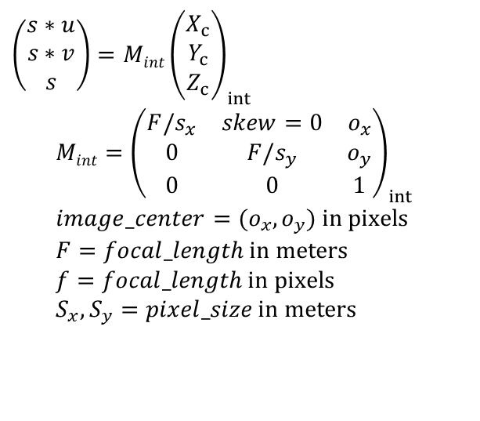
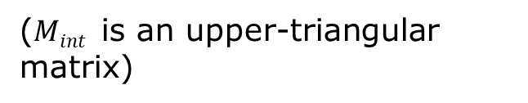
Intrinsic parameters M_{int}
(Pin hole camera model)
_{3D=Xc,Yc,Zc in meters}
_{Image=u,v in pixels}
_{s= arbitrary rating factor}
_{Exercise:}
Show equations (3) (4) are the same as this matrix form eq(5).
Recall:
u=(F/s_{x})*(X_{c}/Z_{c}) + o_{x} --(3)
v=(F/s_{y})*(Y_{c}/Z_{c}) + o_{y} --(4)
Answer: from (5) use matrix multiplication
s*u=(F/s_{x})*(X_{c}) + o_{x} *Z_{c}--(i)
s*v=(F/s_{y})*(Y_{c}) + o_{y} *Z_{c}--(ii)
Set s= Z_{c}-------------------------(iii)
(i)/(iii), hence u=(F/s_{x})*(X_{c}/Z_{c}) + o_{x} , same as (3)
(ii)/(iii), hence v=(F/s_{y})*(Y_{c}/Z_{c}) + o_{y} , same as (4)
(proved!)
($Mint$ is an upper-triangular matrix)
$$\left(\begin{matrix}s∗u \\ s∗v \\ s\end{matrix}\right)={Mint\left(\begin{matrix}X_{c} \\ Y_{c} \\ Z_{c}\end{matrix}\right)}_{int} \\ {Mint=\left(\begin{matrix}F/s_{x} & skew=0 & o_{x} \\ 0 & F/s_{y} & o_{y} \\ 0 & 0 & 1\end{matrix}\right)}_{int} \\ image_center=(o_{x},o_{y}) \text{in} \text{pixels} \\ F=focal_length \text{in} \text{meters} \\ f=focal_length \text{in} \text{pixels} \\ S_{x},S_{y}=pixel_size \text{in} \text{meters}$$
Notes:
Equation 3 and 4 have been shown before, we can convert them into a matrix form in equation 5, you may try to show the conversion as an exercise.
Equation 5 has an advantage over formula 3 and 4, equation 5 is a linear system, in computer science we love linear systems because you can find a lot of math tools to solve linear problems.
Equation 3,4 are non-linear, because they involve division terms (1/Z) and make them difficult to solve.
But there is a hitch, (u,v) are what we want to find but the left hand side of the equation is a 3x1 vector [s*u,s*v,s]’ =[su,sv,s]’ , when you want to get u,v you need to do
u=su/s=first element of [su,sv,s]’ / last element of [su,sv,s]’
v=sv/s=second element of [su,sv,s]’ / last element of [su,sv,s]’
In fact we just delay the non-linear operation (the division operation) at the end. But we can use linear system math-tools to handle the more difficult stages and find u,v at the final step.
We call (u,v) as homogenous coordinates, remember that the actual pixel coordinates is (u,v) not su and sv.
%%% p26 %%%%%%%%%%%%%%%%%%
%---------- 1------------
slide 26
%\[
\begin{equation}
\begin{bmatrix}
s*u\\
s*v\\
s
\end{bmatrix}
=M_{int}
\begin{bmatrix}
X_c\\
Y_c\\
Z_c
\end{bmatrix}
\end{equation}
\begin{equation}
%- 2 --------------------------------
%
M_{int} =
\begin{bmatrix}
F/s_x & 0 & o_x\\
0 & F/s_y & o_y\\
0 & 0 & 1
\end{bmatrix}
\end{equation}
Image center =$(o_x,o_y)$ in pixels\\
$F$=Focal length in meters\\
$f$=Focal length in pixels\\
$s_x,s_y$=horizontal and vertical pixel size in meters, resp.

Slide 34
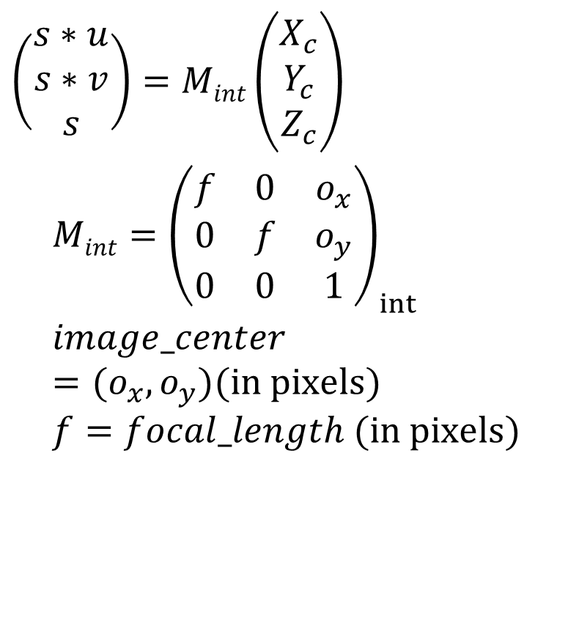
Simplified Intrinsic parameters M_{int} in pixels
Sx=Sy and F/sx= f in pixels
$$\left(\begin{matrix}s∗u \\ s∗v \\ s\end{matrix}\right)={Mint\left(\begin{matrix}X_{c} \\ Y_{c} \\ Z_{c}\end{matrix}\right)}_{} \\ {Mint=\left(\begin{matrix}f & 0 & o_{x} \\ 0 & f & o_{y} \\ 0 & 0 & 1\end{matrix}\right)}_{int} \\ image_center=(o_{x},o_{y})(\text{in} \text{pixels}) \\ f=focal_length (\text{in} \text{pixels})$$
3D=X_{c},Y_{c},Z_{c} in meters
Image=u,v in pixels
s= arbitrary rating factor
Notes:
Latex Formulas see previous slide

Slide 35

Examples, center of CCD is at image center (right hand coordinate system with ideal CCD)
y
Z
$${Mint=\left(\begin{matrix}f & 0 & o_{x} \\ 0 & f & o_{y} \\ 0 & 0 & 1\end{matrix}\right)}_{int}$$
v (pixels)
CCD
768
x
(Ox,Oy)=
(512,384) in pixels
u (pixels)
1024
1,1

Slide 36
Worksheet 3
The camera CCD has 1024 x 768 pixels, and the size of the CCD is 5mm x 3.75mm
(Horizontal(x), vertical(y)) pixel size=(Sx,Sy)
MC choices: Which one is true?
(1) Sx= 4.66mm; (2) Sx= 4.77m;
(3) Sx= 4.88mm; (4) Sx= 4.99mm;
Ans:____________

Slide 37
Answer Worksheet 3
The camera CCD has 1024x768 pixels and is 5mmx3.75mm
(Horizontal(x), vertical(y)) pixel size=(Sx,Sy)
Ans: Sx=5mm/1024=4.88um
  Sy=3.75mm/768=4.88um
MC choices: Which one is true?
(1) Sx= 4.66mm; (2) Sx= 4.77m;
(3) Sx= 4.88mm; (4) Sx= 4.99mm
Answer: Choice (3) Sx= 4.88mm is correct
  Why Sx=Sy? Calculate the Sx , Sy of your favorite digital camera.

Slide 38
CCD is glued to the back of a camera
W2
Ideally the CCD center is at ([512, 384]= image center) of a 1024x768 resolution camera.
Because of manufacturing fault, the CCD center may not be at the image center.
Examples: 2 cameras of the same model .
CCD
sensor
CCD
sensor
Camera 2: The sensor slight shifted to leftward and upward
Camera 1
Notes:
We mentioned this problem before, now here is the solution.

Slide 39
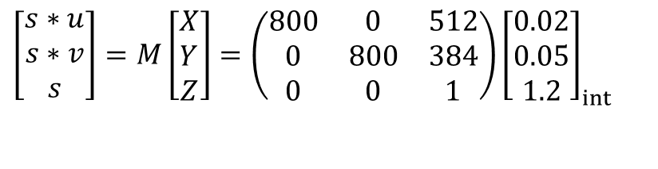
Worksheet 4, 3D projection on image
(Ch1_e1.m )
s_{x}=s_{y}=5.4um
(o_{x},o_{y})=(512,384) in pixels
f=4.3mm/5.4um=800 pixels
[X_{c},Y_{c},Z_{c}]^{T} =[0.02,0.05,1.2]^{T}meters
M=M_{int}
[u v]’=?
Answer: ___________
Write a pseudo code (or matlab) program to calculate the projected point [u v] ^{T from} [X_{c},Y_{c},Z_{c}]^{T based on the}
above camera intrinsic parameters.
$$\left[\begin{matrix}s∗u \\ s∗v \\ s\end{matrix}\right]={M\left[\begin{matrix}X \\ Y \\ Z\end{matrix}\right]=\left(\begin{matrix}800 & 0 & 512 \\ 0 & 800 & 384 \\ 0 & 0 & 1\end{matrix}\right)\left[\begin{matrix}0.02 \\ 0.05 \\ 1.2\end{matrix}\right]}_{int}$$

Slide 40
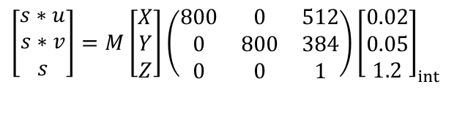
Answer: Worksheet 4,
3D projection on image
(Ch1_e1.m )
%matlab
k=[800 0 512
0 800 384
0 0 1]
x=[0.02 0.05 1.2]'
im=k*x
im(1)/im(3)
im(2)/im(3)
%answer:
im =
630.4000
500.8000
1.2000
u,v=
525.3333
417.3333
Updated 2023.Feb 8
s_{x}=s_{y}=5.4um
(o_{x},o_{y})=(512,384) in pixels
f=4.3mm/5.4um=800 pixels
[X_{c},Y_{c},Z_{c}]^{T} =[0.02,0.05,1.2]^{T}meters
[u v]’=??
^{Answer: [525.3, 717.3]T}
Write a pseudo code (or matlab) program to calculate the projected point [u,v]’ from [Xc,Yc,Zc]’ based on the above camera intrinsic parameters. (no answer given)
$$\left[\begin{matrix}s∗u \\ s∗v \\ s\end{matrix}\right]={M\left[\begin{matrix}X \\ Y \\ Z\end{matrix}\right]\left(\begin{matrix}800 & 0 & 512 \\ 0 & 800 & 384 \\ 0 & 0 & 1\end{matrix}\right)\left[\begin{matrix}0.02 \\ 0.05 \\ 1.2\end{matrix}\right]}_{int}$$

Slide 41
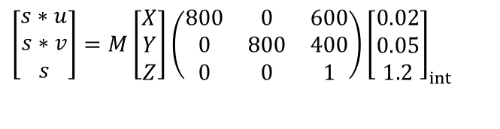
Worksheet 5
Because of manufacturing fault, the CCD center may not always be at the image center, see(Ch1_e2.m )
X,Y,Z are in 3D
u,v are in 2D
Sx=sy=5.4um
(Ox,oy)=(600,400) in pixels
f=4.3mm/5.4um=800 pixels
[X_{c},Y_{c},Z_{c}]^{T}=[0.02,0.05,1.2]^{T} meters
[u v]^{T}=??
^{Answer:} [u v]^{T =____________________}
Conclusion: A 3D object point can have different image positions for different cameras (different M_{int}) placed at the same position.
Y
v
Z
$$\left[\begin{matrix}s∗u \\ s∗v \\ s\end{matrix}\right]={M\left[\begin{matrix}X \\ Y \\ Z\end{matrix}\right]\left(\begin{matrix}800 & 0 & 600 \\ 0 & 800 & 400 \\ 0 & 0 & 1\end{matrix}\right)\left[\begin{matrix}0.02 \\ 0.05 \\ 1.2\end{matrix}\right]}_{int}$$
u=400
Y=384 X
(1,1)
X=512
v=600
o_{x},o_{y}=600, 400
(Image center is shifted to o_{x},o_{y})

Slide 42
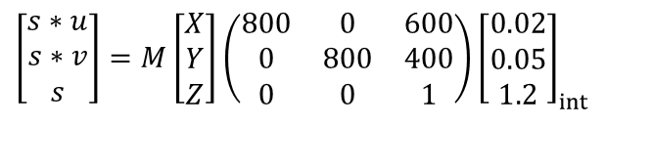
Answer Worksheet 5
Because of manufacturing fault CCD center may not be at image center, example
(Ch1_e2.m )
Sx=sy=5.4um
(Ox,oy)=(600,400) in pixels
f=4.3mm/5.4um=800 pixels
[X_{c},Y_{c},Z_{c}]^{T}=[0.02,0.05,1.2]^{T} meters
Answer: [u v]^{T}=[613.3, 433.3]^{T}
Conclusion: A 3D object point can have different image positions for different cameras (different M_{int}) placed at the same position.
X,Y,Z are in 3D
u,v are in 2D
Y
v
Z
$$\left[\begin{matrix}s∗u \\ s∗v \\ s\end{matrix}\right]={M\left[\begin{matrix}X \\ Y \\ Z\end{matrix}\right]\left(\begin{matrix}800 & 0 & 600 \\ 0 & 800 & 400 \\ 0 & 0 & 1\end{matrix}\right)\left[\begin{matrix}0.02 \\ 0.05 \\ 1.2\end{matrix}\right]}_{int}$$
u=400
Y=384 X
(1,1)
X=512
v=600
o_{x},o_{y}=600, 400
(Image center is shifted to o_{x},o_{y})

Slide 43
Worksheet 6: Discussion
Two Brandx cameras of the same model are taking pictures of a static object from the same position (using the same tripod), why the pictures are not the same. What are the differences and why?

Slide 44
Answer: Worksheet 6
Discussion
Two Brandx cameras of the same model are taking pictures of a static object from the same position (using the same tripod), why the pictures are not the same. What are the differences and why?
  Answer:
  CCD are not at the same position, o_{x},o_{y} may not be the same due to manufacturing fault
  Focal lengths are not the same (zooming)

Slide 45
Extrinsic parameters
M_{ext} ( a 3x4 matrix)
(Enable camera center moves away from world center)

Slide 46
Extrinsic parameters M_{ext}
External camera parameters
Move the camera to a new position

Slide 47
The camera moves to a new position :
Rotate of the camera Rcam, and translate (T_{C}) to a new position
P_{w}
Z_{w}
Y_{w}
Camera
coordinates
Y_{c}
Z_{c}
R_{c}
X_{c}
T_{Cam}= T_{C} =camera translation
in the world coordinates
Rcam
Rotation
World center
Camera center
X_{w}
Convention used: In this chapter we rotate the camera theta_z (angle around z axis) first, then theta_y and finally theta_x.
World coordinates
(reference)
Notes:
The world coordinate system is always the reference. The camera is first placed at the world center and then translated to Tc (Tc is actual a vector in the world coordinate system).
Then it is rotated using a transformation Rc which can rotate a vector in the world coordinate system to the camera coordinate system.
What we want to know is what is a point Pw (in the world coordinate system) should be described (as Pc) in the camera coordinate system.
The answer is Pc=Rc(Pw-Tc), we are about to show it

Slide 48


Coordinate change calculation
In the following slides, assume the world coordinate sys. does not change
The object Pw does not change
Only the camera coordinate system has changed, therefore Pc will change because it is measure in the camera coordinate system.
Pc is the same point as Pw but measured in the camera coordinates
$$P_{c}=\left[\begin{matrix}X_{c} \\ Y_{c} \\ Z_{c}\end{matrix}\right],$$
P_{w}
$$P_{w}=\left[\begin{matrix}X_{w} \\ Y_{w} \\ Z_{w}\end{matrix}\right]$$
Z_{w}
Y_{w}
Camera
coordinates
Y_{c}
Z_{c}
R_{c}
X_{c}
T_{Cam}= T_{C} =camera translation
in the world coordinates
Rcam
Rotation
World center
Camera center
X_{w}

Slide 49

Camera coordinates rotated θ_{z} about Z-axis relative to the world coordinates
A vector Pw=[Xw,Yw,Zw]’ is in the world coordinates (blue/solid_axes) is the same vector [Xc,Yc,Zc]’ in the camera coordinates (red/dash_axes)
Z-axis is facing you
$$\text{Case} \left(1\right) \text{Rotate} \text{about} \text{Z} \text{axis} \text{only}\text{,}θ_{x}=0,θ_{y}=0,$$
$$\left[\begin{matrix}X_{c} \\ Y_{c} \\ Z_{c}\end{matrix}\right]=R_{c_z}\left[\begin{matrix}X_{w} \\ Y_{w} \\ Z_{w}\end{matrix}\right]=\left[\begin{matrix}\cos{(}θ_{z}) & \sin{(}θ_{z}) & 0 \\ −\sin{(}θ_{z}) & \cos{(}θ_{z}) & 0 \\ 0 & 0 & 1\end{matrix}\right]\left[\begin{matrix}X_{w} \\ Y_{w} \\ Z_{w}\end{matrix}\right]$$
Concentrate
on Yc
Y_{c}= -X_{w}sin(θ_{z})+Y_{w}cos(θ_{z})
Y_{c}
Concentrate on Xc
θ_{z}
Y_{w}
θ_{z}
Y_{w}
θ_{z}
θ_{z}
X_{w}cos(θ_{z})
X_{w}
X_{w}
X_{w}sin(θ_{z})
θ_{z}
Pw
θ_{z}
Pw
X_{c}
X_{c}=X_{w}cos(θ_{z})+Y_{w}sin(θ_{z})
Y_{w}sin(θ_{z})
Y_{w}cos(θ_{z})

Slide 50
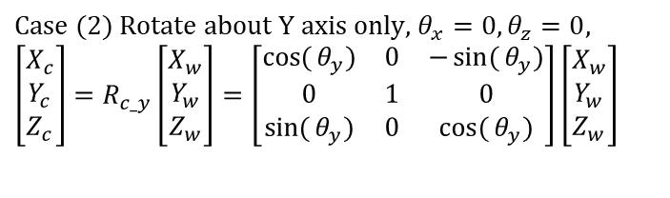
Camera coordinates rotated θ_{y} about Y-axis relative to the world coordinates
A vector Pw=[Xw,Yw,Zw]’ is in the world coordinates (green/dotted_axes) is the same vector [Xc,Yc,Zc]’ in the camera coordinates (red/dash_axes)
Y-axis is facing away from you
$$\text{Case} (2) \text{Rotate} \text{about} \text{Y} \text{axis} \text{only}\text{, }θ_{x}=0,θ_{z}=0, \\ \left[\begin{matrix}X_{c} \\ Y_{c} \\ Z_{c}\end{matrix}\right]=R_{c_y}\left[\begin{matrix}X_{w} \\ Y_{w} \\ Z_{w}\end{matrix}\right]=\left[\begin{matrix}\cos{(}θ_{y}) & 0 & −\sin{(}θ_{y}) \\ 0 & 1 & 0 \\ \sin{(}θ_{y}) & 0 & \cos{(}θ_{y})\end{matrix}\right]\left[\begin{matrix}X_{w} \\ Y_{w} \\ Z_{w}\end{matrix}\right]$$
Concentrate on Zc
Z_{c}=X_{w}sin(θ_{y})+Z_{w}cos(θ_{y})
Z_{w}
Z_{w}
Concentrate on Xw
θ_{y}
Z_{c}
θ_{y}
Z_{c}
θ_{y}
θ_{y}
Z_{w} cos(θ_{y})
X_{w}cos(θ_{y})-Z_{w}sin(θ_{y})
X_{w}
cos(θ_{y})
θ_{y}
Pw
θ_{y}
Pw
X_{c}
X_{w} sin(θ_{y})
X_{c}
Z_{w}sin(θ_{y})
X_{w}
Z_{w}
X_{w}

Slide 51
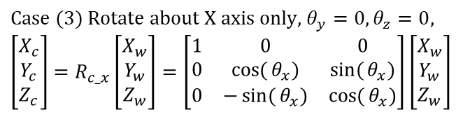
Camera coordinates rotated θ_{x} about X-axis relative to the world coordinates
A vector Pw=[Xw,Yw,Zw]’ is in the world coordinates (purple/dotted_axes) is the same vector [Xc,Yc,Zc]’ in the camera coordinates (red/dash_axes)
X-axis is facing you
$$\text{Case} (3) \text{Rotate} \text{about} \text{X} \text{axis} \text{only}\text{, }θ_{y}=0,θ_{z}=0, \\ \left[\begin{matrix}X_{c} \\ Y_{c} \\ Z_{c}\end{matrix}\right]=R_{c_x}\left[\begin{matrix}X_{w} \\ Y_{w} \\ Z_{w}\end{matrix}\right]=\left[\begin{matrix}1 & 0 & 0 \\ 0 & \cos{(}θ_{x}) & \sin{(}θ_{x}) \\ 0 & −\sin{(}θ_{x}) & \cos{(}θ_{x})\end{matrix}\right]\left[\begin{matrix}X_{w} \\ Y_{w} \\ Z_{w}\end{matrix}\right]$$
Concentrate on Zc
Z_{c}= -Y_{w}sin(θ_{x})+Z_{w}cos(θ_{x})
Concentrate on Yc
θ_{x}
Z_{w}
θ_{x}
Z_{w}
θ_{x}
θ_{x}
Y_{w}cos(θ_{x})
Y_{w}
Y_{w}
Y_{w}sin(θ_{x})
θ_{x}
Pw
θ_{x}
Pw
X_{c}
Y_{c}=Y_{w}cos(θ_{x})+Z_{w}sin(θ_{x})
Z_{w}sin(θ_{x})
Z_{w}cos(θ_{x})

Slide 52

We now try to examine Rcam
Assume a vector V_{z} =[X,Y,Z] (the principal axis of a camera ) of length r in the world coordinate is being rotated (R_{cam}) around the Z-axis only by θ_{z}, the vector after rotation is V_{z}’= [X’,Y’,Z’]
$$X′=r\cos{(}θ_{z}+α)=r\cos{(}θ_{z})\cos{(}α)−r\sin{(}θ_{z})\sin{(}α), \text{by} \text{definition} \\ Y′=r\sin{(}θ_{z}+α)=r\sin{(}θ_{z})\cos{(}α)+r\cos{(}θ_{z})\sin{(}α), \text{by} \text{definition} \\ \text{since} X=r\cos{(}α),Y=r\sin{(}α)\text{, }\text{hence} \\ X′=X\cos{(}θ_{z})−Y\sin{(}θ_{z}) \\ Y′=Y\cos{(}θ_{z})+X\sin{(}θ_{z}), \\ hence \\ \left[\begin{matrix}X′ \\ Y′ \\ Z′\end{matrix}\right]=\left[\begin{matrix}\cos{(}θ_{z}) & −\sin{(}θ_{z}) & 0 \\ \sin{(}θ_{z}) & \cos{(}θ_{z}) & 0 \\ 0 & 0 & 1\end{matrix}\right]\left[\begin{matrix}X \\ Y \\ Z\end{matrix}\right],or \\ \left[\begin{matrix}X′ \\ Y′ \\ Z′\end{matrix}\right]=R_{cam}\left[\begin{matrix}X \\ Y \\ Z\end{matrix}\right],\text{or} V_{z}^{′}=R_{cam}V_{Z},$$
Camera principal axis after rotation(V_{z}’)
Y-axis
Camera principal axis before rotation (V_{z})
r
Y’
θ_{z}
r
Y
α
Z-axis direction is facing you
Anti-clockwise rotation direction is +ve
X-axis
X’
X
Notes:
%%% p 37 %%%%%%%%%%
slide 37
\begin{flalign}
\begin{aligned}
X'&=r \cos(\theta_z+\alpha)=r\cos(\theta_z)\cos(\alpha)-r\sin(\theta_z)\sin(\alpha),\text{by definition}\\
Y'&=r \sin(\theta_z+\alpha)=r\sin(\theta_z)\cos(\alpha)-r\cos(\theta_z)\sin(\alpha),\text{by definition}\\
\text{since } X&=r\cos(\alpha), Y=r\sin(alpha), \text{hence}\\
X'&=X\cos(\theta_z)-Y\cos(\theta_z)\\
Y'&=Y\cos(\theta_z)-X\sin(\theta_z)\\
%----------------------------------
\begin{bmatrix}
X'\\
Y'\\
Z'
\end{bmatrix}&=
\begin{bmatrix}
\cos(\theta_z) &-\sin(\theta_z) &0 \\
\sin(\theta_z) &\cos(\theta_z) &0 \\
0 &0 &1
\end{bmatrix}
\begin{bmatrix}
X\\
Y\\
Z
\end{bmatrix}, or \\
\begin{bmatrix}
X\\
Y\\
Z
\end{bmatrix}&=R_{cam}
\begin{bmatrix}
X\\
Y\\
Z
\end{bmatrix}, \text{or } V_z^{`}=R_{cam}V_z
\end{aligned}
\end{flalign}

Slide 53
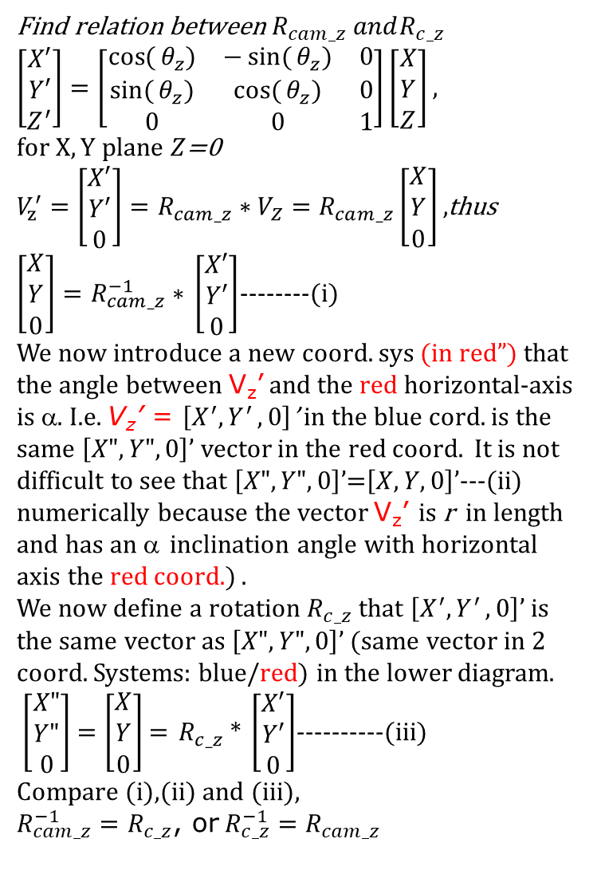
Find relation between$R_{cam_z} andR_{c_z}$
$\left[\begin{matrix}X′ \\ Y′ \\ Z^{′}\end{matrix}\right]=\left[\begin{matrix}\cos{(}θ_{z}) & −\sin{(}θ_{z}) & 0 \\ \sin{(}θ_{z}) & \cos{(}θ_{z}) & 0 \\ 0 & 0 & 1\end{matrix}\right]\left[\begin{matrix}X \\ Y \\ Z\end{matrix}\right],$ $for X,Y plane Z$=0
$V_{z}^{′}=\left[\begin{matrix}X′ \\ Y′ \\ 0\end{matrix}\right]=R_{cam_z}∗V_{Z}=R_{cam_z}\left[\begin{matrix}X \\ Y \\ 0\end{matrix}\right],$thus
${\left[\begin{matrix}X \\ Y \\ 0\end{matrix}\right]=R}_{cam_z}^{−1}∗$ $\left[\begin{matrix}X′ \\ Y′ \\ 0\end{matrix}\right]$--------(i)
We now introduce a new coord. sys (in red”) that the angle between V_{z}’ and the red horizontal-axis is α. I.e. V_{z}’ = $\left[X^{′}{,Y}^{′},0\right]$’ in the blue cord. is the same $\left[X",Y",0\right]$’ vector in the red coord. It is not difficult to see that $\left[X",Y",0\right]$’=$\left[X,Y,0\right]$’---(ii) numerically because the vector V_{z}’ is r in length and has an α inclination angle with horizontal axis the red coord.) .
We now define a rotation $R_{c_z}$ that $\left[X^{′}{,Y}^{′},0\right]$’ is the same vector as $\left[X",Y",0\right]$’ (same vector in 2 coord. Systems: blue/red) in the lower diagram.
$\left[\begin{matrix}X" \\ Y" \\ 0\end{matrix}\right]$ $=\left[\begin{matrix}X \\ Y \\ 0\end{matrix}\right]$ = $R_{c_z}$* $\left[\begin{matrix}X′ \\ Y′ \\ 0\end{matrix}\right]$----------(iii)
Compare (i),(ii) and (iii),
$R_{cam_z}^{−1}=R_{c_z}$, or$R_{c_z}^{−1}=R_{cam_z}$
Camera principal axis after rotation(V_{z}’)
Y-axis
V_{z}’
Camera principal axis
before rotation (V_{z})
r
V_{z}
Y’
θ_{z}
r
Y
α
X’
X-axis
X
Remove Vz in the above fig. and draw coords. (in red) rotated by θ_{z}
Y-axis
Camera
principal
axis after rotation(V_{z}’)
V_{z}’
r
Y’
α
Y”
X”
θ_{z}
X’
X-axis

Slide 54
Precise definition of Rc, Tc and Rcam
  Rc: A vector Pw will appear as Pc in camera coordinates using Rc
    Pc=Rc*Pw, where a vector Pw in world coordinates is the same vector Pc in camera coordinates . Pw does not change; it is only the coordinate system changes
R_{cam} is the rotational matrix that rotates the principal axis (Vz) of the camera position to a new position in the world coordinates. R_{cam} will change Vz, but it is always in the world coord. Sys. before and after the change.
Pc=Rc*Pw, where a vector Pw in world coordinates is the same vector Pc in camera coordinates
R_{cam} = (R_{c}) ⁻¹ (Note R⁻¹=R^{T} for rotation matrices)
T_{cam}=T_{c} is the translation of the camera center in the world coordinate system.
(-Tc) takes the cam. center back to the world center in the world coordinate system. While Rc = (R_{cam}) ⁻¹ rotates the camera coords. back to the world coords.
Notes:
We learned that a vector P in the world coordinates is described as Pc= Rc*P=Rx*Ry*Rz*P
if the coordinate system is rotated Rz in the z-axis, Ry in the y-axis and Rx-in the x-axis.

Slide 55
Study the rotation matrix Rc
Relate world 3D to camera 3D coordinates
We study pure camera rotation first
  Assume Translation (Tc) =0 (from world center to camera center)
  P_{w}=a stationary vector in World 3D coordinates P_{w}=[X_{w},Y_{w},Z_{w}]^{T}
Pc=a point in camera 3D coordinates =[X_{c},Y_{c},Z_{c}] ^{T}
Rotation of camera is R_{cam} ,
  We introduce a transform R_{c} , such that R_{c} =(R_{cam})⁻¹
  Pc=Rc*Pw where a vector Pw in world coordinates is the same vector Pc in camera coordinates
  That means a vector Pw in the world coordinate system will appear as Pc=Rc*Pw in the camera coordinate system
Rotation and Translation can be treated independently
We will study Rc in the following slides
P_{w}
Y_{w}
Z_{w}
R_{cam}
=Rc⁻¹
X_{w}
World coordinates
(reference)
Camera rotated R_{cam}

Slide 56

Explanation for the previous slide
Assume the camera coordinate system is rotated by θ_{z} relative to the world coordinate system. A vector in the world coordinates (large blue) is (Xw,Yw) . We are not interested in Zw , because it will not be changed by rotation in the Z-axis.
Note: The large blue vector Pw is not changed, the only change here is the camera coordinate system (rotated θ_{z} against the z-axis). And the same (large blue) Pw vector as observed in the camera coordinate system is (Xc,Yc)
The left-hand diagram shows that the relation between Xc and (Xw,Yw, and θ_{z}), which is X_{c}=X_{w}cos(θ_{z})+Y_{w}sin(θ_{z})
The right-hand diagram shows that Y_{c}= -X_{w}sin(θ_{z})+Y_{w}cos(θ_{z})
And Zw = Zc , because there is no change of value in the z-axis.
So, it generates the matrix formula at the top
Copied here for your reference:
That means a vector Pw in the world coordinate system will appear as Pc=Rc*Pw in the camera coordinate system.
Or it means [Xc,Yc,Zc]’=Rz*[Xw,Yw,Zw]’ in the camera coordinate system refers to the same vector as [Xw,Yw,Zw]’ in the world coordinate system.
Remember that Pc=[Xc,Yc,Zc]’ is a vector in the camera coordinate system and Pw=[Xw,Yw,Zw]’ is a vector in the world coordinate system.
$$\text{Case} (1) \text{Rotate} \text{about} \text{Z} \text{axis} \text{only}\text{, }θ_{x}=0,θ_{y}=0, \\ \left[\begin{matrix}X_{c} \\ Y_{c} \\ Z_{c}\end{matrix}\right]=R_{c_z}\left[\begin{matrix}X_{w} \\ Y_{w} \\ Z_{w}\end{matrix}\right]=\left[\begin{matrix}\cos{(}θ_{z}) & \sin{(}θ_{z}) & 0 \\ −\sin{(}θ_{z}) & \cos{(}θ_{z}) & 0 \\ 0 & 0 & 1\end{matrix}\right]\left[\begin{matrix}X_{w} \\ Y_{w} \\ Z_{w}\end{matrix}\right]$$

Slide 57

Given rotation angles of a camera find Rc=RxRyRz
A point in World Pw=[Xw,Yw,Zw]’ is the same as Pc=[Xc,Yc,Zc]’ in the camera coordinates by these transformations
$$\text{Case} (1) \text{Rotate} \text{about} \text{Z} \text{axis} \text{only}\text{, }θ_{x}=0,θ_{y}=0, \\ \left[\begin{matrix}X_{c} \\ Y_{c} \\ Z_{c}\end{matrix}\right]=R_{c_z}\left[\begin{matrix}X_{w} \\ Y_{w} \\ Z_{w}\end{matrix}\right]=\left[\begin{matrix}\cos{(}θ_{z}) & \sin{(}θ_{z}) & 0 \\ −\sin{(}θ_{z}) & \cos{(}θ_{z}) & 0 \\ 0 & 0 & 1\end{matrix}\right]\left[\begin{matrix}X_{w} \\ Y_{w} \\ Z_{w}\end{matrix}\right] \\ \text{Case} (2) \text{Rotate} \text{about} \text{Y} \text{axis} \text{only}\text{, }θ_{x}=0,θ_{z}=0, \\ \left[\begin{matrix}X_{c} \\ Y_{c} \\ Z_{c}\end{matrix}\right]=R_{c_y}\left[\begin{matrix}X_{w} \\ Y_{w} \\ Z_{w}\end{matrix}\right]=\left[\begin{matrix}\cos{(}θ_{y}) & 0 & −\sin{(}θ_{y}) \\ 0 & 1 & 0 \\ \sin{(}θ_{y}) & 0 & \cos{(}θ_{y})\end{matrix}\right]\left[\begin{matrix}X_{w} \\ Y_{w} \\ Z_{w}\end{matrix}\right] \\ \text{Case} (3) \text{Rotate} \text{about} \text{X} \text{axis} \text{only}\text{, }θ_{y}=0,θ_{z}=0, \\ \left[\begin{matrix}X_{c} \\ Y_{c} \\ Z_{c}\end{matrix}\right]=R_{c_x}\left[\begin{matrix}X_{w} \\ Y_{w} \\ Z_{w}\end{matrix}\right]=\left[\begin{matrix}1 & 0 & 0 \\ 0 & \cos{(}θ_{x}) & \sin{(}θ_{x}) \\ 0 & −\sin{(}θ_{x}) & \cos{(}θ_{x})\end{matrix}\right]\left[\begin{matrix}X_{w} \\ Y_{w} \\ Z_{w}\end{matrix}\right]$$
Proved in the previous slide
You may prove the other 2 cases as an exercise
http://ccar.colorado.edu/ASEN5070/handouts/coordsys.htm
http://www.google.com.hk/url?sa=t&rct=j&q=&esrc=s&source=web&cd=1&ved=0CCwQFjAA&url=http%3A%2F%2Fwww.colorado.edu%2FASEN%2Fasen3200%2Fhandouts%2FCoordinateTransformations.doc&ei=nAfdUfTzBqWSiQeo-oCYDw&usg=AFQjCNGp5O37pYqGghl5Fft1skUmSXJ2-A&sig2=6q91UADC3ZZreVm_frd7rg&bvm=bv.48705608,d.aGc&cad=rja
Notes:
%%% %%% p 45 %%%%%%%%%%
slide 45
\begin{flalign}
\begin{aligned}
%-------1 ---------------------------
\begin{bmatrix}
X_c\\
Y_c\\
Z_c
\end{bmatrix}&=R_{c\_z}
\begin{bmatrix}
X_w\\
Y_w\\
Z_w
\end{bmatrix}=
\begin{bmatrix}
\cos(\theta_z) &\sin(\theta_z) &0 \\
-\sin(\theta_z) &\cos(\theta_z) &0 \\
0 &0 &1
\end{bmatrix}
\begin{bmatrix}
X_w\\
Y_w\\
Z_w
\end{bmatrix}\\
%------2-----------------------------
\begin{bmatrix}
X_c\\
Y_c\\
Z_c
\end{bmatrix}&=R_{c\_y}\begin{bmatrix}
X_w\\
Y_w\\
Z_w
\end{bmatrix}=
\begin{bmatrix}
\cos(\theta_y) &0 &-\sin(\theta_y)\\
0 &1 &0\\
\sin(\theta_y) &0 &\cos(\theta_y)
\end{bmatrix}
\begin{bmatrix}
X_w\\
Y_w\\
Z_w
\end{bmatrix}\\
%------3-----------------------------
\begin{bmatrix}
X_c\\
Y_c\\
Z_c
\end{bmatrix}&=R_{c\_x}\begin{bmatrix}
X_w\\
Y_w\\
Z_w
\end{bmatrix}=
\begin{bmatrix}
1 &0 &0\\
0 &\cos(\theta_x) &\sin(\theta_x)\\
0 &-\sin(\theta_x) &\cos(\theta_x)
\end{bmatrix}
\begin{bmatrix}
X_w\\
Y_w\\
Z_w
\end{bmatrix}
\end{aligned}
\end{flalign}
%-----------------------------------

Slide 58
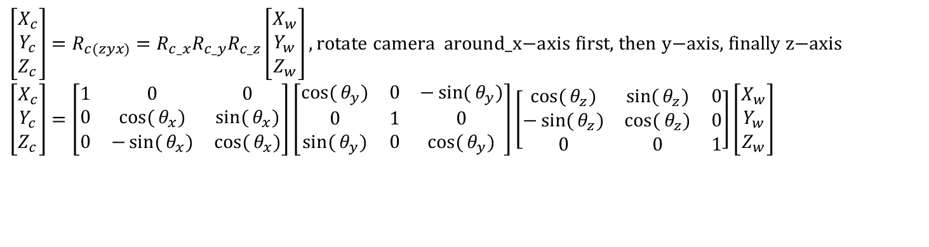
Combine rotations in 3 axes: The camera has rotated (θx, θy, θz), Rc brings a vector in world coordinates to the camera coordinates
Convention used: In this chapter we rotate the camera an_x (angle around x-axis) first, then an_y and finally an_z.
So Rcam=Rcam_z*Rcam_y*Rcam_x
Rc=transpose(Rcam)=(Rcam_z*Rcam_y*Rcam_x)^{T}
=(Rcam_x)^{T}*(Rcam_y)^{T}*(Rcam_z)^{T} , since (AB)^{T=}B^{T}*A^{T}
=Rc_x*Rc_y*Rc_z, because Rc_x=(Rcam_x)^{T} etc.
$$\left[\begin{matrix}X_{c} \\ Y_{c} \\ Z_{c}\end{matrix}\right]=R_{c(zyx)}=R_{c_x}R_{c_y}R_{c_z}\left[\begin{matrix}X_{w} \\ Y_{w} \\ Z_{w}\end{matrix}\right],\text{rotate} \text{camera} \text{around}\text{_}\text{x}\text{−}\text{axis} \text{first}\text{, }\text{then} \text{y}\text{−}\text{axis}\text{, }\text{finally} \text{z}\text{−}\text{axis} \\ \left[\begin{matrix}X_{c} \\ Y_{c} \\ Z_{c}\end{matrix}\right]=\left[\begin{matrix}1 & 0 & 0 \\ 0 & \cos{(}θ_{x}) & \sin{(}θ_{x}) \\ 0 & −\sin{(}θ_{x}) & \cos{(}θ_{x})\end{matrix}\right]\left[\begin{matrix}\cos{(}θ_{y}) & 0 & −\sin{(}θ_{y}) \\ 0 & 1 & 0 \\ \sin{(}θ_{y}) & 0 & \cos{(}θ_{y})\end{matrix}\right]\left[\begin{matrix}\cos{(}θ_{z}) & \sin{(}θ_{z}) & 0 \\ −\sin{(}θ_{z}) & \cos{(}θ_{z}) & 0 \\ 0 & 0 & 1\end{matrix}\right]\left[\begin{matrix}X_{w} \\ Y_{w} \\ Z_{w}\end{matrix}\right]$$
Note: Rcam and Rc are not the same; Rc=(Rcam)⁻¹=(Rcam)^{T}
Notes:
According the formula Rcam=Rcam_x*Rcam_y*Rcam_z, the camera rotations must be in this order: first rotate in z-axis , then y-axis , finally x-axis. See that Rcam_z is closest to [Xw,Yw,Zw]’ , hence it is rotated first.
Make sure your camera is rotated in this way, then you can use the above formula.
You may use another camera rotation sequence but you must change the formula .
E.g. If first rotate in x-axis , then y-axis , finally z-axis you should use the formula Rcam=Rcam_z*Rcam_y*Rcam_x

Slide 59
Matlab program for Rc
Used the Matlab/symbolic processor to create the transformation matrix
% ---- matlab demo: camera position change ----------------------
%Init position of the camera
%A camera is normally at eye(3)(Identity matrix of 3x3), no rotate in world coord.sys,
%rotated vs 3 axes: an_x,an_y,an_z (an_z first, an_y second, an_x third here),to a new (camera) coord sys.
%Rc will bring a vector in world coord. to camera coord. Such that
%so Pc=Rc*Pw, Pw is a vector in world, Pc is the same vector in cam. sys.
syms an_x an_y an_z
Rc_z=[cos(an_z) sin(an_z) 0
-sin(an_z) cos(an_z) 0
0 0 1]
Rc_y=[cos(an_y) 0 -sin(an_y)
0 1 0
sin(an_y) 0 cos(an_y)]
Rc_x=[1 0 0
0 cos(an_x) sin(an_x)
0 -sin(an_x) cos(an_x)]
Rc = Rc_x*Rc_y*Rc_z % For Rcam, the camera moves around x-axis first, then y-axis, finally z-axis
% (assume extrinsic rotation), therefore Rcam = *Rcam_z*Rcam_y*Rcam_x, since Rc=inverse(Rcam) ,
% so Rc= Rc_x*Rc_y*Rc_z
%Properties transpose(R)*R=I, inverse(R)*R=I, inverse(R)=transpose(R), det(R)=I .
Rc =
[ cos(an_y)*cos(an_z), cos(an_y)*sin(an_z), -sin(an_y)]
[ cos(an_z)*sin(an_x)*sin(an_y) - cos(an_x)*sin(an_z), cos(an_x)*cos(an_z) + sin(an_x)*sin(an_y)*sin(an_z), cos(an_y)*sin(an_x)]
[ sin(an_x)*sin(an_z) + cos(an_x)*cos(an_z)*sin(an_y), cos(an_x)*sin(an_y)*sin(an_z) - cos(an_z)*sin(an_x), cos(an_x)*cos(an_y)]
Notes:
%%%%%% 47 %%%%%%%%%%%%%%%%%%%%%%%
%slide47
$R_c$ =
\begin{flalign}
\begin{aligned}
\begin{bmatrix}
\cos(\alpha_y)\cos(\alpha_y) &\cos(\alpha_y)\sin(\alpha_z) &-\sin(\alpha_y)\\
%
\cos(\alpha_z)\sin(\alpha_z)\sin(\alpha_y) -\cos(\alpha_x)\sin(\alpha_z) &\cos(\alpha_x)\cos(\alpha_z) + \sin(\alpha_x)\sin(\alpha_y)\sin(\alpha_z) &\cos(\alpha_y)\sin(\alpha_x)\\
%
\sin(\alpha_x)\sin(\alpha_z) + \cos(\alpha_x)\cos(\alpha_z)\sin(\alpha_y) &\cos(\alpha_x)\sin(\alpha_y)\sin(\alpha_z) - \cos(\alpha_z)\sin(\alpha_x) &cos(\alpha_x)\cos(\alpha_y)
\end{bmatrix}
\end{aligned}
\end{flalign}

Slide 60
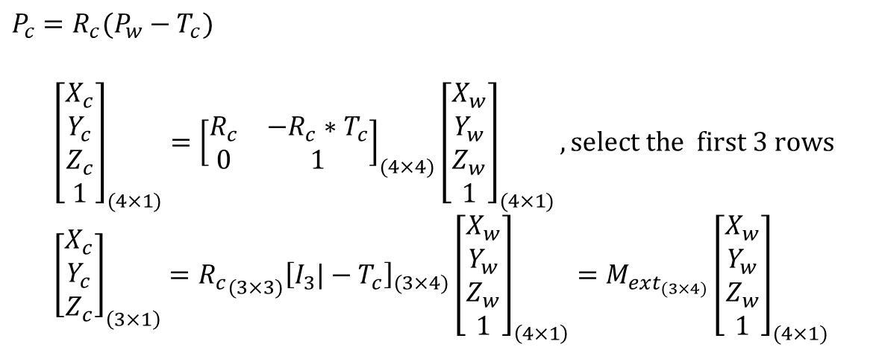

Study the rotation matrix Rc and Translation vector Tc
M_{ext} (3x4)Matrix form
When Tc is not Zero
P_{w}
Y_{w}
Camera
coordinates
Z_{c}
Y_{c}
X_{c}
Z_{w}
T_{C}= camera translation
$\text{R}\text{efer} \text{to} \text{a} \text{previous}$ slide
R_{cam}=(R_{c})⁻¹
Camera center
$$P_{c}=R_{c}(P_{w}−T_{c})$$
$${\left[\begin{matrix}X_{c} \\ Y_{c} \\ Z_{c} \\ 1\end{matrix}\right]}_{(4×1)}={\left[\begin{matrix}R_{c} & −R_{c}∗T_{c} \\ 0 & 1\end{matrix}\right]}_{(4×4)}{\left[\begin{matrix}X_{w} \\ Y_{w} \\ Z_{w} \\ 1\end{matrix}\right]}_{(4×1)},\text{select} \text{the} \text{first}\text{ 3 }\text{rows} \\ {\left[\begin{matrix}X_{c} \\ Y_{c} \\ Z_{c}\end{matrix}\right]}_{\left(3×1\right)}={R_{c}}_{(3×3)}{\left[I_{3}|−T_{c}\right]}_{(3×4)}{\left[\begin{matrix}X_{w} \\ Y_{w} \\ Z_{w} \\ 1\end{matrix}\right]}_{\left(4×1\right)}=M_{ext_{(3×4)}}{\left[\begin{matrix}X_{w} \\ Y_{w} \\ Z_{w} \\ 1\end{matrix}\right]}_{(4×1)}$$
X_{w}
World center
World coordinates
(reference)
Notes:
After studying the effect of pure camera rotation where Tc=0, we now study the problem when the camera has translation Tc.
From the diagram you should observe that , the vector from the camera (camera center) to the top of the Christmas tree is equal to Pw-Tc.
So now we have a vector (Pw-Tc, from the camera center to the Christmas tree top) in the world coordinates,
we want to know how the vector is described in the camera coordinate system, so Rc is no used.
We learned that a vector P in the world coordinates is described as Pc= Rc*P=Rx*Ry*Rz*P
if the coordinate system is rotated Rz in the z-axis, Ry in the y-axis and Rx-in the x-axis.
Hence the total transformation (combining translation and rotation) becomes Pc=Rc(Pw-Tc)
That means a point Pw in the world coordinates is the same point Pc in the camera coordinates if the camera is translated and rotated.
%%% latext formula
%%%% %%% p 45 %%%%%%%%%%
slide 45
\begin{flalign}
\begin{aligned}
%=================
%...... 1 ......................................
P_x&=R_c(P_w-T_c)\\
%...... 2 ......................................
\begin{bmatrix}
X_c\\
Y_c\\
Z_c\\
1
\end{bmatrix}_{(4 \times 1)}&=
\begin{bmatrix}
R_c &-R_c*T_c\\
0 &1
\end{bmatrix}_{(4 \times 4)}
\begin{bmatrix}
X_w\\
Y_w\\
Z_w\\
1
\end{bmatrix}_{(4 \times 1)}\\
%...... 3 ......................................
\begin{bmatrix}
X_c\\
Y_c\\
Z_c
\end{bmatrix}_{(3 \times 1)}&=R_{c(3 \times 3)}
[I_3 | -T_c]_{(3 \times 4)}
\begin{bmatrix}
X_w\\
Y_w\\
Z_w\\
1
\end{bmatrix}_{(4 \times 1)}=
M_{ext(3x4))}\begin{bmatrix}
X_w\\
Y_w\\
Z_w\\
1
\end{bmatrix}_{(4 \times 1)}
%=================
\end{aligned}
\end{flalign}

Slide 61
Recall: The most important concept for a camera is the image formation process
3D Object points (X_{w},Y_{w},Z_{w}): world coordinates
Step1:
Motion of camera (R_{cam}=R_{c}⁻¹,T_{cam})
Camera Coordinates(rotated, translated)
result → X_{c},Y_{c},Z_{c}
Step2:
Projection of camera (F)
Result → image (x,y)
Notes:
\documentclass{article} %for testing formulas ppt cam,
\usepackage{amsmath}
\begin{document}
%%%###### slide 7 ################
\begin{flalign}
\begin{aligned}
R_{cam} = R_c^{-1}, T_{cam}
\end{aligned}
\end{flalign}
\end{document}

Slide 62
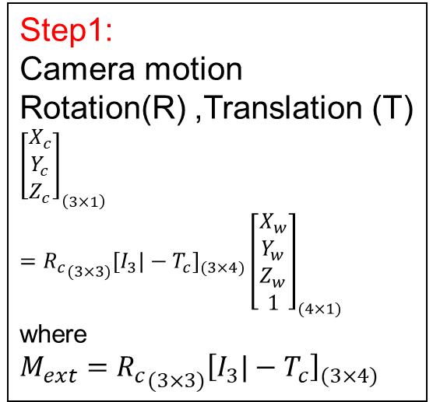

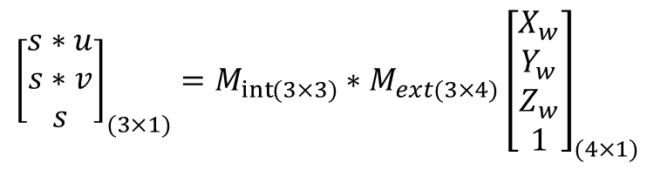

Combine Mint and Mext
Step2:
Projection
$$\left(\begin{matrix}s∗u \\ s∗v \\ s\end{matrix}\right)={Mint\left(\begin{matrix}X_{c} \\ Y_{c} \\ Z_{c}\end{matrix}\right)}_{(3×1)}, where \\ {Mint=\left(\begin{matrix}f & 0 & o_{x} \\ 0 & f & o_{y} \\ 0 & 0 & 1\end{matrix}\right)}_{int}$$
Cam.
Coord
[Xc
Yc
Zc]
Step1:
Camera motion
Rotation(R) ,Translation (T)
$${\left[\begin{matrix}X_{c} \\ Y_{c} \\ Z_{c}\end{matrix}\right]}_{\left(3×1\right)}={R_{c}}_{(3×3)}{\left[I_{3}|−T_{c}\right]}_{(3×4)}{\left[\begin{matrix}X_{w} \\ Y_{w} \\ Z_{w} \\ 1\end{matrix}\right]}_{(4×1)}$$
where
$${M_{ext}=R_{c}}_{(3×3)}{\left[I_{3}|−T_{c}\right]}_{(3×4)}$$
World
Coord.
[X_{w}
Y_{w}
Z_{w}
_{1]}
Image
[u,v]’
Where
u = $s∗u$/s
v = $s∗v$/s
$${\left[\begin{matrix}s∗u \\ s∗v \\ s\end{matrix}\right]}_{(3×1)}=M_{\operatorname{int}{(}3×3)}∗M_{ext(3×4)}{\left[\begin{matrix}X_{w} \\ Y_{w} \\ Z_{w} \\ 1\end{matrix}\right]}_{(4×1)}$$

Slide 63
Take home exercise
Given the camera rotation angles are:
  an_z is the rotation about the Z-axis.
  an_y is the rotation about the Y-axis.
  an_x is the rotation about the X-axis.
and the camera translation Tc=[tcx,tcy,tcz]’
Test using matlab to verify the Properties
  R^{T}*R=I,R^{-1*}R=I, R⁻¹⁼R^{T}, det(R)=I are true
Write a matlab (or pseudo code) program to find [Xc,Yc,Zc]^{T} from [Xw,Yw,Zw]^{T}

Slide 64

Projection matrix P
Combine Mint and Mext to become projection P
$${\left[\begin{matrix}s∗u \\ s∗v \\ s\end{matrix}\right]}_{(3×1)}=M_{\operatorname{int}{(}3×3)}∗M_{ext(3×4)}{\left[\begin{matrix}X_{w} \\ Y_{w} \\ Z_{w} \\ 1\end{matrix}\right]}_{(4×1)} \\ {\left[\begin{matrix}s∗u \\ s∗v \\ s\end{matrix}\right]}_{(3×1)}=P_{(3×4)}∗{\left[\begin{matrix}X_{w} \\ Y_{w} \\ Z_{w} \\ 1\end{matrix}\right]}_{(4×1)}$$
Notes:
%%%% 51 %%%%%%%%%%%%%%%%%%%
\begin{flalign}
\begin{aligned}
\begin{bmatrix}
s*u\\
s*v\\
s
\end{bmatrix}_{(3 \times 1)}&=M_{int(3 \times 3)}*M_{ext(3 \times 4)}\begin{bmatrix}
X_w\\
Y_w\\
Z_w\\
1
\end{bmatrix}_{(4 \times 1)}\\
%-----------------------------------
\begin{bmatrix}
s*u\\
s*v\\
s
\end{bmatrix}_{(3 \times 1)}&=P_{(3 \times 4)}*\begin{bmatrix}
X_w\\
Y_w\\
Z_w\\
1
\end{bmatrix}_{(4 \times 1)}
\end{aligned}
\end{flalign}

Slide 65
Camera calibration and lens distortion
Theory and practice

Slide 66
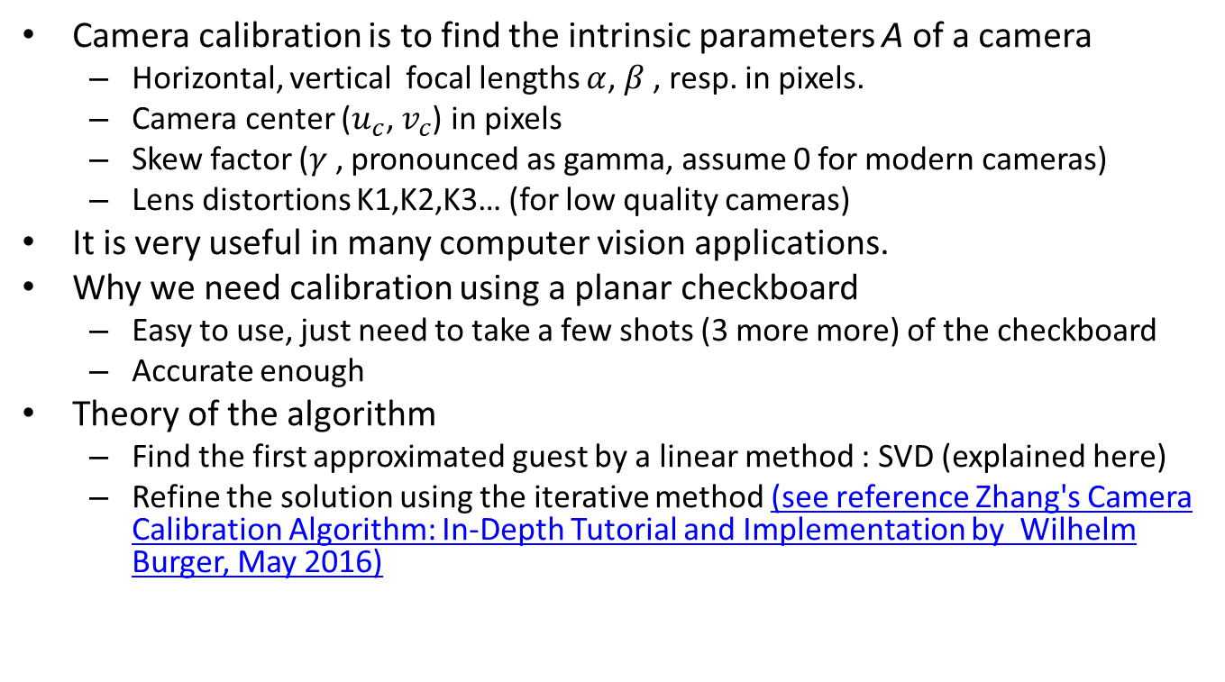

Camera calibration by a checkerboard: Introduction
Camera calibration is to find the intrinsic parameters A of a camera
  Horizontal, vertical focal lengths $α$, $β$, resp. in pixels.
  Camera center ($u_{c}$, $v_{c}$) in pixels
  Skew factor ($γ$, pronounced as gamma, assume 0 for modern cameras)
  Lens distortions K1,K2,K3… (for low quality cameras)
It is very useful in many computer vision applications.
Why we need calibration using a planar checkboard
  Easy to use, just need to take a few shots (3 more more) of the checkboard
  Accurate enough
Theory of the algorithm
  Find the first approximated guest by a linear method : SVD (explained here)
  Refine the solution using the iterative method (see reference Zhang's Camera Calibration Algorithm: In-Depth Tutorial and Implementation by Wilhelm Burger, May 2016)
$$A=\left[\begin{matrix}α & γ & u_{c} \\ 0 & β & v_{c} \\ 0 & 0 & 1\end{matrix}\right]$$

Slide 67
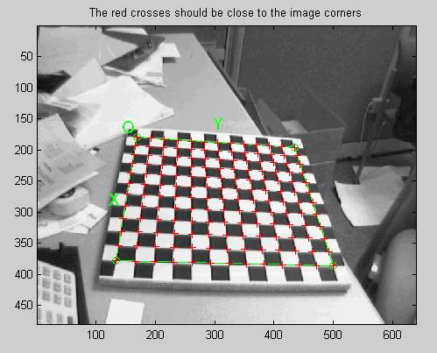

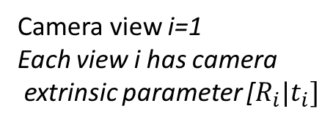
Our task: from N-view of the checkboard to find the camera intrinsic parameter matrix A
World Origin: top-left corner of the checkboard
Z-axis is the vector facing the camera
Z
Z
O= world origin
Y
Y
Camera view i=1
Each view i has camera
extrinsic parameter [$R_{i}|t_{i}]$
Feature j=[X_{j} Y_{j} Z_{j}]^{T}
Z_{j}=0 because it is
on the planar surface
X
The checkboard is at the z=0, x-y plane of the world coordinates (reference)
Camera view i=2
Demo video
https://www.youtube.com/watch?v=ViPN810E0SU&t=6s
X
Camera view i=M
http://www.vision.caltech.edu/bouguetj/calib_doc/htmls/example.html

Slide 68
References for Opencv camera calibration
  Demo video : https://www.youtube.com/watch?v=ViPN810E0SU&t=6s
  Basic tutorial: https://docs.opencv.org/4.x/dc/dbb/tutorial_py_calibration.html
  Demo code using the OPENCV library cv2.calibrateCamera() which is accurate enough. https://github.com/ChihaoZhang/camera-calibration-and-image-undistortion
  An interactive tool can be found at https://github.com/ObeidaElJundi/Camera-Calibration . If you prefer an interactive tool for camera calibration you may consider using this. But the result may not be too accurate since it is only a linear method and not included the refinement by iterative procedures. However, it is a good demonstrative program to see how the linear method works. It would be ideal if you can combine the above two tools.

Slide 69
What is lens distortion?
Unlike a pin hole camera, any camera with a lens has distortion
We will study lens distortion (radial and tangential)
and see how we can correct the distortion

Slide 70
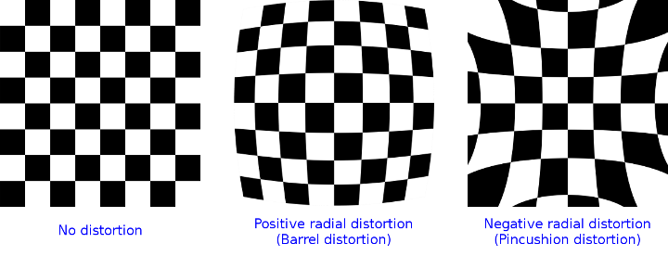
Radial distortion of different types
https://docs.opencv.org/2.4/modules/calib3d/doc/camera_calibration_and_3d_reconstruction.html (opencv)

Slide 71
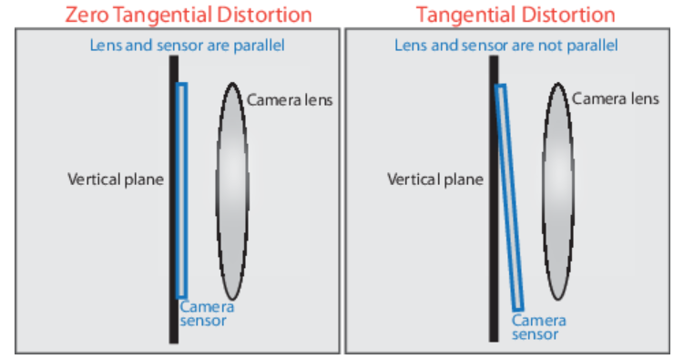
Tangential distortion causes
https://www.mathworks.com/help/vision/ug/camera-calibration.html

Slide 72
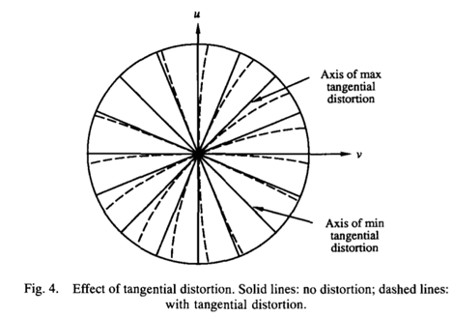
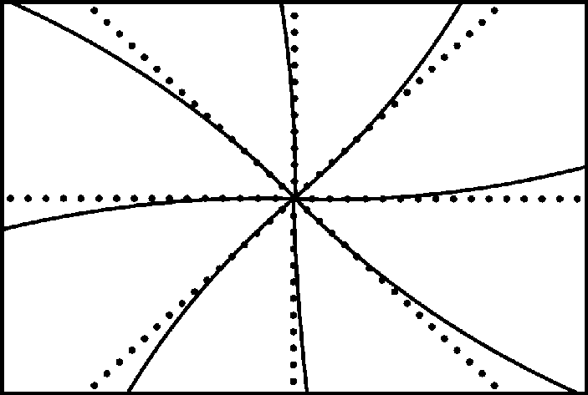
Effect of tangential distortion
https://www.researchgate.net/figure/Effect-of-tangential-distortion_fig14_224369547
Camera Calibration with Distortion Models and Accuracy Evaluation
J. Weng, P. Cohen, M. Herniou, Published 1992, IEEE PAMI

Slide 73
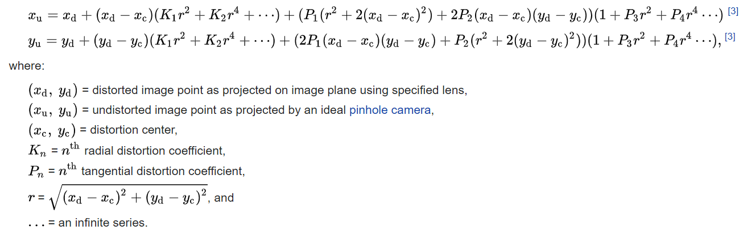
https://en.wikipedia.org/wiki/Distortion_(optics)
Radial distortion, whilst primarily dominated by low order radial components,^{[3]} can be corrected using Brown's distortion model,^{[4]} also known as the Brown–Conrady model based on earlier work by Conrady.^{[5]} The Brown–Conrady model corrects both for radial distortion and for tangential distortion caused by physical elements in a lens not being perfectly aligned. The latter is also known as decentering distortion. See Zhang^{[6]} for additional discussion of radial distortion.

Slide 74
Image correction (opencv) https://docs.opencv.org/2.4/doc/tutorials/calib3d/camera_calibration/camera_calibration.html
r²=x²+y², (x,y) = distorted image position,
k₁, k₂, k₃ are radial distortion coefficients
p₁, p₂ are tangential distortion coefficients
x_{corrected}=x(1+k₁r² +k₂r⁴+k₃r⁶)
y_{corrected}=y(1+k₁r² +k₂r⁴+k₃r⁶)
x_{corrected}=x+ [2p₁xy+p₂ (r²+2x²)]
y_{corrected}=y+ [p₁(r²+2y²)+2p₂xy]

Slide 75
Opencv: Radial distortion coefficients and tangential distortion coefficients https://docs.opencv.org/2.4/modules/calib3d/doc/camera_calibration_and_3d_reconstruction.html
Lens distortion:k1, k2, k3, k4, k5, k6 are radial distortion coefficients
p1 and p2 are tangential distortion coefficients
cv2.calibrationMatrixValues(cameraMatrix, imageSize, apertureWidth, apertureHeight) →output (k1, k2, p1, p2, k3,[ k4, k5, k6]])
In opencv: “All the pixels are previously computed and a look-up table is generated to store the mapping”. From : An Exact Formula for Calculating Inverse Radial Lens Distortions by Pierre Drap, Julien Lefèvre

Slide 76
Opencv camera calibration demo https://github.com/opencv/opencv https://docs.opencv.org/4.x/d4/d94/tutorial_camera_calibration.html (with demo) https://github.com/ChihaoZhang/camera-calibration-and-image-undistortion
Demo code using the OPENCV library cv2.calibrateCamera() which is accurate enough. https://github.com/ChihaoZhang/camera-calibration-and-image-undistortion
or
camera calibration demo by opencv-python
ref: extracted from https://github.com/opencv/opencv
download the whole \openc-master
1) you at least need python files from opencv-master\samples:
calibrate.py and common.py
2) and image files from
opencv-master\samples\data
and /left01.jpg
data have to be in the directory /data
keep the directory structure with
calibrate_py_demo2\calibrate_py
calibrate_py_demo2\data
then run in python
>cd calibrate_py
>python calibrate.py
# undistorted images will be generated in
\calibrate_py_demo2\calibrate_py\output
============ output -=====-
you will get result
camera matrix:
[[532.79536562 0. 342.4582516 ]
[ 0. 532.91928338 233.90060514]
[ 0. 0. 1. ]]
= lens distorition output, 5 numbers
Distortion coefficients=(k1,k2,p1,p2,k3)
K1,k2,k3 are radial distortion coefficients
p1,p2 are tangential distortion coefficients
distortion coefficients:
[-2.81086258e-01
2.72581018e-02
1.21665908e-03
-1.34204275e-04
1.58514022e-01]
===========
So focal length= 532 pixels, skew factor=0
[ox,oy]=[342.5,233.9]
================
#!/usr/bin/env python
'''
camera calibration for distorted images with chess board samples
reads distorted images, calculates the calibration and write undistorted images
usage:
calibrate.py [--debug <output path>] [--square_size] [<image mask>]
default values:
--debug: ./output/
--square_size: 1.0
<image mask> defaults to ../data/left*.jpg
'''
# Python 2/3 compatibility
from __future__ import print_function
import numpy as np
import cv2 as cv
# local modules
from common import splitfn
# built-in modules
import os
def main():
import sys
import getopt
from glob import glob
args, img_mask = getopt.getopt(sys.argv[1:], '', ['debug=', 'square_size=', 'threads='])
args = dict(args)
args.setdefault('--debug', './output/')
args.setdefault('--square_size', 1.0)
args.setdefault('--threads', 4)
if not img_mask:
img_mask = '../data/left??.jpg' # default
#img_mask = '../calimg/calimg??.jpg' # default
else:
img_mask = img_mask[0]
img_names = glob(img_mask)
debug_dir = args.get('--debug')
if debug_dir and not os.path.isdir(debug_dir):
os.mkdir(debug_dir)
square_size = float(args.get('--square_size'))
pattern_size = (9, 6)
pattern_points = np.zeros((np.prod(pattern_size), 3), np.float32)
pattern_points[:, :2] = np.indices(pattern_size).T.reshape(-1, 2)
pattern_points *= square_size
obj_points = []
img_points = []
h, w = cv.imread(img_names[0], cv.IMREAD_GRAYSCALE).shape[:2] # TODO: use imquery call to retrieve results
def processImage(fn):
print('processing %s... ' % fn)
img = cv.imread(fn, 0)
if img is None:
print("Failed to load", fn)
return None
assert w == img.shape[1] and h == img.shape[0], ("size: %d x %d ... " % (img.shape[1], img.shape[0]))
found, corners = cv.findChessboardCorners(img, pattern_size)
if found:
term = (cv.TERM_CRITERIA_EPS + cv.TERM_CRITERIA_COUNT, 30, 0.1)
cv.cornerSubPix(img, corners, (5, 5), (-1, -1), term)
if debug_dir:
vis = cv.cvtColor(img, cv.COLOR_GRAY2BGR)
cv.drawChessboardCorners(vis, pattern_size, corners, found)
_path, name, _ext = splitfn(fn)
outfile = os.path.join(debug_dir, name + '_chess.png')
cv.imwrite(outfile, vis)
if not found:
print('chessboard not found')
return None
print(' %s... OK' % fn)
return (corners.reshape(-1, 2), pattern_points)
threads_num = int(args.get('--threads'))
if threads_num <= 1:
chessboards = [processImage(fn) for fn in img_names]
else:
print("Run with %d threads..." % threads_num)
from multiprocessing.dummy import Pool as ThreadPool
pool = ThreadPool(threads_num)
chessboards = pool.map(processImage, img_names)
chessboards = [x for x in chessboards if x is not None]
for (corners, pattern_points) in chessboards:
img_points.append(corners)
obj_points.append(pattern_points)
# calculate camera distortion
################////////////////////////////////////#####################################################
rms, camera_matrix, dist_coefs, _rvecs, _tvecs = cv.calibrateCamera(obj_points, img_points, (w, h), None, None)
print("\nRMS:", rms)
print("RMS should be between 0.1 and 1.0 \n")
print("camera matrix:\n", camera_matrix)
print("distortion coefficients ravel: ", dist_coefs.ravel())#numpy.ravel: returns contiguous flattened 1D array
print("distortion coefficients: all", dist_coefs)
#revsied
print("\n tx,ty,tz as (same unit as obj_points,so 1=wdith of a checker sqaure in meters) _tvecs:\n", _tvecs )
print("\n rotation vector ) _rvecs:\n", _rvecs )
input("hit key to continue")
# undistort the image with the calibration
print('')
for fn in img_names if debug_dir else []:
_path, name, _ext = splitfn(fn)
img_found = os.path.join(debug_dir, name + '_chess.png')
outfile = os.path.join(debug_dir, name + '_undistorted.png')
img = cv.imread(img_found)
if img is None:
continue
h, w = img.shape[:2]
newcameramtx, roi = cv.getOptimalNewCameraMatrix(camera_matrix, dist_coefs, (w, h), 1, (w, h))
dst = cv.undistort(img, camera_matrix, dist_coefs, None, newcameramtx)
# crop and save the image
x, y, w, h = roi
dst = dst[y:y+h, x:x+w]
print('Undistorted image written to: %s' % outfile)
cv.imwrite(outfile, dst)
print('Done')
if __name__ == '__main__':
print(__doc__)
main()
cv.destroyAllWindows()
9x6
Checker
board

Slide 77
Translation (_tvecs 3x1) and rotation (_rves 3x1) of each image
See next slide for _rvecs (rotation vector for axis-angle representation)
Translation (_tvecs)
tx,ty,tz as (same unit as obj_points,so 1=wdith of a checker sqaure in meters) tvecs: [array([[-3.01491219],
[-4.30712358],
[15.8980211 ]]), array([[-2.33921313],
[ 3.33212639],
[14.09377862]]), array([[-1.59773385],
[-3.9768615 ],
[12.66140731]]), array([[-3.94235355],
[-2.6516654 ],
[13.15750229]]), array([[ 2.33650933],
[-4.57258639],
[12.63322017]]), array([[ 6.68582959],
[-2.57827113],
[13.36732368]]), array([[ 0.77695642],
[-2.82285097],
[15.49189276]]), array([[ 3.15687941],
[-3.47809823],
[12.60203554]]), array([[-2.65602219],
[-3.20468496],
[11.05802945]]), array([[ 1.87240207],
[-4.3969396 ],
[13.45665441]]), array([[ 2.02550523],
[-4.06391184],
[12.8279161 ]]), array([[ 1.3451132 ],
[-3.6178422 ],
[11.56725912]]), array([[ 1.7964161 ],
[-4.28702172],
[12.43417015]])]
Roatation (_rvecs, each is a 3x1 vector, based on Rodrigues in Opencv
_rvecs:
[array([[0.16640241],
[0.27440366],
[0.0131105 ]]), array([[ 0.41703699],
[ 0.65504011],
[-1.33660696]]), array([[-0.27987778],
[ 0.18692513],
[ 0.35483011]]), array([[-0.11417611],
[ 0.23776232],
[-0.00241371]]), array([[-0.29478126],
[ 0.42962401],
[ 1.31248048]]), array([[0.40490705],
[0.30565637],
[1.6483234 ]]), array([[0.17470345],
[0.34612036],
[1.86818083]]), array([[-0.09356551],
[ 0.48155669],
[ 1.75273655]]), array([[ 0.19957004],
[-0.42533828],
[ 0.13302806]]), array([[-0.42149058],
[-0.49715402],
[ 1.33660049]]), array([[-0.24148131],
[ 0.34848304],
[ 1.53044254]]), array([[ 0.46489234],
[-0.28439022],
[ 1.23903183]]), array([[-0.17311708],
[-0.46851781],
[ 1.34686389]])]

Slide 78
The vector translation _tvecs=[x,y,z]
One unit for _tvecs is the length of one side of a square of the checker-pattern
Reference :
Code: https://docs.opencv.org/4.5.5/dc/dbb/tutorial_py_calibration.html
What about the 3D points from real world space? Those images are taken from a static camera and chess boards are placed at different locations and orientations. So, we need to know (X,Y,Z) values. But for simplicity, we can say chess board was kept stationary at XY plane, (so Z=0 always) and camera was moved accordingly. This consideration helps us to find only X,Y values. Now for X,Y values, we can simply pass the points as (0,0), (1,0), (2,0), ... which denotes the location of points. In this case, the results we get will be in the scale of size of chess board square. But if we know the square size, (say 30 mm), we can pass the values as (0,0), (30,0), (60,0), ... . Thus, we get the results in mm. (In this case, we don't know square size since we didn't take those images, so we pass in terms of square size).

Slide 79
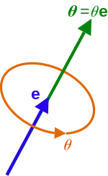

The rotation vector:
_rvecs , using axis–angle representation
The axis–angle representation of a rotation parameterizes a rotation in a three-dimensional Euclidean space by two quantities: a unit vector e indicating the direction of an axis of rotation, and an angle θ describing the magnitude of the rotation about the axis. Only two numbers, not three, are needed to define the direction of a unit vector e rooted at the origin because the magnitude of e is constrained.
https://en.wikipedia.org/wiki/Axis%E2%80%93angle_representation
https://www.vectorjunky.com/vector/delicious-red-apple-arrow/

Slide 80

Using Rodrigues of OPENCV, a 3x1 rotation vector (r_{3x1} for representing rotation) can be converted to a 3x3 rotation matrix R_{3x3}
https://docs.opencv.org/2.4/modules/calib3d/doc/camera_calibration_and_3d_reconstruction.html?highlight=camera%20calibration#rodrigues
A rotation vector (_rves) is a convenient and most compact representation of a rotation matrix (since any rotation matrix has just 3 degrees of freedom). The representation is used in the global 3D geometry optimization procedures like calibrateCamera(), stereoCalibrate(), or solvePnP()
in opencv .
Example: https://www.programcreek.com/python/example/89450/cv2.Rodrigues
R_{3x3}= cv2.Rodrigues(r_{3x1}), r=_rvec(i)
r is 3x1, R is 3x3. I=eye(3). Use the norm of ‘r’ to encode the angle of axis-angle rotation
$θ←norm\left(r\right)$, $θ$is the axis angle
$r ←$r/ $θ, then r is a unit vector$
R=cos $θ$I+(I-cos $θ$)rr^{T}+sin $θ\left[\begin{matrix}0 & −r_{z} & r_{y} \\ r_{z} & 0 & −r_{x} \\ −r_{y} & r_{x} & 0\end{matrix}\right]$
Inverse transform can be done ,since
Sin($θ$)=$\frac{R−RT}{2}$

Slide 81

Python example: =_rvecs=[-2.100418 ; -2.167796 ; 0.273330]
R=cos $θ$I+(I-cos $θ$)rr^{T}+sin $θ\left[\begin{matrix}0 & −r_{z} & r_{y} \\ r_{z} & 0 & −r_{x} \\ −r_{y} & r_{x} & 0\end{matrix}\right]$
import math
import sys
import numpy as np
def rodrigues_vec_to_rotation_mat(rodrigues_vec):
theta = np.linalg.norm(rodrigues_vec)
if theta < sys.float_info.epsilon:
rotation_mat = np.eye(3, dtype=float)
else:
r = rodrigues_vec / theta
I = np.eye(3, dtype=float)
r_rT = np.array([
[r[0]*r[0], r[0]*r[1], r[0]*r[2]],
[r[1]*r[0], r[1]*r[1], r[1]*r[2]],
[r[2]*r[0], r[2]*r[1], r[2]*r[2]]
])
r_cross = np.array([
[0, -r[2], r[1]],
[r[2], 0, -r[0]],
[-r[1], r[0], 0]
])
rotation_mat = math.cos(theta) * I + (1 - math.cos(theta)) * r_rT + math.sin(theta) * r_cross
return rotation_mat
v = np.array([-2.100418, -2.167796, 0.273330])
rotation_mat=rodrigues_vec_to_rotation_mat(v)
print(rotation_mat)
Running example
v = np.array([-2.100418, -2.167796, 0.273330])
rotation_mat=rodrigues_vec_to_rotation_mat(v)
print(rotation_mat)
[[-0.03625454 0.97836355 -0.20369188]
[ 0.99830445 0.02616836 -0.0519947 ]
[-0.04553944 -0.20523155 -0.9776534 ]]
https://stackoverflow.com/questions/62345076/how-to-convert-a-rodrigues-vector-to-a-rotation-matrix-without-opencv-using-pyth

Slide 82
Matlab example:_rvec=[-2.100418 ; -2.167796 ; 0.273330]
R=cos $θ$I+(I-cos $θ$)rr^{T}+sin $θ\left[\begin{matrix}0 & −r_{z} & r_{y} \\ r_{z} & 0 & −r_{x} \\ −r_{y} & r_{x} & 0\end{matrix}\right]$
clc
clear
r=[ -2.100418; -2.167796; 0.273330];
theta=norm(r)
r=r/norm(r)
R=cos(theta)*eye(3)+...
(1-cos(theta))*r*r'+...
sin(theta)*[0 -r(3) r(2); r(3) 0 -r(1); -r(2) r(1) 0]
Result: If r=[ -2.100418; -2.167796; 0.273330];
Then
R =
-0.0363 0.9784 -0.2037
0.9983 0.0262 -0.0520
-0.0455 -0.2052 -0.9777
Same as that from python

Slide 83
Further reading and different approaches
There are many other modeling & approaches
  Accuracy evaluation of optical distortion calibration by digital image correlation by Zeren Gao, Qingchuan Zhang∗ , Yong Su, Shangquan Wu
  An Exact Formula for Calculating Inverse Radial by Lens Distortions Pierre Drap, Julien Lefèvre

Slide 84
Summary for lens distortion and camera calibration
Studied lens radial, tangential distortions and camera calibration using a checkerboard
Learn their causes and how to correct the distorted image
Calibration results _rvecs and _tvecs are explained and examined.

Slide 85
Conclusion
Studied camera model intrinsic parameters
Studied camera rotation matrix R
Studied camera translation matrix T
Studied camera projection matrix P
85

Slide 86
References
[1A] Hartley and Zisserman, Multiple geometry in computer vision, Cambridge, University Press. 2004 (2nd edition, paperback).
[1B] Hartley and Zisserman, Multiple geometry in computer vision, Cambridge, University Press. 1999 (1st edition, hardback).
[2] CVonline: http://homepages.inf.ed.ac.uk/rbf/CVonline
[3] On Skew Symmetric matrix http://mathworld.wolfram.com/SkewSymmetricMatrix.html
[4] On Skew Symmetric matrix http://www.ee.ic.ac.uk/hp/staff/dmb/matrix/special.html#Skew_Symmetric
[5]On RQ decomposition http://wwwcsif.cs.ucdavis.edu/~wangjj/gsvd/codes/rq5.m
[6] Camera calibration matlab toolbox http://www.vision.caltech.edu/bouguetj/calib_doc/index.html#examples
[7] OpenGL Angles to Axes: http://www.songho.ca/opengl/gl_anglestoaxes.html
[8] http://www.ewerksinc.com/refdocs/coordinate%20and%20unit%20vector.pdf
[9] coordinate systems http://www.colorado.edu/ASEN/asen3200/handouts/
[10]http://www.google.com.hk/url?sa=t&rct=j&q=&esrc=s&source=web&cd=1&ved=0CCwQFjAA&url=http%3A%2F%2Fwww.colorado.edu%2FASEN%2Fasen3200%2Fhandouts%2FCoordinateTransformations.doc&ei=nAfdUfTzBqWSiQeo-oCYDw&usg=AFQjCNGp5O37pYqGghl5Fft1skUmSXJ2-A&sig2=6q91UADC3ZZreVm_frd7rg&bvm=bv.48705608,d.aGc&cad=rja
[11] https://docs.opencv.org/4.x/dc/dbb/tutorial_py_calibration.html
[12] https://github.com/ChihaoZhang/camera-calibration-and-https://github.com/ObeidaElJundi/Camera-Calibration
86

Slide 87
Appendices: Advanced topics:
Appendix 1) Latex formulas
Appendix 2) Differences between Rc and Rcam
Appendix 3) Self-study tutorials

Slide 88
Appendix topic 1) Latex formulas
\documentclass{article} %for testing formulas ppt cam, dec8, 2019
\usepackage{amsmath}
\begin{document}
\begin{flalign}
\begin{aligned}
R_{cam} = R_c^{-1}, T_{cam}
\end{aligned}
\end{flalign}
test\\
%%###### slide 11 #############
slide 11\\
$P_w$=World 3D coordinates=$[X_w,Y_w,Z_w]^T$.\\
$P_c$= Camera 3D coordinates =$[X_c,Y_c,_Zc]^ T$.\\
$R_{cam}$=Rotate of the camera in world coord. \\
$T_{cam}$=$T_c$=Translation of the camera in world coord.
%------------------------------
\begin{flalign}
\begin{aligned}
R_{cam} &= R_c^{-1}, T_{cam}\\
P_c&=(R_{cam})^{-1}(P_w-T_{cam})=R_c(P_w-T_c)\\
R_c&=
\begin{bmatrix}
r_{11} & r_{12} & r_{13}\\
r_{21} & r_{32} & r_{33}\\
r_{31} & r_{32} & r_{33}
\end{bmatrix}, T_{cam}=
\begin{bmatrix}
t_{1}\\
t_{2}\\
t_{3}
\end{bmatrix}=T_c
\end{aligned}
\end{flalign}
%%%%%% 47 %%%%%%%%%%%%%%%%%%%%%%%
%slide47
$R_c$ =
\begin{flalign}
\begin{aligned}
\begin{bmatrix}
\cos(\alpha_y)\cos(\alpha_y) &\cos(\alpha_y)\sin(\alpha_z) &-\sin(\alpha_y)\\
%
\cos(\alpha_z)\sin(\alpha_z)\sin(\alpha_y) -\cos(\alpha_x)\sin(\alpha_z) &\cos(\alpha_x)\cos(\alpha_z) + \sin(\alpha_x)\sin(\alpha_y)\sin(\alpha_z) &\cos(\alpha_y)\sin(\alpha_x)\\
%
\sin(\alpha_x)\sin(\alpha_z) + \cos(\alpha_x)\cos(\alpha_z)\sin(\alpha_y) &\cos(\alpha_x)\sin(\alpha_y)\sin(\alpha_z) - \cos(\alpha_z)\sin(\alpha_x) &cos(\alpha_x)\cos(\alpha_y)
\end{bmatrix}
\end{aligned}
\end{flalign}
%%%%% %%% p 48 %%%%%%%%%%
slide 48
\begin{flalign}
\begin{aligned}
%=================
%...... 1 ......................................
P_x&=R_c(P_w-T_c)\\
%...... 2 ......................................
\begin{bmatrix}
X_c\\
Y_c\\
Z_c\\
1
\end{bmatrix}_{(4 \times 1)}&=
\begin{bmatrix}
R_c &-R_c*T_c\\
0 &1
\end{bmatrix}_{(4 \times 4)}
\begin{bmatrix}
X_w\\
Y_w\\
Z_w\\
1
\end{bmatrix}_{(4 \times 1)}\\
%...... 3 ......................................
\begin{bmatrix}
X_c\\
Y_c\\
Z_c
\end{bmatrix}_{(3 \times 1)}&=R_{c(3 \times 3)}
[I_3 | -T_c]_{(3 \times 4)}
\begin{bmatrix}
X_w\\
Y_w\\
Z_w\\
1
\end{bmatrix}_{(4 \times 1)}=
M_{ext(3x4))}\begin{bmatrix}
X_w\\
Y_w\\
Z_w\\
1
\end{bmatrix}_{(4 \times 1)}
%=================
\end{aligned}
\end{flalign}
%%####### p 46 ############
slide 46
\begin{flalign}
\begin{aligned}
\begin{bmatrix}
X_c\\
Y_c\\
Z_c
\end{bmatrix}&=R_{c(zyx)}=R_{c\_x}R_{c\_y}R_{c\_z}
\begin{bmatrix}
X_w\\
Y_w\\
Z_w
\end{bmatrix}
\end{aligned}
\end{flalign}
Rotate around $z$-first, then $y$-axis, fianlly $x$-axis
%-------------------------------------------------------
\begin{flalign}
\begin{aligned}
\begin{bmatrix}
X_c\\
Y_c\\
Z_c
\end{bmatrix}&=
\begin{bmatrix}
1 &0 &0\\
0 &\cos(\theta_x) &\sin(\theta_x)\\
0 &-\sin(\theta_x) &\cos(\theta_x)
\end{bmatrix}
%.....................................
\begin{bmatrix}
\cos(\theta_y) &0 &-\sin(\theta_y)\\
0 &1 &0\\
\sin(\theta_y) &0 &\cos(\theta_y)
\end{bmatrix}
%.....................................
\begin{bmatrix}
\cos(\theta_z) &\sin(\theta_z) &0 \\
-\sin(\theta_z) &\cos(\theta_z) &0 \\
0 &0 &1
\end{bmatrix}
%.....................................
\begin{bmatrix}
X_w\\
Y_w\\
Z_w
\end{bmatrix}
\end{aligned}
\end{flalign}
%############ p 45 ###########
slide 45
\begin{flalign}
\begin{aligned}
%-------1 ---------------------------
\begin{bmatrix}
X_c\\
Y_c\\
Z_c
\end{bmatrix}&=R_{c\_z}
\begin{bmatrix}
X_w\\
Y_w\\
Z_w
\end{bmatrix}=
\begin{bmatrix}
\cos(\theta_z) &\sin(\theta_z) &0 \\
-\sin(\theta_z) &\cos(\theta_z) &0 \\
0 &0 &1
\end{bmatrix}
\begin{bmatrix}
X_w\\
Y_w\\
Z_w
\end{bmatrix}\\
%------2-----------------------------
\begin{bmatrix}
X_c\\
Y_c\\
Z_c
\end{bmatrix}&=R_{c\_y}\begin{bmatrix}
X_w\\
Y_w\\
Z_w
\end{bmatrix}=
\begin{bmatrix}
\cos(\theta_y) &0 &-\sin(\theta_y)\\
0 &1 &0\\
\sin(\theta_y) &0 &\cos(\theta_y)
\end{bmatrix}
\begin{bmatrix}
X_w\\
Y_w\\
Z_w
\end{bmatrix}\\
%------3-----------------------------
\begin{bmatrix}
X_c\\
Y_c\\
Z_c
\end{bmatrix}&=R_{c\_x}\begin{bmatrix}
X_w\\
Y_w\\
Z_w
\end{bmatrix}=
\begin{bmatrix}
1 &0 &0\\
0 &\cos(\theta_x) &\sin(\theta_x)\\
0 &-\sin(\theta_x) &\cos(\theta_x)
\end{bmatrix}
\begin{bmatrix}
X_w\\
Y_w\\
Z_w
\end{bmatrix}
\end{aligned}
\end{flalign}
-----------------------------------
%############# 51 ###############
\begin{flalign}
\begin{aligned}
\begin{bmatrix}
s*u\\
s*v\\
s
\end{bmatrix}_{(3 \times 1)}&=M_{int(3 \times 3)}*M_{ext(3 \times 4)}\begin{bmatrix}
X_w\\
Y_w\\
Z_w\\
1
\end{bmatrix}_{(4 \times 1)}\\
%-----------------------------------
\begin{bmatrix}
s*u\\
s*v\\
s
\end{bmatrix}_{(3 \times 1)}&=P_{(3 \times 4)}*\begin{bmatrix}
X_w\\
Y_w\\
Z_w\\
1
\end{bmatrix}_{(4 \times 1)}
\end{aligned}
\end{flalign}
%############ 38 ##################
slide 38
\begin{flalign}
\begin{aligned}
\begin{bmatrix}
X_c\\
Y_c\\
Z_c
\end{bmatrix}&=R_z\begin{bmatrix}
X_w\\
Y_w\\
Z_w
\end{bmatrix}=
\begin{bmatrix}
\cos(\theta_z) &\sin(\theta_z) &0 \\
-\sin(\theta_z) &\cos(\theta_z) &0 \\
0 &0 &1
\end{bmatrix}
\begin{bmatrix}
X_w\\
Y_w\\
Z_w
\end{bmatrix}\\
\end{aligned}
\end{flalign}
%%% p 37 %%%%%%%%%%
slide 37
\begin{flalign}
\begin{aligned}
X'&=r \cos(\theta_z+\alpha)=r\cos(\theta_z)\cos(\alpha)-r\sin(\theta_z)\sin(\alpha),\text{by definition}\\
Y'&=r \sin(\theta_z+\alpha)=r\sin(\theta_z)\cos(\alpha)-r\cos(\theta_z)\sin(\alpha),\text{by definition}\\
\text{since } X&=r\cos(\alpha), Y=r\sin(alpha), \text{hence}\\
X'&=X\cos(\theta_z)-Y\cos(\theta_z)\\
Y'&=Y\cos(\theta_z)-X\sin(\theta_z)\\
%----------------------------------
\begin{bmatrix}
X'\\
Y'\\
Z'
\end{bmatrix}&=
\begin{bmatrix}
\cos(\theta_z) &-\sin(\theta_z) &0 \\
\sin(\theta_z) &\cos(\theta_z) &0 \\
0 &0 &1
\end{bmatrix}
\begin{bmatrix}
X\\
Y\\
Z
\end{bmatrix}, or \\
\begin{bmatrix}
X\\
Y\\
Z
\end{bmatrix}&=R_{cam}
\begin{bmatrix}
X\\
Y\\
Z
\end{bmatrix}, \text{or } V_z^{`}=R_{cam}V_z
\end{aligned}
\end{flalign}
%############ p26 ##################
%---------- 1------------
slide 26
%\[
\begin{equation}
\begin{bmatrix}
s*u\\
s*v\\
s
\end{bmatrix}
=M_{int}
\begin{bmatrix}
X_c\\
Y_c\\
Z_c
\end{bmatrix}
\end{equation}
\begin{equation}
%- 2 --------------------------------
%
M_{int} =
\begin{bmatrix}
F/s_x & 0 & o_x\\
0 & F/s_y & o_y\\
0 & 0 & 1
\end{bmatrix}
\end{equation}
Image center =$(o_x,o_y)$ in pixels\\
$F$=Focal length in meters\\
$f$=Focal length in pixels\\
$s_x,s_y$=horizontal and vertical pixel size in meters, resp.
%%%%%%% p20 %%%%%%%%%%%%%%%%%%%%%%%%%%
Recall that
\begin{equation}
\label{eq:t}
\begin{aligned}
x & =F*X_c/Z_c \\
y & =F*Y_c/Z_c\\
\text{therefore}\\
u & =(F/s_x)(X_c/Z_c) + o_x\\
v & =(F/s_y)(Y_c/Z_c) + o_y\\
\text{hence}\\
u & =x/s_x*(X_c/Z_c) + o_x\\
v & =y/s_y*(Y_c/Z_c) + o_y
\end{aligned}
\end{equation}
%############ p4 ##################
slide 4 %%%%%%%%%%%%%%%%%%
\[ R_{cam} = R_c^{-1}, T_{cam} \]
\begin{equation}
P_c=(R_{cam})^{-1}(P_w-T_{cam})=R_c(P_w-T_c)
\end{equation}
%%% p 7 %%%%%%%%%%%%%%%%%%
slide 7
\[
R_c=
\begin{bmatrix}
r_{11} & r_{12} & r_{13}\\
r_{21} & r_{32} & r_{33}\\
r_{31} & r_{32} & r_{33}
\end{bmatrix}, t_{cam}=
\begin{bmatrix}
t_{1}\\
t_{2}\\
t_{3}
\end{bmatrix}=t_c
\]
%%%%%% p 12 %%%%%%%%%%%%
slide 12
\[
\begin{bmatrix}
X_{c}\\
Y_{c}\\
Z_{c}\end{bmatrix}=R_c \left(
\begin{bmatrix}
X_{w}\\
Y_{w}\\
Z_{w}
\end{bmatrix}-T_c
%\begin{bmatrix}
%t_{1}\\
%t_{2}\\
%t_{3}
%\end{bmatrix}
\right)
\]
%-------------------------------------------
\[
R_c=
\begin{bmatrix}
r_{11} & r_{12} & r_{13}\\
r_{21} & r_{32} & r_{33}\\
r_{31} & r_{32} & r_{33}
\end{bmatrix}, T_{c}=
\begin{bmatrix}
t_{1}\\
t_{2}\\
t_{3}
\end{bmatrix}
\]
%##########p 13 #####################
slide 13
%--1 -----------------------------
\[
\begin{bmatrix}
X_{c}\\
Y_{c}\\
Z_{c}\end{bmatrix}_{(3\times1)}=R_c \left(
\begin{bmatrix}
X_{w}\\
Y_{w}\\
Z_{w}
\end{bmatrix}_{(3\times1)}-T_{c(3\times1)}
%\begin{bmatrix}
%t_{1}\\
%t_{2}\\
%t_{3}
%\end{bmatrix}
\right)_{3\times1}
\]
%--2 -----------------------------
where \[
R_c=
\begin{bmatrix}
r_{11} & r_{12} & r_{13}\\
r_{21} & r_{32} & r_{33}\\
r_{31} & r_{32} & r_{33}
\end{bmatrix}, T_{c}=
\begin{bmatrix}
t_{1}\\
t_{2}\\
t_{3}
\end{bmatrix}
\]
%--3 -----------------------------
\[
\begin{bmatrix}
X_{c}\\
Y_{c}\\
Z_{c}\end{bmatrix}=R_c \left(
\begin{bmatrix}
X_{w}\\
Y_{w}\\
Z_{w}
\end{bmatrix}-T_c
\right)=R_c
\begin{bmatrix}
t_{1}\\
t_{2}\\
t_{3}
\end{bmatrix}-R_c T_c
%\right)
%\]=R_c\begin{bmatrix}
%X_{w}\\
%Y_{w}\\
%Z_{w}
%\end{bmatrix}-R_c * T_c, add 1 to the bottom for both sides
\] add 1 to the bottom for both sides
%--4 -----------------------------
\[
\begin{bmatrix}
X_{c}\\
Y_{c}\\
Z_{c}\\
1 \end{bmatrix}_{(4 \times 1)}= \left(
\begin{bmatrix}
R_{c(3 \times 3)} & -(R_c*T_c)_{(3 \times 1)}\\
0_{(1 \times 3)} & 1_{(1 \times 1)}
\end{bmatrix}
\right)_{(4 \times 4)}
\begin{bmatrix}
X_{w}\\
Y_{w}\\
Z_{w}\\
1
\end{bmatrix}_{(4 \times 1)}
\]This the same as (i)
The 4x1 vector $[X, Y, Z, 1]^T$ is in 3-D homogeneous coordinates
\end{document}

Slide 89
Appendix 2
Differences between Tc and Rcam
Rcam vs. Rc, we will see the difference.
Cameras v.3a
89

Slide 90
Precise definition of Rc, Tc and Rcam
  Rc: A vector (V) Pw will appear as Pc in camera coordinates using Rc
    Pc=Rc*Pw , where a vector Pw in world coordinates is the same vector Pc in camera coordinates . V does not change, it is only the coordinate system changes
R_{cam} is the rotational matrix that rotates the principal axis (Vz) of the camera position to a new position in the world coordinates. R_{cam} will change Vz, but it is always in the world coord. Sys. before and after the change.
So R_{cam} rotates the camera but R_{c} is the transform to bring a vector in the world corrd. sys to the camera corrd sys. Hence Pc=Rc*Pw.
R_{cam} = (R_{c}) ⁻¹ (Note R⁻¹=R^{T} for rotation matrices)
T_{cam}=T_{c} is the translation of the camera center in the world coordinate system.
(-Tc) takes the camera center back to the world center in the world coordinate system.
Notes:
We learned that a vector P in the world coordinates is described as Pc= Rc*P=Rx*Ry*Rz*P
if the coordinate system is rotated Rz in the z-axis, Ry in the y-axis and Rx-in the x-axis.

Slide 91

To rotate a vector in 2D
The vector u_{x} [1,0]’ is rotated by the matrix R(θ) to become
  x’=cos(θ), y’=sin(θ)
The vector u_{y} [0,1]’ is rotated by the matrix R(θ) to become
  x’’= -sin(θ), y’’= cos(θ)
A general vector v is a combination of
  x component (v_{x}) * u_{x} and
  y component (v_{y}) * u_{y}
So, v is rotated to v’ by R(θ) to produce x’+x’’ in x and y’+ y’’ in y
-sin(θ)
u_{y}
cos(θ)
-θ
θ
sin(θ)
cos(θ)
u_{x}
Radius=1
$$V′=R(θ)∗V=\left[\begin{matrix}\cos{(}θ) & −\sin{(}θ) \\ \sin{(}θ) & \cos{(}θ)\end{matrix}\right]\left[\begin{matrix}v_{x} \\ v_{y}\end{matrix}\right]\text{,}\text{where}V=\left[\begin{matrix}v_{x} \\ v_{y}\end{matrix}\right]$$
http://reedbeta.wordpress.com/2011/09/18/rotations-and-infinitesimal-generators/

Slide 92


To show Rcam = Rc⁻¹
$$R_{cam_2D}(θ_{z})=\left[\begin{matrix}\cos{(}θ) & −\sin{(}θ) \\ \sin{(}θ) & \cos{(}θ)\end{matrix}\right],so \\ R_{cam}(θ_{z})=\left[\begin{matrix}\cos{(}θ_{z}) & −\sin{(}θ_{z}) & 0 \\ \sin{(}θ_{z}) & \cos{(}θ_{z}) & 0 \\ 0 & 0 & 1\end{matrix}\right] \\ \text{Since} R_{c}(θ_{z})=\left[\begin{matrix}\cos{(}θ_{z}) & \sin{(}θ_{z}) & 0 \\ −\sin{(}θ_{z}) & \cos{(}θ_{z}) & 0 \\ 0 & 0 & 1\end{matrix}\right], \\ \text{You} \text{can} \text{show} \text{that} R_{cam}∗R_{c}(θ_{z})=I \\ \text{hence} R_{cam}(θ_{z})=R_{c}(θ_{z})^{−1}$$
We can think of R_{cam}(θ_{Z})rotates the camera pointing to Yw in the world coordinate system to a new direction of Yc. Using the result of vector rotation described in the last slide we can show that R_{cam}(θ_{Z})=Rc(θ_{Z})⁻¹
(Note R⁻¹=R^{T} for rotation matrices R.)
Y_{c}
θ_{z}
Y_{w}
a=0.3 %matlab demo:
Rc_pos_a=[cos(a) sin(a) 0
-sin(a) cos(a) 0
0 0 1]
Rcam=[cos(a) -sin(a) 0
sin(a) cos(a) 0
0 0 1]
Rc_pos_a*Rcam %it is I3
θ_{z}
X_{c}
X_{w}

Slide 93

This slide is shown earlier combine rotations in 3 axes:
The camera has rotated (θx, θy, θz), Rc brings a vector in world coordinates to the camera coordinates
$$\left[\begin{matrix}X_{c} \\ Y_{c} \\ Z_{c}\end{matrix}\right]=R_{c}=R_{c_x}R_{c_y}R_{c_z}\left[\begin{matrix}X_{w} \\ Y_{w} \\ Z_{w}\end{matrix}\right] \\ \left[\begin{matrix}X_{c} \\ Y_{c} \\ Z_{c}\end{matrix}\right]= \\ \left[\begin{matrix}1 & 0 & 0 \\ 0 & \cos{(}θ_{x}) & \sin{(}θ_{x}) \\ 0 & −\sin{(}θ_{x}) & \cos{(}θ_{x})\end{matrix}\right]\left[\begin{matrix}\cos{(}θ_{y}) & 0 & −\sin{(}θ_{y}) \\ 0 & 1 & 0 \\ \sin{(}θ_{y}) & 0 & \cos{(}θ_{y})\end{matrix}\right]\left[\begin{matrix}\cos{(}θ_{z}) & \sin{(}θ_{z}) & 0 \\ −\sin{(}θ_{z}) & \cos{(}θ_{z}) & 0 \\ 0 & 0 & 1\end{matrix}\right]\left[\begin{matrix}X_{w} \\ Y_{w} \\ Z_{w}\end{matrix}\right] \\ \left[\begin{matrix}\cos\left(θ_{y}\right)\cos\left(θ_{z}\right) & \cos\left(θ_{y}\right)\sin\left(θ_{z}\right) & −\sin\left(θ_{y}\right) \\ \cos\left(θ_{z}\right)\sin\left(θ_{x}\right)\sin\left(θ_{y}\right)−\cos\left(θ_{x}\right)\sin\left(θ_{z}\right) & \cos\left(θ_{x}\right)\cos\left(θ_{z}\right)+\sin\left(θ_{x}\right)\sin\left(θ_{y}\right)\sin\left(θ_{z}\right) & \cos\left(θ_{y}\right)\sin\left(θ_{x}\right) \\ \sin\left(θ_{x}\right)\sin\left(θ_{z}\right)+\cos\left(θ_{x}\right)\cos\left(θ_{z}\right)\sin\left(θ_{y}\right) & \cos\left(θ_{x}\right)\sin\left(θ_{y}\right)\sin\left(θ_{z}\right)−\cos\left(θ_{z}\right)\sin\left(θ_{x}\right) & \cos\left(θ_{x}\right)\cos\left(θ_{y}\right)\end{matrix}\right]\left[\begin{matrix}X_{w} \\ Y_{w} \\ Z_{w}\end{matrix}\right]$$
Notes:
According the formula Rc=Rx*Ry*Rz, the camera rotations must be in this order: first rotate in z-axis , then y-axis , finally x-axis. See that Rz is closest to [Xw,Yw,Zw]’ , hence it is rotated first.
Make sure your camera is rotated in this way, then you can use the above formula.
You may use another camera rotation sequence but you must change the formula .
E.g. If first rotate in x-axis , then y-axis , finally z-axis you should use the formula Rc=Rz*Ry*Rx

Slide 94

Rc=Rc_xyz, Here we use Rc_zyx (rotate x –axis first, then y the z)
Here we show Rc_zyx, and Inverse(Rc_zyx)
If we need Rc_zyx (rotate against x-axis first) which is the coordinate change rotation matrix
and (Rc_zyx)⁻¹ is the camera motion rotation matrix (proved in previous slides, around p39) (Note R⁻¹=R^{T} for rotation matrices R.)
This (Rc_zyx)⁻¹ is the rotation matrix used in P333 of Intro. Techno. For 3-D comp. vision by Trucco and verri.
(Note R⁻¹=R^{T} for rotation matrices R.)
$$R_{c_zyx}=R_{c_z}R_{c_y}R_{c_x}= \\ \left[\begin{matrix}\cos{(}θ_{z}) & \sin{(}θ_{z}) & 0 \\ −\sin{(}θ_{z}) & \cos{(}θ_{z}) & 0 \\ 0 & 0 & 1\end{matrix}\right]\left[\begin{matrix}\cos{(}θ_{y}) & 0 & −\sin{(}θ_{y}) \\ 0 & 1 & 0 \\ \sin{(}θ_{y}) & 0 & \cos{(}θ_{y})\end{matrix}\right]\left[\begin{matrix}1 & 0 & 0 \\ 0 & \cos{(}θ_{x}) & \sin{(}θ_{x}) \\ 0 & −\sin{(}θ_{x}) & \cos{(}θ_{x})\end{matrix}\right] \\ {R_{c_zyx}}^{−1}={\left(R_{c_z}R_{c_y}R_{c_x}\right)}^{−1}= \\ \left[\begin{matrix}\cos\left(θ_{y}\right)\cos\left(θ_{z}\right) & −\cos\left(θ_{y}\right)\sin\left(θ_{z}\right) & \sin\left(θ_{y}\right) \\ \sin\left(θ_{x}\right)\cos\left(θ_{z}\right)\sin\left(θ_{y}\right)+\cos\left(θ_{x}\right)\sin\left(θ_{z}\right) & \cos\left(θ_{x}\right)\cos\left(θ_{z}\right)−\sin\left(θ_{x}\right)\sin\left(θ_{y}\right)\sin\left(θ_{z}\right) & −\cos\left(θ_{y}\right)\sin\left(θ_{x}\right) \\ \sin\left(θ_{x}\right)\sin\left(θ_{z}\right)−\cos\left(θ_{x}\right)\cos\left(θ_{z}\right)\sin\left(θ_{y}\right) & \cos\left(θ_{x}\right)\sin\left(θ_{y}\right)\sin\left(θ_{z}\right)+\cos\left(θ_{z}\right)\sin\left(θ_{x}\right) & \cos\left(θ_{x}\right)\cos\left(θ_{y}\right)\end{matrix}\right] \\ \text{See} \text{P}\text{333 }\text{of} Introductory Technques for 3−D computer Vision \text{by} \text{Trucco} \text{and} \text{Verri}$$
Notes:
According the formula Rc=Rx*Ry*Rz, the camera rotations must be in this order: first rotate in z-axis , then y-axis , finally x-axis. See that Rz is closest to [Xw,Yw,Zw]’ , hence it is rotated first.
Make sure your camera is rotated in this way, then you can use the above formula.
You may use another camera rotation sequence but you must change the formula .
E.g. If first rotate in x-axis , then y-axis , finally z-axis you should use the formula Rc=Rz*Ry*Rx

Slide 95
syms an_x an_y an_z
%- demo to show relation between
% ---Rc and its inverse-------------
Rc_z=[cos(an_z) sin(an_z) 0
-sin(an_z) cos(an_z) 0
0 0 1]
%---------------------------------------
Rc_y=[cos(an_y) 0 -sin(an_y)
0 1 0
sin(an_y) 0 cos(an_y)]
%-------------------------------------
Rc_x=[1 0 0
0 cos(an_x) sin(an_x)
0 -sin(an_x) cos(an_x)]
%-----------------------------------------
'This is to show the following 3 important results'
Rxyz=Rc_x*Rc_y*Rc_z
Rzyx=Rc_z*Rc_y*Rc_x
inv_Rzyx=inv(Rzyx)
%inv_Rzyx is used in P333 of Trucco

Slide 96
%show transpose(Rc_pos_a)=Rc_neg_a and Rc_pos_a *transpose(Rc_pos_a) =I
% '----------results--------'
% a = 0.3000
%Rc_pos_a =
% 0.9553 0.2955 0
% -0.2955 0.9553 0
% 0 0 1.0000
% transpose (Rc_pos_a is)
% 0.9553 -0.2955 0
% 0.2955 0.9553 0
% 0 0 1.0000
% Rc_neg_a =
% 0.9553 -0.2955 0
% 0.2955 0.9553 0
% 0 0 1.0000
% shown: transpose(Rc_pos_a)=Rc_neg_a
% show that Rc_pos_a*transpose(Rc_pos_a)=I
% 1 0 0
% 0 1 0
% 0 0 1
a=0.3 %any angle a is ok
'Rc_pos_a is '
Rc_pos_a=[cos(a) sin(a) 0
-sin(a) cos(a) 0
0 0 1]
'transpose (Rc_pos_a is) '
Rc_pos_a'
'Rc_neg_a is '
Rc_neg_a=[cos(-a) sin(-a) 0
-sin(-a) cos(-a) 0
0 0 1]
‘shown: transpose(Rc_pos_a)=Rc_neg_a '
'------------------------------------------------'
'show that Rc_pos_a*transpose(Rc_pos_a)=I '
Rc_pos_a*Rc_pos_a'

Slide 97

Practical issue: center of CCD is at image center (right hand coordinate system with realistic CCD)
**Image origin at left-top (if you use matlab imread() to read it ) etc.
‘-f’ instead of ‘f’
y
Z
$$Use \\ {M\left(\begin{matrix}−f & 0 & o_{x} \\ 0 & −f & o_{y} \\ 0 & 0 & 1\end{matrix}\right)}_{int}$$
1024
CCD
1,1
u (pixels)
(Ox,Oy)=
(512,384) in pixels
x
768
v (pixels)

Slide 98
Summary and meanings of notations used in this chapter
  Pw=a vector in the world coordinate system.
  Pc= the same vector (as Pw) but in the camera coordinate system.
  Rcam, Tc : rotation, translation, resp., in the world coord. sys.
  Rc : After the camera is rotated Rcam and translated Tc in the world coordinate system, Pc=Rc*(Pw-Tc)-----(i)
  We proved that Rcam=Rc⁻¹, so equation (i) becomes
  Pc=(Rcam)⁻¹*(Pw-Tc)----(ii), or
  Pc=(Rcam)⁻¹*(Pw)+ (-(Rcam)⁻¹*Tc)----(ii), so we can make
  Pc=R*Pw+T---(iii), if
    R=(Rcam)⁻¹=Rc and
    T=(-(Rcam)⁻¹*Tc) = -Rc*Tc
Equation (iii) is an expression used in many articles.

Slide 99
rot_syms.m : use the matlab symbolic processor to show varies possible arrangements of the Rotational matrix
% rot_syms.m
%show varies arrangement of the
%R rotation matrix, khw 140319
syms an_x an_y an_z real
Rz=[cos(an_z) sin(an_z) 0
-sin(an_z) cos(an_z) 0
0 0 1];
Ry=[cos(an_y) 0 -sin(an_y)
0 1 0
sin(an_y) 0 cos(an_y)];
Rx=[1 0 0
0 cos(an_x) sin(an_x)
0 -sin(an_x) cos(an_x)];
Rxyz= Rz*Ry*Rx %do x first then y, z
transpose_Rxyz= (Rz*Ry*Rx)'
inverse_Rxyz= inv(Rz*Ry*Rx)
Rzyx= Rx*Ry*Rz %do z first then y, x
transpose_Rzyx= (Rx*Ry*Rz)' %do z first, then z, and y
inverse_Rzyx= inv(Rx*Ry*Rz)%do z first, then z, and y
%ANOTHER SET , IN THIS SET r_x=Rx', r_y=Ry', r_z=Rz'
rz=Rz';
ry=Ry';
rx=Rx';
rxyz= rz*ry*rx %do x first then y, z
transpose_rxyz= (rz*ry*rx)'
inverse_rxyz= inv(rz*ry*rx)
rzyx= rx*ry*rz %do z first then y, x
transpose_rzyx= (rx*ry*rz)' %do z first, then z, and y
inverse_Rzyx= inv(rx*ry*rz)%do z first, then z, and y

Slide 100
Output of rot_syms.m (page1)
>> rot_syms
Rxyz =
[ cos(an_y)*cos(an_z), cos(an_x)*sin(an_z) + cos(an_z)*sin(an_x)*sin(an_y), sin(an_x)*sin(an_z) - cos(an_x)*cos(an_z)*sin(an_y)]
[ -cos(an_y)*sin(an_z), cos(an_x)*cos(an_z) - sin(an_x)*sin(an_y)*sin(an_z), cos(an_z)*sin(an_x) + cos(an_x)*sin(an_y)*sin(an_z)]
[ sin(an_y), -cos(an_y)*sin(an_x), cos(an_x)*cos(an_y)]
transpose_Rxyz =
[ cos(an_y)*cos(an_z), -cos(an_y)*sin(an_z), sin(an_y)]
[ cos(an_x)*sin(an_z) + cos(an_z)*sin(an_x)*sin(an_y), cos(an_x)*cos(an_z) - sin(an_x)*sin(an_y)*sin(an_z), -cos(an_y)*sin(an_x)]
[ sin(an_x)*sin(an_z) - cos(an_x)*cos(an_z)*sin(an_y), cos(an_z)*sin(an_x) + cos(an_x)*sin(an_y)*sin(an_z), cos(an_x)*cos(an_y)]
inverse_Rxyz =
[ cos(an_y)*cos(an_z), -cos(an_y)*sin(an_z), sin(an_y)]
[ cos(an_x)*sin(an_z) + cos(an_z)*sin(an_x)*sin(an_y), cos(an_x)*cos(an_z) - sin(an_x)*sin(an_y)*sin(an_z), -cos(an_y)*sin(an_x)]
[ sin(an_x)*sin(an_z) - cos(an_x)*cos(an_z)*sin(an_y), cos(an_z)*sin(an_x) + cos(an_x)*sin(an_y)*sin(an_z), cos(an_x)*cos(an_y)]
Rzyx =
[ cos(an_y)*cos(an_z), cos(an_y)*sin(an_z), -sin(an_y)]
[ cos(an_z)*sin(an_x)*sin(an_y) - cos(an_x)*sin(an_z), cos(an_x)*cos(an_z) + sin(an_x)*sin(an_y)*sin(an_z), cos(an_y)*sin(an_x)]
[ sin(an_x)*sin(an_z) + cos(an_x)*cos(an_z)*sin(an_y), cos(an_x)*sin(an_y)*sin(an_z) - cos(an_z)*sin(an_x), cos(an_x)*cos(an_y)]
transpose_Rzyx =
[ cos(an_y)*cos(an_z), cos(an_z)*sin(an_x)*sin(an_y) - cos(an_x)*sin(an_z), sin(an_x)*sin(an_z) + cos(an_x)*cos(an_z)*sin(an_y)]
[ cos(an_y)*sin(an_z), cos(an_x)*cos(an_z) + sin(an_x)*sin(an_y)*sin(an_z), cos(an_x)*sin(an_y)*sin(an_z) - cos(an_z)*sin(an_x)]
[ -sin(an_y), cos(an_y)*sin(an_x), cos(an_x)*cos(an_y)]
inverse_Rzyx =
[ cos(an_y)*cos(an_z), cos(an_z)*sin(an_x)*sin(an_y) - cos(an_x)*sin(an_z), sin(an_x)*sin(an_z) + cos(an_x)*cos(an_z)*sin(an_y)]
[ cos(an_y)*sin(an_z), cos(an_x)*cos(an_z) + sin(an_x)*sin(an_y)*sin(an_z), cos(an_x)*sin(an_y)*sin(an_z) - cos(an_z)*sin(an_x)]
[ -sin(an_y), cos(an_y)*sin(an_x), cos(an_x)*cos(an_y)]

Slide 101
Output of rot_syms.m (page2)
rxyz =
[ cos(an_y)*cos(an_z), cos(an_z)*sin(an_x)*sin(an_y) - cos(an_x)*sin(an_z), sin(an_x)*sin(an_z) + cos(an_x)*cos(an_z)*sin(an_y)]
[ cos(an_y)*sin(an_z), cos(an_x)*cos(an_z) + sin(an_x)*sin(an_y)*sin(an_z), cos(an_x)*sin(an_y)*sin(an_z) - cos(an_z)*sin(an_x)]
[ -sin(an_y), cos(an_y)*sin(an_x), cos(an_x)*cos(an_y)]
transpose_rxyz =
[ cos(an_y)*cos(an_z), cos(an_y)*sin(an_z), -sin(an_y)]
[ cos(an_z)*sin(an_x)*sin(an_y) - cos(an_x)*sin(an_z), cos(an_x)*cos(an_z) + sin(an_x)*sin(an_y)*sin(an_z), cos(an_y)*sin(an_x)]
[ sin(an_x)*sin(an_z) + cos(an_x)*cos(an_z)*sin(an_y), cos(an_x)*sin(an_y)*sin(an_z) - cos(an_z)*sin(an_x), cos(an_x)*cos(an_y)]
inverse_rxyz =
[ cos(an_y)*cos(an_z), cos(an_y)*sin(an_z), -sin(an_y)]
[ cos(an_z)*sin(an_x)*sin(an_y) - cos(an_x)*sin(an_z), cos(an_x)*cos(an_z) + sin(an_x)*sin(an_y)*sin(an_z), cos(an_y)*sin(an_x)]
[ sin(an_x)*sin(an_z) + cos(an_x)*cos(an_z)*sin(an_y), cos(an_x)*sin(an_y)*sin(an_z) - cos(an_z)*sin(an_x), cos(an_x)*cos(an_y)]
rzyx =
[ cos(an_y)*cos(an_z), -cos(an_y)*sin(an_z), sin(an_y)]
[ cos(an_x)*sin(an_z) + cos(an_z)*sin(an_x)*sin(an_y), cos(an_x)*cos(an_z) - sin(an_x)*sin(an_y)*sin(an_z), -cos(an_y)*sin(an_x)]
[ sin(an_x)*sin(an_z) - cos(an_x)*cos(an_z)*sin(an_y), cos(an_z)*sin(an_x) + cos(an_x)*sin(an_y)*sin(an_z), cos(an_x)*cos(an_y)]
transpose_rzyx =
[ cos(an_y)*cos(an_z), cos(an_x)*sin(an_z) + cos(an_z)*sin(an_x)*sin(an_y), sin(an_x)*sin(an_z) - cos(an_x)*cos(an_z)*sin(an_y)]
[ -cos(an_y)*sin(an_z), cos(an_x)*cos(an_z) - sin(an_x)*sin(an_y)*sin(an_z), cos(an_z)*sin(an_x) + cos(an_x)*sin(an_y)*sin(an_z)]
[ sin(an_y), -cos(an_y)*sin(an_x), cos(an_x)*cos(an_y)]
inverse_Rzyx =
[ cos(an_y)*cos(an_z), cos(an_x)*sin(an_z) + cos(an_z)*sin(an_x)*sin(an_y), sin(an_x)*sin(an_z) - cos(an_x)*cos(an_z)*sin(an_y)]
[ -cos(an_y)*sin(an_z), cos(an_x)*cos(an_z) - sin(an_x)*sin(an_y)*sin(an_z), cos(an_z)*sin(an_x) + cos(an_x)*sin(an_y)*sin(an_z)]
[ sin(an_y), -cos(an_y)*sin(an_x), cos(an_x)*cos(an_y)]

Slide 102

Rotation matrix
$$R=\left[\begin{matrix}r_{11} & r_{12} & r_{13} \\ r_{21} & r_{22} & r_{23} \\ r_{31} & r_{32} & r_{33}\end{matrix}\right]= \\ \left[\begin{matrix}\cos\left(θ_{y}\right)\cos\left(θ_{z}\right) & \cos\left(θ_{y}\right)\sin\left(θ_{z}\right) & −\sin\left(θ_{y}\right) \\ \cos\left(θ_{z}\right)\sin\left(θ_{x}\right)\sin\left(θ_{y}\right)−\cos\left(θ_{x}\right)\sin\left(θ_{z}\right) & \cos\left(θ_{x}\right)\cos\left(θ_{z}\right)+\sin\left(θ_{x}\right)\sin\left(θ_{y}\right)\sin\left(θ_{z}\right) & \cos\left(θ_{y}\right)\sin\left(θ_{x}\right) \\ \sin\left(θ_{x}\right)\sin\left(θ_{z}\right)+\cos\left(θ_{x}\right)\cos\left(θ_{z}\right)\sin\left(θ_{y}\right) & \cos\left(θ_{x}\right)\sin\left(θ_{y}\right)\sin\left(θ_{z}\right)−\cos\left(θ_{z}\right)\sin\left(θ_{x}\right) & \cos\left(θ_{x}\right)\cos\left(θ_{y}\right)\end{matrix}\right] \\ And \\ R^{−1}=R^{T},R^{T}R=I_{3},\det{(}R)=1 \\ \text{Also}\text{, }\text{when} φ_{x},φ_{y},φ_{z} \text{are} \text{small} \\ R=\left[\begin{matrix}r_{11} & r_{12} & r_{13} \\ r_{21} & r_{22} & r_{23} \\ r_{31} & r_{32} & r_{33}\end{matrix}\right]≈\left[\begin{matrix}1 & −φ_{z} & φ_{y} \\ φ_{z} & 1 & −φ_{x} \\ −φ_{y} & φ_{x} & 1\end{matrix}\right],\text{when} φ_{x},φ_{y},φ_{z} \text{are} \text{small}\text{,}\text{so}$$

Slide 103

Rotation of a point in 3D
You may take this as R_{cam}
Assume a point [X,Y,Z] of length r in the world coordinate is being rotated (R_{cam}) around the Z-axis only by θ_{z}
$$X′=r\cos{(}θ_{z}+α)=r\cos{(}θ_{z})\cos{(}α)−r\sin{(}θ_{z})\sin{(}α),\text{by} \text{defn}\text{.} \\ Y′=r\sin{(}θ_{z}+α)=r\sin{(}θ_{z})\cos{(}α)+r\cos{(}θ_{z})\sin{(}α),\text{by} \text{defn}\text{.} \\ \text{since} X=r\cos{(}α),Y=r\sin{(}α)\text{, }\text{hence} \\ X′=X\cos{(}θ_{z})−Y\sin{(}θ_{z}) \\ Y′=Y\cos{(}θ_{z})+X\sin{(}θ_{z}), \\ hence \\ \left[\begin{matrix}X′ \\ Y′ \\ 1\end{matrix}\right]=\left[\begin{matrix}\cos{(}θ_{z}) & −\sin{(}θ_{z}) & 0 \\ \sin{(}θ_{z}) & \cos{(}θ_{z}) & 0 \\ 0 & 0 & 1\end{matrix}\right]\left[\begin{matrix}X \\ Y \\ 1\end{matrix}\right]$$
Y-axis
r
Y’
θ_{z}
r
Y
α
X’
X-axis
X

Slide 104

You may compare with an earlier slide as shown below
Camera coordinates rotated θ_{z} about Z-axis relative to the world coordinates
A vector Pw=[Xw,Yw,Zw]’ is in the world coordinates (blue/solid_axes) is the same vector [Xc,Yc,Zc]’ in the camera coordinates (red/dash_axes)
Z-axis is facing you
$$\text{Case} (1) \text{Rotate} \text{about} \text{Z} \text{axis} \text{only}\text{, }θ_{x}=0,θ_{y}=0, \\ \left[\begin{matrix}X_{c} \\ Y_{c} \\ Z_{c}\end{matrix}\right]=R_{c_z}\left[\begin{matrix}X_{w} \\ Y_{w} \\ Z_{w}\end{matrix}\right]=\left[\begin{matrix}\cos{(}θ_{z}) & \sin{(}θ_{z}) & 0 \\ −\sin{(}θ_{z}) & \cos{(}θ_{z}) & 0 \\ 0 & 0 & 1\end{matrix}\right]\left[\begin{matrix}X_{w} \\ Y_{w} \\ Z_{w}\end{matrix}\right]$$
Concentrate on Yc
Y_{c}= -X_{w}sin(θ_{z})+Y_{w}cos(θ_{z})
Y_{c}
Concentrate on Xc
θ_{z}
Y_{w}
θ_{z}
Y_{w}
θ_{z}
θ_{z}
X_{w}cos(θ_{z})
X_{w}
X_{w}
X_{w}sin(θ_{z})
θ_{z}
Pw
θ_{z}
Pw
X_{c}
X_{c}=X_{w}cos(θ_{z})+Y_{w}sin(θ_{z})
Y_{w}sin(θ_{z})
Y_{w}cos(θ_{z})

Slide 105

Relating R_{cam} and R_{c}
$$\text{We} \text{have} \text{shown} \text{how} \text{the} \text{world} \text{and} \text{camera} \text{coordinates} \text{are} \text{related} \\ \left[\begin{matrix}X_{c} \\ Y_{c} \\ Z_{c}\end{matrix}\right]=R_{c_z}\left[\begin{matrix}X_{w} \\ Y_{w} \\ Z_{w}\end{matrix}\right]=\left[\begin{matrix}\cos{(}θ_{z}) & \sin{(}θ_{z}) & 0 \\ −\sin{(}θ_{z}) & \cos{(}θ_{z}) & 0 \\ 0 & 0 & 1\end{matrix}\right]\left[\begin{matrix}X_{w} \\ Y_{w} \\ Z_{w}\end{matrix}\right] \\ \text{For} R_{z}=R_{c_z}=\left[\begin{matrix}\cos{(}θ_{z}) & \sin{(}θ_{z}) & 0 \\ −\sin{(}θ_{z}) & \cos{(}θ_{z}) & 0 \\ 0 & 0 & 1\end{matrix}\right], \\ \text{We} \text{have} \text{also} \text{shown} \text{the} \text{rotation} \text{of} \text{a}\text{ 3}\text{D} \text{point} \text{can} \text{be} \text{described} \text{as} \\ \left[\begin{matrix}X′ \\ Y′ \\ 1\end{matrix}\right]=R_{cam}\left[\begin{matrix}X \\ Y \\ 1\end{matrix}\right]=\left[\begin{matrix}\cos{(}θ_{z}) & −\sin{(}θ_{z}) & 0 \\ \sin{(}θ_{z}) & \cos{(}θ_{z}) & 0 \\ 0 & 0 & 1\end{matrix}\right]\left[\begin{matrix}X \\ Y \\ 1\end{matrix}\right] \\ \text{For} R_{cam}=\left[\begin{matrix}\cos{(}θ_{z}) & −\sin{(}θ_{z}) & 0 \\ \sin{(}θ_{z}) & \cos{(}θ_{z}) & 0 \\ 0 & 0 & 1\end{matrix}\right] \\ \text{It} \text{is} \text{interesting} \text{to} \text{see} \text{that} \\ (R_{cam})^{−1}={R_{cam}}^{T}=\left[\begin{matrix}\cos{(}θ_{z}) & \sin{(}θ_{z}) & 0 \\ −\sin{(}θ_{z}) & \cos{(}θ_{z}) & 0 \\ 0 & 0 & 1\end{matrix}\right]=R_{c_z}$$
Exercise: Think clearly what is the meaning of R_{cam} and R_{c}?

Slide 106
Test rpymat(angs) and rool_pitch_yaw_mat2(angs), angs=[roll,pitch,yaw]
[roll(around x first),then pitch(around y),finally yaw(around z)]
%http://www.grc.nasa.gov/WWW/k12/airplane/rotations.html
%http://planning.cs.uiuc.edu/node102.html
%demo_roll_pitch_yaw
function demo_roll_pitch_yaw()
clear
clc
%They are the same
%They are the same
R=rpymat([10,20,30]*pi/180);
R2=roll_pitch_yaw_mat2([10,20,30]*pi/180);
R-R2
rpyAng(R)*180/pi
rpyAng(R)*180/pi
% result ans =
% 1.0e-15 *
% 0 -0.1110 0
% 0 0 0
% 0 0 0
%%%%%%%%%%%%%%%%%%%%%%%%%%%%%%%%%%%%%%%%%%%%%%%%%%%%%%%%%%%%
% Author: Rodrigo Carceroni
cosA = cos (angs(3));
sinA = sin (angs(3));
cosB = cos (angs(2));
sinB = sin (angs(2));
cosC = cos (angs(1));
sinC = sin (angs(1));
cosAsinB = cosA .* sinB;
sinAsinB = sinA .* sinB;
R = [ cosA.*cosB cosAsinB.*sinC-sinA.*cosC cosAsinB.*cosC+sinA.*sinC ;
sinA.*cosB sinAsinB.*sinC+cosA.*cosC sinAsinB.*cosC-cosA.*sinC ;
-sinB cosB.*sinC cosB.*cosC ];
%%%%%%%%%%%%%%%%%%
function angs = rpyAng (R)
%https://stackoverflow.com/questions/15022630/how-to-calculate-the-angle-from-rotation-matrix
% Returns a set of Roll, Pitch and Yaw angles that describe a certain 3x3
% transformation matrix. The magnitude of the Pitch angle is constrained
% to be not bigger than pi/2.
sinB = -R(3,1);
cosB = sqrt (R(1,1) .* R(1,1) + R(2,1) .* R(2,1));
if abs (cosB) > 1e-15
sinA = R(2,1) ./ cosB;
cosA = R(1,1) ./ cosB;
sinC = R(3,2) ./ cosB;
cosC = R(3,3) ./ cosB;
angs = [atan2(sinC,cosC); atan2(sinB,cosB); atan2(sinA,cosA)];
else
sinC = (R(1,2) - R(2,3)) ./ 2;
cosC = (R(2,2) + R(1,3)) ./ 2;
angs = [atan2(sinC,cosC); pi./2; 0];
if sinB < 0
angs = -angs;
end;
end;
%%%%%%%%%%%%%%%%%%%%%%%%%%%%%%%%%%%%%%%%%%%%%%%%%%%%%%%
function R=roll_pitch_yaw_mat2(angs)
% % same as berlow
an_x=angs(1);
an_y=angs(2);
an_z=angs(3);
%below are Rcam
Rz=[cos(an_z) -sin(an_z) 0
sin(an_z) cos(an_z) 0
0 0 1];
Ry=[cos(an_y) 0 sin(an_y)
0 1 0
-sin(an_y) 0 cos(an_y)];
Rx=[1 0 0
0 cos(an_x) -sin(an_x)
0 sin(an_x) cos(an_x)];
R= Rz*Ry*Rx ;%rotate x first, then y, final z

Slide 107
demo_roll_pitch_yaw.m
%Test rpymat(angs) and rool_pitch_yaw_mat2(angs),
%angs=[roll,pitch,yaw]
%[roll(around x first),then pitch(around y),finally yaw(around z)]
%http://www.grc.nasa.gov/WWW/k12/airplane/rotations.html
%http://planning.cs.uiuc.edu/node102.html
%demo_roll_pitch_yaw
function demo_roll_pitch_yaw()
clear
clc
%They are the same
R=rpymat([10,20,30]*pi/180);
R2=roll_pitch_yaw_mat2([10,20,30]*pi/180);
R-R2
rpyAng(R)*180/pi
rpyAng(R)*180/pi
% result ans =
% 1.0e-15 *
% 0 -0.1110 0
% 0 0 0
% 0 0 0
%%%%%%%%%%%%%%%%%%%%%%%%%%%%%%%%%%%%%%%%%%%%%%%%%%%%%%%%%%%%
% Author: Rodrigo Carceroni
% Disclaimer: This code comes with no guarantee at all and its author
% is not liable for any damage that its utilization may cause.
%khw added 3.3002 , input angs is a 1x3 matrix,
% angs(1) is yaw angle about x-axis
% angs(2) is pitch angle about y-aixs
% angs(3) is roll angle about z-axis
%then X'=RX+T; X,T are 3X1 matrixes for [X,Y,Z]' 3D corrd. and translations.
function R = rpyMat (angs)
% Return the 3x3 rotation matrix described by a set of Roll, Pitch and Yaw
% angles.
cosA = cos (angs(3));
sinA = sin (angs(3));
cosB = cos (angs(2));
sinB = sin (angs(2));
cosC = cos (angs(1));
sinC = sin (angs(1));
cosAsinB = cosA .* sinB;
sinAsinB = sinA .* sinB;
R = [ cosA.*cosB cosAsinB.*sinC-sinA.*cosC cosAsinB.*cosC+sinA.*sinC ;
sinA.*cosB sinAsinB.*sinC+cosA.*cosC sinAsinB.*cosC-cosA.*sinC ;
-sinB cosB.*sinC cosB.*cosC ];
%%%%%%%%%%%%%%%%%%%%%%%%%%%%%%%%%%%%%%%%%%%%%%%%%%%%%%%
function R=roll_pitch_yaw_mat2(angs)
% % same as berlow
an_x=angs(1);
an_y=angs(2);
an_z=angs(3);
%below are Rcam
Rz=[cos(an_z) -sin(an_z) 0
sin(an_z) cos(an_z) 0
0 0 1];
Ry=[cos(an_y) 0 sin(an_y)
0 1 0
-sin(an_y) 0 cos(an_y)];
Rx=[1 0 0
0 cos(an_x) -sin(an_x)
0 sin(an_x) cos(an_x)];
R= Rz*Ry*Rx ;%rotate x first, then y, final z
%%%%%%%%%%%%%%%%%%%%%%%%%%%%%%%%%%%%%%%%%%%%%%%%%%%%%%%
function angs = rpyAng (R)
%https://stackoverflow.com/questions/15022630/how-to-calculate-the-angle-from-rotation-matrix
% Returns a set of Roll, Pitch and Yaw angles that describe a certain 3x3
% transformation matrix. The magnitude of the Pitch angle is constrained
% to be not bigger than pi/2.
sinB = -R(3,1);
cosB = sqrt (R(1,1) .* R(1,1) + R(2,1) .* R(2,1));
if abs (cosB) > 1e-15
sinA = R(2,1) ./ cosB;
cosA = R(1,1) ./ cosB;
sinC = R(3,2) ./ cosB;
cosC = R(3,3) ./ cosB;
angs = [atan2(sinC,cosC); atan2(sinB,cosB); atan2(sinA,cosA)];
else
sinC = (R(1,2) - R(2,3)) ./ 2;
cosC = (R(2,2) + R(1,3)) ./ 2;
angs = [atan2(sinC,cosC); pi./2; 0];
if sinB < 0
angs = -angs;
end;
end;
Result:
ans =
1.0e-17 *
0 0 0
0 0 0.3469
0 0 0
ans =
10.0000
20.0000
30.0000
ans =
10.0000
20.0000
30.0000

Slide 108
Appendix 3
Self-study
Tutorial exercises
Cmsc5711 : camera models

Slide 109

CMSC5711: Tutorial T.1
: Intrinsic parameters M_{int}
(an upper-triangular matrix)
_{3D=Xc,Yc,Zc in meters}
_{Image=u,v in pixels}
_{s= arbitrary rating factor}
_{Exercise:}
Show equations (3) (4) are the same as this matrix form eq(5).
Recall:
u=(F/s_{x})*(X_{c}/Z_{c}) + o_{x} --(3)
v=(F/s_{y})*(Y_{c}/Z_{c}) + o_{y} --(4)
$$\left(\begin{matrix}s∗u \\ s∗v \\ s\end{matrix}\right)={M\left(\begin{matrix}X_{c} \\ Y_{c} \\ Z_{c}\end{matrix}\right)}_{int} \\ {M\left(\begin{matrix}F/s_{x} & 0 & o_{x} \\ 0 & F/s_{y} & o_{y} \\ 0 & 0 & 1\end{matrix}\right)}_{int} \\ image_center=(o_{x},o_{y}) \text{in} \text{pixels} \\ F=focal_length \text{in} \text{meters} \\ f=focal_length \text{in} \text{pixels} \\ S_{x},S_{y}=pixel_size \text{in} \text{meters}$$
Notes:
Equation 3 and 4 have been shown before, we can convert them into a matrix form in equation 5, you may try to show the conversion as an exercise.
Equation 5 has an advantage over formula 3 and 4, equation 5 is a linear system, in computer science we love linear systems because you can find a lot of math tools to solve linear problems.
Equation 3,4 are non-linear, because they involve division terms (1/Z) and make them difficult to solve.
But there is a hitch, (u,v) are what we want to find but the left hand side of the equation is a 3x1 vector [s*u,s*v,s]’ =[su,sv,s]’ , when you want to get u,v you need to do
u=su/s=first element of [su,sv,s]’ / last element of [su,sv,s]’
v=sv/s=second element of [su,sv,s]’ / last element of [su,sv,s]’
In fact we just delay the non-linear operation (the division operation) at the end. But we can use linear system math-tools to handle the more difficult stages and find u,v at the final step.
We call (u,v) as homogenous coordinates, remember that the actual pixel coordinates is (u,v) not su and sv.

Slide 110
Answer: Tutorial T.1
Intrinsic parameters M_{int}
(an upper-triangular matrix)
_{3D=Xc,Yc,Zc in meters}
_{Image=u,v in pixels}
_{s= arbitrary rating factor}
_{Exercise:}
Show equations (3) (4) are the same as this matrix form eq(5).
Recall:
u=(F/s_{x})*(X_{c}/Z_{c}) + o_{x} --(3)
v=(F/s_{y})*(Y_{c}/Z_{c}) + o_{y} --(4)
Answer: from (5) use matrix multiplication
s*u=(F/s_{x})*(X_{c}) + o_{x} *Z_{c}--(i)
s*v=(F/s_{y})*(Y_{c}) + o_{y} *Z_{c}--(ii)
Set s= Z_{c}-------------------------(iii)
(i)/(iii), hence u=(F/s_{x})*(X_{c}/Z_{c}) + o_{x}
(i)/(iii), hence v=(F/s_{y})*(Y_{c}/Z_{c}) + o_{y}
(proved!)
$$\left(\begin{matrix}s∗u \\ s∗v \\ s\end{matrix}\right)={M\left(\begin{matrix}X_{c} \\ Y_{c} \\ Z_{c}\end{matrix}\right)}_{int} \\ {M\left(\begin{matrix}F/s_{x} & 0 & o_{x} \\ 0 & F/s_{y} & o_{y} \\ 0 & 0 & 1\end{matrix}\right)}_{int} \\ image_center=(o_{x},o_{y}) \text{in} \text{pixels} \\ F=focal_length \text{in} \text{meters} \\ f=focal_length \text{in} \text{pixels} \\ S_{x},S_{y}=pixel_size \text{in} \text{meters}$$
Notes:
Equation 3 and 4 have been shown before, we can convert them into a matrix form in equation 5, you may try to show the conversion as an exercise.
Equation 5 has an advantage over formula 3 and 4, equation 5 is a linear system, in computer science we love linear systems because you can find a lot of math tools to solve linear problems.
Equation 3,4 are non-linear, because they involve division terms (1/Z) and make them difficult to solve.
But there is a hitch, (u,v) are what we want to find but the left hand side of the equation is a 3x1 vector [s*u,s*v,s]’ =[su,sv,s]’ , when you want to get u,v you need to do
u=su/s=first element of [su,sv,s]’ / last element of [su,sv,s]’
v=sv/s=second element of [su,sv,s]’ / last element of [su,sv,s]’
In fact we just delay the non-linear operation (the division operation) at the end. But we can use linear system math-tools to handle the more difficult stages and find u,v at the final step.
We call (u,v) as homogenous coordinates, remember that the actual pixel coordinates is (u,v) not su and sv.

Slide 111

Tutorial T.2
Given
X,Y,Z are in 3D
u,v are in 2D
Focal length is 3mm, sx=sy=3um
(ox,oy)=(620,410) in pixels
A 3D point is at X=0.015 meters, Y=0.02 meters and Z=2 meters away from the camera center.
Fill in the blanks (__?)
[u v]^{T}=??
^{Answer:} [u v]^{T =____________________?}
Y
v
Z
$$\left[\begin{matrix}s∗u \\ s∗v \\ s\end{matrix}\right]={M\left[\begin{matrix}X \\ Y \\ Z\end{matrix}\right]\left(\begin{matrix}____? & 0 & ____? \\ 0 & ____? & ____? \\ 0 & 0 & 1\end{matrix}\right)\left[\begin{matrix}____? \\ ____? \\ 2\end{matrix}\right]}_{int}$$
u=410
Y=384 X
(1,1)
X=512
v=620
o_{x},o_{y}=620, 410
(Image center is shifted to o_{x},o_{y})

Slide 112

Answer:
Tutorial T.2
Given
%matlab
m=[1000 0 620; 0 1000 410; 0 0 1]
p=[0.015 0.02 2]'
x=m*p
u=x(1)/x(3)
v=x(2)/x(3)
Answer :
u =627.5,v = 420
X,Y,Z are in 3D
u,v are in 2D
Focal length is 3mm, sx=sy=3um
(ox,oy)=(620,410) in pixels
A 3D point is at X=0.015 meters, Y=0.02 meters high and Z=2 meters away from the camera center.
Fill in the blanks (__?)
[u v]^{T}=??
^{Answer:} [u v]T =___627.5, 420_________________?
Y
v
Z
$$\left[\begin{matrix}s∗u \\ s∗v \\ s\end{matrix}\right]={M\left[\begin{matrix}X \\ Y \\ Z\end{matrix}\right]\left(\begin{matrix}__1000__? & 0 & _620___? \\ 0 & _1000___? & _410___? \\ 0 & 0 & 1\end{matrix}\right)\left[\begin{matrix}_0.015___? \\ _0.02___? \\ 2\end{matrix}\right]}_{int}$$
u=410
Y=384 X
(1,1)
X=512
v=620
o_{x},o_{y}=620, 410
(Image center is shifted to o_{x},o_{y})

Slide 113

Tutorial T.3: Camera coordinates rotated θ_{y} about Y-axis relative to the world coordinates. A vector Pw=[Xw,Yw,Zw]’ is in the world coordinates (blue/solid_axes) is the same vector [Xc,Yc,Zc]’ in the camera coordinates (red/dash_axes)
Q1: Y-axis is facing in or out of the paper?
Q2: Fill in the blanks (__?)
$$\text{Case} (2) \text{Rotate} \text{about} \text{Y} \text{axis} \text{only}\text{, }θ_{x}=0,θ_{z}=0, \\ \text{This} \text{exercise} \text{helps} \text{you} \text{to} \text{proof} \text{that} \\ P_{c}=\left[\begin{matrix}X_{c} \\ Y_{c} \\ Z_{c}\end{matrix}\right]=R_{c_y}P_{w}=R_{y}\left[\begin{matrix}X_{w} \\ Y_{w} \\ Z_{w}\end{matrix}\right]=\left[\begin{matrix}\cos{(}θ_{y}) & 0 & −\sin{(}θ_{y}) \\ 0 & 1 & 0 \\ \sin{(}θ_{y}) & 0 & \cos{(}θ_{y})\end{matrix}\right]\left[\begin{matrix}X_{w} \\ Y_{w} \\ Z_{w}\end{matrix}\right]$$
Show:Z_{c}= -X_{w}sin(-θ_{y})+Z_{w}cos(-θ_{y})
__?
___?
Mark vector Pc on the paper
-θ_{y}
Z_{w}
-θ_{y}
Z_{w}
-θ_{y}
-θ_{y}
X_{w}cos(__?)
X_{w}
X_{w}
X_{w}___?(-θ_{y})
-θ_{y}
Pw
-θy
Pw
X_{y}
Show
X_{c}=Xwcos(-θ_{y}) +Zw_sin(-θ_{y})
___?sin(-θ_{y})
__?cos(-θ_{z})

Slide 114

ANSWER Tutorial T.3: Camera coordinates rotated θ_{y} about Y-axis relative to the world coordinates. A vector Pw=[Xw,Yw,Zw]’ is in the world coordinates (blue/solid_axes) is the same vector [Xc,Yc,Zc]’ in the camera coordinates (red/dash_axes)
Q1: Y-axis is facing in or out of the paper?
Ans: in, Q2: Fill in the blanks (__?)
$$\text{Case} (2) \text{Rotate} \text{about} \text{Y} \text{axis} \text{only}\text{, }θ_{x}=0,θ_{z}=0, \\ \text{This} \text{exercise} \text{helps} \text{you} \text{to} \text{proof} \text{that} \\ \left[\begin{matrix}X_{c} \\ Y_{c} \\ Z_{c}\end{matrix}\right]=R_{c_y}\left[\begin{matrix}X_{w} \\ Y_{w} \\ Z_{w}\end{matrix}\right]=\left[\begin{matrix}\cos{(}θ_{y}) & 0 & −\sin{(}θ_{y}) \\ 0 & 1 & 0 \\ \sin{(}θ_{y}) & 0 & \cos{(}θ_{y})\end{matrix}\right]\left[\begin{matrix}X_{w} \\ Y_{w} \\ Z_{w}\end{matrix}\right]$$
Show:Z_{c}= -X_{w}sin(-θ_{y})+Z_{w}cos(-θ_{y})
Zc_?
Mark vector Pc on the paper
Zc_?
-θ_{y}
Z_{w}
-θ_{y}
Z_{w}
-θ_{y}
-θ_{y}
X_{w}cos(-θ_{y}?)
X_{w}
X_{w}
X_{w}sin?(-θ_{y})
-θ_{y}
Pw
-θy
Pw
X_{y}
Show
X_{c}=Xwcos(-θ_{y}) +Zw_sin(-θ_{y})
Zw_?sin(-θ_{y})
Z_{w}?cos(-θ_{z})

Slide 115

Tutorial T.4:
Study the rotation matrix Rc and Translation vector Tc
M_{ext} (3x4)Matrix form
When Tc is not Zero
P_{w}
Y_{w}
Camera
coordinates
Z_{c}
Y_{c}
X_{c}
Z_{w}
T_{C}= camera translation
$$P_{c}=R_{c}(P_{w}−T_{c})−−−−−(i) \\ \left[\begin{matrix}X_{c} \\ Y_{c} \\ Z_{c} \\ 1\end{matrix}\right]=\left[\begin{matrix}R_{c} & −R_{c}∗T_{c} \\ 0 & 1\end{matrix}\right]\left[\begin{matrix}X_{w} \\ Y_{w} \\ Z_{w} \\ 1\end{matrix}\right],\text{select} \text{the} \text{first}\text{ 3 }\text{rows} \\ \left[\begin{matrix}X_{c} \\ Y_{c} \\ Z_{c}\end{matrix}\right]=R_{c}\left[I_{3}|−T_{c}\right]\left[\begin{matrix}X_{w} \\ Y_{w} \\ Z_{w} \\ 1\end{matrix}\right]=M_{ext}\left[\begin{matrix}X_{w} \\ Y_{w} \\ Z_{w} \\ 1\end{matrix}\right]$$
R_{cam}=(R_{c})⁻¹
Camera center
X_{w}
World center
World coordinates
(reference)
Tutorial :
Show the dimensions of the variables.
Notes:
After studying the effect of pure camera rotation where Tc=0, we now study the problem when the camera has translation Tc.
From the diagram you should observe that , the vector from the camera (camera center) to the top of the Christmas tree is equal to Pw-Tc.
So now we have a vector (Pw-Tc, from the camera center to the Christmas tree top) in the world coordinates,
we want to know how the vector is described in the camera coordinate system, so Rc is no used.
We learned that a vector P in the world coordinates is described as Pc= Rc*P=Rx*Ry*Rz*P
if the coordinate system is rotated Rz in the z-axis, Ry in the y-axis and Rx-in the x-axis.
Hence the total transformation (combining translation and rotation) becomes Pc=Rc(Pw-Tc)
That means a point Pw in the world coordinates is the same point Pc in the camera coordinates if the camera is translated and rotated.

Slide 116
ANSWER Tutorial T.4:
Study the rotation matrix Rc and Translation vector Tc
M_{ext} (3x4)Matrix form
When Tc is not Zero
P_{w}
Y_{w}
Camera
coordinates
Z_{c}
Y_{c}
X_{c}
Z_{w}
T_{C}= camera translation
R_{cam}=(R_{c})⁻¹
Camera center
X_{w}
World center
World coordinates
(reference)
Answer
Exercise :
Show the dimensions
of the variables.
Notes:
After studying the effect of pure camera rotation where Tc=0, we now study the problem when the camera has translation Tc.
From the diagram you should observe that , the vector from the camera (camera center) to the top of the Christmas tree is equal to Pw-Tc.
So now we have a vector (Pw-Tc, from the camera center to the Christmas tree top) in the world coordinates,
we want to know how the vector is described in the camera coordinate system, so Rc is no used.
We learned that a vector P in the world coordinates is described as Pc= Rc*P=Rx*Ry*Rz*P
if the coordinate system is rotated Rz in the z-axis, Ry in the y-axis and Rx-in the x-axis.
Hence the total transformation (combining translation and rotation) becomes Pc=Rc(Pw-Tc)
That means a point Pw in the world coordinates is the same point Pc in the camera coordinates if the camera is translated and rotated.

Slide 117

Tutorial T.5
$$\left[\begin{matrix}X_{c} \\ Y_{c} \\ Z_{c}\end{matrix}\right]=R_{c}\left[I_{3}|−T_{c}\right]\left[\begin{matrix}X_{w} \\ Y_{w} \\ Z_{w} \\ 1\end{matrix}\right]=M_{ext}\left[\begin{matrix}X_{w} \\ Y_{w} \\ Z_{w} \\ 1\end{matrix}\right] \\ where \\ I_{3}=\left[\begin{matrix}1 & 0 & 0 \\ 0 & 1 & 0 \\ 0 & 0 & 1\end{matrix}\right],R_{c}=\left[\begin{matrix}r11 & r12 & r13 \\ r21 & r22 & r23 \\ r31 & r32 & r33\end{matrix}\right],T_{c}=\left[\begin{matrix}t_{cx} \\ t_{cy} \\ t_{cz}\end{matrix}\right] \\ M_{ext}=\left[\begin{matrix}M11 & M12 & M13 & M14 \\ M21 & M22 & M23 & M24 \\ M31 & M32 & M33 & M34\end{matrix}\right]$$
Write M_{exti=1,2,3; j=1,2,3,4} in terms of R_{i=1,2,3;j=1,2,3} and T_{c}=[t_{cx} ,t_{cy} ,t_{cz}]^{T}

Slide 118
Answer for Tutorial T.5 (i)
%Matlab code
%Worksheet 2.7(i) Write Mi=1,2,3; %j=1,2,3,4 in terms of
%Ri=1,2,3;j=1,2,3 and %tc=[tcx;tcy;tcz]
clear
syms Mext Rc tcx tcy tcz r11 r12 r13 r21 r22 r23 r31 r32 r33
Rc=[ r11 r12 r13; r21 r22 r23; r31 r32 r33]
Tc=[tcx ;tcy ;tcz]
'%%% answer ws 2.7 (i) %%%%%%%%%%'
'now look at the answers for ws 2.7(i)'
Mext=Rc*[eye(3) -1*Tc]
'size of Mext is '
size(Mext)
'kit any key to continue'
pause
Answer:
Mext =
[ r11, r12, r13, - r11*tcx - r12*tcy - r13*tcz]
[ r21, r22, r23, - r21*tcx - r22*tcy - r23*tcz]
[ r31, r32, r33, - r31*tcx - r32*tcy - r33*tcz]

Slide 119
Tutorial T.6
If the camera has moved T_{c}=[t_{cx} ,t_{cy} ,t_{cz}]^{T}
and rotates θz first , θy second and then θx in the world camera, discuss the procedures to find M_{exti=1,2,3; j=1,2,3,4}

Slide 120

Answer: Tutorial T.6
If the camera has moved T_{c}=[t_{cx},t_{cy},t_{cz}]^{T}
and rotates θz first , θy second and then θz in the world camera, discuss how do you find Mext_{i=1,2,3; j=1,2,3,4}
Answer:
Find Rc first (see below), then find M_{ext} as in the previous exercise.
$$R_{c(xyz)}= \\ \left[\begin{matrix}\cos\left(θ_{y}\right)\cos\left(θ_{z}\right) & \cos\left(θ_{y}\right)\sin\left(θ_{z}\right) & −\sin\left(θ_{y}\right) \\ \cos\left(θ_{z}\right)\sin\left(θ_{x}\right)\sin\left(θ_{y}\right)−\cos\left(θ_{x}\right)\sin\left(θ_{z}\right) & \cos\left(θ_{x}\right)\cos\left(θ_{z}\right)+\sin\left(θ_{x}\right)\sin\left(θ_{y}\right)\sin\left(θ_{z}\right) & \cos\left(θ_{y}\right)\sin\left(θ_{x}\right) \\ \sin\left(θ_{x}\right)\sin\left(θ_{z}\right)+\cos\left(θ_{x}\right)\cos\left(θ_{z}\right)\sin\left(θ_{y}\right) & \cos\left(θ_{x}\right)\sin\left(θ_{y}\right)\sin\left(θ_{z}\right)−\cos\left(θ_{z}\right)\sin\left(θ_{x}\right) & \cos\left(θ_{x}\right)\cos\left(θ_{y}\right)\end{matrix}\right]$$

Slide 121
Answer continue for tutorial T.6 (i)
Answer:
Mext =
[ r11, r12, r13, - r11*tcx - r12*tcy - r13*tcz]
[ r21, r22, r23, - r21*tcx - r22*tcy - r23*tcz]
[ r31, r32, r33, - r31*tcx - r32*tcy - r33*tcz]
%Matlab code
%Worksheet 2.7(i) Write Mi=1,2,3; %j=1,2,3,4 in terms of
%Ri=1,2,3;j=1,2,3 and %tc=[tcx;tcy;tcz]
clear
syms Mext Rc tcx tcy tcz r11 r12 r13 r21 r22 r23 r31 r32 r33
Rc=[ r11 r12 r13; r21 r22 r23; r31 r32 r33]
Tc=[tcx ;tcy ;tcz]
'%%% answer ws 2.7 (i) %%%%%%%%%%'
'now look at the answers for ws 2.7(i)'
Mext=Rc*[eye(3) -1*Tc]
'size of Mext is '
size(Mext)
'kit any key to continue'
pause

Slide 122
Answer continue for tutorial T.6 (ii)
clear
%'Worksheet 2.7(ii) If the camera has moved
disp('Tt=1,2,3 and rotates an_x, an_y, anz in the world camera, ')
disp('find Mi=1,2,3; j=1,2,3,4')
syms P Mint Mext f ox oy tcx tcy tcz r11 r12 r13 r21 r22 r23 r31 r32 r33 an_x an_y an_z
Rz=[cos(an_z) sin(an_z) 0
-sin(an_z) cos(an_z) 0
0 0 1];
Ry=[cos(an_y) 0 -sin(an_y)
0 1 0
sin(an_y) 0 cos(an_y)];
Rx=[1 0 0
0 cos(an_x) sin(an_x)
0 -sin(an_x) cos(an_x)]
Tc=[tcx ;tcy ;tcz]
Rc=Rx*Ry*Rz
Mext=Rc*[eye(3) -1*Tc]
Mint=[-f 0 ox; 0 f oy; 0 0 1]
'%%%%% answer ws 2.7 (ii) %%%%%%%%%%%%%'
'now look at the answers for 2.7 (ii)'
P=Mint*Mext
'P(:,1)------- first column'
P(:,1)
'P(:,2)------- second column'
P(:,2)
'P(:,3)------- third column'
P(:,3)
'size of P is '
size(P)

Slide 123
Answer continue for tutorial T.6 (ii)
%Answer:
P(:,1)------------first column----------------------------------
ans =
ox*(sin(an_x)*sin(an_z) + cos(an_x)*cos(an_z)*sin(an_y)) - f*cos(an_y)*cos(an_z)
oy*(sin(an_x)*sin(an_z) + cos(an_x)*cos(an_z)*sin(an_y)) - f*(cos(an_x)*sin(an_z) - cos(an_z)*sin(an_x)*sin(an_y))
sin(an_x)*sin(an_z) + cos(an_x)*cos(an_z)*sin(an_y)
P(:,2) -----------second column--------------------------------
ans =
- ox*(cos(an_z)*sin(an_x) - cos(an_x)*sin(an_y)*sin(an_z)) - f*cos(an_y)*sin(an_z)
f*(cos(an_x)*cos(an_z) + sin(an_x)*sin(an_y)*sin(an_z)) - oy*(cos(an_z)*sin(an_x) - cos(an_x)*sin(an_y)*sin(an_z))
cos(an_x)*sin(an_y)*sin(an_z) - cos(an_z)*sin(an_x)
P(:,3) ------------third column-----------------------------------
ans =
f*sin(an_y) + ox*cos(an_x)*cos(an_y)
oy*cos(an_x)*cos(an_y) + f*cos(an_y)*sin(an_x)
cos(an_x)*cos(an_y)

Slide 124

Tutorial T.7 Write p_{i=1,2,3; j=1,2,3,4} in terms of M_{ext:i=1,2,3;j=1,2,3} and f
$$P=\text{Projection} \text{matrix} \\ P={Mext}_{int} \\ where \\ {M\left[\begin{matrix}f & 0 & 0 \\ 0 & f & 0 \\ 0 & 0 & 1\end{matrix}\right]}_{int} \\ M_{ext}=\left[\begin{matrix}M11 & M12 & M13 & M14 \\ M21 & M22 & M23 & M24 \\ M31 & M32 & M33 & M34\end{matrix}\right] \\ P=\left[\begin{matrix}p11 & p12 & p13 & p14 \\ p21 & p22 & p23 & p24 \\ p31 & p32 & p33 & p34\end{matrix}\right]$$

Slide 125
Answer: Tutorial T.7
%Matlab code
clear
syms Mext f M11 M12 M13 M14 M21 M22 M23 M24 M31 M32 M33 M34
Mext=[M11 M12 M13 M14 ;M21 M22 M23 M24 ;M31 M32 M33 M34]
[f 0 0 ; 0 f 0 ; 0 0 1]*Mext
% answer %%%%%%%%%%%%%%%%%%%%%%%%%%
P =
[ M11*f, M12*f, M13*f, M14*f]
[ M21*f, M22*f, M23*f, M24*f]
[ M31, M32, M33, M34]

Slide 126
Answer for tut T.7, ref: http://www.colorado.edu/ASEN/asen3200/handouts a demo program to show the camera model (demo_cam_model6b.m)
% demo_cam_model6b.m
function demo_cam_model %
clear, xmax=1024 ,ymax=768 , xmin=1,ymin=1
anx=0,any=0,anz=0
command=0;%init
while(command ~= 'q')
command = input('Enter a command:a<, s>, w^, zv ,e(Z-axis: +ve),x(Z-axis: -ve),r(y-axis: +ve),c(y-axis: -ve),q=quit : ', 's');
switch command
case {'a'} ,any=any+5
case {'s'} ,any=any-5
case {'w'} ,anx=anx-5
case {'z'} ,anx=anx+5
case {'e'} ,anz=anz+5
case {'x'} ,anz=anz-5
case {'r'} ,any=any+5
case {'c'} ,any=any-5
otherwise ,disp('Unknown command'), end
[u,v]=rt(anx*pi/180,any*pi/180,anz*pi/180,xmax,xmin,ymax,ymin)
figure(1), clf, subplot(2,2,1),hold on
plot(xmin,ymin),plot(xmax,ymax)
plot([u],[v],'c-'),title('image point')
axis([xmin xmax ymin ymax])
set(gca,'XDir','reverse'); end
%%%%%%% rt function %%%%%
function [u,v]=rt(anx,any,anz,xmax,xmin,ymax,ymin)
%Find basic parameters----------------------------
pixel_width=5.4*10^-6 %5.4um (micron), assume square pixels
F=3*10^-3 %3mm foval length in meters
f=F/pixel_width %focal length in pixels
%assume the picture is 1024 x 768
ox=xmax/2, oy=ymax/2 %cam center is at middle
oy=ymax/2
Kint=[f 0 ox; 0 f oy; 0 0 1]
% ---- camera position change ----------------
%Init position of the camera
%A camera is normally at eye(3), no rotate io in world coord.sys,
%rotated about the 3 axes:an_x,an_y,an_z to the cam coord sys.
%Rc will bring a vector in world cood. to camera cood. Such that
%so vc=Rc*vw, vw is a vector in world, vc is same vector in cam. sys.
Rc=rot(anx,any,anz)
Tc=[0,0,0]'%camera translation

Slide 127
Continue(answer: tutorial T.7)
% a 3D point P
xx=300 %object width
yy=300 %object height
zz=1000 %object distance from the world origin
Pw1=[0 -yy*f zz*f 1]' %P_w is at a 3D position in world coorinates
Pw2=[0 yy*f zz*f 1]' %P_w is at a 3D position in world coorinates
Pw3=[-xx*f 300*f zz*f 1]' %P_w is at a 3D point in world coord.
Pw4=[xx*f 300*f zz*f 1]' %P_w is at a 3D point in world coord.
Pw=[Pw1 Pw2 Pw3 Pw4]
%Pcam=Rcw*(Pw-Tc) %P_c is at a 3D position in cam coord.
%%---- projection----------------------
%Kext=Rc*[eye(3), -1*Tc] %eye(n) is an identity matrix of size nxn
Kext=Rc*[eye(3), -1*Tc] %eye(n) is an identity matrix of size nxn
x=Kint*Kext*[Pw]
u=x(1,:)./x(3,:), v=x(2,:)./x(3,:)
%Properties transpose(R)*R=I, inverse(R)*R=I, inverse(R)=transpose(R), det(R)=I .
%%%%%%%% rot function %%%%%%%%%%%
%matlab : usage e.g. Rc=rot(1*pi/180, 3*pi/180, 5*pi/180) % three angles 1,3,5
function Rc=rot(an_x,an_y,an_z) %in radians
%an_x=angle rotates about the x-axis(Yaw )
%an_y=angle rotates about the y-axis (Pitch)
%an_z= angle rotates about the z-axis (Roll)
Rz=[cos(an_z) sin(an_z) 0
-sin(an_z) cos(an_z) 0
0 0 1];
Ry=[cos(an_y) 0 -sin(an_y)
0 1 0
sin(an_y) 0 cos(an_y)];
Rx=[1 0 0
0 cos(an_x) sin(an_x)
0 -sin(an_x) cos(an_x)]
Rc = Rx*Ry*Rz;
%Properties transpose(R)*R=I, inverse(R)*R=I, inverse(R)=transpose(R), det(R)=I .

Slide 128

Tutorial T.8
Assume that the rotation transformation R_{cam} =R_{c}⁻¹ from the world coordinate system to camera coordinate system is
$Rc=\left(\begin{matrix}−0.6612 & −0.4121 & −0.6269 \\ −0.6742 & −0.0400 & 0.7375 \\ −0.3290 & 0.9103 & −0.2513\end{matrix}\right)$ and the camera center in the world coordinates is denoted as $C={(1, 2, 3)}^{T}$ meters.
There is a 3-D point $p_{w}={\left(5, 5, 5\right)}^{T}$ meters in the world coordinates. Compute the 3D coordinates of this point , called P_{a}, at the camera coordinate system.

Slide 129

Answers tutorial T.8
From the question, we can get that
$$p_{a}=R_{c}\left(p_{w}−C\right)$$
$=\left(\begin{matrix}−0.6612 & −0.4121 & −0.6269 \\ −0.6742 & −0.0400 & 0.7375 \\ −0.3290 & 0.9103 & −0.2513\end{matrix}\right)∗\left({\left(5, 5, 5\right)}^{T}−{\left(1, 2, 3\right)}^{T}\right)$
$={\left(−5.1349, −1.3418, 0.9123\right)}^{T}$
%matlab
rc=[-0.6612 -0.4121 -0.6269
-0.6742 -0.0400 0.7375
-0.3290 0.9103 -0.2513]
c=[1 2 3]'
pw=[5 5 5]'
pa=rc*(pw-c)
Answer: p_{a} =
-5.1349
-1.3418
0.9123

Slide 130


Tutorial T.9
Suppose that the intrinsic parameters of our camera can be represented by $Mint=\left(\begin{matrix}f & & o_{x} \\ & f & o_{y} \\ & & 1\end{matrix}\right)$
The camera coordinate center is the same as the world center, hence M_{ext} =[ I | 0]
There are two points P1, P2 in the world coordinates
  P1 $={\left(0.1, 0.2, 1\right)}^{T}$ meters , its image is at $I_{1}={\left(1000, 2000\right)}^{T}$
  $P2={\left(0.3, 0.4, 1\right)}^{T}$ meters, its image is at $I_{2}={\left(3000, 2200\right)}^{T}$ respectively.
Compute the matrix $Mint$. (hints : image $Ii=Mint∗Mext∗Pi$)
$$M_{ext}=\left[\begin{matrix}1 & 0 & 0 & 0 \\ 0 & 1 & 0 & 0 \\ 0 & 0 & 1 & 0\end{matrix}\right]$$

Slide 131

Answers Tutorial T.9
$$I={Mext}_{int} \\ M_{ext}=\left[\begin{matrix}1 & 0 & 0 & 0 \\ 0 & 1 & 0 & 0 \\ 0 & 0 & 1 & 0\end{matrix}\right] \\ \left[\begin{matrix}s_{1}∗1000 \\ s_{1}∗2000 \\ s_{1}\end{matrix}\right]=\left[\begin{matrix}f & & o_{x} \\ & f & o_{y} \\ & & 1\end{matrix}\right]\left[\begin{matrix}1 & 0 & 0 & 0 \\ 0 & 1 & 0 & 0 \\ 0 & 0 & 1 & 0\end{matrix}\right]\left[\begin{matrix}0.1 \\ 0.2 \\ 1 \\ 1\end{matrix}\right]=\left[\begin{matrix}f & & o_{x} \\ & f & o_{y} \\ & & 1\end{matrix}\right]\left[\begin{matrix}0.1 \\ 0.2 \\ 1\end{matrix}\right]and \\ \left[\begin{matrix}s_{2}∗3000 \\ s_{2}∗x \\ s_{2}\end{matrix}\right]=\left[\begin{matrix}f & & o_{x} \\ & f & o_{y} \\ & & 1\end{matrix}\right]\left[\begin{matrix}0.3 \\ 0.4 \\ 1\end{matrix}\right] \\ \text{From} \text{the} \text{last} \text{row} \text{of} \text{each} \text{matrix} \text{equation}\text{:} s_{1}=1,s_{2}=1 \\ 1000=f∗0.1+o_{x}, hence o_{x}=1000−f∗0.1−−−(i) \\ 3000=f∗(0.3)+o_{x}−−−−(ii) \\ put (i) in (ii) \\ 3000=f∗(0.3)+1000−f∗0.1 \\ 2000=f∗0.2,f=1000 \\ \text{Put} \text{back} \text{to} (i)\text{ , }o_{x}=1000−1000∗0.1=900 \\ Since \\ 2000=f∗0.2+o_{y}, \text{so} o_{y}=2000−1000∗0.2=1800 \\ {M\left[\begin{matrix}1000 & & 900 \\ & 1000 & 1800 \\ & & 1\end{matrix}\right]}_{int}$$

Slide 132

Use tutorial T.9 to show how to achieve camera calibration : For a 3D object, assume the camera center is at [0 0 0] meters of the world coordinates. The cube is 1 meter away from the camera along the Z-axis. This model is easy to find if the size of squares are known, say 0.1m² for each checker element
u,v=1,1
u=4000
Zw
Set here as
Object origin,
[0,0,1] meter
what is the 3D positions [Xw,Yw,Zw],[u,v] of this point in cm, pixels resp.?
Answer:
[0.1,0.2,1]meters
Estimate its [u,v] image position
Ans: estimated by inspection as [1000,2000]
Xw
what is the 3D/2D positions [Xw,Yw,Zw],[u,v] of this point in cm,pixels resp.?
Answer:
[0.3,0.4,1]meters
Estimate its [u,v] image position
Ans: estimated by inspection as [3000,2200?]
v=4000
Yw
Note: you may use this object to calibrate a camera using the method in this tutorial exercise. You can try it on your camera.

Slide 133

Exercise/answer T.9 :Illustration of Camera calibration by a 3D object
[0.1, 0.2,1] meters
Set here as
World origin
[0,0,0]
Zw
[1000,2000]
Xw
[3000,2200]
[0 0 0]^{T}
Camera center
= world center
[0.3,0.4,1] meters
Image
Yw
Assume it is [ 0 0 0 1]^{T} meter away from the object
$$M_{ext}=\left[\begin{matrix}1 & 0 & 0 & 0 \\ 0 & 1 & 0 & 0 \\ 0 & 0 & 1 & 1\end{matrix}\right]$$

Slide 134

Camera model: essential Formulas
$P_{c}={inv(R}_{cam})(P_{w}−T_{c})$ , index c is for camera , w is for w=world. R=rotation, T=translation. Mext= extrinsic, Mint=intrinsic parameters, [u,v]=pixel, s=scale factor
$${\left[\begin{matrix}X_{c} \\ Y_{c} \\ Z_{c}\end{matrix}\right]}_{\left(3×1\right)}=M_{ext_{(3×4)}}{\left[\begin{matrix}X_{w} \\ Y_{w} \\ Z_{w} \\ 1\end{matrix}\right]}_{(4×1)}$$
$${{M_{ext_{(3×4)}}=R}_{c}}_{(3×3)}{\left[I_{3}|−T_{c}\right]}_{(3×4)}$$
$${\left[\begin{matrix}s∗u \\ s∗v \\ s\end{matrix}\right]}_{(3×1)}=M_{\operatorname{int}{(}3×3)}∗M_{ext(3×4)}{\left[\begin{matrix}X_{w} \\ Y_{w} \\ Z_{w} \\ 1\end{matrix}\right]}_{(4×1)}$$
Rodrigues formula
R=cos $θ$I+(I-cos $θ$)rr^{T}+sin $θ\left[\begin{matrix}0 & −r_{z} & r_{y} \\ r_{z} & 0 & −r_{x} \\ −r_{y} & r_{x} & 0\end{matrix}\right]$,

Slide 135

Relating R_{cam} and R_{c}
$$\text{We} \text{showed} \text{earlier} \text{how} \text{the} \text{world} \text{and} \text{camera} \text{coord}\text{. }\text{are} \text{related} \\ P_{c}=R_{c_z}P_{w},\text{hence} \left[\begin{matrix}X_{c} \\ Y_{c} \\ Z_{c}\end{matrix}\right]=R_{c_z}\left[\begin{matrix}X_{w} \\ Y_{w} \\ Z_{w}\end{matrix}\right]=\left[\begin{matrix}\cos{(}θ_{z}) & \sin{(}θ_{z}) & 0 \\ −\sin{(}θ_{z}) & \cos{(}θ_{z}) & 0 \\ 0 & 0 & 1\end{matrix}\right]\left[\begin{matrix}X_{w} \\ Y_{w} \\ Z_{w}\end{matrix}\right]−−(i) \\ \text{Also} \text{in} \text{a} \text{previous} \text{sl}\text{ide}\text{ , }\text{the} \text{rotation} \text{of} \text{the} \text{camera} \text{principal} \text{axis} V_{Z} \text{is} \\ V_{z}^{′}=R_{cam_z}V_{Z}=\left[\begin{matrix}\cos{(}θ_{z}) & −\sin{(}θ_{z}) & 0 \\ \sin{(}θ_{z}) & \cos{(}θ_{z}) & 0 \\ 0 & 0 & 1\end{matrix}\right]V_{Z}−−−−(ii) \\ \text{Asumme} V_{Z}=\left[\begin{matrix}X_{w} \\ Y_{w} \\ Z_{w}\end{matrix}\right] \text{before} \text{rotation}\text{, }\text{and} \text{after} \text{rotation} \text{it} \text{becomes} V_{z}^{′} \\ \text{For} R_{cam} \text{calculation}\text{, }\text{the} \text{rotated} \text{vector} \text{is} V_{z}^{′} \\ \text{For} R_{c} \text{calculation}\text{,}P_{w} \text{becomes} P_{c}.F\text{rom} \text{the} \text{diagram} \text{we} \text{see} \text{that} \\ V_{z}^{′} \text{is} \text{the} \text{same} \text{as} P_{c}\text{,}\text{hence} V_{z}^{′}=\left[\begin{matrix}X_{c} \\ Y_{c} \\ Z_{c}\end{matrix}\right] \\ \text{By} \text{comparing} (i) \text{and} (ii) ,R_{cam_z}R_{c_z}=I=\text{identity} \text{matrix} \\ \text{you} \text{may} \text{prove} \text{it} \text{or} \text{test} \text{it} \text{by} \text{using} \text{matlab} \text{of} \text{some} \text{arbitary} \text{angle} θ_{z} \\ \text{Hence}\text{,}R_{cam_z}={\left(R_{c_z}\right)}^{T}={\left(R_{c_z}\right)}^{−1}$$
Exercise: Think clearly what is the meaning of R_{cam} and R_{c}?
And how do they are related?
Note: we only look at rotation , translation is considered separately

