Slide 1
Chapter 1: Image processing and computer vision
Introduction
by K.H. Wong,
Computer Science and Engineering Dept. CUHK
khwong

Slide 2
Content
  1) Introduction
  2) Camera model
  3) Edges detection
  4) Feature extraction and tracking
  5) Hough transform for line circle and shape detection
  6) Histogram for color equalization
  7) Meanshift for motion tracking
  8) Stereo vision
  9) Pose estimation (linear and iterative) & Structure From Motion SFM in virtual reality applications
  10) Bundle adjustment for SFM
  11) 3D display formats
  12) camera calibration
  13) Neural networks for object detection and recognition

Slide 3
Image processing
and applications

Slide 4
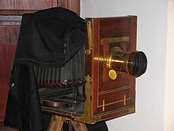
Introduction
Cameras
Images
  Raw
  Jpeg
Sensors
  CMOS
  CCD
Column (c) or x
Row (r), or y
Pixel value I(c,r) or I(x,y)=(0->255)

Slide 5
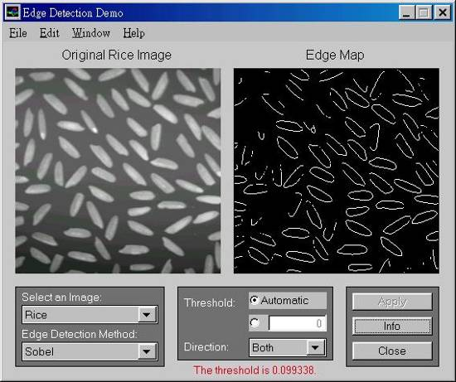
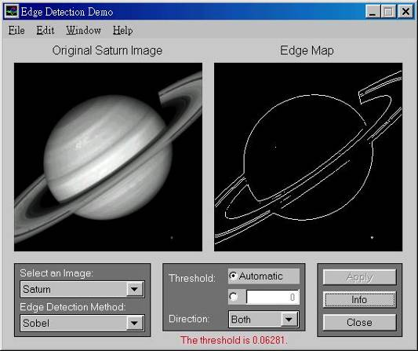
2) Edge detection
Features have many applications: recognition, tracking etc.
The most common are
  Point edges
    Shape intensity change positions
  Boundary edges
    Shape intensity changing lines

Slide 6
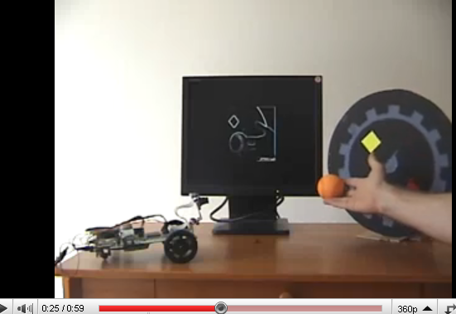
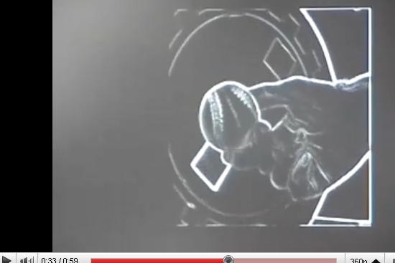
Sobel Demo
http://www.youtube.com/watch?v=z_a6e30aOXo

Slide 7
Kanade–Lucas–Tomasi feature (KLT) tracker
KLT feature tracker
Video demo
https://www.youtube.com/watch?v=8VbylCRn3iI

Slide 8
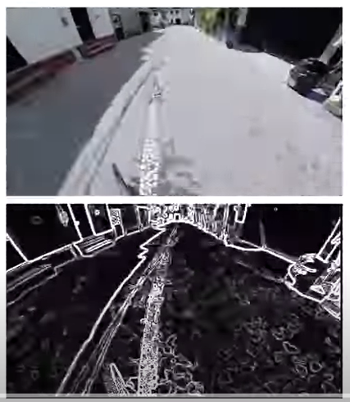
Edge detection
Demo
https://www.youtube.com/watch?v=UMsJNC3dCIA

Slide 9
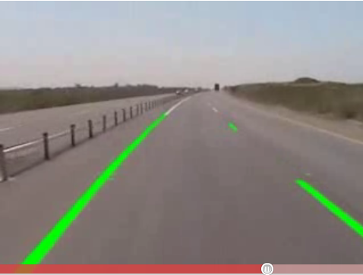
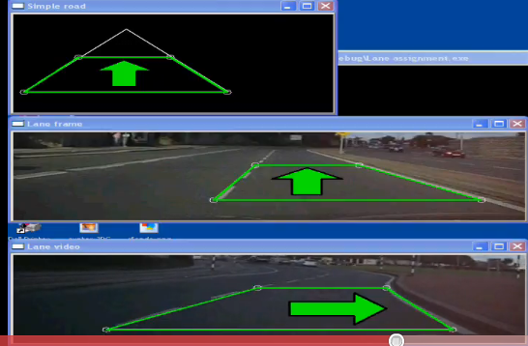
Application of edges
Lane detection
http://www.youtube.com/watch?v=Al4DnNkZUeA&feature=related
http://www.youtube.com/watch?v=9F3_6xL8hEY&feature=related

Slide 10
3) Shape detection (Hough Transform)
Lines
Circles
Irregular shapes

Slide 11
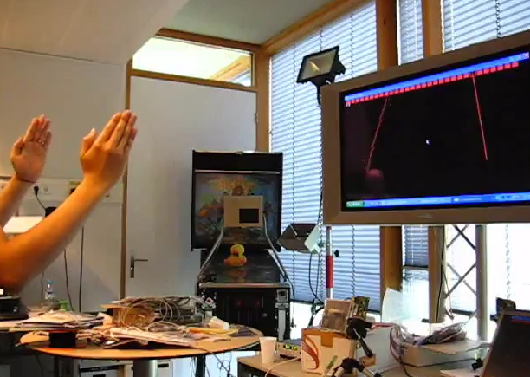
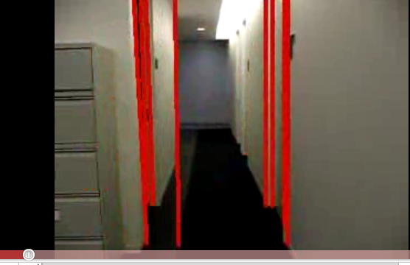
Rectangular object detection in video
Demos using the Hough Transform
https://www.youtube.com/watch?v=6afjN1ranTw
http://www.youtube.com/watch?v=jPEfoi9g0Lw&feature=related

Slide 12
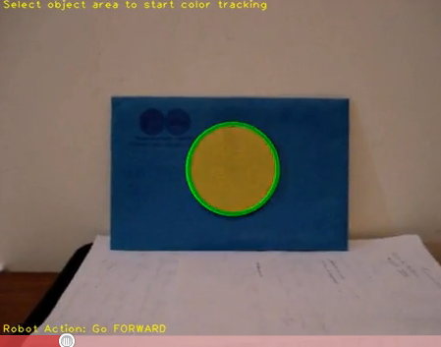
Hough circle detection
Using the opencv library
http://www.youtube.com/watch?v=jVQL1DODyUE

Slide 13
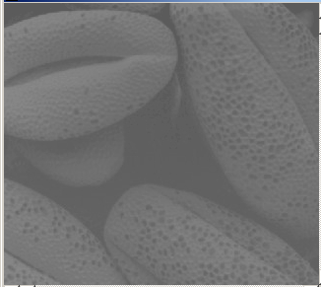
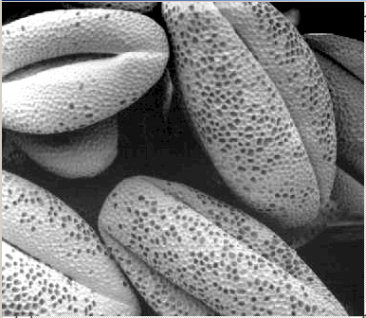
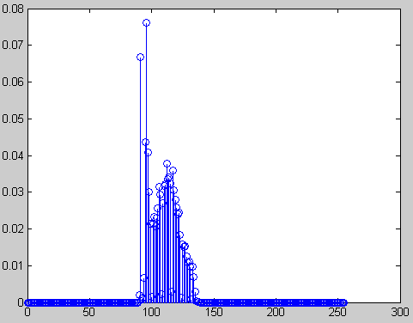
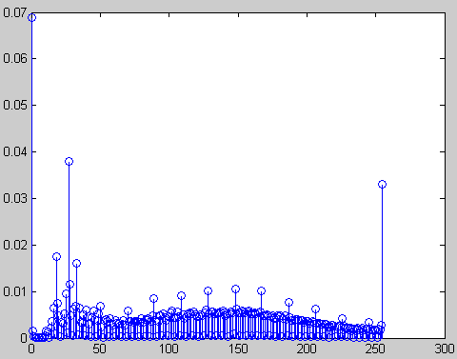
4) Histogram equalization
Input: The picture is poorly shot. Most pixel gray levels are located in a narrow range.
Output: Use histogram transform to map the marks in ‘r’ domain to ‘S’ domain. So in the ‘S’ domain, each S gray level has similar number of pixels.
Input: Low contrast image
r domain
Output: High contrast image
S domain
13

Slide 14
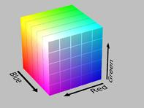
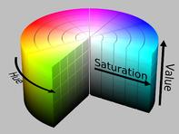
4) (continue) Color models
Cartesian-coordinate representation
  RGB (Red , Green , Blue)
Cylindrical-coordinate representation
  HSV (Hue, saturation, value)
  HSL (Hue, saturation, Light)
RGB
HSV
  http://en.wikipedia.org/wiki/HSL_and_HSV#From_HSV
14

Slide 15
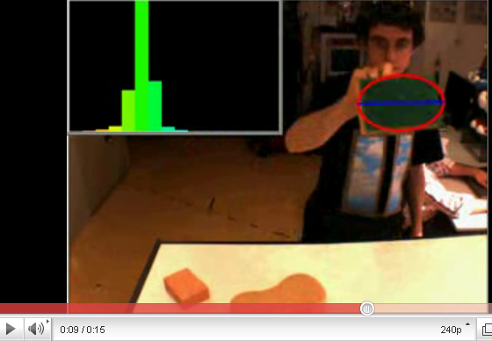
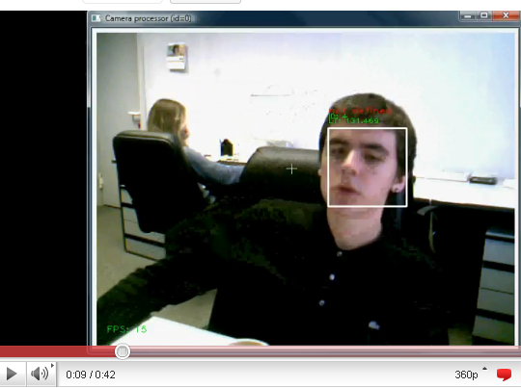
5) Mean shift (cam-shift)
http://www.youtube.com/watch?v=iBOlbs8i7Og
http://www.youtube.com/watch?v=zjteYlhjm-s&feature=related

Slide 16
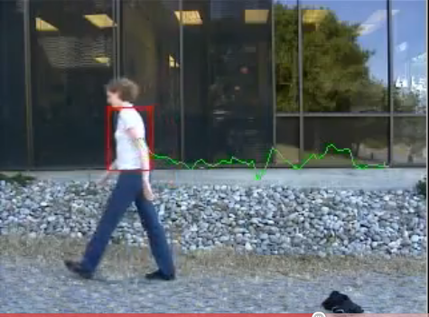
Mean shift application
Track human movement
http://www.youtube.com/watch?v=I53-SZ1o_c0&feature=related

Slide 17
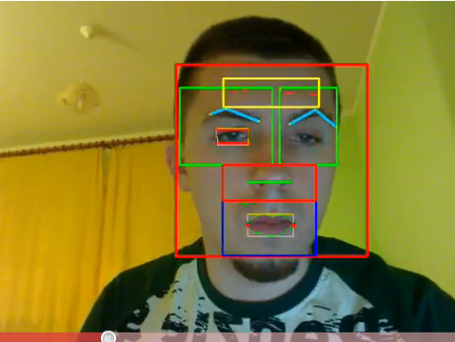
Face detection and tracking
Face tracking
http://www.youtube.com/watch?v=V7UdYzCMKvw&feature=related

Slide 18
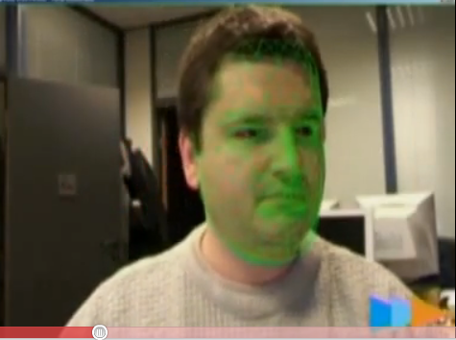
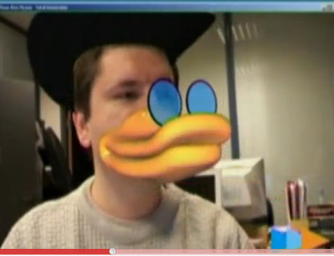
Face tracking applications
Face change
http://www.youtube.com/watch?v=i_bZNVmhJ2o

Slide 19

Application of Epnp (solvepnp in opencv Aruco pose tracker) https://docs.opencv.org/3.4.0/d5/dae/tutorial_aruco_detection.html
From //https://github.com/njanirudh/Aruco_tracker
Download project.zip ,
unzip to a dir. e.g. \Aruco_Tracker-master
Copy Aruco_Tracker-master\calib_images\checkerboard\*.jpg to Aruco_Tracker-master\calib_images
change line 6 of aruco_tracker.py to :
  cap = cv2.VideoCapture(0) (laptop PCcam)
  Run it
  conda>>python aruco_tracker.py
Print the 6x6 aruco marker (in \Aruco_Tracker-master\images\marker_66.jpg) and show to the camera, it will be tracked
https://www.youtube.com/watch?v=sV7vOTvUCx8
https://youtu.be/IsXWrcB_Hvs?t=6

Slide 20
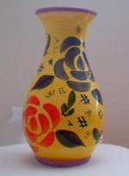
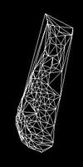
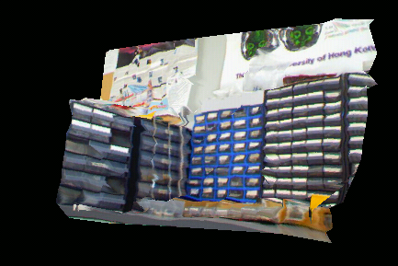
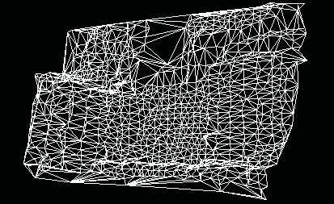
Application 1: Model reconstruction see http://www.cs.cuhk.hk/~khwong/khwong.html
From a sequence of images
Of an object
3D Model
found

Slide 21
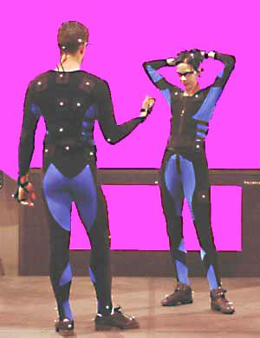
Application 2: Motion tracking
X2
X3
Camera
X1
Body pose
and motion tracking
--By tracking
Images of
white dots and
compute the
3D motion
www.cybercollege.com/tvp026-2.htm

Slide 22
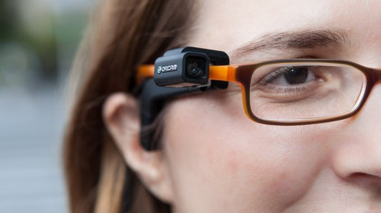
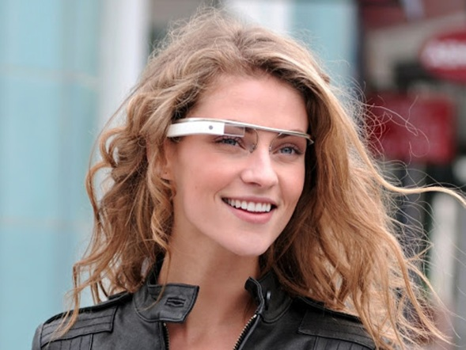
New computer vision products
Orcam
  (http://www.orcam.com/)
  Demos: https://www.youtube.com/watch?v=24yIl8tPvfU
  https://www.youtube.com/watch?v=j8lScHO2mM0
Google glass
(http://www.google.com/glass/start/)
Demo:
https://www.youtube.com/watch?v=j8lScHO2mM0

Slide 23
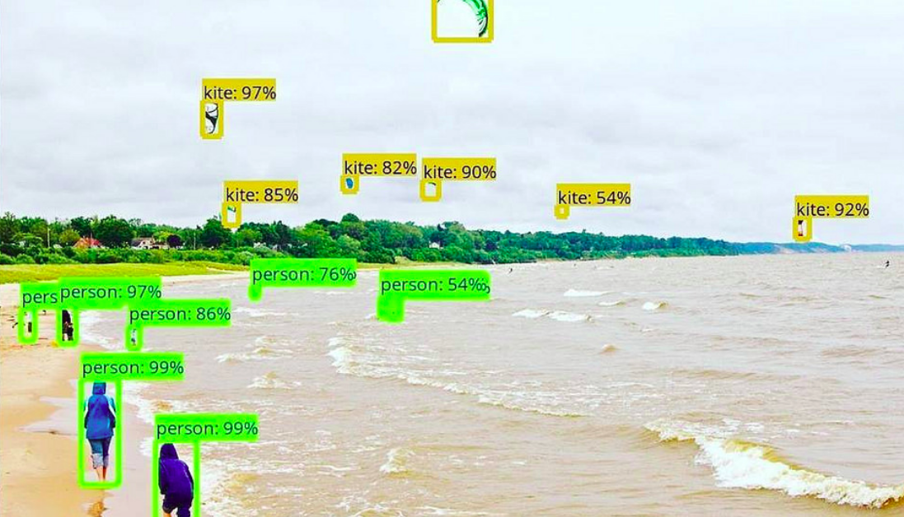
Object detection
https://www.analyticsvidhya.com/blog/2018/06/understanding-building-object-detection-model-python/

Slide 24
Summary
Image processing and computer vision are useful in many applications
Becoming more and more popular since everyone is carrying one or more cameras in his/her mobile devices.
We will study the mathematics and algorithms of image processing and vision programming

Slide 25
Appendix

Slide 26
Topics in 3D computer vision
by Prof. K.H. Wong,
Computer Science and Engineering Dept. CUHK
khwong@cse.cuhk.edu.hk

Slide 27
Motivation
Study the 3D vision problems
Study how to obtain 3D information from 2D images
Study various applications

Slide 28
Applications
3D models from images
Game development
Robot navigation
3G Mobil phone applications,
  Location systems
  User input

Slide 29
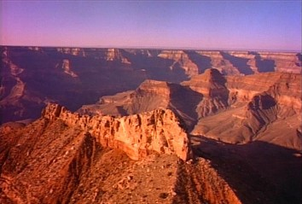
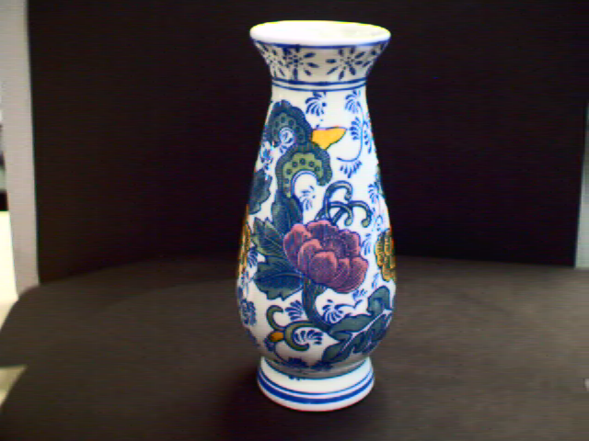
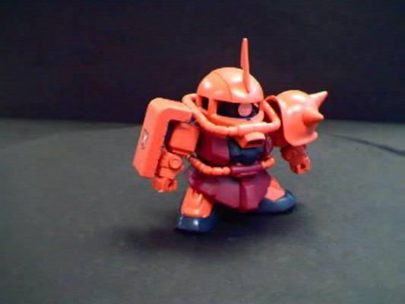
Demo1: 3D reconstruction (see also http://www.cse.cuhk.edu.hk/khwong/demo/index.html)
(Click picture to see movie)
Grand Canyon Demo
Flask
Robot
http://www.youtube.com/watch?v=2KLFRILlOjc
http://www.youtube.com/watch?v=xgCnV--wf2k
http://www.youtube.com/watch?v=ONx4cyYYyrI
http://www.youtube.com/watch?v=4h1pN2DIs6g

Slide 30
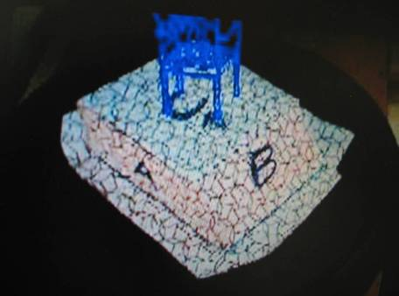
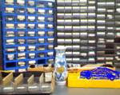
Demo2: augmented reality
(Click picture to see movie)
Augmented reality demo
http://www.youtube.com/watch?v=gnnQ_OEtj-Y
http://www.youtube.com/watch?v=zPbgw-ydB9Y

Slide 31
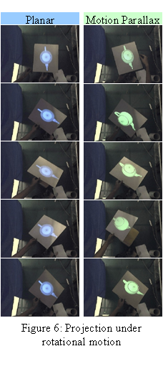
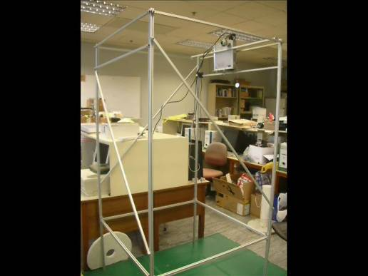
Demo3 Projector camera system (PROCAM) Click pictures to see movies
CVPR 09
A Projector-based Movable
Hand-held Display System
VRCAI09:A Hand-held 3D Display
System that facilities direct
manipulation of 3D virtual
objects
http://www.youtube.com/watch?v=YHhQSglmuqY&feature=channel_page
http://www.youtube.com/watch?v=vVW9QXuKfoQ

Slide 32
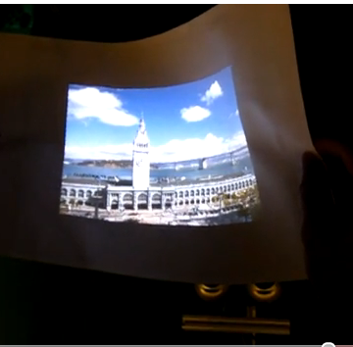
Demo 4
Flexible projected surface
http://www.youtube.com/watch?v=isqg8O9a4LE

Slide 33
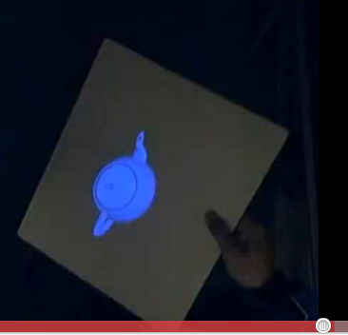
Demo 5
3-D display without the use of spectacles.
http://www.youtube.com/watch?v=oyxR_RT4NNc

Slide 34
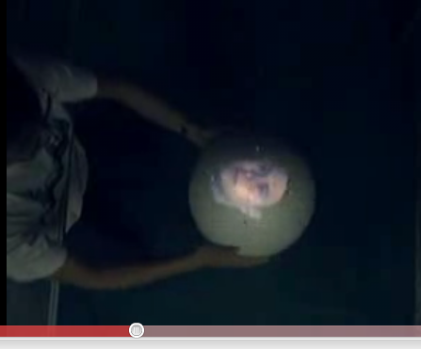
Demo 6
Spherical projected surface for 3D viewing without spectacles.
http://www.youtube.com/watch?v=yVDFcZZ8gDo

Slide 35
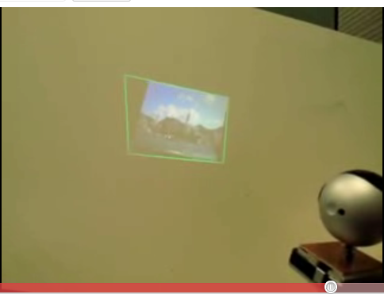
Demo 7
A KEYSTONE-FREE HAND-HELD MOBILE PROJECTION
http://www.youtube.com/watch?v=mbl-BpTnbeA

Slide 36
A quick tour of 3D computer vision
Image capturing
Feature extraction
Model reconstruction or pose estimation
Application of model and pose obtained

Slide 37
Camera structure
Object
CCD
1024x768
Focal length= f
Y
y
f
Z

