Slide 1
Computer vision and machine learning research at CUHK
Prof. Kin Hong Wong

Slide 2
Summary
In this talk I will discuss various projects carried out in CUHK on computer vision and machine learning. First I will talk about research of an instant language assistant in a form of a wearable computer that can help users to translate foreign printed words. When the user is pointing to the word using his/her finer, the system will read out the word and translate its meaning. I will also discuss a system that uses a robust ARUCO marker for applications in virtual reality.
Since machine learning has shown to be very promising in many pattern recognition applications, we have conducted research using neural networks for machine translation, edge detection, object tracking, and music genre classification. Theories together practical issues encountered in these research projects will be elaborated in the talk.

Slide 3
Overview
First I will talk about research of a instant language assistant in a form of wearable computer that can help user to translate foreign printed words when the user is pointing to the word using his/her finer.
I will also discuss a system that uses a robust ARUCO marker for applications in virtual reality.
Furthermore, since machine learning has show to be very promising in many pattern recognition applications, we have conducted research using neural networks for machine ,
machine translation,
edge detection,
object tracking,
and even music genre classification.
Theory together practical issues encounter in these research projects will be elaborated in the talk.

Slide 4
Content
Pose estimation and model reconstruction
Vision methods , trifocal tensor
3D range sensors
3D range sensor (KINECT) research
Human counting system
Multi KINECTs for whole body reconstruction: Calibration of Multiple Kinect Depth Sensors for full surface model reconstruction
An efficient 3-D environment scanning method
Kalman filter based method: point + line
Tracking 3-D motion from straight lines with trifocal tensors.
Object tracking : mean-transform :A Robust Mean-Transform Based Visual Tracker
Face tracking
Robust and efficient pose tracking using perspective-four-point algorithm and Kalman filter
Mirror research, rotation averaging
Calibration of camera using mirror
Dual Back-to-Back Kinects for 3-D Reconstruction
VR application
ARUCO + IMU sensor
language assistant system for smart glasses
Virtual hand
Head, hand tracking
Augmented vision system by wearing two camera sand a head mount device HMD
Robot Avatar: a virtual tourism robot for people with disabilities
Pepper Noise removal for ultrasonic images (Zhu Lei)
Hardware vision:
Corner detection using hardware: Harris Corner feature detector
Machine learning
A neural network approach to visual tracking (Zhe Chang)
GAP for edge detection
Trifocal tensor using neural networks
English to Chinese translation using sequence-to-sequence (seq2seq LSTM)
Music genre classification

Slide 5
Part 1
Text Detection and Marker Based Finger Tracking in Building a Language Assistant for Wearable Glasses

Slide 6
Text Detection and Marker Based Finger Tracking in Building a Language Assistant for Wearable Glasses
Ting Kwok Chan, Ying Kin Yu and Kin Hong Wong
Dept. of Computer Science and Engineering
The Chinese University of Hong Kong
Shatin, Hong Kong
khwong@cse.cuhk.edu.hk

Slide 7
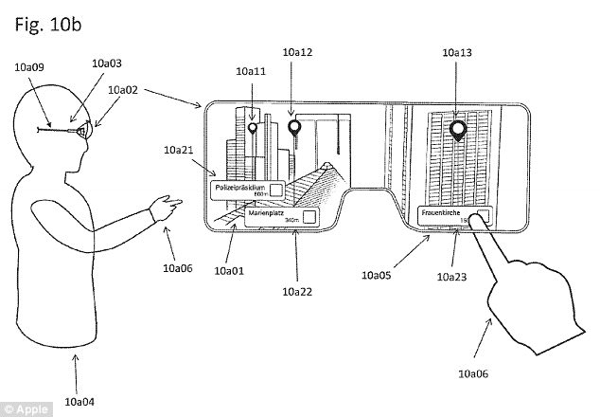
Introduction
Invention of wearable smart glasses makes mobile internet computing easier
Users can see the world with virtual objects augmented into the real space
Figure 1. Apple’s smart glasses patent Patently Apple. (2017). Apple Patent Reveals the Exciting Possibility of Augmented Reality Smartglasses [Online], Accessed: 9th December, 2017,
URL: http://www.patentlyapple.com/patently-apple/2017/07/apple-patent-reveals-the-exciting-possibility-of-augmented-reality-smartglasses.html

Slide 8
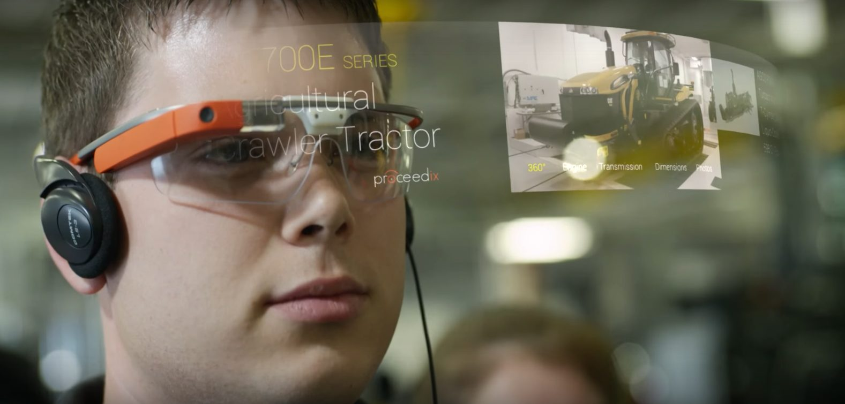
Background
Smart wearable computers are becoming popular because it is easy to use and carry
Wearable cameras are mobile devices that can be taken outdoors for various usages
Figure 2. Google Glasses Edgly Labs. (2017). Look out! Google Glass is Back With Enterprise Edition [Online], Accessed: 27th February, 2018,
URL: https://edgylabs.com/google-glass-back-enterprise-edition

Slide 9
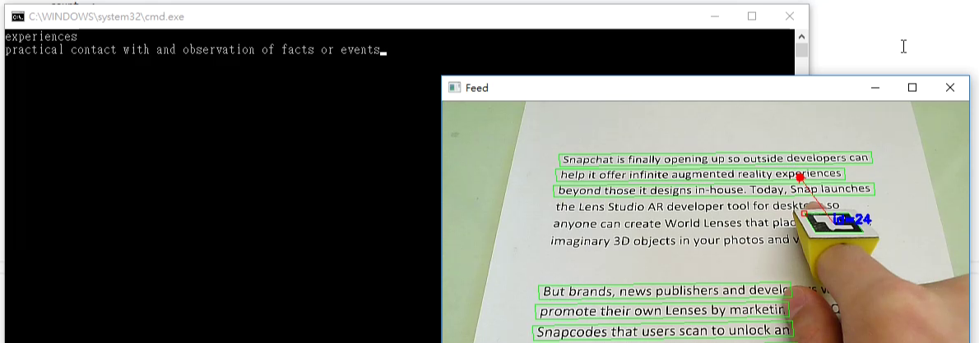
Application Overview
Recognize the word pointed by the user’s finger based on an optical character recognition approach
Lookup the recognized word from dictionary
ArUco markers were introduced to improve fingertip detection performance
Figure 3. Our OCR Dictionary Application

Slide 10
Application Overview
OpenCV was used for image processing and contour and marker detections
Tesseract was used for optical character recognition
Oxford dictionary was used for word definition lookup
SAPI was used for text to speech

Slide 11
Demonstration
https://www.youtube.com/watch?v=I3bowdnqcHM

Slide 12
Overall Design
Figure 4. A flowchart showing the overall design of our system

Slide 13
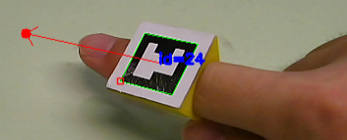
Background
The application can be divided into 3 main modules
Text Detection and Extraction
Finger Detection
Optical Character Recognition

Slide 14
Text Detection and Extraction
Figure 5. The procedure for text detection
Input: Original image from the camera
Output: A list of 4 corners of the detected text regions
Stroke thickening with a series of image processing functions
Nearby characters can be merged together and represented by a block of white pixels in a binary image
Contour detection to group pixel blocks
Simplify contours into rectangles by polygon approximation
Remove small or tall contours

Slide 15
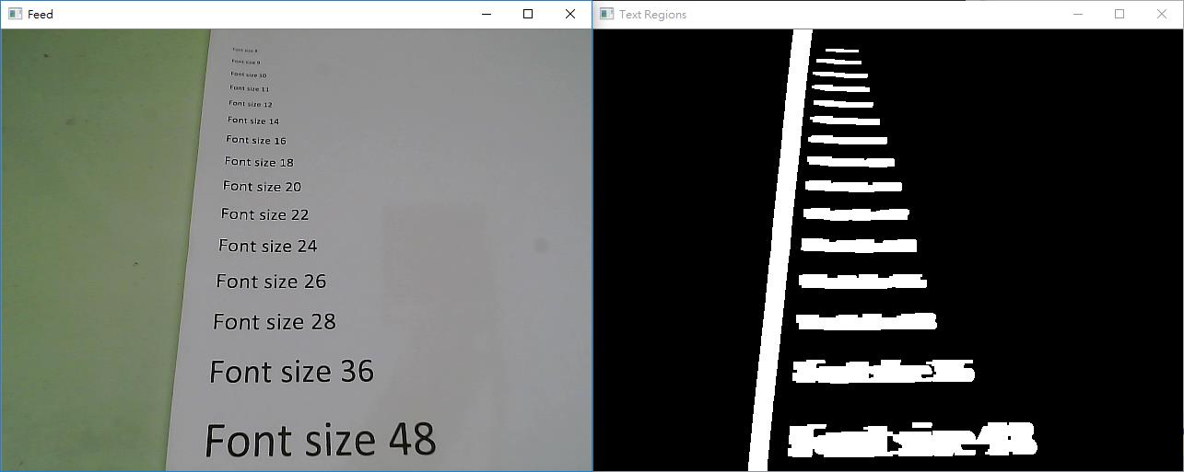
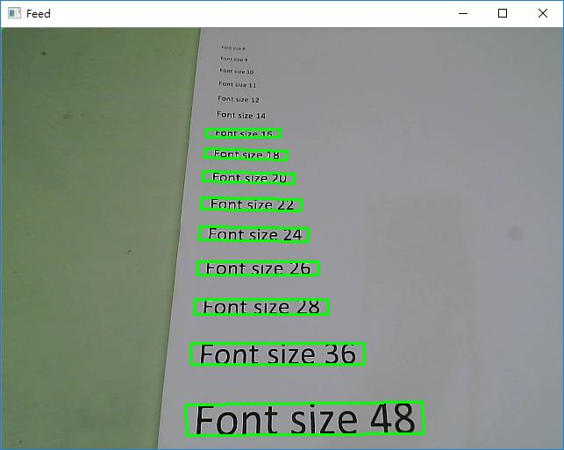
Text Detection and Extraction
Figure 6. The original image from the camera Figure 7. The potential text regions
Figure 8. The finalized detected text regions

Slide 16
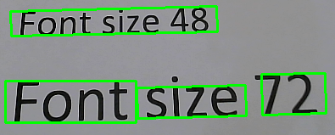
Text Detection
From 20cm away, the algorithm can detect characters of
3mm in height or higher
1.1cm in width or wider
May not be able to separate words from a line for smaller font sizes
Figure 9. The text detection algorithm may not always be able separate words

Slide 17
Finger Detection
Input: Original image from the camera
Output: Coordinates of the fingertip
2 algorithms were developed to tackle this problem

Slide 18
Finger Detection (with color)
Figure 10. The procedure for finger detection based on colors
Convert the original image from the camera into HSV color space
Filter out pixels outside human hand HSV range to obtain a binary image containing the human hand’s shape
Erode and dilate to clean up obtained binary image
Find hand contour from binary image
Select biggest contour
Search fingertip by finding the point with the smallest y-coordinate from hand contour

Slide 19
Finger Detection (with color)
Figure 11. Original image from the camera with an overlaid red dot indicating the fingertip
Figure 12. hand contour with an overlaid red dot indicating the fingertip

Slide 20
Demonstration (Finger Detection with HSV)
https://www.youtube.com/watch?v=j7t7a8maBv0

Slide 21
Finger Detection (with color)
The algorithm has several problems
Color filter is user dependent
Need to tune the filter for different environment
Highest point in the contour may not always mean the fingertip
Accuracy was within 30 pixels in Euclidean distance
There is a better solution for this problem

Slide 22
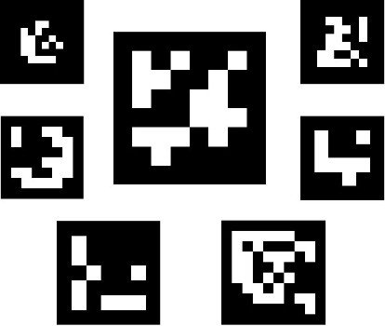
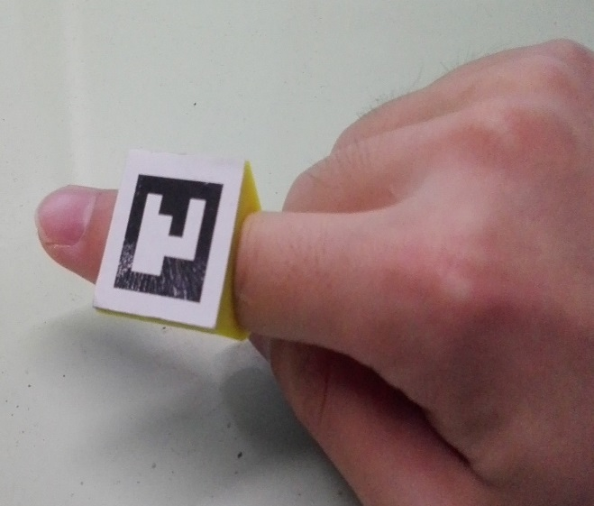
Finger Detection (with marker)
ArUco Marker
Made of black and white squares
Robust detection, identification and pose estimation
The simplest 4x4x50 marker set was used for highest detection speed
Figure 13. Some example ArUco Markers
Figure 14. A custom 3D-printed pointing device for our application

Slide 23
Finger Detection (with marker)
Figure 15. The procedure for finger detection with ArUco Markers
Apply marker detection function by OpenCV
Select the marker with correct pattern (identification)
The coordinates of the fingertip are obtained by extrapolating the line joining the center and the mid-point of the top edge of the marker.
In some circumstances, the markers may be wrongly detected as a text region in the image. To avoid the situation, bitwise operation is applied to the text and the marker region.

Slide 24
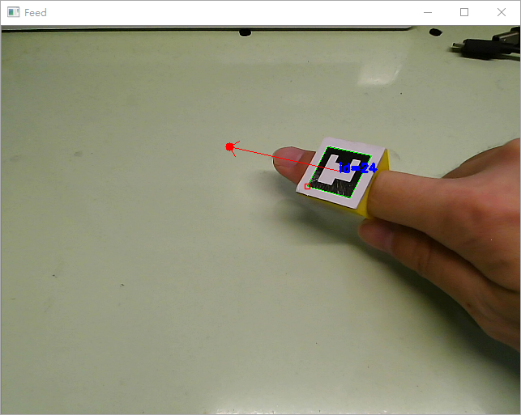
Finger Detection (with marker)
Figure 16. The ArUco cursor that we have implemented.
The red point in the above image is the position where the user is targeted at.

Slide 25
Finger Detection (with marker)
Although user need to wear a custom ring for this implementation
Detection is no longer environment and user dependent and is very robust
Accuracy is within 10 pixels in Euclidean distance

Slide 26
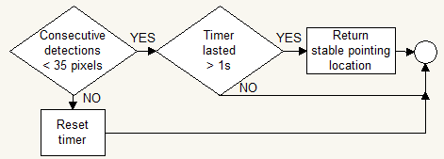
Estimating the Stable Cursor Coordinates
Figure 17. The procedure for finding the stable cursor coordinates
Input: current pointing coordinates
Output: Stable pointing coordinates
The program is required to determine if the finger is moving. If so, the program will not extract the nearest text region for character recognition. If the distance between the previous and the current detected fingertip is less than a threshold within 1 second, the fingertip position retrieved is regarded as stable

Slide 27
Finding Nearest Detected Word Region
Figure 18. The procedure for finding the nearest detected word region
Input: Detected text regions vector, stable pointing coordinates
Output: The index of the nearest text region in the detected text regions vector

Slide 28
Optical Character Recognition
Figure 19. The procedure for character recognition
Input: Index of the nearest text region
Output: The recognized string of text
Perspective transform is applied to the selected text region to warp the image view such that the shapes of the characters are not distorted
A small boundary region with white pixels is added to the extracted image to optimize the recognition performance of Tesseract
The resulting image patches are fed to Tesseract for character recognition

Slide 29
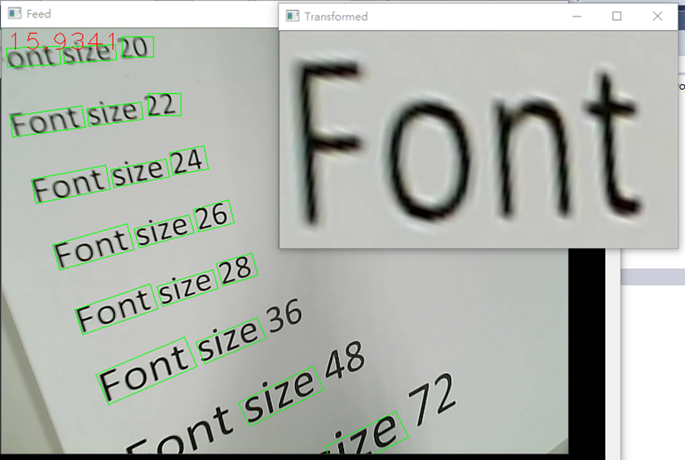
Optical Character Recognition
Figure 20. An example of perspective transformation. The word “Font” is transformed

Slide 30
Result Clean Up
Figure 21. The procedure to tidy up word extraction results
Input: The string of text from Tesseract
Output: The actual word indicated by the user
The text detection procedure described in the previous section may not be able to separate words from a sentence when the words are small or the words are too close together
If the string returned by Tesseract contains one or more spaces, this string is decomposed into individual words
The relative position of the selected word in the extracted area is calculated in terms of the number of characters

Slide 31
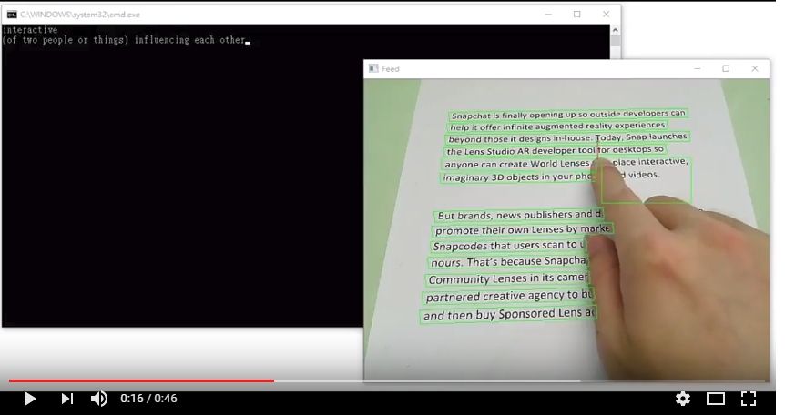
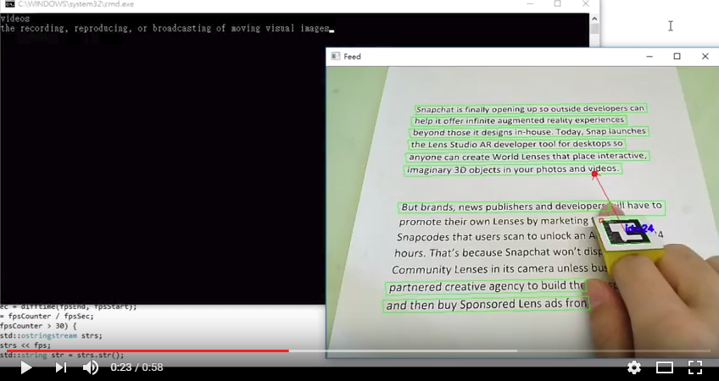
Demo: Finger pointing dictionary
OCR with finger tracking (YouTube)
https://www.youtube.com/watch?v=j7t7a8maBv0
OCR with ARUCO finger tracking (YouTube)
https://youtu.be/I3bowdnqcHM

Slide 32
Discussion
The program could not detect words that are too small and might not be able to separate the words from sentences. The cause of the problem was due to the use of erosion and dilation during image pre-processing.
The current system used a camera of fixed focus. The software had neither mechanism for detecting out of focus camera images nor ways of communicating with the camera to adjust focus, resulting in blurred images when it is aiming at farther texts.
The accuracy and speed of the Tesseract OCR engine were high in general. However, it is worth mentioning that it took noticeably longer time to process long sentences as well as blurred characters. This is because the engine is unable to separate words from sentences and the images captured are out of focus.

Slide 33
Overall Performance
To become a wearable application, it should not be too demanding on the computational power and memory requirement
Our program was tested on a computer with:
2.4GHz Core 2 Duo, 8GB RAM, No graphics card
14-17 fps
Therefore, the program can probably run well on mobile devices with relatively low computation power such as smartphones and the Raspberry Pi board

Slide 34
Conclusion
Described the implementation of a smart wearable glasses application that can recognize a word pointed by the user on a page of text document.
The user wears a ring with a marker printed on it.
The system finds out the position of the ring from the camera images.
From the marker position, the word that the user is pointing at can be determined.
The image region containing the word is then passed to an optical character recognition engine to transform the image pattern into a character string.

Slide 35
Conclusion
Considering the speed performance of the current implementation, the proposed system can be run in an embedded system of a wearable device.
Our solution is useful for a great variety of mobile applications, for example an interactive electronic dictionary.

Slide 36
Part 2
VR and AURCO marker applications

Slide 37
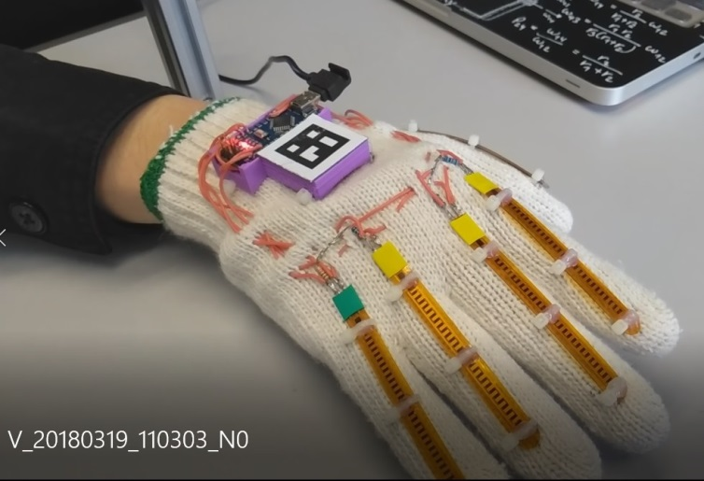
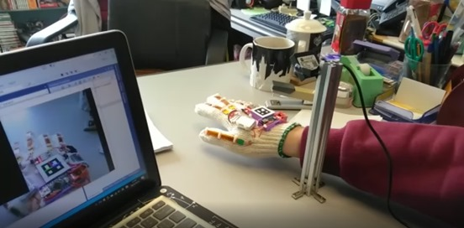
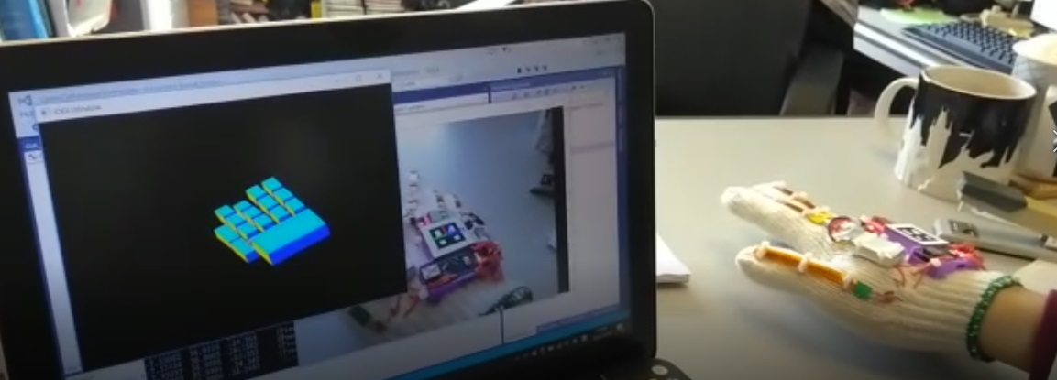
The virtual hand
Demo
https://youtu.be/3zmR82BS3ow (hand track, vision+ imu+wireless)
https://youtu.be/m3-0fvhzRGQ (previous version : hand track, vision+ imu)

Slide 38
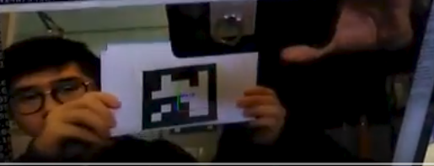
Kalman based ArUco tracking
Kalman based ArUco tracking
https://youtu.be/Wdxpue20--s

Slide 39
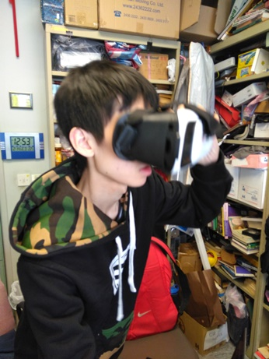
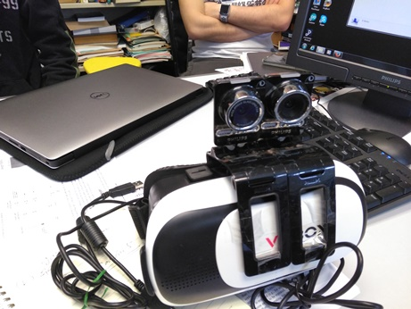
VR through head mount device HMD

Slide 40
Part 3a
Machine learning: GAN for edge detection

Slide 41
Machine learning research
GAN for edge detection
Seq2seq machine translation
LSTM for music genre classification

Slide 42
Generative adversarial networks (GANs) for edge detection
Z. Zeng Y.K. Yu, K.H. Wong
In
IEEE iciev2018, International Conference on Informatics, Electronics & Vision 'June,kitakyushu exhibition center, japan, 25~29, 2018. (http://cennser.org/ICIEV/scope-topics.html)

Slide 43
Overview
Introduction
Background
Theory
Experiment
Discussions / Future work
Conclusion

Slide 44
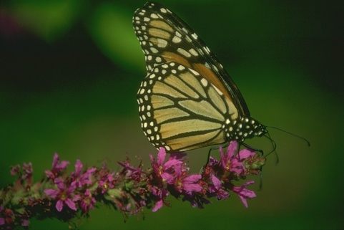
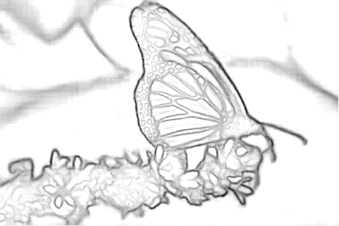
Introduction
What is edge detection?
Why edge detection?
What are the problems?
Single pixel width requirement, non-maximum suppression
How to solve the problem: Machine learning approach
Our results.

Slide 45
Background of edge detection
Traditional methods
Sobel, etc.
Canny
Machine learning methods
CNN methods
RCF (state of the art)
Generative adversarial networks (GANs)
Conditional GAN (cGANs)
cGAN with U-NET (=our approach, first team to apply cGAN for edge detection)
https://lmb.informatik.uni-freiburg.de/people/ronneber/u-net/

Slide 46
Theory of Generative adversarial networks (GAN)
GAN
Discriminator (D)
Generator(G)

Slide 47
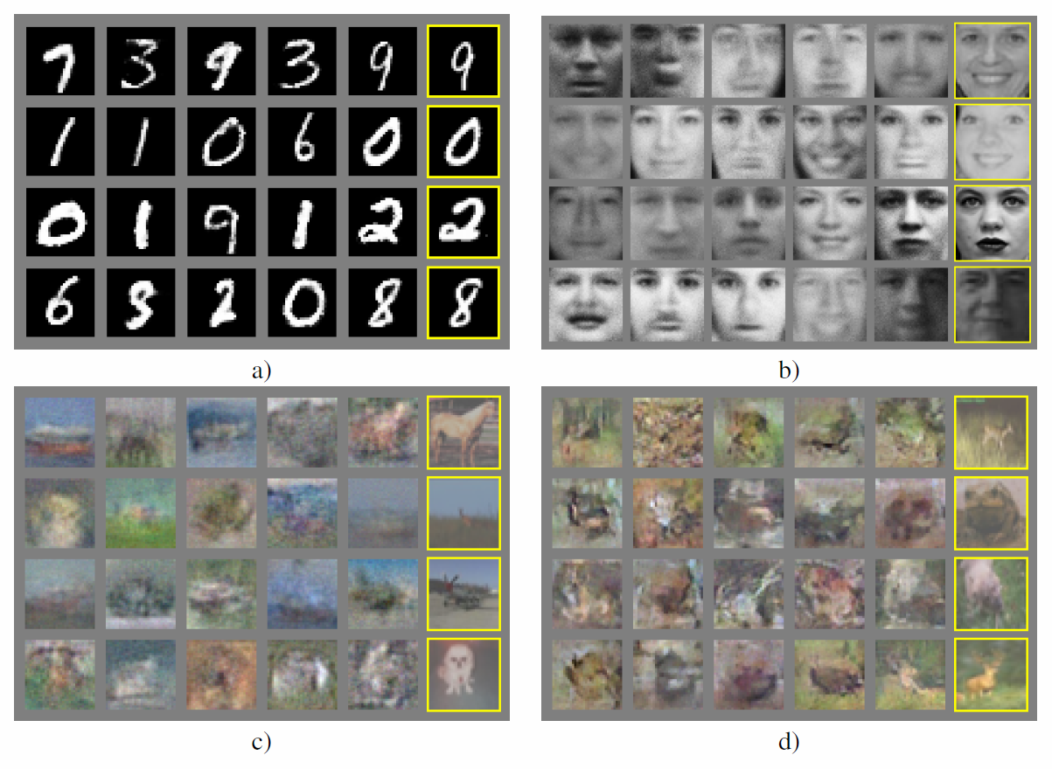
Application of GAN
Generate data with the same distribution of training samples
Application :Enrich data sets, e.g. use some data in MINST dataset to train G, so G can generate more training samples.
Good for face datasets etc.
MINST dataset: http://yann.lecun.com/exdb/mnist/

Slide 48
The idea, from : Goodfellow, Ian, et al. "Generative adversarial nets." Advances in neural information processing systems. 2014. https://arxiv.org/abs/1406.2661
The proposed adversarial nets framework, the generative model is pitted against an adversary:
a discriminative model (D) that learns to determine whether a sample is from the model distribution or the data distribution. The generative model (G) can be thought of as analogous to a team of counterfeiters, trying to produce fake currency and use it without detection, while the discriminative model is analogous to the police, trying to detect the counterfeit currency. Competition in this game drives both teams to improve their methods until the counterfeits are indistinguishable from the genuine articles.

Slide 49
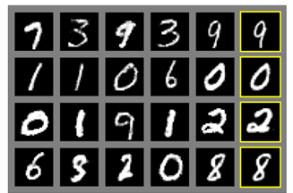
The concept of a generator G
Input noise z (with distribution p_{g}) to a generator G which can produce output data
Application example: You train G using many samples of handwritten character images (from MINST dataset), after training you input a noise z (with distribution p_{g} ), then G will give you an image of a handwritten character.
Usage: create more training data for machine leaning systems
Z (distribution p_{g}): a vector
G can generate data according to Z
Output is a picture of a hand written character
MINST dataset: http://yann.lecun.com/exdb/mnist/

Slide 50
GAN training procedure https://arxiv.org/abs/1406.2661
Step1
Training images with distribution p_{data}
The training Algorithm
x
Train parameters θ_{d} of discriminator D: CNN
First train D (discriminator)
Send a new batch of training data to D, with label 1=‘real images’
Can loop (1) many times , e.g. from 1 to 10 times.
Keep D and train G (generator)
sending noise to G so that the output should be labeled as ‘0 =‘fake image’
Can loop (2) many times , e.g. from 1 to 10 times.
Go to 1, until D output is 0.5
One scalar: Label=‘1’ when training
Train D to maximize the probability of assigning the correct label to training examples, (and samples from G, in step2)
Step2
Noise (z) with distribution P_{z}(a vector)
Train parameters θ_{g} of generator G: CNN
Image generated
Both D (parameters θ_{d} ) and G (parameters θ_{g} ) are CNN Convolution neural networks.
Keep D: CNN
One scalar: Label=‘0’ when training
Train G to minimize log(1-D(G(z))

Slide 51
The idea
Blue dashed error (D)
Green solid Pg (move closer to Px)
Black dotted P_{x=data} (from x true data)
Blue dashed (D)=1/2
Green solid Pg (G generated fake)
x=real samples
z=noise with a known distribution (uniform this this case)
Figure 1: Generative adversarial nets are trained by simultaneously updating the discriminative distribution (D, blue, dashed line) so that it discriminates between samples from the data generating distribution (black, dotted line) Px from those of the generative distribution Pg (G) (green, solid line). The lower horizontal line is the domain from which z is sampled, in this case uniformly. The horizontal line above is part of the domain of x. The upward arrows show how the mapping x = G(z) imposes the non-uniform distribution Pg on transformed samples. G contracts in regions of high density and expands in regions of low density of Pg. (a) Consider an adversarial pair near convergence: Pg is similar to pdata and D is a partially accurate classifier. (b) In the inner loop of the algorithm D is trained to discriminate samples from data, converging to D(x) = pdata(x) pdata(x)+pg(x) . (c) After an update to G, gradient of D has guided G(z) to flow to regions that are more likely to be classified as data. (d) After several steps of training, if G and D have enough capacity, they will reach a point at which both cannot improve because pg = pdata. The discriminator is unable to differentiate between the two distributions, i.e. D(x) = 1/2 .

Slide 52
Theory of conditional GAN (cGAN)
GAN is difficult to train because the search space is too large.
Add condition (prior y) to GAN
Compare formulas
GAN
cGAN
https://arxiv.org/pdf/1411.1784.pdf Conditional Generative Adversarial Nets by Mehdi Mirza

Slide 53
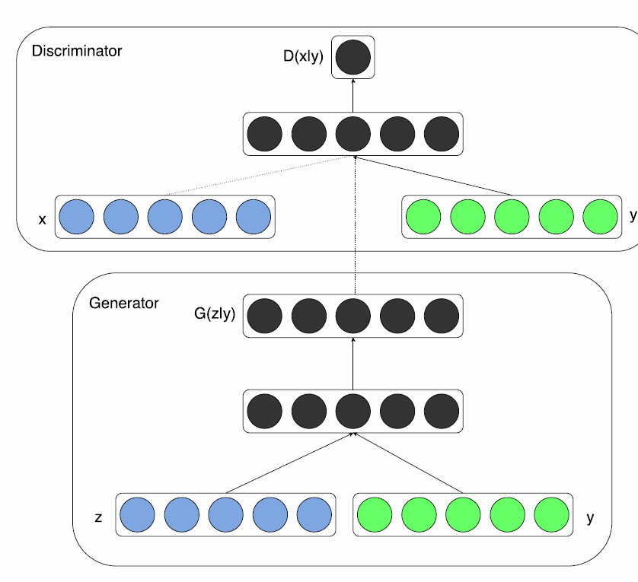
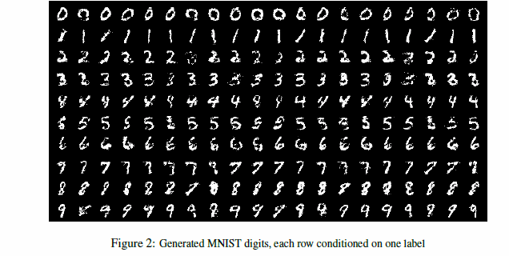
Theory of conditional GAN (cGAN)
GAN is difficult to train because the search space is too large.
Add condition (prior y, usually a label) to GAN
D(x|y)
Conditions added: so can generate different testing sets
Condition y
0
1
2
3
4
5
6
7
8
9
G(z|y)
https://arxiv.org/pdf/1411.1784.pdf Conditional Generative Adversarial Nets by Mehdi Mirza

Slide 54
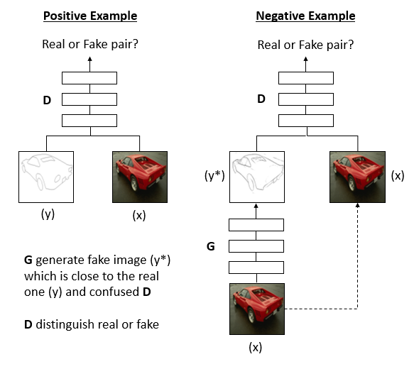
Our approach: Theory of conditional Generative adversarial networks(cGAN)
Real example
Fake example
x=real image sample
Y=real edge of x
y*=false (generated) edge
To optimze
Real = label ‘1’
Fake = label ‘0’
Fake
Real edges
Real image
Real image

Slide 55
Our implementation procedures
The training data set has 1440 batches
1 batch has 20 edge-image pairs.
Each image =256x256x3 integers(color) edge image =256x256x1 binary
G (CNN 3x3 kernel network):
Input:256x256x3 integers
Output 256x256x1 binary (real or fake)
G has 5 stages
Stage 1: 2 layers →(256x256xdim)
Stage 2: 2 layers→(128x128xdim)
Stage 3: 3 layers
Stage 4: 3 layers
Stage 5: 3 layers
Plus 2 predict layer
D (CNN network):
Input:256x256x4 (image + edge) concatenation
Output: 1 binary (represents real or fake)
same as VGG:16 layers
Training procedures
Step1: Get a new batch of 20 Paris (real + edge)
Step2: Positive example side: feed 1 batch to train D with target output label real (1)
Step1: Negative example side: Keep D, train G with target output label fake (0)
Repeat Step1,2,3 until output on Negative example side of D is 0.5. That means D cannot tell if the generated edge image is rea l or fake
Usually 9000 iterations will get D produce 0.5 to complete the training
Real example
Fake example
Real = label ‘1’
Fake = label ‘0’
Fake
256x256x1 binary
256x256x1 binary
Real edges
Real image
256x256x3 integer
Real image
55

Slide 56
Positive/negative sample balancing problem
Real example
Fake example
Real = label ‘1’
Fake = label ‘0’
Fake
Real edges
Real image
Real image
56

Slide 57
Overall objective function
Real example
Fake example
Real = label ‘1’
Fake = label ‘0’
Fake
Real edges
Real image
Real image
57
57

Slide 58
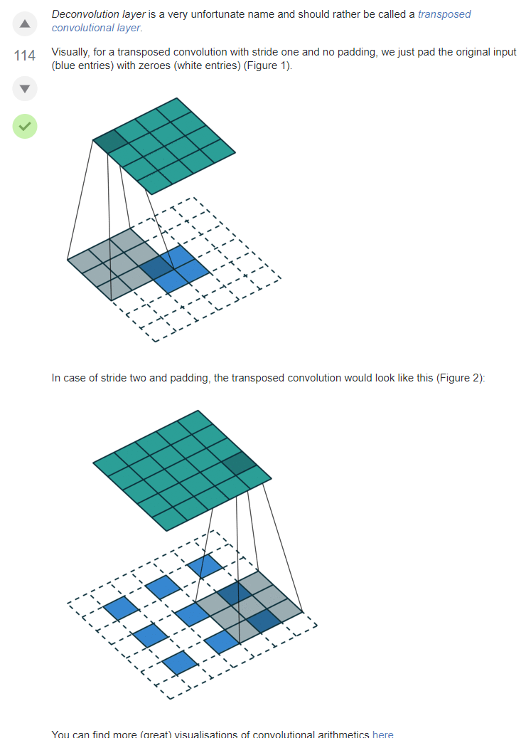
De-Convolution layer https://datascience.stackexchange.com/questions/6107/what-are-deconvolutional-layers

Slide 59
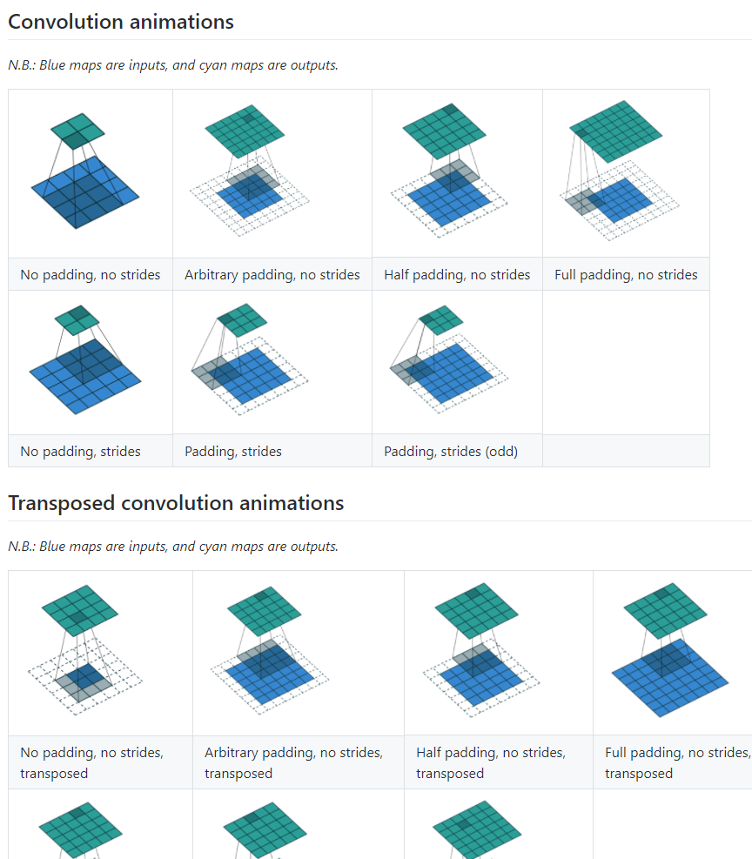
More de-convolution demo https://github.com/vdumoulin/conv_arithmetic
Convolution:
No padding
No strides
Input=4x4 image
Kernel=3x3
Output =2x2
De-convolution:
No padding
No strides
Input=2x2 image
Kernel=3x3
Output =4x4

Slide 60
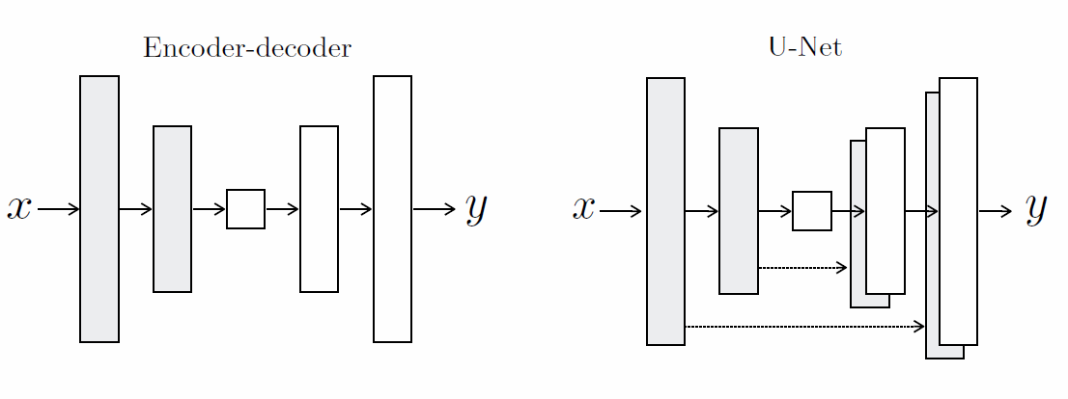
U-Net From: Image-to-Image Translation with Conditional Adversarial Networks Phillip Isola Jun-Yan Zhu Tinghui Zhou Alexei A. Efros https://arxiv.org/pdf/1611.07004.pdf
Figure 3: Two choices for the architecture of the generator. The “U-Net” [49] is an encoder-decoder with skip connections between mirrored layers in the encoder and decoder stacks.
convolution
De-convolution (transpose convolution)

Slide 61
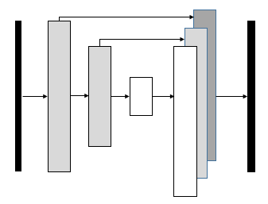
Modified U-net

Slide 62
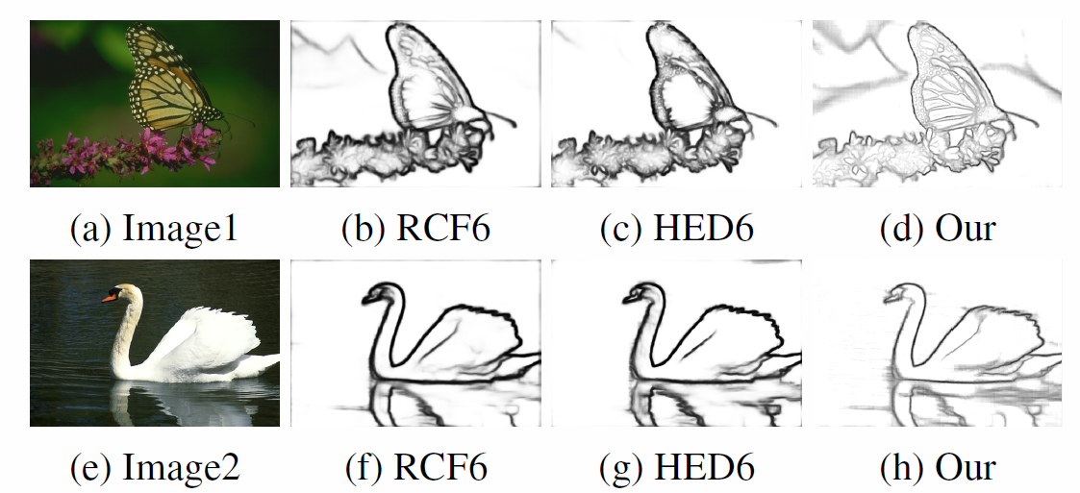
Result
Figure 1
Figure 1. We build a simple generator network based on UNET [25] to produce the edge map. Since RCF [23] and HED [28] contains multiple output, we only compare the final output of both network, which denote as RCF6 and HED6. We show two image examples here. One can clearly see that our result contains more detail information, and produce thinner edge even without apply the non-maximum suppression method.

Slide 63
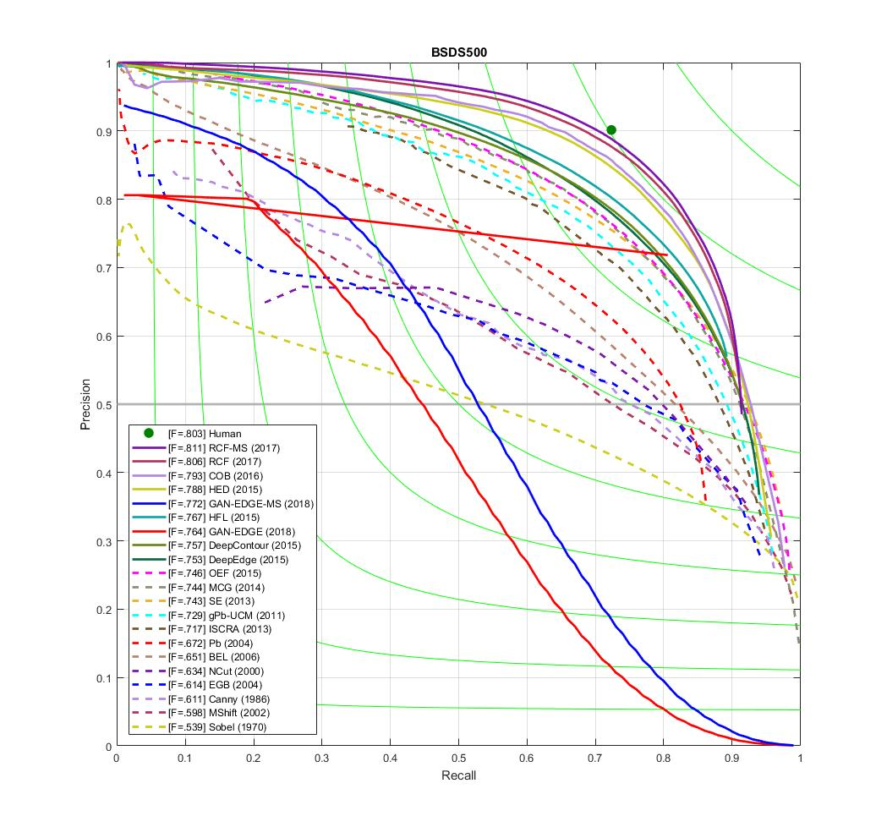
Result

Slide 64
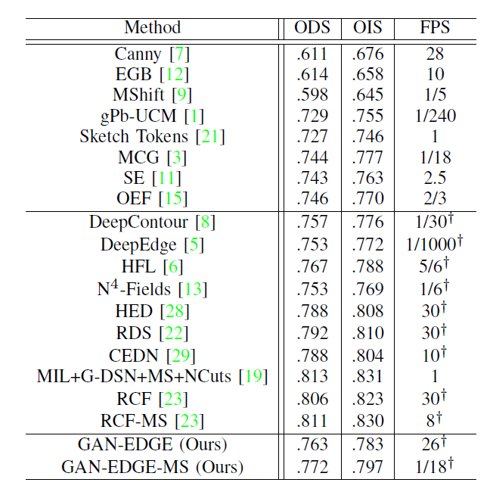
Results
To compare with other edge detection methods, we used the same evaluation metric to illustrate our edge detection results.
Normally, a threshold is necessary to produce the final edge map when an edge probability map is given.
There are various methods to determine the threshold, out of which two well-known evaluation metrics can be used. The first one is called the optimal dataset scale (ODS), which applies a fixed threshold for all edge probability maps. The second one is known as the optimal image scale (OIS), which tries to apply different thresholds to the images and then selects the optimal one from the trial values. For both ODS and OIS, we used Fmeasure to compare the algorithm performances. The formula
can be expressed as ( 2PrecisionRecall
Precision+Recall ).
Ours

Slide 65
Conclusions
we have devised an innovative edge detection algorithm based on generative adversarial network.
Our approach achieved ODS and OIS scores on natural images that are comparable to the state-of-the-art methods. Our model is computation efficient.
It took 0.016 seconds to compute the edges from an image having a resolution of 224X224X3 with GPU. For a 512X512X image, it took 0.038 seconds. Our algorithm is devised based on the UNET and the conditional generative adversarial neural network (cGAN) architecture.
It is different from the convolutional networks in a way that cGAN can produce an image which is close to the real one.
Therefore, the edges resulting from the cGAN generator is much thinner compared to that from the existing convolutional networks.
Even without using any pre-trained network parameters, the proposed method is still able to produce high quality edge images.

Slide 66
Part 3b
Computing the relations among three views based on artiﬁcial neural network

Slide 67
Computing the relations among three views based on artiﬁcial neural network
Ying Kin Yu, Kin Hong Wong and Siu Hang Or
The Dept. of Computer Science and Engineering
The Chinese University of Hong Kong
Shatin, Hong Kong
Email: khwong.cse.cuhk.edu.hk

Slide 68
Overview
Motivations
Related Work
The Proposed Neural Network
Experiments and Results
Conclusions and Discussions

Slide 69
Motivations
The estimation of relative pose among image views is a fundamental computer vision problem
Traditionally, such estimation problem is tackled in an analytical way
We address this issue based on a machine learning framework

Slide 70
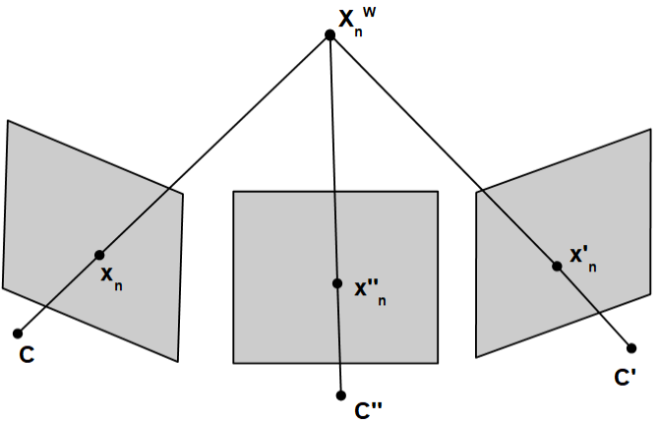
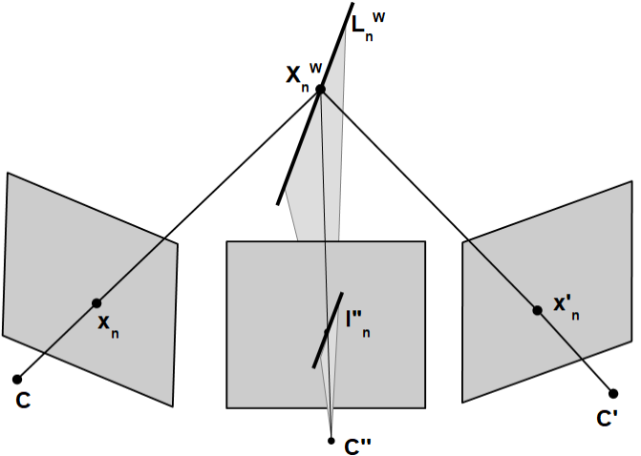
Motivations
Geometric relationship among three views: Trifocal tensor
With the relative pose of three camera views, the tensor can be computed easily
With an accurate tensor, one can establish the corresponding point features among three images

Slide 71
Motivations
However, camera pose estimation from images is an inverse of the above process
Features are ﬁrst extracted and correspondences can be setup
The trifocal tensor can be calculated by forming an over-determined system
The noise from outlying point features can be rejected using RANSAC
Then the camera matrices consisting of the rotation and translation parameters can be extracted

Slide 72
Motivations
The major disadvantage is high computational requirement
The extraction process is analytical and the relation between the image projection and camera pose is highly non-linear
The ﬁnal camera pose extracted may be erroneous
We now solve this problem based on machine learning instead

Slide 73
Related Work
Wunsch et. al. [5] trained a classiﬁer with different views of an object
The trained network is able to respond to an input pattern with the approximate orientation parameters of the presented view
Benton and Chu in [6] applied a multi-layered feed forward network solution to estimate the relative pose of the two cameras
Kendall et. al. in [7], [8] adopted a Bayesian convolutional neural network to regress the camera pose from a single image
The training was end-to-end. No explicit feature extraction procedure nor graph optimization was necessary.
Melekhov et. al. in [9] proposed another convolutional neural network based method to compute the relative pose between two cameras
With the use of transfer learning from a large scale classiﬁcation dataset, the proposed network was trained in an end-to-end manner

Slide 74
The Proposed Neural Network
A multi-layer feed forward neural network is used to estimate the pose parameters directly
The connection of neurons in a feed forward artiﬁcial neural network do form no cycles
Our neural network consists of one hidden layer.
The nodes are interconnected in a feedforward way.
Each neuron in the hidden layer has directed connections to the nodes in the output layer.
A sigmoid function is applied as an activation function in the hidden layer.
A linear transfer function is used in the output layer.

Slide 75
The Proposed Neural Network
To train the neural network, the coordinates of the corresponding points from three image views are used as the inputs
A minimum of 6 points is used

Slide 76
The Proposed Neural Network
Assuming that the pose of the ﬁrst camera is P =I, the target output of the network consists of two sets of pose parameters, i.e. the second and the third camera relative to the ﬁrst image.
For N point correspondences in the views, there are 2N, 80 and 12 neurons in input, hidden and output layer of our feed forward neural network, respectively.
The cost function is typical Euclidean distance measure
Standard Levenberg-Marquardt optimization with backpropagation is used to estimate the network weights

Slide 77
Experiments and Results
Synthetic data were used to train the neural network
Three cameras were viewing at a synthetic scene consisting of a synthetic structure with 100 random features.
With the assumption that the ﬁrst camera was in the world center, the second and the third camera were moved away from the world randomly with a pose of 0 to 10 degrees for the yaw pitch, row and 0 to 0.25 meters for the translation along the x,y and z axis.
10000 sets of synthetic data were generated, within which 7000, 1500 and 1500 sets were used for training, validation and testing, respectively. .

Slide 78
Experiments and Results
We trained the network using points of with increasing input noise level so as to investigate how the 2-D image noises affect the accuracy.
We retrained the network with 6, 12 and 18 point correspondences to examine the relation on the number of input point features and the resulting pose parameter errors
We also studied the effects of mismatched noise level in the training and testing data sets.

Slide 79
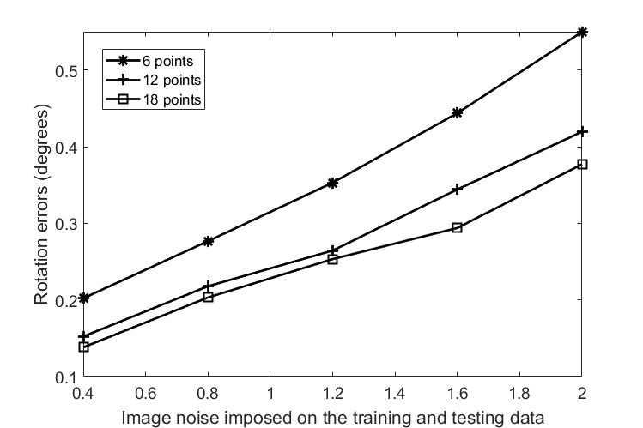
Experiments and Results

Slide 80
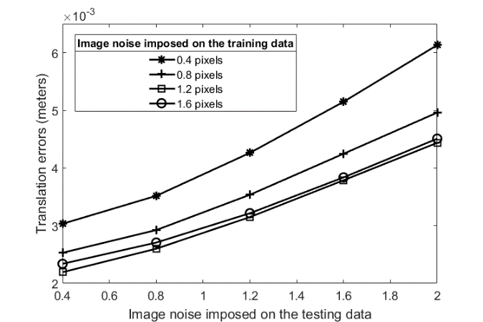
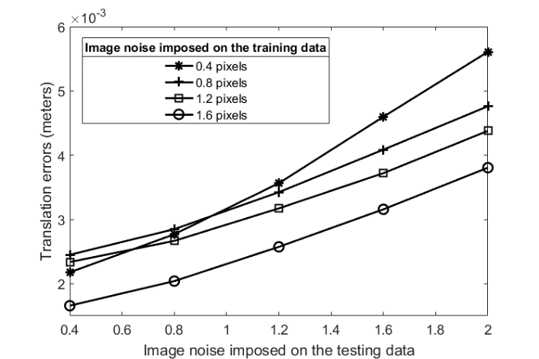
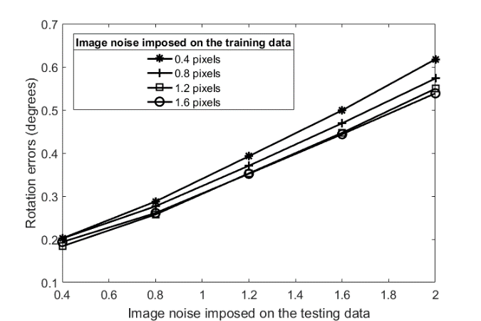
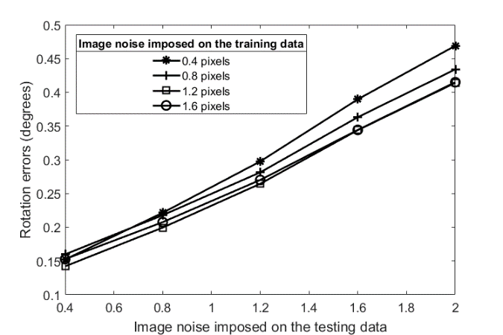
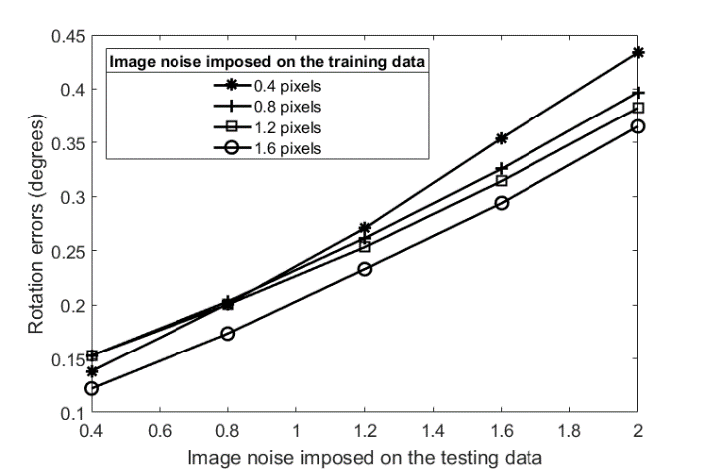
Experiments and Results

Slide 81
Conclusions and Discussions
The estimation accuracy can be increased if more input points are available
This is similar to the RANSAC procedure in a way that the quality of solution could be improved if redundant information is available
The computed pose parameters are more accurate if the noise in the training data is a bit larger than the testing data
If the actual situation is similar to the training environment, the neural network based approach could perform better than the traditional analytical methods
The proposed neural network may be unable to estimate the camera pose if the testing values are out of the range of the training data

Slide 82
Conclusions and Discussions
We have successfully trained a feed forward neural network to estimate the camera poses from three image views.
Our machine learning based approach is able to avoid the complicated algebraic procedure to compute the trifocal tensor and extract the pose parameters
The proposed solution is more stable if it is applied to compute the camera poses within the ranges of the training data set.
In the future, we will train a universal neural network that is able to compute the commonly encountered camera poses in three views
Our goal is to use a limited set of synthetic training data to make a neural network that can estimate the poses of three cameras from real images

