Slide 1
Source separation and analysis of piano music signals using instrument-specific sinusoidal model
Wai Man SZETO and Kin Hong WONG (KHWONG@CSE.CUHK.EDU.HK)
The Chinese University of Hong Kong
DAFx-13, National University of Ireland, Maynooth, Ireland. Sep 2-5 2013.

Slide 2
Faculty of Engineering, CUHK
Electronic Engineering (since 1970)
Computer Science & Engineering (since 1973)
Information Engineering (since 1989)
Systems Engineering & Engineering Management (since 1991)
Electronic Engineering (since 1970)
Computer Science & Engineering (since 1973)
Information Engineering (since 1989)
Systems Engineering & Engineering Management (since 1991)
Mechanical and Automation Engineering (since 1994)
110 faculty members
2,200 undergraduates (15% non-local)
800 postgraduates

Slide 3
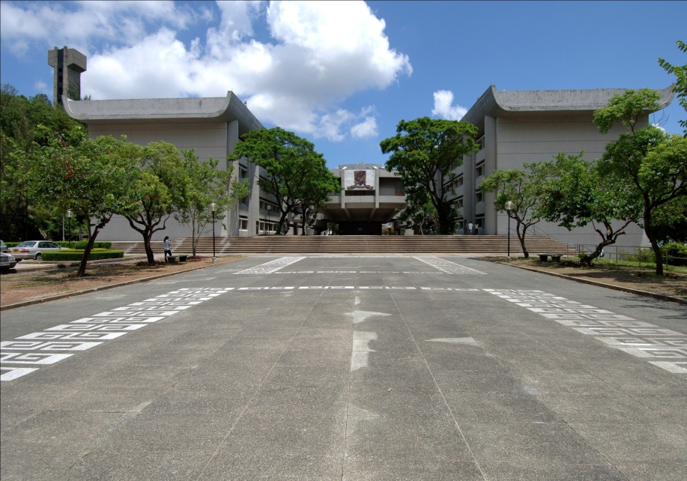
The Chinese University of Hong Kong
Department of Computer Science and Engineering

Slide 4
Outline
Introduction
Signal model
Properties of piano tones
Proposed Piano Model
Training: Parameter estimation
Source separation: Parameter estimation
Experiments
Evaluation on modeling quality
Evaluation on separation quality
Conclusions
Notes:
3.1 Problem formulation for training
3.2 Extraction of partials with the General Model
3.3 Finding the initial guess for the Piano Model
3.4 Parameter estimation of the Piano Model

Slide 5
1. Introduction

Slide 6
Motivation
What makes a good piano performance?
Analysis of musical nuances
Nuance - subtle manipulation of sound parameters including attack, timing, pitch, intensity and timbre
Major obstacle – mixture signals
Our aims
High separation quality
Nuance (extracted tones, intensity and fine-tuned onset)
Vladimir Horowitz (1903-89)
Notes:
Add Horowitz’s photo

Slide 7
Introduction
Many existing monaural source separation systems use sinusoidal modeling to model pitched musical sounds
Sinusoidal modeling
A musical sound is represented by a sum of time-varying sinusoidals
Source separation
Estimate the parameter values of each sinusoidal

Slide 8
Our work
Piano Model (PM)
Instrument-specific sinusoidal model tailored for a piano tone
Monaural source separation system
Based on our PM
Extract each individual tone from mixture signals of piano tones by estimating the parameters in PM
PM can facilitate the analysis of nuance in an expressive piano performance
PM: fine-tuned onset and intensity
Notes:
propose an instrument-specific sinusoidal model tailored for a piano tone. Based on our proposed Piano Model (PM), we develop a monaural source separation system to extract each individual tone from mixture signals of piano tones. Specifically, tone extraction can be facilitated by estimating the parameters in PM. In addition to source separation, PM can facilitate the analysis of nuance in an expressive piano performance. Nuance can be defined as the subtle differences in manipulation of sound parameters including attack, timing, pitch, loudness and timbre that makes the music sound alive and human [lehmann07expresschpt]. A major obstacle to a computational analysis of musical nuances is that it is often difficult to uncover relevant sound parameters from mixture signals. This problem can be formulated as a source separation problem.

Slide 9
Major difficulty
Major difficulty of the source separation problem is to resolve overlapping partials
Music is usually not entirely dissonant
Some partials from different tones may overlap with each other.
E.g. octave: the frequencies of the upper tone are totally immersed within those of the lower
Serious problem
A sum of two partials with the same frequency also gives a sinusoidal with that same frequency
Amplitude and the phase of an overlapped partial cannot be uniquely determined
Cannot recover the original two partials if only the resulting sinusoidal is given
Notes:
The major difficulty of the source separation problem is to resolve overlapping partials. As music is usually not entirely dissonant, it is common that some partials from different tones may overlap with each other. For example, octave intervals often appear in piano music. For an octave mixture, the frequencies of the upper tone are totally immersed within those of the lower. Overlapping partials cause a serious problem in separation because a sum of two partials with the same frequency also gives a sinusoidal with that same frequency; there are infinite ways to generate the resulting sinusoidal, so the amplitude and the phase of an overlapped partial cannot be uniquely determined and the overlapping partials cannot be resolved. Hence, we cannot recover the original two partials if only the resulting sinusoidal is given.

Slide 10
Resolving overlapping partials
Assumptions for the existing systems
Smooth spectral envelope [Vir06, ES06]
Use neighboring non-overlapping partials to recover
Fail in octave cases
Not fully suitable for piano tones
Common amplitude modulation (CAM) [LWW09]
Amplitude envelope of each partial from the same note tends to be similar
Fail in octave cases
Not fully suitable for piano tones
Harmonic temporal envelope similarity (HTES) [HB11]
Amplitude envelope of a partial evolves similarly among different notes of the same musical instrument
Not fully suitable for piano tones
Notes:
the spectral envelope of tones is assumed to be smooth (as in [virtanen06thesis, every06spectralfilter]). The information of neighboring non-overlapping partials can also be utilized to estimate the parameters of an overlapping partial. Another assumption is that the amplitude envelope of each partial from the same note tends to be similar [li09CAM]. This is known as common amplitude modulation (CAM). Non-overlapping partials are used to estimate the overlapping partials of the same note by the property of CAM. However, these assumptions may not be suitable for the source separation of piano mixtures. For a piano tone, the spectral envelope may not be smooth. Moreover, there may be lack of neighboring non-overlapping partials. For example, the partials of the upper tone in an octave are totally immersed within the frequencies of the lower tone. In such cases, spectral smoothness and CAM cannot be applied. Moreover, the assumption in CAM may not be applied to piano sounds. In Figure [fig:partial-extraction] (c), the amplitude envelopes of the same note are not similar. Harmonic Temporal Envelope Similarity (HTES) tries to these problems by assuming that the amplitude envelope of a partial evolves similarly among different notes of the same musical instrument [han11overlap]. Overlapping partials of a note are reconstructed by the non-overlapping partials of another note. However, the amplitude envelopes can vary significantly across pitches in a piano [fletcher98instr]. Thus, HTES may not resolve the overlapping partials of piano tones accurately.

Slide 11
Our source separation system
Assumptions
Input mixtures: mixtures of individual piano tones
The pitches in the mixtures are known (e.g. by music transcription systems)
The pitches in the mixtures reappear as isolated tones in the target recording
Performed without pedaling
PM captures the common characteristics of the same pitch
Isolated tones used as the training data to train PM
Goal: accurately resolve overlapping partials even for the case of octaves → high separation quality
Notes:
Instead of formulating assumptions from the general properties of musical sounds, we make use of the fact that the input mixtures in question are piano music signals. This allows us to design an instrument-specific model for the piano sound to accurately resolve overlapping partials. In piano music, a particular pitch rarely appears only once. The tones of the same pitch share some common characteristics which can be captured by PM. In particular, we consider the case when the pitches in the mixtures reappear as isolated tones in the target recording, and when the piano music is performed without pedaling. The isolated tones are used as the training data to train PM. This approach enables high separation quality even for the case of octaves in which the partials of the upper tone completely overlap with those of the lower tone.

Slide 12
2. Signal model

Slide 13
Problem definition
Figure 1.1
Press 1 key → piano tone (signal)
Press multiple keys → mixture signal
Goal 1: Recover the individual tones from the mixture signal
Goal 2: Find the intensity and fine-tuned onset of each individual tone
Notes:
When a piano key is pressed, a piano tone is generated. (demo)
In piano music, usually, there are multiple keys being pressed at the same time.
When multiple keys are pressed simultaneously, the piano tones generated by these keys mix together, a mixture signal is formed. (demo)
Our goal is to recover the individual tones from the mixture signal.

Slide 14
Problem definition
Figure 1.1
1 key = 1 sound source
Press multiple keys → mixture signal from multiple sound sources
Problem formulation: monaural source separation
Notes:
1 piano key is considered as 1 sound source
(an individual tone in a mixture is considered as a signal generated by the particular sound source of the corresponding key)
Mixture signal is generated by pressing multiple keys. The mixture signal is coming from multiple sound sources
The whole problem can be formulated as a source separation problem
In our research, we use the signal from one microphone or one channel for the source separation process.
This problem is called monaural source separation

Slide 15
Problem definition
A mixture signal – a linear superposition of its corresponding individual tones
y(t_{n}) - observed mixture signal in the time domain
x_{k}(t_{n}) - kth individual tone in the mixture
K - number of tones in the mixture
t_{n} - time in second at discrete time index n
Source separation: given y(t_{n}), estimate x_{k}(t_{n})

Slide 16
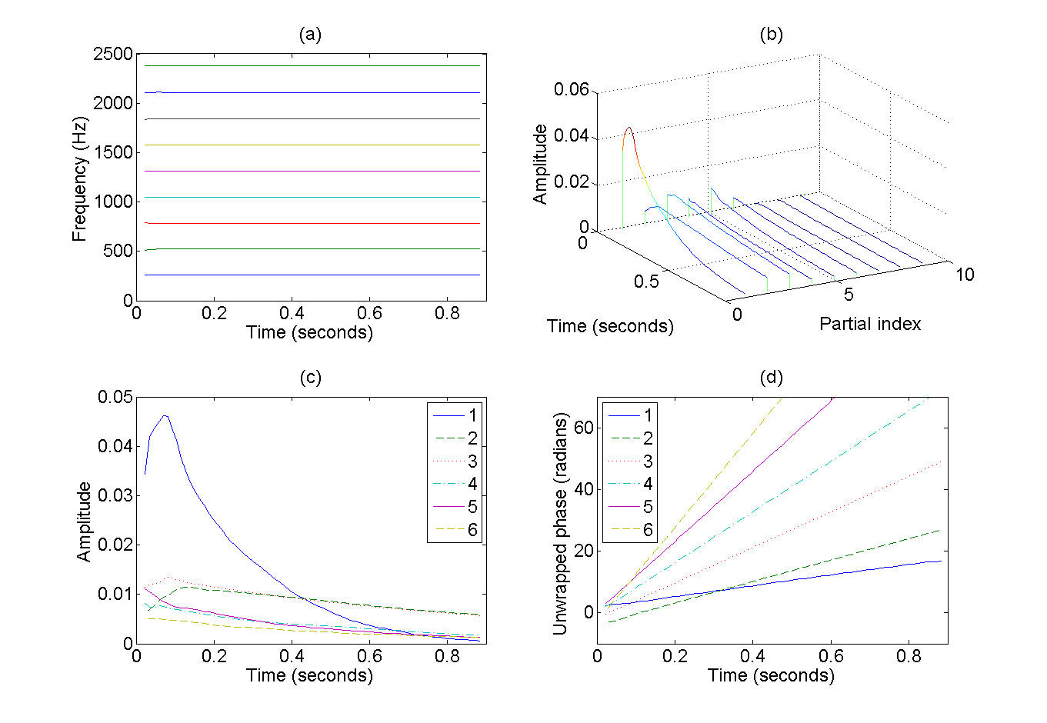
Properties of piano tones
Stable frequency values against time and instances
Amplitude of each partial
Time-varying
Generally follows a rapid rise and then a slow decay
The partials can be considered as linear-phase signals
Notes:
A piano tone consists of its frequency components and noise. The frequency components, also called partials, are usually dominating over the noise and are stable against time. In piano sound, the partials of a tone are usually not exactly harmonic. This phenomenon is called inharmonicity and it is perceptually significant for the sound quality of pianos [askenfelt90book]. Hence, the assumption of harmonicity cannot be taken for modeling piano tones. The amplitude of each partial generally follows a rapid rise and then a slow decay. The rapid rise is the building up of the sound. The slow decay is the damping of the sound and it is exponential-like [palmieri03encylo]. Note that each partial has its own rate of rising and decaying. The peaks of the partials exhibit a general trend that a higher partial has a weaker peak than a lower partial but there are irregularities. For the piano tone in Figure [fig:partial-extraction] (b), the fundamental frequency has the highest peak. The third partial is stronger than the second and the fifth is stronger than the fourth. Figure [fig:partial-extraction] (d) shows the unwrapped phase against time. The unwrapped phase is linear and the partials can be considered as linear-phase signals.

Slide 17
Properties of piano tones
Piano hammer velocity ∝ peak amplitude of the tone [PB91]
Peak amplitude can be used as a measure of intensity of a tone
Figure
12 intensity levels of C4 (from our piano tone database) → 12 instances of C4
Partial amplitude (temporal envelope) against peak amplitude and time
Smooth envelope surface → to be modeled
Notes:
Here, we propose PM to resolve the overlapping partials by exploring the common properties of recurring tones. PM employs a time-varying sum-of-sinusoid signal model for piano tones, and it describes a tone in an entire duration instead of a single analysis frame. For each partial, we aim to model the envelope surface against intensity and time. The intensity of a tone can be measured by the peak amplitude of its time-domain signal. When the key pressing velocity increases, the peak amplitude also increases up to the physical limit of the piano [palmer91amp]. The envelope surfaces of the first, second, seventh and eighth partials are plotted in Figure [fig:envelope-surface]. The surface is constructed from the extracted partials of the C4 tones from the same piano played with 12 hitting strengths.

Slide 18
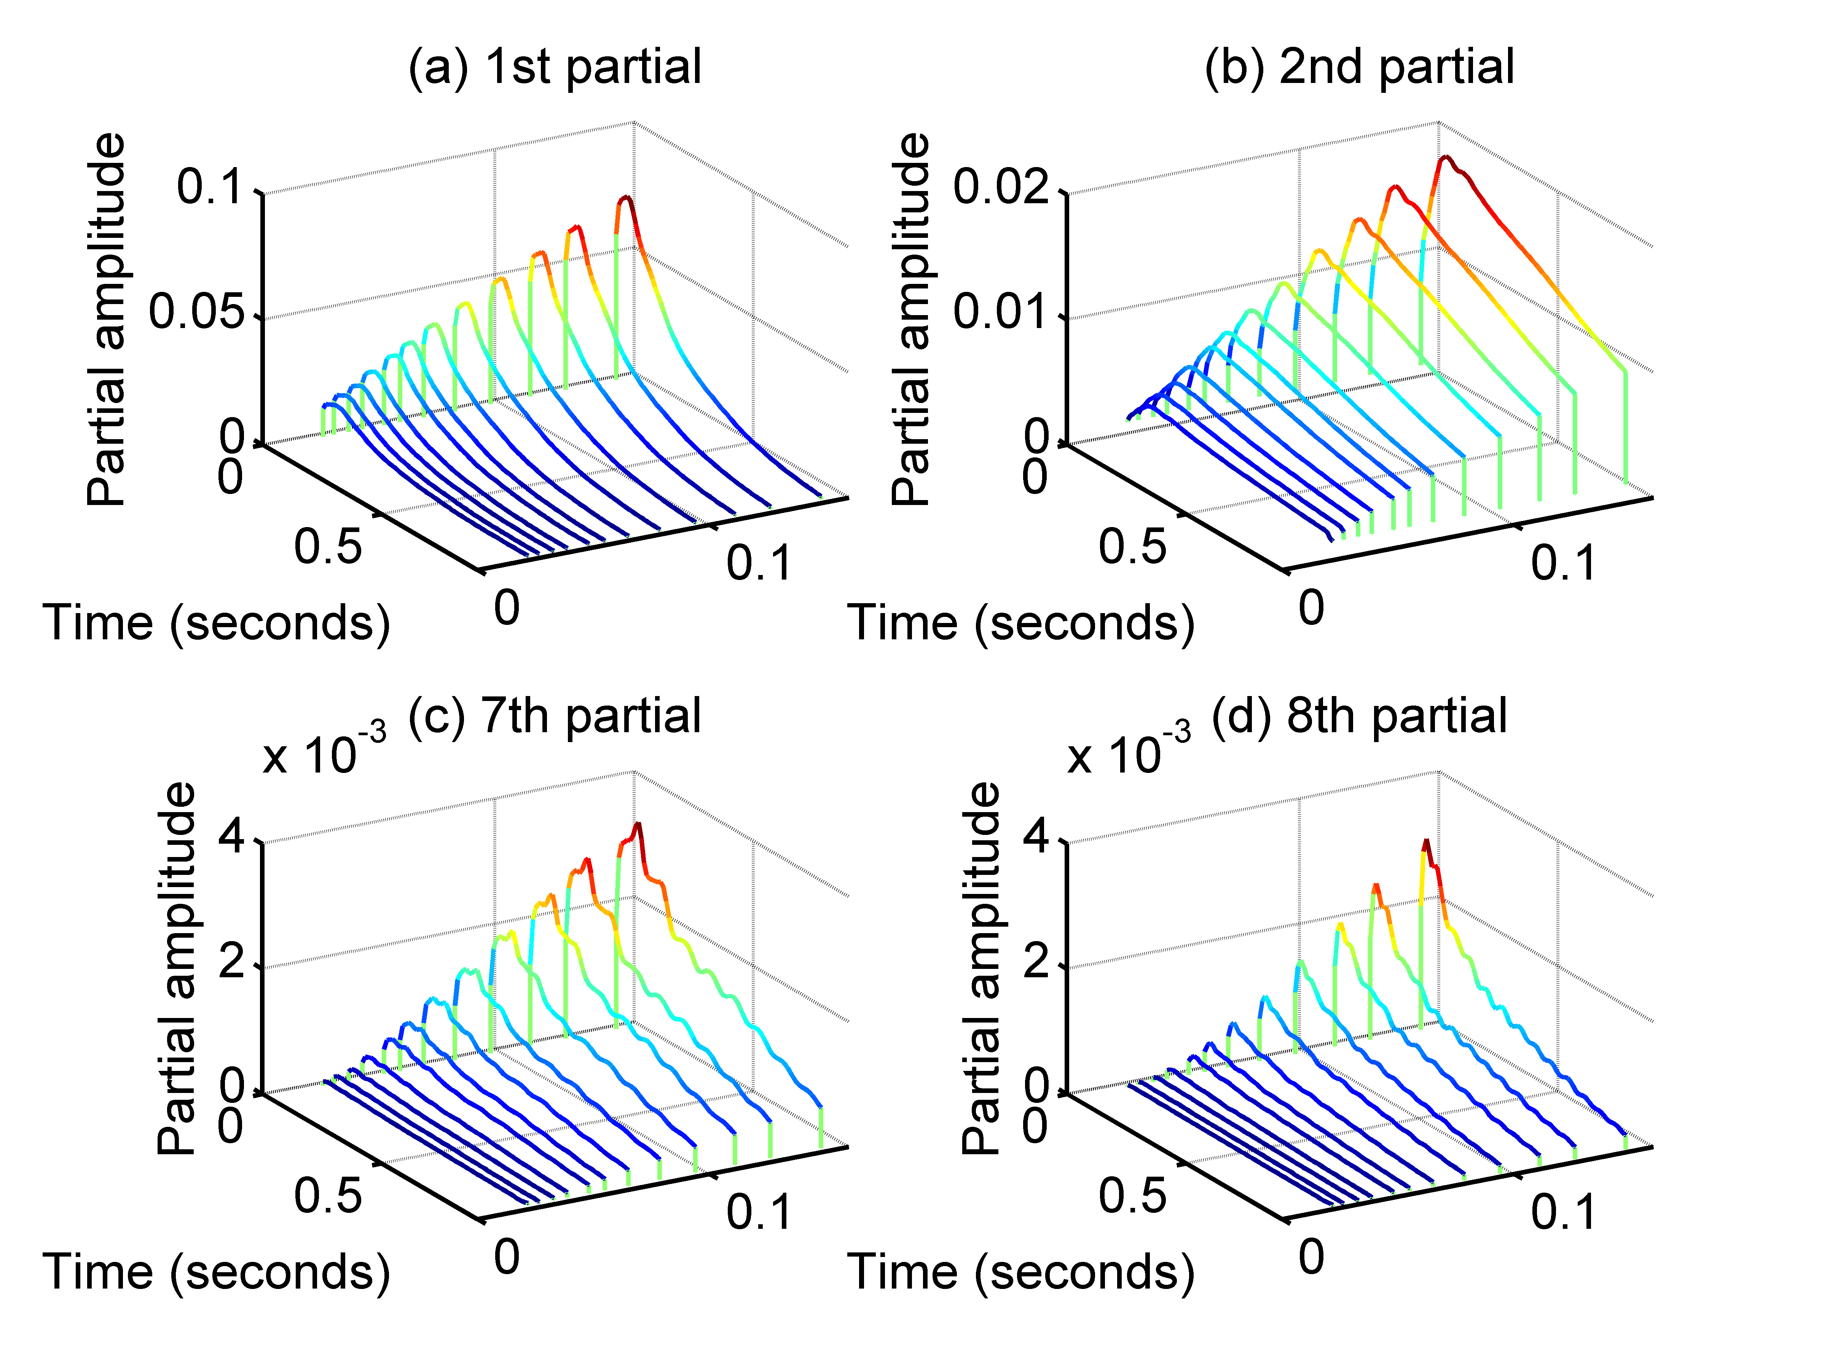
Properties of piano tones
Same partial from various instances of the pitch exhibits a similar shape of rising and decay
But a loud note is not a linear amplification of a soft note
High frequency partials are boosted significantly when the key is hit heavily
Envelope surface against peak amplitude of the time-domain signal and time.
Notes:
The envelope surfaces of the first, second, seventh and eighth partials are plotted in Figure [fig:envelope-surface]. The surface is constructed from the extracted partials of the C4 tones from the same piano played with 12 hitting strengths.
It is observed that the same partial from various instances of the pitch exhibits a similar shape of rising and decay. When the peak amplitude of the signal increases, the whole partial is also scaled up smoothly. However, this scaling is not the same for all partials. The fact is that a loud note is not a linear amplification of a soft note. High frequency partials are boosted significantly when the key is hit heavily due to nonlinear material property of the piano hammer [askenfelt90book, fletcher98instr].

Slide 19
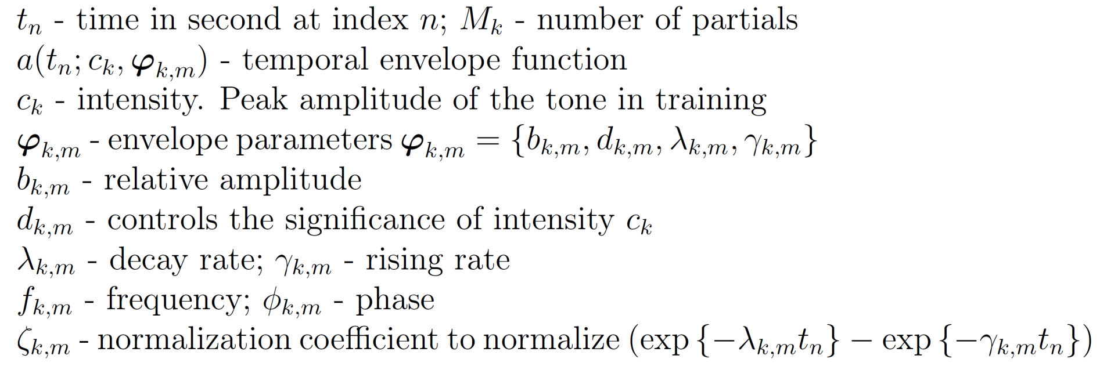
Proposed Piano Model
PM models a tone for its entire duration

Slide 20
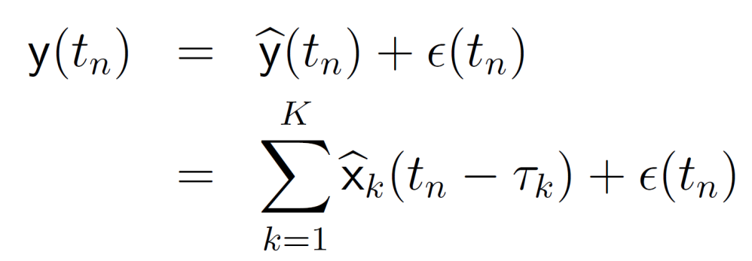
Proposed Piano Model
Reasons for adding time shift τ_{k}
Detected onset may not be accurate
Tones in the mixture may not be sounding exactly at the same time
Fine-tuned onset can be obtained by adjusting the detected onset with the time shift

Slide 21
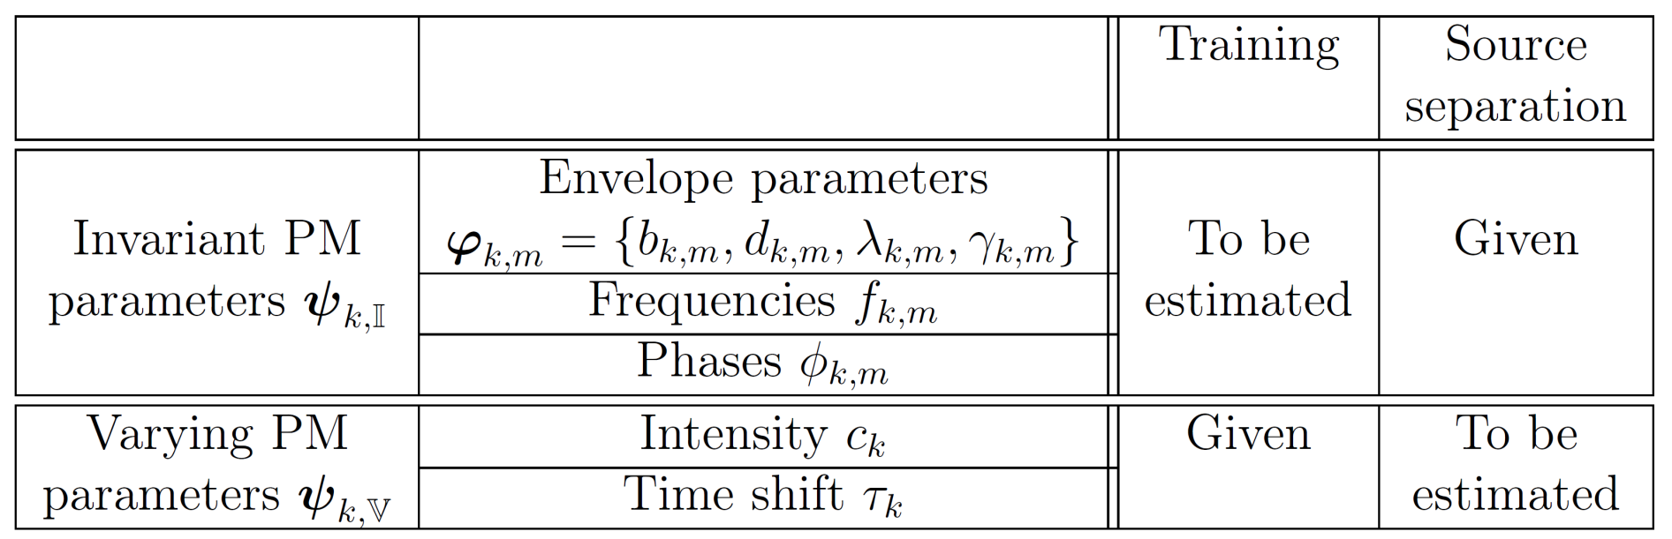
Proposed Piano Model
Our proposed Piano Model (PM) – 2 sets of parameters
Invariant PM parameters of a mixture
Invariant to instances of the same pitch in the recording
Already estimated in training
Varying PM parameters of a mixture
Varying across instances
To be estimated in source separation

Slide 22
Our source separation system
Invariant PM parameters: parameters invariant to instances of the same pitch in the recording
Varying PM parameters: parameters may vary across instances.
Figure 1: The main steps of our source separation process.
Notes:
The goals of our source separation system are to separate each individual tone from the mixture signal and at the same time, to identify the intensity and adjust the onset of each tone for characterizing the nuance of the music performance. The intensity and fine-tuned onset of a tone will be defined in Section [sec:Proposed-piano-model]. The main steps in our source separation system are depicted in Figure [fig:The-main-steps]. The whole separation process is divided into the training stage and the source separation stage. In the training stage, the inputs are the isolated tones from the target recording being investigated. The parameters in PM are estimated. PM contains two sets of parameters. (i) One set contains parameters invariant to instances of the same pitch in the recording. (ii) Another set consists of parameters which may vary across instances. The goal of the training stage is to estimate the invariant model parameters so that they can be used in the source separation stage. If the invariant PM parameters of a mixture are known, only the varying PM parameters are required to be estimated. In the source separation, the varying PM parameters, which include the intensity and fine-tuned onsets, are estimated. Signals of the individual tones in the mixtures can be reconstructed by PM.

Slide 23
3. Training: Parameter estimation

Slide 24
Training: Parameter estimation
Goal of the training stage: to estimate the invariant PM parameters given the training data (isolated tones)
Major difficulty: PM is a nonlinear model
Find a good initial guess (close to the optimal solution)
Main steps
Extract the partials from each tone by using the method in [SW13]
Given the extracted partials, find the initial guess of the invariant PM parameters
Given the initial guess, find the optimal solution for PM
Notes:
This section will show how to use the training data to train our proposed Piano Model (PM). The goal of the training stage is to estimate the invariant PM parameters given the training data. The major difficulty of estimating the invariant PM parameters is that PM in ([eq:piano-model-est-tone]) is nonlinear. A good initial guess, which is close to the optimal solution, is crucial for accurately estimating the parameters. The procedures for finding a good initial guess will be discussed in Sections [sec:train-partial-extract] and [sec:train-find-initial]. The main idea is to extract the partials of each isolated tone in the training data, so that the initial guess for the PM parameters for each partial can be found independently. Before discussing how to find the initial guess, the problem of estimating the invariant PM parameters will be formulated first.

Slide 25
4. Source separation: Parameter estimation

Slide 26
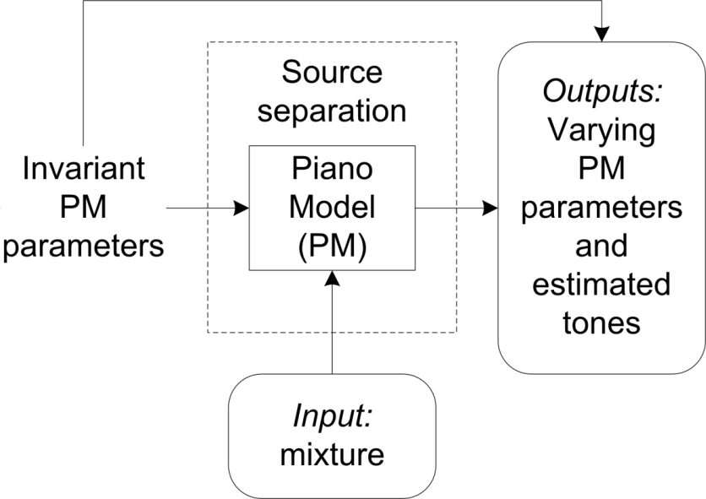
Source separation: Parameter estimation
Given the invariant PM parameters, perform the source separation by estimating the varying PM parameters for the mixture
Varying PM parameters: intensity and time shift for each tone in the mixture
Minimize the least-squares errors
The signals of each individual tone in the mixture can be reconstructed by using PM
Notes:
Given the invariant PM parameters \widehat{\boldsymbol{\Psi}}_{\mathbb{I}} estimated in the previous section and the mixture \boldsymbol{\mathsf{y}} , we perform the source separation by estimating the varying PM parameters \boldsymbol{\Psi}_{y,\mathbb{V}} for the mixture \boldsymbol{\mathsf{y}} . The varying PM parameters \boldsymbol{\Psi}_{y,\mathbb{V}} include the intensity c_{k} and the time shift \tau_{k} for each kth tone in the mixture. The output of this stage is the estimated varying PM parameters \widehat{\boldsymbol{\Psi}}_{y,\mathbb{V}} which maximize the likelihood function of \boldsymbol{\Psi}_{y,\mathbb{V}} . With \widehat{\boldsymbol{\Psi}}_{\mathbb{I}} and widehat{\boldsymbol{\Psi}}_{y,\mathbb{V}} in PM, the signals of each individual tone in the mixture can be reconstructed by using PM.
The noise term \epsilon(t_{n}) in ([eq:piano-model-obs-est]) is modeled as the zero-mean Gaussian noise. Hence, the maximization of the likelihood is equivalent to the minimization of the least-squares errors. Then given the mixture \boldsymbol{\mathsf{y}}
and the estimated invariant PM parameters \widehat{\boldsymbol{\Psi}}_{\mathbb{I}}
, the objective function for source separation with PM isE_{\text{sep}}(\boldsymbol{\Psi}_{y,\mathbb{V}})=\vectornorm{\boldsymbol{\mathsf{y}}-\boldsymbol{\mathsf{\widehat{y}}}(\boldsymbol{\Psi}_{y,\mathbb{V}})}^{2}.
The goal of source separation with PM is to find the varying PM parameters \widehat{\boldsymbol{\Psi}}_{y,\mathbb{V}}
which minimize E_{\text{sep}}
in ([eq:ss-pm-obj]). The objective function E_{\text{sep,PM}}
can be minimized by using the trust-region-reflective algorithm. There are 100 starting points randomly generated to minimize E_{\text{sep}}
. The best solution, which gives the smallest E_{\text{sep}}
, will be chosen as the estimated varying PM parameters \widehat{\boldsymbol{\Psi}}_{y,\mathbb{V}}
.

Slide 27
5. Experiments

Slide 28
Experiments
Objective: to evaluate the performance of our source separation system
Data
Piano tone database from RWC music database (3 pianos) [GHNO03]
Our own piano tone database (1 piano)
Mixtures were generated by mixing selected tones in the database.
Ground truth is available to evaluate the separation quality
Sampling frequency f_{s} = 11.025 Hz

Slide 29
Generation of mixtures
Randomly select 25 chords from 12 piano pieces of RWC music database [GHNO03]
Generate 25 mixtures from these 25 chords by selecting isolated tones from the database
25 mixtures consist of 62 tones
Number of tones: 1≤K≤ 6
Average number of tones in a mixture = 2.48
9 mixtures contain at least one pair of octaves. Two of them contain 2 pairs of octaves
Number of isolated tones per pitch for training I_{k}= 2
Duration of each mixture and each training tone = 0.5 sec
Random time shift was added to the isolated tones before mixing [-10 ms, 10 ms] to test PM

Slide 30
Generation of mixtures
Examples
Mixtures
D♯6
C4, C5
B1, D♯4, G♯4
D4, F4, A4, D5
C3, G3, C4, E4, G4
F♯3, C4, F4, C5, D5, F5

Slide 31
Evaluation criteria
Signal-to-noise ratio
Absolute error ratio of estimated intensity
Absolute error of time shift

Slide 32
Modeling quality
Evaluate the quality of PM to represent an isolated tone
Compare the estimated tones with the input tones
Provide a benchmark for evaluation of the separation quality
Average of SNR: 11.15 dB
Pitch | Ref | SNR (dB) of PM
D5 |  | 15.55
D3 |  | 9.94
D♯6 |  | 9.23
E4 |  | 11.84

Slide 33
Separation quality
Evaluate the quality of PM to extract the individual tones from a mixture
Compare the estimated tones with the input tones (before mixing)
Input tones provide the ground truth
Mixing – summing the shifted tones to form a mixture

Slide 34
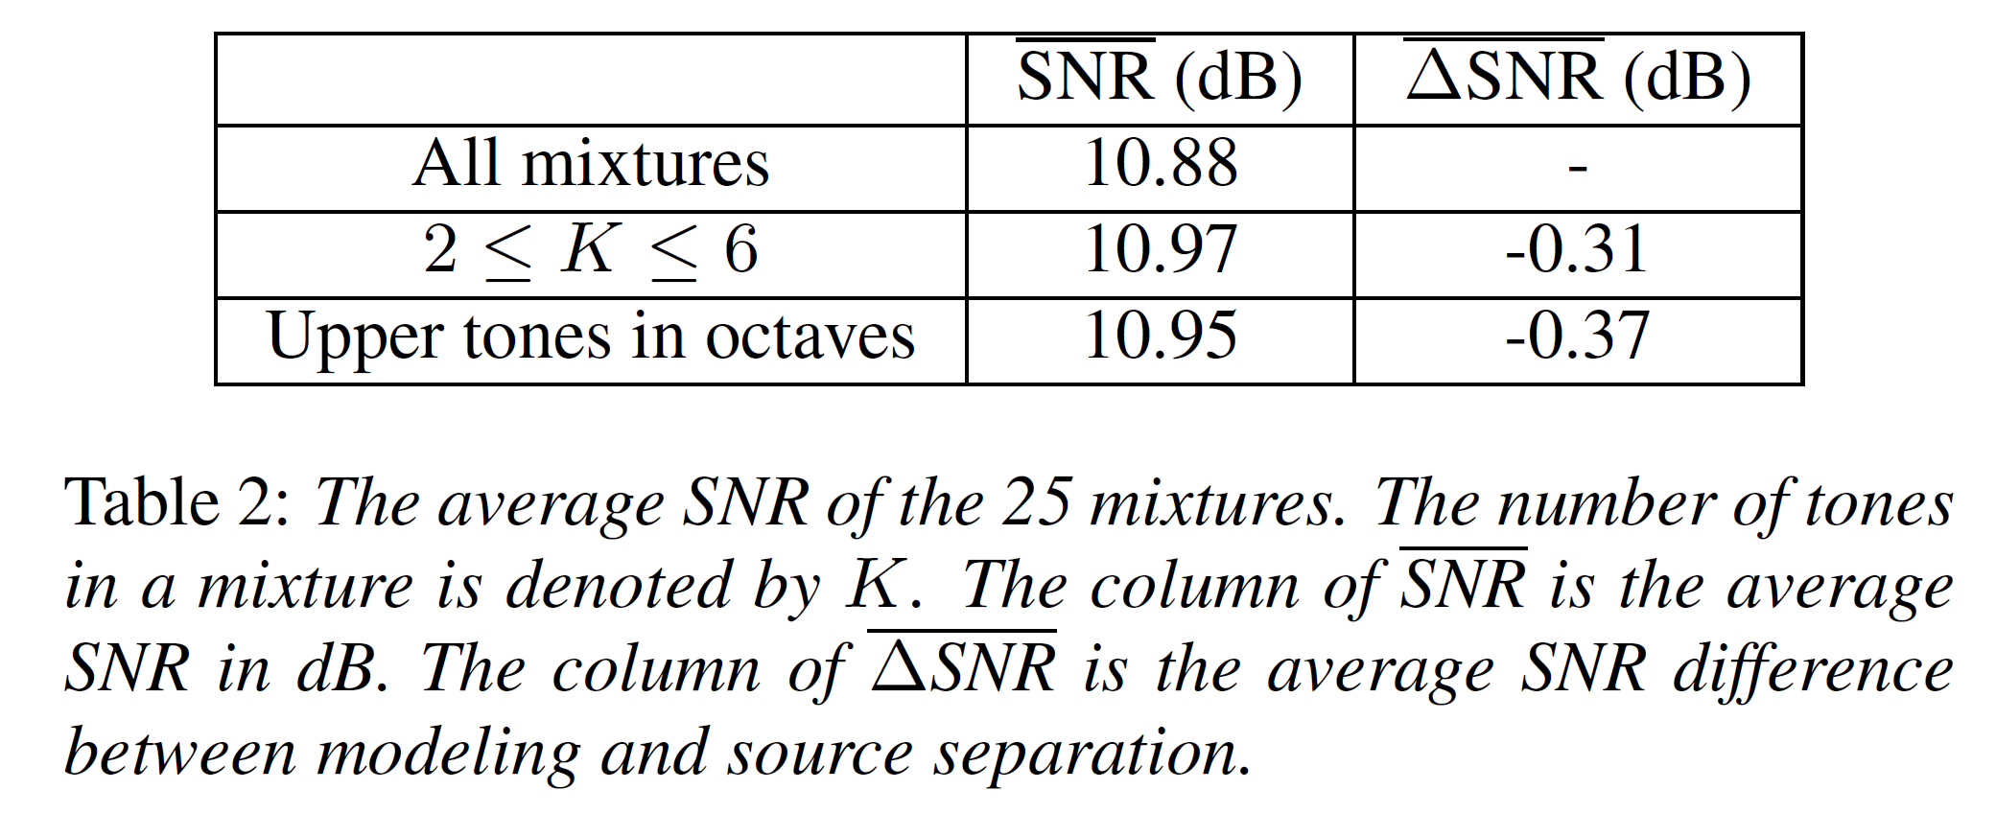
Separation quality: SNR
Average ΔSNR slightly drops
Upper tones in octaves can be reconstructed
Overlapping partials can be resolved

Slide 35
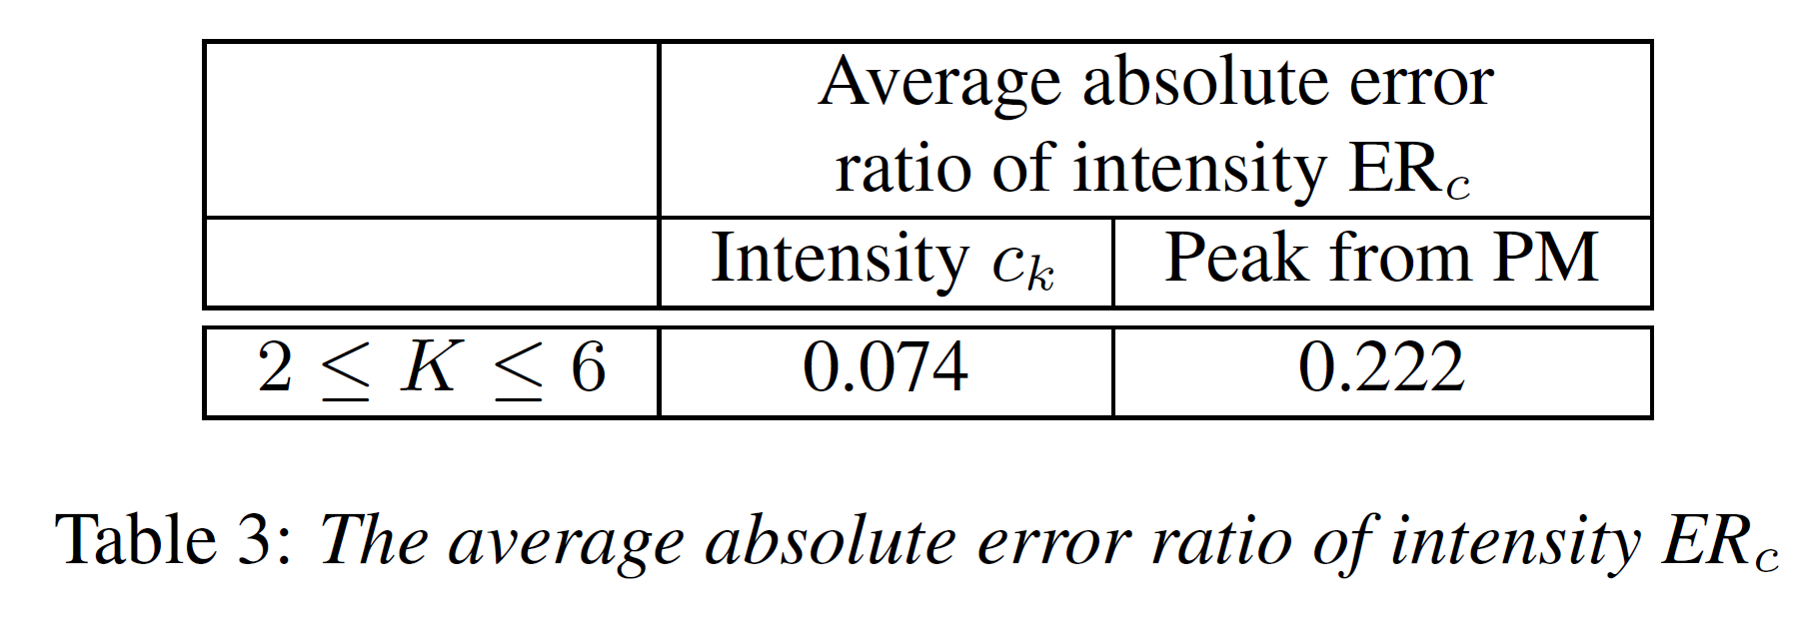
Separation quality: intensity
Average ER_{c} : Intensity c_{k}< Peak from PM
Peak from PM
Peak amplitude of the estimated tone of PM
Peak from PM depends on all estimated parameters
Intensity c_{k} : depends on the envelope function
Less sensitive to the estimation error from other parameters

Slide 36
Separation quality: time shift
The avereage error is only 3.16 ms so the estimated time shift can give an accurate fine-tuned onset
Notes:
The average absolute error of the estimated time shift \text{Err}_{\tau} in PM. The error is only 3.16 ms so the estimated time shift can give an accurate fine-tuned onset.

Slide 37
Comparison
Compared to a system of monaural source separation (Li's system) in [LWW09] which is also based on sinusoidal modeling
[LWW09] Y. Li, J. Woodruff, and D. Wang. Monaural musical sound separation based on pitch and common amplitude modulation. IEEE Transactions on Audio, Speech, and Language Processing, 17(7):1361–1371, 2009.
Frame-wise sinusoidal model
Resolve overlapping partials by common amplitude modulation (CAM)
Amplitude envelope of each partial from the same note tends to be similar
True fundamental frequency of each tone supplied to Li's system

Slide 38
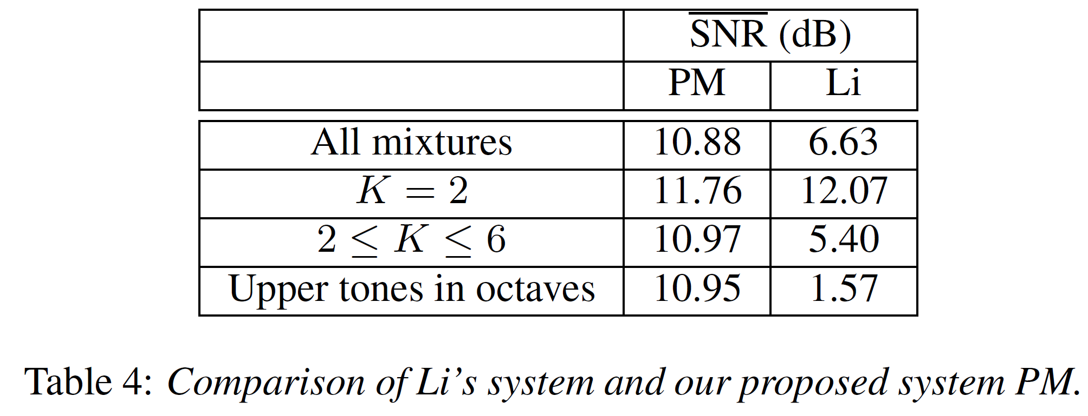
Comparison to other method
Average SNR: PM > Li
Resolve the overlapping partials of the upper tones in octaves
Li's system: No
PM: Yes

Slide 39
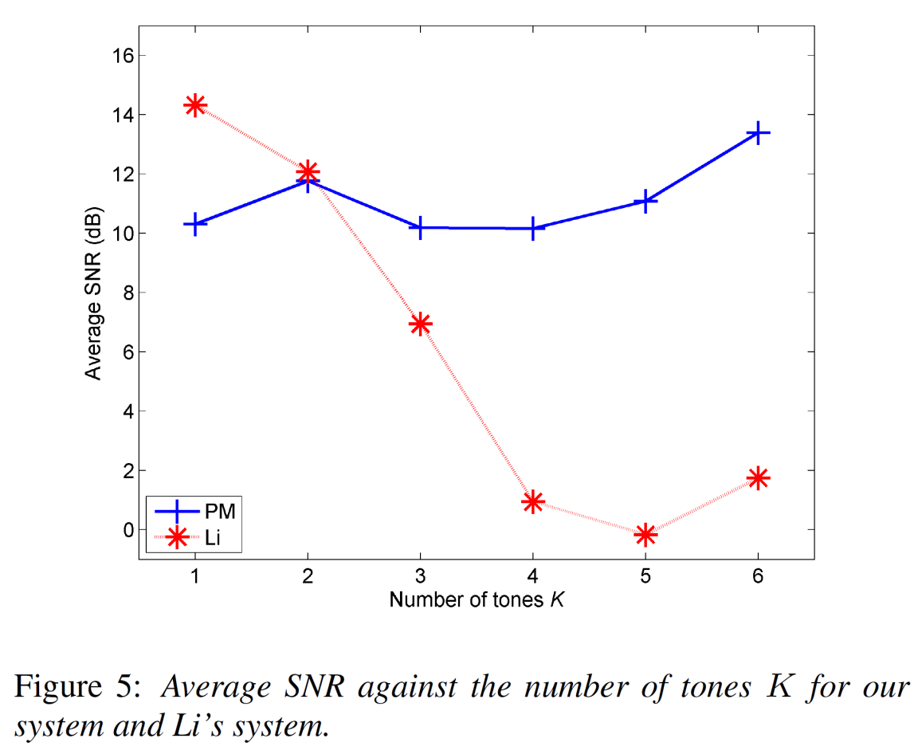
Comparison
Average SNR: Li's system decreases much more rapidly than PM
Our system can make use of the training data to give higher separation quality
Notes:
The average SNR against the number of tones K is plotted in Figure [fig:exp-sdr-CAM-K]. The average SNR of Li's system decreases more rapidly than our system. Our system can make use of the training data to give higher separation quality.

Slide 40
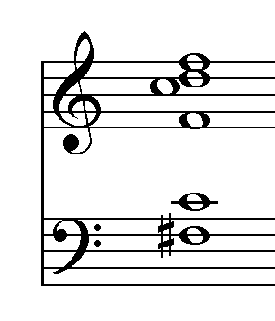
Separation quality
Demonstration: 6-note mixture with double octaves
Mixture | Ref | SNR (dB) of PM | SNR (dB) of Li
F♯3, C4, F4, C5, D5, F5
F♯3 |  | 12.74 | 5.20
C4 (8ve) |  | 16.08 | -6.35
F4 (8ve) |  | 13.75 | 3.62
C5 (8ve) |  | 16.39 | 0.82
D5 |  | 11.56 | 7.80
F5 (8ve) |  | 9.81 | -0.64
Y. Li, J. Woodruff, and D. Wang. Monaural musical sound separation based on pitch and common amplitude modulation. IEEE Transactions on Audio, Speech, and Language Processing, 17(7):1361–1371, 2009.

Slide 41
6. Conclusions

Slide 42
Conclusions
Proposed a monaural source separation system to extract individual tones from mixture signals of piano tones
Designed a Piano Model (PM) based on sinusoidal modeling to represent piano tones
Able to resolve overlapping partials in the source separation process
The recovered parameters (frequencies, amplitudes, phases, intensities and ﬁne-tuned onsets) of partials for
Signal analysis
Characterizations of musical nuances
Experiments show that our proposed PM method gives robust and accurate results in separation of signal mixtures even when octaves are included
Separation quality is significantly better than those reported in the previous work
Notes:
In this paper, we have proposed a monaural source separation system to extract individual tones from mixture signals of piano tones. We designed a Piano Model (PM) based on a sum of sinusoidal components to represent piano tones. Based on this PM model, the system is able to resolve overlapping partials in the source separation process. The recovered parameters (frequencies, amplitudes, phases, intensities and ﬁne-tuned onsets) of partials are essential for thorough signal analysis and characterizations of musical nuances. The experiments show that our proposed PM method gives robust and accurate results in separation of signal mixtures even when octaves are included. The separation quality is significantly better than those reported in the previous work. However, when measuring modeling quality used for sound reproduction of isolated tones, our approach is still inferior to other methods such as the framewise model in [li09CAM]. Our future direction is to combine these two methods: our PM and our framewise model in [szeto13icspcc] by using a hierarchical Bayesian framework to achieve better performances both in source separation and in sound reproduction.

Slide 43
Selected bibliography
[Vir06] T. Virtanen, Sound Source Separation in Monaural Music Signals, Ph.D. thesis, Tampere University of Technology, Finland, November 2006.
[ES06] M. R. Every and J. E. Szymanski, “Separation of synchronous pitched notes by spectral filtering of harmonics,” IEEE Transactions on Audio, Speech & Language Processing, vol. 14, no. 5, pp. 1845–1856, 2006.
[LWW09] Y. Li, J. Woodruff, and D. Wang. Monaural musical sound separation based on pitch and common amplitude modulation. IEEE Transactions on Audio, Speech, and Language Processing, 17(7):1361–1371, 2009.
[HB11] Jinyu Han and B. Pardo, “Reconstructing completely overlapped notes from musical mixtures,” in Acoustics, Speech and Signal Processing (ICASSP), 2011 IEEE International Conference on, 2011, pp. 249–252.
[PB91] C. Palmer and J. C. Brown. Investigations in the amplitude of sounded piano tones. Journal of the Acoustical Society of America, 90(1):60–66, July 1991.
[SW13] W. M. Szeto and K. H. Wong, “Sinusoidal modeling for piano tones,” in 2013 IEEE International Conference on Signal Processing, Communications and Computing (ICSPCC 2013), Kunming, Yunnan, China, Aug 5-8, 2013.
[GHNO03] M. Goto, H. Hashiguchi, T. Nishimura, and R. Oka. RWC music database: Music genre database and musical instrument sound database. In the 4th International Conference on Music Information Retrieval (ISMIR 2003), October 2003.

Slide 44
End

Slide 45
List of the piano pieces

Slide 46
List of mixtures

Slide 47
Estimation of the number of partials
Extraction of partials from an independent piano tone database (will not be used in testing)
No. of the partials that contains 99.5% of the power of all partials picked

