Slide 1
Tensorflow (tf) programming
KH Wong

Slide 2
resources: https://keras.io/examples/
Download examples from
https://github.com/keras-team/keras-io

Slide 3
Introduction
How to install
https://sites.google.com/site/hongslinks/1-tensor_windows-installation-through-anaconda3
How to run
**Remember to "Restart and clear output" the "Kernel" - at the top menu everything you run a jupter notebook file.
Tests:
MNMIST for OCR
MNIST for fashion design

Slide 4
Part1: tensorflow2 using karas
KH Wong

Slide 5
Test1.1a: MNIST
Download from
http://www.cse.cuhk.edu.hk/~khwong/www2/GISM5033/cnn_mnist1.py
RUN
conda>python cnn_mnist.py

Slide 6
Test1.1b: MNIST
Download examples from
https://github.com/keras-team/keras-io
In \example, run
conda> python mnist_convnet.py

Slide 7
Code: mnist_convnet.py
# Model / data parameters
num_classes = 10
input_shape = (28, 28, 1)
# the data, split % train & test sets
(x_train, y_train), (x_test, y_test) = keras.datasets.mnist.load_data()
# Scale images to the [0, 1] range
x_train = x_train.astype("float32") / 255
x_test = x_test.astype("float32") / 255
# Make sure images have shape (28, 28, 1)
x_train = np.expand_dims(x_train, -1)
x_test = np.expand_dims(x_test, -1)
print("x_train shape:", x_train.shape)
print(x_train.shape[0], "train samples")
print(x_test.shape[0], "test samples")
# convert class vectors to binary class matrices
y_train = keras.utils.to_categorical(y_train, num_classes)
y_test = keras.utils.to_categorical(y_test, num_classes)
"""
## Build the model
"""
model = keras.Sequential(
[
keras.Input(shape=input_shape),
layers.Conv2D(32, kernel_size=(3, 3), activation="relu"),
layers.MaxPooling2D(pool_size=(2, 2)),
layers.Conv2D(64, kernel_size=(3, 3), activation="relu"),
layers.MaxPooling2D(pool_size=(2, 2)),
layers.Flatten(),
layers.Dropout(0.5),
layers.Dense(num_classes, activation="softmax"),
]
)
model.summary()
""“ ## Train the model """
batch_size = 128
epochs = 15
model.compile(loss="categorical_crossentropy", optimizer="adam", metrics=["accuracy"])
model.fit(x_train, y_train, batch_size=batch_size, epochs=epochs, validation_split=0.1)
""“ ## Evaluate the trained model"""
score = model.evaluate(x_test, y_test, verbose=0)
print("Test loss:", score[0])
print("Test accuracy:", score[1])
"""
Title: Simple MNIST convnet
Author: [fchollet](https://twitter.com/fchollet)
Date created: 2015/06/19
Last modified: 2020/04/21
Description: A simple convnet that achieves ~99% test accuracy on MNIST.
"""
"""
## Setup
"""
import numpy as np
from tensorflow import keras
from tensorflow.keras import layers
"""
## Prepare the data
"""

Slide 8
Code: mnist_convnet.py (all)
"""
Title: Simple MNIST convnet
Author: [fchollet](https://twitter.com/fchollet)
Date created: 2015/06/19
Last modified: 2020/04/21
Description: A simple convnet that achieves ~99% test accuracy on MNIST.
"""
"""
## Setup
"""
import numpy as np
from tensorflow import keras
from tensorflow.keras import layers
"""
## Prepare the data
"""
# Model / data parameters
num_classes = 10
input_shape = (28, 28, 1)
# the data, split between train and test sets
(x_train, y_train), (x_test, y_test) = keras.datasets.mnist.load_data()
# Scale images to the [0, 1] range
x_train = x_train.astype("float32") / 255
x_test = x_test.astype("float32") / 255
# Make sure images have shape (28, 28, 1)
x_train = np.expand_dims(x_train, -1)
x_test = np.expand_dims(x_test, -1)
print("x_train shape:", x_train.shape)
print(x_train.shape[0], "train samples")
print(x_test.shape[0], "test samples")
# convert class vectors to binary class matrices
y_train = keras.utils.to_categorical(y_train, num_classes)
y_test = keras.utils.to_categorical(y_test, num_classes)
"""
## Build the model
"""
model = keras.Sequential(
[
keras.Input(shape=input_shape),
layers.Conv2D(32, kernel_size=(3, 3), activation="relu"),
layers.MaxPooling2D(pool_size=(2, 2)),
layers.Conv2D(64, kernel_size=(3, 3), activation="relu"),
layers.MaxPooling2D(pool_size=(2, 2)),
layers.Flatten(),
layers.Dropout(0.5),
layers.Dense(num_classes, activation="softmax"),
]
)
model.summary()
"""
## Train the model
"""
batch_size = 128
epochs = 15
model.compile(loss="categorical_crossentropy", optimizer="adam", metrics=["accuracy"])
model.fit(x_train, y_train, batch_size=batch_size, epochs=epochs, validation_split=0.1)
"""
## Evaluate the trained model
"""
score = model.evaluate(x_test, y_test, verbose=0)
print("Test loss:", score[0])
print("Test accuracy:", score[1])

Slide 9
Test1.2 fashion mnist, run this code
from __future__ import absolute_import, division, print_function, unicode_literals
import tensorflow as tf
from tensorflow import keras
import os
import sys
import numpy as np
from matplotlib import pyplot as plt
os.environ['TF_CPP_MIN_LOG_LEVEL'] = '2'
def plot_prediction(im, label, pred):
plt.imshow(im, cmap='gray')
plt.axis('off')
plt.title('label = {}, pred = {}'.format(label, pred))
plt.savefig('prediction.png')
###########################
#fashion_mnist = keras.datasets.fashion_mnist
fashion_mnist = tf.keras.datasets.fashion_mnist
#fashion_mnist = keras.datasets.fashion_mnist
(train_images, train_labels), (test_images, test_labels) = fashion_mnist.load_data()
# load data
#fashion_mnist = keras.datasets.fashion_mnist
#(train_images, train_labels), (test_images, test_labels) = fashion_mnist.load_data()
#trian_images = train_images/255.0
#test_images = test_images/255.0
train_images = train_images.astype('float32') #//fix by khw
test_images = test_images.astype('float32')#//fix by khw
train_images /= 255#//fix by khw
test_images /= 255#//fix by khw
# network forward
model = keras.Sequential([
keras.layers.Flatten(input_shape=(28, 28)),
keras.layers.Dense(128, activation='relu'),
keras.layers.Dense(10, activation='softmax')
])
# model compile: define optimizer & evaluation metrics
model.compile(optimizer='adam',
loss='sparse_categorical_crossentropy',
metrics=['accuracy'])
# train processing
model.fit(train_images, train_labels, epochs=30)
# test
#test_loss, test_acc = model.evaluate(test_images, test_labels, verbose=2)
test_loss, test_acc = model.evaluate(test_images, test_labels)
print('\nTest accuracy:', test_acc)
# prediction using first test case
im = test_images[0]
label = test_labels[0]
pred = np.argmax(model.predict(im.reshape(1,28,28)), axis=-1)
plot_prediction(im, label, pred)

Slide 10
Test1.2 continue fashion mnist, run this code (whole program)
from __future__ import absolute_import, division, print_function, unicode_literals
import tensorflow as tf
from tensorflow import keras
import os
import sys
import numpy as np
from matplotlib import pyplot as plt
os.environ['TF_CPP_MIN_LOG_LEVEL'] = '2'
def plot_prediction(im, label, pred):
plt.imshow(im, cmap='gray')
plt.axis('off')
plt.title('label = {}, pred = {}'.format(label, pred))
plt.savefig('prediction.png')
###########################
#fashion_mnist = keras.datasets.fashion_mnist
fashion_mnist = tf.keras.datasets.fashion_mnist
#fashion_mnist = keras.datasets.fashion_mnist
(train_images, train_labels), (test_images, test_labels) = fashion_mnist.load_data()
# load data
#fashion_mnist = keras.datasets.fashion_mnist
#(train_images, train_labels), (test_images, test_labels) = fashion_mnist.load_data()
#trian_images = train_images/255.0
#test_images = test_images/255.0
train_images = train_images.astype('float32') #//fix by khw
test_images = test_images.astype('float32')#//fix by khw
train_images /= 255#//fix by khw
test_images /= 255#//fix by khw
# network forward
model = keras.Sequential([
keras.layers.Flatten(input_shape=(28, 28)),
keras.layers.Dense(128, activation='relu'),
keras.layers.Dense(10, activation='softmax')
])
# model compile: define optimizer & evaluation metrics
model.compile(optimizer='adam',
loss='sparse_categorical_crossentropy',
metrics=['accuracy'])
# train processing
model.fit(train_images, train_labels, epochs=30)
# test
#test_loss, test_acc = model.evaluate(test_images, test_labels, verbose=2)
test_loss, test_acc = model.evaluate(test_images, test_labels)
print('\nTest accuracy:', test_acc)
# prediction using first test case
im = test_images[0]
label = test_labels[0]
pred = np.argmax(model.predict(im.reshape(1,28,28)), axis=-1)
plot_prediction(im, label, pred)

Slide 11
Part2: Using Jupyter
KH Wong

Slide 12
Test1: MNIST
http://www.cse.cuhk.edu.hk/~khwong/www2/GISM5033/cnn_mnist1.py
RUN
conda>python cnn_mnist.py

Slide 13
How to install?
Install anaconda and then
Jupter 6.4.11

Slide 14
Test2.1 Keras.io example run to get familiar with colab
https://keras.io/examples/
Try colab : “Simple MNIST convnet”
(Note: slow to run but you see the progress on screen)

Slide 16
Test2.2
Image segmentation with a U-Net-like architecture
Masked image modeling with Autoencoders
Code examples / Generative Deep Learning / Variational AutoEncoder (vae)
Code examples / Natural Language Processing / Bidirectional LSTM on IMDB
keras-io/examples/nlp/neural_machine_translation_with_transformer.py

Slide 17
MNIST OCR
https://github.com/thegeekynerd/mnist_cnn

Slide 18
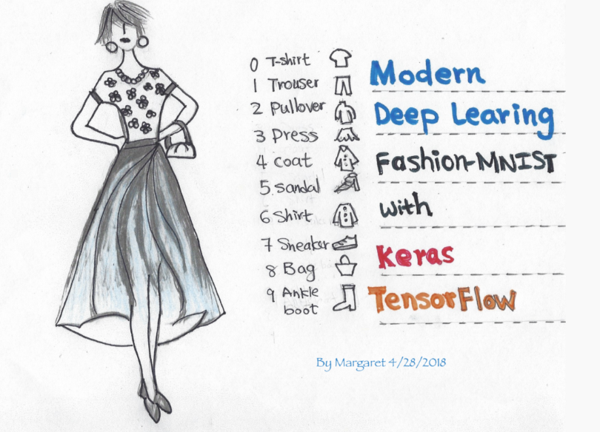
MNIST Demo for fashion design: tested on Jupiter 6.4.11 under tensorflow 2
Fashion-MNIST with tf.Keras. Deep Learning for Everyone | by Margaret Maynard-Reid | TensorFlow | Medium

Slide 19
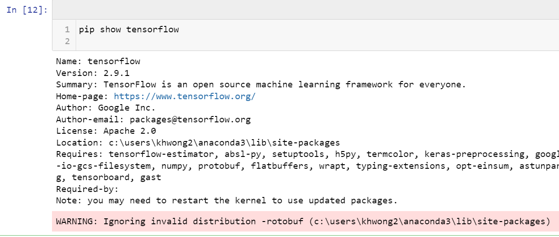
After running
Run this to show TensorFlow version. The result is tensorflow 2.91

